Slide 1


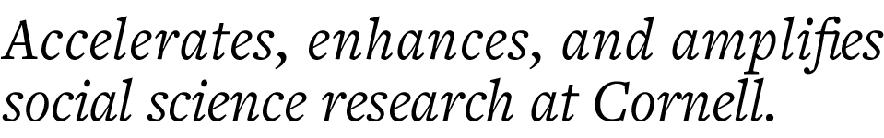
Introduction to Atlas.ti
Florio Arguillas, Ph.D.
foa2@cornell.edu
CCSS-researchsupport@cornell.edu

Slide 2

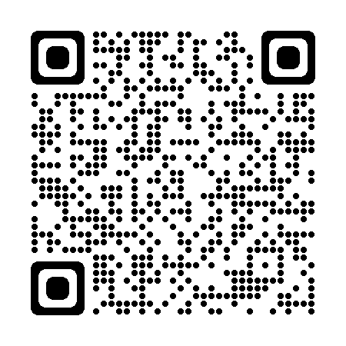
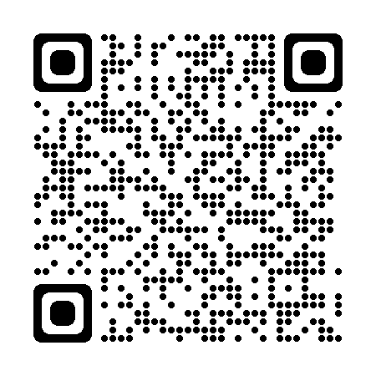
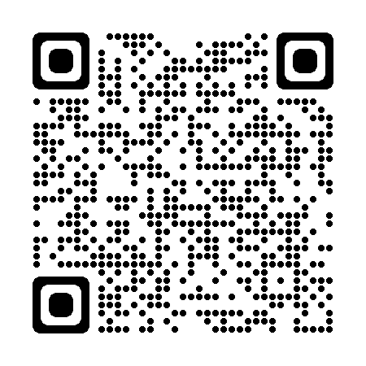
Email: ccss-researchsupport@cornell.edu
Computing
Shared & Dedicated Cloud Computing Resources
Secure Data Enclave
Software
Stata, SPSS, SAS
Python
R
Matlab
ArcGIS
Atlas.ti
NVivo
MaxQDA
Data Services
Data Access
Secure Data Services
Data Sharing & Archiving
Results Reproduction
Consulting
Popular Topics:
Qualitative Methods
Data Cleaning
Visualizations
Survey Analysis
Finding Data
Web Scraping
Text Analysis
Request Appointment

Slide 3
Objectives
To help get you started with using Atlas.ti
Specific objectives:
Prepare and manage qualitative data and attribute files
Create, save, and export a project
Code transcripts, videos, audio, pictures, and pdf files
Code using AI Coding and Summaries
Search text and autocode text
Query projects using conditions and attributes
Create memos, relationships, and report

Slide 4
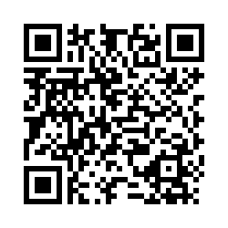
Evaluation Form

Slide 5
THANK YOU
Feedback welcome and encouraged!
Please complete our CCSS Qualitative Series Bootcamp evaluation form:
https://cornell.ca1.qualtrics.com/jfe/form/SV_7NvW5DZMxoYrU4C
Florio Arguillas, Ph.D.
foa2@cornell.edu

