Slide 1
Data Preprocessing w/ R
SP24
Instructor: Aishat Sadiq
Helper: Jacob Grippen

Slide 2
This Workshop Will Cover…
Subset Columns of Interest
Transforming Variable Type
Identifying and removing duplicate observations/rows
Remove Missing Data
Multiple Imputation of NAs
Computing new variables
Merge & Join Separate DFs
Flagging and dropping outliers
Reshaping: transform long to wide data using melt()
sort observations and reorder columns
Aggregate Summary Stats

Slide 3

Houston, we have a problem: Big Data!
Notes:
(https://time.com/6108001/data-protection-richard-stengel/)
It's estimated that 1.7 MB of data are created every second for every person on earth---the same amount of data needed to store an 850 page book, per second. Researchers believe that data consumption will increase by 23% annually until 2025. Our ability to generate, gather, and store volumes of data has far outpaced our ability to derive useful information from it in many fields, with available computational resources. Therefore, data reduction is a critical step in order to turn large datasets into useful information, the overarching purpose of data science.

Slide 4
Data Structure
A `data.frame` is a collection of vectors of identical lengths. Each vector represents a column, and each vector can be of a different data type (e.g., characters, integers, factors).
You should separate the original data (raw data) from intermediate datasets that you may create for the need of a particular analysis.
For instance, you may want to create a `data/` directory within your working directory that stores the raw data, and have a `data_output/` directory for intermediate datasets and a `figure_output/` directory for the plots you will generate.

Slide 5
Why Does It Matter?
Tidy data...
1. Makes it easier to focus on manipulating and analyzing data
2. Makes data visualization simpler and more intuitive
3. Help ML algorithms perform and learn more effectively
"Modeling is the driving inspiration of this work because most modeling tools work best with tidy datasets." Hadley Wickham

Slide 6
Load Packages & Messy data
Base R vs. packages
Tidyverse package was created by Hadley Wickham. Learn more about the 'tidyverse' online at <https://www.tidyverse.org> or <https://github.com/tidyverse/tidyverse>
Key information: Version, Depends, Imports

Slide 7
Access Mass Mobilization (MM) Dataset
Easiest Option: Download from GitHub
Intermediate Option: Download from site

Slide 8
Raw Data Files
mmALL_073120_csv.tab - .csv file
mmALL_073120_v16.tab - Stata file
Both have the same number of variables and observations!
Click the triangle to the right of the download/access file icon
Select RData
Please note: If the original file was created in Stata it is usually better to download the Stata file & convert in RStudio to maintain attributes like column labels.

Slide 9
Dataset Background
The Mass Mobilization (MM) data are an effort to understand citizen movements against governments, what citizens want when they demonstrate against governments, and how governments respond to citizens.
The data cover 162 countries between 1990 and March 2020.
For each protest event, the project records protester demands, government responses, protest location, and protester identities. The unit of observation is the protest-country-year, where protests are recorded individually within each country and year.

Slide 10
Cont.
The Principal Investigators for the Mass Mobilization project are David H. Clark (Binghamton University) and Patrick M. Regan (University of Notre Dame).
The Mass Mobilization project is sponsored by the Political Instability Task Force (PITF). The PITF is funded by the Central Intelligence Agency. The views expressed herein are the Principal Investigators' alone and do not represent the views of the US Government.

Slide 11
Define Research Question & Select Key Variables
Using the Mass Mobilization data, what are the geopolitical differences in citizen participation in protest movements against governments over time? In other words, can we determine if the number of participants and the number of protests change across country, region, or year?

Slide 12
Subset Columns of Interest
Use filter() to get the rows you want
Use select() to get the columns you want
Use pipe commands ( |> vs. %>% ) to input & output the data you want
Pipes in R look that like `%>%` are made available via the `magrittr` package installed as part of `dplyr`
Data will not save if it created into an object, unless using the last baseR script

Slide 13
Transforming Variable Type
Use str() function to detail (class, length, and content) of each column in your dataframe's structure.

Slide 14
Identifying and removing duplicate observations/rows
With big data, it is inefficient to manually remove duplicates
Also, using code makes for a more reproducible result

Slide 15
What should we do when we encounter missing data in our datasets?
Listwise-deletion/Complete Case Analysis
When dealing with simple statistics like the mean, the easiest way to ignore `NA` (the missing data) is to use `na.rm=TRUE` (`rm` stands for remove).
watch what happens to the number of observations!
Multiple Imputation
Mean/median Imputation
Ask yourself if you were to guess what those missing values were without any additional information, which would you choose?

Slide 16
Multiple Imputation of NAs
In statistics, imputation means "filling in the data." Mice is an algorithm that allows us to fill in the missing data by creating a multivariate imputation model and conditional probability distribution for each variable in our dataset.
Think about it as an iterative series of matrix calculations!
The mice package includes functions for diagnostic plots to inspect the quality of the imputations
When to not use mice? Large p, small n.

Slide 17
Mean/Median Imputation Steps
Start the mutate() function.
Specify the column in which you want to replace the missing values.
Use the ifelse() function to identify NA's, and once found, replace them with the median.
Finish the mutate() function.
Multiple Imputation using MICE

Slide 18
Flagging and Dropping Outliers
When we analyze data, it's important to recognize outliers because they can affect the accuracy of our models. Outliers can cause bias when performing statistical calculations like mean, standard deviation, and correlation on continuous variables.
Although outliers can have a big impact, experts suggest not automatically removing them from our observations during analysis!!

Slide 19
Methods of Removal
Interquartile Range
Mean +/- 3 Standard Deviations
Median Absolute Deviation (MAD)
Z-score & modified Z-score
Statistical Tests
Dixon's Q Test
Grubb's test
Rosner's test/generalized ESD many-outliers test (GESD)
Chi-squared test

Slide 20
Reshaping: transform long to wide data using melt()
Dataframes often come in less-than-ideal formats, especially when you are using secondary data. Helpful to prepare it for tables or for plotting with `ggplot2`
Data comes in two primary shapes: *wide* and *long*.
Wide: a row has more than one observation, and the units of observation (e.g., individuals, countries, households) are on one row each. (eg. survey or assessment data, or if you have ever downloaded data from Qualtrics)
Long: when a row has only one observation, but the units of observation are repeated down a column. (eg. Longitudinal data)

Slide 21
Aggregate Summary Stats
Use plyr::summarise() to apply a function to the variables in a dataset, especially important for aggregating across grouping variables.
Summarise multiple columns:
summarise_all() affects every variable
summarise_at() affects variables selected with a character vector or vars()
summarise_if() affects variables selected with a predicate function

Slide 22
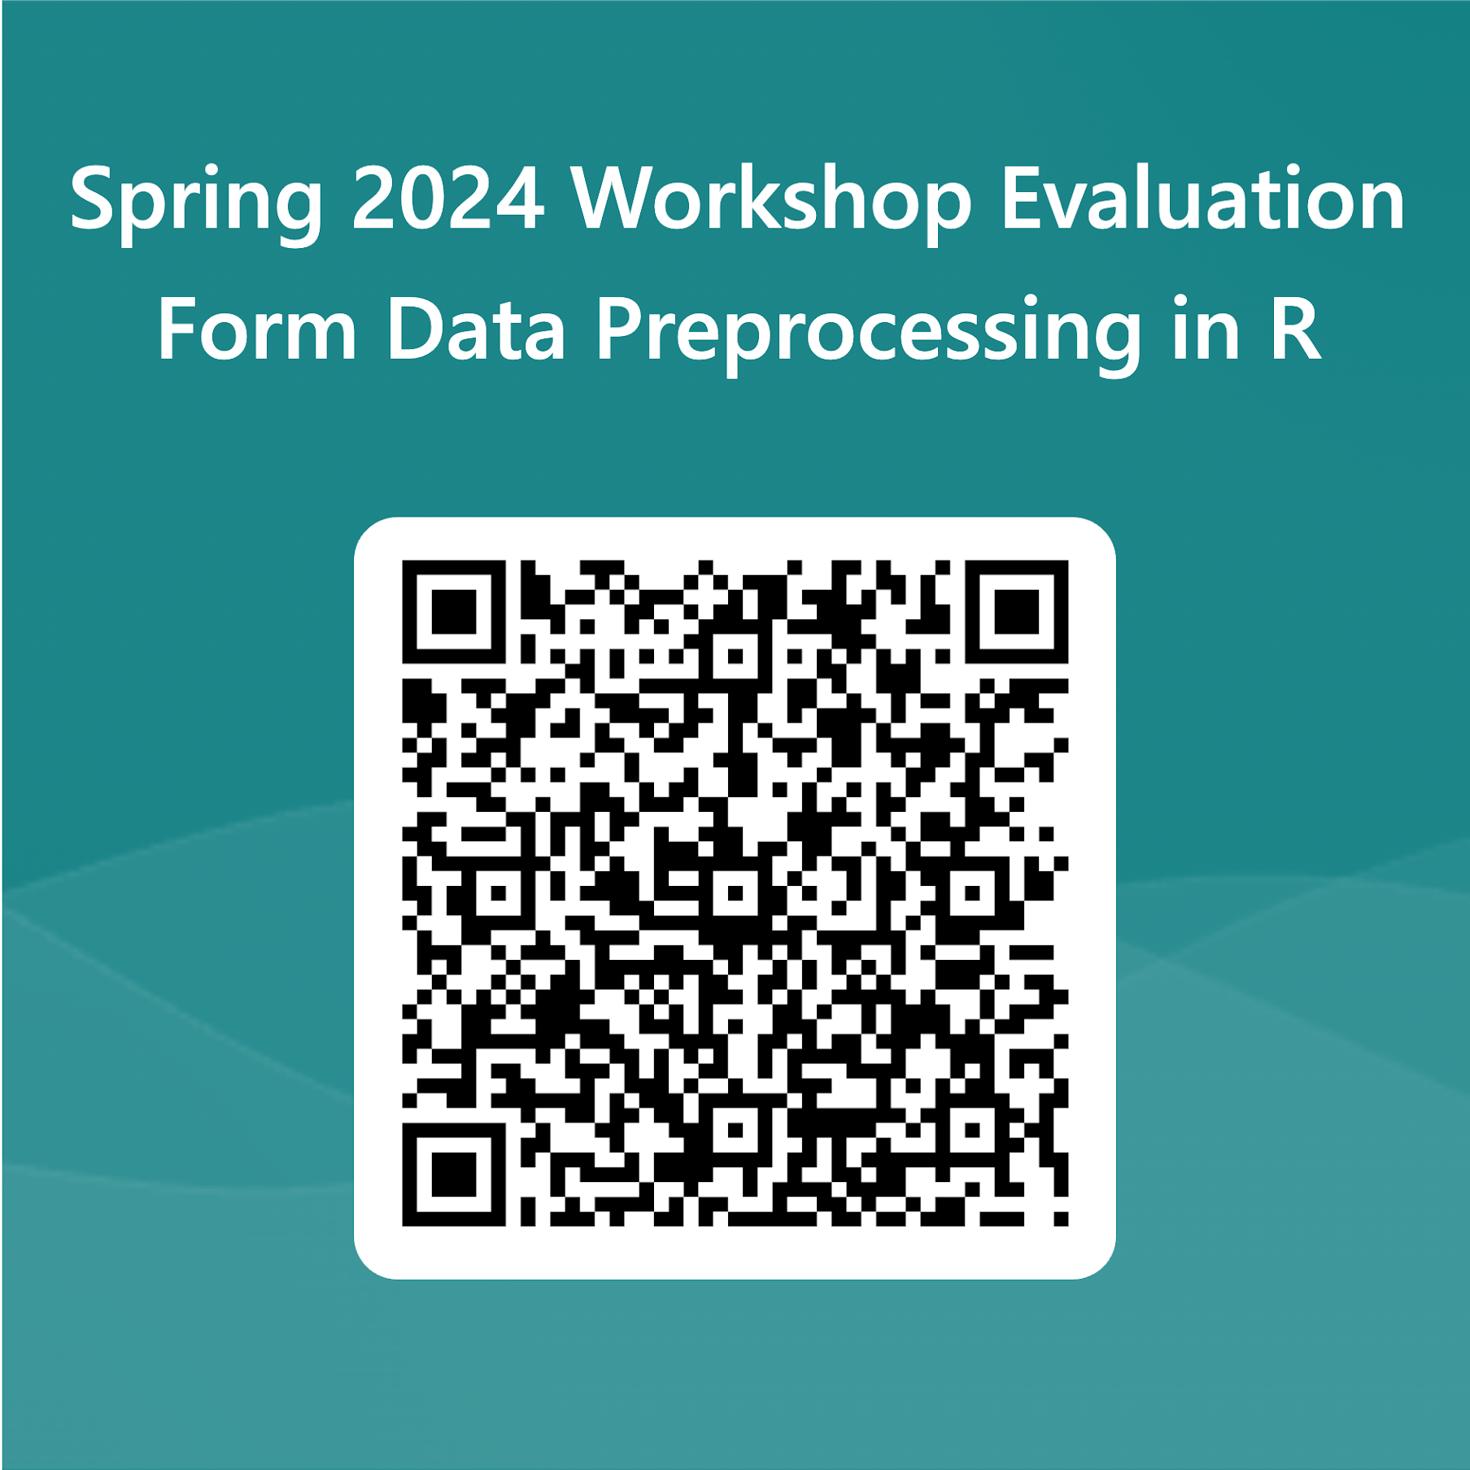
Workshop Evaluation QR Code

Slide 23
Sources
Gillespie, C. & Lovelace, R. (2016). Efficient R programming Wickham, H. (2014). Tidy Data. Journal of Statistical Software, 59(10), 1--23.
Wickham, H., Çetinkaya-Rundel, M., Grolemund, G. (2023) R for Data Science, 2e.
YAML Syntax
https://docs.ansible.com/ansible/latest/reference_appendices/YAMLSyntax.html
https://rstudio.github.io/cheatsheets/html/lubridate.html?_gl=1*iabz4g*_ga*MTAwNzU0ODg4NC4xNzA1NTExNDA4*_ga_2C0WZ1JHG0*MTcwNTUxMzk2Ni4yLjEuMTcwNTUxNTExNC4wLjAuMA

Slide 24
Cont.
Zhang Z. (2016). Multiple imputation with multivariate imputation by chained equation (MICE) package. Annals of translational medicine, 4(2), 30. https://doi.org/10.3978/j.issn.2305-5839.2015.12.63
van Buuren, S., & Groothuis-Oudshoorn, K. (2011). mice: Multivariate Imputation by Chained Equations in R. Journal of Statistical Software, 45(3), 1–67. https://doi.org/10.18637/jss.v045.i03
Data Wrangling with R, UNIVERSITY of WISCONSIN—MADISON Social Science Computing Cooperative

