Slide 1


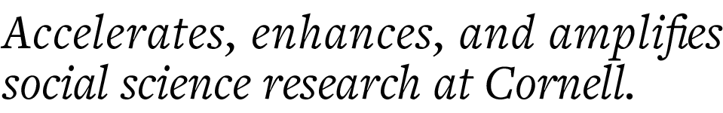
CCSS Python Machine Learning Series, Part 2 Unsupervised Learning
Instructor: Jonathan P. Chang
Helper: Aishat Sadiq
CCSS-ResearchSupport@cornell.edu

Slide 2
Series Overview
Introduction to Machine Learning
Unsupervised Learning
Supervised Learning
Natural Language Processing

Slide 3
Reminder: Supervised vs Unsupervised Learning
Labeled data
Unlabeled data
Supervised learning
Unsupervised learning

Slide 4
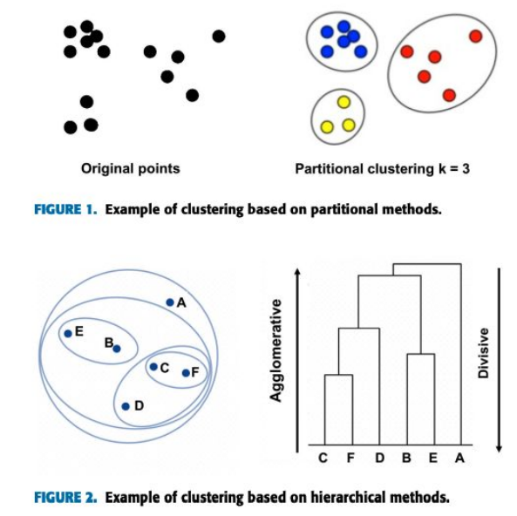
Reminder: What is Unsupervised Learning?
Learning from unlabeled data
Instead of modeling a specific relationship between designated variables, look for patterns and structures across the data
Common techniques:
K-means (segmenting the data)
Hierarchical clustering, association rules (finding structural relationships)
Commonly used as a bottom-up approach to exploratory research
Luna-Romera et al., 2019

Slide 5
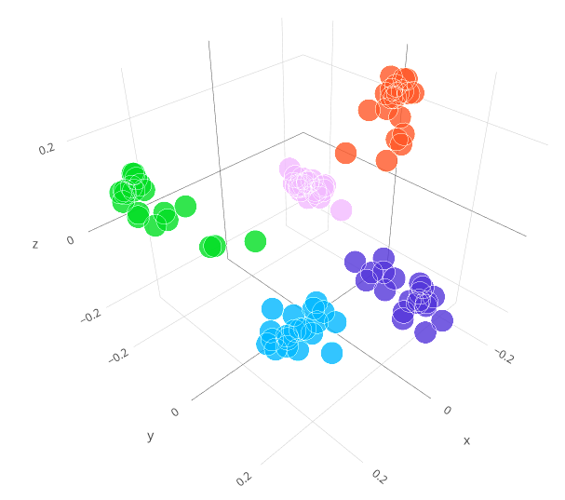
Clustering
The most commonly used unsupervised learning technique
Identifies similar "groups" (i.e., clusters) in unlabeled data
Image source: https://openai.com/blog/introducing-text-and-code-embeddings/

Slide 6
Clustering
Feature 1 | Feature 2 | Feature 3 | Feature 4 | ...
5.1 | 3.5 | 1.4 | 0.2 | ...
4.9 | 3.0 | 1.4 | 0.2
4.7 | 3.2 | 1.3 | 0.2
4.6 | 3.1 | 1.5 | 0.2
...

Slide 7
Clustering
Feature 1 | Feature 2 | Feature 3 | Feature 4 | ...
5.1 | 3.5 | 1.4 | 0.2 | ...
4.9 | 3.0 | 1.4 | 0.2
4.7 | 3.2 | 1.3 | 0.2
4.6 | 3.1 | 1.5 | 0.2
...
5.9 | 3.0 | 5.1 | 1.8

Slide 8
Clustering
Feature 1 | Feature 2 | Feature 3 | Feature 4 | ...
5.1 | 3.5 | 1.4 | 0.2 | ...
4.9 | 3.0 | 1.4 | 0.2
4.7 | 3.2 | 1.3 | 0.2
4.6 | 3.1 | 1.5 | 0.2
...
5.9 | 3.0 | 5.1 | 1.8
Cluster
?
?
?
?
...
?

Slide 9
Clustering
Feature 1 | Feature 2 | Feature 3 | Feature 4 | ...
5.1 | 3.5 | 1.4 | 0.2 | ...
4.9 | 3.0 | 1.4 | 0.2
4.7 | 3.2 | 1.3 | 0.2
4.6 | 3.1 | 1.5 | 0.2
...
5.9 | 3.0 | 5.1 | 1.8
Cluster
0
0
0
0
...
1

Slide 10
Clustering
DISCUSSION: What applications can you think of where clustering might be useful?

Slide 11
Clustering
DISCUSSION: What applications can you think of where clustering might be useful?
Just a few examples:
Recommendation systems (if you liked product X, you might like similar product Y)
Search results (X was relevant to your search, Y might be too since it's similar)
Market segmentation (group customers by spending habits)

Slide 12
The K-Means Clustering Algorithm
The goal of clustering is to separate data so that datapoints similar to one another are in the same group, while datapoints different from each other are in different groups. So, two questions arise:
Pick a "K" that represents the number of groups (clusters) we expect to find in the data
How many groups do we choose?
Minimize the average, or "mean", distance of data to each cluster center ("centroid")
How do we define similarity?

Slide 13
The K-Means Clustering Algorithm
K-Means clustering is done iteratively:
Randomly place k centroids
Assign each datapoint to its nearest centroid
Compute the mean of all points assigned to a cluster, and use that as the new centroid for that cluster
Repeat steps 2 and 3 until the means stop changing
Assign each datapoint to its nearest (finalized) centroid

Slide 14
The K-Means Clustering Algorithm
Animation source: https://mubaris.com/posts/kmeans-clustering/

Slide 15
The K-Means Clustering Algorithm
K-Means clustering is done iteratively:
Randomly place k centroids
Assign each datapoint to its nearest centroid
Compute the mean of all points assigned to a cluster, and use that as the new centroid for that cluster
Repeat steps 2 and 3 until the means stop changing
Assign each datapoint to its nearest (finalized) centroid
model = KMeans(n_clusters = k)
model.fit(X)
model.transform(X)

Slide 16
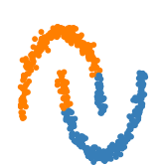
K-Means Drawbacks
Using distance as a similarity metric suffers the "curse of dimensionality": when you have many dimensions, distances are naturally larger
Not suited to clusters with "weird" geometry (see figure)
Image source: https://scikit-learn.org/stable/auto_examples/cluster/plot_cluster_comparison.html

Slide 17
K-Means Drawbacks
Using distance as a similarity metric suffers the "curse of dimensionality": when you have many dimensions, distances are naturally larger
Solution: before running K-Means, do dimensionality reduction
Not suited to clusters with "weird" geometry (see figure)
Solution: use other clustering algorithms (not covered here)
Image source: https://scikit-learn.org/stable/auto_examples/cluster/plot_cluster_comparison.html

Slide 18
Dimensionality Reduction: Intuition
How many dimensions does this data have?
1 dimension (let's call it "x")

Slide 19
Dimensionality Reduction: Intuition
How many dimensions does this data have?
2 dimensions (x and y)

Slide 20
Dimensionality Reduction: Intuition
How many dimensions does this data have?
2 dimensions...but they seem (roughly) related
y = mx + b (approximately)
So x is all you actually need!

Slide 21
Dimensionality Reduction
Automatically discover relationships (correlations) between features, reduce the data to the bare minimum needed to recover the original
Commonly used algorithms include principal component analysis (PCA) and singular value decomposition (SVD)

Slide 22
Summary: Unsupervised Learning Workflow
Visualize the data: does clustering even make sense?
(Optionally) If there are many features, apply dimensionality reduction
Pick a number of clusters
Fit the K-Means model
Examine the clustering results: do they look like they make sense?

Slide 23
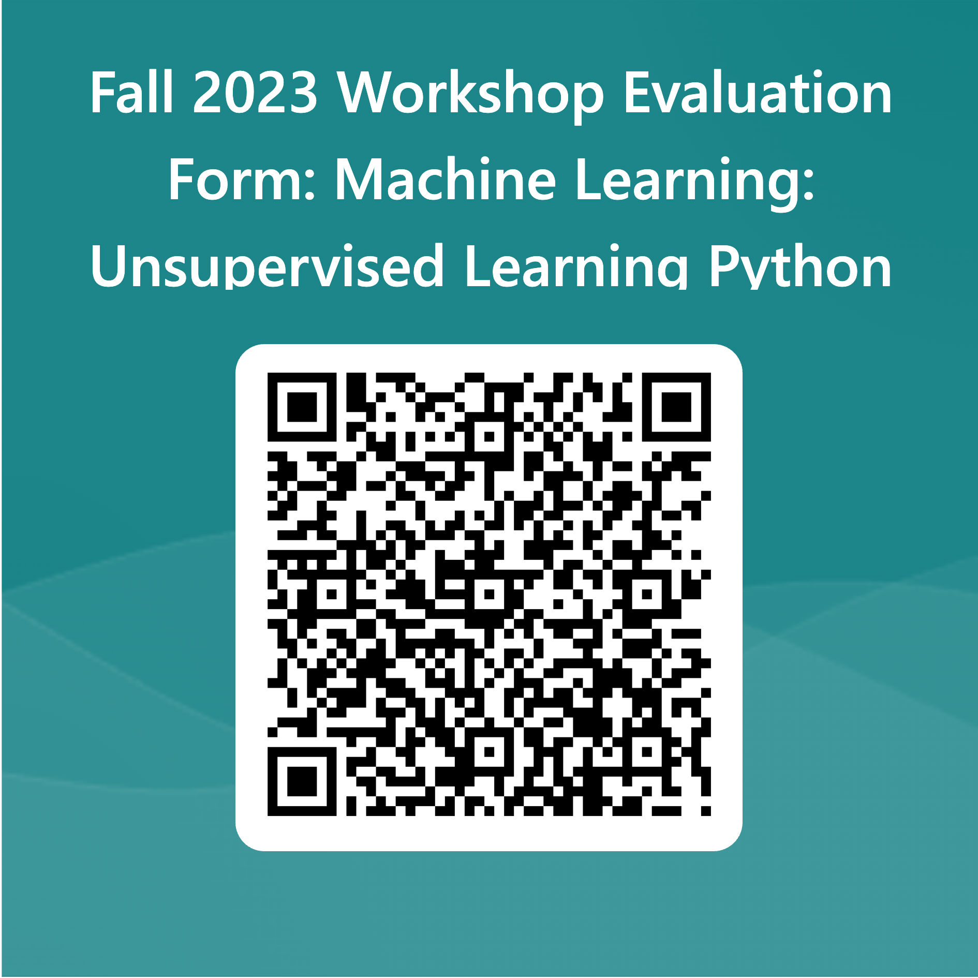
Thank you! Questions?

