Slide 1


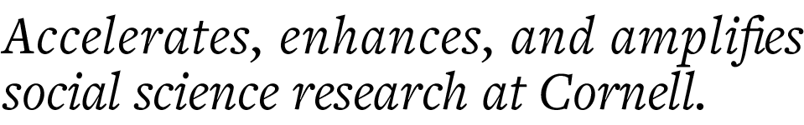
CCSS Python Machine Learning Series, Part 1 Introduction to Machine Learning
Instructor: Jonathan P. Chang
Helper: Aishat Sadiq
CCSS-ResearchSupport@cornell.edu

Slide 2
Series Overview
Introduction to Machine Learning
Supervised Learning
Unsupervised Learning
Natural Language Processing

Slide 3
What is Machine Learning (ML)?
DISCUSSION: What do you think of when you hear "Machine Learning"?

Slide 4
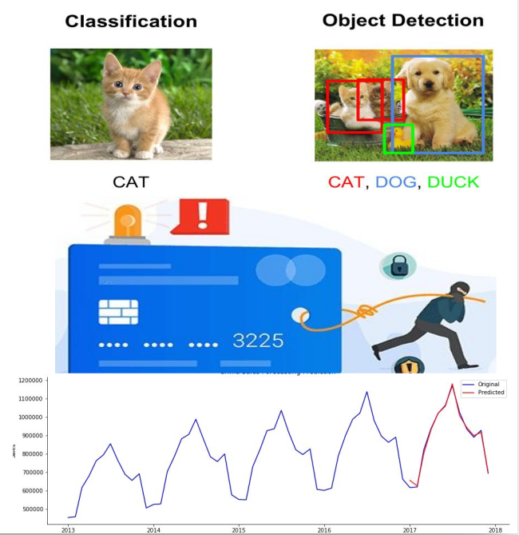
What is Machine Learning (ML)?
Machine Learning can:
Identify patterns & generate replications
By learning from thousands of images, ML can generate an accurate image of a "dog" or a "cat"
Flag abnormalities
If fed a large collection of card transactions, ML can identify the rare occurrence of credit fraud
Predict future outcomes
Given the purchasing trends of customers over multiple years, ML can predict how much revenue to expect next month

Slide 5
But what is it really?
A class of statistical techniques that uses data to improve performance on a task, leading to data-informed predictions.
In social science, we are used to running statistical tests to find correlations
E.g., Pearson and Spearman tests; Ordinary Least Squares
Machine Learning is about finding these correlations at extremely large scale

Slide 6
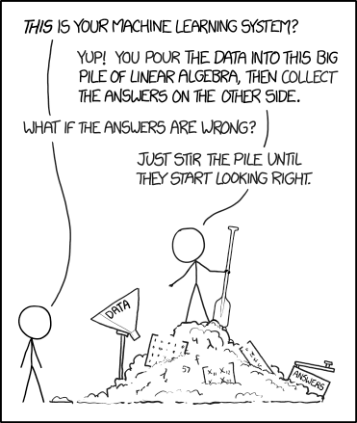
Source: https://xkcd.com/1838

Slide 7
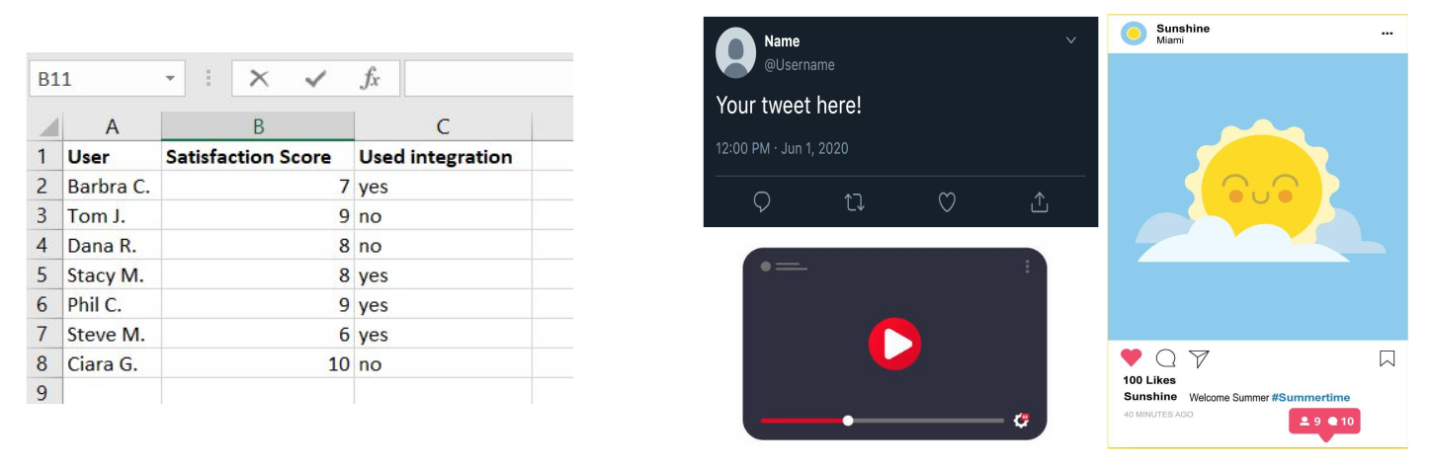
Let's talk about data...
Structured Data
Pre-specified format: survey results with set columns for variables
Unstructured Data
No pre-specified format: raw text, images, audio, video

Slide 8
Why Would Social Scientists be Interested in ML?
Apply innovative techniques to understand human behavior and social systems
Can be integrated with classic subdiscipline theories and methodologies
Applies to a variety of traditional social science data: panel surveys, digitized documents, experiments, etc.
Well-suited for Big Data age and greater presence of social behavior now on social platforms

Slide 9
What can ML do for us? 2 Examples from Political Science
I have a dataset containing the outcomes of various bills (whether or not they passed), together with tweets about those bills. Based on the text of the tweets, can I predict whether each bill passed? (Zhang and Counts, 2016)
I have transcripts of debates from British Parliament. Can I identify recurring patterns of speech in the questions that were asked? (Zhang et al., 2017)
Labeled data
Unlabeled data
Supervised learning
Unsupervised learning

Slide 10
What is Supervised Learning?
Model the relationship between independent variables (model inputs) and dependent variables (model outputs) using labeled data
Use model for prediction on new data where the labels are unknown
Research questions can be further separated into regression and classification tasks:
Regression: labels are continuous
Wage, GPA, housing prices, etc.
Classification: labels are discrete
Binary: 0/1, Yes/No, True/False
Multi-class (aka Categorical): Cat/Dog/Duck, Digit (0, 1, …, 9)

Slide 11
What is Supervised Learning?
Regression
Classification
Animations by Davi Frossard (https://www.cs.toronto.edu/~frossard/)

Slide 12
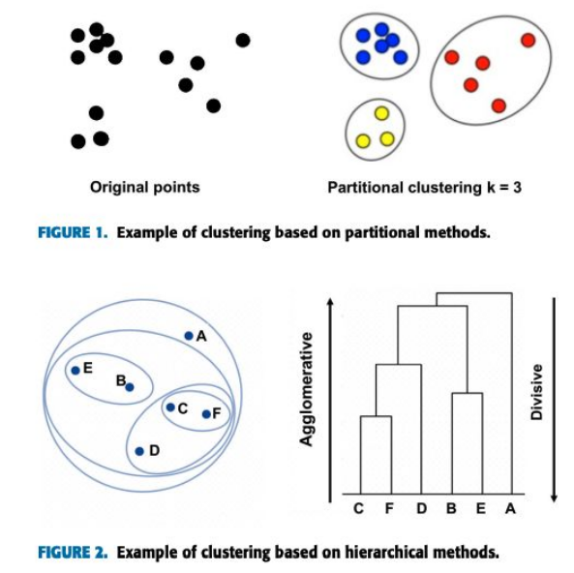
What is Unsupervised Learning?
Learning from unlabeled data
Instead of modeling a specific relationship between designated variables, look for patterns and structures across the data
Common techniques:
K-means (segmenting the data)
Hierarchical clustering, association rules (finding structural relationships)
Commonly used as a bottom-up approach to exploratory research
Luna-Romera et al., 2019

Slide 13
Getting Started
More technical details on supervised and unsupervised learning at the upcoming sessions! But before we can get to that...
...A more fundamental question we must answer: how does ML "understand" our data?
As social scientists we're used to doing correlation tests with numerical variables. But what does it mean to "correlate" something with raw text? Or images?
Important first step for ALL machine learning: data preparation
All data science requires data preparation, but data preparation for ML involves some unique steps and concepts

Slide 14
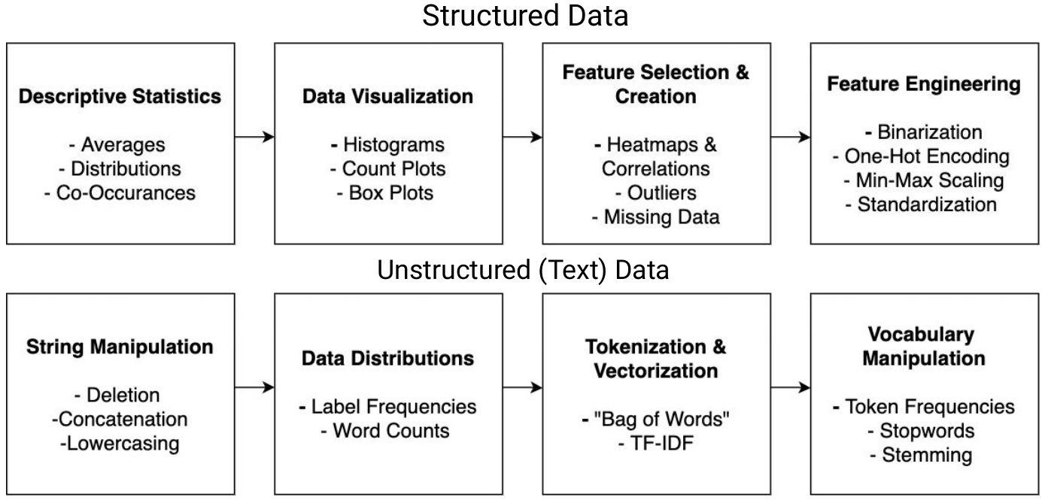
Coding Demo Outline

Slide 15
Thank you! Questions?

