Slide 1
Dimension(ality) Reduction R Series
Part I - Feature Selection; SP24
Instructor: Aishat Sadiq
Helper: Jacob Grippen

Slide 2

Houston, we have a problem: Big Data!
Notes:
(https://time.com/6108001/data-protection-richard-stengel/)
It's estimated that 1.7 MB of data are created every second for every person on earth---the same amount of data needed to store an 850 page book, per second. Researchers believe that data consumption will increase by 23% annually until 2025. Our ability to generate, gather, and store volumes of data has far outpaced our ability to derive useful information from it in many fields, with available computational resources. Therefore, data reduction is a critical step in order to turn large datasets into useful information, the overarching purpose of data science.

Slide 3
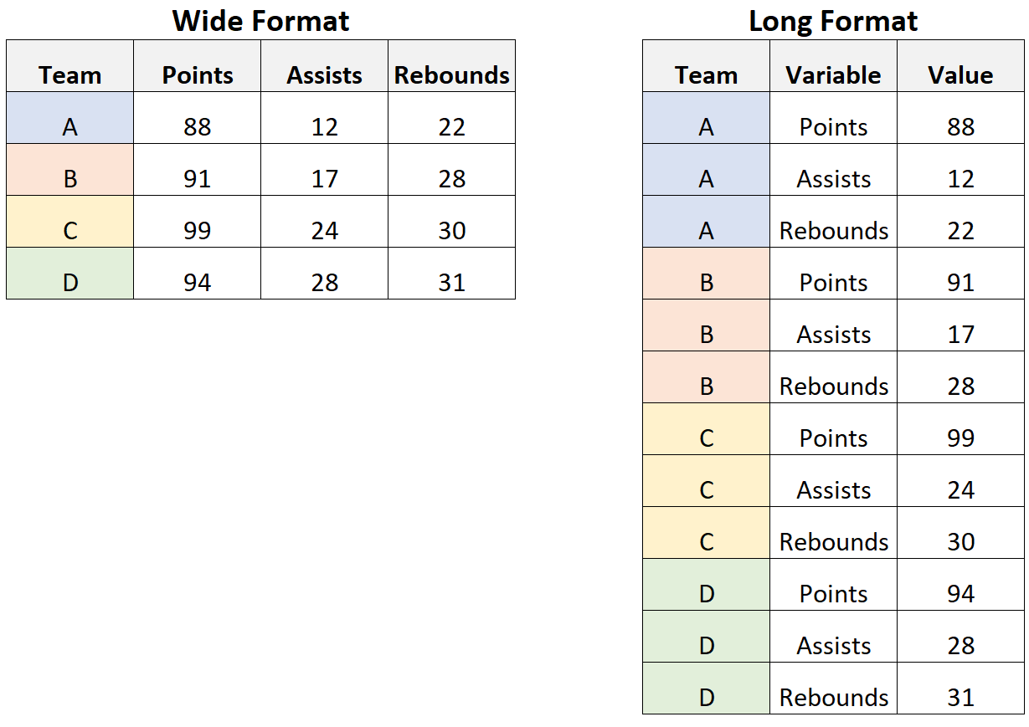
What are high-dimensional data?
Popular uses of high dimensional data:
Genetic data
fMRI data
high-dimensional time series
feature engineering
data mining
exploratory data analysis/Structural Equation Modeling
topic modeling
signal detection/counting/identification/estimation clustering observations
Notes:
https://carpentries-incubator.github.io/high-dimensional-stats-r/aio/index.html
data in which the number of features (variables observed), p, are close to or larger than the number of observations (or data points), n.
Similar to wide data learned in the Data Preprocessing Workshop
High dimensional data can lead to the following:
long training times
Overfitting

Slide 4
Definition
Feature Selection is the process that removes irrelevant and redundant features from the data set. The model, in turn, will be of reduced complexity, thus, easier to interpret.

Slide 5
Benefits of Dimensionality Reduction
Compact storage for big, high dimensional data
Reduce model training/computation time
Improve Reduce multi-collinearity between features & lessens redundant data
Prevents overfitting
Sometimes improves model accuracy, interpretability, and visualization

Slide 6
Popular Feature Linear Extraction Techniques
Principal Component Analysis (PCA)
Independent Component Analysis (ICA)
Factor Analysis (FA)
Linear Discriminant Analysis (LDA)
Singular Value Decomposition (SVD)
Non-negative matrix factorization (NMF)
Notes:
PCA looks for dimensions with greatest variance between components then transforms the coordinates of each data point to fit the new dimensions. This should minimize the distance between similar data points and maintain distances between dissimilar data along the new component axis to preserve the original space structure as much as possible. Unsupervised learning!

Slide 7
Non-linear Techniques/Manifold Learning
[Student] t-distributed Stochastic Neighbor Embedding (t-SNE)
Kernel PCA
Iso-map, UMAP
Multidimensional Scaling (MDS)
Autoencoders & Neural Networks
Locally-linear embedding (LLE)
Notes:
Lasso & Ridge Regularization?
The R package Rtsne implements t-SNE in R.

Slide 8
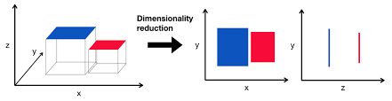
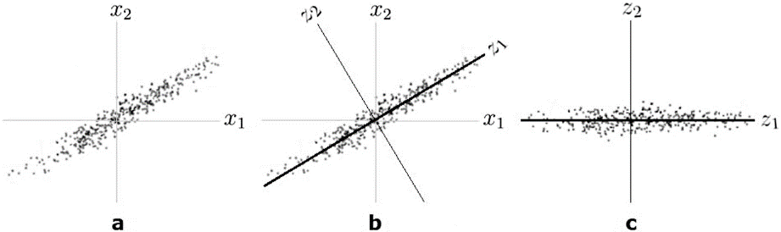
Dimensionality reduction incurs data loss
Goal: represent the same data with fewer variables by preserving the structure of the data*
In PCA the structure is defined by variance
How much of the variance of Y can be
explained by X?
Notes:
* Images and speech are usually high dimensional data because we choose to represent text with individual words and images with individual pixels.
The ”true” dimensionality of the data is typically lower while the rest of the data can be seen as noise.

Slide 9

So, what are features?
Example: Predicting House Prices
Square footage
Number of rooms
Build date/Age
Location
Dependent Variable: Price

Slide 10



Example: Animal Classification
Features: ears, eyes, nose

Slide 11
Examine dataset

Slide 12
Code - Introduce dataset
We study race in the labor market by sending fictitious resumes to help-wanted ads in Boston and Chicago newspapers. To manipulate perceived race, resumes are randomly assigned African-American- or White-sounding names. White names receive 50 percent more callbacks for interviews. Callbacks are also more responsive to resume quality for White names than for African-American ones. The racial gap is uniform across occupation, industry, and employer size. We also find little evidence that employers are inferring social class from the names. Differential treatment by race still appears to still be prominent in the U. S. labor market.
Notes:
https://vincentarelbundock.github.io/Rdatasets/doc/openintro/labor_market_discrimination.html

Slide 13
Research Questions
https://vincentarelbundock.github.io/Rdatasets/doc/openintro/labor_market_discrimination.html
https://www.openicpsr.org/openicpsr/project/116023/version/V1/view
https://www.nber.org/system/files/working_papers/w9873/w9873.pdf

Slide 14
The Curse of Dimensionality
[Bellman et al., 1957]
Notes:
As dimensionality increases, the number of observations per dimension typically decreases. Thus, rendering statistical tests difficult.

Slide 15
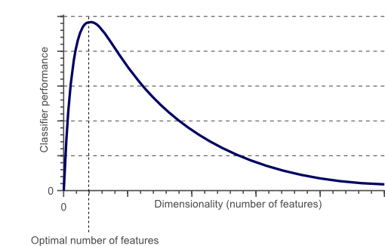
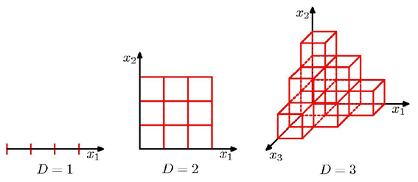
Curse of Dimensionality & Model Overfitting
If the amount of available training data is fixed, then overfitting occurs if we keep adding dimensions. On the other hand, if we keep adding dimensions, the amount of training data needs to grow exponentially fast to maintain the same coverage and to avoid overfitting.
With overfitting, the training error will be very low (can even be 0) while test error will be very high. This is because with overfitting, you were able to perfect explain the training data with your model and bias is very low (training error decreases). However, your over-fit model will not be able to explain new data sets well and thus variance will increase (test error increases)
As the dimensionality increases, the classifier’s performance increases until the optimal number of features is reached. Further increasing the dimensionality without increasing the number of training samples results in a decrease in classifier performance.
Notes:
Avoiding curse of dimensionality - Figure 1 showed that the performance of a classifier decreases when the dimensionality of the problem becomes too large. The question then is what ‘too large’ means, and how overfitting can be avoided. Regrettably there is no fixed rule that defines how many feature should be used in a classification problem. In fact, this depends on the amount of training data available, the complexity of the decision boundaries, and the type of classifier used.
The more features we use, the more sparse the data becomes such that accurate estimation of the classifier’s parameters (i.e. its decision boundaries) becomes more difficult. Another effect of the curse of dimensionality, is that this sparseness is not uniformly distributed over the search space.

Slide 16
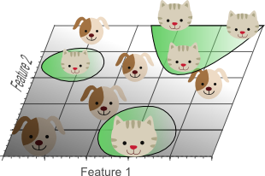
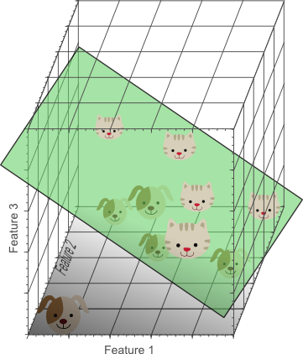
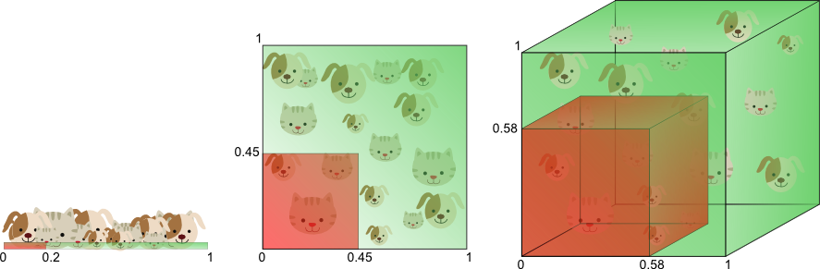
The curse of dimensionality introduces sparseness of the training data
The more features we use, the higher the likelihood that we can successfully separate the classes perfectly.
The amount of training data needed to cover 20% of the feature range grows exponentially with the number of dimensions.
Notes:
If the theoretical infinite number of training samples would be available, the curse of dimensionality does not apply and we could simply use an infinite number of features to obtain perfect classification. The smaller the size of the training data, the less features should be used.
Furthermore, classifiers that tend to model non-linear decision boundaries very accurately (e.g. neural networks, KNN classifiers, decision trees) do not generalize well and are prone to overfitting. Therefore, the dimensionality should be kept relatively low when these classifiers are used. If a classifier is used that generalizes easily (e.g. naive Bayesian, linear classifier), then the number of used features can be higher since the classifier itself is less expressive. Figure 6 showed that using a simple classifier model in a high dimensional space corresponds to using a complex classifier model in a lower dimensional space.
An invaluable technique used to detect and avoid overfitting during classifier training is cross-validation. Cross validation approaches split the original training data into one or more training subsets. During classifier training, one subset is used to test the accuracy and precision of the resulting classifier, while the others are used for parameter estimation. If the classification results on the subsets used for training greatly differ from the results on the subset used for testing, overfitting is in play. Several types of cross-validation such as k-fold cross-validation and leave-one-out cross-validation can be used if only a limited amount of training data is available.

Slide 17
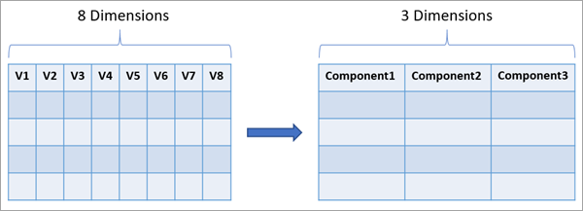
Feature Selection vs. Feature Extraction
Feature Selection
Uses domain knowledge and/or statistical tests to select the most relevant variables.
Feature Extraction
Constructs a new set of dimensions/attributes.
Notes:
Most of the classical statistical model building and machine learning methods are quite inefficient with a huge number of input variables. Applying an exhaustive search of the space for feature/variable selection is computationally intractable for all but the smallest of data sets, especially when the number of features p is large. Because of the complexity of big data, it is often necessary to use DR techniques before attempting to conduct statistical inference or solve a problem. In general, choosing between feature extraction or just feature/variable selection depends mostly on the problem being solved.
In addition, most methods have parameters to tune and/or make specific assumptions.

Slide 18
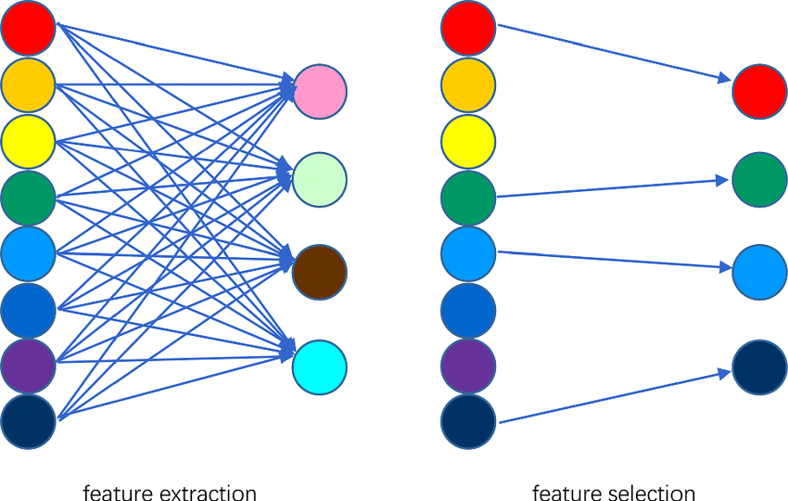
Selection v. Extraction

Slide 19
Common Feature Selection Techniques
Filter Methods (uni/multi-variate test)
Wrapper Methods
Backward Stepwise Selection
Forward Stepwise Selection
Exhaustive Search Selection
Sequential Replacement Selection
Embedded Methods
LASSO
Tree-based methods

Slide 20
Code - Filter Methods
Correlation-based feature selection using cor() function
Features are filtered based metrics like Pearson’s correlation with the dependent variable
Pro: Fast Con: may not select the best features
Notes:
Information gain and chi-square statistics using info.gain() and chisq.test()
Gain – find meaningful information and attribute features
Chi-squared test of observed vs expected counts
Remove all features using the variance threshold

Slide 21
Code - Wrapper Methods
Feature selection algorithm “wraps” around the predictive model algorithm and uses the same model to select the best features
Pro: Selects the best features/best model performance
Con: Computationally expensive, prone to overfitting
Forward and backward selection with stepwise regression
Recursive Feature Elimination (RFE) using rfe() from the caret package

Slide 22
Code - Embedded Methods
Use concepts from both wrap and filter methods.
Pro: fast, accurate, and less prone to overfitting
Con:
LASSO (Least Absolute Shrinkage and Selection Operator) with the glmnet package
Tree-based methods for feature importance using randomForest or xgboost

Slide 23
Evaluating Feature Selection Performance
R ² ⁻ tend to choose models with more predictors, can never become smaller with added predictors, larger is better
RMSE - root mean-squared error, tends to choose models with more predictors
Adjusted R ² ⁻ penalizes for additional predictors and can decrease with added predictors, larger is better
Other penalization methods: LASSO and Ridge Regression
Akaike Information Criterion (AIC) - 2p is called a penalty component, smaller is better.
Bayesian Information Criterion (BIC) - larger penalty than AIC, generally picks a smaller model than AIC, smaller is better.
Notes:
penalty for BIC is log(n)p rather than the AIC’s penalty of 2p

Slide 24
Be careful of P-hacking!!

Slide 25
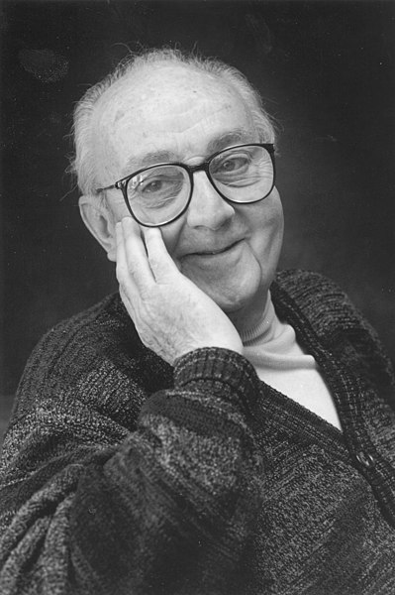
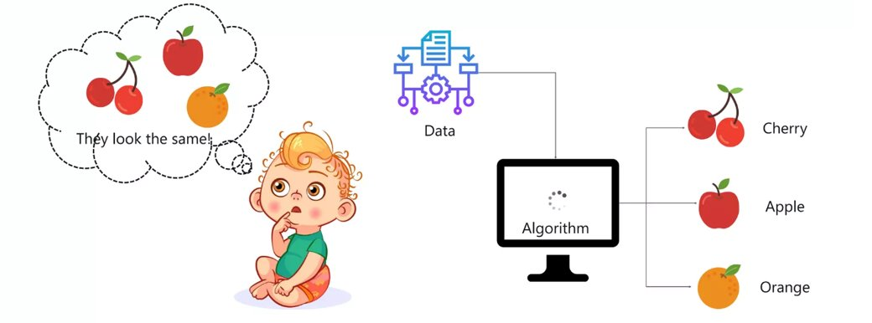
Machine Learning is defined as...
...
Notes:
Literally machines learning through input

Slide 26
Ten quick tips for effective dimensionality reduction
https://journals.plos.org/ploscompbiol/article?id=10.1371/journal.pcbi.1006907

Slide 27

Workshop Evaluation QR Code

Slide 28
Resources/Further Reading
https://www.john-ros.com/Rcourse/multivariate.html
https://doi.org/10.4324/9781003279693
Evaluation of economics journals based on structural equation dimension reduction method: https://doi.org/10.1080/15140326.2021.1984163
https://link-springer-com.proxy.library.cornell.edu/book/10.1007/978-3-031-05371-9

Slide 29
Resources/Further Reading
https://rpubs.com/Saskia/520216
Nguyen, Lan Huong, and Susan Holmes. “Ten quick tips for effective dimensionality reduction.” PLOS Computational Biology 15.6 (2019): e1006907.
Li, Lexin. “Dimension reduction for high-dimensional data.” Statistical methods in molecular biology. Humana Press, Totowa, NJ, 2010. 417-434.
https://www.tmwr.org/dimensionality

Slide 30
Resources/Further Reading
An Introduction to Statistical Learning (ISLR) by James, Witten, Hastie and Tibshirani: http://www-bcf.usc.edu/~gareth/ISL/
R code for feature extraction and model performance
https://www.john-ros.com/Rcourse/unsupervised.html#dim-reduce
https://rpubs.com/marwahsi/tnse

Slide 31
Resources/Further Reading
animation example
https://stats.stackexchange.com/questions/2691/making-sense-of-principal-component-analysis-eigenvectors-eigenvalues
Topic modeling
https://krisrs1128.github.io/stat679_notes/2022/06/02/week12-1.html#:~:text=Topic%20modeling%20is%20a%20type,word%20in%20the%20document%20i.

Slide 32
What questions do you have?

Slide 33
Junkyard

Slide 34
Agenda
Introduction to Dimensionality Reduction
The Curse & Blessing of Dimensionality
Introduce Dataset & Research Questions
Common Feature Selection Methods
Model Performance Evaluation
Feature Elimination vs. Feature Extraction

Slide 35
Evaluation of economics journals based on structural equation dimension reduction method
https://doi.org/10.1080/15140326.2021.1984163

Slide 36
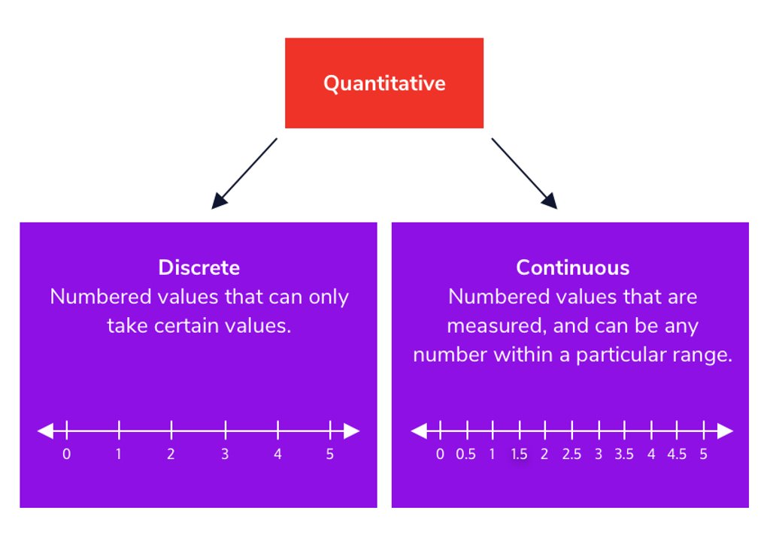
Choose statistical techniques based on your goals and the properties of the data.
Collecting Data
Cleaning Data
Choosing Features
Bias-Variance Tradeoff
Selection v Extraction
Evaluate Model Performance + Error
Iterative process of optimizing parameters
Notes:
Model performance -> Number of Features & feature Selection w/ CV, Feature extraction = dimensionality reduction, Measurng error

Slide 37
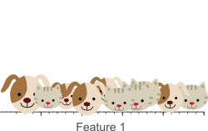
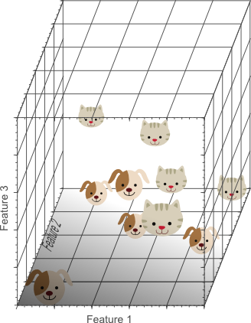
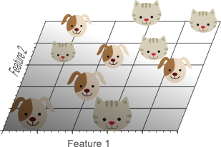
Building Intuition: Cat-Dog Example
Notes:
Consider an example in which we have a set of images, each of which depicts either a cat or a dog. We would like to create a classifier that is able to distinguish dogs from cats automatically. To do so, we first need to think about a descriptor for each object class that can be expressed by numbers, such that a mathematical algorithm, i.e. a classifier, can use these numbers to recognize the object. We could for instance argue that cats and dogs generally differ in color. A possible descriptor that discriminates these two classes could then consist of three number; the average red color, the average green color and the average blue color of the image under consideration. A simple linear classifier for instance, could combine these features linearly to decide on the class label:
However, these three color-describing numbers, called features, will obviously not suffice to obtain a perfect classification. Therefore, we could decide to add some features that describe the texture of the image, for instance by calculating the average edge or gradient intensity in both the X and Y direction. We now have 5 features that, in combination, could possibly be used by a classification algorithm to distinguish cats from dogs.
To obtain an even more accurate classification, we could add more features, based on color or texture histograms, statistical moments, etc. Maybe we can obtain a perfect classification by carefully defining a few hundred of these features? The answer to this question might sound a bit counter-intuitive: no we can not!. In fact, after a certain point, increasing the dimensionality of the problem by adding new features would actually degrade the performance of our classifier. This is illustrated by figure 1, and is often referred to as ‘The Curse of Dimensionality’.

