Slide 1

University of Macau
Faculty of Science and Technolog
Detecting Software Defects Using Verification Tools

Slide 2
Final Report
Project Supervisor
Prof. Qiwen XU
IP TONG, DB625785
ANSON CHIU， DB626242

Slide 3

Software In Modern
Quality
Security
Reliability
Verification

Slide 4
Contents
INTRODUCTION
KNOWLEDGE OF VERIFICATION
VERIFICATION TOOL
RELATED WORK
STUDY CASE

Slide 5


INTRODUCTION
Background
Programmer
Code detector

Slide 6
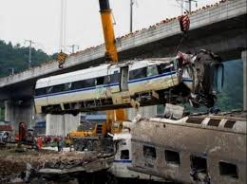
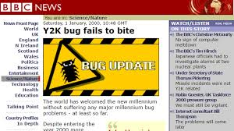
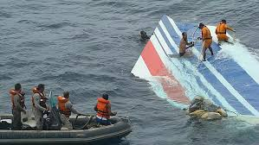
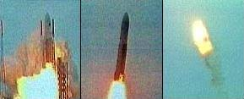
INTRODUCTION
Benefit
If do not have a good verification, there would be a risk existence.
Historical event:

Slide 7

INTRODUCTION
Target
Defining problems
Finding problems
Solve problems
Avoiding problems

Slide 8
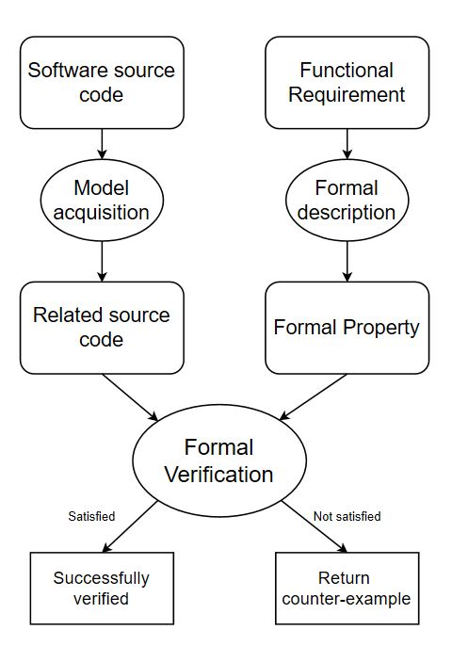
KNOWLEDGE OF VERIFICATION
Introduction of Formal verification
Principle:
Hoare Logic
Hoare Triple： {P}S{Q}
P: Precondition (State) S: Instructions Q: Postcondition (State)

Slide 9
KNOWLEDGE OF VERIFICATION
Introduction of Formal verification
Weakest per-condition
{wp(S,Q)} ⇒ S{Q}
Suppose 'S' is a statement and 'Q' is a predicate, which describes a certain relationship determined after' s' is executed. Define another predicate from 'S' and 'Q'。

Slide 10
KNOWLEDGE OF VERIFICATION
Introduction of static analysis
Indicators:
False negatives
False positions
Categories:
Annotation analysis
Lexical analysis
semantic analysis
Memory leaks analysis

Slide 11
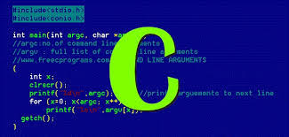

VERIFICATION TOOL
Introduction

Slide 12
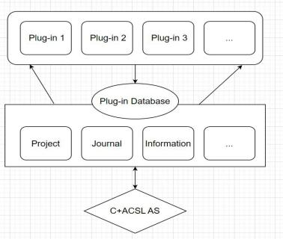
VERIFICATION TOOL
Frama-C
Plug-Ins:
Value Analysis plug-in
WP plug-in
Jessie plug-in
Slicing plug-in
Framework

Slide 13
VERIFICATION TOOL
Frama-C
Annotations:
ANSI/ISO C Specification Language (ACSL)
/*@ requires \valid(n) && \valid(m);
assigns *n, *m;
ensures *n == \old(*m) && *m == \old(*n);
*/
void swap(int * n, int * m);

Slide 14
RELATED WORK
Formal verification
2-1=1 √
2-1=other ×
1+1=2

Slide 15
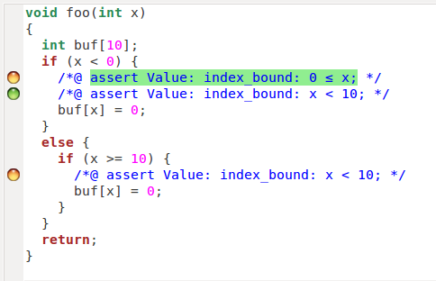
RELATED WORK
void foo(int x)
{
int buf[10];
if (x < 0 || x >= 10)
buf[x] = 0;
}
Run-time error problems
Buffer overflow
Memory leak
Null pointer
Wild pointer
…….
…….

Slide 16
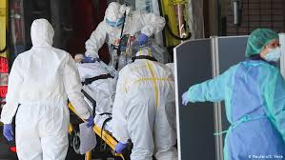
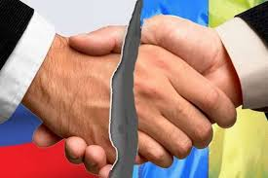


CASE STUDY
Problems

Slide 17
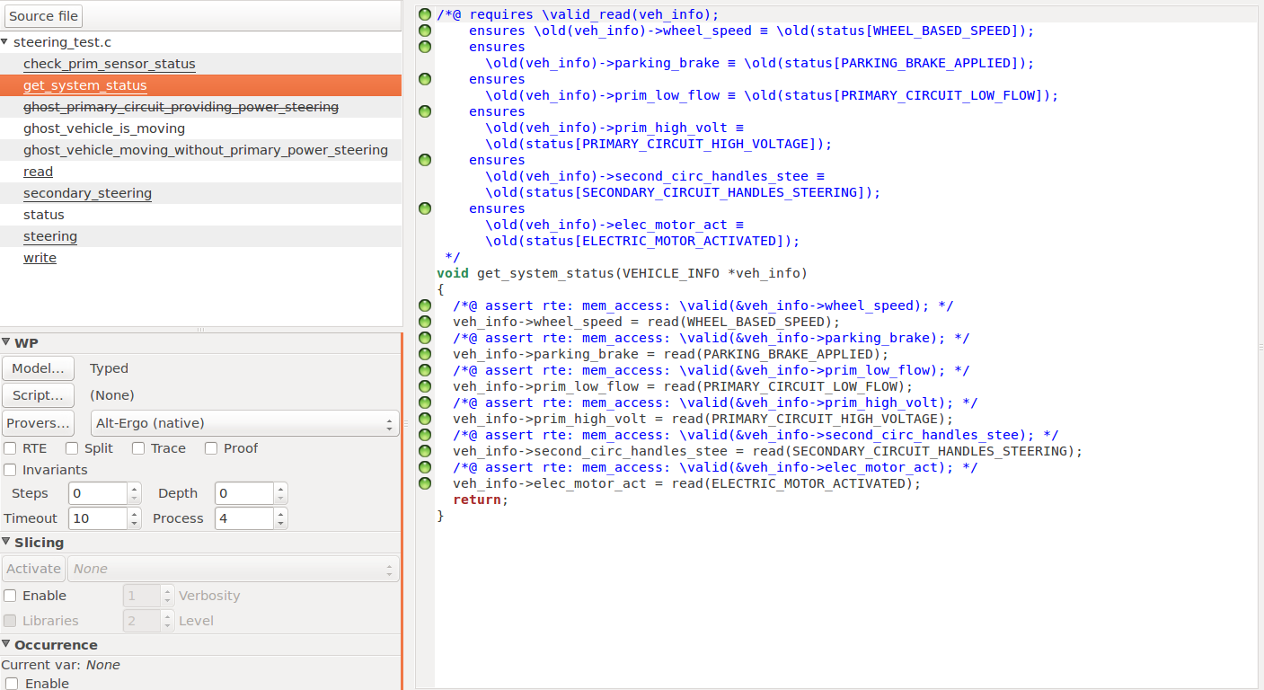
CASE STUDY

Slide 18
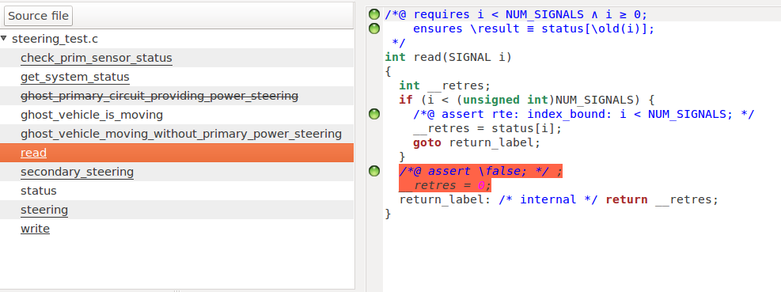
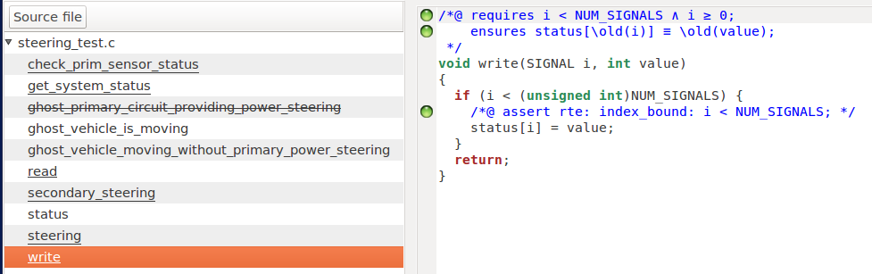
CASE STUDY

Slide 19
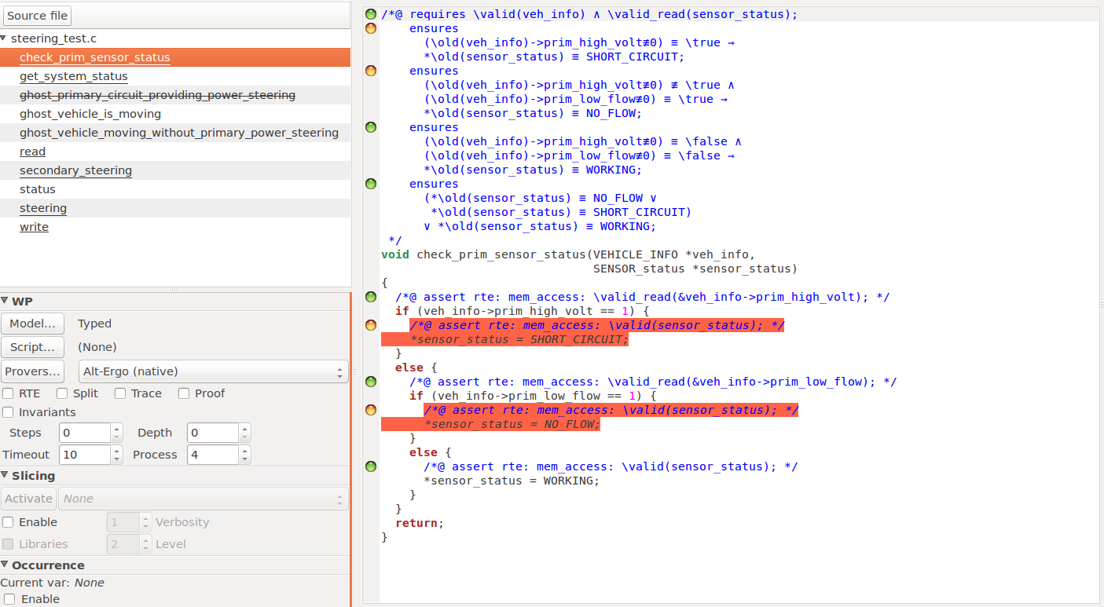
CASE STUDY

Slide 20
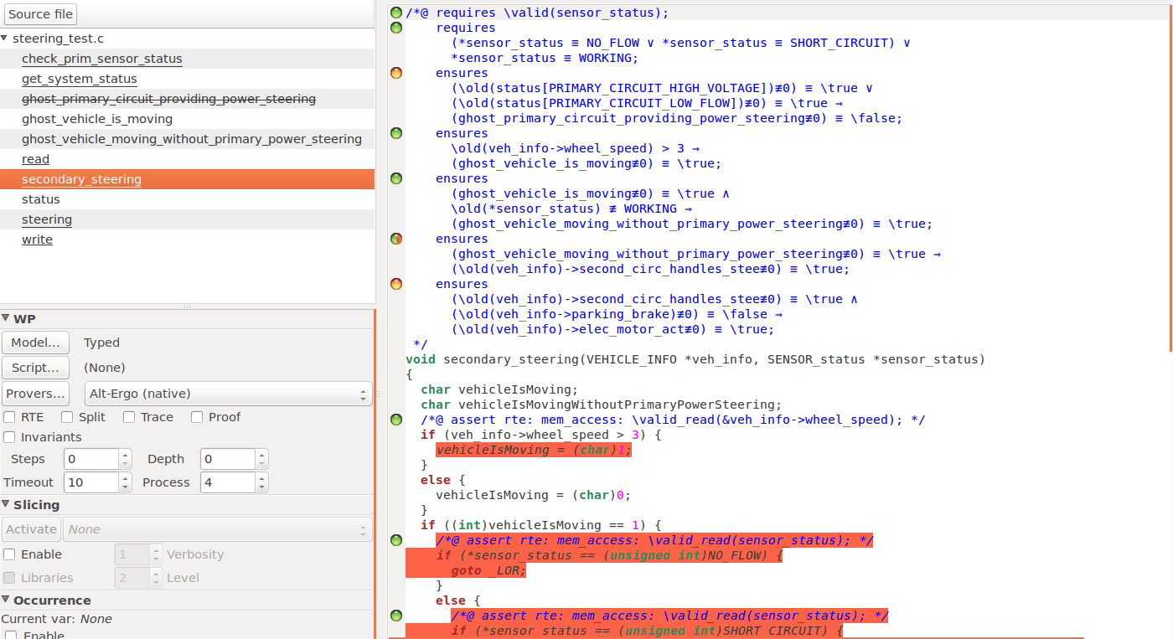
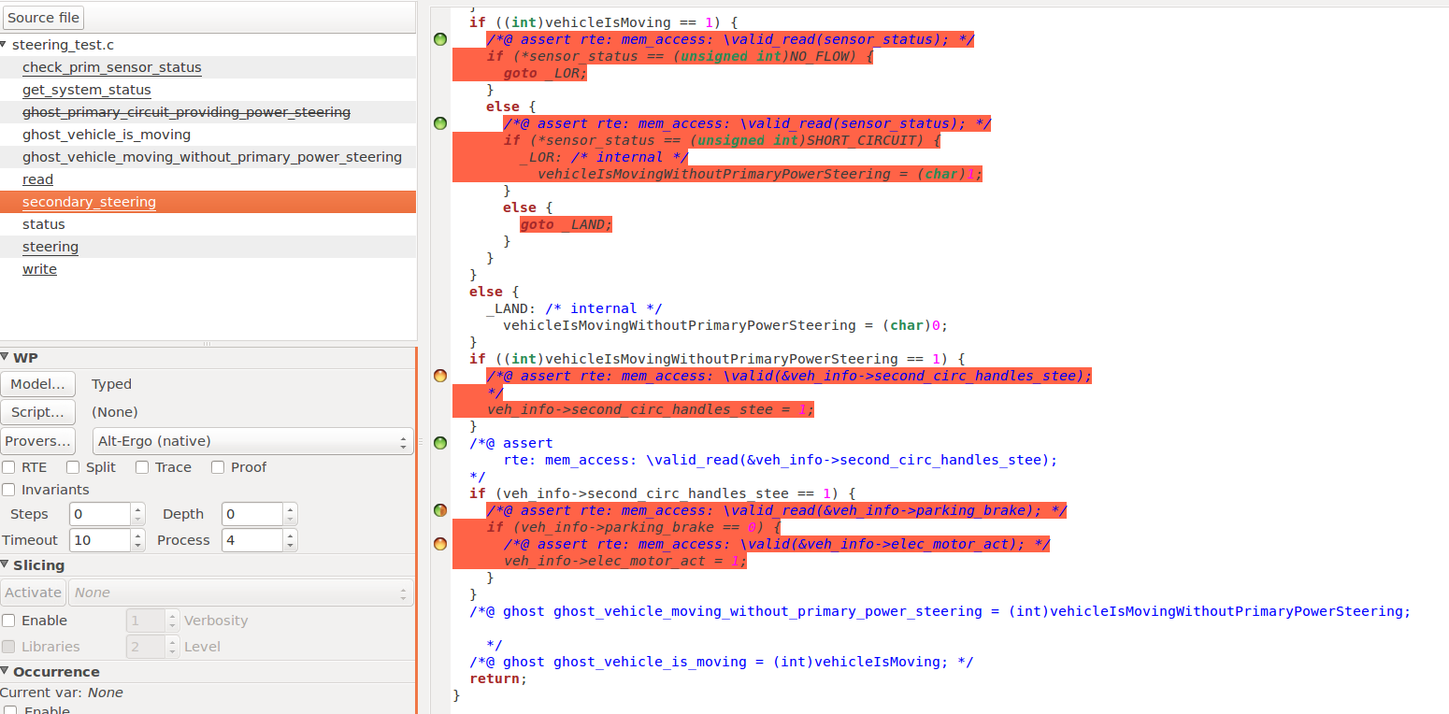
CASE STUDY

Slide 21
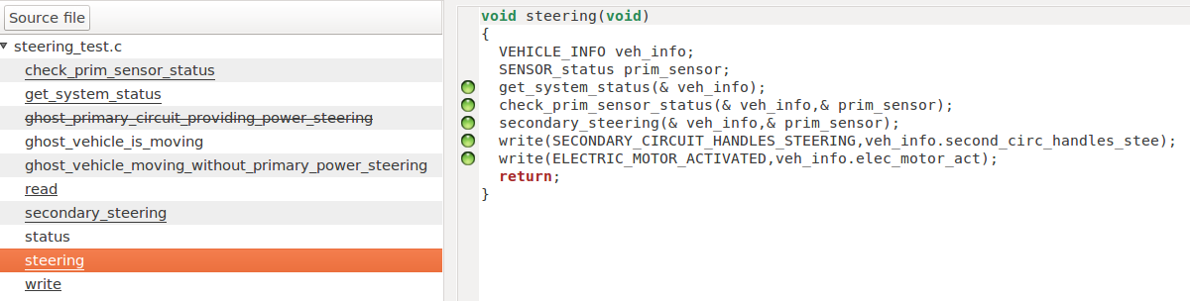
CASE STUDY

Slide 22


CONCLUSION AND FUTURE WORK

