Slide 1
Literacy rates
and book bans

Slide 2
The Process
Define the problem
Data wrangling and data cleaning
Developing and comparing algorithms
Conclusions and recommendations
1.
2.
3.
4.
5.
6.
7.
8.
Methodology
Exploratory data analysis
Machine learning predictive modeling
Future work

Slide 3
Defining the problem:
Literacy rates in the United States increased through the nineteenth and twentieth centuries and have remained relatively stable since the 1980s. However, the United States has a sizable illiterate or minimally literate population, and recent data suggests a decrease in childhood literacy.
Book bans in public school systems have increased dramatically in the past few years. Does this reflect broader attitudes toward reading, education, and knowledge in these areas? What will the impact of banning books have on students’ understanding of other perspectives, interest in reading, etc?
Issues of cause and effect are outside the scope of this research, but understanding the relationships between these factors may provide insight to school systems and administrators as they face these problems and attempt to develop solutions.

Slide 4
Question:
Are literacy rates different in school districts that have banned books than in districts that have not banned books?

Slide 5

“Books and ideas are the most effective weapons against intolerance and ignorance.”
-Lyndon B Johnson

Slide 6
Data
Sources, Metadata, Background information

Slide 7
Data sources
PEN America’s list of banned books 2021-22
- gathered from district websites, correspondence with librarians, authors, teachers, letters to school districts
- contains 2531 book bans with 10 features for each banned book, including information about the book, such as title and author, the state and district banning the book, and the origin and date of the ban
8th grade literacy rates
4th grade literacy rates
- US Department of Education publishes datasets collected from statewide assessments each year
-these datasets contain summary data from each school district with features for each such as district name and ID, state, student percentage proficient in reading and math, and various student demographic variables

Slide 8
2. methods
Data cleaning, Exploratory analysis, Regression and classification,
Model performance metrics, Predictive analysis

Slide 9
3. Data cleaning
Fix structural errors, Merge datasets, Handle anomalies

Slide 10
Data Cleaning
Problem 1: Book ban dates are in different formats
Solution: I converted all dates to one common format. For entries without specific dates listed, I used the midpoint date of the season or year listed. For “Fall 2021” I used November 7th, 2021, as this is the midway point between the start and end of Fall. I then converted this to a datetime object like the entries with specific dates given.
Problem 2: Combining two datasets, one of bookbans and one of reading scores, some districts were named differently than in the other dataset
Solution: I standardized capitalization and spelling of commonly used district names. Then I referenced ID number, district, and state to be sure of matching districts then changed the district name to match before merging datasets.
Problem 3: Some reading scores seem to be misrecorded
Solution: With such a large dataset (all public school districts in the country), I chose to drop any districts that had non-numeric and negative reading assessment scores recorded. As I was not using math assessments, I kept districts where math scores may have been wrong but dropped the column for math scores.

Slide 11
4. Exploratory data analysis
Descriptive statistics, Data visualization,
Analyze variable relationships, Identify patterns

Slide 12
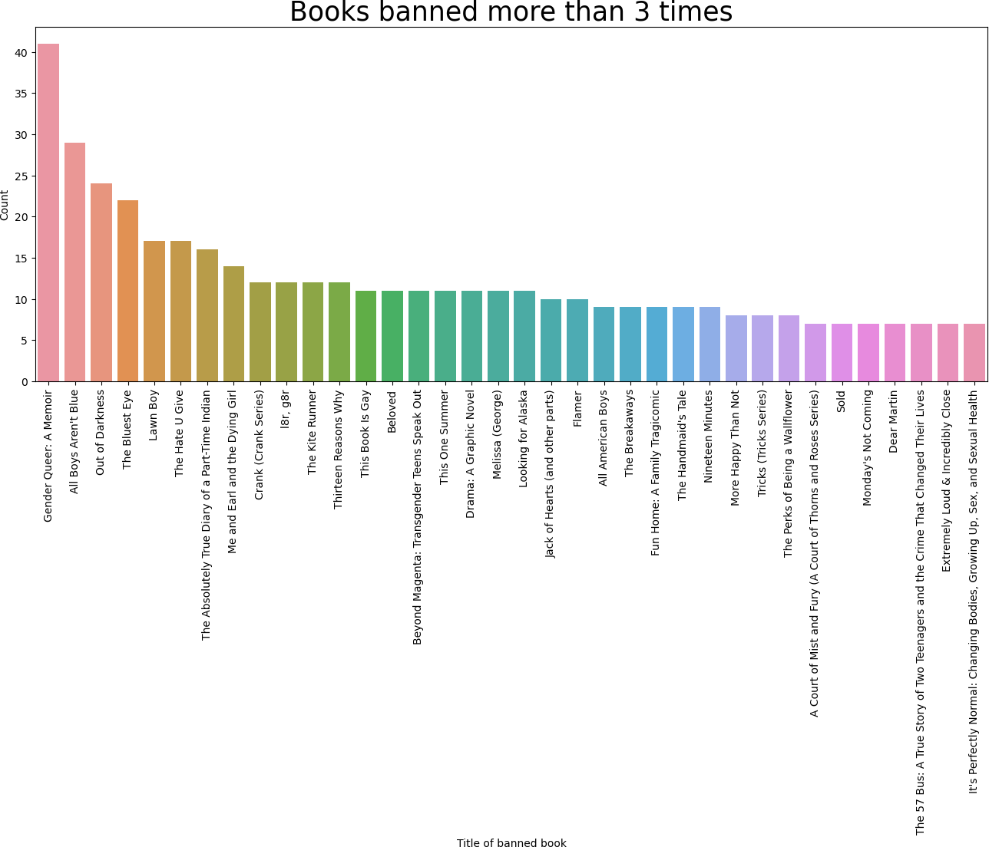

Slide 13
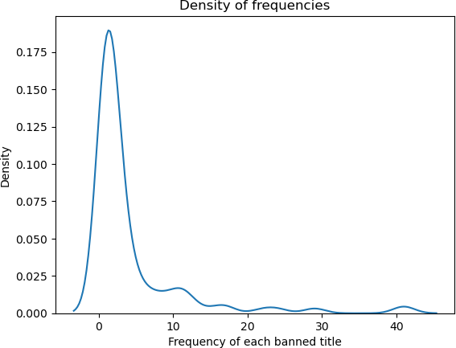

Slide 14
Reading Proficiency Data Summary
Number of districts scored | Mean | Standard deviation | Median
11250 | 54.323556 | 19.430093 | 55

Slide 15
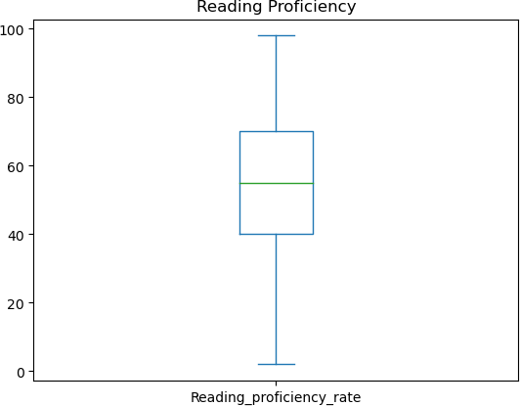

Slide 16
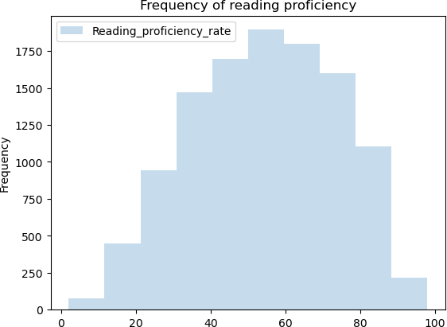

Slide 17
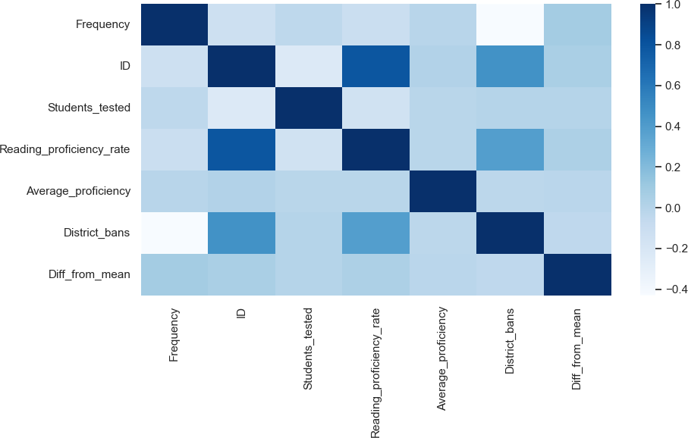

Slide 18
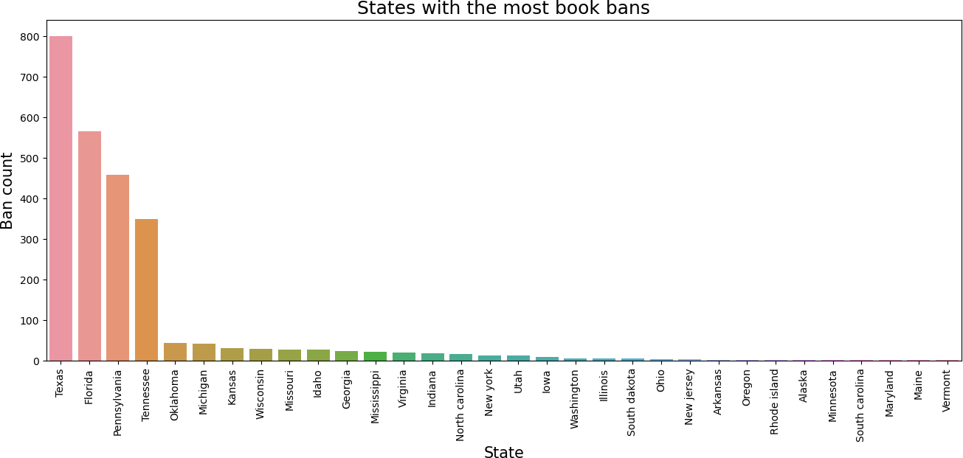

Slide 19
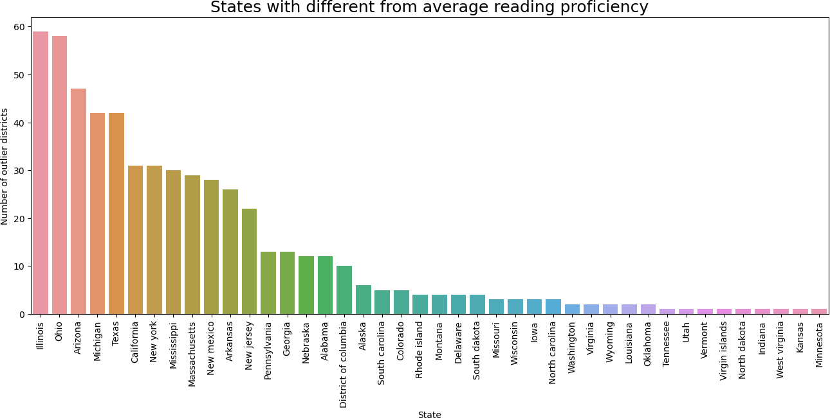

Slide 20

“The books that the world calls immoral are the books that show the world its own shame.”
-Oscar wilde

Slide 21
5. developing algorithms

Slide 22
Models tried:
Regression:
Linear
Linear regression through pipeline
Random forest regression
KBest means (for feature selection)
(Logistic regression is actually a classification model.)
Classification:
Logistic regression
Random forest classification
Support vector classification

Slide 23
Metrics for Model Performance and comparison:
Classification models:
Accuracy–useful with others but not alone, does not work well for imbalanced data
Precision–good for when false positives must be avoided, but works best as a metric with others
Recall–useful when false negatives must be avoided but ignores false positives, best with other metrics
F1–balances precision and recall for a reasonably good overall metric
ROC/AUC–good overall metric when both positives and negatives are important, how well a model ranks predictions, not for highly imbalanced data
Regression models:
R²–useful for correlation but not machine learning models, not a good metric for model comparison, does not identify predictive error
MAE–can be too simple to measure overall performance, fails to punish large errors in prediction, good for avoiding any error
MSE–more sensitive to large errors, can be difficult to interpret, but good when needing to avoid any large prediction errors
Comparing the performance on both training and testing data can help recognize overfitting. If a model performs better on the training set than the testing set, we should examine whether overfitting is a concern.

Slide 24
Model | R² | Mean absolute error | Mean squared error | Average Cross-validation score
Mean (train set) | 0 | 0.299667 | 0.149833 | -0.000248
Mean (test set) | -0.000637 | 0.312088 | 0.156044 | -0.002697
Linear regression (train set) | 0.885923 | 0.058184 | 0.017093 | -3.26574E23
Linear regression (test set) | 0.878168 | 0.061115 | 0.017093 | 0.787575
Pipeline LR (train) | 0.871842 | 0.061202 | 0.019202 | 0.7670300
Pipeline LR (test) | 0.862477 | 0.064859 | 0.021460 | 0.7490550

Slide 25
Model | R² | Mean absolute error | Mean squared error | Average Cross-validation score
KBest (train set) | 0.882158 | 0.056304 | 0.017657 | 0.774363
KBest (test set) | 0.876071 | 0.058888 | 0.019338 | 0.752611
Random forest regression (train) | 0.999937 | 0.040559 | 0.866197 | 0.999352
Random forest regression (test) | 0.999881 | 0.077457 | 1.789218 | 1.000000
Logistic regression (train) | 0.962793 | 1.696198 | 510.0467247 | 0.8561610
Logistic regression (test) | 0.947894 | 2.401979 | 782.888604 | 0.8391340

Slide 26
Model | Accuracy | Precision | Recall | F1 | Average CV
Random forest (training set) | 1.000000 | 1.000000 | 1.000000 | 1.000000 | 1.000000
Random forest (testing set) | 1.0000000 | 1.000000 | 1.000000 | 1.000000 | 1.000000
SVC (training set) | 0.885923 | 0.999439 | 0.985724 | 0.987723 | 0.987448
SVC (testing set) | 0.984610 | 0.999546 | 0.981705 | 0.990545 | 0.976549

Slide 27
Chosen model:
Support vector classification(SVC)
Best hyperparameters: c=1, gamma=1, kernel=rbf

Slide 28
6. Modeling
Predictions and insights using the model

Slide 29
Modeling scenarios:
Scenario 1: Is a school district with higher than average reading proficiency more likely to have book bans than a district with lower reading proficiency?
Result: Regardless of how high (or low) I made input average reading proficiency, the algorithm did not result in a book ban. The proportion of the dataset with book bans appears too small to output a predicted ban (or at least very rarely).
Scenario 2: Does the number of students in a district have any correlation with book bans?
Result: Yes! A theoretical school district having 50,000 students was the first when increasing numbers of students input which resulted in predicted a book ban. The number of students has a positive correlation with book bans. It appears that 50,000 students is approximately the threshold at which the algorithm predicts a book ban.
Scenario 3: Are some of the largest school districts in the country likely to have book bans?
Result: Yes, it appears as though some of the largest districts do have book bans, both according to our model and according to the data. Using data from some of the 20 largest real school districts in our country, the algorithm predicted at least one book ban for each district. However, when these results are compared against our book ban data, we find that only 1 of those 4 districts did in fact have banned books.

Slide 30
7. Conclusions

Slide 31
Summary
Slight positive correlation between reading proficiency and book bans
a district with at least one book ban tends to have higher than average student reading proficiency rates compared with districts without any book bans.
Larger school districts are more likely to have at least one book ban
Books are more frequently banned in districts with a large number of student than in districts with smaller numbers of students.
Recommendations for school boards and administrators
I would recommend conducting further research to determine what additional variables might affect both literacy rates and bans books. I suspect that extraneous variables are likely contributing to both rather than either being acause of increase for the other. Further research would be required in order to offer recommendations such as whether to increase or decrease district sizes, whether to encourage or discourage book bans, and any insights as to how to increase literacy.

Slide 32

“Assumptions are made and most assumptions are wrong.”
-ALBERT EINSTEIN

Slide 33
8. Future work
Additional research, Further reading, Getting involved

Slide 34
Before beginning this research, I imagined that were there any correlation between book bans and literacy, it would be a negative one. That is to say that I hypothesized that where more books were banned there might be lower than average reading proficiency. However, my research indicates the opposite. I cannot make any larger predictions or stronger guesses about causation, but these findings do leave me curious to look more closely and to examine how these results may change when adding additional variables to the analysis.
For future research, I would include reading proficiency over a longer time period to establish broader patterns for each district. I would also be interested in examining other possibly relevant variables, particularly economic environment, political views, religious views, parental involvement, and graduation rates for each district. If I included all these factors, I could develop algorithms to examine which, if any, variable(s) most correlate with book bans. This may allow for seeing a more complete picture. It might be that reading rates and book bans correlate only because they are a reflection of other patterns in school districts. More research would be necessary to discover whether this could be the case.
One possible first step in examining possible extraneous variables would be to return to the original dataset for reading proficiency and look at the variables for student demographics for each district. I decided to exclude those variables in this project in order to focus on the features I was considering in the research question and to remain in the scope of the intended project. However, this may be a great way to add issues of poverty, race, and other possible social and societal variables to this research. Considering whether these sorts of demographics reflect difference in district with book bans and also different than average reading proficiency, we might be able to develop algorithms that offer stronger recommendations for school boards and administrators.

Slide 35
For further information:
Updated book ban data for 2022-23 by PEN America
Ideas for supporting literacy:
For schools and districts
For parents and families
For state agencies
Donate to charities for literacy improvement
Get involved with the American Library Association to fight book bans

Slide 36
9. Credits
Sources, Guidance, Inspiration, Design, Art

Slide 37

Data sources
Pen America's Index of Banned Books
US Dept of Education EDFacts Data Files
National Center for Education Statistics: National Achievement-level Results in Reading (grades 4 and 8)
Education Data Portal

Slide 38
Additional references
hechingerreport.org/americas-reading-problem-scores-were-dropping-even-before-the-pandemic/
www.theguardian.com/books/2023/apr/20/book-bans-us-public-schools-increase-pen-america
www.oecd.org/skills/piaac/Country%20note%20-%20United%20States.pdf

Slide 39

Inspiration and project guidance
Special thanks to:
Springboard
Silvia Seceleanu, data science mentor
Ricardo Alanis, former mentor

Slide 40
design
Presentation template was created by SlidesCarnival
This presentation uses the following typographies:
Titles: Amatic SC
Body copy: Caveat
Quotes found or verified by:
LIBQUOTES: 100% Sourced Quotations
LitQuotes
Art throughout presentation and notebooks:
Clipart from Public domain vectors
Photographs by Unsplash

Slide 41
Thanks!
Questions?
You can find me at at
linkedin/carrie-cate-jenkins

