Slide 1
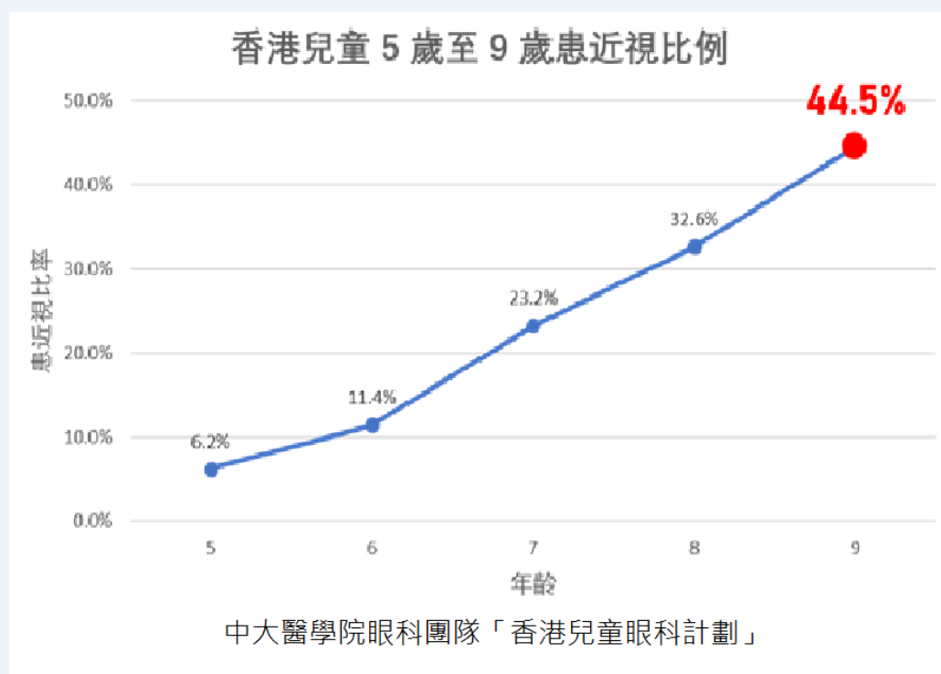



Gifted Education Fund AIoT Coding, Engineering and Entrepreneurial Skills Education for Gifted Students Eyesight Protector – Distance Detector
Student: 05 CHAN Chun Ting, 18 LAI Ching Fung
Objective/Background/Motivation
It is proven that keeping too few distance from the computer makes people very prone to short-sightedness. Hong Kong 45% of 9-year-old students having short-sightedness, proving it very important to deal with the root cause. Therefore, this detector gives students a warning when the distance is smaller than 40cm between their eyes and the computer.
Existing Solution
Current solutions mostly rely on their personal awareness
Users have to be aware that they are getting too close by themselves
Few technological solutions have been developed
Your Solution
Using AI to identify the trunk and facial features of a person
By calibration, calculate the distance between the screen and the person
Camera geometry is used
One camera for basic use and two cameras for accurate and precise calculations
Resources Needed
Help on understanding camera geometry
Web-cams (tentative)

