Slide 1

Eyesight Protector
CityU-EE Gifted Education Fund Programme: AIoT Coding, Engineering and Entrepreneurial Skills Education for Gifted Students
Team Members (P3)
05 CHAN Chun Ting, 18 LAI Ching Fung

Slide 2
Introduction
Eyesight Protector
It measures the distance between users’ eyes and the screen and alert the users when they are too close

Slide 3
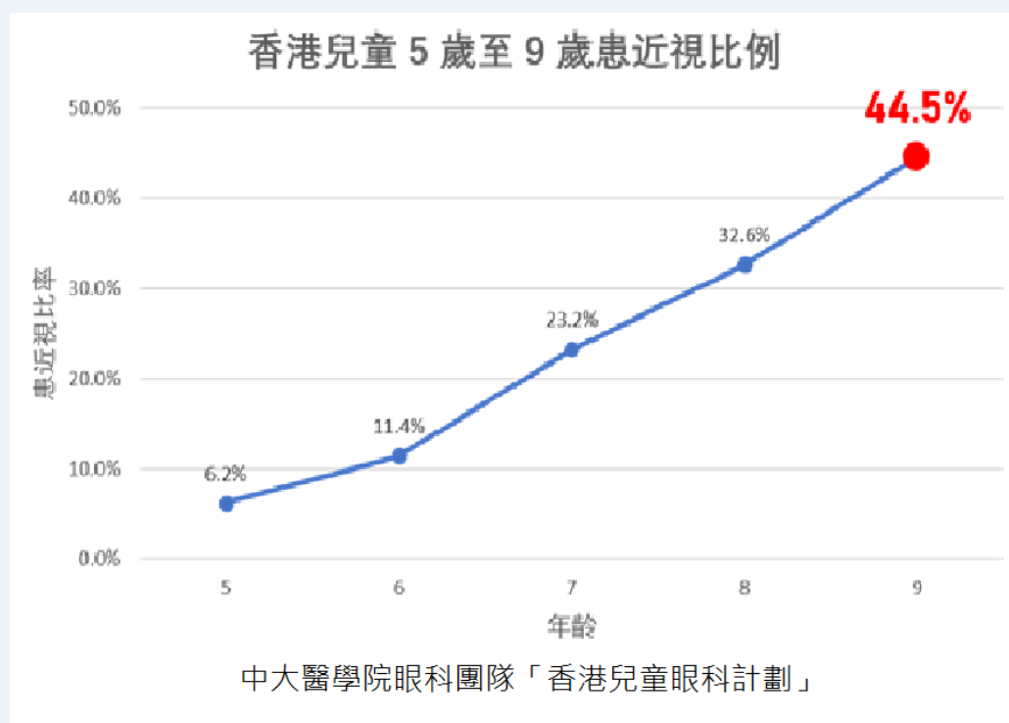
Background & Motivation
Short-sightedness is rife in Hong Kong
45% of 9-year-old students have short-sightedness

Slide 4
Existing Solutions
Existing solutions generally focus on limiting usage time through parental control
Yet, these usage time monitors are unable to promote healthy habits during usage
For example, they do not encourage maintaining good posture and sufficient distance from screen
Thus, current solutions heavily rely on users’ personal awareness
Most smart devices such as smartphones, tablets and personal computers have built-in cameras, if not distance detectors in the autofocus module
Nevertheless, existing solutions rarely take advantage of the wide array of available built-in equipment to address the problem of short distance from screen
Notes:
Add stock pictures of: parental control function; functions limiting usage time; bad posture in screen usage; built-in cameras

Slide 5
Background & Motivation
Children, whose eyes are developing, are especially prone to shortsightedness
With the increasing availability and necessity of electronic devices with a display, children have easy access to these devices
However, children may lack awareness for maintaining an appropriate distance from the screen.
The combined effects of the increased usage and low awareness have led to myopia being ubiquitous among children
Notes:
Quote: average age of electronic device users; use statistics to illustrate the correlation between myopia in young patients (e.g. average age of first-time patients/ average extent of visual impairment) and increasing usage of smartphone among youngsters Electronic device usage among US kids during the pandemic: https://www.insiderintelligence.com/content/electronic-device-usage-nearly-doubled-among-us-kids-during-pandemic

Slide 6
Our Solution
Eyesight Protector
Encourage maintaining appropriate distance from screen and proper posture by measuring the users’ distance from screen
Makes full use of built-in webcams of laptops or computers/ front-facing cameras of phones
Notes:
How focus works:
https://www.bhphotovideo.com/explora/photography/tips-and-solutions/how-focus-works#:~:text=A%20computer%20inside%20the%20camera,the%20image%20is%20in%20focus.

Slide 7
Working Principles
AI is used to identify the trunk and facial features of the user
The orientation of the users’ faces is thus determined
By calibrating with unmoved objects beforehand, estimate the viewing distance
One camera suffices for basic use, but with two cameras, and accurate and precise result can be obtained

Slide 8
Technologies used and feasibility assessment
AI: object detection, facial recognition
Camera geometry
Pre-trained ai models are widely available
The equipment required (camera) is readily available
Processing power requirement is low, so the computations can be performed locally on most devices

Slide 9
Timeline
Phase 1: Research
Look up camera geometry, pre-trained AI models on facial recognition, inner workings of cameras and lenses, python modules for image processing
Phase 2: Production
Make a prototype
Get feedback from mentors
Phase 3: Introduce the Project
- [b] Project Poster, [c] YouTube video and [d] Source Code
Phase 4: Finalizing
- Make [e] Final Pitching Deck and [f] Learning Summary
Phase 1
Phase 2
Phase 3
Phase 4
Start
23/1 (Mon)
30/1 (Mon)
6/2(Mon)
13/2(Mon)

Slide 10
Future Work
Compile the software into a smartphone application and/or an .exe
Publish on GitHub/ Smartphone APP platforms

Slide 11
Thanks!
Contact details:
GitHub: https://github.com/cctjustin/eegf-project2022-05-18

