Slide 1

International Scrum Institute
Accredited Scrum Certifications for Agile Software Practitioners

Slide 2
Scrum Master Certification Program
What is International Scrum Institute?
Scrum framework
A real world example
Why waterfall model fails?
What makes scrum framework succeed?
The scrum team roles
The scrum master
Scrum master accredited certification program
The certificate

Slide 3
What is International Scrum Institute?
International Scrum Institute is an independent Institute which helps IT Companies and Professionals to get certified with our Accredited Scrum Certifications and to prove their competence in Scrum domain.
As of September 2012 International Scrum Institute has provided in 143 Countries more than 349'000 Scrum Master Accredited Certifications and Scrum Product Owner Accredited Certifications. They reinforce IT Professionals in Worldwide to build their careers, and Companies to sell their Agile Products and Services.

Slide 4
Scrum Framework
Scrum is a lightweight agile project management framework mainly used for software development. It describes an iterative and incremental approach for project work.
Scrum can be used in all kinds of software development:
for developing complete software packages,
for developing only some parts of bigger systems,
for customer or internal projects.

Slide 5
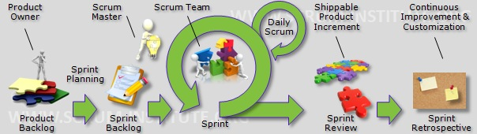
Scrum Framework (cont’d)

Slide 6
Scrum Framework (cont’d)
The Scrum Framework implements the cornerstones defined by the agile manifesto:
Individuals and interactions over processes and tools
Working software over comprehensive documentation
Customer collaboration over contract negotiation
Responding to change over following a plan

Slide 7
Scrum Framework (cont’d)
The main components of Scrum Framework are: The three roles: Scrum Master, Scrum Product Owner and the Scrum Team
A prioritized Backlog containing the end user requirements
Sprints
Scrum Events: Sprint Planning Meeting (WHAT-Meeting, HOW-Meeting), Daily Scrum Meeting, Sprint Review Meeting, Sprint Retrospective Meeting

Slide 8
Scrum Framework (cont’d)
Important in all Scrum projects are self-organization and communication within the team. There is no longer a project manager in a classical sense. In the Scrum Framework the Scrum Master and the Scrum Product Owner share his responsibilities. However, in the end the team decides what and how much they can do in a given project iteration (Sprint).

Slide 9
A Real World Example
Before starting the first Sprint
Alex is assigned as the Scrum Product Owner of a new software development project. One of his first tasks is to start requirement engineering. He writes down the most important use-cases and discusses them with the architects, customer representatives and other stakeholders. After collecting the high-level use-cases and requirements, he writes them into the Scrum Product Backlog and initiates an estimation and prioritization session with the architects and some senior developers. As a result of this session all the items in the Scrum Product Backlog have an initial rough estimation and a prioritization. Now he starts to break-down the high-level requirements into smaller-grained user stories. With this list he then calls for the first Sprint Planning meeting.

Slide 10
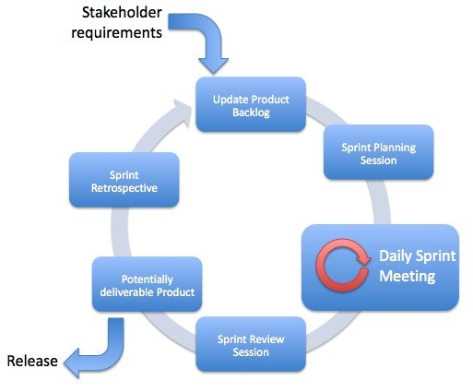
A Real World Example (cont’d)

Slide 11
A Real World Example (cont’d)
Sprint 1 - Day 0
During the Sprint Planning meeting Alex presents the Scrum Product Backlog items from the highest priority to the lowest. The team clarifies open questions and for each item the team discusses if they have enough capacity, the required know-how and if everything else needed is available. After this discussion they commit to complete the stories 1,2,3,6,7 and 8 until the end of this sprint. The items 4 and 5 cannot be realized in this sprint, as some technical infrastructure is not yet in place. After the Sprint Planning meeting Frank - the Scrum Master of the team - calls the team to define the details of how the committed items are going to be implemented. The resulting tasks are written down on the cards at the prepared Sprint Task board. Now everyone of the Scrum Team selects a task to work on.

Slide 12
A Real World Example (cont’d)
Sprint 1 - Day 1
In the morning the whole team gets together for their Daily Scrum Meeting. Everyone gives a short statement what has been achieved so far, updates the estimation of remaining hours on the cards of the Sprint Task board, tells what he or she is planning to do today and tells if there are any impediments that hinders him to continue his work. Today one of the team members tells that he has problems because he needs a new license for one of the software tools he is using. Frank checks if other team members have the same problem and says that he'll take care of that after the meeting. After 15 minutes everyone goes back to work. After the meeting Frank updates the Sprint Burndown. Then he calls the software vendor of the tool, orders licenses and forwards them to the people that need them.

Slide 13
A Real World Example (cont’d)
Sprint 1 - Day 2
In the morning again the whole team gets together for their Daily Scrum meeting. In the afternoon one of the Scrum team members is unsure about the details of one of the user stories. He calls Alex –Scrum Product Owner- and discusses the open points with him. After the team member finds out what to do, then he can continue with his implementation.

Slide 14
A Real World Example (cont’d)
Sprint 1 - Day 28
This is the final day of the first Sprint and Frank –Scrum Master- has invited the team for the Sprint Review Meeting. The team has prepared a machine with the current software implementation. Alex –Scrum Product Owner- sits in front of the machine and checks if the implementation meets his expectations and if the features are documented as required. At the end of the Review Session he concludes:
Stories 1,2,6 and 7 are finished as expected.
Story 3 couldn't be finished in time and was not presented at all.
Story 8 has some points that have to be re-factoring.
In the afternoon the team gets together for the Sprint Retrospective Meeting and discusses what went well during the sprint and what could be improved. One of the feedback is that the team has the feeling that they do not know enough about the overall system architecture. Frank takes the task to invite the system architect to give a more detailed introduction.

Slide 15
A Real World Example (cont’d)
Sprint 2 - Day 1
Alex –Scrum Product Owner- adds new items to the Scrum Product Backlog based on his recent customer meetings. Moreover, he adds additional items for the re-factoring of story 8. Alex then invites the team for the Sprint Planning Meeting for Sprint 2. The team discusses and commits to stories with the guidance of Frank –Scrum Master- and the second Sprint begins.

Slide 16
Why Waterfall Model fails?
Studies have shown that in over 80% of the investigated and failed software projects, the usage of the Waterfall methodology was one of the key factors of failure.

Slide 17
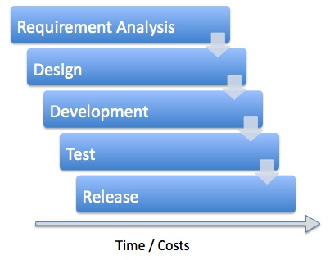
Why Waterfall Model fails?(cont’d)

Slide 18
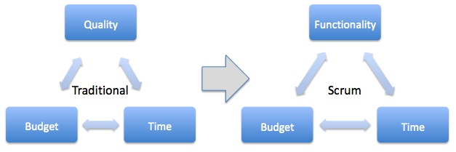
What Makes Scrum Framework Succeed?
The Scrum framework changes the classical triangle of project management.

Slide 19
What Makes Scrum Framework Succeed? (cont’d)
Quality is no longer an option. In Scrum the factors that define when a feature is complete (in terms of quality, required testing, documentation etc.) are defined by the Definition Of Done (DoD) right at the start of the project. No incomplete or untested feature will be released to the customer. Now the functionality to implement will be defined throughout the course of the project and implemented incrementally. This incremental development allows to remain flexible and to change in a controlled manner without the additional costs and risks of jeopardizing large chunks of previous work. At the end of each increment (Sprint) a result is available that can be shown and discussed with the customer to get and incorporate feedback as soon as possible.

Slide 20
What Makes Scrum Framework Succeed? (cont’d)
Studies have shown that Scrum has following positive effects in practice:
Increased productivity
Better product quality
Reduced or stable project costs after introducing agile methods
Higher customer satisfaction
Increased satisfaction and motivation of the employees

Slide 21
The Scrum Team Roles
Within the Scrum Framework three roles are defined:
The Scrum Team
Scrum Master
Scrum Product Owner

Slide 22
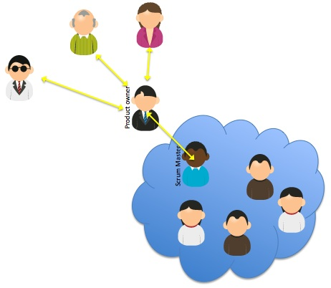
The Scrum Team Roles (cont’d)

Slide 23
The Scrum Team Roles (cont’d)
Within the Scrum Framework all work delivered to the customer is done by dedicated Scrum Teams. A Scrum Team is a collection of individuals working together to deliver the requested and committed product increments. To work effectively it is important for a Scrum Team that everyone within the team
follows a common goal
adheres the same norms and rules
shows respect to each other

Slide 24
The Scrum Master
The Scrum Master is part of the Scrum Team and acts as a servant-leader for the Scrum Team. In the beginning this will be a full-time job so that the Scrum Master will not be able to directly contribute to the Sprint results. However after some Sprints the processes will settle so that the workload for the Scrum Master will drop and he could actively contribute to the Sprint Goal. Since it is crucial that there is trust between the Scrum Master and the other team members it would be ideal if the Scrum Team selects the Scrum Master itself. However, in reality most often the Management selects the Scrum Master.

Slide 25
The Scrum Master (cont’d)
Responsibilities of the Scrum Master
The Scrum Master has several important responsibilities: Guard the Scrum Team from external requests and disruptions
Act as a change agent and adapt processes to maximize productivity of the team
Coach the Scrum Team
Remove impediments for the Scrum Team
Ensure efficient communication between the Scrum Team and the Scrum Product Owner
Facilitate the various Scrum Events

Slide 26
The Scrum Master (cont’d)
Facilitation of Scrum Events
The Scrum Framework defines several meetings that have to be organized and facilitated by the Scrum Master: Daily Scrum Meetings
Sprint Planning Meetings
Sprint Review Meetings
Sprint Retrospective Meeting

Slide 27
Scrum Master Accredited Certification Program
Scrum Master Accredited Certification Program is
a multiple-choice online test examination in which you can participate from a PC from anywhere around the world
the test contains 50 questions and within 60 minutes in a single session to answer all of the questions
in order to pass the examination and to obtain Scrum Master Accredited Certification one need to correctly answer at least 60% of the questions
examination success rate 97%

Slide 28
Scrum Master Accredited Certification Program (cont’d)
The overall process of Scrum Master Accredited Certification Program is as easy and fast as the following:
Register Scrum Master Accredited Certification Program.
Get Examination Access Code for Certification Program in a few seconds.
Access Certification Examination within one year after registration and answer 50 multiple-choice questions.
Receive Lifetime and Worldwide valid Scrum Master Accredited Certification Document in pdf-format per e-mail in one day.

Slide 29
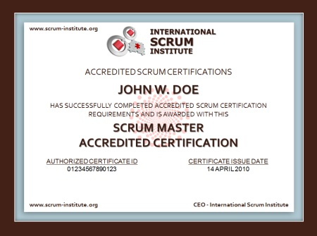
The certificate

Slide 30
For More Information
http://www.scrum-institute.org/

