Slide 1
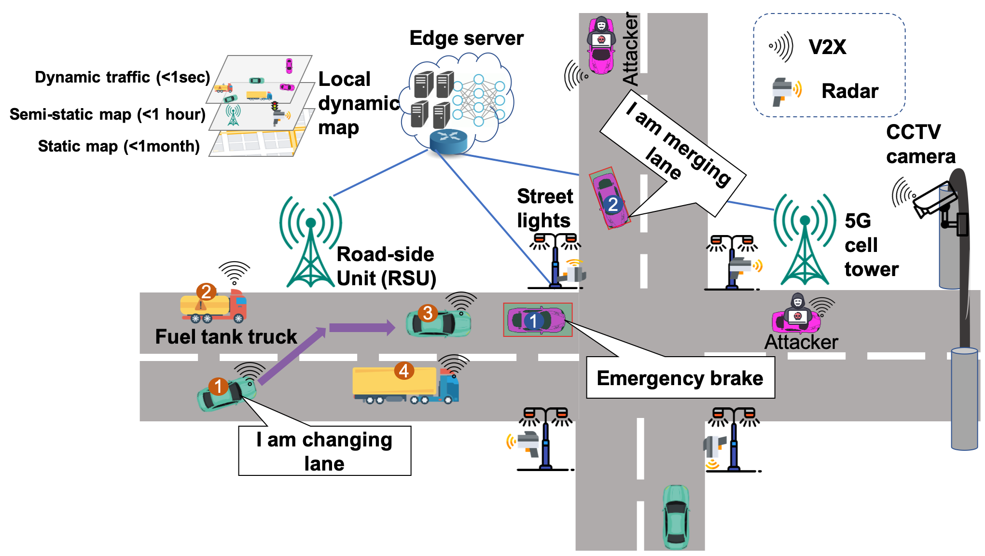
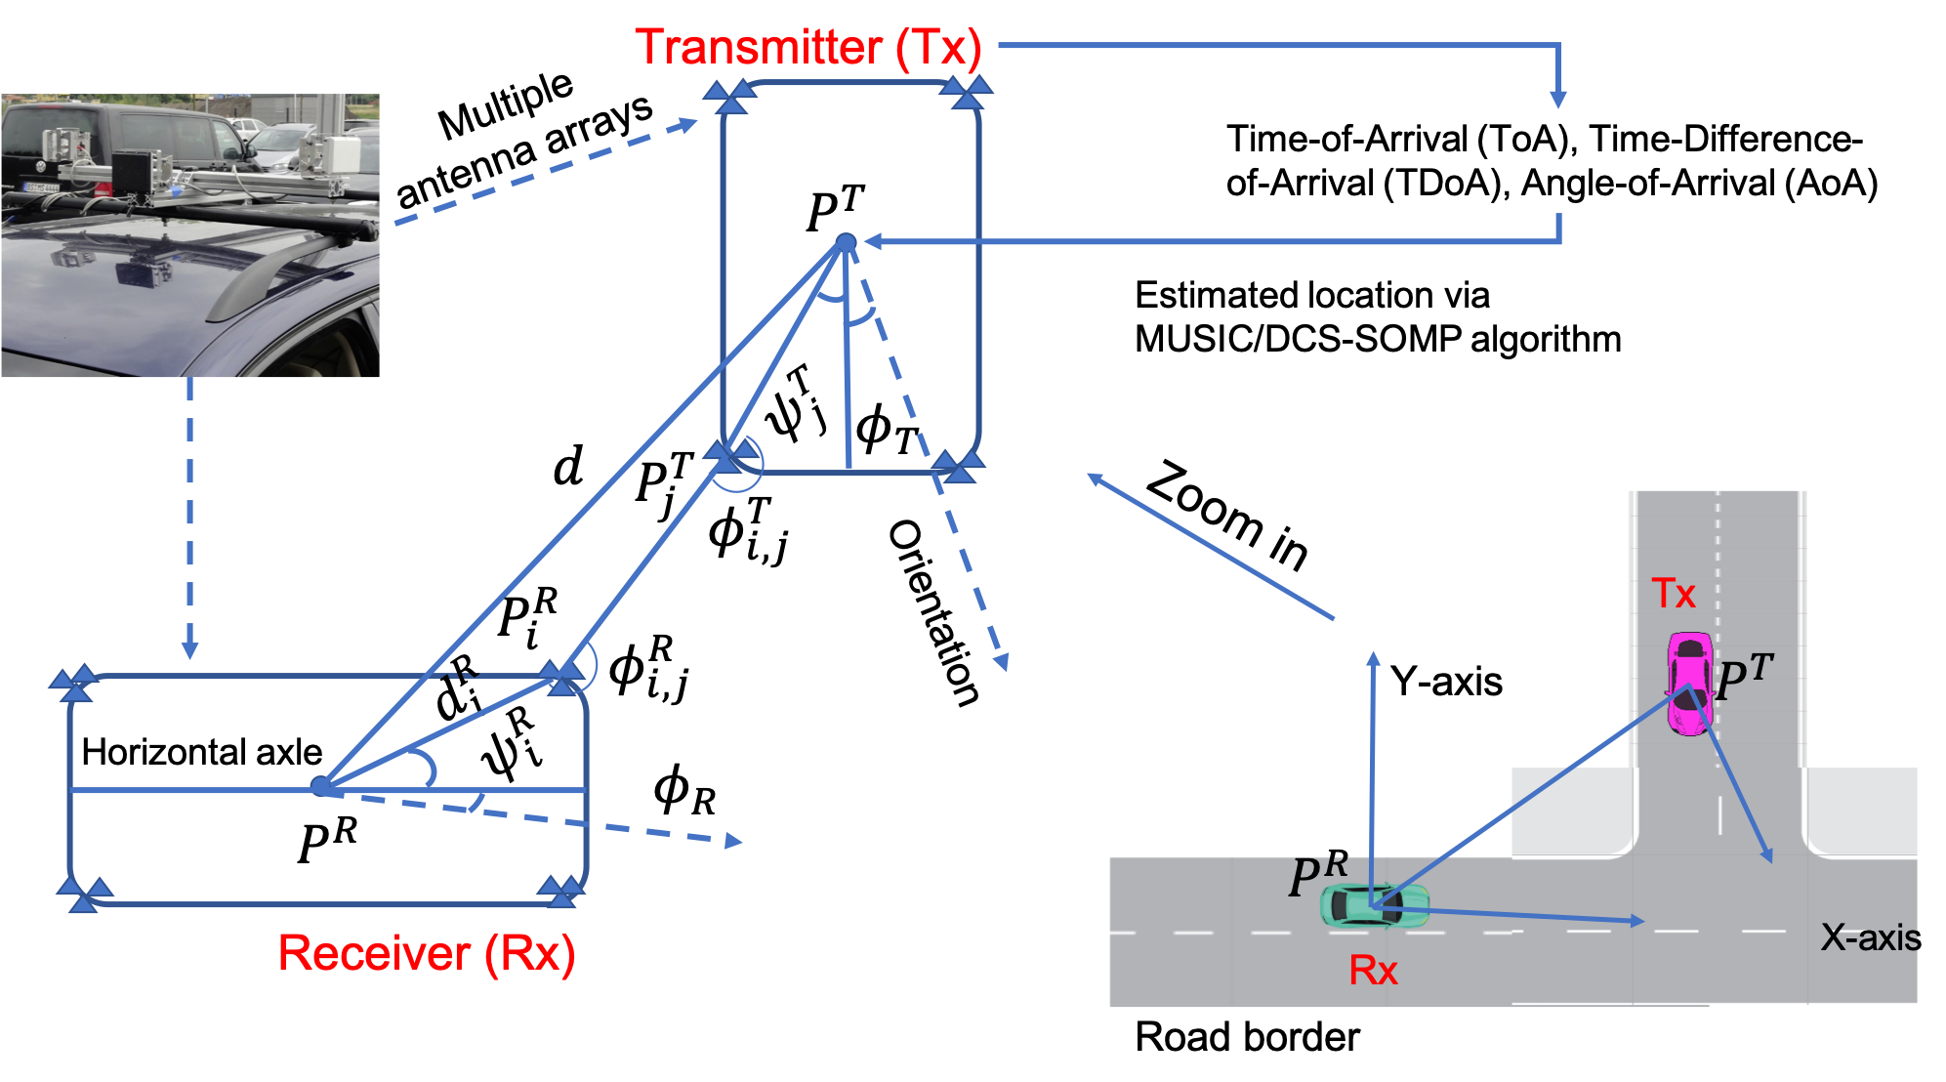
Vehicular security
Misbehavior detection
Physical layer authentication
I have a granted project: 2024-2026
Sharing information among the vehicles
should NOT be trusted in default
We use signal-based localization data to determine whether the transmitter is honest in reporting its locations

Slide 2
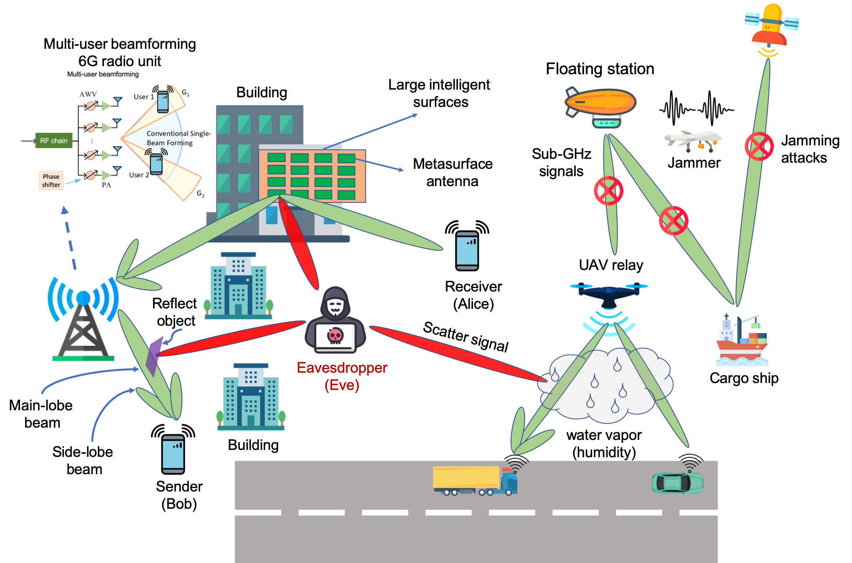
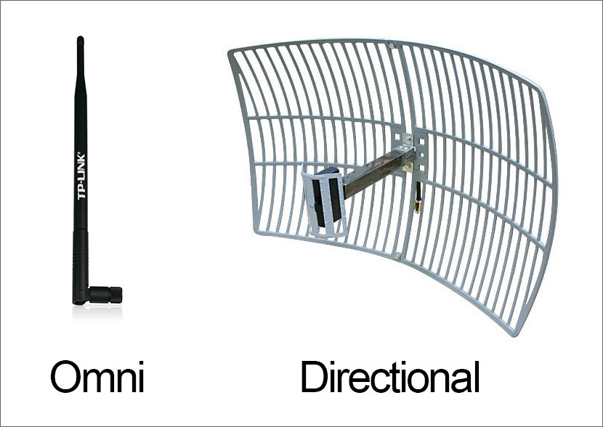
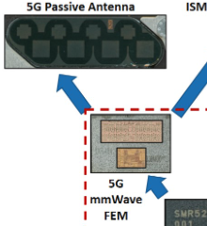
6G security
6G will be ready in 2030
Top security research issues:
UAV secure communications
Directional secure wireless
communications
2
1
Before 2023
After 2023
Omnidirectional
antennas
Directional
Antennas/DFRC
Our COMST paper: Security and privacy for 6G: A survey
On prospective technologies and challenges

Slide 3
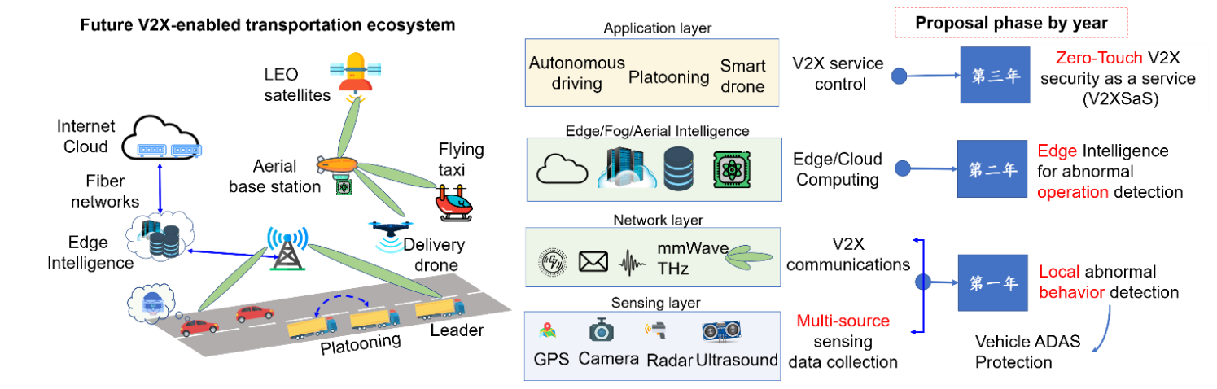
My ongoing project
2026
2025
2024

Slide 4
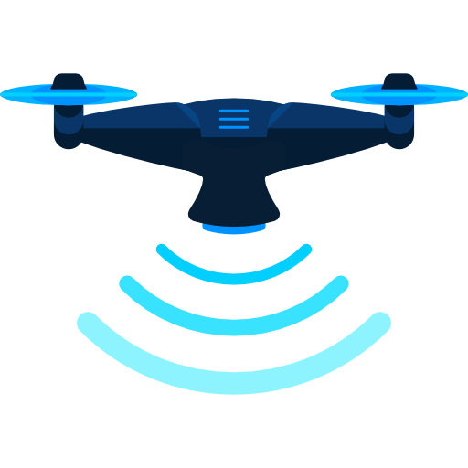
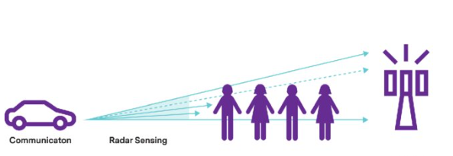

Extend for intl cooperation
2026
(V2U)
2025
(V2V)
Roadmap
2024 (V2I)
2025
2026
2024
DFRC for Misbehavior detection in Platooning/Adaptive control
General dual-functional radar
and communication (DFRC) security
DFRC for Enhancing Security of 6G Aerial-assisted Vehicular Networks

Slide 5
Some key points to emphasize in our proposal
We are a PI of an ongoing project ( Mine: 2024-2026)
Our school just signed a MOU
We are young scientists who have energy to enrich our cooperation for a long term.
Our proposal content per year is well-justified

Slide 6
High Impact
The sponsor will significantly promote its development (New South Policy)
We are young scientists who have energy to enrich our cooperation for a long term.

