Slide 1

Intelligent Transmission Control Schemes for Enhancing Reliability in Vehicular Networks
Department of Computer Science and Information Engineering
College of Engineering, National Chung Cheng University
Dissertation presentation
Lan-Huong Nguyen
Advisor: Prof. Jian-Jhih Kuo, Ph.D.
Taiwan, Fall 2022

Slide 2
Outline
Motivation & literature review
Problem identification
Our proposed methods
Evaluation results
Conclusion

Slide 3
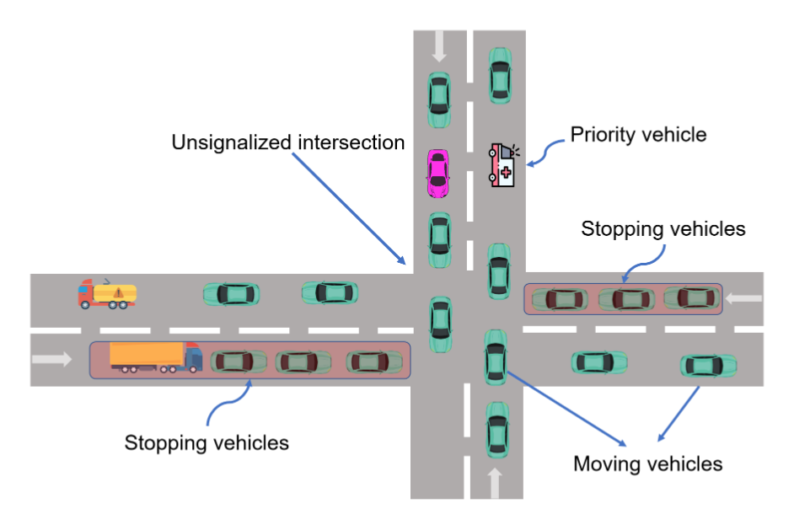
Motivation
Factors influence the reliability of vehicular communications
Channel congestion
Security attacks
Mitigating vehicular network congestion can be done by
Increasing V2V channel bandwidth
Utilizing resource allocation
Controlling sending data rate
Source: our work [2]
Our main focus
3GPP specification
Under development
Channel congestion in V2V communications

Slide 4
Literature Review (1/2)
Study | Support 5G V2X | Safety/risk factor | Fairness factor | Machine learning support | Measurement metric | Learning model
DCC [1] [12] | ✓ | ✘ | ✘ | ✘ | PDR, CBR | Linear data rate adjustment
S-DCC [9] | ✓ | ✘ | ✘ | ✓ | CBR | Fuzzy C-Mean clustering
SAE-DCC [10] | ✘ | ✘ | ✓ | ✘ | CBR | Age-of-Information Optimization
DR-DCC [15] | ✓ | ✘ | ✘ | ✓ | CBR | Deep Q-learning, K-Means
LIMERIC [14] | ✘ | ✘ | ✓ | ✘ | CBR, IPG | Adaptive data rate control
Ours | ✓ | ✓ | ✓ | ✓ | PDR, CBR, CR | Distance-risk optimization, Double Deep Q-learning

Slide 5
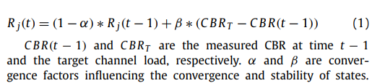
Literature Review (2/2)
*
Rate control for Channel Congestion Mitigation
Channel-based rate control
Collision risk rate control
ETSI DCC
(DSRC, C-V2X)
LIMERIC*
(DSRC)
RTC+
(5G V2V)
DEEPCUT
(5G V2V)
S-DCC [9]
Fuzzy C-mean
clustering
3GPP
doesn’t
specify
to use
these
SAE-DCC [10]
DR-DCC [15]
DR/K-means
Our
work
C-LIMERIC [15]
SVM
DBRA [15]
Reinforcement
Learning

Slide 6
Our Contributions
Two novel intelligent risk-based rate control methods to suggest the proper data rate of broadcasting V2V messages.
The vehicles can automatically adjust their sending rate based on the risk assessment. Therefore, the system can reduce the redundant sending data to mitigate the channel congestion while still maintaining the safety.
The evaluation results demonstrate the significant effects of the method in reducing the potential congestion for V2X applications, particularly maintaining safety (cut up 16% redundant data while increasing 22% packet delivery rate compared with baseline models)

Slide 7
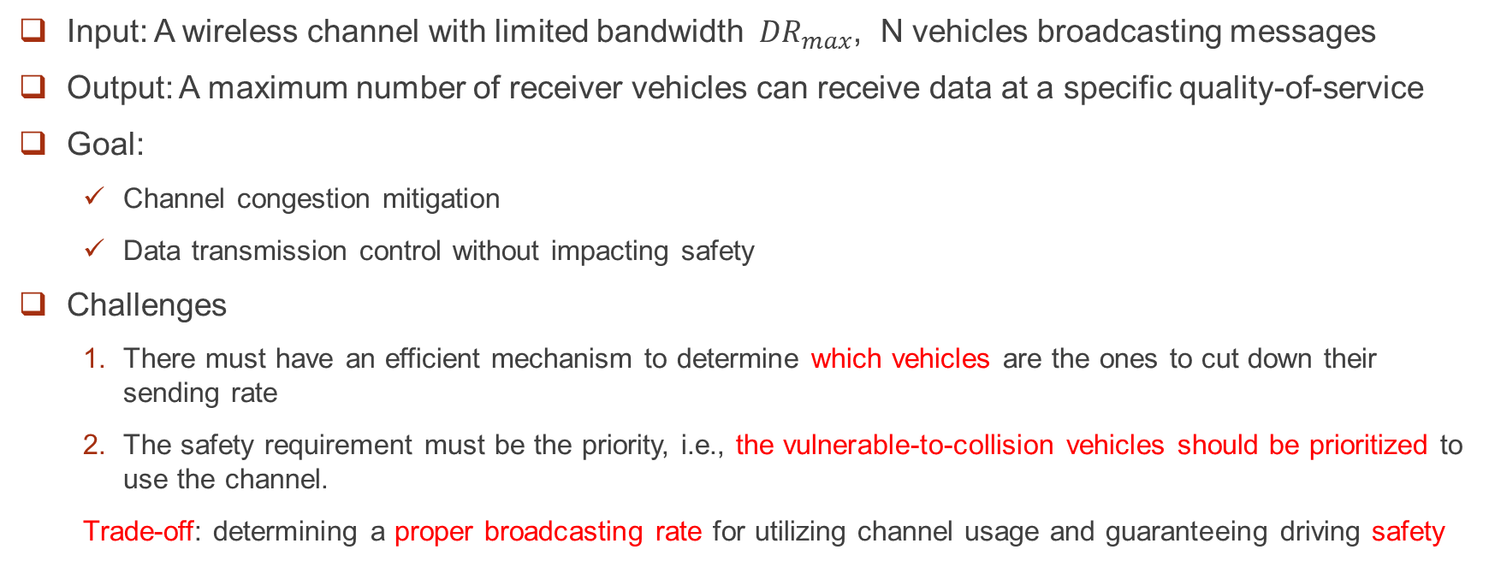
Problem Statement
Input: A wireless channel with limited bandwidth ${ DR}_{max}$, N vehicles broadcasting messages
Output: A maximum number of receiver vehicles can receive data at a specific quality-of-service
Goal:
Channel congestion mitigation
Data transmission control without impacting safety
Challenges
There must have an efficient mechanism to determine which vehicles are the ones to cut down their sending rate
The safety requirement must be the priority, i.e., the vulnerable-to-collision vehicles should be prioritized to use the channel.
Trade-off: determining a proper broadcasting rate for utilizing channel usage and guaranteeing driving safety

Slide 8
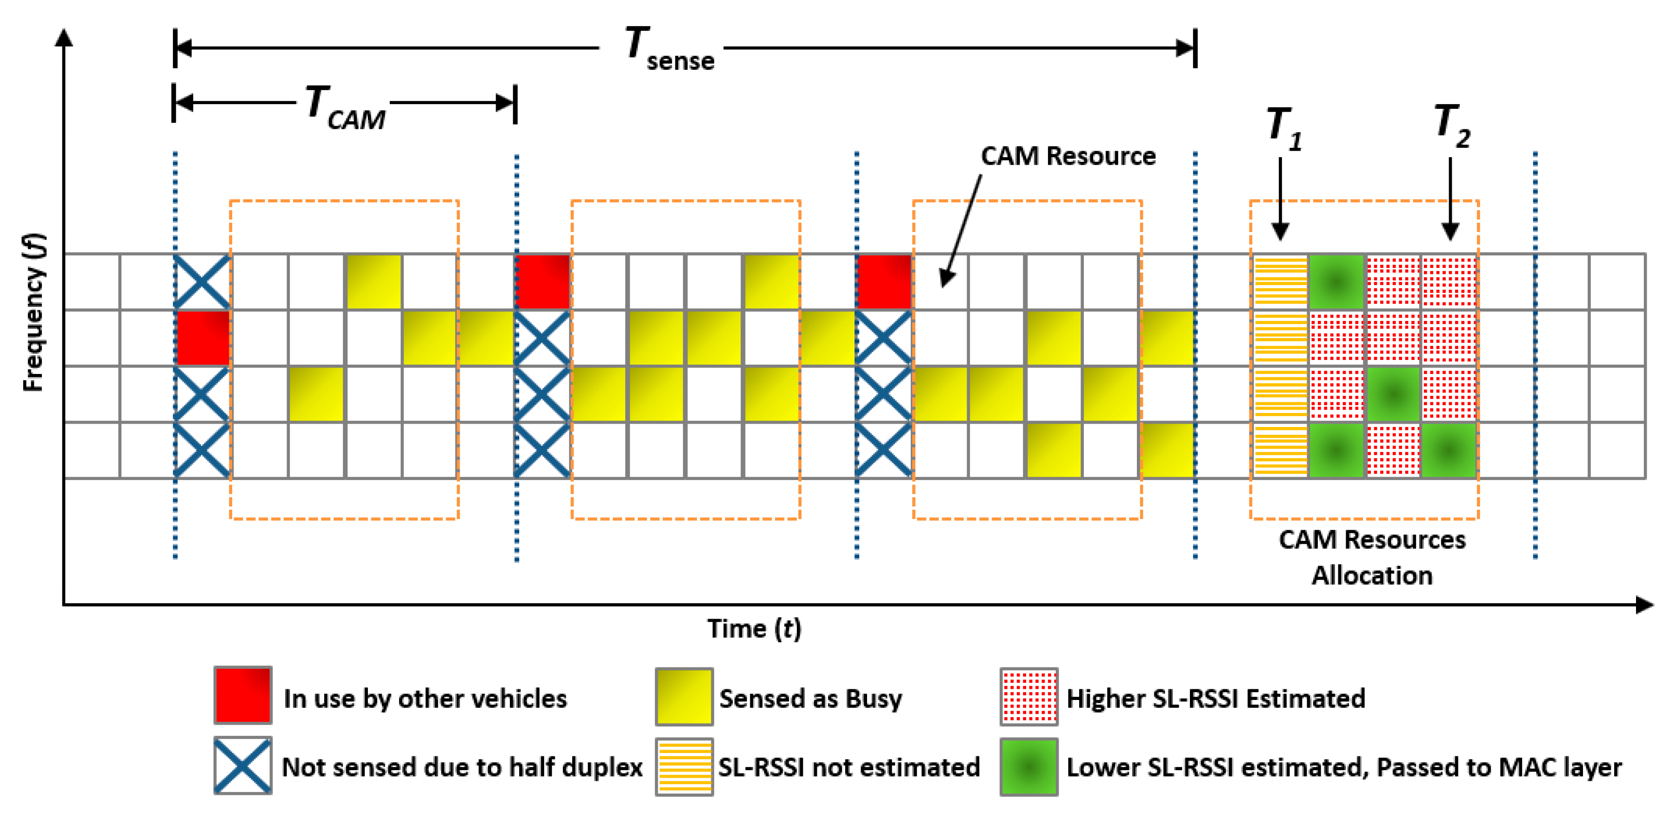


Rate Control vs Resource Allocation
Rate control
Manage the congestion through adjusting the sending rate of connected vehicles
Resource allocation
Sensing-based semi-persistent scheduling (SB-SPS) manages the congestion through scheduling resource reservation interval (RRI) and power transmission for connected vehicles ($T_{CAM})$
Reduce
Data rate (R)= $\frac{Number of messages}{Time interval }$
increase
LIMERIC

Slide 9
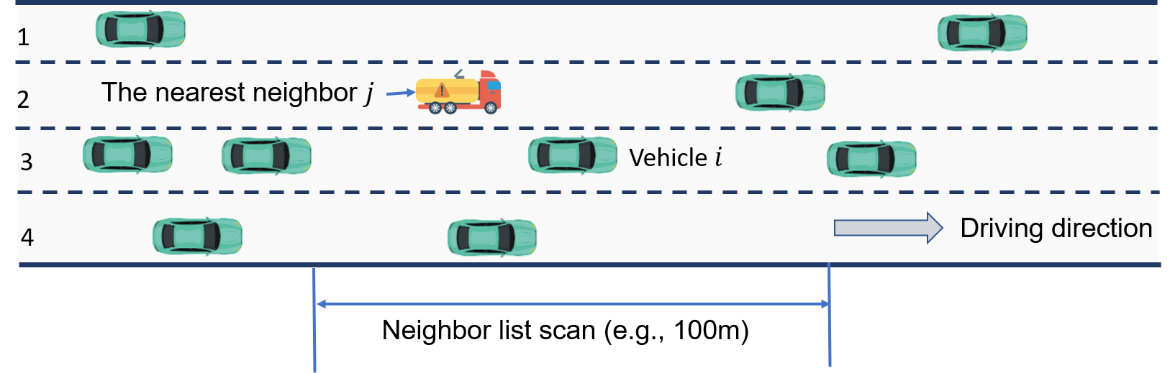
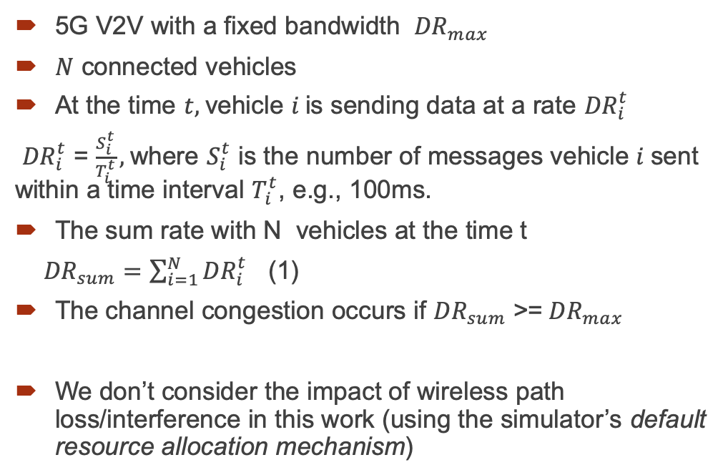
System Model (1/2)
5G V2V with a fixed bandwidth ${ DR}_{max}$
$N$ connected vehicles
At the time $t,$vehicle $i$is sending data at a rate ${DR}_{i}^{t}$
${DR}_{i}^{t}$ = $\frac{S_{i}^{t}}{T_{i}^{t}},$where $S_{i}^{t}$ is the number of messages vehicle $i$sent within a time interval $T_{i}^{t}$, e.g., 100ms.
The sum rate with N vehicles at the time t
${DR}_{sum}=$ $\sum_{i=1}^{N}{{DR}_{i}^{t}}$ (1)
The channel congestion occurs if ${DR}_{sum}$ >=${ DR}_{max}$
We don’t consider the impact of wireless path loss/interference in this work (using the simulator’s default resource allocation mechanism)

Slide 10
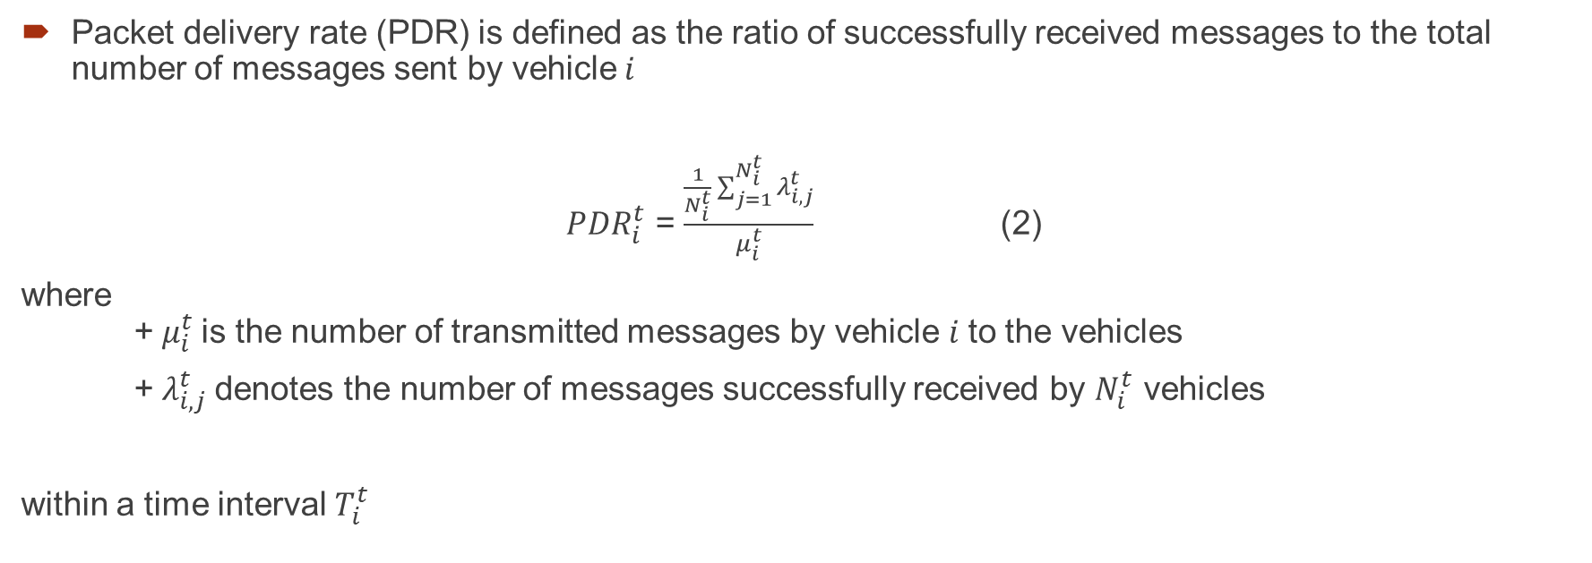
System Model (2/2)
Packet delivery rate (PDR) is defined as the ratio of successfully received messages to the total number of messages sent by vehicle$i$
${PDR}_{i}^{t}$ = $\frac{\frac{1}{N_{i}^{t}}\sum_{j=1}^{N_{i}^{t}}{λ_{i,j}^{t}}}{μ_{i}^{t}}$ (2)
where + $μ_{i}^{t}$is the number of transmitted messages by vehicle $i$to the vehicles
+ $λ_{i,j}^{t}$denotes the number of messages successfully received by $N_{i}^{t}$ vehicles
within a time interval $T_{i}^{t}$

Slide 11
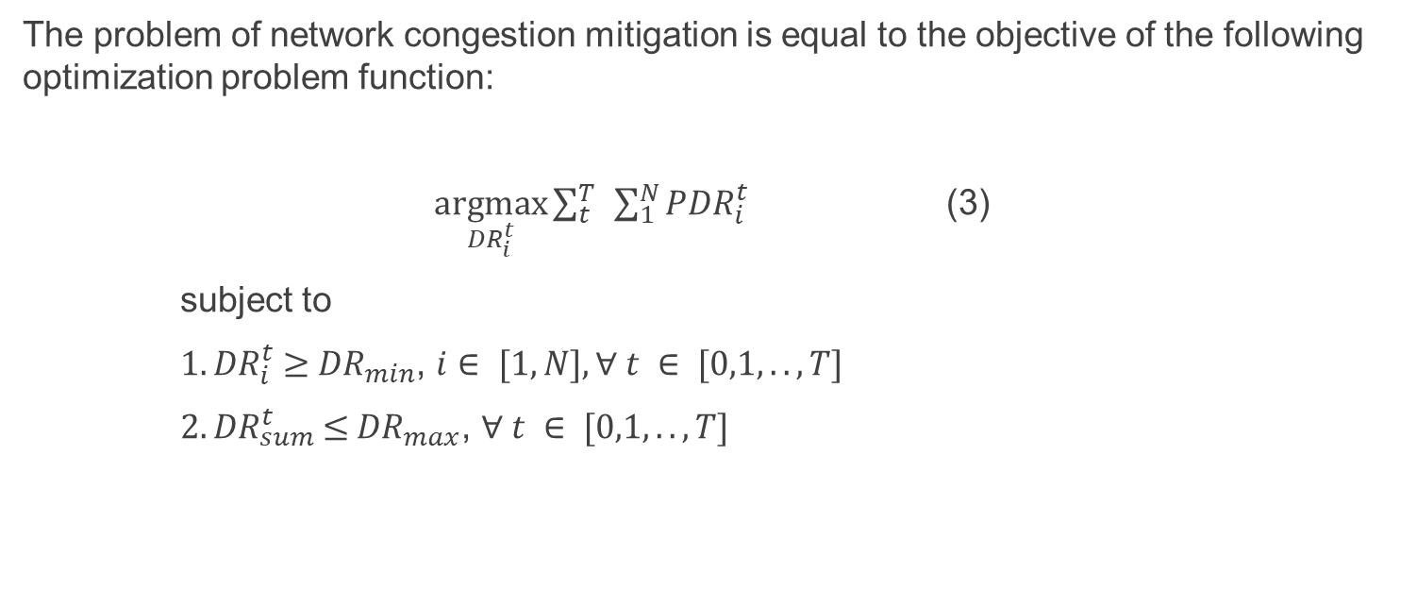
Problem Formulation
The problem of network congestion mitigation is equal to the objective of the following optimization problem function:
$\underset{{DR}_{i}^{t}}{argmax}{\sum_{t}^{T}{ }\sum_{1}^{N}{{PDR}_{i}^{t}}}$ (3)
subject to
${ 1. DR}_{i}^{t} ≥$ ${DR}_{min}$, $i∈ [1,N], ∀ t ∈ [0,1,..,T]$
${ 2. DR}_{sum}^{t} ≤{ DR}_{max}$, $∀ t ∈ [0,1,..,T]$
Minimum data rate for V2X applications
Channel capacity

Slide 12
The Key Question
Which vehicles (low-risk or high-risk) should we reduce the sending/broadcasting rate?
V2V communications under congestion
How to determine?
Low-risk vehicles
High-risk vehicles

Slide 13
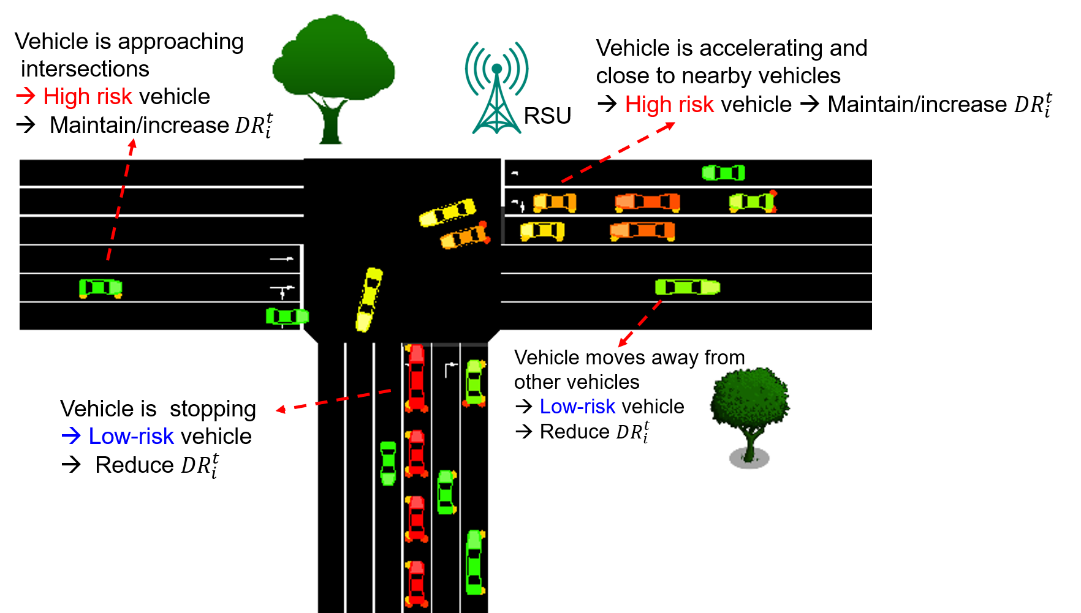
Our Idea to Reduce Vehicles’ Sending Rate
Decrease the data rate of low-risk vehicles
Maintain the data rate of high-risk vehicles (if that is the current state)
Increase the data rate of high-risk vehicles (if the state is a transition from low risk to high risk)
Our idea is to gain two goals:
1. Help to mitigate congestion
2. Maintain the safety

Slide 14
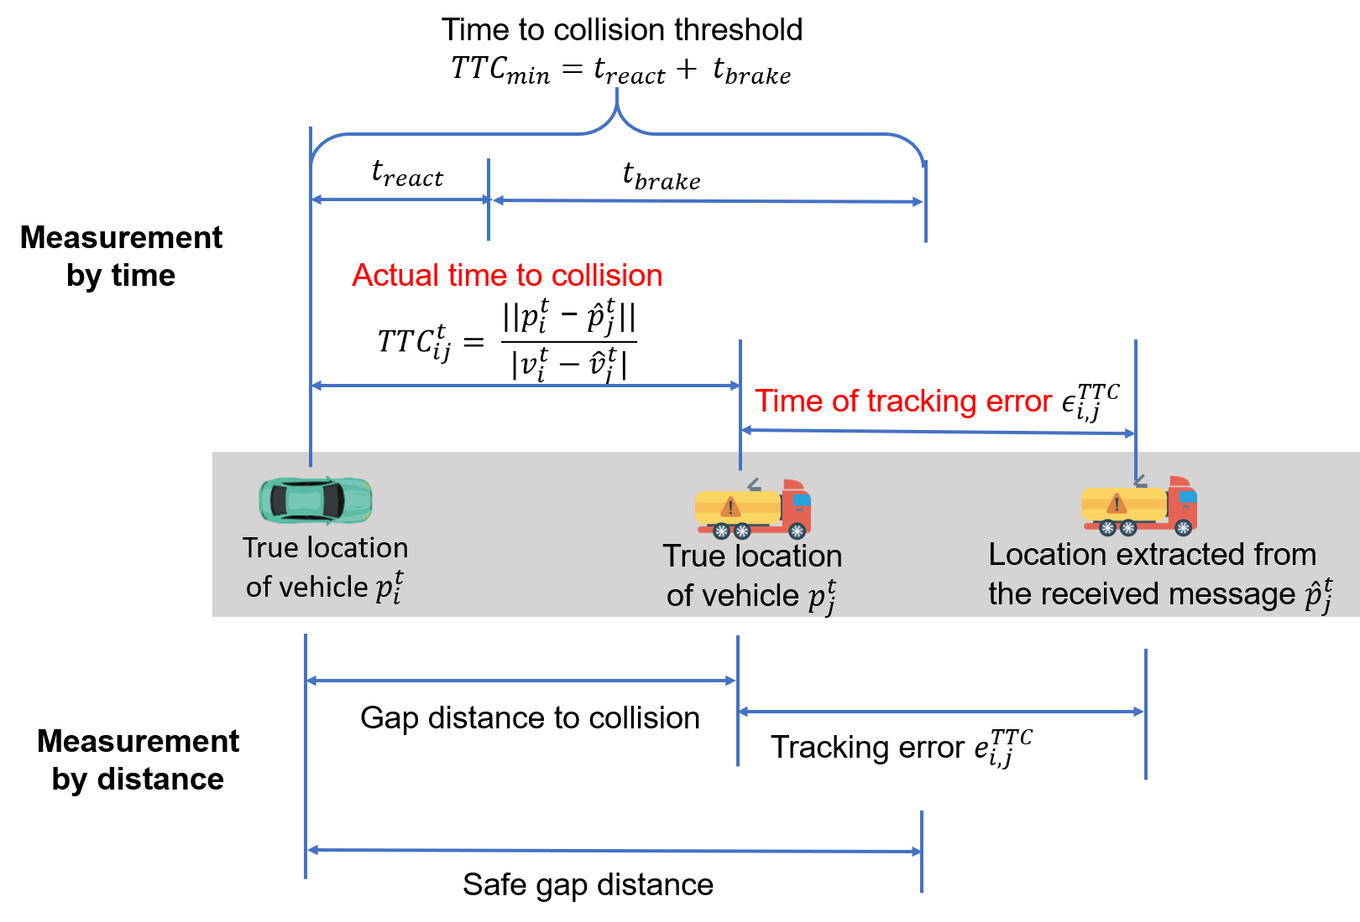
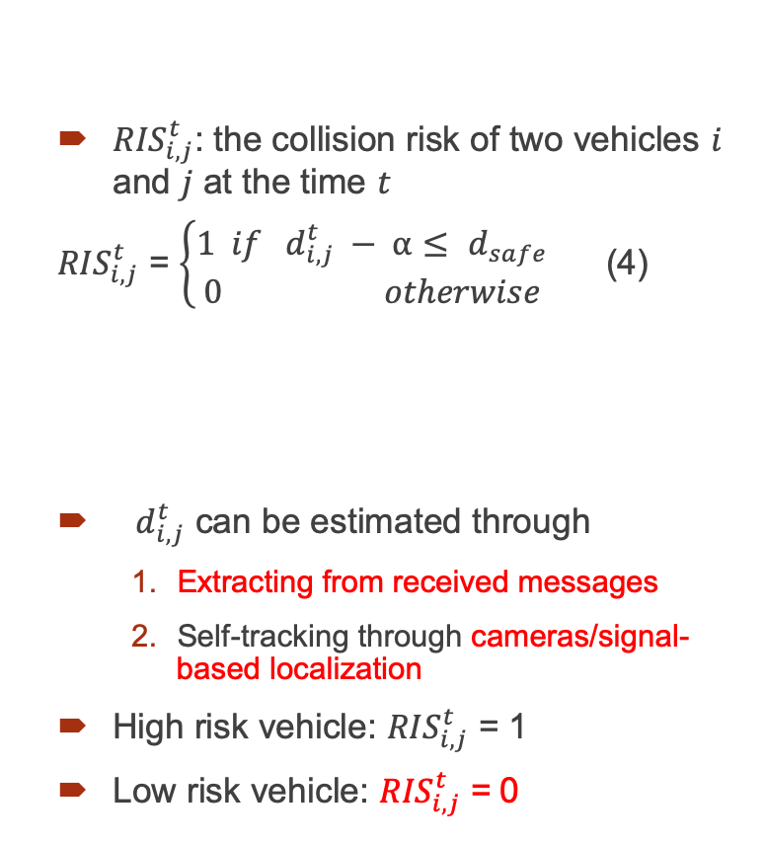

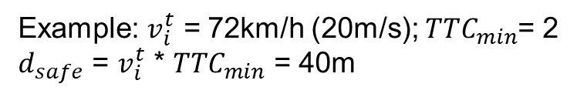
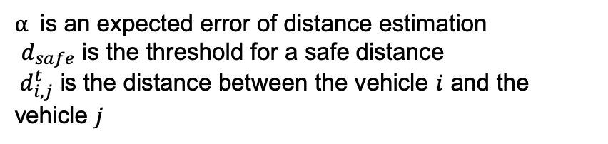
How to Define Collision Risk?
${RIS}_{i,j}^{t}$: the collision risk of two vehicles $i$ and $j$ at the time $t$
${RIS}_{i,j}^{t}$ = $\left\{\begin{aligned}1 if{ d}_{i,j}^{t} − α≤ d_{safe} \\ 0 otherwise\end{aligned}\right.$ (4)
${ d}_{i,j}^{t}$ can be estimated through
Extracting from received messages
Self-tracking through cameras/signal-based localization
High risk vehicle: ${RIS}_{i,j}^{t}$ = 1
Low risk vehicle: ${RIS}_{i,j}^{t}$ = 0
$d_{safe}$ = ${TTC}_{min}$ *$v_{i}$
$α$ is an expected error of distance estimation
$d_{safe}$ is the threshold for a safe distance
${ d}_{i,j}^{t}$ is the distance between the vehicle $i$ and the vehicle $j$
Example: $v_{i}^{t}$ = 72km/h (20m/s); ${TTC}_{min}$= 2
$d_{safe}$ = $v_{i}^{t}$ * ${TTC}_{min}$ = 40m

Slide 15
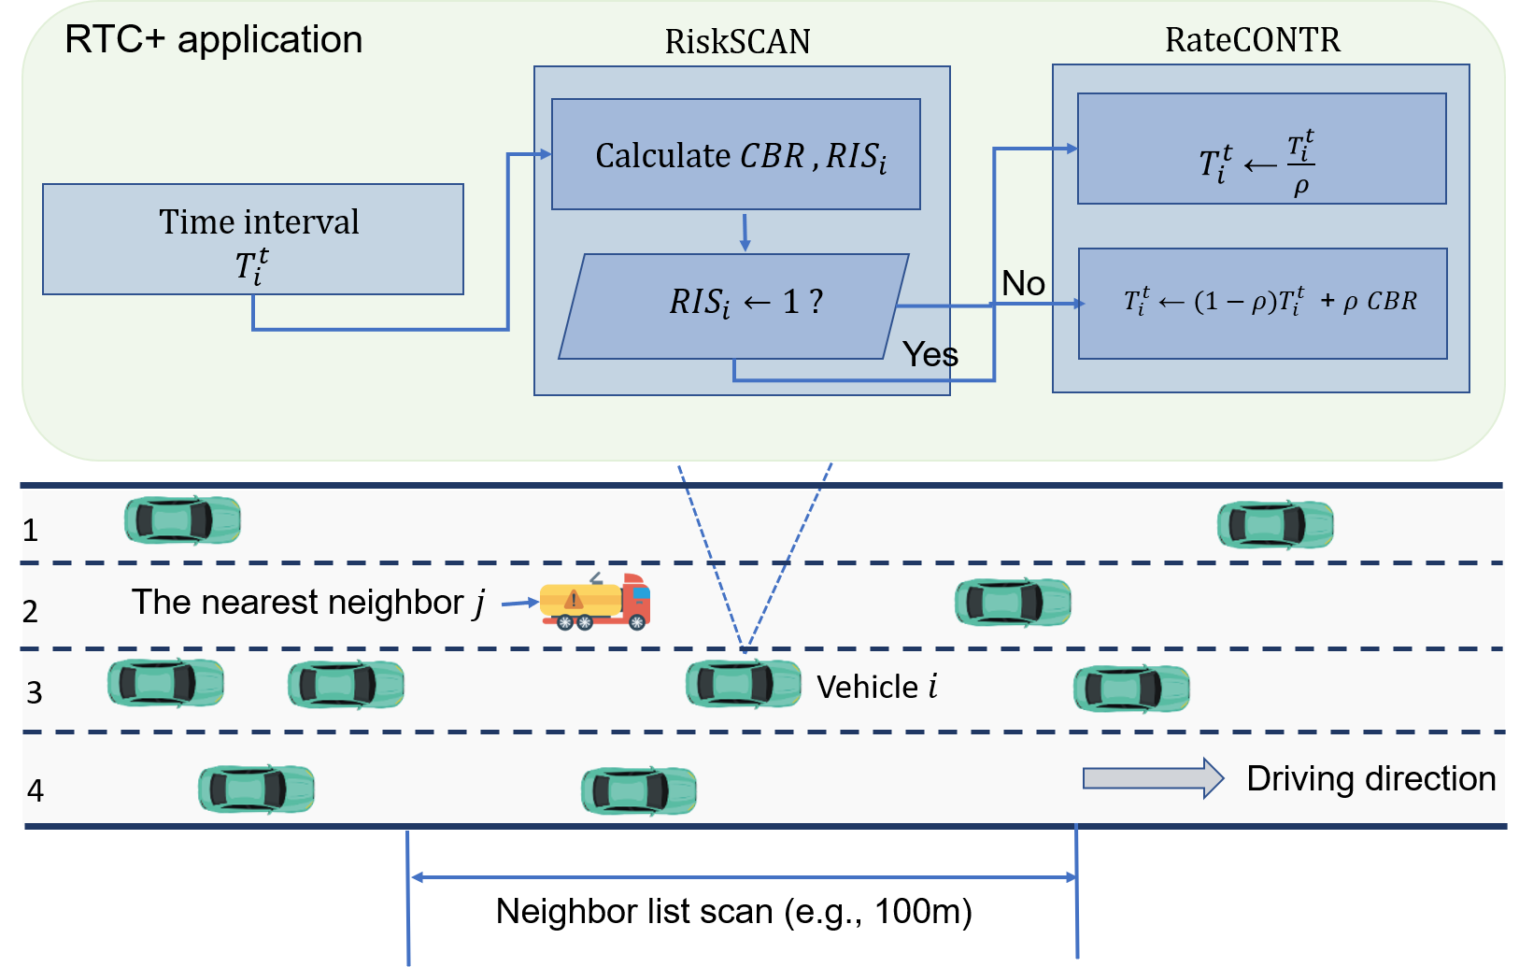
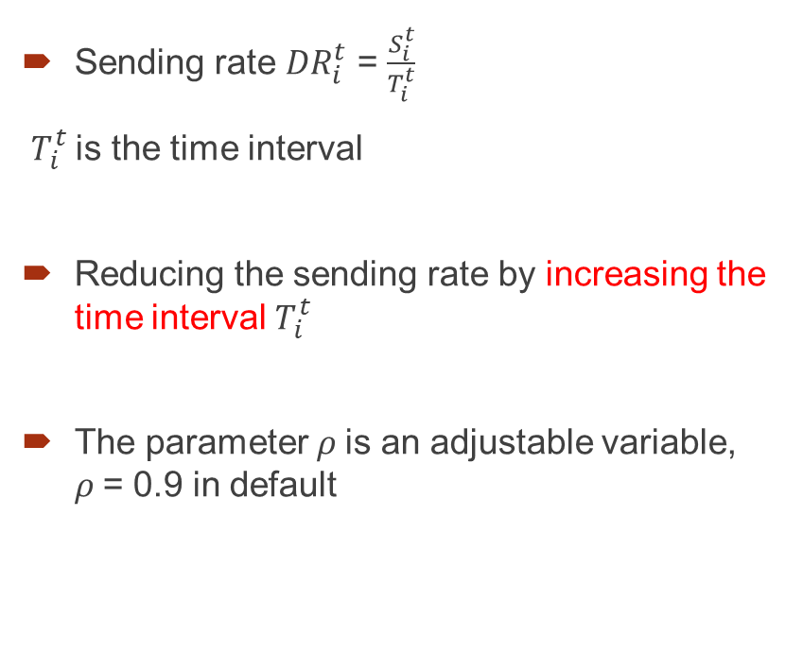
RTC+: Simple Risk-Based Transmission Control
Sending rate ${DR}_{i}^{t}$ = $\frac{S_{i}^{t}}{T_{i}^{t}}$
$T_{i}^{t}$is the time interval
Reducing the sending rate by increasing the time interval $T_{i}^{t}$
The parameter$ρ$ is an adjustable variable, $ρ$= 0.9 in default
Source: our work [1]

Slide 16
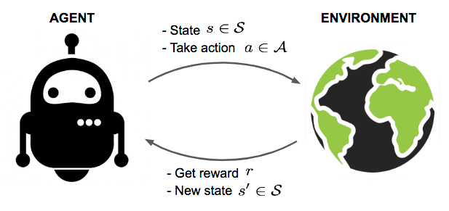
DEEPCUT: Smart DRL-based Transmission Control
We use Deep Reinforcement Learning
Smart: Vehicles can interact with V2V communications to adjust learning strategy and broadcasting rate properly
Efficiency: Does not require labeled datasets for training
We use the Double Deep Q-Networks (DDQN) type
Easy to implement
Action space is discrete so estimating max. Q-value is feasible.
Source: Lil’Log

Slide 17
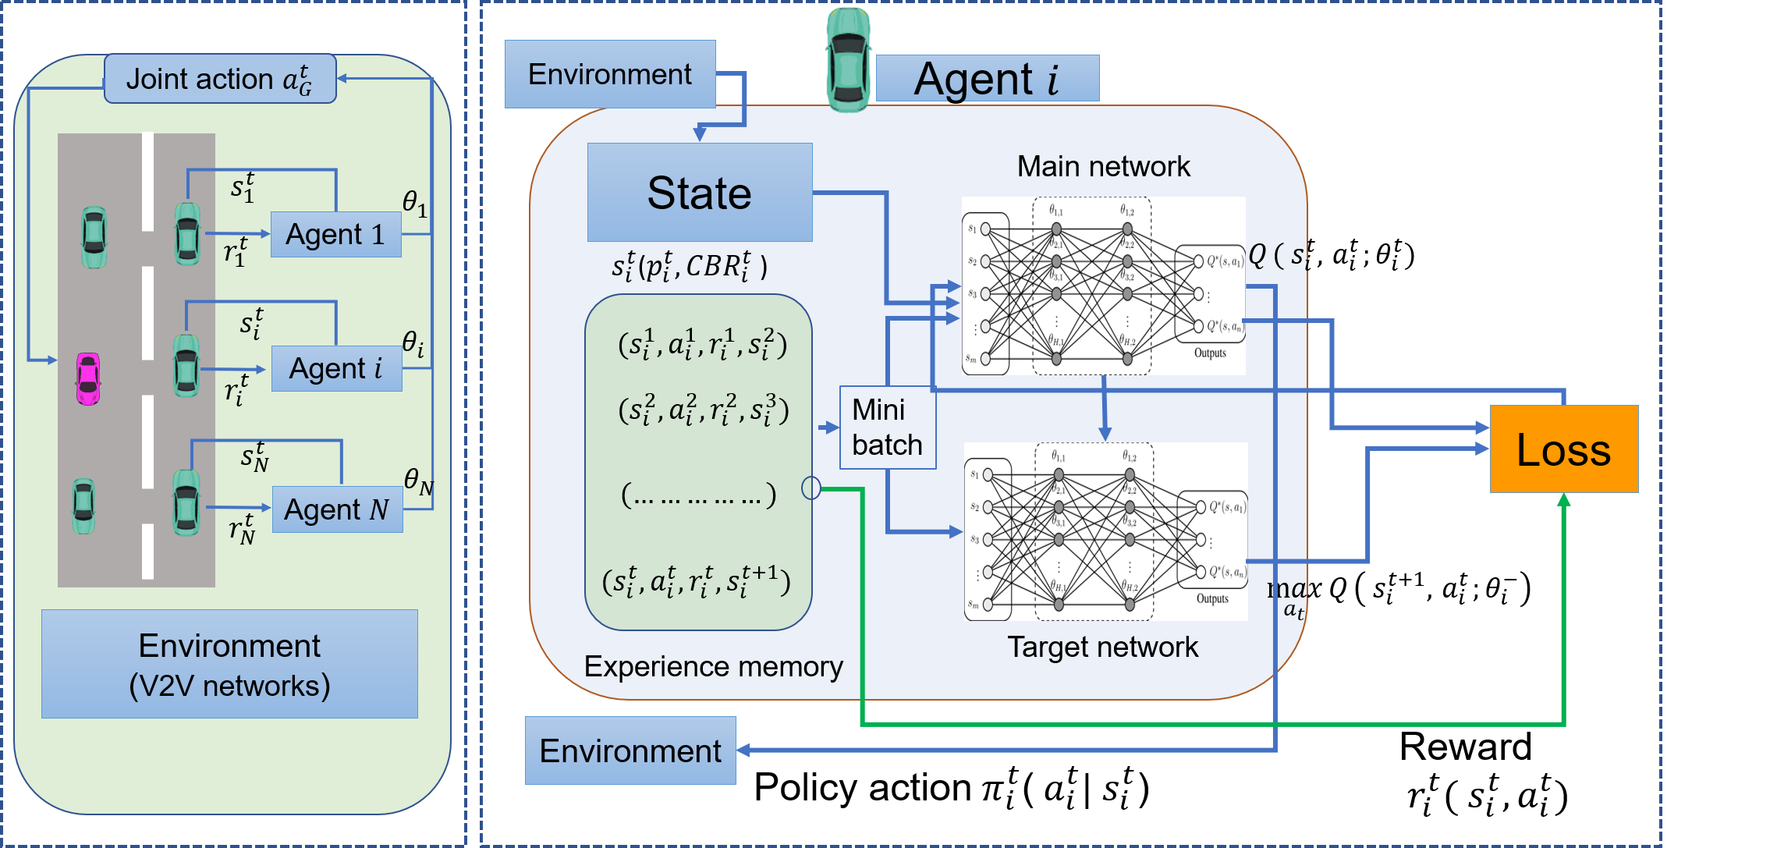
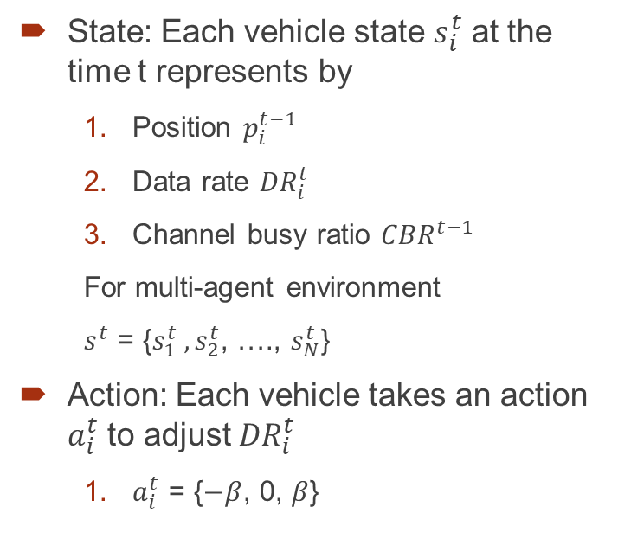
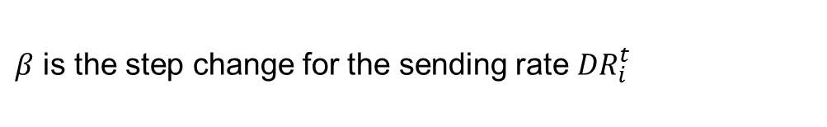
Deep Reinforcement Learning Definition (1/3)
State: Each vehicle state $s_{i}^{t}$ at the time t represents by
Position $p_{i}^{t−1}$
Data rate ${DR}_{i}^{t}$
Channel busy ratio ${CBR}^{t−1}$
For multi-agent environment
$s^{t}$ = {$s_{1}^{t} ,s_{2}^{t}$, …., $s_{N}^{t}$}
Action: Each vehicle takes an action $a_{i}^{t}$ to adjust ${DR}_{i}^{t}$
$a_{i}^{t}$ = {$−β$, 0, $β$}
$β$ is the step change for the sending rate ${DR}_{i}^{t}$
Our DDQN-based model architecture

Slide 18
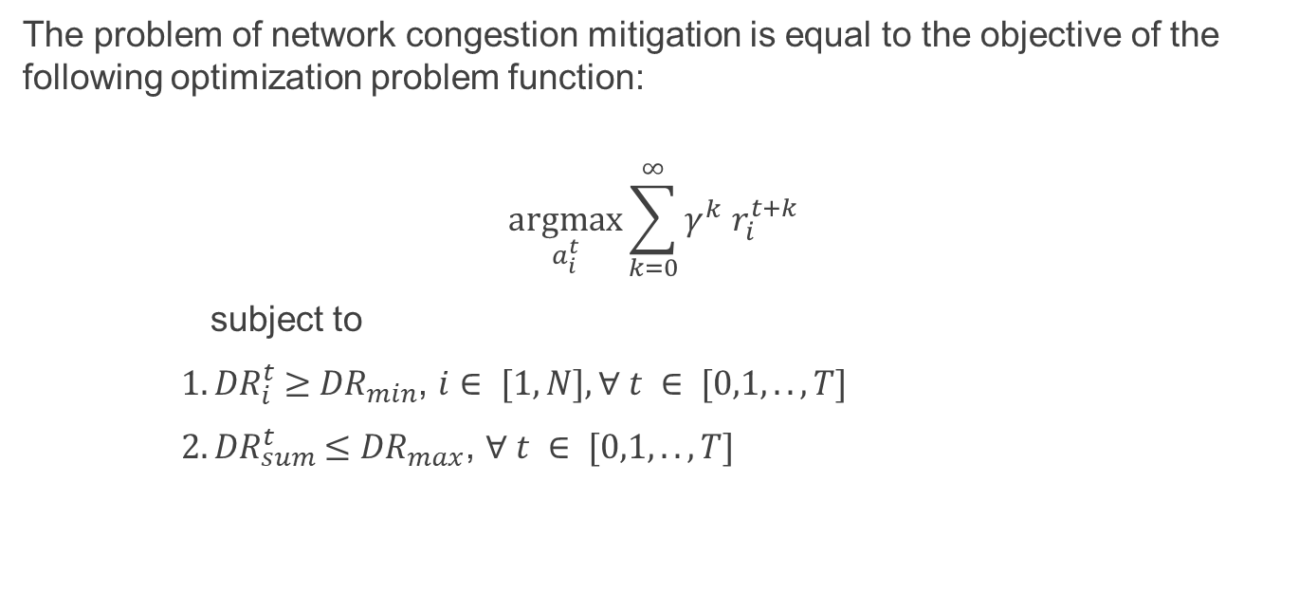
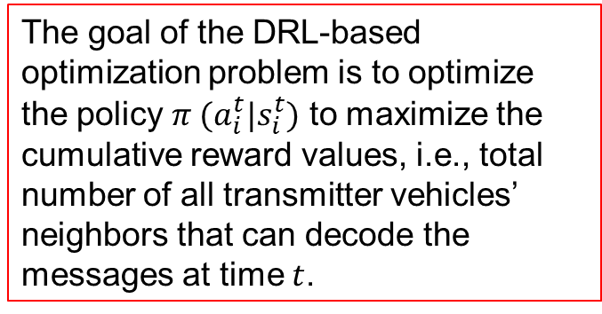
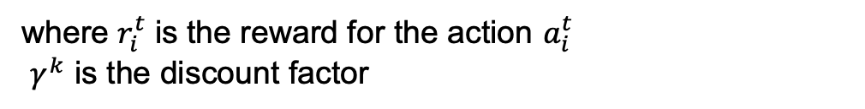
Deep Reinforcement Learning Definition (2/3)
The problem of network congestion mitigation is equal to the objective of the following optimization problem function:
$$\underset{a_{i}^{t}}{argmax}{\sum_{k=0}^{∞}{γ^{k}}{ r}_{i}^{t+k}}$$
subject to
${ 1. DR}_{i}^{t} ≥$ ${DR}_{min}$, $i∈ [1,N], ∀ t ∈ [0,1,..,T]$
${ 2. DR}_{sum}^{t} ≤{DR}_{max}$, $∀ t ∈ [0,1,..,T]$
(5)
The goal of the DRL-based optimization problem is to optimize the policy $π (a_{i}^{t}|s_{i}^{t})$ to maximize the cumulative reward values, i.e., total number of all transmitter vehicles’ neighbors that can decode the messages at time $t$.
where $r_{i}^{t}$ is the reward for the action $a_{i}^{t}$
$γ^{k}$ is the discount factor

Slide 19
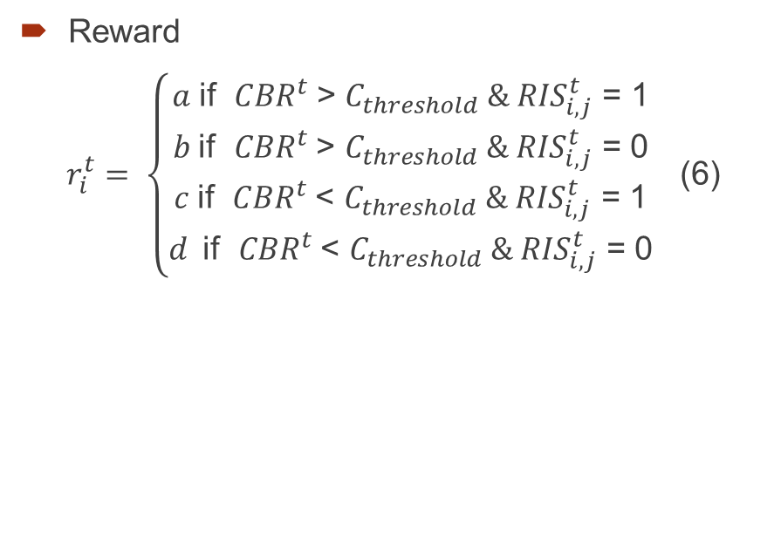
Deep Reinforcement Learning Definition (3/3)
Reward
$r_{i}^{t}$ $= \left\{\begin{aligned}a \text{if} {CBR}^{t} \text{> }C_{threshold}\text{ & }{RIS}_{i,j}^{t}\text{ = 1} \\ b \text{if} {CBR}^{t} \text{> }C_{threshold}\text{ & }{RIS}_{i,j}^{t}\text{ = }\text{0} \\ c \text{if} {CBR}^{t} \text{<} C_{threshold}\text{ & }{RIS}_{i,j}^{t}\text{ = }\text{1} \\ d \text{if} {CBR}^{t} \text{< }C_{threshold}\text{ & }{RIS}_{i,j}^{t}\text{ = }\text{0}\end{aligned}\right.$ (6)
The value of a, b, c, d are adjustable values but should be proportional to the state of the channel and risks
- The higher risk + congestion the action causes, the higher penalty it gets (negative value)
- For example, a=-10, b=-2, c=-4, d = 2
$C_{threshold}$ is the CBR threshold to
determine the channel busy, e.g., = 0.85 (85%).

Slide 20
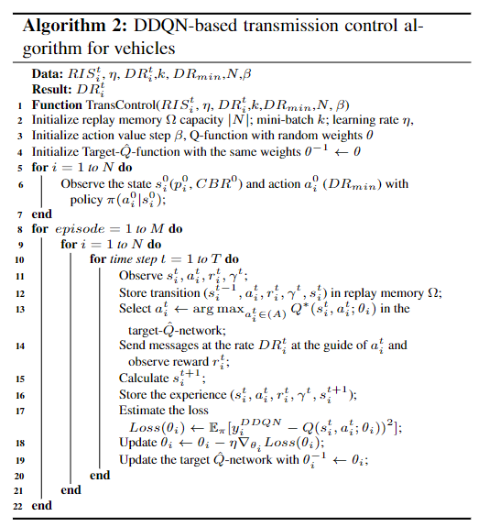
DDQN-based Transmission Control Algorithm
Multi-agent model to make a consensus decision
DDQN-based transmission control architecture

Slide 21
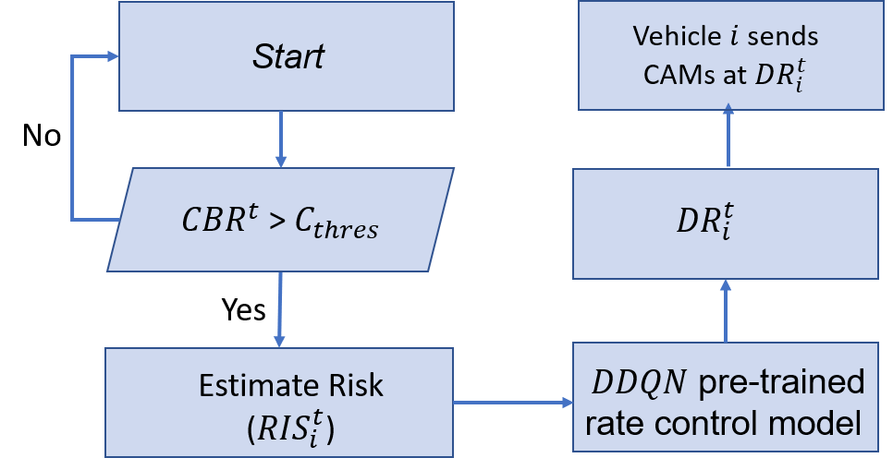
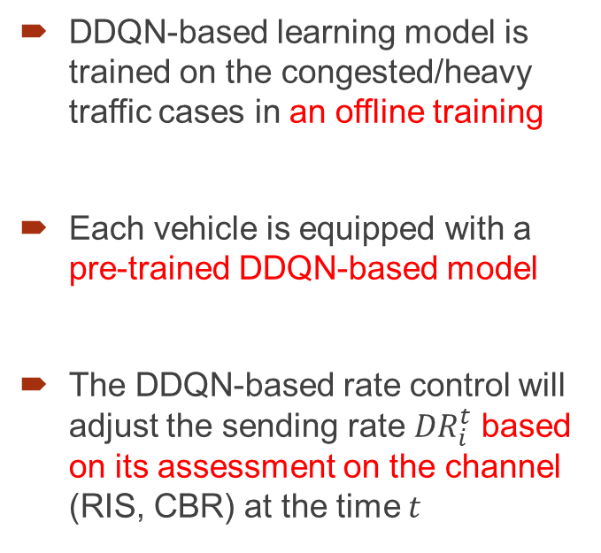
DDQN-based Transmission Control Algorithm
Workflow
1
DDQN-based learning model is trained on the congested/heavy traffic cases in an offline training
Each vehicle is equipped with a pre-trained DDQN-based model
The DDQN-based rate control will adjust the sending rate ${DR}_{i}^{t}$ based on its assessment on the channel (RIS, CBR) at the time $t$
2
3
Source: our work [2]

Slide 22
Centralized vs Decentralized
Suitable for urban areas
Suitable for rural areas
Centralized method: Road-side unit to play the role of data rate control
Advantage
Fast learning convergence
Easy to adjust hyperparameters
Disadvantage
Require centralized server connections (V2I), e.g., cloud server, road side units
Challenge to deploy in the areas without core network infrastructure
Decentralized method: Vehicles negotiate with each other to determine the data rate
Advantage
Work well with V2V environments
Disadvantage
Slower learning convergence
Difficult to maintain the consistency of learning models for vehicles with different computation capabilities.

Slide 23
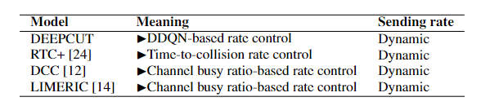
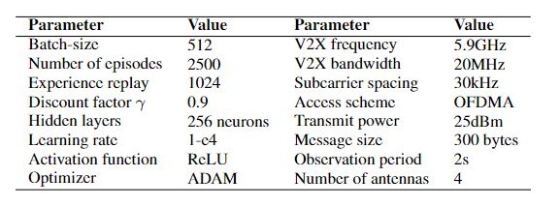
Evaluation Results
Ours
Simulator: Veins, OpenCV2X
System configuration
DSRC rate control
C-V2X/DSRC rate control
Adjust the broadcasting rate based on
the CBR level, regardless of risk/no-risk states

Slide 24
Measurement Metric
Packet Delivery Rate
→ the ratio of successfully received messages to the total number of messages sent
Channel Busy Ratio
→ the ratio of time that the channel has been sensed busy in a given time window T
Collision risk
→ the total times each pair of vehicles exceeds the safe distance at their relative speed
Computing time
→ The latency of suggesting a proper broadcasting rate adjustment once the congestion occurs
V2V communication standard
IEEE 802.11p: 5.9GHz
5G C-V2X NR: 40GHz
V2X communication scenario
Heavy traffic (5-10 vehicles broadcasting)
→ 200 vehicles/km
Network congestion (> 20 vehicles broadcasting)
→ 300 vehicles/km
Luxembourg SUMO Traffic
(mobility model follows real traffic patterns)

Slide 25
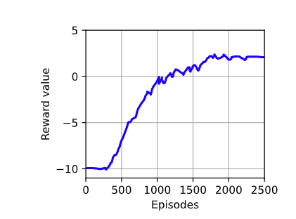
Result – DDQN training
The training converges after 2500 episodes
If we set a high timestep and replay memory (large exploration), the training convergence is expected to be longer than this result
Source: from our work [2]

Slide 26
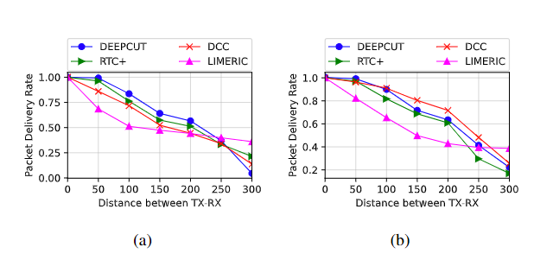
Packet Delivery Rate performance
DEEPCUT yields 22.63% PDR performance better than DCC/LIMERIC with TX-RX distance < 200m
If the TX-RX distance > 200m (far distance), collision risk is less critical → high cut + poor communication for far distance → low PDR but OK
Advantage of DEEPCUT:
Hundreds of thousands of trial-and-fail training to find the best sending rate for multiple vehicle (multi-agent DRL)
Heavy traffic
Congested channel
Source: from our work [2]

Slide 27
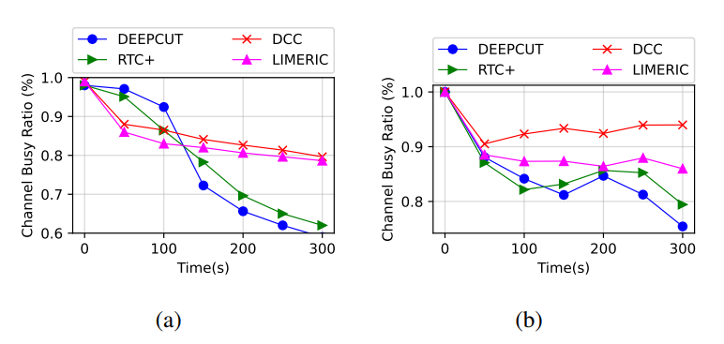
Channel Busy Ratio performance
DEEPCUT maintains 20% better performance in overall CBR
If traffic jam occurs ( after 150th seconds), the risk of slow-moving vehicles is low → an aggressive rate control like ours can significantly reduce the CBR
150th
Heavy traffic
Congested channel
Source: from our work [2]

Slide 28
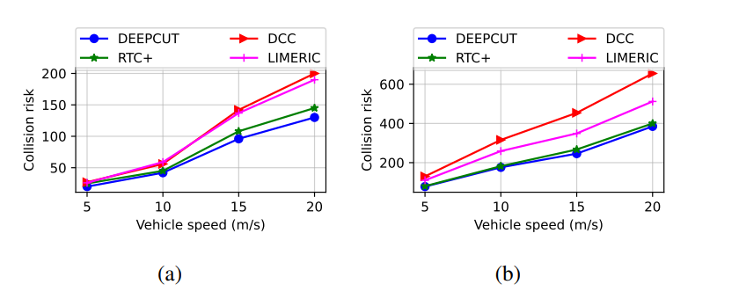
Collision risk performance
DEEPCUT/RTC+ can reduce average 21% less collision risk in all the cases of traffic density
Our risk-based assessment model contributed positive results
Collision risk still occurs in some cases, if traffic jam or group vehicles moving near each others → we didn’t control the vehicle behavior in this work
~21%
Heavy traffic
Congested channel
Source: from our work [2]

Slide 29
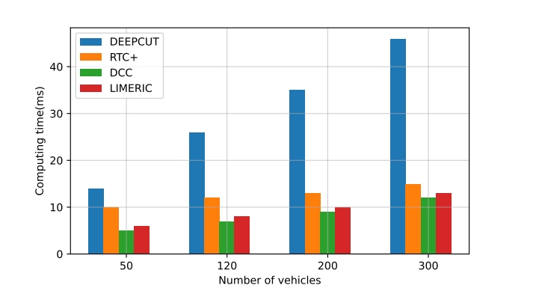
Computing Time performance
The most
common
case
The
rare
case
DEEPCUT gives the highest computing time, particularly to support many vehicles
Hard to find the consensus
Include the extensive computation (risk assessment)
Computing time is still acceptable
Many V2X road-safety apps can accept latency up to 100ms [5]
In the future, computers in vehicles will be much stronger
The case of 300 vehicles per km is not common
Source: from our work [2]

Slide 30
Conclusion
Two novel intelligent control schemes are efficient to resolve the channel congestion in V2V communications while still maintaining the safety proportionally.
The risk factor is an advantage of our methods. It can help to the rate control to know exactly which vehicles should reduce the sending rate.
Ongoing work: Support the fairness index in data rate control
Future work: We move to support aerial vehicular communications, given their prospective to be deployed in 6G networks

Slide 31
Publication Overview
Lan-Huong Nguyen, Van-Linh Nguyen, and Jian-Jhih Kuo, “Risk-Based Transmission Control for Mitigating Network Congestion in Vehicle-to-Everything Communications,” IEEE Access, vol. 9, pp. 144469-144480, Oct. 2021
Lan-Huong Nguyen, Van-Linh Nguyen, and Jian-Jhih Kuo, “Efficient Reinforcement Learning-based Transmission Control for Mitigating Channel Congestion in 5G V2X Sidelink,” IEEE Access, vol. 10, pp. 62268 - 62281, Jun. 2022
Lan-Huong Nguyen, Ren-Hung Hwang, Po-Ching Lin, Van-Linh Nguyen, and Jian-Jhih Kuo, ”Robust Positioning-based Verification Scheme for Enhancing Reliability of Vehicle Platoon Control,” in IEEE Vehicular Technology Conference (VTC), Sep. 2021
Yun-Hao Ye, Zhi-Yang Lin, Chih-Chiung Yao, Lan-Huong Nguyen, Jian-Jhih Kuo, and Ren-Hung Hwang “Efficient Multi-maneuver Platooning Framework for Autonomous Vehicles on Multi-lane Highways” in IEEE Vehicular Technology Conference (VTC), Sep. 2021.
Van-Linh Nguyen, Lan-Huong Nguyen, Jian-Jhih Kuo, Po-Ching Lin, Ren-Hung Hwang “Intelligent Aerial Relay Deployment for Enhancing Connectivity in Emergency Communications,” IEEE Transactions on Vehicular Technology (Major revision)
Van-Linh Nguyen, Lan-Huong Nguyen, Jian- Jhih Kuo, Ren-Hung Hwang, Po-Ching Lin,” Efficient Aerial Relaying Station Path Planning for Emergency Event-based Communications”, accepted to appear in IEEE CCNC 2023, Jan 2023.

Slide 32
Reference
S. Kühlmorgen, H. Lu, A. Festag, J. Kenney, S. Gemsheim, and G. Fettweis, “Evaluation of congestion-enabled forwarding with mixed data traffic in vehicular communications,” IEEE Transactions on Intelligent Transportation Systems, vol. 21, no. 1, pp. 233–247, 2020.
G. Thandavarayan, M. Sepulcre, and J. Gozalvez, “Cooperative perception for connected and automated vehicles: Evaluation and impact of conges- tion control,” IEEE Access, vol. 8, pp. 197 665–197 683, 2020.
S. Husain, A. Kunz, A. Prasad, E. Pateromichelakis, K. Samdanis, and J. Song, “The road to 5G V2X: Ultra-high reliable communications,” in 2018 IEEE Conference on Standards for Communications and Networking (CSCN), 2018, pp. 1–6.
H. Zhou, W. Xu, J. Chen, and W. Wang, “Evolutionary V2X technologies toward the internet of vehicles: Challenges and opportunities,” Proceeding of IEEE, vol. 108, no. 2, pp. 309–323, 2020.
3GPP.TR.22.886, “Study on enhancement of 3gpp support for 5G V2X services,” 3GPP TR 22.886 V16.1.1 (2018-09), 2018.
R. Liu, J. Wang, and B. Zhang, “High definition map for automated driving: Overview and analysis,” The Journal of Navigation, vol. 73, no. 2, pp. 324–341, 2020.
5GAA, “V2X functional and performance test procedures – selected assessment of device to device communication aspects,” 5G Automotive Association, 2018.
3GPP, “Study on LTE-based V2X services (v14.0.0, release 14),” Techni- cal Specification Group Radio Access Network, 2016

Slide 33
Reference
P. Sewalkar and J. Seitz, “Mc-coco4v2p: Multi-channel clustering-based congestion control for vehicle-to-pedestrian communication,” IEEE Transactions on Intelligent Vehicles, pp. 1–1, 2020.
N. Lyamin, B. Bellalta, and A. Vinel, “Age-of-information-aware decentralized congestion control in VANETs,” IEEE Networking Letters, vol. 2, no. 1, pp. 33–37, 2020.
C. Belagal Math, H. Li, S. Heemstra de Groot, and I. G. Niemegeers, “V2X application-reliability analysis of data-rate and message-rate congestion control algorithms,” IEEE Communications Letters, vol. 21, no. 6, pp. 1285–1288, 2017.
ETSI, “Intelligent transport systems (ITS);decentralized congestion control mechanisms for intelligent transport systems operating in the 5 GHz range; access layer part,” ETSI TS 102 687 V1.2.1, 2018.
——, “Intelligent transport systems (its); vehicular communications; basic set of applications; part 2: Specification of cooperative awareness basic service,” ETSI - EN 302 637-2, 2014.
G. Bansal, J. B. Kenney, and C. E. Rohrs, “Limeric: A linear adaptive message rate algorithm for dsrc congestion control,” IEEE Transactions on Vehicular Technology, vol. 62, no. 9, pp. 4182–4197, 2013.
A. Balador, E. Cinque, M. Pratesi, F. Valentini, C. Bai, A. A. Gómez, and M. Mohammadi, “Survey on decentralized congestion control methods for vehicular communication,” Vehicular Communications, vol. 2021, p. 100394, 2021

Slide 34
Thank you for listening!
Notes:
Thank you for listening my dissertation presentation.
If you have any questions on our work, please let me know.
Thank you professors.

Slide 35
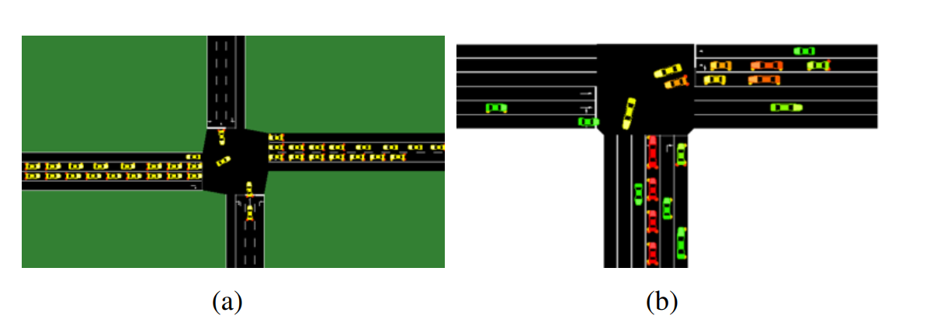
Ongoing work
If there are so many vehicles with the same risk assessment level, how to manage the fairness in cutting data for all vehicles?
This part is addressed in our ongoing work which partially submitted to ICC 2023 for reviewing
Platooning
Mixed traffic case

Slide 36

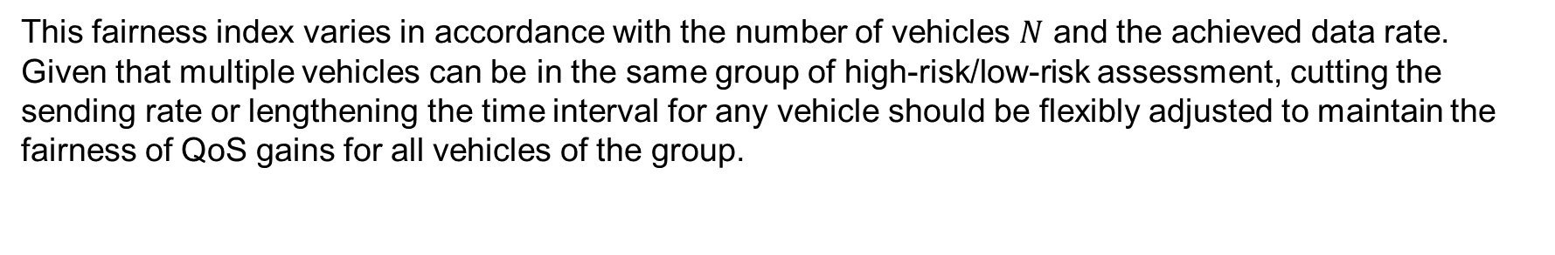
Support fairness assessment factor
We supply the fairness index
Jain’s fairness index $J^{t}$of data rate for all vehicles is defined as follows:
$J^{t}$ = $\frac{{(\sum_{i}^{N}{{DR}_{i}^{t}) }}^{2}}{N\sum_{i}^{N}{{({DR}_{i}^{t})}^{2}}}$
(6)
This fairness index varies in accordance with the number of vehicles $N$ and the achieved data rate. Given that multiple vehicles can be in the same group of high-risk/low-risk assessment, cutting the sending rate or lengthening the time interval for any vehicle should be flexibly adjusted to maintain the fairness of QoS gains for all vehicles of the group.

Slide 37
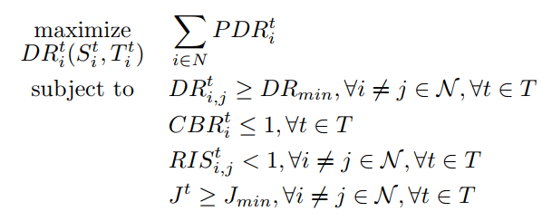

Rewritten problem statement
The goal is to adjust the number of messages that transmit from $N$ vehicles or the time interval for maximizing packet delivery rate of each vehicle ${PDR}_{i}^{t}$. This target is equal to the objective of the following optimization problem function
Where $J_{min}$ is the minimum Jain’s fairness index value.
(7)
Update this constraint

Slide 38
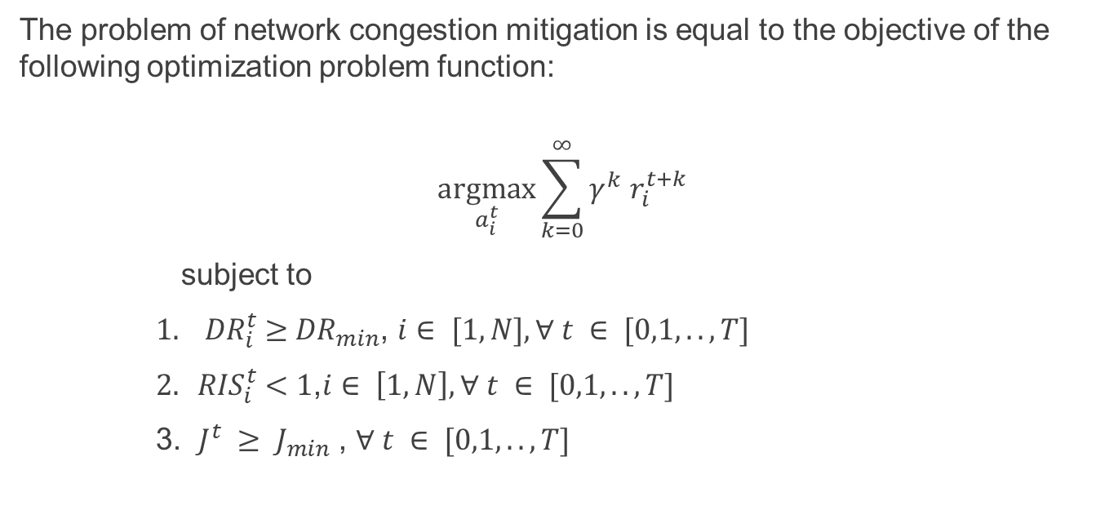
Updated Deep Reinforcement Learning
The problem of network congestion mitigation is equal to the objective of the following optimization problem function:
$$\underset{a_{i}^{t}}{argmax}{\sum_{k=0}^{∞}{γ^{k}}{ r}_{i}^{t+k}}$$
subject to
${ 1. DR}_{i}^{t} ≥$ ${DR}_{min}$, $i∈ [1,N], ∀ t ∈ [0,1,..,T]$
${ 2. RIS}_{i}^{t} <1$,$i∈ \left[1,N\right],∀ t ∈ [0,1,..,T]$
3. ${J^{t} ≥ J}_{min}$ , $∀ t ∈ [0,1,..,T]$
(8)
Update this constraint
where $r_{i}^{t}$ is the reward for the action $a_{i}^{t}$

Slide 39
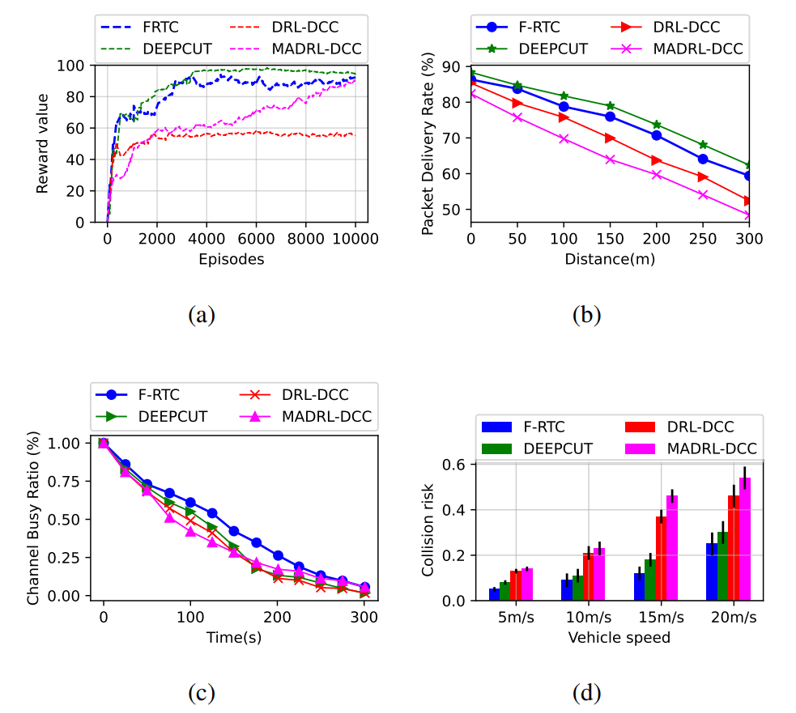
Some performance comparison (1/2)
F-RTC : Fairness Risk-based Transmission Control
Performance comparison
Reward accumulation
Packet Delivery Rate
Channel Busy Ratio
Collision risk

Slide 40
Some performance comparison (2/2)
F-RTC : Fairness Risk-based Transmission Control
F-RTC/DEEPCUT: 50-80ms
Others: 90-120ms
Shorter time interval is better

