Slide 1
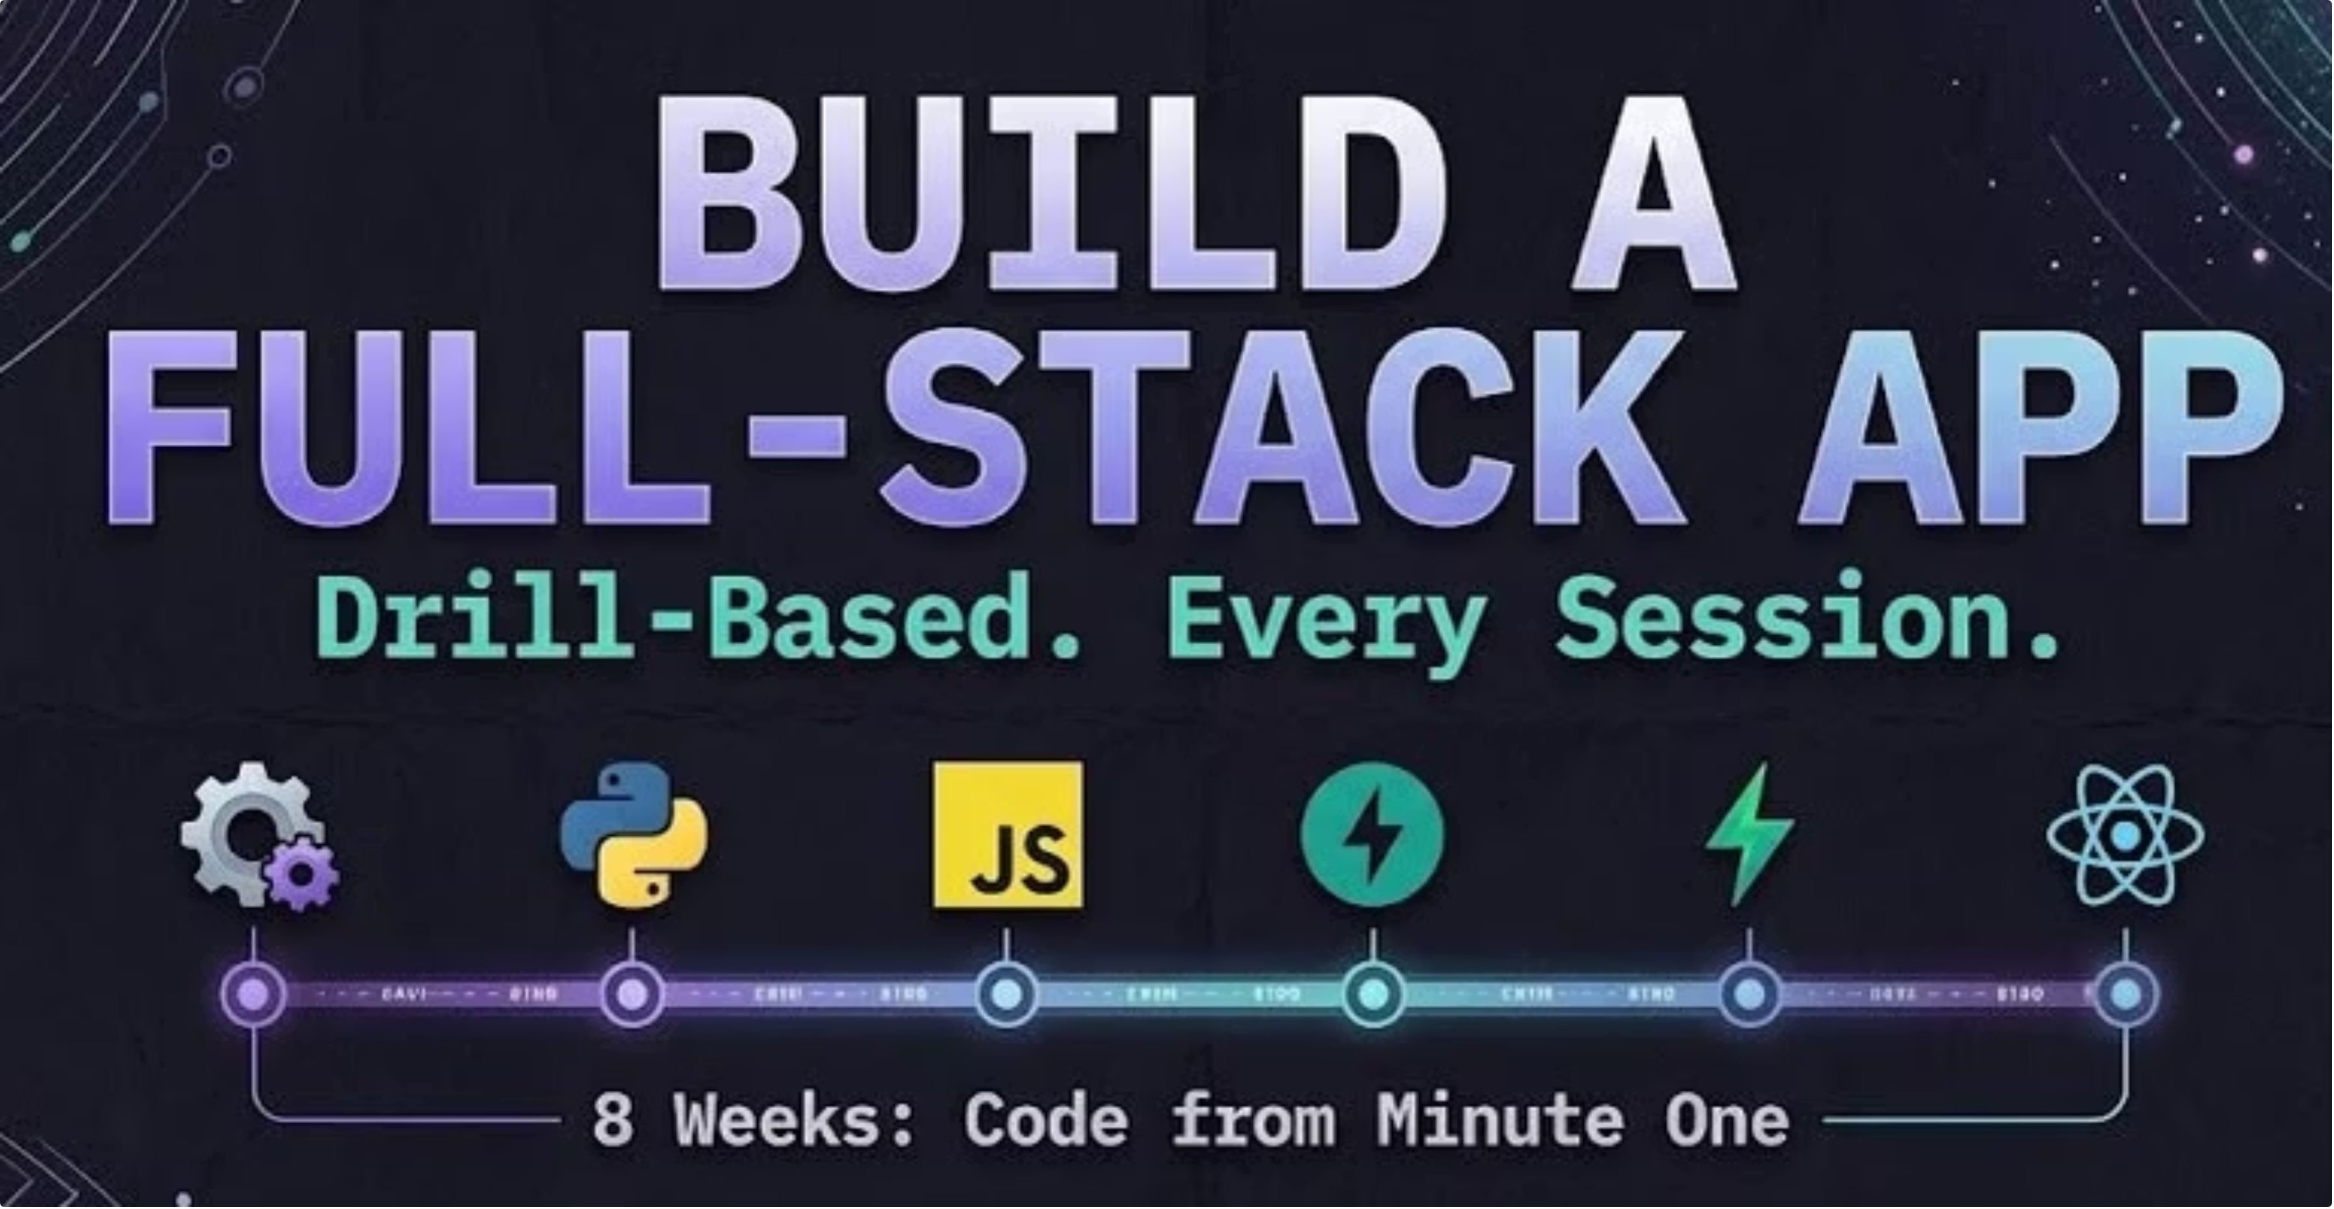
1
Notes:
Welcome everyone. BFA stands for Build Full Stack Application.

Slide 2
The 8-week roadmap
Setup & Tooling
HTML, CSS & Vanilla JS
1
Complete
5
Python Fundamentals
React, Rebuilt
2
Complete
6
JavaScript Fundamentals
Full-Stack Integration
3
You are here
7
Backend with FastAPI
Capstone & Demo Day
4
8
2

Slide 3
CLASS 3
JavaScript on the web,
browser and Node
Browser · DevTools · Console · Node.js · npm
Hands-on course. No slides to memorize, just tasks to do.
3
Notes:
Welcome back. Python gave us the programming basics. Today we do not relearn loops and functions in JavaScript. We look at the platform: where JavaScript runs, how to use the browser Console and DevTools, and what Node.js and npm are.

Slide 4
Today's plan
1
2
3
4
5
Where JS runs
DevTools
JS in a page
Node and npm
Practice
HTML, CSS, JS, browser vs Node
Console, Elements, Network
script tag, DOM, events
Run files, install packages
Python ideas in Console and Node
Green = platform ideas. Blue = we practise.
4
Notes:
Roughly: 10 min recap and setup check, 25 min browser and DevTools, 25 min JS in a page and Node, break in the middle, 10 min homework walkthrough.

Slide 5
Setup check (minute 0)
DevTools opens in Chrome or Edge
1
Mac: Cmd + Option + I. Windows: F12
Node works
2
node --version (same on Mac and Windows)
You can run a file
3
Save console.log("Hello") in a .js file, run: node file.js
Stuck? Fix it now, before we start.
5

Slide 6
1. What is on a web page
HTML is the structure
<h1>Hello</h1>
<style>
h1 { color: red; }
</style>
<script>
alert("Hi from JS");
</script>
CSS is the look
JavaScript is the behaviour
Every website uses all three
Files: lecture/01_html_css_js/
6

Slide 7
2. One language, two places
Browser
Node.js
Runs inside a web page
Has: document, window
Can change the page
Cannot read your files
Used for: websites
Run it: open an .html file
Runs in your terminal
Has: fs, process, require
No page, no document
Can read and write files
Used for: servers, tools
Run it: node file.js
Same language, different built-in tools. | File: lecture/02_browser_vs_node/
7
Notes:
Both use the V8 engine. The language is the same, but each place gives you different built-in objects.

Slide 8
3. Python to JavaScript
Python
JavaScript
name = "Asha"
if age >= 18:
print("Adult")
for i in range(3):
print(i)
def add(a, b):
return a + b
const name = "Asha";
if (age >= 18) {
console.log("Adult");
}
for (let i = 0; i < 3; i++) {
console.log(i);
}
function add(a, b) {
return a + b;
}
Run: python3 example.py (Win: python), node example.js | Files: lecture/03_python_to_js/
8
Notes:
Do not teach this slide line by line. It is a translation table students use when porting their Python. Also mention: or is ||, not is !, elif is else if, f-string is a backtick template string, list is array, dict is object.

Slide 9
4. Opening DevTools
Mac and Windows use different keys
Elements page HTML and CSS
Console run JS, logs, errors
Sources files and debugger
Network every request made
# Mac: Cmd + Option + I
# Windows: F12 or Ctrl + Shift + I
Or right-click a page, then Inspect
Works in Chrome, Edge and Firefox
Four panels matter most today
File: lecture/04_devtools/
9

Slide 10
5. The Console
Type JavaScript, press Enter
> 2 + 3
5
> document.title
'Wikipedia'
> console.log("hi")
hi
> console.error("oops")
> nope
ReferenceError: nope is not defined
console.log, warn and error print here
Red errors show the file and line
Up arrow repeats the last command
File: lecture/05_console/
10

Slide 11
Live practice 1: Console explorer
Uses: DevTools · the Console · document
Open any website, then open DevTools
> document.title
'Wikipedia, the free
encyclopedia'
> h = document.querySelector("h1")
> h.textContent = "Hello BFA"
'Hello BFA'
Run document.title in the Console
Change the main heading text
Refresh: your change is gone. Why?
File: live-practice/01_console_explorer.md
11

Slide 12
Q&A

Slide 13
6. Elements and Network
Elements: click, edit HTML and CSS live
Method URL Status
GET /index.html 200
GET /style.css 200
GET /app.js 200
GET /api/user 404
# Browser asks, server answers
# Class 4 builds the server
Edits are local: refresh and they vanish
Network: each row is one request
Status 200 is OK, 404 is not found
File: lecture/06_network/
13

Slide 14
7. JavaScript in a page
index.html
app.js
<h1>My page</h1>
<button id="btn">Click</button>
<p id="out"></p>
<script src="app.js">
</script>
console.log("app.js loaded");
// document is the whole page
console.log(document.title);
// open the page, look in Console
Script last, so the page exists first. | Files: lecture/07_js_in_a_page/
14

Slide 15
8. The DOM: the page as objects
DOM = the page as JS objects
// find
document.getElementById("title")
document.querySelector(".item")
document.querySelectorAll(".item")
// change
title.textContent = "Hello";
// react
btn.addEventListener("click", fn)
Find: getElementById, querySelector
textContent reads and changes text
addEventListener reacts to clicks
Files: lecture/08_dom/
15
Notes:
Only a taste. Students paste these into the Console on any site. Class 5 builds real pages with HTML, CSS and vanilla JS.

Slide 16
Live practice (optional): Tiny page
Uses: HTML · script tag · getElementById · textContent · events
index.html: a heading and a button, each with an id
I love pizza [ Change it ]
(click the button)
I love pasta too
# Open the file in the browser
# Mac: open index.html
# Windows: start index.html
app.js: get the heading by its id
app.js: on button click, change the heading text
Open index.html in the browser, click
File: live-practice/02_tiny_page_optional/
16

Slide 17
Q&A

Slide 18
9. Node.js runs JS on your laptop
Node runs JavaScript in the terminal
# run a file (Mac and Windows)
node hello.js
# or type JS live (REPL)
node
> 2 + 3
5
> .exit
Same engine as Chrome (V8)
node alone opens a REPL: .exit to quit
No document or window in Node
Files: lecture/09_node/
18

Slide 19
Live practice 2: Even numbers in Node
Uses: Python to JS · Node · functions · loops
Port is_even(n) to isEven(n)
# same on Mac and Windows
$ node 02_even_numbers.js
2
4
6
8
10
Set const limit = 10 at the top
Loop 1 to limit, print each even number
Run it: node 02_even_numbers.js
File: live-practice/02_even_numbers.js
19

Slide 20
10. npm and packages
npm downloads code other people wrote
npm init -y
npm install dayjs
// app.js
const dayjs = require("dayjs");
const today = dayjs();
console.log(today.format("MMM D"));
package.json lists what your project uses
node_modules is the download folder
Never push node_modules (.gitignore)
File: lecture/10_npm/app.js
20

Slide 21
Live practice 3: npm and React
Uses: npm --version · npm init -y · npm create vite
Check npm exists: npm --version
# same on Mac and Windows
$ npm --version
10.x.x
$ npm init -y
$ npm create vite@latest my-react-app
-- --template react
$ cd my-react-app
$ npm install
$ npm run dev
Local: http://localhost:5173/
Make a folder, then run npm init -y
Create the React app with npm create vite
cd in, npm install, npm run dev
File: live-practice/03_npm_react_setup.md
21

Slide 22
Homework
Multiplication table
1
Print a table from 1 to 10 with a for loop
Temperature converter
2
A function that returns Fahrenheit, then Hot or not
Guess the number
3
Loop until the guess is right, count the tries
Python tasks from Class 2, now in JavaScript. Run each with node.
22

Slide 23
Homework 4: A small site
Uses: HTML · CSS · JavaScript · the DOM · events
Three files: index.html, style.css, script.js
Change title -> heading changes
+1 slice -> number goes up
Dark mode -> colours switch
Greet me -> Hello, Asha!
Empty input -> Please type your name
A heading, a paragraph and a Change title button
A counter button and a dark mode button
An input and a Greet me button
File: homework/04_interactive_site/
23

Slide 24
Q&A

Slide 25
The 8-week roadmap
Setup & Tooling
HTML, CSS & Vanilla JS
1
Complete
5
Python Fundamentals
React, Rebuilt
2
Complete
6
JavaScript Fundamentals
Full-Stack Integration
3
Complete
7
Backend with FastAPI
Capstone & Demo Day
4
Next Class
8
25

Slide 26
Thank you

