Slide 1
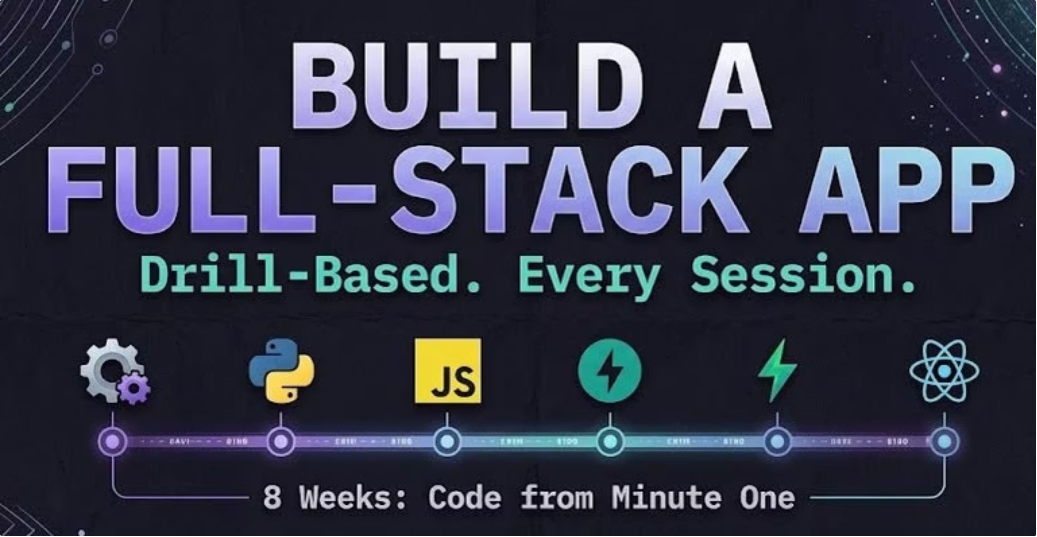
1
Notes:
Welcome everyone. BFA stands for Build Full Stack Application.

Slide 2


Your instructors
Raji RV
Faisal K
AI – FDE · IBM
AI – FDE
Enterprise AI & Agentic Systems
Full-stack developer
From Prototype to Production
Software engineer (SDE)
Leading Women 2026
AI engineer
2

Slide 3
The 8-week roadmap
Setup & Tooling
HTML, CSS & Vanilla JS
1
Complete
5
Python Fundamentals
React, Rebuilt
2
Complete
6
JavaScript Fundamentals
Full-Stack Integration
3
Complete
7
Backend with FastAPI
Capstone & Demo Day
4
You are here
8
3

Slide 4
CLASS 4
Backend with
FastAPI
Client · Server · API · JSON · FastAPI · CRUD
Hands-on course. No slides to memorize, just tasks to do.
4

Slide 5
Today's plan
1
2
3
4
5
Big picture
First API
Inputs
To-do API
With AI
Frontend, backend, API
Install, run, routes
URL values and POST
List, add, delete, /docs
A page calls it, build with AI
Green = backend ideas. Blue = we practise.
5

Slide 6
Setup check (minute 0)
Python works
1
python3 --version (Windows: python --version)
pip works
2
pip3 --version (Windows: pip --version)
FastAPI is installed
3
pip install "fastapi[standard]", then fastapi --version
Stuck? Fix it now, before we start.
6

Slide 7
1. The big picture
Frontend: what the user sees (React)
Browser page (React)
| asks: GET /tasks
v
Server (FastAPI, Python)
| reads and saves
v
Database (later)
{"id": 1, "title": "Buy milk"}
Backend: the server and the rules (FastAPI)
Database: where data is kept (later)
An API is the menu between them, in JSON
Files: lecture/01_client_server_api/
7

Slide 8
1b. What is an API, and why?
An API lets one system talk to another
1. JSONPlaceholder (no key)
GET https://jsonplaceholder
.typicode.com/posts/1
2. NewsData.io (free key)
GET https://newsdata.io/api/1/latest
?apikey=YOUR_API_KEY
Why: reuse data and services (news, maps)
Test any API in Postman or Talend API Tester
Try the two free sample APIs on the right
Postman app, or Talend API Tester (Chrome extension). Files: lecture/01b_what_is_an_api/
8

Slide 9
1b. Real world: a news website
API response (JSON)
What the frontend shows
{
"results": [
{
"title": "City opens
new library",
"description": "The new
library has...",
"image_url": "https://...",
"link": "https://..."
}, ...
]
}
[ picture from image_url ]
City opens new library
(title, a heading)
The new library has...
(description, a paragraph)
Read more (link)
...one card per article
Example data. The frontend loops over results and draws one card for each article.
9

Slide 10
2. Setup: install FastAPI
Install FastAPI once, for the whole laptop
# Install (once)
# Mac
pip3 install "fastapi[standard]"
# Windows
pip install "fastapi[standard]"
# Check
fastapi --version
# Run, in the file's folder
fastapi dev main.py
No venv to create or activate
Then in any folder: fastapi dev file.py
Not found? python -m fastapi dev file.py
Same list in class-4/requirements.txt. Files: lecture/02_setup/
10

Slide 11
3. Your first API
main.py
Browser
from fastapi import FastAPI
app = FastAPI()
@app.get("/")
def home():
return {"message":
"Hello from my first API"}
@app.get("/about")
def about():
return {"course": "BFA"}
GET /
{"message":"Hello from my
first API"}
GET /about
{"course":"BFA"}
GET /nope
{"detail":"Not Found"}
Run: fastapi dev main.py | Docs: /docs | Files: lecture/03_hello_api/
11

Slide 12
Live practice 1: Hello API
Uses: FastAPI app · @app.get · a route · JSON
Create 01_hello_api.py with app = FastAPI()
$ fastapi dev 01_hello_api.py
/
{"message":"Hello, API"}
/nothing
{"detail":"Not Found"}
Add ONE route: GET /
It returns {"message": "Hello, API"}
Run it, open / and then /docs
File: live-practice/01_hello_api.py
12

Slide 13
4. Path and query parameters
Path parameter: after a /, written {name}
/greet/Asha
^ path parameter
name = Asha
/ticket-price?age=20&student=true
^ query parameters
age = 20
student = true
Query parameter: after the ?, as key=value
More than one? Join them with &
Each one reaches the function as an argument
Path = which thing. Query = options and filters. Files: lecture/04_path_and_query/
13

Slide 14
4. Values in the URL: the code
main.py
URLs
@app.get("/greet/{name}")
def greet(name: str):
return {"message":
f"Hello, {name}!"}
@app.get("/ticket-price")
def ticket_price(age: int,
student: bool = False):
...
/greet/Asha
name = Asha (path)
/ticket-price?age=20&student=true
age = 20, student = true
(query)
/ticket-price?age=old
an error message
The argument name in the function matches the name in the URL. Files: lecture/04_path_and_query/
14

Slide 15
Live practice 2: Ticket price API
Uses: query parameters · type hints · default values · if / elif
Route GET /ticket-price
/ticket-price?age=20&student=true
{"age":20,"student":true,
"price":10}
/ticket-price?age=3
{"age":3,"student":false,
"price":0}
/ticket-price gives 422
Query parameters: age (int), student (bool)
Under 5: $0. 5 to 12, or 65 and over: $8
A student: $10. Everyone else: $12
File: live-practice/02_ticket_price_api.py
15

Slide 16
Q&A

Slide 17
5. Sending data with POST
GET asks for data. POST sends data to save
class Item(BaseModel):
name: str
price: float
@app.post("/items")
def add_item(item: Item):
return {"message":
f"Added {item.name}",
"price": item.price}
The data travels as JSON in the body
A model class is the form: fields and types
Test POST in /docs, not in the address bar
Files: lecture/05_post_and_models/
17

Slide 18
6. A to-do API
GET /tasks reads tasks.json
def load_tasks():
with open("tasks.json") as f:
return json.load(f)
def save_tasks(tasks):
with open("tasks.json", "w") as f:
json.dump(tasks, f, indent=2)
@app.get("/tasks")
def list_tasks():
return load_tasks()
POST /tasks adds a task and saves the file
DELETE /tasks/{id} removes one and saves
Open tasks.json and watch it change
Load, change, save. The data stays after a restart. Files: lecture/06_todo_crud/
18

Slide 19
6. File or variable?
JSON file (tasks.json)
Variable (a list)
@app.post("/tasks")
def add_task(body: NewTask):
tasks = load_tasks()
...
tasks.append(task)
save_tasks(tasks)
return task
Kept after a restart
tasks = [
{"id": 1, ...},
{"id": 2, ...},
]
@app.post("/tasks")
def add_task(body: NewTask):
...
tasks.append(task)
return task
Lost after a restart
Same API, only where the data lives changes. Files: lecture/06_todo_crud/ and in_memory/
19

Slide 20
Live practice 3: Books API
Uses: GET · POST · a model class · a list in memory
Keep the books list in memory (given)
GET /books
[{"id":1,"title":"Dune",...},
{"id":2,...}]
POST /books
{"title":"Emma",
"author":"Jane Austen"}
{"id":3,"title":"Emma",...}
Make a model class BookIn: title, author
GET /books returns the whole list
POST /books adds a book and returns it
File: live-practice/03_books_api.py
20

Slide 21
7. The /docs page
/docs is built from your code, for free
127.0.0.1:8000/docs
GET /tasks Try it out
POST /tasks Try it out
DELETE /tasks/3 Try it out
200 OK
404 Not Found
Try it out, fill in, Execute
Read the answer and its status code
Use it to test code that AI writes for you
Files: lecture/07_swagger_docs/
21

Slide 22
8. Calling the API from a page
main.py (copy this)
index.html (fetch)
app.add_middleware(
CORSMiddleware,
allow_origins=["*"],
allow_methods=["*"],
allow_headers=["*"],
)
const res = await fetch(
"http://127.0.0.1:8000/tasks");
const tasks = await res.json();
await fetch(API + "/tasks", {
method: "POST",
headers: {"Content-Type":
"application/json"},
body: JSON.stringify(
{ title: input.value }),
});
Copy the CORS block into any API a page will call. Tasks are saved in tasks.json. Files: lecture/08_fetch_from_a_page/
22

Slide 23
Q&A

Slide 24
9. Building with AI
Say what you want, in plain words
Prompt:
"Here is my FastAPI file.
Add GET /notes/count that
returns how many notes
there are, like
{"count": 2}. Keep the
code simple."
Ask for one small change at a time
Run it, test it in /docs
Paste the full error back to the AI
Always read what AI wrote. Files: lecture/09_build_with_ai/
24

Slide 25
Homework
Even numbers API
1
GET /is-even/{n} and GET /evens/{limit}
Temperature API
2
?celsius= returns Fahrenheit and Hot, Nice or Cold
Notes API
3
List, add and delete notes (GET, POST, DELETE)
Python tasks from Class 2, now as APIs. Run with fastapi dev, test in /docs.
25

Slide 26
Q&A

Slide 27
The 8-week roadmap
Setup & Tooling
HTML, CSS & Vanilla JS
1
Complete
5
Next Class
Python Fundamentals
React, Rebuilt
2
Complete
6
JavaScript Fundamentals
Full-Stack Integration
3
Complete
7
Backend with FastAPI
Capstone & Demo Day
4
Complete
8
27

Slide 28
Thank you

