Slide 1
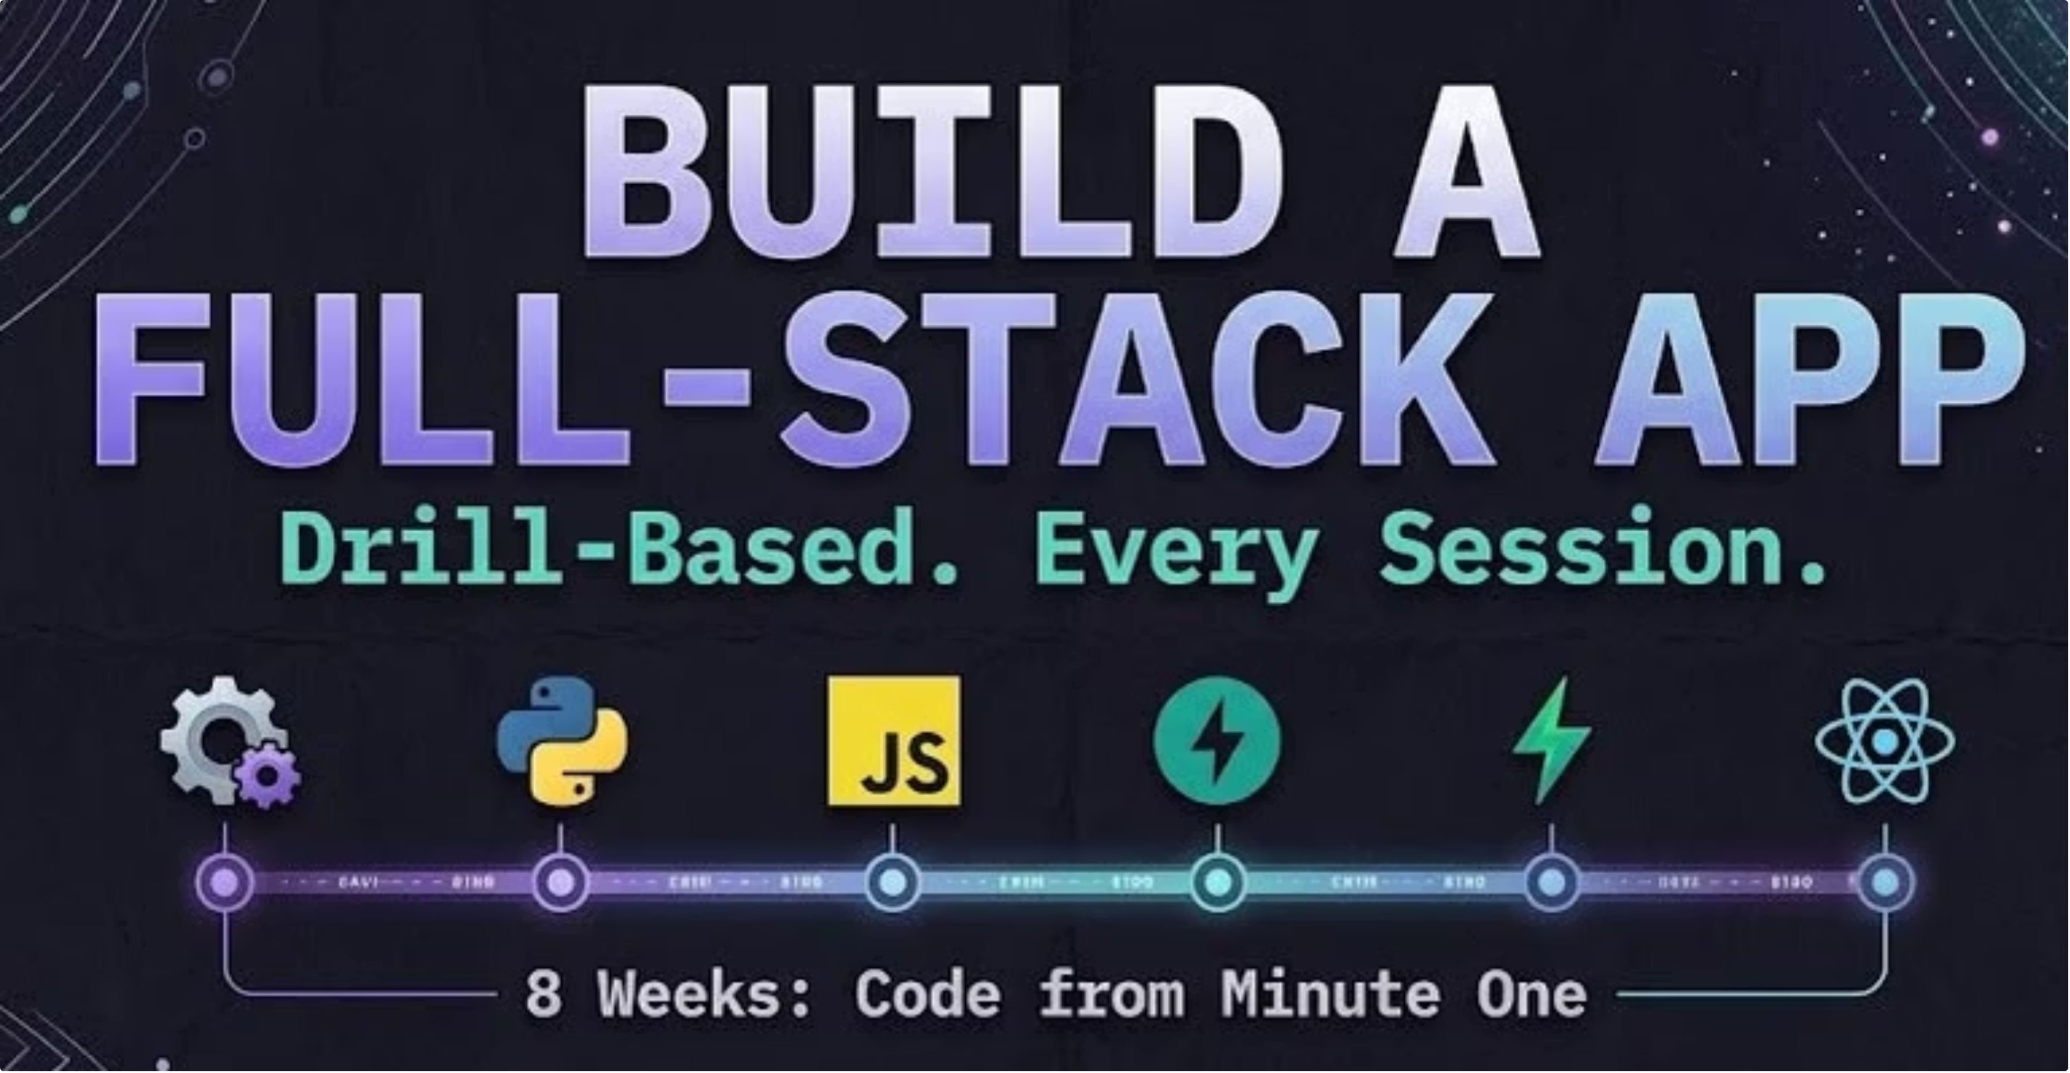
1
Notes:
Welcome everyone. BFA stands for Build Full Stack Application.

Slide 2
Introduction

Slide 3

Your instructor: Raji RV
AI Forward Deployed Engineer
1
Enterprise AI & Agentic Systems
2
From Prototype to Production
Raji RV
3
Leading Women 2026
AI – FDE · IBM
3
Notes:
Introduce Raji. Details come from her profile headline.

Slide 4

Your instructor: Faisal K
Previously worked as
Full-stack developer
1
Built web apps end to end, front end to back end.
Software engineer (SDE)
2
Shipped and maintained production software.
Faisal K
AI engineer
3
Built AI-powered features and systems.
AI – FDE
4
Notes:
Introduce yourself. Mention you have worked across full stack, SDE and AI roles, so you know what the industry expects.

Slide 5

About this course
How the course goes
What it is
A hands-on, task-based course
Learn by doing, not by watching slides
No programming experience needed
Includes working with modern tools, including AI
Live class
1
You code alongside the instructor
After-class tasks
2
Finish more tasks on your own
Submit
3
Push your work to your GitHub repo
Kick start your github portfolio to showcase!!
5
Notes:
Explain what BFA is in your own words here. Hands-on, no prior experience needed, everything lives in one repository.

Slide 6
The 8-week roadmap
1
Setup & Tooling
You are here
5
HTML, CSS & Vanilla JS
2
Python Fundamentals
6
React, Rebuilt
3
JavaScript Fundamentals
7
Full-Stack Integration
4
Backend with FastAPI
8
Capstone & Demo Day
6
Notes:
Today is Week 1: setup and the start of Python. Next lecture is Week 2: Python Fundamentals. The course ends with a capstone and demo day.

Slide 7
CLASS 1
Set up your computer,
then write your first code
Git and GitHub · Node.js · Python · VS Code
Hands-on course. No slides to memorize, just tasks to do.
7
Notes:
Welcome everyone. Today we get every laptop ready, then write our first Python.

Slide 8
Today's plan
1
2
3
4
5
Git and GitHub
Install tools
Verify
Write Python
Homework
What they are, account, fork, clone
Node.js, Python, VS Code
Run check_setup.py
Live coding together
Practice problems
Green = setup (before we code). Blue = coding.
9
Notes:
Roughly: 45-60 min setup, 10 min break/checkpoint, 45 min coding, 5 min homework.

Slide 9
Git, GitHub and GitHub Desktop
Git
GitHub
GitHub Desktop
A tool on your laptop that records every version of your files. Like unlimited undo.
A website that stores your Git projects online. Your backup, and how you share work.
An app with buttons for Git. No commands to memorize.
Every developer uses Git. It is how teams work on the same code without overwriting each other.
10
Notes:
Analogy: Git is the save-game system on your laptop. GitHub is the cloud where saves live. GitHub Desktop is the friendly buttons.

Slide 10

How your copy of the course works
Course repo
Your fork
Your laptop
Original, on GitHub
Your copy, on GitHub
Cloned folder in VS Code
Fork
Clone
Your work goes into your copy. You can still pull updates from the original.
11
Notes:
Walk left to right. Original repo is ours. Fork is yours on GitHub. Clone puts it on the laptop.

Slide 11
Git in four words
Repository
Commit
Push
Pull
A project folder plus its full history. Also called a repo.
A save point with a short message, like "Add greeting function".
Upload your commits from your laptop to GitHub.
Download new commits from GitHub to your laptop.
Your daily loop: edit files → commit → push
12
Notes:
Use the save-game analogy. Repository = project folder with history. Commit = a save point. Push = upload saves. Pull = download others' saves.

Slide 12
Why developers use Git
Undo anything
Nothing gets lost
1
2
Every commit is a snapshot. Go back to any earlier version.
Your code lives on GitHub too, not just on one laptop.
Work together
Show your work
3
4
Many people change the same project without overwriting each other.
Your GitHub profile becomes your portfolio for clients and employers.
13
Notes:
Real-world: freelancers and teams both rely on this daily.

Slide 13

How teams work on GitHub
1
2
3
4
5
Branch
Commit
Pull request
Review
Merge
Your own safe copy of the project
Save your changes on the branch
Ask the team to add your work
Teammates read and comment
Your work joins main
main = the stable, shared version. branch = your own workspace.
In this course you use a fork and push to it. Later we will practise branches and pull requests.
14
Notes:
Main is the stable version. Nobody edits it directly. Each person works on a branch, then asks to merge with a pull request.

Slide 14


What branches look like
main
merge
merge
Priya's branch: login-page
Sam's branch: greeting-feature
Time →
Each dot is a commit. Each coloured line is a separate workspace.
15
Notes:
Point at the picture. Main is the stable line. Priya and Sam each branch off, commit on their own line, then merge back. Nobody breaks main while working.

Slide 15
How to read the branch picture
main
Branch
The stable, shared version of the project. It should always work.
A copy where you work freely. You cannot break main from here.
Commits
Merge
Save points on your branch. Make small ones as you go.
When the work is reviewed and ready, the branch joins main.
Priya and Sam work at the same time, and neither can break the other's work.
16
Notes:
Walk through the four ideas, then tell the story: Priya and Sam work at the same time without touching each other's files.

Slide 16
Good team habits (and merge conflicts)
Team habits
Merge conflict
Pull before you start working
Make small, frequent commits
Write clear commit messages
Never work directly on main
Ask for review before merging
Two people edited the same line. Git marks both versions and you choose what to keep.
<<<<<<< yours
print("Hello")
=======
print("Hi")
>>>>>>> theirs
17
Notes:
A merge conflict happens when two people edit the same lines. Git asks a human to decide. It is normal, not a disaster.

Slide 17
Q&A

Slide 18
Step 1: Create a GitHub account – 2 min
1
Open github.com/signup
Tip
Pick a username you are happy to show an employer or client later.
2
Sign up with your email and pick a username
3
Verify your email
4
Write down your username and password
Video: step 1 in the setup guide (docs/)
19

Slide 19
Step 2: Install GitHub Desktop – 2 min
1
Open desktop.github.com and download for your computer
2
Mac: unzip and drag to Applications. Windows: run the installer
3
Click Sign in to GitHub.com and authorize
4
Keep the name and email it suggests
Only need to sign in once.
20

Slide 20
Step 3: Fork and clone the course repo – 2 min
1
Open github.com/ccunnect-tech/BFA, click Fork, then Create fork
2
In GitHub Desktop: File, Clone Repository
3
Pick your fork on the GitHub.com tab
4
Choose a folder you will remember, click Clone
5
Choose "To contribute to the parent project"
Mac
Documents/course
Windows
Documents\course
21

Slide 21
Step 4: Install Node.js and npm – 2 min
1
Open nodejs.org, click the LTS button (not Current)
node --version
npm --version
2
Run the installer with default options
Expected:
v22.x.x
10.x.x
3
Close and reopen VS Code and your terminal
4
Check both versions
22
Notes:
Node runs JavaScript on your computer. We use it with React in later classes. npm comes with it.

Slide 22
Step 5: Install Python – 2 min
python.org/downloads, click the yellow Download button
Mac
Windows
Open the .pkg, keep defaults.
Then open Terminal.
Tick "Add python.exe to PATH"
before Install Now. Then open Command Prompt.
python3 --version
python --version
Expected: Python 3.12.x (or newer)
23
Notes:
Windows: the PATH checkbox is the number one cause of problems. Say it loudly.

Slide 23
Step 6: Install VS Code – 5 mins
1
Open code.visualstudio.com and download for your computer
Open Extensions
Mac: drag to Applications. Windows: run installer, tick Add to PATH
Mac
Cmd+Shift+X
2
Windows
Ctrl+Shift+X
3
Open VS Code
4
Extensions icon (left sidebar), search Python, install the one by Microsoft
24

Slide 24
Step 7: Run the setup check
1
GitHub Desktop: Open in Visual Studio Code
✅ Python 3.x.x
✅ Visual Studio Code installed
✅ VS Code Python extension
✅ GitHub Desktop installed
✅ git version 2.x.x
✅ Node.js v22.x.x
✅ npm 10.x.x
Setup complete!
2
Click Yes, I trust the authors
3
Terminal, New Terminal
4
Run the command, then screenshot the output
Mac
python3 check_setup.py
❌ must be fixed. ⚠ is optional.
Windows
python check_setup.py
25
Notes:
Everyone must show a screenshot of the output. Walk the room.

Slide 25
The 8-week roadmap
1
Setup & Tooling
Complete
5
HTML, CSS & Vanilla JS
2
Python Fundamentals
6
React, Rebuilt
Next Class
3
JavaScript Fundamentals
7
Full-Stack Integration
4
Backend with FastAPI
8
Capstone & Demo Day
26
Notes:
Today is Week 1: setup and the start of Python. Next lecture is Week 2: Python Fundamentals. The course ends with a capstone and demo day.

