Slide 1
Panel - Housing Affordability Is an Issue Everywhere: Why Are Housing Markets Becoming Less Elastic? 1) -Built Out Cities? a New Approach to Measuring Land Use Regulation -Paavo Monkkonen, Michael Manville, Michael Lens, UCLA 2) Monocentricity, Amenitized Land, and the Future of Housing Supply Channel Surfing: The Evolving Provision of New Housing Supply & Declining Elasticity -Clemens Pilgram, Christian L. Redfearn, USC 3) Why Are Housing Markets Becoming Less Elastic? - The Rising Barrier to Affordability: The Cost of Re-Development & the Effectiveness of New Supply Houston, You Have A Problem: How Large Cities Accommodate More Housing -Anthony W. Orlando, Christian L. Redfearn, Cal State Pamona, USC
Discussant: Chris Cunningham, Federal Reserve Bank of Atlanta*
*All views expressed are my own and do not reflect those of the Federal Reserve Bank of Atlanta or the Federal Reserve System

Slide 2
Panel - Housing Affordability Is an Issue Everywhere: Why Are Housing Markets Becoming Less Elastic? 2) Monocentricity, Amenitized Land, and the Future of Housing Supply Channel Surfing: The Evolving Provision of New Housing Supply & Declining Elasticity -Clemens Pilgram, Christian L. Redfearn, USC 3) Why Are Housing Markets Becoming Less Elastic? - The Rising Barrier to Affordability: The Cost of Re-Development & the Effectiveness of New Supply Houston, You Have A Problem: How Large Cities Accommodate More Housing -Anthony W. Orlando, Christian L. Redfearn, Cal State Pamona, USC 1) Built out Cities? a New Approach to Measuring Land Use Regulation -Paavo Monkkonen, Michael Manville, Michael Lens, UCLA
Discussant: Chris Cunningham, Federal Reserve Bank of Atlanta*
*All views expressed are my own and do not reflect those of the Federal Reserve Bank of Atlanta or the Federal Reserve System

Slide 3
Overview of: Monocentricity, Amenitized Land, and the Future of Housing Supply Channel Surfing: The Evolving Provision of New Housing Supply & Declining Elasticity
Document where (what types of neighborhoods) are accommodating new housing production over time
Create boundary consistent over time block groups
Identify employment clusters and specific industrial block group based on industry employment
Provides a Taxonomy of Neighborhoods
Exurban
Suburban Residential
Urban Residential
Postindustrial
Incorporates access to amenities (non-chain restaurants) beyond usual monocentric (CBD anchored) framework

Slide 4
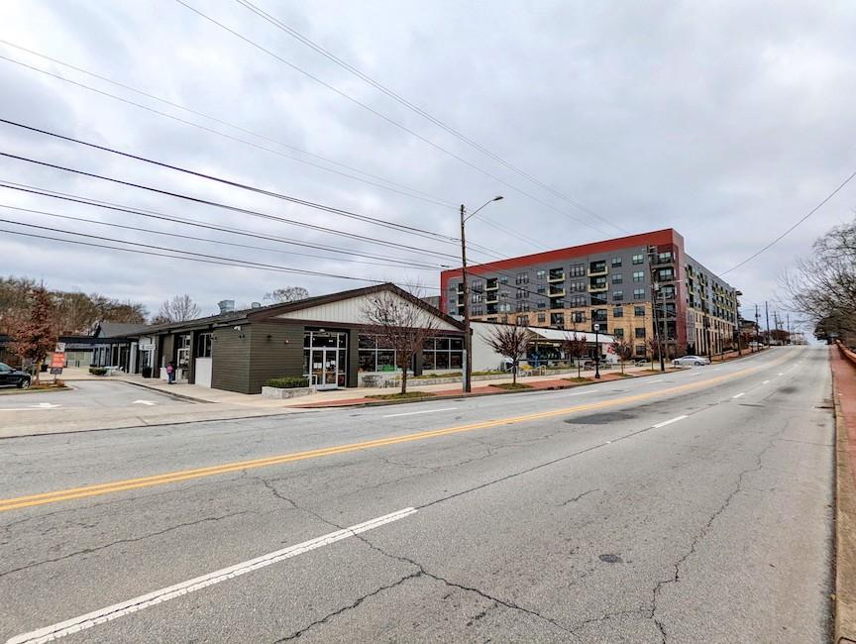
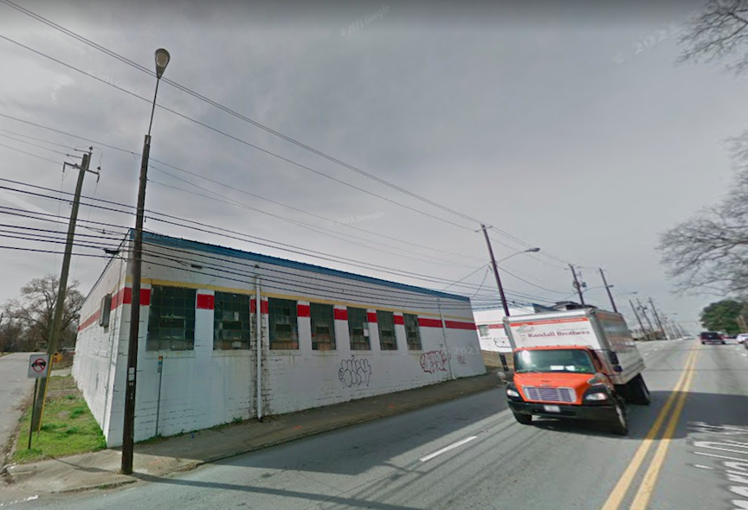
Was it post-industrial or was the land bid away from industry because we could densify existing residential
“potentially due to fewer land assemblage issues”? Or… fewer incumbent homeowners to oppose?

Slide 5
Findings: Monocentricity, Amenitized Land, and the Future of Housing Supply Channel Surfing: The Evolving Provision of New Housing Supply & Declining Elasticity
In major metros, most growth still occurring in exurban locations
Ex: In Atlanta, between 2010-2020, 165K new “exurban” units, only, 12K and 25K new units in “urban residential” and “postindustrial”, respectively
Exurban growth slowing, denser areas getting more growth
Average of Table 1
Exurban (<2 units/acre) Suburban (2-6 units/acre) Urban (>6 units/acre) Postindustrial
 | 2000-10 | 2010-20 | 2000-10 | 2010-20 | 2000-10 | 2010-20 | 2000-10 | 2010-20
Avg. | 36.7% | 16.2% | 3.9% | 3.4% | 0.1% | 4.6% | 8.3% | 20.4%

Slide 6

Next steps:
Summary table showing share of land within the MSA by typology
A table to summarize findings across major MSAs
Share of all unit growth captured by each topology
You’ve got the LODES and amenity access isochrones, maybe look at housing+transportation costs?

Slide 7
Overview of: Houston, You Have A Problem: How Large Cities Accommodate More Housing
Land price
D²
D¹
What if supply elasticity is less about regulation and mostly just a function of the remaining accessible green space?
0
Distance from CBD
Density
frictionless density
D²
D¹
ossified density
net housing growth
0
Distance from CBD

Slide 8
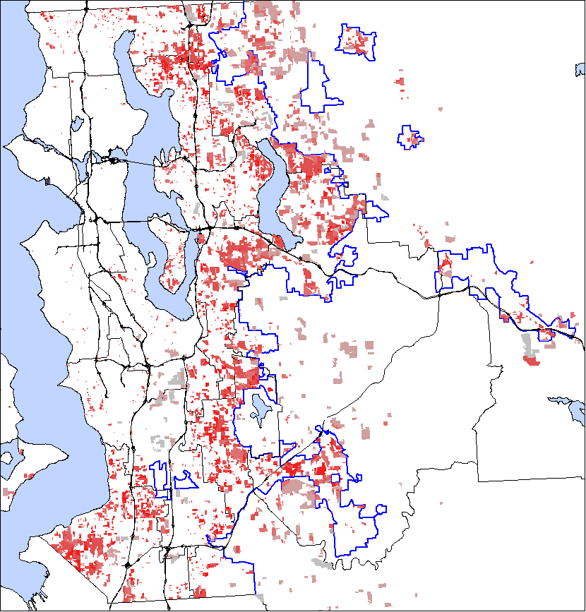
Seattle Density of Newly Permitted Subdivisions 1965-2005
Zoning Constraints on Density
Minimum lot size
FAR
Number of multifamily units on a lot
Non-Zoning Constraints on Density
Demolition existing structures and re-construction
Land Assembly
Rising construction cost with density
2002 lot lines
Successful Assembly
2007 lot lines

Slide 9
What if CA is just got built out first?
Houston, 2000
Houston
Land Supply Elasticities
2000
S.F.
Dallas

Slide 10
Findings
Transitions to more dense urban forms?
Not really, but less rural to exurban/suburban

Slide 11
Findings
California
Transitions to more dense urban forms?
Not really, but less rural to exurban/suburban
Texas

Slide 12
Overview of: Built Out Cities? A New Approach to Measuring Land Use Regulation Why Are Housing Markets Becoming Less Elastic? - Built out Cities? a New Approach to Measuring Land Use Regulation -Paavo Monkkonen, Michael Manville, Michael Lens, UCLA
Use an existing planning/coordination tool that requires cities to document their “buildable land capacity” as another measure of the supply restriction.
Compare to other measures of zoning restriction or veto-points in the development process.
Merits include mandate and the universal participation in CA, and less likely to have erroneous answers.

Slide 13

What does “unbuilt capacity” really capture?
It doesn’t seem to account for land area, vacant land or viability of development
Ratio of unbuilt capacity to allocated minium?
Perhaps create a synthetic allocation rule and then compare a city’s unbuilt capacity number to this baseline?
Just because you’re captured by NIMBYs doesn’t mean you can (profitably) build more housing

Slide 14
Econometric Specification:
Permits 2014-2019_{j} = α + β1(ln(Rent_{j})) + β2Reg_{j} + β3City_{j} + β4Dem_{j} + Metro_{m} + e
All permits,
multifamily
process complexity, # prohibitions,
“unbuilt capacity”
City chars
MSA FEs
We’re running this regression because we think small changes in units (y) are the cause of high rent
What is the appropriate denominator for unbuilt capacity? Is it the existing stock?

Slide 15
Findings
Unbuilt capacity more predictive of new construction than more conventional measures
Also just for MF
Not sure how to interpret the interaction specs.

