Slide 1



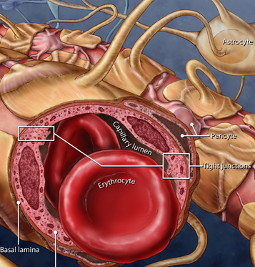
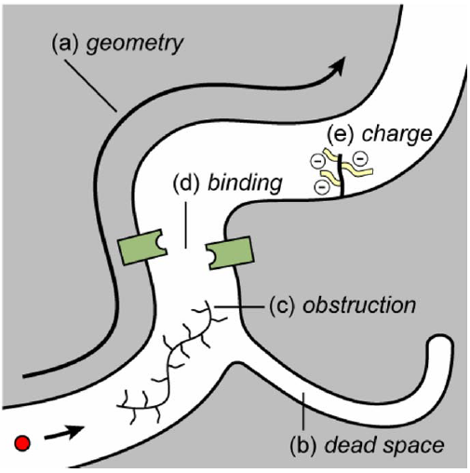
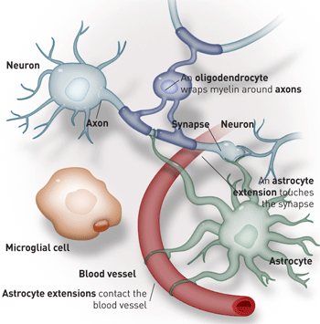
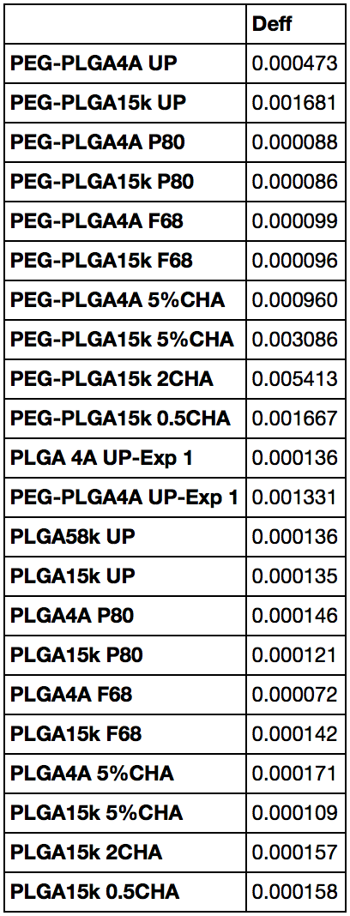
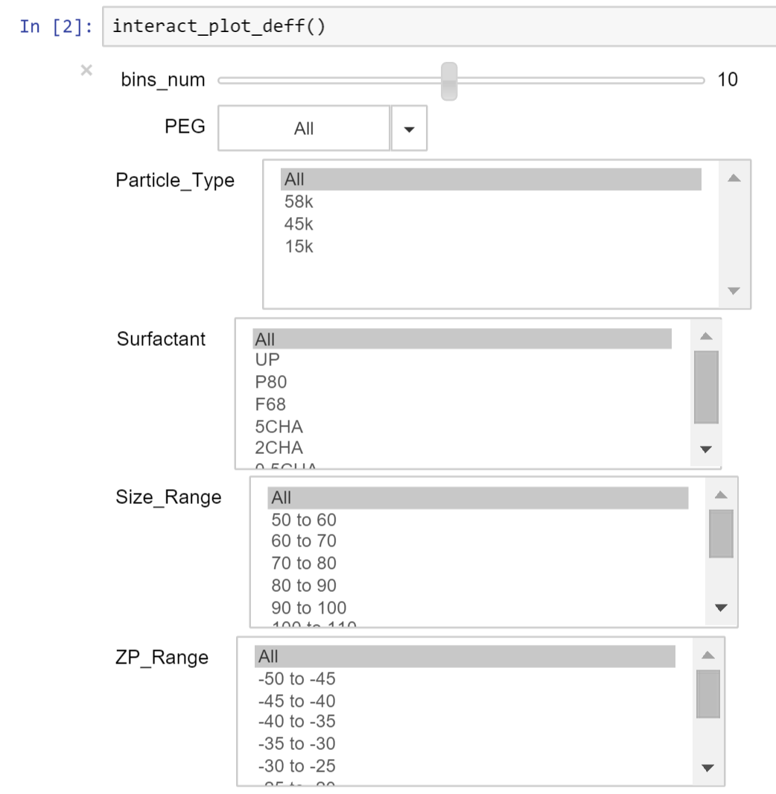
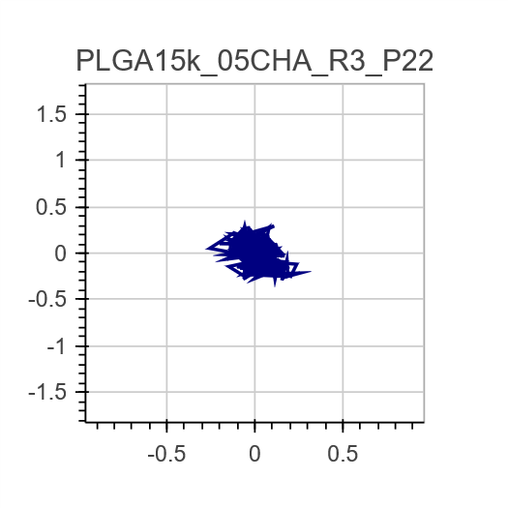
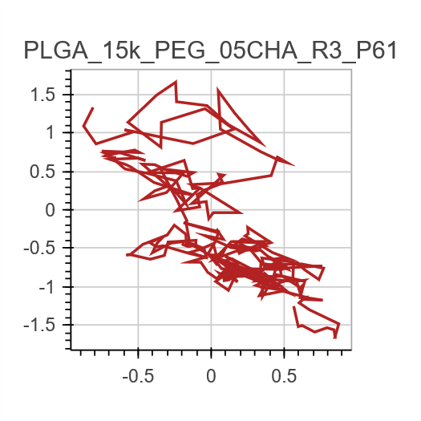
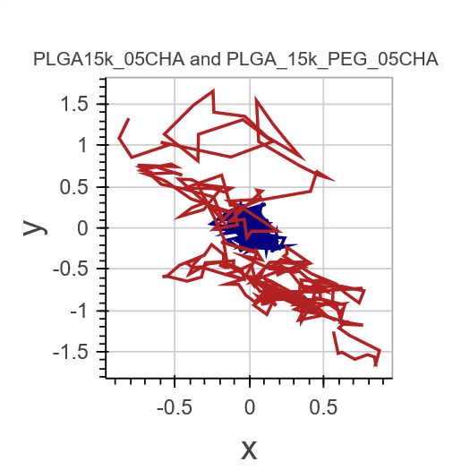
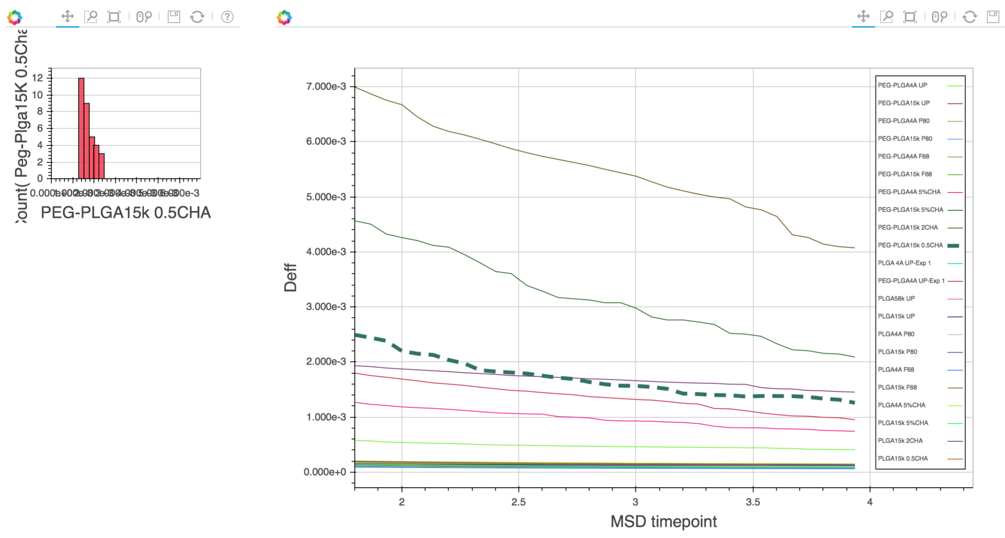
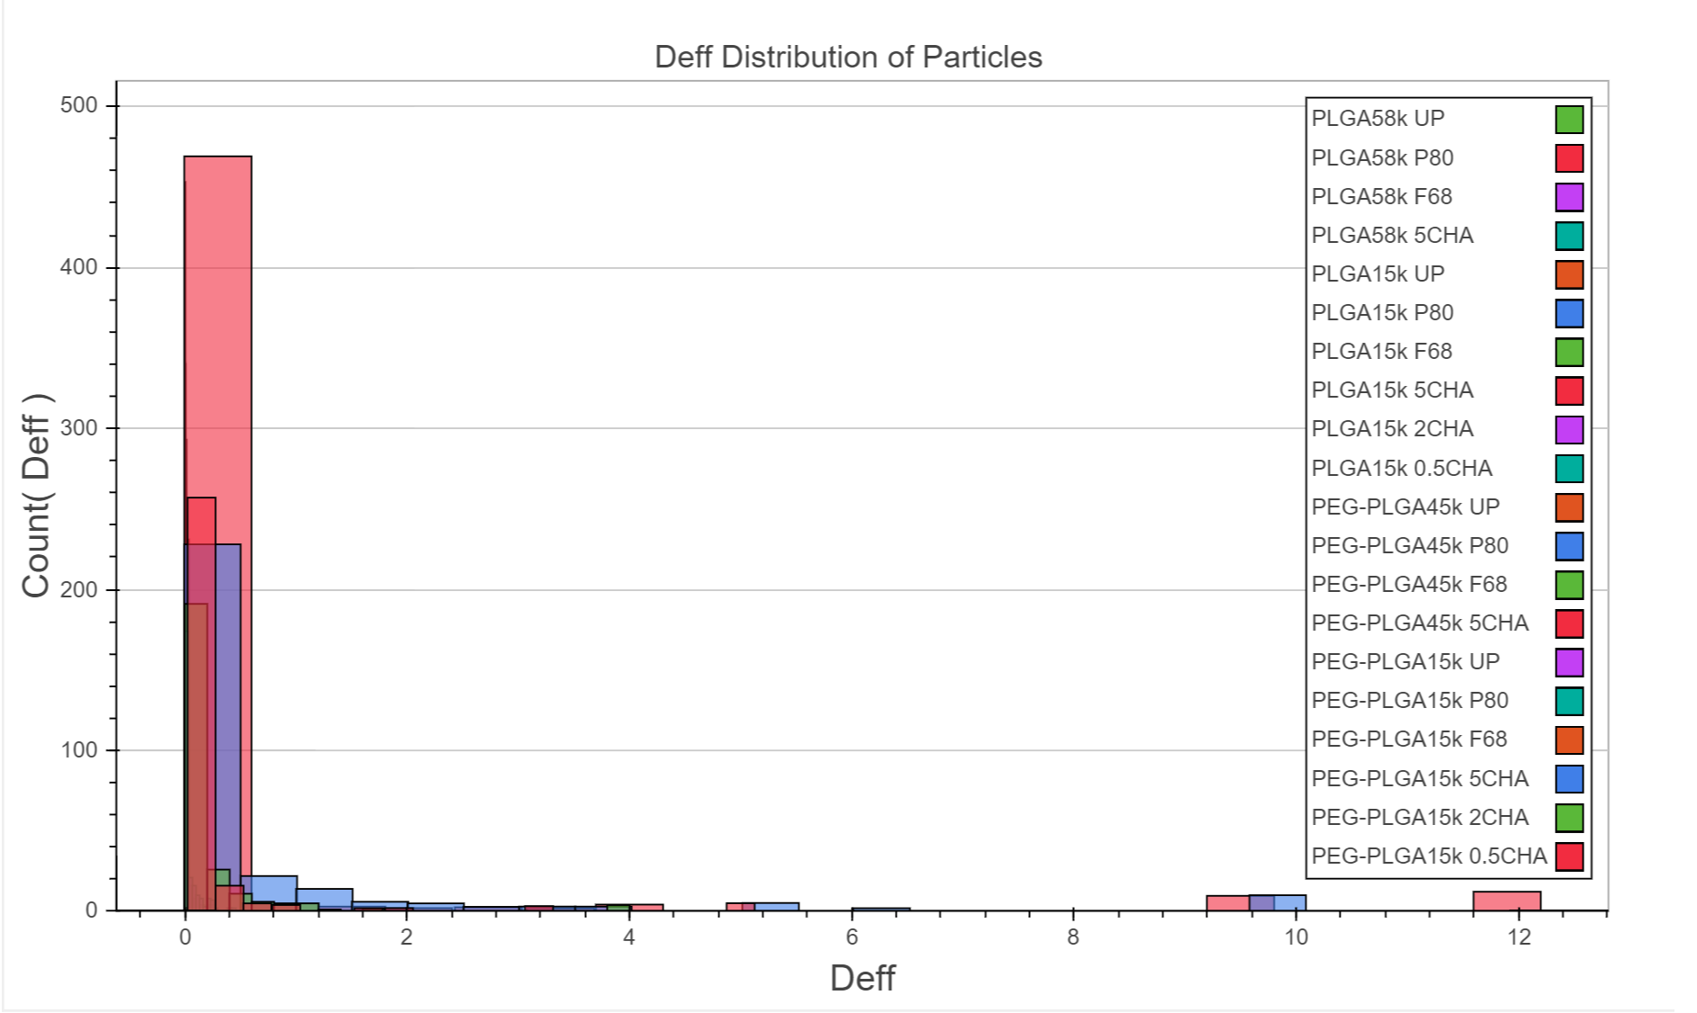
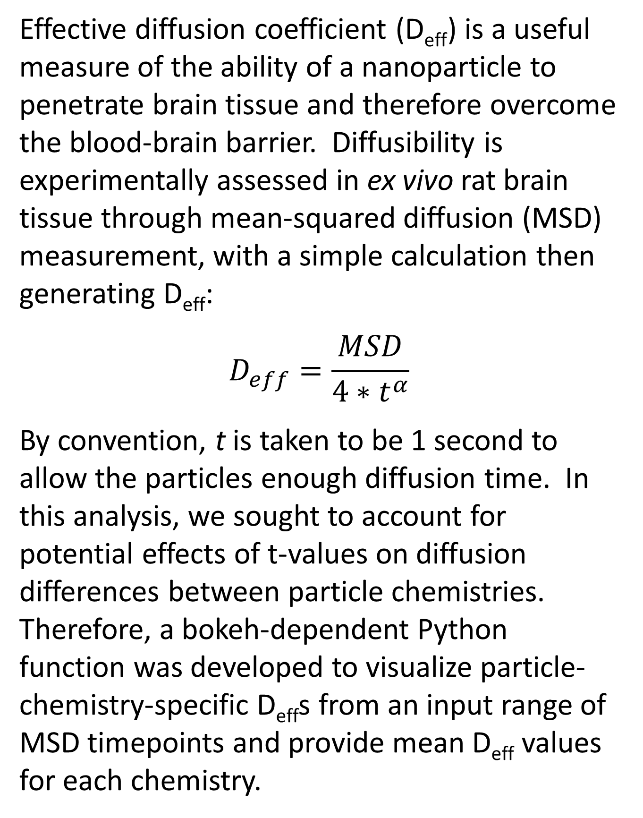
Graphically exploring diffusion of brain-penetrating nanoparticles
Effects of timescale and particle chemistry on effective diffusion coefficient and particle trajectories
Chad Curtis,* Rick Liao,* Ian Faulkner,* and Elizabeth Nance
Important Neurological Problems
Blood-brain barrier and therapeutic challenges
Neurological disorders account for 13% of the global burden of disease ($700 billion annually)
Therapeutics for neurological disorders take 35% longer to develop than drugs for other disorders
Childhood neurodevelopmental disorders are chronic disabilities with no effective cure, and are often underserved by novel drug delivery technologies, which primarily focus on adults.
1
Overcome the blood-brain barrier
2
Move within diseased brain tissue parenchyma
3
Uptake into specific disease associated cells
Less than 5% of therapeutics are able to cross the blood-brain barrier (BBB). Nanotechnology-based approaches provide potential platforms for site-specific, controlled release of therapeutics to central nervous system (CNS) diseases. Optimizing NPs capable of CNS mobility can enable faster and more effective development of therapeutics for these disorders. A vital step towards finding effective therapeutics is understanding how nanoparticles move in the brain, and how the chemical properties of nanoparticles affect the effective diffusion.
Effective diffusion coefficient (D_{eff}) calculation
D_{eff} comparison by nanoparticle chemistry
Particle trajectory visualization and comparison
Effective diffusion coefficient (D_{eff}) is a useful measure of the ability of a nanoparticle to penetrate brain tissue and therefore overcome the blood-brain barrier. Diffusibility is experimentally assessed in ex vivo rat brain tissue through mean-squared diffusion (MSD) measurement, with a simple calculation then generating D_{eff}:
$$D_{eff}=\frac{MSD}{4∗t^{α}}$$
By convention, t is taken to be 1 second to allow the particles enough diffusion time. In this analysis, we sought to account for potential effects of t-values on diffusion differences between particle chemistries. Therefore, a bokeh-dependent Python function was developed to visualize particle-chemistry-specific D_{eff}s from an input range of MSD timepoints and provide mean D_{eff} values for each chemistry.
Particle chemistry
For analyzing the effective diffusion of particles, we started with experimental effective diffusion data of 6709 particles calculated at t=1 second from the 20 different particle chemistries. As done previously, organizing this data manually to visualize and decipher meaningful trends was laborious and inefficient.
Bokeh was used to explore the relations between nanoparticle chemistries and diffusion rates for the 20 nanoparticle formulations with histograms.
Rationale: Plots are an easy way of quickly evaluating and comparing the behavior of particles. Plots give an idea of the comparative magnitude of diffusion coefficients, distinguish diffusion from convection and other flow patterns, and aids in identifying errors in instrumentation.
Bokeh was used to develop interactive plots within an iPython notebook. Bokeh provides built-in toolbars, and output can easily be used to generate HTML code to embed in a website.
Functions were written to compare trajectory data side-by-side:
With interactive features, the output from a single call of the “interact_plot_deff” function allows the user to choose whichever nanoparticles to display, based on the size of abscissa bins, whether the particles are PEGylated, PLGA particle type, surfactant, categorical size ranges, and categorical zeta potential ranges.
An example of the histogram produced with all nanoparticle chemistries included is displayed below.
as well as in an overlay format:
The output plots show populations of calculated D_{eff}s and how they compare with other particle chemistries over the input timepoints before outputting mean D_{eff} values.
Bokeh was also used to develop animated videos of particle trajectories. This is much more compact than large video files that are regularly used in presentations of particle diffusion.
* These authors contributed equally to this work.

