Slide 1



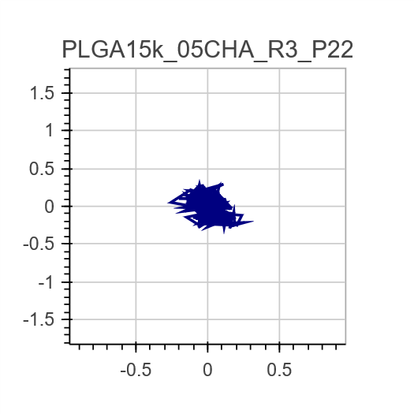
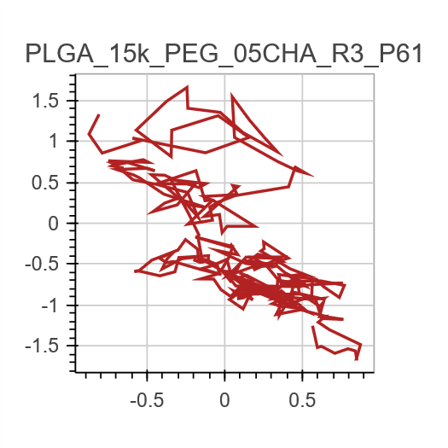
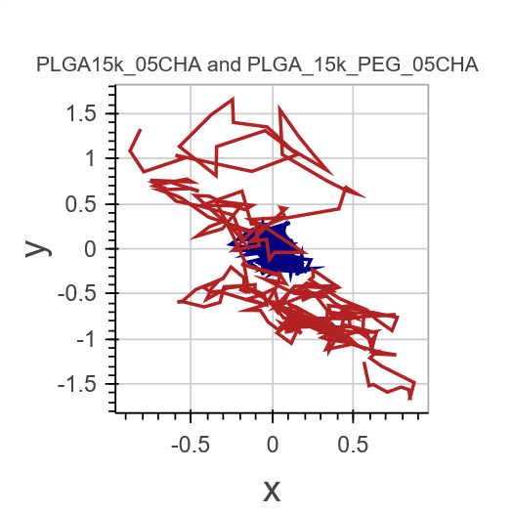
Graphically exploring diffusion of brain-penetrating nanoparticles
Effects of timescale and particle chemistry on effective diffusion coefficient and particle trajectories
Chad Curtis,* Rick Liao,* Ian Faulkner,* and Elizabeth Nance
Effective diffusion coefficient (D_{eff}) calculation
D_{eff} comparison by nanoparticle chemistry
Particle trajectory visualization and comparison
Rationale: Plots are an easy way of quickly evaluating and comparing the behavior of particles. Plots give an idea of the comparative magnitude of diffusion coefficients, distinguish diffusion from convection and other flow patterns, and aids in identifying errors in instrumentation.
Bokeh was used to develop interactive plots within an iPython notebook. Bokeh provides built-in toolbars, and output can easily be used to generate HTML code to embed in a website.
Functions were written to compare trajectory data side-by-side:
as well as in an overlay format:
Bokeh was also used to develop animated videos of particle trajectories. This is much more compact than large video files that are regularly used in presentations of particle diffusion.
* These authors contributed equally to this work.

