Slide 1



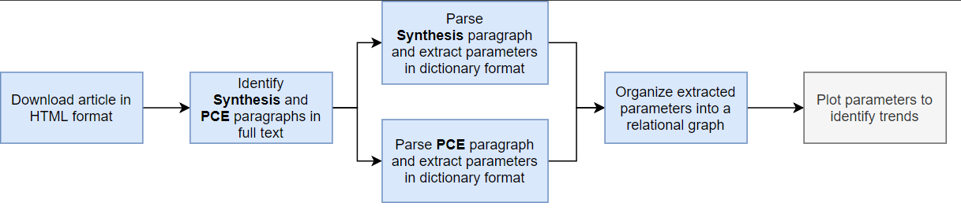
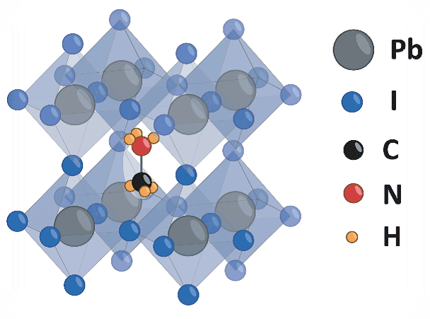
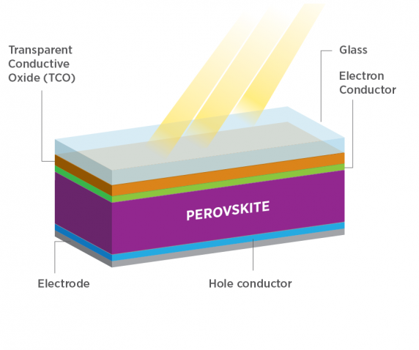
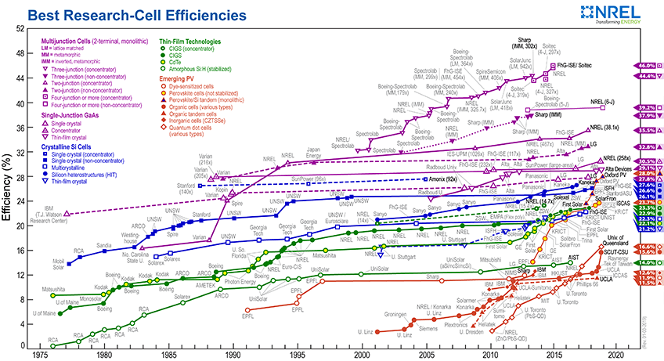
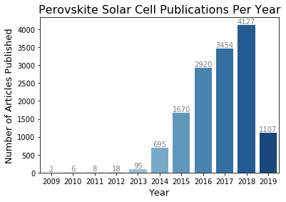
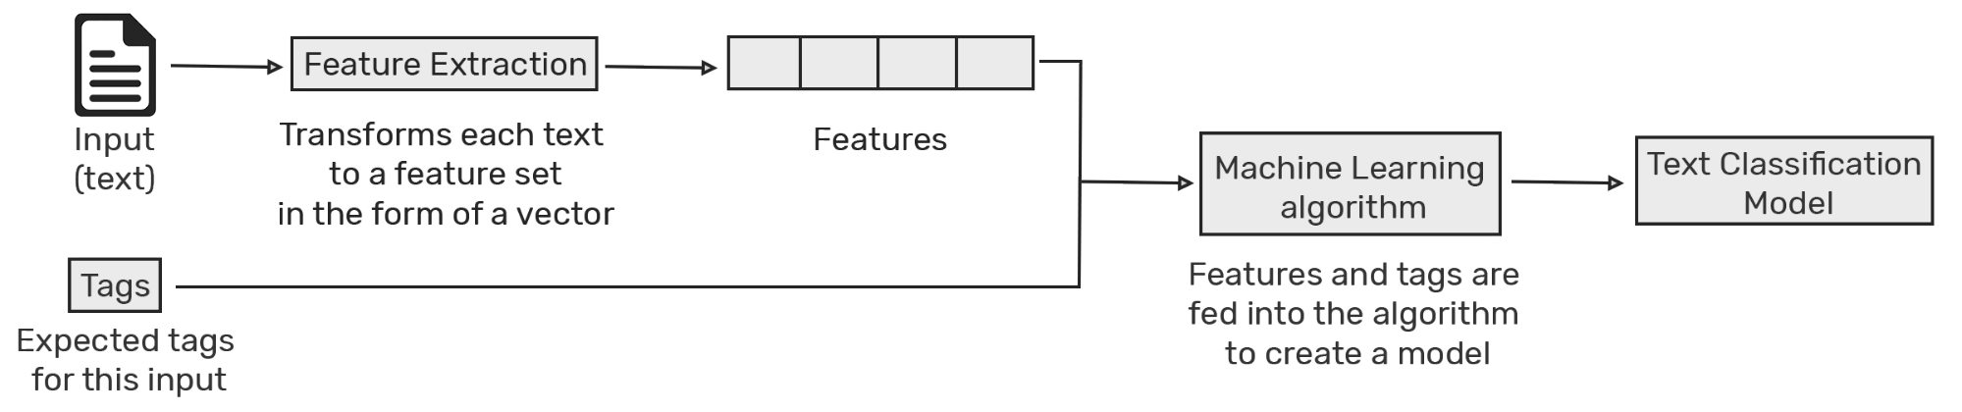
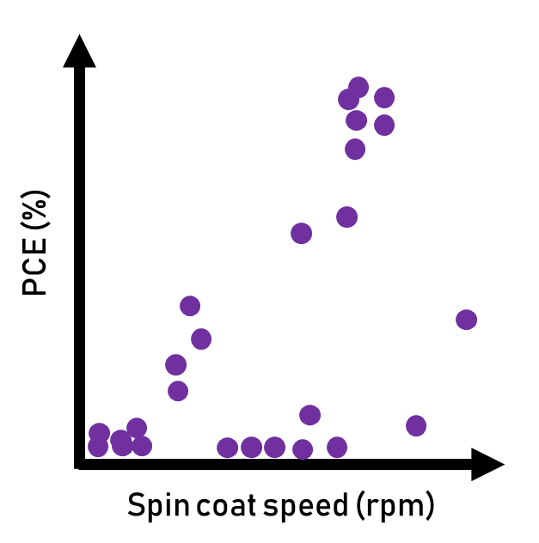
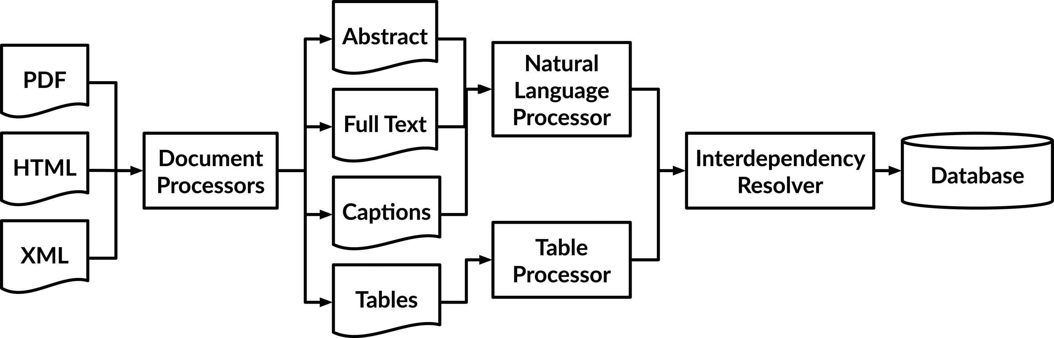
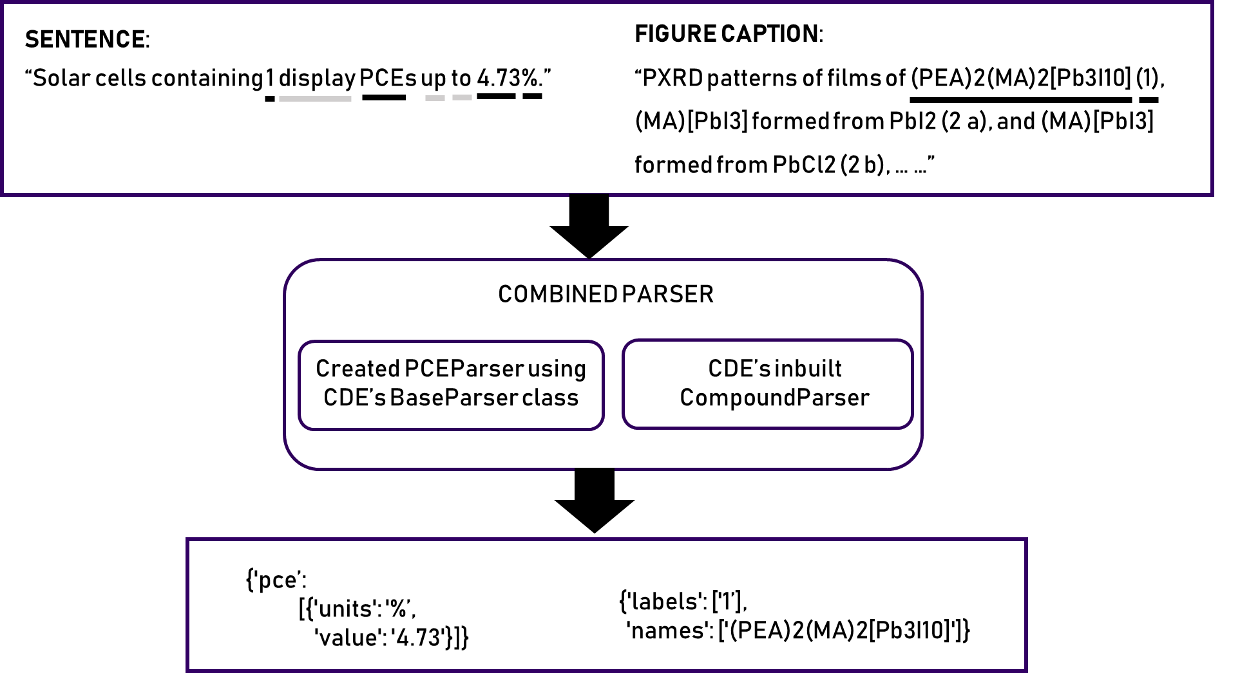
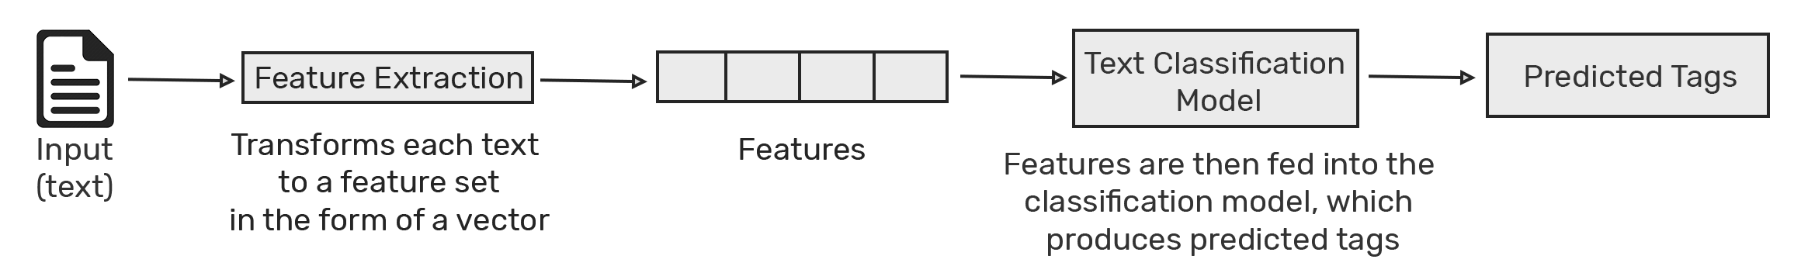
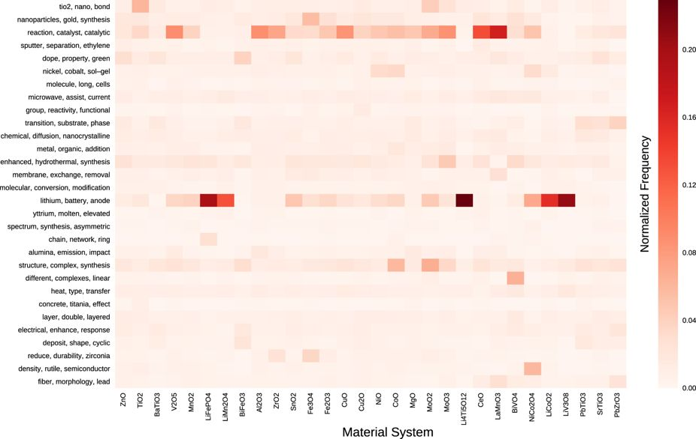
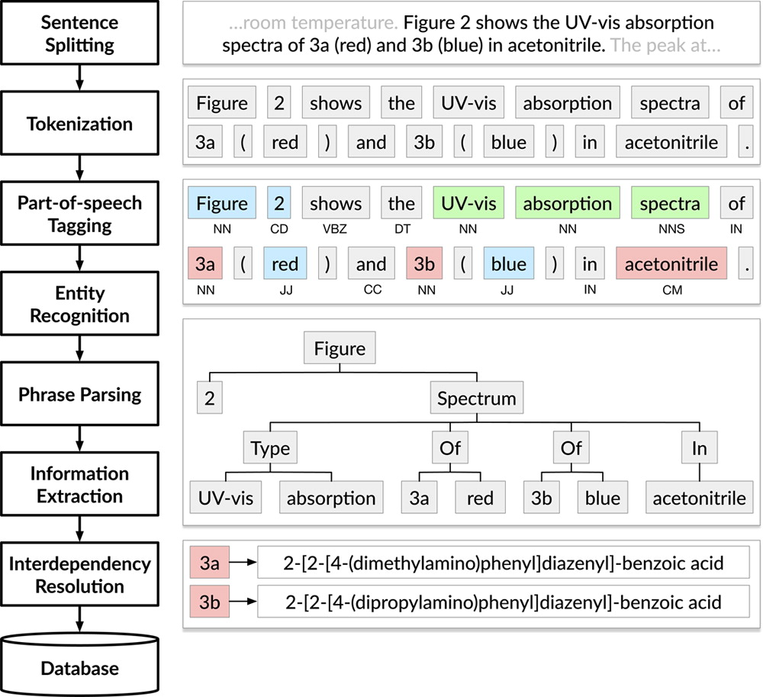
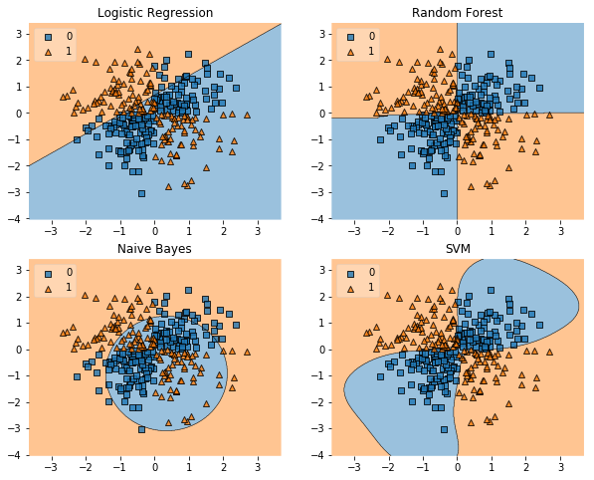


PaperParser: Text Mining for Solar Cell Literature
Christine Chang¹, Harrison Goldwyn², Linnette Teo³, Neel Shah³
¹Department of Materials Science and Engineering, University of Washington, Seattle, WA; ²Department of Chemistry, University of Washington, Seattle, WA; ³Department of Chemical Engineering, University of Washington, Seattle, WA
paper-parser/ paper-parser
Introduction
Package Design
Results
OVERVIEW
PACKAGE FLOWCHART
OUTPUT DATA TREE
Parse Synthesis paragraph and extract parameters in dictionary format
Material Identifier
As research in a given field progresses, and the volume of literature increases accordingly, scientific advances are hindered by the difficulty of information sharing. Currently, researchers must manually read literature to extract key insights and design improvements. PaperParser is a package designed to automate this process.
Download article in HTML format
Identify Synthesis and PCE paragraphs in full text
Organize extracted parameters into a relational graph
Plot parameters to identify trends
Synthesis
Device Performance
Parse PCE paragraph and extract parameters in dictionary format
Other steps
labels...
Step Order
VOC
Spincoat
Anneal
JSC
time
PCE
value, units
PEROVSKITE SOLAR CELLS
speed
temperature
1. Spincoat
Perovskites are a high-performance next-gen solar cell material. However, with enormous advances in performance come enormous increases in literature volume.
IDENTIFYING SENTENCES
SYNTHESIS EXTRACTION
time
value, units
2. Anneal
value, units
SPACY
The resulting solution was coated onto the mp-TiO2/bl-TiO2/FTO substrate by a consecutive two-step spin-coating process at 1,000 and 5,000 r.p.m for 10 and 20 s, respectively.
value, units
3. etc…
spaCy is a powerful and industrial strength package for almost all NLP tasks. Using spaCy as a pre-processing tool to remove punctuations, stopwords and stemming words to root forms improves the accuracy of our classification model.
value, units
value, units
value, units
Best Research-Cell Efficiencies
Data from SciFinder
Regular Expression Identification and Parsing
ChemDataExtractor Parsers
Efficiency (%)
SUPPORT VECTOR MACHINE (SVM)
SpinCoatParser
AnnealParser
Conclusions and Future Work
23.7%
An SVM is a machine learning algorithm for text classification. Unlike other text classification models, SVM doesn’t need much training data for accurate results. Although it needs more computational resources than Naive Bayes, SVM can achieve higher accuracy.
POSSIBLE IMPROVEMENTS
1975
1980
1985
1990
1995
2000
2005
2010
2015
2020
'spds': [
{'value': '1,000', 'units': 'r.p.m'},
{'value': '5,000', 'units': 'r.p.m'}
]
'temps': [
{'value': '100', 'units': '°C'},
{'value': '150', 'units': '°C'}
]
Increase training dataset for SVC model to improve accuracy
Extend extraction methods to include more synthesis actions and performance metrics
Year
ChemDataExtractor
PIPELINE
'times': [
{'timevalue': '10', 'units': 's'},
{'timevalue': '20', 'units': 's'}
]
'times': [
{'value': '10', 'units': 'min'}
]
PaperParser is built on ChemDataExtractor, an open-source software package that extracts chemical information from scientific literature using pre-trained models
OUR BIGGER PICTURE END GOAL
PERFORMANCE EXTRACTION
Integrate publisher APIs to download large number of papers based on user input search queries
Generate a large data set and identify trends
OVERVIEW
OUR TRAINED MODEL
NATURAL LANGUAGE PROCESSING PIPELINE
OUTPUT
Classifier | Accuracy
Logistic Regression | 0.9835
Random Forest | 0.9835
Naive Bayes | 0.9247
SVM-SVC | 0.9858
Olivetti group example: Heatmap of topics across material systems from mining the synthesis parameters of oxide materials
Acknowledgments
References
The authors acknowledge the University of Washington DIRECT program, including instructional staff (Dr. David Beck, Theodore Cohen, Chad Curtis, Torin Stetina, and Caitlyn Wolf) for support. Only open-source packages were used in this work; all documentation can be found on our Github repository (github.com/paper-parser/paper-parser/).
Perovskite solar cells: materials and devices. United States Department of Energy (DoE).
Best Research Cell Performance Chart. National Renewable Energy Laboratory (NREL).
Swain, M.C. and Cole, J.M., 2016. ChemDataExtractor: a toolkit for automated extraction of chemical information from the scientific literature. Journal of chemical information and modeling, 56(10), pp.1894-1904.
Kim, E., Huang, K., Tomala, A., Matthews, S., Strubell, E., Saunders, A., McCallum, A. and Olivetti, E., 2017. Machine-learned and codified synthesis parameters of oxide materials. Scientific data, 4, p.170127.

