Slide 1

ISMT E-101 Project Presentation
Charles Cushing
4/8/2016
Technology Reference Guide Website

Slide 2
Project Management
Create a Shared Vision of the Solution
Identify and Scope the Need
Create the Story Board
Create the Vision Statement
Identify and Scope the User Roles
Design the Solution

Slide 3
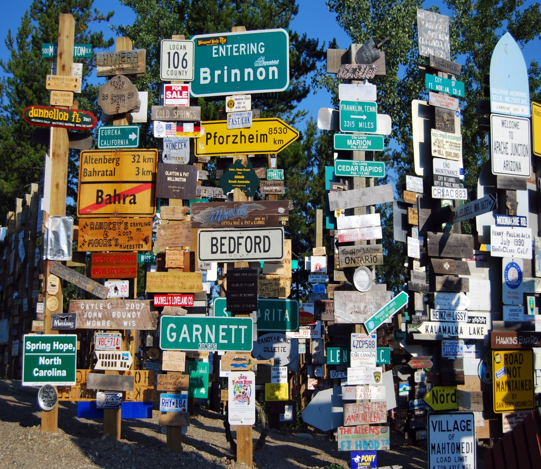
The Need
How do IT professionals keep on top of the constantly changing technology landscape?
Image Credit : MorgueFile.com http://mrg.bz/ZliAMS

Slide 4
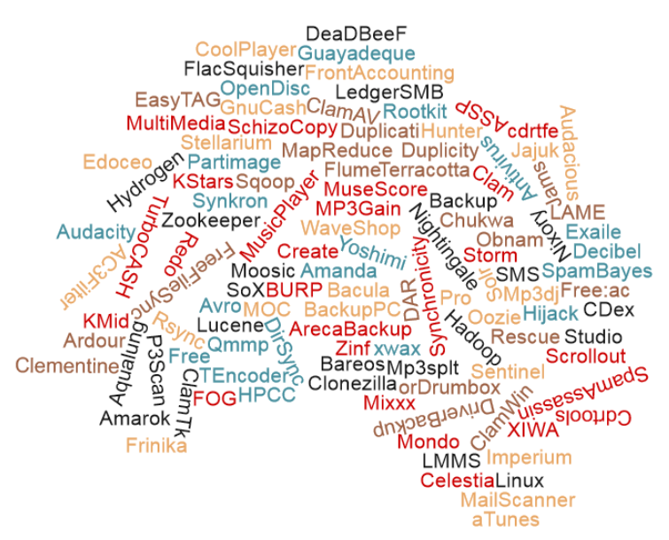
The Need
The world of open-source software has created a virtual jungle of products, frameworks, platforms and services.

Slide 5
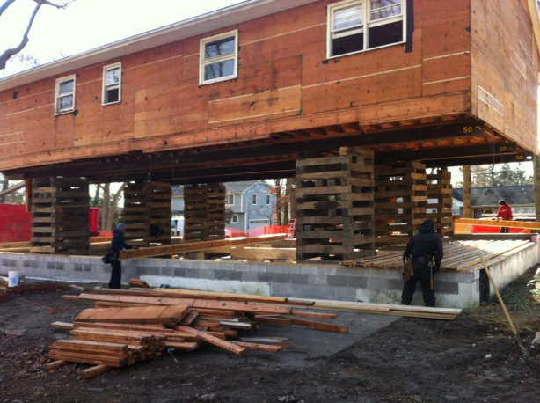
The Need
Many important infrastructure decisions are uninformed and the consequences of a bad decision will have severe long term consequences.
Image Credit : joewehnerandsons.com (http://www.joewehnerandsons.com/uploads/1/7/2/7/17279082/3765383_orig.jpg)

Slide 6
The Need
Having one place which where decision makers can keep on top of the different technologies and trends is essential to aiding better decisions.
Forums
Social Media
News
Industry Sites
Not only being able to know what solutions are out there, but which ones are industry favorites and which ones are legacy is important.

Slide 7
The Vision
The Technology Reference Guide website is the recognized source for unbiased and comprehensive analysis of the most relevant technologies, platforms and frameworks used in the Information Technology field. This web site strives to be the Consumer Reports equivalent for products and technologies related to the IT industry.

Slide 8
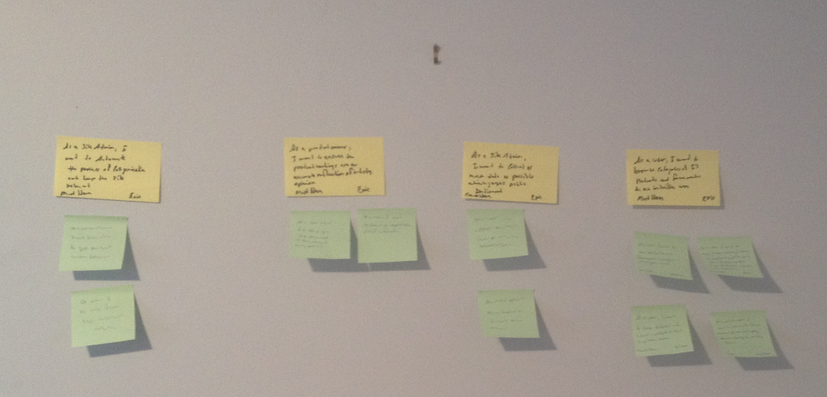
Being Agile!
Creating the Story Board
Identifying Opportunities & Risks
Forming a Shared Vision

Slide 9

Epic Stories
Epic #1
As a Site Admin, I want to collect as much data as possible which gauges the industry’s opinion of IT products and frameworks so that I can effectively manage the content on the site in a timely fashion
Nice to Have
EPIC

Slide 10
Epic Stories
Epic #2
As a Product Owner, I want to ensure the product rankings are an accurate reflection of industry opinion so that users come to trust our site as being the best source for IT platform, product and framework trends.
Must Have
EPIC

Slide 11
Epic Stories
Epic #3
As a Super User, I want to provide content and guidance on industry product rankings so that we can incorporate a wide variety of views.
Must Have
EPIC

Slide 12
Epic Stories
Epic #4
As a user, I want to browse categories of IT products and frameworks in an intuitive way so that I can easily keep on top of technology trends.
Must Have
EPIC

Slide 13
Smaller Stories
Keeping these principles in mind
Independent
Negotiable
Valuable
Estimable
Small
Testable
As a user, I want to see item rankings based on popularity, price, and other factors so that I can determine which one may be suited to my needs
Must Have
Large
As a user, I want to view detailed information about a product so that I can learn more about it without having to leave the site
As a user, I want to see products and frameworks categorized in a logical hierarchy so that I can easily browse through site
Nice to Have
X-Large
Must Have
Medium

Slide 14
Different User Roles
Site Admin | This user is responsible for approving and providing all of the dynamic content on the site.
Content Provider | These users are the subject matter experts who provide detailed content on products and frameworks.
User | User - These are the users of the web site.
Super User | These users are approved to vote on category rankings and are provided a login to do so.

Slide 15
Different User Roles
 | Roles
Function | Site Admin | Content Provider | User | Super User
Approves Queued Content | X
Creates Categories | X
Creates Content Pages | X | X
Creates Product Ranking Pages | X
Removes Content Pages | X | X
Removes Categories | X
Removes Product Ranking Pages | X
Updates Content Pages | X | X
Updates Categories | X
Updates Product Ranking Pages | X
Views Site Content | X | X | X | X
Votes for Product Rankings |  |  |  | X
Matrix of site functionality and user roles answers “What” and “Who”

Slide 16




High Level Design
Users
Tech. Reference Guide Web Site
Content Mgmt Site
Super Users (SMEs)
Content Providers
Site Admin(s)
Analytics
Social Media
Tech Ref Data Engine
News Sites
Developer Forums

Slide 17
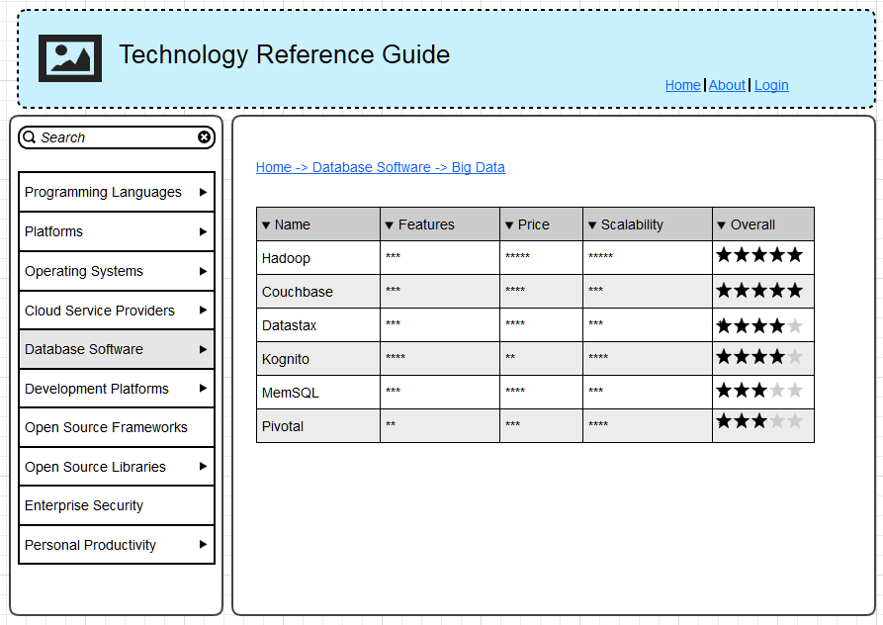
Wireframes
Start with the outputs first
Create a shared vision
Repeat until everyone agrees
* Created with Moqups.com

Slide 18
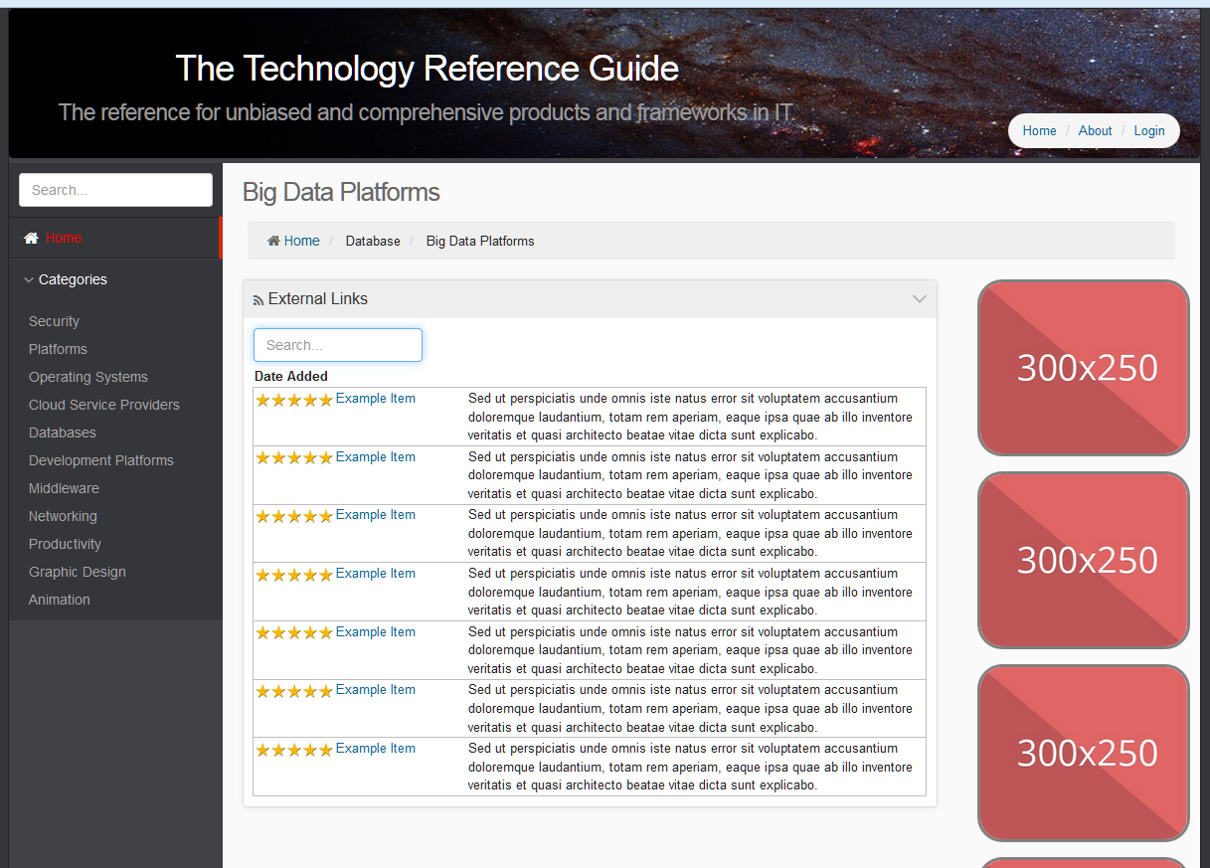
Prototype Website
A prototype provides even more detail from the Wireframe.
Each step incorporates team feedback
Start with the output, work your way back to the inputs.

Slide 19
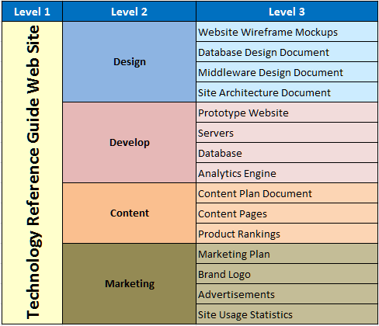
Work Breakdown Structure

Slide 20

Risks
Engaging the right Subject Matter Experts
Team Availability
Getting enough traffic to the site
Automating the generation of quality content

Slide 21

Next Steps
Choose a Content Management System
Design the Data Analytics Engine
Finish the Web Site

