Slide 1
Mental Health and Technology
A presentation by Christopher Cutcliffe

Slide 2
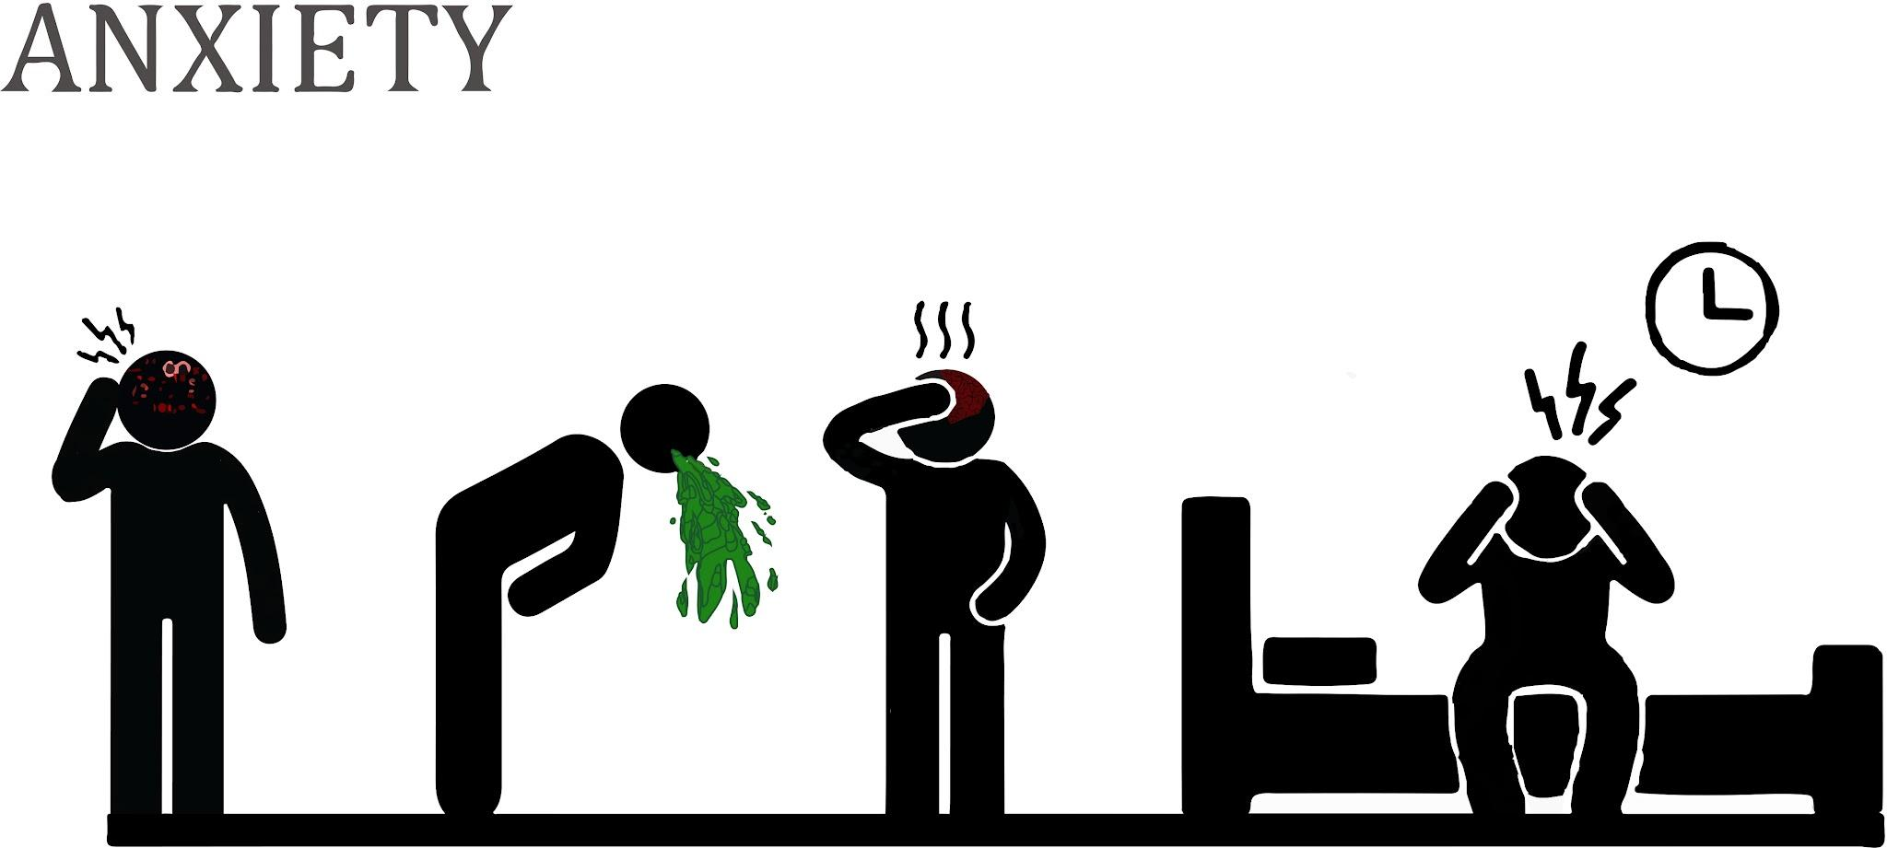
An Unspoken Crisis Plaguing Our Society
“The need for treatment of common mental health problems such as depression or anxiety has steadily increased. However, many people still do not receive effective and timely treatment due to the low availability, accessibility, and acceptability of traditional counseling.” (Ha 1)
“The need for mental good health should be considered equally as important as physical health, however, in contrast to the extensive literature on physiological/physical health information needs, very little is known about mental health information needs” (Xuguang 1)

Slide 3

Why does this matter to me?
Personally, while it does not affect me, myself. I have a lot of friends who suffer from issues like anxiety and depression, and they frequently complain about not being able to receive adequate help for their issues, or worry about the social stigma that comes from seeking help. I’d like to be able to help them with their problems better- Or, if possible, ensure that people like them across the world can get the help that they need.

Slide 4
In Summary:
According to the research I have done, there aren’t really any existing solutions to these problems because they are only recently actually being acknowledged.
Historically, people with mental health problems have been severely stigmatized. There are also serious issues with pricing and the actual availability of counselors. (Ha 1) And what we do know about these issues (rather than those caused by specific illnesses) are poorly understood. (Li 1)
However, the research I did found several proposed solutions. Author Ha proposed a mobile app which provides counseling paid for by crowd funding. Li proposes that information tools for mental health should be designed with those seeking help in mind, rather than professionals who are organizing data. And lastly, Chan proposes that virtual reality could be used as an outlet for those seeking refuge in nature during the pandemic- An event which has passed us, but certainly remains an applicable solution for the future for those unable to go outside.

Slide 5
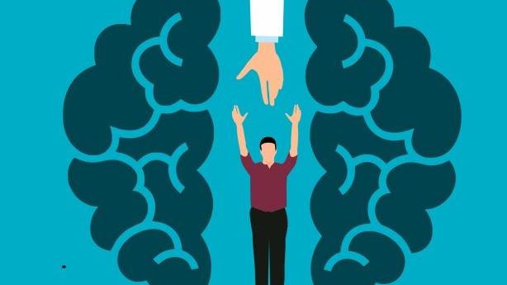
Applicability?
Most of what I described is already very much real world scenarios, but if this requires a separate section, I suppose it would be good to highlight the fact that most people seek answers to their problems online in the current day. When is the last time you, for example, had a question you needed an answer to and asked someone in person unless it was already the conversation topic? So having the answers that people seek available online is just common sense.

Slide 6

My Own Ideas
Once I thought up what I wanted to do, it was a simple enough matter to come to my conclusion: As is often the case with me, once I had the answer, I settled on it swiftly. I tend to come up with good answers once I settle on one at all.
So, this is a rather complex issue. Obviously, a computer can’t solve someone’s anxiety or depression (despite people attempting to do so often enough that the machines are now obligated to tell you to talk to an actual professional when they try to use Chat GPT for therapy), but it can connect them with an appropriate individual. I believe that a perfect blend of Ha and Li’s ideas might be good. Perhaps even with a mix of Chan’s proposal. We have the technology to speak with people from great distances- which resolves issues related to there being no appropriate individuals nearby someone’s area, or none with openings. And the convenience of long distance communication over the internet means that doctors can handle far more patients now than they could in the past- Least of all when there is nothing physically wrong with them. It also provides a convenient way to store huge amounts of information that can be accessed at any time. It also makes gathering data far more convenient.

Slide 7
Flow Chart
User describes their own experiences, what has helped them, what has not, etc. People are more honest when things are anonymous.
Doctors use this to gather information about how to better treat mental health, administer to other patients.
Other people use the recommendations of doctors and use the system to hook up with available therapists and such who can help them.
Following the chart to the right (top to bottom) the functions of the program are simple enough to follow. Rather than focusing on the benefit of either doctors or patients, I think it would be best to design things in a manner that is accessible to both. Information meant to be used as research data should be organized as data points, and information meant to assist users should be organized as advice. The device should also be capable of connecting patients with capable therapists to provide the counseling that they need and help managing their fears and troubles. If an interpersonal element improves their situation despite the desire for anonymity, a VR environment may be helpful so that it can feel like you are with the doctor despite still being in your own home. -And being in your own home and also anonymous definitely helps a patient relax in an unfamiliar social situation like this. For that one I will cite both common knowledge and personal experience. It certainly has helped me stay on track during college being able to learn from my own home rather than in a building full of strangers.

Slide 8
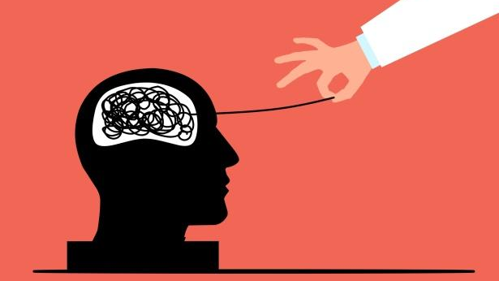
What else is there to ask?
A couple of questions I still have are why there are so few mental health professionals in the first place who deal with non-chronic conditions, and also why there remains such a stigma to this very day- I understand why it existed before. Cultural views on masculinity demanded that not being able to deal with your emotional problems made you weak, but that’s far less valued today than it was a few decades ago. Perhaps this is just something we need to finish phasing out before we can progress as a society.

Slide 9
Works Cited
Ha, Seung Wan, and Jusub Kim. “Designing a Scalable, Accessible, and Effective Mobile App Based Solution for Common Mental Health Problems.” International Journal of Human-Computer Interaction, vol. 36, no. 14, Aug. 2020, pp. 1354–1367. Serialssolutions.Com, MegaSearch, https://doi.org/10.1080/10447318.2020.1750792.
Li, Xuguang, et al. "The Mental Health Information Needs of Chinese University Students and their use of Online Resources: A Holistic Model." Journal of Documentation 79.2 (2023): 442-67. ProQuest. Web. 17 Dec. 2024.
Chan, Sarah Hian May, et al. "Nature in Virtual Reality Improves Mood and Reduces Stress: Evidence from Young Adults and Senior Citizens." Virtual Reality 27.4 (2023): 3285-300. ProQuest. Web. 17 Dec. 2024.

