Slide 1



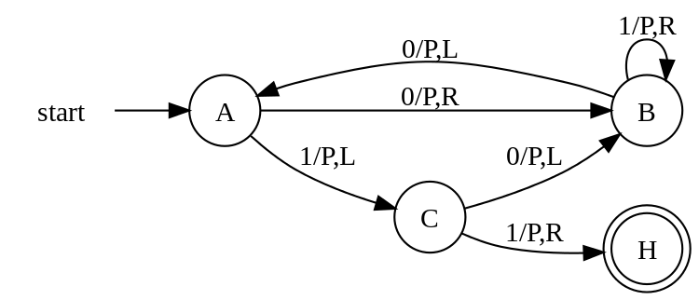
Digital Logic Design and Application
Topic 2 - Principles for digital design Yan Bo
School of Information & Communication Engineering, UESTC
Email: yanboyu@uestc.edu.cn

Slide 2
Topic2： Principles for digital design
Combinational Logic
Sequential Logic
Testbench
Gates and Logic
DFF/Latch, Register & Memory
State machine Description
Design & Analysis
Design & Analysis
Function Description
Response Monitor
Test module
Stimulus Generator

Slide 3
Topic2： Principles for digital design
Combinational Logic
Sequential Logic
Testbench
Gates and Logic
DFF/Latch, Register & Memory
State machine Description
Design & Analysis
Design & Analysis
Function Description
Response Monitor
Test module
Stimulus Generator

Slide 4
Where we are
Central Process Unit
Central Process Unit
TEST
TEST
Datapath
(ALU, MUX…)
Datapath
(ALU, MUX…)
Controller
(State Machine)
Controller
(State Machine)
Combinational Circuit
Sequential
Circuit
Sequential
Circuit
Chap
2&3&4
Gates
Topic2-1
Chap1
Boolean Algebra
Boolean Algebra
Chap1

Slide 5
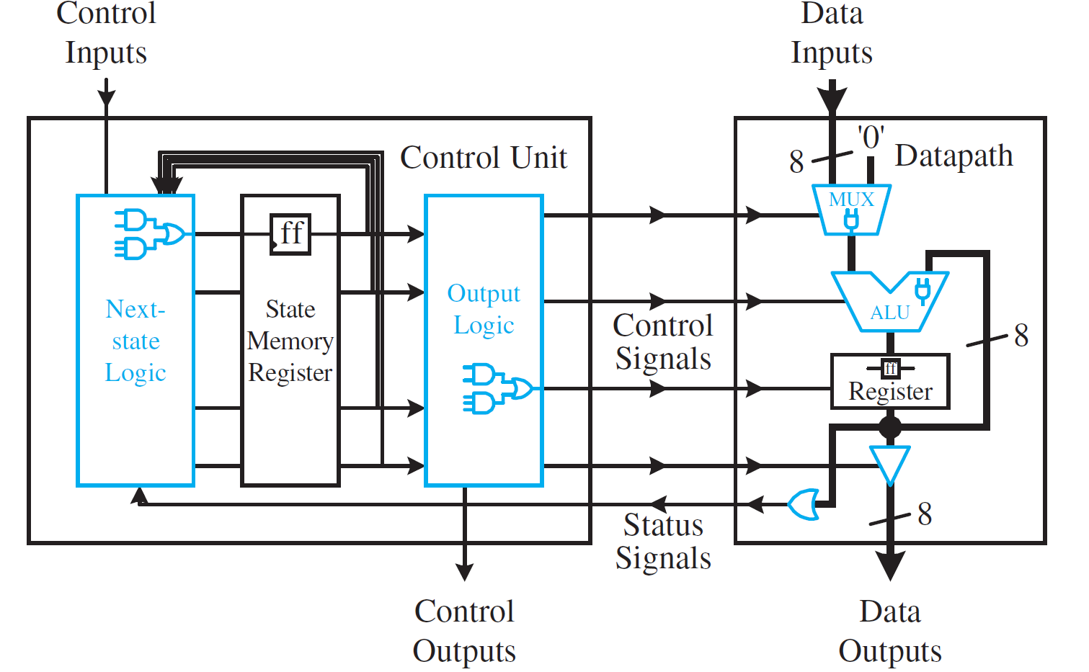
Organization of Center Processor Unit
P65
2026-03-21

Slide 6
Topic2： Principles for digital design
Combinational Logic
Sequential Logic
Testbench
Gates and Logic
DFF/Latch, Register & Memory
State machine Description
Design & Analysis
Design & Analysis
Function Description
Response Monitor
Test module
Stimulus Generator

Slide 7
Gates and Logic: basic gates
Chap2.5
Gates: A Device executes Boolean Operation
（a）AND gate （b）OR gate （c）NOT gate or Inverter

Slide 8
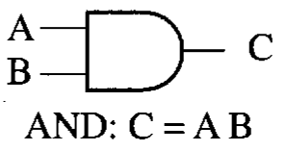
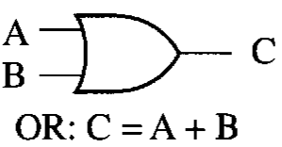
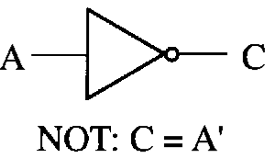
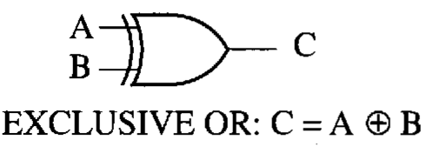
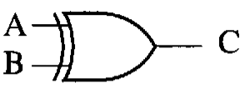

Gates and Logic: other gates
N
N
N
N
Q1: Could you write out any other gates?
Q2: Could you recognize the gates with same function?
Q3: Do we need to fabricate all types of gates?
XN
X
XN

Slide 9
Gates and Logic: complete Set of Gates
A set is COMPLETE
if we can implement any logical function using only the type of gates in the set.
Minimal Complete set
A complete set with no redundant elements.
Examples
{AND, OR, NOT}
{OR, NOT}
{NAND}
{NOR}
Not a minimal complete set
Simplest and Lowest Cost

Slide 10
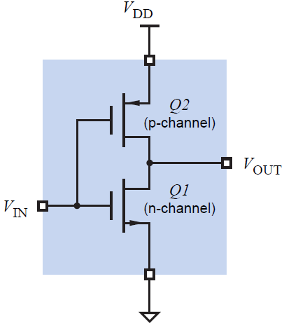
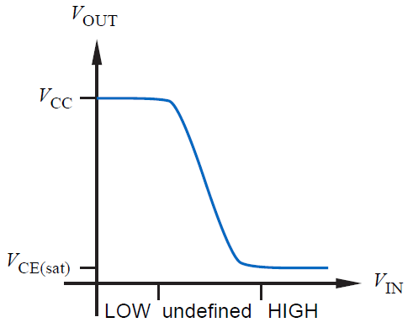
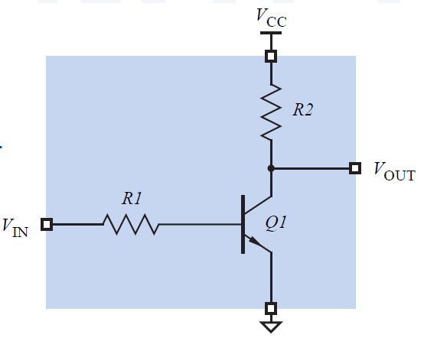
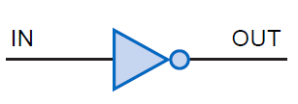
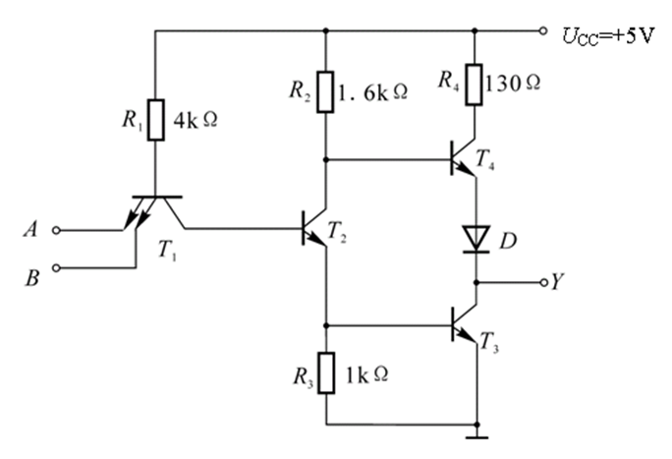
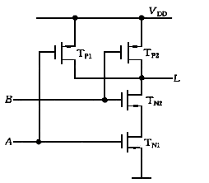
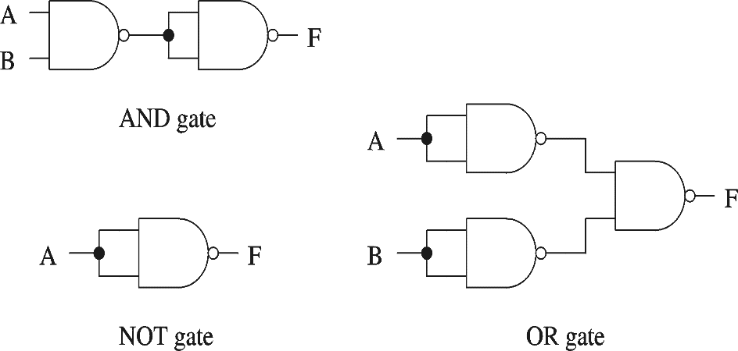
Gates and Logic: NAND as a Complete Set
Inverter is the most basic and cheapest component.
How can we achieve the basic logic operations only by NAND gate?
Proving NAND gate is universal:

Slide 11
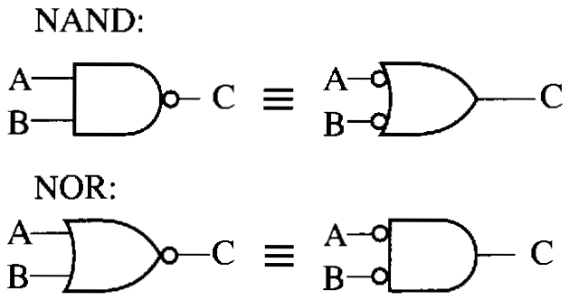
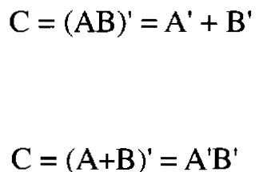
Gates and Logic: Circle rule
Basic Forms of Logic Function
OR-AND-NOT ，AND-OR-NOT
NAND-NAND， NOR-NOR
(A+B)(A+C)’
(AB+AC)’
Minimal complete set
P38 Figure2.10 13a，13b DeMorgan’s laws

Slide 12
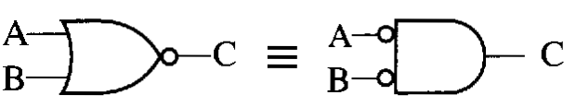
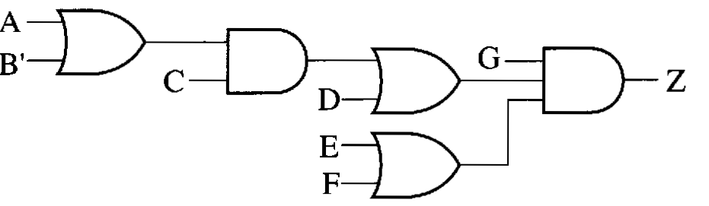
Gates and Logic: Circle rule
Please use the NOR-gates to replace all gates.
Step 1: replace all OR gates by NOR gates;
Step 2: replace all AND gates by NOR gates;
Double inversion cancels
‘
‘
complemented input cancels inversion
P38 Double Complement 8a
DeMorgan’s laws 13a，13b

Slide 13
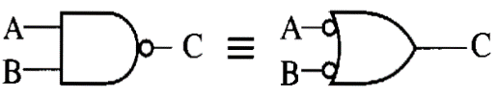
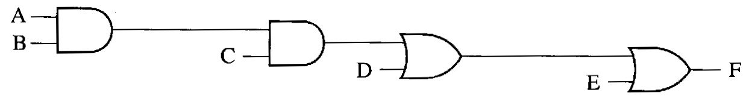
Gates and Logic: Circle rule
Chap3.2.1
Please use the Nand-gates to replace all gates
Step 1: replace all AND gates by NAND gates;
Step 2: replace all ORgates by NAND gates;
Bobbles cancels
‘
‘
Add inverter
P38 Double Complement 8a
DeMorgan’s laws 13a，13b

Slide 14
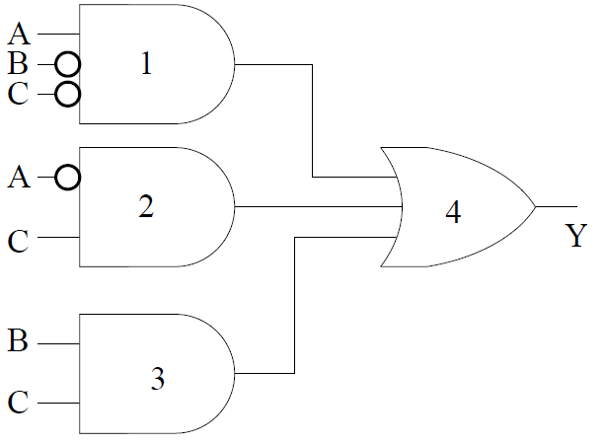
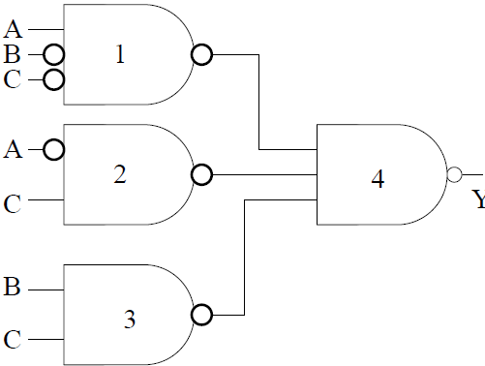
Exercise
Please give the Nand-Nand logic diagram and expression for the following circuit.

Slide 15
Exercise
Chap2.3&2.4
Switch X/Y/Z: 1-Close,0-Open
Lamp F: 1-ON,0-OFF
Z
X
Y
F
X
Y
Z
F
Truth table
0 0 0
0 0 1
0 1 0
0 1 1
1 0 0
1 0 1
1 1 0
1 1 1
0
0
0
0
0
1
1
1
F (X,Y,Z ) =
X·(Y+Z)
Logic expression
X
Y
F
Logic circuit
Z

Slide 16

Exercise
Please write down the truth table, logic expression and the logic symbol of these electronic circuit.
Switch/Lamp: 1-Close/ON, 0-Open/OFF
A
B
Produce a 1 output if and only if all of its inputs are 1.
A
Z
Z
Z = A · B
B
A
Produce a 1 if and only if one or more of its input are 1.
A
B
Z
Z = A + B
Z
B
R
Produce an output value that is the opposite of its input value.
A
Z
A
Z
Z = A’
How about this situation: 0-Close/ON, 1-Open/OFF

Slide 17
Exercise
Please write down the truth table, logic expression and the logic symbol of these electronic circuit.
Switch/Lamp
1- Close/ON,0-Open/OFF
1-Open/OFF,0-Close/ON
Positive logic
Negative logic
A
B
A
A
A’
Z’
Z
Z
Z
B
B
B’
A
A
A
A’
Z
Z
Z’
B
Z
B
B
B’
R
Z
A’
Z’
A
Z
A
Z
A

Slide 18
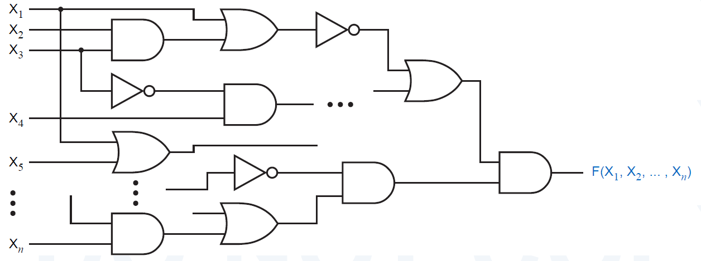

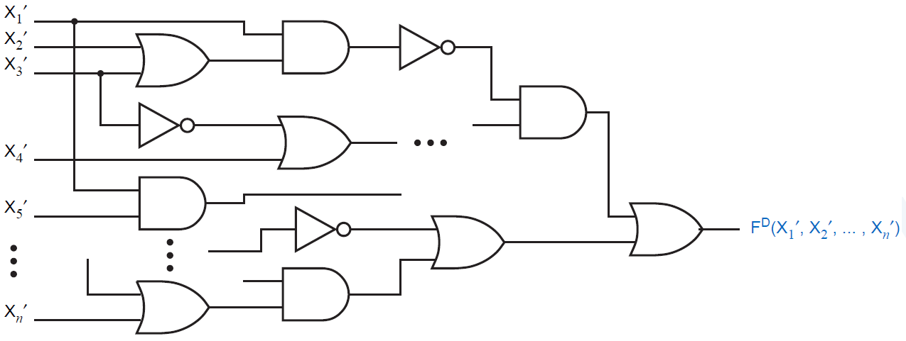
Gates and Logic: Positive Logic vs. Negative Logic
Positive logic
Chap4.1
AND⇔OR
Negative logic
F^{D} (X₁ , X₂ , … , X_{n} )
Duality expression

Slide 19
Gates and Logic: Principle of Duality
Chap2.7.2
Dual of a logic expression
F^{D}(X₁ , X₂ , … , X_{n} ,0,1, + , · )= F(X₁ , X₂ , … , X_{n} ,1,0, · , + )
Rule for Duality expression
AND ⇔ OR；
0 ⇔ 1
Keep the operation order of the original function
Principle of Duality
If F1=F2, then F1^{D}=F2^{D}.
X is not changed !!

Slide 20
Gates and Logic: Perform the dualities
F1 = X + X · Y
= X (1+Y)
= X
= F1^{D}
Wrong!
+
F1^{D}= X X Y
F1^{D}= X·(X + Y)
·
= X + Y
= X
F2 = X + Y · (Z + W)
F2^{D} = X·(Y+Z ·W)
F3 = ( X’·(Y+Z’) + (Z+W)’ )’
F3^{D}= ((X’+Y ·Z’ ) · ( Z · W)’)’
Defination:
F3’ = X’·(Y+Z’) +(Z + W)’
DeMogan’s law:
= ((X+ Y’·Z ) · (Z’ · W’)’ )’

Slide 21
Gates and Logic: Duality vs. DeMorgan’s Law
Dual of a logic expression
F^{D}(X₁ , X₂ , … , X_{n} ,0,1, + , · )
= F(X₁ , X₂ , … , X_{n} ,1,0, · , + )
Complement of a logic expression
F’ (X₁ , X₂ , … , X_{n} ,0,1, + , · )
= F(X₁ ’ , X₂ ’ , … , X_{n} ’ ,1,0, · , + )
Chap2.7.2，2.7.3
X is not changed !!
X is inverted !!
F^{D}(X₁ ’ , X₂ ’ , … , X_{n} ’ ,0,1, + , · )=F’ (X₁ , X₂ , … , X_{n} ,0,1, + , · )
F(X₁ , X₂ , … , X_{n})=(F’ (X₁ , X₂ , … , X_{n} ))’=(F^{D}(X₁ ’ , X₂ ’ , … , X_{n} ’ ))’

Slide 22
Exercise
Please give the Dual function and the Inverse function for F(a,b,c)=a + bc, and then draw the logic circuit.
F^{D}(a,b,c)
=a (b+c)
Duality
=F^{D}(a’,b’,c’ )
F’(a,b,c)
=(a+bc)’
=a’ (bc)’
=a’ (b’+c’)
DeMorgan’s law
a
a
a'
F(a,b,c)
F^{D}(a,b,c)
F’(a,b,c)
b
b
b'
c
c
c'
F^{D}(a’,b’,c’)
a
a
a
F’(a,b,c)
F’(a,b,c)
b
b
F’(a,b,c)
b
c
c
c

Slide 23
Topic2： Principles for digital design
Combinational Logic
Sequential Logic
Testbench
Gates and Logic
DFF/Latch, Register & Memory
State machine Description
Design & Analysis
Function Description
Response Monitor
Test module
Stimulus Generator
Design & Analysis

Slide 24
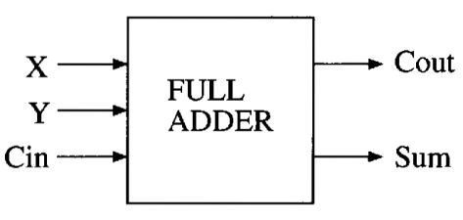
Description for Combinational Circuit
which adds 2 binary digits (X,Y) and a carry(Cin) to give a sum(Sum) and a carry out(Cout) .
Full adder
SOP (Sum of Products)
POS(Products of Sum)
Logic Symbol
Logical expression
Cout= X’YCin + XY’Cin + XYCin’ + XYCin
Sum=(X+Y+Cin) (X+Y’+Cin’) (X’+Y+Cin’) (X’+Y’+Cin）
=∑(3,5,6,7)
=∏(0,3,5,6)
Input
Output
Summary for getting SOP from truth table:
Get an AND-OR expression by adding some products;
Each product come from one input combination which make the output is “1”;
For the input combination, using original signal for ‘1’ and complemented signal for “0”;
Summary for getting POS from truth table:
Get an OR-AND expression by multiplying some sums;
Each sum come from one input combination which make the output is “0”;
For the input combination, using original signal for ‘0’ and complemented signal for “1”;
Truth table
X Y Cin Cout Sum
Row#
0
1
2
3
4
5
6
7
0 0 0
0 0 1
0 1 0
0 1 1
1 0 0
1 0 1
1 1 0
1 1 1
0 0
0 1
0 1
1 0
0 1
0
1 0
1 1

Slide 25
Description for Combinational Circuit
which adds 2 binary digits (X,Y) and a carry(Cin) to give a sum(Sum) and a carry out(Cout) .
Full adder
SOP (Sum of Products)
POS(Products of Sum)
Logic Symbol
Logical expression
Cout= X’YCin + XY’Cin + XYCin’ + XYCin
Sum=(X+Y+Cin) (X+Y’+Cin’) (X’+Y+Cin’) (X’+Y’+Cin）
=∑(3,5,6,7)
=∏(0,3,5,6)
Input
Output
Karnaugh map
Verilog code
module (
output reg ,
input
);
always @ （ ）
begin
end
endmodule
Truth table
X Y Cin Cout Sum
Cout
Fulladder
XY
Cout,Sum
Row#
0
1
2
3
4
5
6
7
Cin
00 01 11 10
0
0
0
1
0
X,Y,Cin
0 0 0
0 0 1
0 1 0
0 1 1
1 0 0
1 0 1
1 1 0
1 1 1
0 0
0 1
Input
1
0
1
1
1
X,Y,Cin
0 1
Output
1 0
XY
Sum
Sum=X ^ Y ^ Cin;
0 1
0
1 0
1 1
Cin
00 01 11 10
Cout=(X&Y) | (Cin& (X^Y));
0
0
1
0
1
1
1
0
1
0

Slide 26
Conversions between different representations
Logic expression
Chap2.6
Chap3.3.2
➔
Truth table / K map
Truth table / K map
➔
Logic expression

Slide 27
Logic expression ➔ Truth table / K map
F(X,Y,Z) = X + Y’Z + X’YZ’
SOP(Sum-of-Products)
“AND-OR”
X
Y
Z
Y’·Z
X’·Y·Z’
F
Gray code
0 0 0
0 0 1
0 1 0
0 1 1
1 0 0
1 0 1
1 1 0
1 1 1
1
1
0
0
0
0
0
0
0
0
0
0
0
1
1
1
1
0
0
0
0
0
0
1
1
1
1
1
1
F
XY
1
Z
00
01
11
10
0
0
0
1
1
1
0
1
1
0
1
1

Slide 28
Logic expression ➔ Truth table / K map
F (X,Y,Z)= (Y’+Z) · (X’+Y+Z’)
POS(Product-of-sums)
OR-AND
X
Y
Z
Y’+Z
X’+Y+Z’
F
0
0
0
0 0 0
0 0 1
0 1 0
0 1 1
1 0 0
1 0 1
1 1 0
1 1 1
0
0
1
1
1
1
1
1
1
1
1
1
1
1
1
1
Gray code
1
1
1
1
F
XY
Z
00
01
11
10
0
1
0
0
1
0
1
1
1
1
0

Slide 29
Truth table / K map ➔ Logic expression
XY
Z
00
01
11
10
X
Y
Z
F
0
0
0
1
0
F
0
1
2
3
4
5
6
7
0 0 0
0 0 1
0 1 0
0 1 1
1 0 0
1 0 1
1 1 0
1 1 1
0
0
0
0
0
X+Y+Z
X+Y+Z’
1
0
1
0
1
more simple
X+Y’+Z
SOP/AND-OR
1
1
1
X’YZ
F(X,Y,Z) = + +
X’YZ
XY’Z
XYZ’
X’+Y+Z
= Σx,y,z (3,5,6)
XY’Z
POS/OR-AND
XYZ’
F(X,Y,Z) =( )( )( ) ( )( )
X+Y+Z
X+Y+Z’
X+Y’+Z
X’+Y’ +Z’
X’+Y+Z
X’+Y’ +Z’
= ∏x,y,z (0,1,2,4,7)
28

Slide 30
Truth table / K map ➔ Logic expression
XY
Z
00
01
11
10
X
Y
Z
F
0
1
0
1
0
F
0
1
2
3
4
5
6
7
0 0 0 1
0 0 1 1
0 1 0 0
0 1 1 1
1 0 0 0
1 0 1 1
1 1 0 1
1 1 1 1
X’Y’Z’
X’Y’Z
1
1
1
1
1
X+Y’+Z
SOP/AND-OR
X’YZ
F(X,Y,Z) = + + + + +
X’Y’Z’
X’Y’Z
X’YZ
X’+Y+Z
XY’Z
XYZ’
XYZ
XY’Z
= Σx,y,z (0,1,3,5,6,7)
XYZ’
more simple
POS/OR-AND
XYZ
F(X,Y,Z) =( )( )
X+Y’+Z
X’+Y+Z
= ∏x,y,z (2,4)

Slide 31
Conversions between different representations
Logic expression
➔
Truth table / K map
Truth table / K map
➔
Logic expression
Chap2.10
Logic expression
Logic/Gates circuit
➔
Logic expression
➔
Logic/Gates circuit

Slide 32
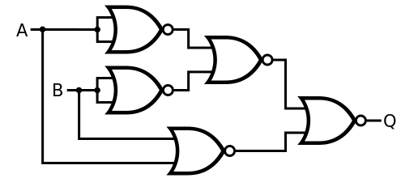

Logic circuit ➔ Logic expression
A
Please build an XOR only with NOR gates.
B
(A+B)’
B’
(A’+B’)’
A’
F =( (A+B)’+(A’+B’)’)’
P38 laws&theorems
13 DeMorgan’s
8 Double Complement
Simplify
=(A+B)(A’+B’)
=AB’+A’B
12 Distributive laws
9 Inverse
=A⊕B
Definition of XOR gate

Slide 33
Logic expression ➔ Logic circuit
F=(A+B’C)’+A’BC’+C
A’BC’
B’C
A+B’C

Slide 34
Exercise
Please give the
K-map,
SOP expression and circuit,
POS expression and circuit,
according to the truth table.
Truth table
Row X Y Z F
0 0 0 0 1
1 0 0 1 0
2 0 1 0 0
3 0 1 1 1
4 1 0 0 1
5 1 0 1 0
6 1 1 0 1
7 1 1 1 1
XY
Z
00
01
11
10
0
1
0
1
1
F
1
0
1
1
0
F_{SOP} = X’Y’Z’ + X’YZ + XY’Z’ + XYZ’ +XYZ
= Σx,y,z (0, 3,4,6,7)
F_{POS} =(X+Y+Z’)(X+Y’+Z)(X’+Y+Z’)
= ∏x,y,z (1,2,5)

Slide 35
Conversions between different representations
Logic expression
➔
Truth table / K map
Truth table / K map
➔
Logic expression
➔
Logic expression
Logic/Gates circuit
Logic expression
➔
Logic/Gates circuit
Logic expression
➔
Other logic expression

Slide 36
Logic expression ➔ other Logic expression
Chap2.8，2.9
Standard representations
Normal Term is a term in which no variable appears more than once.
ex) "Normal " ABC A + B' +C ex) "Non-Normal" ABB' A + A'
Minterm is a product term in which all the variables appear exactly once either complemented or uncomplemented.
Maxterm is a sum term in which all the variables appear exactly once either complemented or uncomplemented.
ex) ABC AB‘C A’B‘C
ex) A+B+C A+B‘+C A’+B‘+C
Canonical sum of Products (canonical SOP):
A sum of the minterms corresponding to truth-table rows for which the function produces a 1 output.
Canonical product of Sums(canonical POS)
A product of the maxterms corresponding to truth-table rows for which the function produces a 0 output.
ex) F(A,B,C) = A‘BC’ + ABC‘ + A’BC
ex) F(A,B,C) =(A+B+C)(A+B+C')(A'+B+C)
Simplify representations
Use the non-normal term to minimize the cost of realizing a logical function.

Slide 37
Minterm vs. Maxterm & Canonical SOP vs. POS
Given F(A,B,C )=C’, please construct the truth table and express in both maxterm and minterm form.
In genaral , the relationship between minterm m_{i} and maxterm M_{i} is:
(m_{i})' = M_{i}
m₀
0
0
0
0
1
1
1
1
Ex:
m₀ = A’B’C’, M₀ = A+B+C
m₁ = A’B’C, M₁ = A+B+C’
m₅ = AB’C, M₅ = A’+B+C’
………
M₁
m₂
M₃
m₄
M₅
m₆
M₇
How about the relationship between the CSOP and the CPOS for a same logic function?
F(A,B,C) = M₁M₃M₅M₇ = Π_{ABC}(1,3,5,7)
=m₀+m₂+m₄+m₆ = Σ_{ABC}(0,2,4,6)
= (A+B+C ')(A+B '+C')(A '+B+C')(A'+B '+C‘)
= A’B’C’ + A’BC’ + AB’C’ + ABC’

Slide 38
Minterm vs. Maxterm & Canonical SOP vs. POS
X
Y
Z
F
F’
F^{D}
0
1
2
3
4
5
6
7
0 0 0 0
0 0 1 0
0 1 0 0
0 1 1 1
1 0 0 0
1 0 1 1
1 1 0 1
1 1 1 0
1
1
1
0
1
0
0
1
1
0
0
1
For F → F’, Do: Σ→Π and j=i
For F → F_{D} , Do: Σ→Π and j=n-i
For F_{SOP} →F_{POS} , Do: Σ→Π and j≠i
0
1
1
1
m₃=X’·Y·Z M₃= X+Y’+Z’
m₅=X·Y’·Z M₅=X’+Y+Z’
m₆= X·Y·Z’ M₆= X’+Y’+Z

Slide 39
Exercise
If
write: (1) The canonical product of F₁ , F₁’ and F^{D}
(2) The standard representation of F=F₁+F₂
(3) The standard representation of G=F₁·F₂
F₁^{D} = Π_{wxyz} (14, 10, 8, 6, 2)
union
intersection

Slide 40
Logic expression simplify
Six standard representations for any logic function:
Simplification Goal
minimize the cost of realizing a logical function
Cost measures and other considerations
Number of gates
Number of cascade levels
Gate fan in and/or fan out
Interconnection complexity
Two-level realizations
Minimize the number of gates (terms in logical function)
Minimize the fan in (literals in logical function)
True table/K map, canonical SOP/minterm list, canonical POS/maxterm list
Formula Method
K Map Method
Other Math Method

Slide 41
Logic expression simplify by manual:
Formula Method depending on the laws
P38 the laws
Simplification theorems:
Combining Method： XY+XY’=X(Y+Y’)=X
Covering Method： X+XY=X(1+Y)=X
Remove literal Method： X+X’Y = X+Y
Idempotent laws: X+X=X
Inverse Laws : X+X’=1
Consensus theorem: XY+X’Z+YZ = XY+X’Z
Could you write out the other expression of Dual pair?
40

Slide 42
Logic expression simplify by manual:
Formula Method depending on the laws
F1 = X·Y’ + X·Z·W + X’·Y’ + X’·Z·W
= Y’ + Z·W
X·Y+X·Y’=X
F2 = X·Y + X·Y·Z’ + X·Y·W + X·Y·Z·W’
= X·Y·( 1 + Z’ + W + Z·W’ )
X+X·Y = X
= X·Y
F3=AC+B’C+BD’+CD’+A(B+C’)+A’BCD’+AB’DE
XY+X’Z+YZ=XY+X’Z
=AC+B’C+BD’ +A(B’C)’ +AB’DE
X+X’Y=X+Y
X+XY=X
=A+B’C+BD’
So difficult~~~~~

Slide 43
Logic expression simplify by manual : K map Method
Karnaugh map (K-map) is a convenient tool for representing logical functions of three to five variables.
Logic functions are mapped (or plotted) by placing the function’s value (0,1,d ) in each cell of the map.
K-map cells are arranged such that adjacent cells correspond to truth table rows that differ in only one bit position (logical adjacency).
K-maps form the basis of useful heuristics for finding MSOP and MPOS representations by combining cells.
Minimal SOP
Canonical SOP
K-map Minimization Steps
Draw maps
Circle 1-cells or 0-cells
Read maps
Chap3.3.2

Slide 44
Step1：Draw Karnaugh Map
XY
Gray code
Put the Truth Table Row number (the minterm number ) so we can copy the Truth Table values into the K-map straight-forward.
Z
00 01 11 10
0
m₀
m₂
m₆
m₄
Row0
Row2
Row6
Row4
1
m₁
m₃
m₇
m₅
Row1
Row3
Row7
Row5
WX
YZ
00
01
11
10
00
0
4
12
8
01
1
5
13
9
Be careful the order of the variables
11
3
7
15
11
10
2
6
14
10

Slide 45
Step2：Circle logical adjacent 1-cells
Two logical adjacent cells can be used to cancel one literal.
WX
00
01
11
10
YZ
00
1
X’Y’Z’+X’YZ’=X’Z’
01
1
1
1
XY
00 01 11 10
11
1
1
1
Z
4 items
10
1
0
1
1
1
WX
1
1
1
1
00
01
11
10
YZ
5 items
00
1
XYZ’+ XYZ = XY
01
1
1
1
11
1
1
1
X’Y’Z + XY’Z = Y’Z
10
1

Slide 46
Step3: Read maps
Four logical adjacent cells can be used to cancel 2 literals.
YW
ZW
XY
00 01 11 10
Z’
00
01
11
10
1
1
XY
0
1
3
2
00 01 11 10
1
1
Z
4
5
7
6
0
1 1 1 1
0
2
6
4
1
1
12
13
15
14
1
1 1
Be careful the order of the variables
1
3
7
5
1
1
8
9
11
10
Y’
Y’W’
F(X,Y,Z) = Y’+Z’
F(X,Y,Z,W) = YW+Y’W’
= Σ_{XYZ} (0,1,2,4,5,6)
= Σ_{XYZW} (0,2,5,7,8,10,13,15)

Slide 47
Logic expression simplify by manual : K map Method
F = XYZ+XYW+XZ’W+Z’W’+XY’Z+X’ZW’
Draw maps
Circle cells
Read maps
ZW
XY
00 01 11 10
00
01
11
10
1
1
W’
Eight logical adjacent cells can be used to cancel 3 literals.
1
1
1
1
1
1
1
1
1
1
X
F = X+W’

Slide 48
Logic expression simplify by manual : K map Method
F = Σ_{(X,Y,Z,W)} ( 0, 2, 3, 5, 7, 8, 10, 11, 13)
Be careful the order of the variables
XY
00 01 11 10
ZW
Draw maps
Circle cells
Read maps
00
01
11
10
1
1
0
4
12
8
Y’W’
1
1
1
5
13
9
YZ’W
1
1
1
3
7
15
11
X’·Y·W
1
1
Y’Z
2
6
14
10
F = Y’Z+Y’W’ +X’YW+YZ’W

Slide 49
Logic expression simplify by manual: K map Method
P83
The basic rules may include:
The number of cells in a cube must be power-of-2. In general, we can circle rectangular sets of 2^{i} 1-cells to form a product term containing n-i literals.
The cubes must be as large as possible.
The cubes must be as few as possible.
All of the 1-cells need to be circled;
Each cube must cover one or more distinguished 1-cells which covered by only one circle;
……
Actually we have some other precise mathematical methods to determine how to combine and remove redundant literals and gates. And fortunately these methods could be implemented by computer ------ EDA tools.

Slide 50
Exercise
Minimizing the following function:
F(A,B,C,D) = ∑m(0,2,3,4,6,7,8,10,11)
B’D’
AB
00 01 11 10
Could you simplify it by formula method?
CD
00
01
11
10
1
1
1
0
4
12
8
A’C
1
5
13
9
1
1
1
3
7
15
11
1
1
1
B’C
2
6
14
10
A’D’

Slide 51
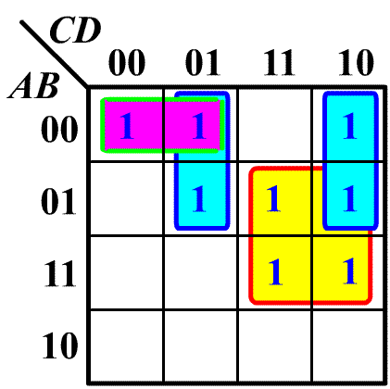
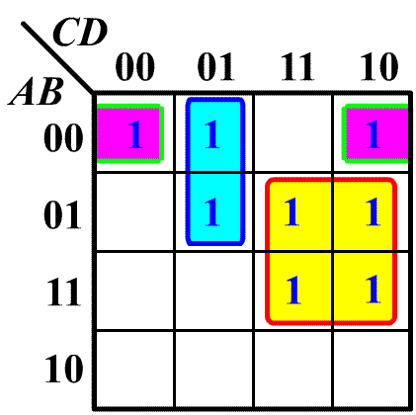
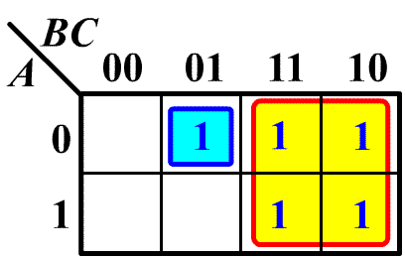
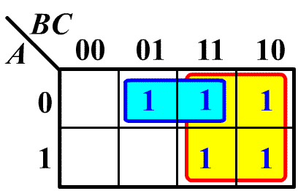
Logic expression simplify by manual : K map Method
Example 1
FALSE more cycles
TRUE
F=BC+A’B’C’+A’C’D+A’CD’
F=BC+A’C’D+A’B’D’
Example 2
FALSE
the circle can be enlarged
TRUE
F=B+A’B’C
F=B+A’C

Slide 52
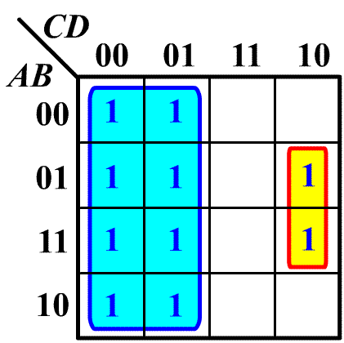
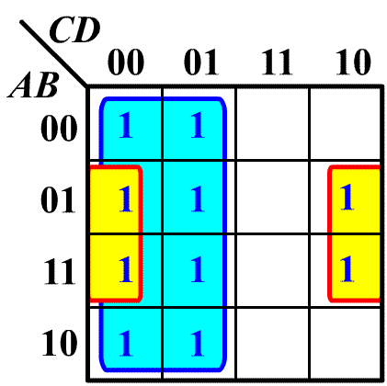
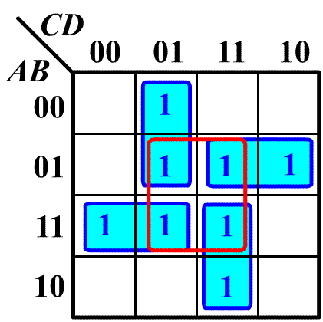
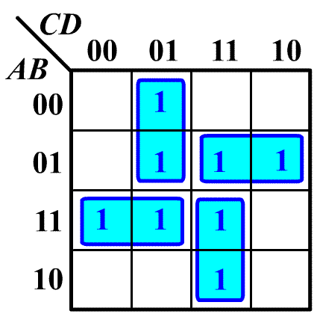
Logic expression simplify by manual : K map Method
Example 3
FALSE
the circle can be enlarged
TRUE
F=C’+BCD’
F=C’+BD’
Example 4
FALSE
dummy circle
TRUE
F=BD+ABC’+A’C’D+A’BC+ACD
F=ABC’+A’C’D+A’BC+ACD

Slide 53
Logic expression simplify by manual : K map Method
How about to circle 0-cells?
Minimize POS
XY
ZW
00 01 11 10
X’+Z
Draw maps
Circle cells
Read maps
0
0
00
01
11
10
0
0
X’+Y
0
0
0
X+Y’+Z’+W
F (X,Y,Z,W)= (X+Y’+Z’+W)·(X’+Z)·(X’+Y)

Slide 54
Logic expression simplify by manual : K map Method
How about the ‘Don’t care’?
Use d as you want
F = Σ_{ABCD}( 0, 2, 3, 5,6, 7, 8, 10, 11)+ d ( 14, 15)
AB
CD
00 01 11 10
Draw maps
Circle cells
Read maps
B’D’
00
01
11
10
1
1
0
4
12
8
1
1
5
13
9
A’BD
1
1
d
1
3
7
15
11
1
1
d
1
C
2
6
14
10
F = B’D’+A’BD+C

Slide 55
Logic expression simplify by manual : K map Method
Minimizing the following function with Don’t Cares
F(A,B,C,D) = ∑m(1,3,4,7,11) + d(5,12,13,14,15)
MSOP
EDA tools~~
AB
MPOS
AB
00 01 11 10
00 01 11 10
CD
CD
00
01
11
10
1
d
00
01
11
10
0
d
0
0
4
12
8
0
4
12
8
1
d
d
d
d
0
1
5
13
9
1
5
13
9
1
1
d
1
d
3
7
15
11
3
7
15
11
d
0
0
d
0
2
6
14
10
2
6
14
10
F= A’·D+C·D+B·C’
F=(A’+C)(C’+D)(B+D)

Slide 56
Exercise
Minimizing the following function with Don’t Cares
F(A,B,C,D) = A’B + B’C + BC’D+ d(14,15)
AB
A’B
CD
00 01 11 10
1
BD
00
01
11
10
1
1
1
1
d
1
1
1
d
1
C
F = A’B+BD+C

Slide 57
Summary
Basic gates & laws
Minimal Complete set (Circle rule)
Positive Logic vs. Negative Logic
Dual (F^{D}) vs. Complement (F’)
Minterm vs. Maxterm
The methods for describing logic circuit
Logic circuit simplify (Formula, K-map )

Slide 58
Topic2： Principles for digital design
Combinational Logic
Sequential Logic
Testbench
Gates and Logic
DFF/Latch, Register & Memory
State machine Description
Design & Analysis
Design & Analysis
Function Description
Response Monitor
Test module
Stimulus Generator

Slide 59
Design & Analysis of Combinational Circuits
Digital Circuit Design is:
To descript and simplify the function
truth table/ K map
logical algebra expressions/equations
CSOP/Minterm list, CPOS/Maxterm list, MSOP, MPOS
circuit diagram (Schematic at Module level, RTL level, etc. )
timing diagram (Waveform)
Hardware Description Language code (VHDL, Verilog, etc.)
To realize the hardware
gates or other devices
Programmable Logic Devices
Application Special Integrate Circuit
Digital Circuit Analysis is:
To determine the behavior of the circuit
To verify the correctness of the circuit
To assist in converting the circuit to a different form
Chap3.2，3.3
Chap3.1

Slide 60
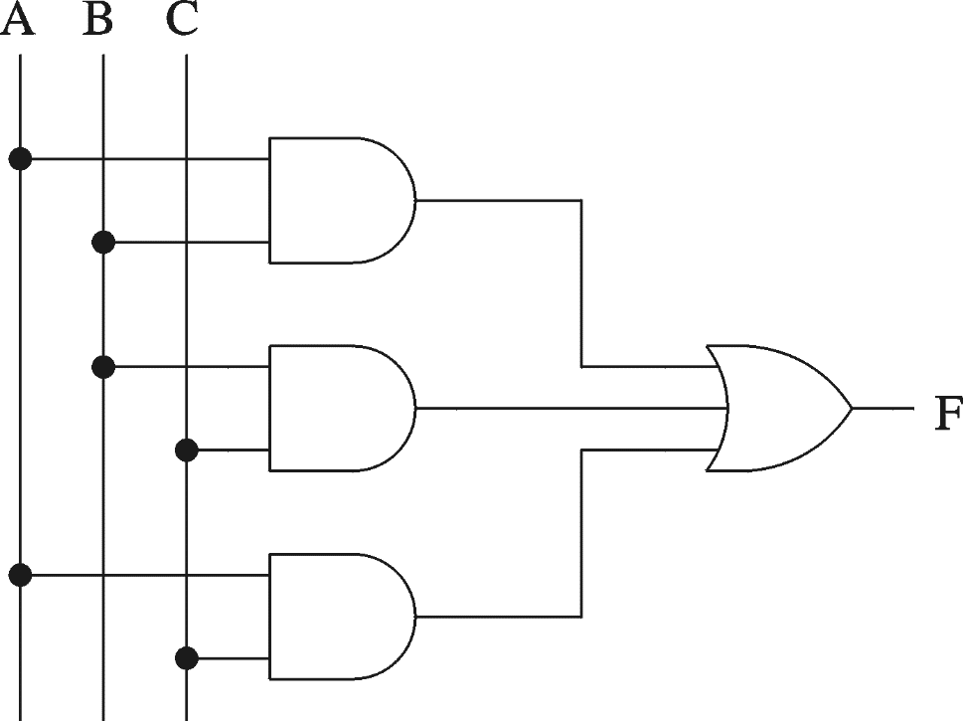
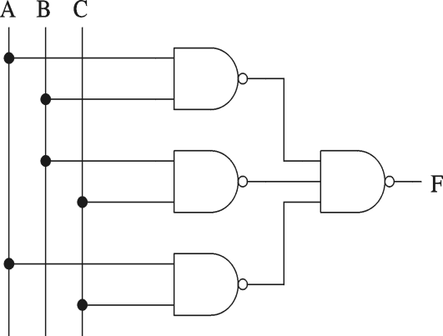
Combinational Digital Circuit Design
1.Description: 3-input Majority function, which output is 1 whenever majority of inputs is 1.
3.K map
5.Circuit schematic
2.Truth table
A B C F
0 0 0
0 0 1
0 1 0
0 1 1
1 0 0
1 0 1
1 1 0
1 1 1
AB
C
00 01 11 10
0
0
0
0
1
1
1
1
0
0
0
1
0
1
0
1
1
1
4.Logical expression
F = AB + BC + AC

Slide 61
Combinational Circuits Analysis
Find a simplified logic for the following circuit :
1.Circuit schematic
3. Truth table
4. K map
ABC
A | B | C | F1 | F2
0 | 0 | 0 | 0 | 0
0 | 0 | 1 | 1 | 0
0 | 1 | 0 | 1 | 0
0 | 1 | 1 | 0 | 1
1 | 0 | 0 | 1 | 0
1 | 0 | 1 | 0 | 1
1 | 1 | 0 | 0 | 1
1 | 1 | 1 | 1 | 1
AB
F1
C
00 01 11 10
A+B+C
0
0
1
0
1
1
1
0
1
0
F1=ABC+A’B’C+A’BC’+AB’C’
AB+BC+AC
AB
F2
C
00 01 11 10
0
0
0
1
0
2.Logical expression
1
0
1
1
1
F1=ABC+(A+B+C)(AB+BC+AC)’
F2=AB+BC+AC
F2=AB+BC+AC
Parity Generator/Checkers
（Even Checker）
Majority circuit
5.Description: What’s the circuit’s function?

Slide 62
Design & Analysis of Combinational Circuits
Digital Circuit Design is:
To descript and simplify the function
truth table/ K map
logical algebra expressions/equations
CSOP/Minterm list, CPOS/Maxterm list, MSOP, MPOS
circuit diagram (Schematic at Module level, RTL level, etc. )
timing diagram (Waveform)
Hardware Description Language code (VHDL, Verilog, etc.)
To realize the hardware
gates or other devices
Programmable Logic Devices
Application Special Integrate Circuit
Digital Circuit Analysis is:
To determine the behavior of the circuit
To verify the correctness of the circuit
To assist in converting the circuit to a different form

Slide 63
Examples for Combinational Digital Circuit Design
Chap1.3，1.4，4.2
Multiplexer/Demultiplexer
Decoder/ Encoder
Parity Generator/Checker
Operator
2026-03-21

Slide 64
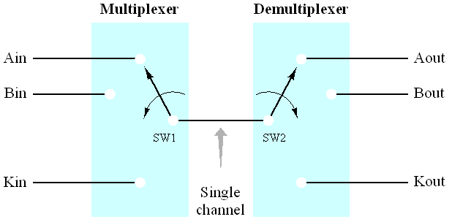
Multiplexer & Demultiplexer
MUX, Digital Switch, Multi-Switch, Data Selector
D₀
2:1
Mux
Z = A' D₀
+ A D₁
D₁
Z
A
D₀
Z = B’A’ D₀
+ B’A D₁
+ BA’ D₂
+ BA D₃
D₁
4:1
D₂
Mux
Z
D₃
B
A
Connect 2^{n} points to a single point
Route the bus data to one of m destinations
Z = C’B’A’ D₀
+ C’B’A D₁
+ C’BA’ D₂
+ C’BA D₃
+ CB’A’ D₄
+ CB’A D₅
+ CBA’ D₆
+ CBA D₇
D₀
D₁
Enable
EN
SEL
D0
Dn-1
D₂
D₃
8:1
Select
D₄
Mux
Z
n
n
D₅
Y
D₆
D₇
Data
n
C
B
A
2026-03-21

Slide 65
Logic design with MUX
F(A,B,C) = m0 + m2 + m6 + m7
1
0
A
B
C
F
0
1
0
0
0
1
1
2
F
C’
C’
0
F
0
8:1
0
0
1
0
3
0
1
0
1
C’
1
4:1
0
4
MUX
C’
0
2
MUX
0
5
0
1
1
0
1
3
1
6
1
0
0
0
S1 S0
1
7
S2 S1 S0
0
1
0
1
0
A
B
A
B
C
1
1
0
1
1
1
1
1
1
Lookup Table
2^{n-1}:1 MUX can implement any function of less than n variables

Slide 66
Exercise
F = Σ_{(W,X,Y,Z)}(0,1,3,7,9,13,14)
WX
74x151
YZ
00 01 11 10
EN
00
01
11
10
1
0
4
12
8
1
Y
X
W
A
B
C
1
1
9
V_{CC}
1
5
13
1
1
15
11
3
7
D0
D1
D2
D3
D4
D5
D6
D7
1
Y
Y
F
2
6
14
10
WX
Y
00 01 11 10
0
1
0
Z
Z
Z
1
Z
Z
Z’
0
2026-03-21

Slide 67
HDL for Octal 2-to-1 MUX
module Mux8 (
);
endmodule
output[7:0] bus1,
input sel,
input [7:0] data1, data0
assign ;
bus1 = sel ? data1 : data0
8
data₀
0
8
8
bus1
condition ？true_expression：false_expression
data₁
1
sel

Slide 68
HDL for 3-to-1 MUX
module Mux31a ( q, a , b, c, sel ) ;
endmodule
module Mux31b ( q, a , b, c, sel ) ;
endmodule
output q;
input a, b, c;
input [ 1:0 ] sel;
output q;
input a, b, c;
input [ 1:0 ] sel;
reg q;
Assigned in Procedural Block
Assigned in Procedural Block
reg q;
always @ ( * )
begin
end
always @ ( * )
begin
end
case ( sel )
endcase
0: q = a ;
1: q = b;
2: q = c;
default: q = a;
if ( sel[0] == 1 ) q = b;
else if ( sel[1] == 1 ) q = c;
else q = a;
No priority
Priority!
Default alternative
Else alternative
HARDWARE!
a
0
a
0
q
b
c
q
c
1
b
1
sel[1]
sel
2
sel[0]

Slide 69
Examples for Combinational Digital Circuit Design
Chap1.3，1.4，4.2
Multiplexer/Demultiplexer
Decoder/ Encoder
Parity Generator/Checker
Operator
Chap4.7
2026-03-21

Slide 70
Decoder and Encoder
Multiple-Input, Multiple-Output Logic Circuit
Translate one code to another code. Normally used case:
Output Code of Decoder has More bits than its Input Code
Output Code of Encoder has Fewer bits than its Input Code
Enable Inputs must be Asserted to perform Normal Mapping Function
n-bit Binary
Decoder
1-out-of 2^{n}
1-out-of 2^{n}
Encoder
n-bit Binary
Input
Code
Input
Code
Map
Map
Output
Code
Output
Code
Enable Inputs
Enable Inputs

Slide 71
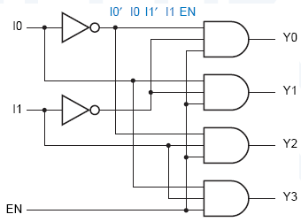
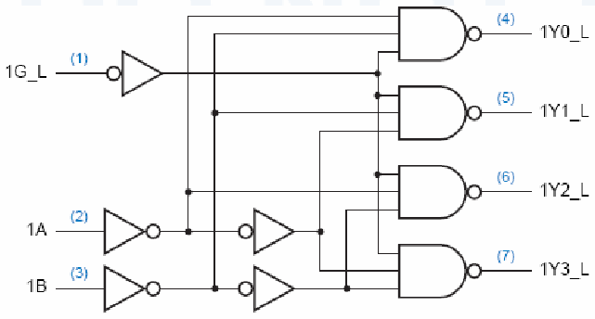
Binary Decoder
1.Truth Table
Truth Table
Negative logic
Inputs
EN I1 I0
Outputs
Y3 Y2 Y1 Y0
Inputs
G_L B A
Outputs
Y3_L Y2_L Y1_L Y0_L
How about the Logical expression?
0 X X 0 0 0 0
1 0 0 0 0 0 1
1 0 1 0 0 1 0
1 1 0 0 1 0 0
1 1 1 1 0 0 0
1 X X 1 1 1 1
0 0 0 1 1 1 0
0 0 1 1 1 0 1
0 1 0 1 0 1 1
0 1 1 0 1 1 1
2.Logical expression
Y0 = EN · ( I1’ · I0’ )
Y1 = EN · ( I1’ · I0 )
Y2 = EN · ( I1 · I0’ )
Y3 = EN · ( I1 · I0 )
2-to-4
Decoder
2-to-4
Decoder
G
A
B
Y0
Y1
Y2
Y3
G
A
B
Y0
Y1
Y2
Y3
3. Schematic and logic symbol
2-to-4
Decoder
2-to-4
Decoder
I0
I1
EN
Y0
Y1
Y2
Y3
G_L
G
A
B
Y0
Y1
Y2
Y3
Y0_L
Y1_L
A
Y2_L
B
Y3_L
2026-03-21

Slide 72
Exercise
Please give the truth table of 3-to-8 Decoder
input |  | output
G1 G2A_L G2B_L | C B A | Y7_L Y6_L Y5_L Y4_L Y3_L Y2_L Y1_L Y0_L
0 X X | X X X | 1 1 1 1 1 1 1 1
X 1 X | X X X | 1 1 1 1 1 1 1 1
X X 1 | X X X | 1 1 1 1 1 1 1 1
1 0 0 | 0 0 0 | 1 1 1 1 1 1 1 0
1 0 0 | 0 0 1 | 1 1 1 1 1 1 0 1
1 0 0 | 0 1 0 | 1 1 1 1 1 0 1 1
1 0 0 | 0 1 1 | 1 1 1 1 0 1 1 1
1 0 0 | 1 0 0 | 1 1 1 0 1 1 1 1
1 0 0 | 1 0 1 | 1 1 0 1 1 1 1 1
1 0 0 | 1 1 0 | 1 0 1 1 1 1 1 1
1 0 0 | 1 1 1 | 0 1 1 1 1 1 1 1
74LS138
Enable
EN
G1
G2A
G2B
Y0
Y1
Y2
Y3
Y4
Y5
Y6
Y7
LSB
MSB
A
B
C
m₆’=M₆
Y6_L=(C·B·A’)’

Slide 73
Logic design with Decoder and Gates
F1 = ∑_{(X,Y,Z)} (0,3,6,7)
While enable input asserted, Yi = m_{i}’=Mi
+5V
74x138
G1
G2A
G2B
Y0
Y1
Y2
Y3
Y4
Y5
Y6
Y7
F2
F1
Z
Y
X
LSB
MSB
A
B
C
F2 = ∏ _{(X,Y,Z)} ( 1, 2, 4, 5 )
= M₁ · M₂ · M₄ · M₅
= m₁’ · m₂’ · m₄’ · m₅’

Slide 74
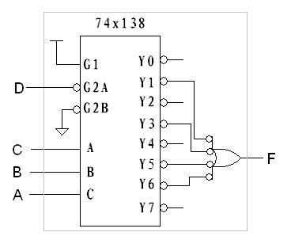
Exercise
Please build the circuit F With only one 3-to-8 Decoder
A B C D
0 0 1 0
0 1 1 0
1 0 1 0
1 1 0 0
Dimension Reduction
A B C
0 0 1
0 1 1
1 0 1
1 1 0
73

Slide 75
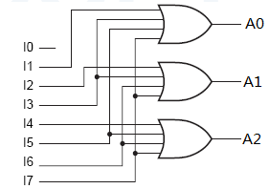
Binary Encoder
I0 I1 I2 I3 I4 I5 I6 I7
A2 A1 A0
A0 = I1 + I3 + I5 + I7
1 0 0 0 0 0 0 0 0 0 0
0 1 0 0 0 0 0 0 0 0 1
0 0 1 0 0 0 0 0 0 1 0
0 0 0 1 0 0 0 0 0 1 1
0 0 0 0 1 0 0 0 1 0 0
0 0 0 0 0 1 0 0 1 0 1
0 0 0 0 0 0 1 0 1 1 0
0 0 0 0 0 0 0 1 1 1 1
A1 = I2 + I3 + I6 + I7
A2 = I4 + I5 + I6 + I7
………..
This 8-to-3 Encoder is the exact opposite of a decoder.
only one input will be asserted at a time (Guarantee).
I0 I1 I2 I3 I4 I5 I6 I7
A2 A1 A0
0 1 1 1 1 1 1 1 0 0 0
1 0 1 1 1 1 1 1 0 0 1
1 1 0 1 1 1 1 1 0 1 0
1 1 1 0 1 1 1 1 0 1 1
1 1 1 1 0 1 1 1 1 0 0
1 1 1 1 1 0 1 1 1 0 1
1 1 1 1 1 1 0 1 1 1 0
1 1 1 1 1 1 1 0 1 1 1
How to deal with low level input?
How to deal with multiple requests?
---more than One Inputs are asserted

Slide 76
Priority Binary Encoder
input | output
EI_L I0_L I1_L I2_L I3_L I4_L I5_L I6_L I7_L | A2_L A1_L A0_L GS_L EO_L
1 x x x x x x x x | 1 1 1 1 1
0 x x x x x x x 0 | 0 0 0 0 1
0 x x x x x x 0 1 | 0 0 1 0 1
0 x x x x x 0 1 1 | 0 1 0 0 1
0 x x x x 0 1 1 1 | 0 1 1 0 1
0 x x x 0 1 1 1 1 | 1 0 0 0 1
0 x x 0 1 1 1 1 1 | 1 0 1 0 1
0 x 0 1 1 1 1 1 1 | 1 1 0 0 1
0 0 1 1 1 1 1 1 1 | 1 1 1 0 1
0 1 1 1 1 1 1 1 1 | 1 1 1 1 0
74x148
5
4
3
2
1
13
12
11
10
EI
I7
I6
I5
I4
I3
I2
I1
I0
6
7
9
A2
A1
A0
14
15
GS
EO
H7 = I7_L
H6 = I6_L + I7_L’
H5 = I5_L + I6’_L + I7’_L
…
H0 = I0_L +I1_L’ + …+I6_L’ + I7_L’
A2_L = H4 · H5 · H6 · H7
A1_L = H2 · H3 · H6 · H7
A0_L = H1 · H3 · H5 · H7
EI_L is implied.
The GS_L Output is invalid if all inputs are invalid or EI_L is invalid.
The EO_L Output is valid only if all inputs are invalid.

Slide 77
HDL for 3-8 Decoder
module decoder3_8 (
);
always @( )
if( )
case( )
endcase
else
endmodule
G1
G2A
G2B
Y0
Y1
Y2
Y3
Y4
Y5
Y6
Y7
module decoder2_4(I0,I1,EN,Y0,Y1,Y2,Y3);
input I0, I1, EN;
output Y0, Y1, Y2, Y3;
endmodule
input G1,G2A_L,G2B_L, input C, B, A,
output reg[7:0] Y_L
wire I0N, I1N;
A
B
C
not U1(I0N, I0),
U2(I1N, I1);
*
G1 & ~G2A_L & ~G2B_L
and U3(Y0, EN, I0N, I1N),
U4(Y1, EN, I0, I1N),
U5(Y2, EN, I0N, I1),
U6(Y3, EN, I0, I1);
结构描述风格
{C,B,A}
0: Y_L = 8'b11111110;
1: Y_L = 8'b11111101;
2: Y_L = 8'b11111011;
3: Y_L = 8'b11110111;
4: Y_L = 8'b11101111;
5: Y_L = 8'b11011111;
6: Y_L = 8'b10111111;
7: Y_L = 8'b01111111;
default: Y_L = 8'b11111111;
行为描述风格
module decoder2_4(I0,I1,EN,Y0,Y1,Y2,Y3);
input I0, I1, EN;
output Y0, Y1, Y2, Y3;
endmodule
U1
I0N
I1N
U3
wire I0N, I1N;
assign I0N = !I0;
assign I1N = !I1;
assign Y0 = !(I0N & I1N & EN);
assign Y1 = !(I0N & in1 & EN);
assign Y2 = !(wire2 & in0 & EN);
assign Y3 = !(in0 & in1 & EN);
U2
U4
U5
数据流
描述
风格
Y_L=8'b11111111;
U6

Slide 78
HDL for 4-2 Encoder
module Code42( F, I ) ;
endmodule
, en);
output [ 1:0 ] F;
input [ 3:0 ] I;
input en;
reg [1:0] t;
z: High impedance
assign F = t ；
en ? t : 2’bz;
I₀
always @ ( * )
begin
end
I₁
F1
I₂
F0
always @ ( * )
begin
if (I[3]) t= 2’b11 ;
else if (I[2]) t = 2’b10 ;
else if (I[1]) t = 2’b01 ;
else t = 2’b00 ;
end
I₃
case ( I )
1: t = 0 ;
2: t = 1 ;
4: t = 2 ;
8 : t = 3 ;
default: t = 0 ;
endcase
en
HARD-WARE!
No priority
Priority!

Slide 79
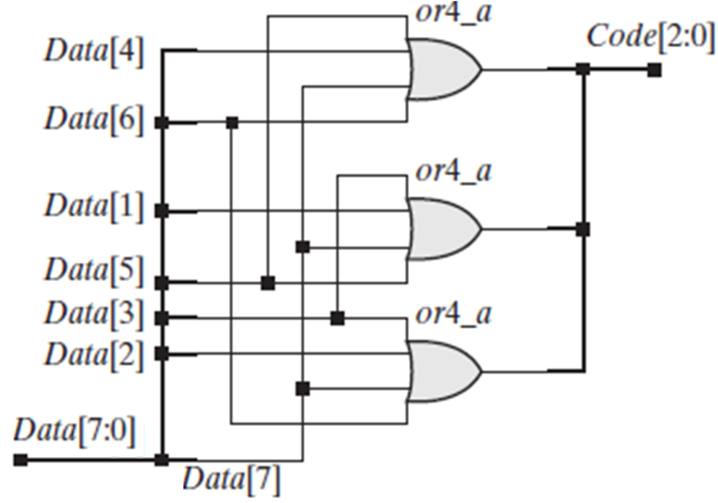
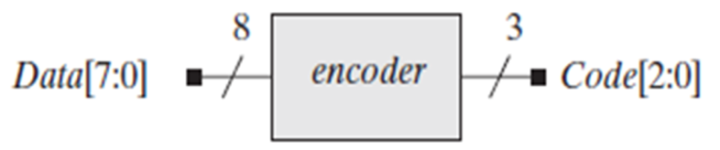
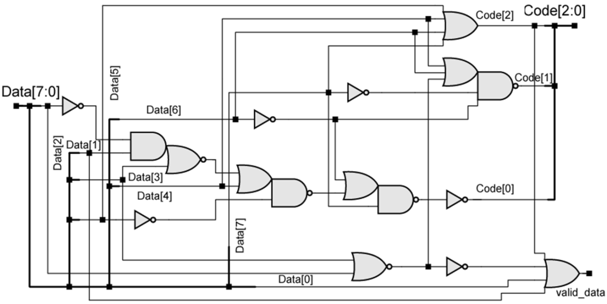
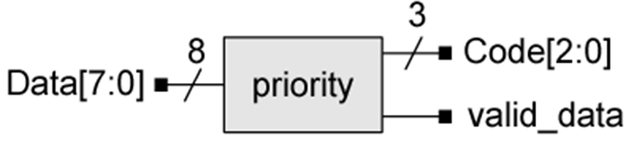
The synthesis results

Slide 80
Examples for Combinational Digital Circuit Design
Chap1.3，1.4，4.2
Multiplexer/Demultiplexer
Decoder/ Encoder
Parity Generator/Checker
Operator
Chap4.7
2026-03-21

Slide 81
Parity-Checking Applications
Detect errors in the transmission and storage process.
DB[0:7]
DB[0:7]
Transmitter
9bits
Receiver
74x280
74x280
A
A
EVEN
Which logic operation we have learned can used for parity circuit?
EVEN
ODD
ODD
ERR
H
I
H
I
Parity Generator
Parity Checker
2026-03-21

Slide 82
Parity Circuit
Even-Parity Gen: Output is 1 if the number of the input 1 are odd.
Odd-Parity Gen: Output is 1 if the number of the input 1 are even.
1
if the number of variable ‘1’ is odd
A₀ ⊕ A₁ ⊕ … ⊕ A_{n} =
0
if the number of variable ‘1’ is even
A0
A1
A2
A3
An
A0
A1
A2
A3
EVEN
EVEN
An-1
An
Daisy-chain Structure
Tree Structure
How can we get an odd-parity circuit?
Invert the output of even-parity circuit
2026-03-21

Slide 83
Review of XOR and XNOR
Any two signals( inputs or output) of an XOR or XNOR gate could be complemented without changing the resulting logic function.
A
B
A
B
F
A
B
F
A
B
F
F
F=A⊕B
F=A’⊕B’
F=(A’⊕B)’
F=(A⊕B’)’
A⊕B=(A⊙B)’ A⊕B’=A⊙B A⊕B=A⊙B’
2026-03-21

Slide 84
Comparator design
Chap4.9
Comparator: Check if two Binary words are equal
Magnitude Comparator: Compare their magnitude (Greater than, Equal, Less than)
How to build a 1-bit Comparator?
A
B
DIFF
A
B
EQ
2026-03-21

Slide 85
Exercise
Please Build a N-bit Comparator with 1-bit comparator.
Paraller/Tree Structure
The upper one is a parallel N-bit Comparator.
The lower one is a Serial N-bit Comparator.
The lower structure is cheaper but slower than the upper one.
A0
B0
A1
B1
DIFF
A2
B2
A3
B3
Serial/Iterative/Daisy-chain structure
A₀
B₀
A₁
B₁
A_{N-1}
B_{N-1}
A
B
X Y
EQI EQO
X Y
EQI EQO
X Y
EQI EQO
EQO
“1”
EQ_{N}
EQI
2026-03-21

Slide 86
Examples for Combinational Digital Circuit Design
Chap1.3，1.4，4.2
Multiplexer/Demultiplexer
Decoder/ Encoder
Parity Generator/Checker
Operator
Chap4.7
Chap4.3，4.5
2026-03-21

Slide 87
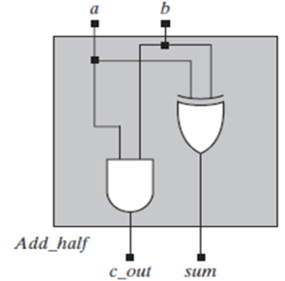
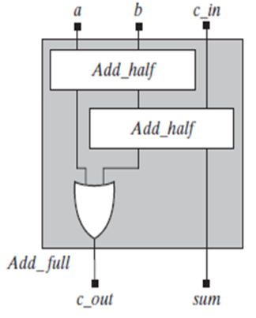
1-bit Adder
Logic Symbol
逻辑符号
Schemitic
电路原理图
Truth table
真值表
Logic Function
逻辑表达式
Verilog code
HDL语言
half adder 半加器
X | Y | C_{O} | S
0 | 0 | 0 | 0
0 | 1 | 0 | 1
1 | 0 | 0 | 1
1 | 1 | 1 | 0
module Add_half(c_out, sum, a, b,);
endmodule
X
Full
Adder
Sum
CO=XY
S=X’ Y+XY’
=X⊕Y
input a,b;
output c_out,sum;
Y
Cout
and(c_out,a,b);
xor(sum,a,b);
full adder 全加器
X | Y | CI | C_{O} | S
0 | 0 | 0 | 0 | 0
0 | 0 | 1 | 0 | 1
0 | 1 | 0 | 0 | 1
0 | 1 | 1 | 1 | 0
1 | 0 | 0 | 0 | 1
1 | 0 | 1 | 1 | 0
1 | 1 | 0 | 1 | 0
1 | 1 | 1 | 1 | 1
module Add_full(c_out,sum,a,b,c_in);
endmodule
X
P1
CO=X’YCI+XY’CI+XYCI’+XYCI
=XY+XCI+YCI
S=X’Y’CI+X’YCI’+XY’CI’+XYCI
=X⊕Y⊕CI
input a,b,c_in;
output c_out, sum;
Full
Adder
Sum
W2= X⊕Y
Y
P2
wire w1,w2,w3;
Cin
Cout
W1=XY
P3
W3=W2 CIN
Add_half P1(w1,w2,a,b);
Add_half P2(w3,sum,w2,c_in);
or P3(c_out,w1,w3);
2026-03-21

Slide 88
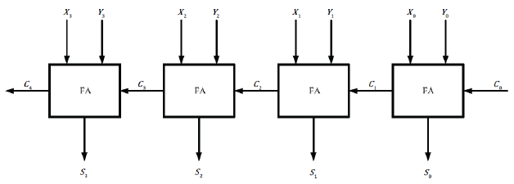
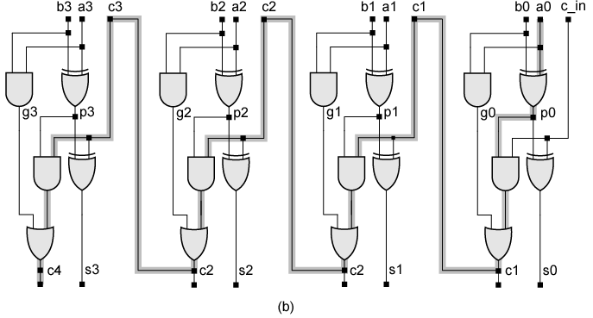
A 4-bit ripple-carry adders
the longest path
87

Slide 89
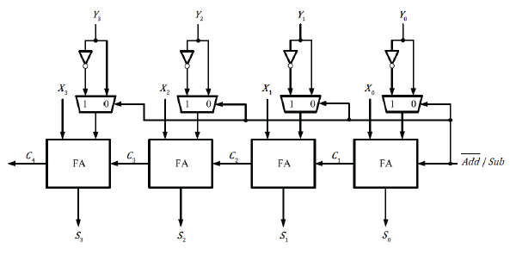


Structure of addition/subtraction
The same function can be achieved by replacing the multiplex and inverter with an XOR gate.

Slide 90
4-bits Signed Adder
module Adder4 ( A, B, Cin, S, Cout , Ovout ) ;
endmodule
input [ 3:0 ] A, B;
input Cin;
output [ 3:0 ] S;
output Cout , Ovout ;
How about the circuit after synthesis?
Check it.
Operator Definition
assign {Cout, S} = A + B + Cin ;
assign OVout= (A[3]==B[3]) && (S[3] !=A[3]);
A
4
Adder4
4
S
B
4
Cin
Cout

Slide 91
4-bit Add_Suber
// select 0=add, 1=subtract
module AddSub ( input S,
input [3:0] A, B,
output reg [3:0] F,
output reg Unsigned_Overflow, Signed_Overflow );
reg [4:0] TempF;
assign F = TempF[3:0];
assign Unsigned_Overflow = TempF[4];
always @ ( * ) begin
if (S == 0) begin
TempF = {1'b0,A} + {1'b0,B};
Signed_Overflow = ((!A[3]) & (!B[3]) & (TempF[3])) + ((A[3]) & (B[3]) & (!TempF[3])); end
else begin
TempF = {1'b0,A} - {1'b0,B};
Signed_Overflow = ((A[3]) & (!B[3]) & (!TempF[3])) + ((!A[3]) & (B[3]) & (TempF[3])); end
end
endmodule
// addition
// zero extend A and B
// subtract
// = MSB of A'B'F + ABF'
// zero extend A and B
// = MSB of AB'F' + A'BF
90

Slide 92
8-bit ALU
module ALU8 (
);
endmodule
output reg [7:0] ALUout
input [7:0] left, right,
input [1:0] mode,
The Declaration of ALUout both as output and reg: Because of assigning it within a Procedural Block
always @(*)
begin
end
case (mode)
0: ALUout = left + right;
1: ALUout = left - right;
2: ALUout = left & right;
3: ALUout = left | right;
default: ALUout = 8'bX;
endcase
x: undetermined
Default alternative if mode contains anything but 1s and 0s

Slide 93
Design & Analysis of Combinational Circuits
Digital Circuit Design is:
To descript and simplify the function
truth table/ K map
logical algebra expressions/equations
CSOP/Minterm list, CPOS/Maxterm list, MSOP, MPOS
circuit diagram (Schematic at Module level, RTL level, etc. )
timing diagram (Waveform)
Hardware Description Language code (VHDL, Verilog, etc.)
To realize the hardware
gates or other devices
Programmable Logic Devices
Application Special Integrate Circuit
Digital Circuit Analysis is:
To determine the behavior of the circuit
To verify the correctness of the circuit
To assist in converting the circuit to a different form

Slide 94
Design & Analysis of Combinational Circuits
Digital Circuit Design is:
To descript and simplify the function
truth table/ K map
logical algebra expressions/equations
CSOP/Minterm list, CPOS/Maxterm list, MSOP, MPOS
circuit diagram (Schematic at Module level, RTL level, etc. )
timing diagram (Waveform)
Hardware Description Language code (VHDL, Verilog, etc.)
To realize the hardware
gates or other devices
Programmable Logic Devices
Application Special Integrate Circuit
Digital Circuit Analysis is:
To determine the behavior of the circuit
To verify the correctness of the circuit
To assist in converting the circuit to a different form
CAD：Computer Aided Design
EDA：Electronic Design Automatic

Slide 95
VHDL vs. Verilog
Government Developed in 1981 | Commercially Developed in 1985
Ada based | C based
Strongly Type Cast | Mildly Type Cast
Case-insensitive | Case-sensitive
Difficult to learn | Easier to Learn
Chap1.4
VHDL is an acronym for :
VHSIC (Very High Speed Integrated Circuit) Hardware Description Language
HDLs is used to describe a HARDWARE!
They are quite different with the tradition program language!

Slide 96
TOP-DOWN Design
Digital circuit
Top-level module
port-function
Control Module
PART 1
(combination)
Datapath Module
PART 1
(combination)
PART 4
(Register)
PART 3
(sequential
FSM)
module
port-function
module
port-function
module
port-function
module
port-function
PART 2
(combination)
PART 2
(combination)
PART 5
(Counter)
Interconnect
module
port-function
module
port-function
PART 4
(sequential
FSM)
module
port-function
PART 3
(combination)
module
port-function
Interconnect
module
port-function
Interconnect

Slide 97
Basic Verilog Modeling
module is a most basic building block of a design.
port declarations describes the interface of the component, i.e. input and output ports.
circuit functionality describes an implementation of the corresponding module.
port_mode port_name1;
port_mode port_name2;
…………
module module_name (port_name1,_port_name2, …);
port declarations
wire interconnect_name1;
wire interconnect_name1;
…………
Interconnect declarations
assign statements;
always @(sensitive signals list)
begin
functionality code
end
circuit functionality
endmodule

Slide 98
Fundamental rules of Verilog
module name
module ports
module MultiplexerC (w，a, b, s);
output reg w;
input a，b，s;
wire m;
assign m = a+b;
always @(*)
begin
if (s) w = b;
else w = m;
end
endmodule
The signal assigned in always block should be ‘reg’ type
Declare port and inter-connect signal
reserved words
lowercase
Continuous Assignment statement is used if the unit is simple
Semicolon
Procedural Block(always)
statement with sensitivity list is used when the unit is too complex
No Semicolon

Slide 99

Verilog Design Styles
Chap1.2
Testbenches
module dataflow (Result, A, B, C);
output Result;
input A, B, C;
assign Result = (A ^ B) ^ C;
endmodule
structural
dataflow
behavioral
(sequential)
Components and
interconnects
Concurrent statements
Subset most suitable for synthesis
module behavioral (Result, A, B, C);
output reg Result;
input A, B, C;
always @ (*)
begin
Result = (A ^ B) ^ C;
end
endmodule
module structural (Result, A, B, C);
output Result;
input A, B, C;
wire U1_OUT;
xor U1(U1_OUT,A,B); xor U2(Result,U1_OUT,C);
endmodule
U1_OUT
I1
I1
Y
Y
I2
I2

Slide 100
Interconnections
module ALU8 (input [7:0] left, right,
input [1:0] mode,
output reg [7:0] ALUout );
……..
endmodule
Defined
module Mux8 ( input sel,
input [7:0] data1, data0,
output[7:0] bus1 );
……..
endmodule
Defined
Defined Port
ALU8 U1 ( .left(Inbus), .right(ABinput),
.mode(Function), .ALUout(Outbus) );
Mux8 U2 ( .sel(select_source), .data1(Aside), .data0(Bside), .bus1 (ABinput));
Real connection
Instantiated
u1 and u2 : Instance Names
ALU8 U1 ( Inbus, ABinput, Function, Outbus );
Ordered Port Connection

Slide 101
Organization of Center Processor Unit
Parity Generator
Parity Checker
Decoder
2026-03-21

Slide 102
Digital Logic Design and Application
Topic 2 - Principles for digital design Yan Bo
School of Information & Communication Engineering, UESTC
Email: yanboyu@uestc.edu.cn
THE END OF Topic2-1
2026-03-21
101

Slide 103
Required reading
Digital System Design with Verilog & VHDL
2nd Edition，Enoch O.Hwang著，阎波 朱晓章 姚毅改编
Chapter 2, Fundamentals of Digital Circuit
Chapter 3, Combinational Circuits
Chapter 4, Standard Combinational Components
Digital Design: Principles and Practices
4th Edition, John F. Wakerly
Chapter 4, Combinational Logic Design Principles
Chapter 5, Combinational Logic Design Practices
数字逻辑设计及应用
姜书艳等，电子科技大学出版社
Chapter 3 , Basis of Logic Algebra
Chapter 5, Combinational Logic Circuit Design
数字集成电路与系统设计
李广军、郭志勇等，电子工业出版社
Chapter 4 , Verilog HDL基础
Chapter 5, 数字逻辑电路的Verilog RTL建模与设计

Slide 104
Homework2-1
P17 1.9、1.10
P59 2.4（ b ）、 2.5（ c ）、2.7（ d ）、
2.10（ c ）、2.12（ c ）、2.14（ d ）
2.27 （a, d）、 2.28（ c ） 、2.34、2.35
P106 3.1（ d ） 、 3.2（ d ） 、3.4（a, e） 、
3.11、3.17（ b ） 、3.23（c, f）、
3.26（a）、3.36
P151 4.2、4.25 、4.28、4.32

Slide 105

Homework2-1（ Additional questions ）
1. Using Karnaugh maps, find a minimal SOP expression and a minimal POS expression for each of the following logic functions. Indicate the distinguished 1-cells (or 0-cells) in each map.
(a) F= Σ_{x,y,z}(1,3,5,6,7)
(b) F= Σ_{W,X,Y ,Z}(0,1,2,8,11)+ d(3,9,15)
2. Please finish the function as below:
1) Consider the 8-to-1 MUX as a single component shown here
2) Use 1 pcs 74LS138 to finish the same F(x,y,z), other basic gates are also allowed to be used.
F (x, y, z) = x'y'z' + x'yz' + xy'z + xyz' + xyz.

