Slide 1
Digital Logic Design and Application
Lab Course 5
Lecturer:
TA:
Lab Room:

Slide 2
Fundamental
Digital Logic + Computer Architecture
Verilog Language
Tools
EDA software: Vivado 2017.1
Evaluation board: EES331
Lab report submitted
e-file name: report no. + student code + name (eg: 1_20xxxxxx_Alex)
send to email: same as the homework
cut-off time: report1 : before lab3 （before 14, May）
report2 : 1 week after lab5（before 10, May ）

Slide 3
Grading
Assessment
Lab1 10% + Lab2 20% + Lab3 20% + Lab4 20% + Lab5 10% + Report1 5% + Repor2 15%
And for each lab:
Pre-Lab preparation and Performance in laboratory (65%)
Laboratory experimental reports (35%)

Slide 4
Note
Please save the screenshots of the code, simulation result, etc.
You will need them to write the Lab_report.

Slide 5
Content
EDA tools
Datapath Design
Controller Design
CPU Integration
CPU Verification and Improvement
Enlarge your own instruction set (for example: add several instructions) and modify the datapath & controller modules based on the new instruction set
Compose a better testbench and do verification again
Describe your work as clearly as possible in your lab report2

Slide 6
Instruction Set
Opcode | Rd | Rs | Imme | assembly | function
4bit | 2bit | 2bit | 8bit
0000 0001 | 01 10 | xx 01 | 00000010 xxxxxxxx | Mov R1 #02 Mov R2 R1 | R1<= 2 R2<=(R1)
0010 0011 | 01 01 | xx 10 | 00001000 xxxxxxxx | Add R1 #08 Add R1 R2 | R1<=(R1)+8 R1<=(R1)+(R2)
0101 | 01 | 10 | xxxxxxxx | Sub R1 R2 | R1<=(R1)-(R2)
0110 0111 | 11 01 | xx 10 | 00000011 xxxxxxxx | And R1 #03 And R1 R2 | R3<= (R3) bit_and (3) R1<= (R1) bit_and (R2)
1001 | 01 | 10 | xxxxxxxx | Or R1 R2 | R1<=(R1) bit_or (R2)
1010 | xx | xx | 00000001 | Jump #01 | PC<= 1
Opcode supports 16 instructions. So you can add other instructions, like shift, multiplication.
Rd and Rs can be expressed in 2 bits that means you can operate 4 registers.
Immediate data is expressed in 8 bits.

Slide 7
1. Create New Hardware Project
Follow the steps of lab1.ppt to create New Hardware Project.

Slide 8
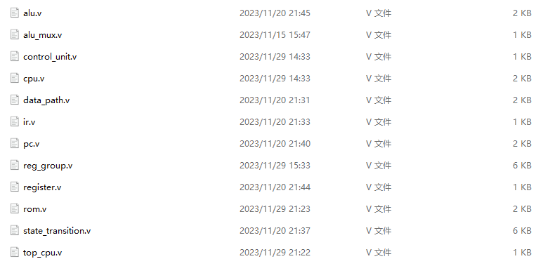
Follow the steps of lab4.ppt to create files in the code folder like this
2. Create New Source File -step1

Slide 9
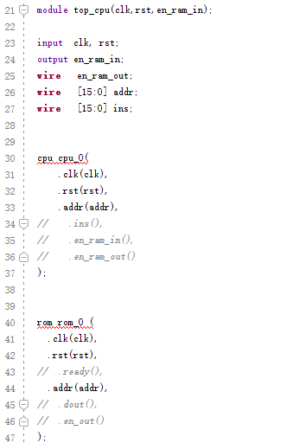
Refer to the next page to combine cpu and rom in top_cpu.v
2. Create New Source File -step2

Slide 10
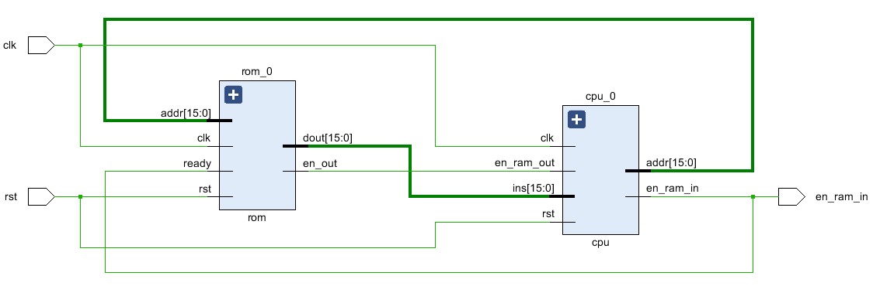
clk
rst
ROM
16
ins
CPU
en_ram_out
16
addr
2. Create New Source File -step3
en_ram_in
system_top

Slide 11
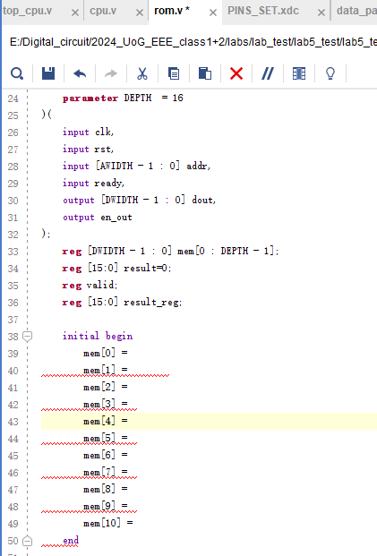
A ROM (Read-only memory), with instructions editable in design phase.
2. Create New Source File -step4
Design your program according to the equation below.
Be aware that data exceeding the defined address is unknown.
[8-(2+1) ]|(2+1)+1

Slide 12
3. Create the ILA IP core (Integrated Logic Analyser)

Slide 13
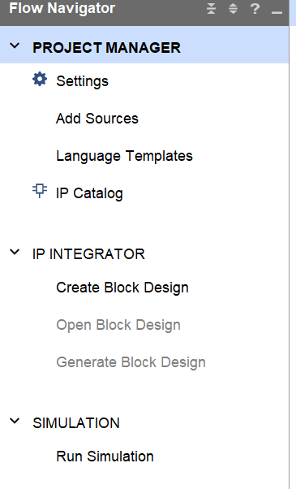
3. Create the ILA IP core
Step-1
1. Left-click

Slide 14
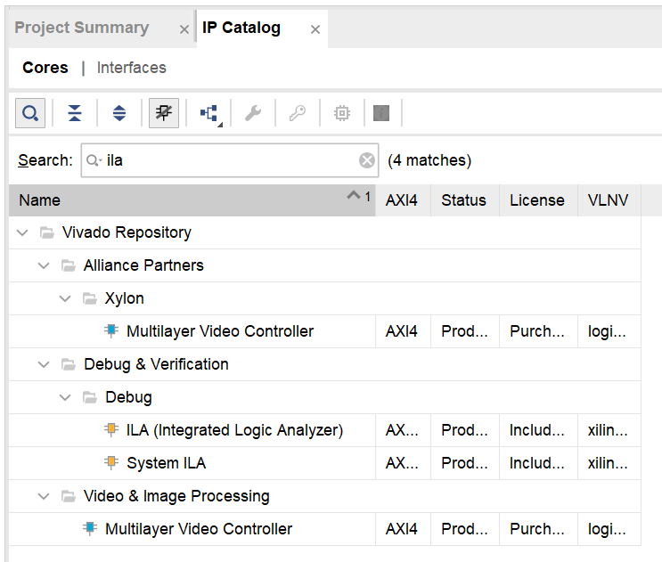
1. Input name to search IP cores
3. Create the ILA IP core
Step-2
1. Left-click
2. Double click

Slide 15
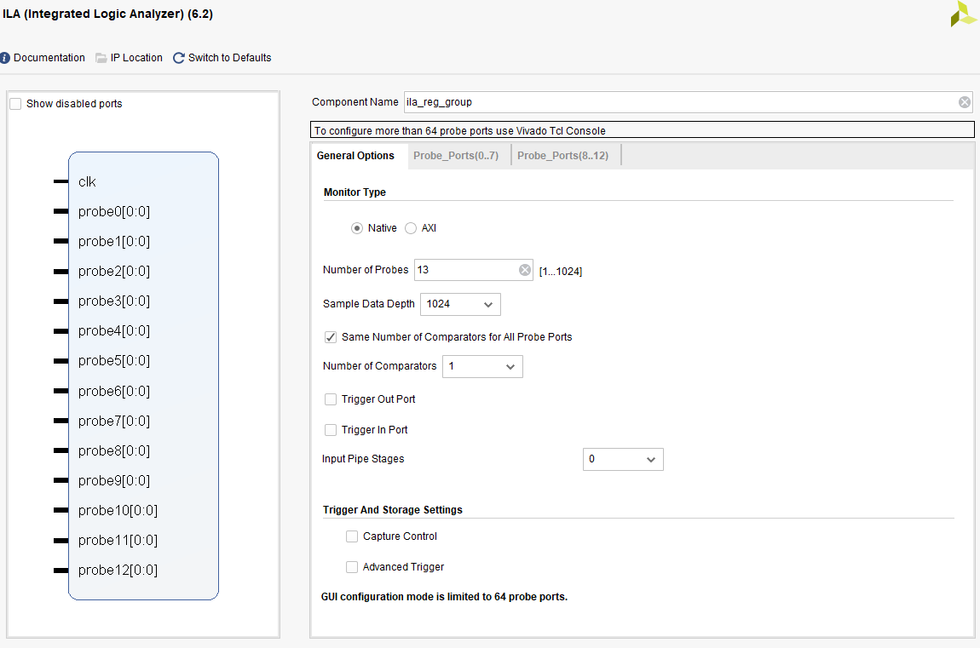
1. Module’s name
3. ADD
IP CORE
-step2-2
2. Input parameter

Slide 16
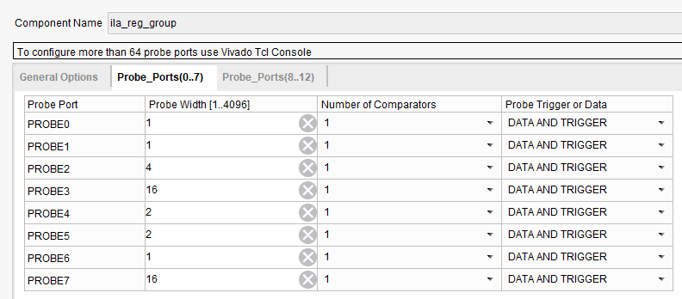
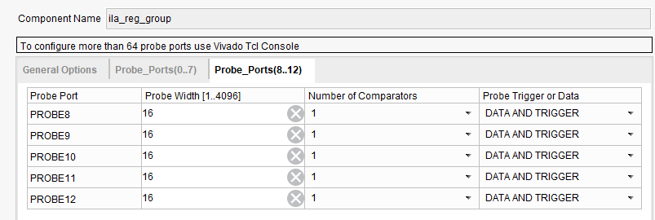
3. ADD
IP CORE
-step2-3
1. Input parameter

Slide 17
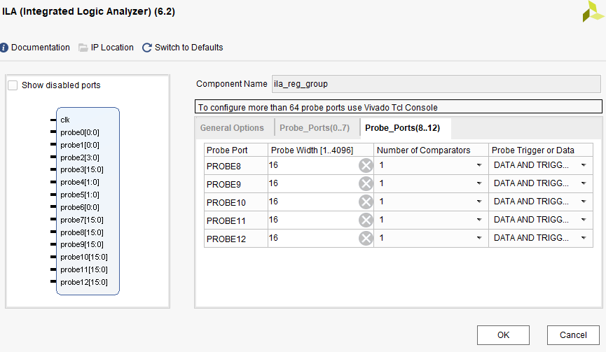
3. ADD
IP CORE
-step2-4
1. Left click

Slide 18
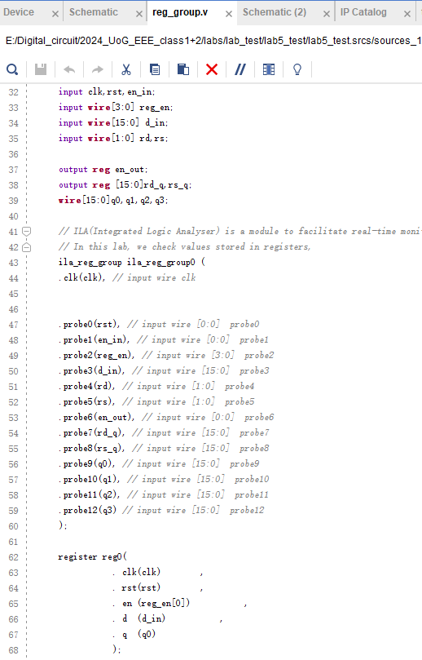
reg_group
3. ADD
IP CORE
-step2-5
Ensure these signals are connected to probes.
We need to pay attention to the signals q0, q1, q2, and q3.

Slide 19
3. Do Synthesis and get the circuit
Follow the steps of lab1.ppt to do Synthesis and get the circuit

Slide 20
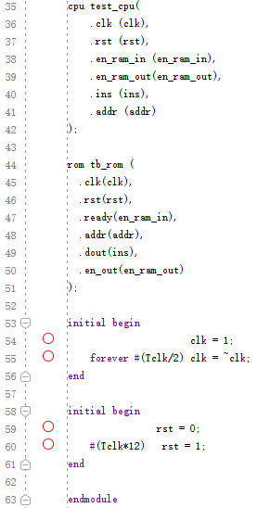

4. Create Simulation Source
File
Add tb_top_cpu.v to the project as simulation source
Define clk
Define rst

Slide 21
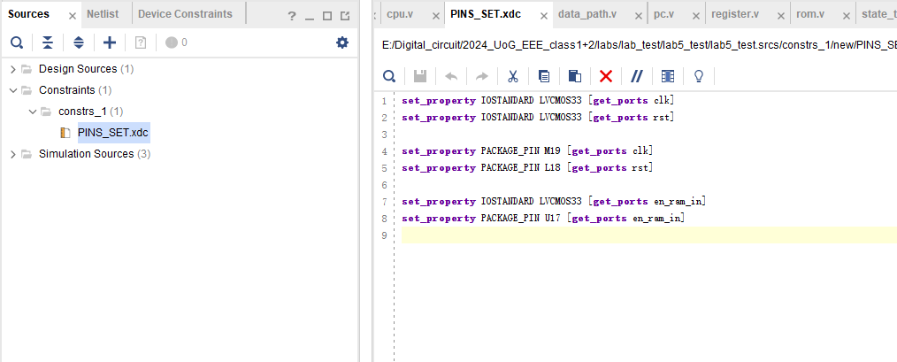
Copy contents in PINS_SET.txt to this window
5. Create the constraint

Slide 22
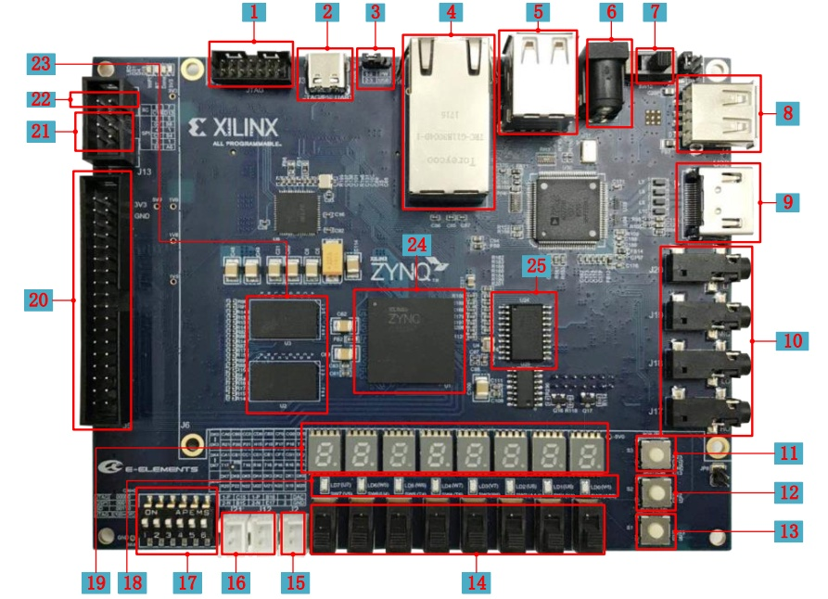
6.Connect FPGA Target Board With Computer
1. Put all switch(17 ) to ON
2.Connect J3(2) and USB port of computer with USB cable
3.Power on with switch (7)
4.system reset L18(13)

Slide 23
7. program device
Follow the steps of lab1.ppt

Slide 24
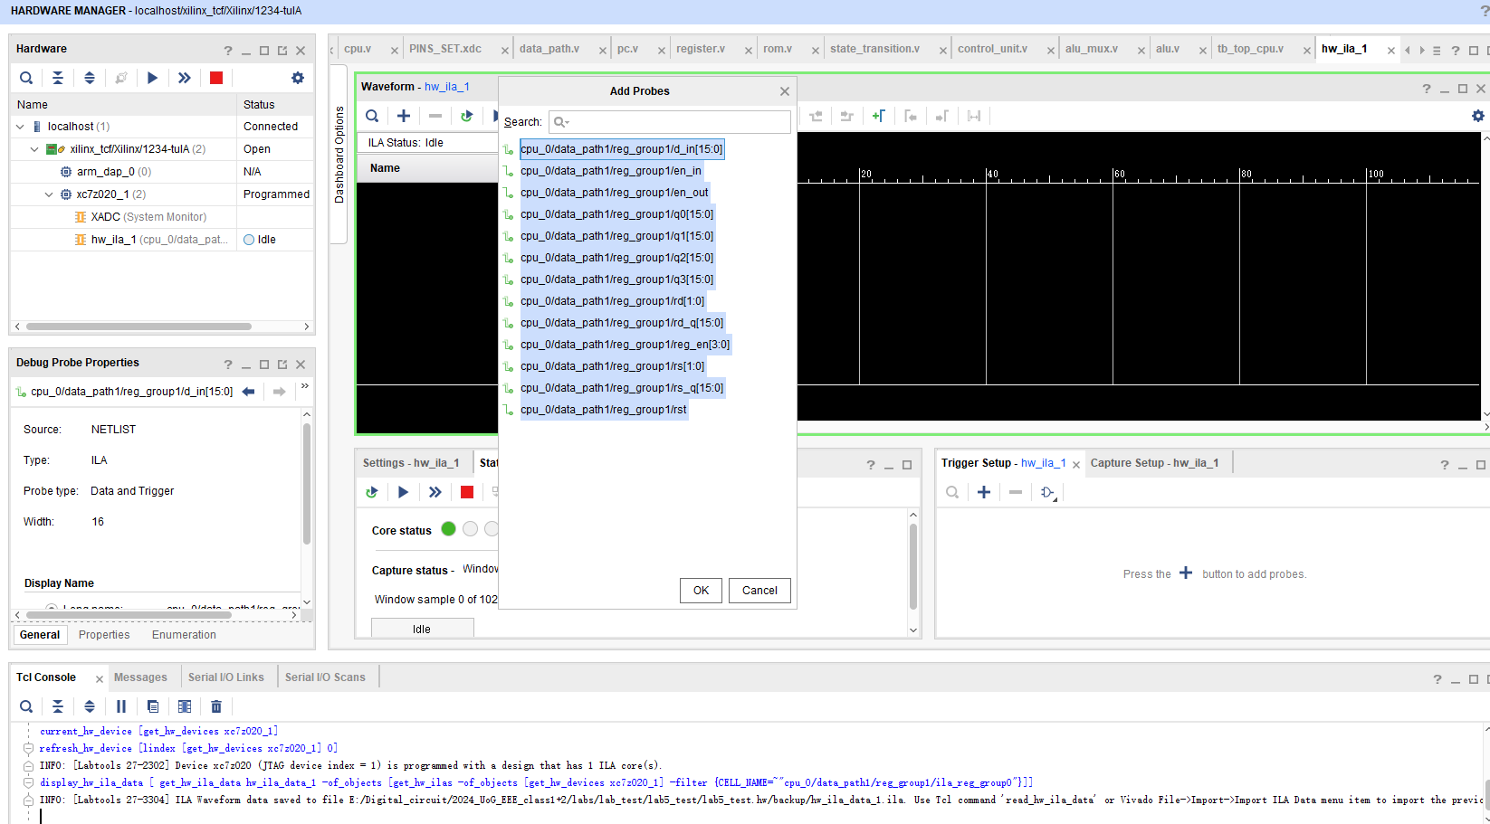
2. Add signals
8. Run ila to see the data in the registers
-step1
1. Select the ila
3. Select all
4. Click ok

Slide 25
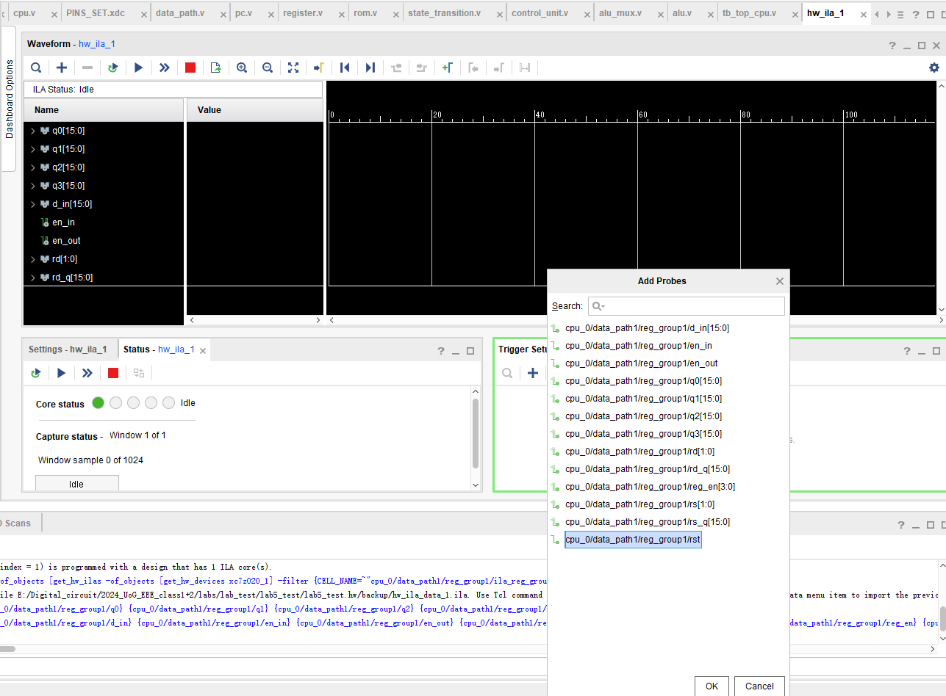
8. Run ila to see the data in the registers
-step2
1
Add Trigger Signal
2
3

Slide 26
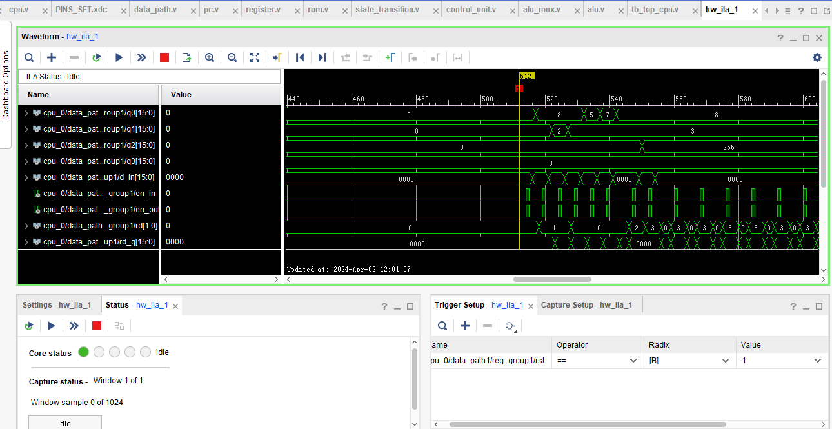
2.Press and hold the reset button on the board !!!!!!
9. Run ila to see the data in the registers
-step3
3.Start Trigger
4.Release the reset button!!!!!!
1. Set Trigger Condition

Slide 27
Some other ideas for Instruction Set
Memory access instructions
Ldr, Str
Conditional branch instructions
Jz, Jnc, …
Other data operation instructions
Xor, Cmp…..
Acc (add 1 to N)

Slide 28
Digital Logic Design and Application
Lab Course 5
~~End~~

