Slide 1
Digital Logic Design and Application
Lab Course 3
Lecturer:
TA:
Lab Room:

Slide 2
Grading
Assessment
Lab1 10% + Lab2 20% + Lab3 20% + Lab4 20% + Lab5 10% + Report1 5% + Repor2 15%
And for each lab:
Pre-Lab preparation and Performance in laboratory (65%)
Laboratory experimental reports (35%)

Slide 3
Requirements
1. Understand the function of the control unit in CPU.
2. Consider about the controller’s STG according to the ISA.
3. Finish the state_transition module based on the given codes .
4. Simulate and check the results.

Slide 4
Note
Please save the screenshots of the code, simulation result, etc.
You will need them to write the Lab_report.

Slide 5
Content
EDA tools
Datapath Design
Controller Design
Understand the STG for control_unit ;
Design state_transition component;
Coding, Synthesis and simulate state_transition component;
CPU Integration
CPU Verification and Improvement

Slide 6
CPU Organization
Datapath
ALU &
ALU MUX
CPU
Registers
Datapath
PC
Control
Unit
Control Unit
state_
transition
IR

Slide 7
data_path.v
reg_group.v
register.v
data_path.v
module reg_group
module register
alu_mux .v
module data_path
module alu_mux
reg_group1
alu_mux1
alu1
pc1
alu.v
module alu
pc.v
register.v
module pc

Slide 8
reg
_
alu_mux .v
datapath .v
4
en
例化名
module alu_mux (
rst,
en_in,
offset,
rd_q,
rs_q,
alu_in_sel,
alu_a,
alu_b
);
alu_mux alu_mux1 (
. rst (rst)
. en_in (en_in ),
. rd_q (rd_q) ,
. rs_q (rs_q),
. offset (offset),
.alu_in_sel (alu_in_sel),
.alu_a (alu_a ),
.alu_b (alu_b)
);
alu alu1 (
.alu_a (alu_a),
.alu_b (alu_b),
……
);
2
设计名
rd
16
reg
_
group
2
rs
与模块引脚相连的信号
名
16
offset
16
模块的引脚名
rd
_
8
q
rs
_
q
alu
_
mux
alu
_
mux
in
_
sel
16
D
16
16
alu
_
a
alu
_
b
alu
_
ALU
3
func
alu
_
out

Slide 9
Top structure of our CPU
CPU
Data
path
Control
Unit
en_group, reg_en,…
reg group
regs control signals
ir
alu_func,…
alu control signals
alu
Opcode
alu_in_sel,…
alu_mux control signals
alu_mux
state
transition
en_pc, pc_ctrl,…
pc control signals
pc
Other signals

Slide 10
Instruction Set
Opcode | Rd | Rs | Imme | assembly | function
4bit | 2bit | 2bit | 8bit
0000 0001 | 01 10 | xx 01 | 00000010 xxxxxxxx | Mov R1 #02 Mov R2 R1 | R1<= 2 R2<=(R1)
0010 0011 | 01 01 | xx 10 | 00001000 xxxxxxxx | Add R1 #08 Add R1 R2 | R1<=(R1)+8 R1<=(R1)+(R2)
0101 | 01 | 10 | xxxxxxxx | Sub R1 R2 | R1<=(R1)-(R2)
0111 | 01 | 10 | xxxxxxxx | And R1 R2 | R1<= (R1) bit_and (R2)
1001 | 01 | 10 | xxxxxxxx | Or R1 R2 | R1<=(R1) bit_or (R2)
1010 | xx | xx | 00000001 | Jump #01 | PC<= 1
Opcode supports 16 instructions. So you can add other instructions, like shift, multiplication.
Rd and Rs can be expressed in 2 bits that means you can operate 4 registers.
Immediate data is expressed in 8 bits.

Slide 11
State transition

Slide 12
Control signals & state signal meaning
Control signals
reg_group
en_group: enable signal, whether get datas from register group
reg_en: enable signal, means whether enable 4 registers to store datas to registers
alu_mux
alu_in_sel: see PPT for the last class
alu
alu_in_func: see PPT for the last class
pc
en_pc: enable signal, whether enable pc unit
pc_ctrl: mux signal, if pc_ctrl = 00 means pc_out <= pc_out ;
if pc_ctrl = 01 means pc_out <= pc_out +1;
if pc_ctrl = 10 means pc_out <= offset;
State signal
alu_out：status signal, whether the alu output is ready

Slide 13
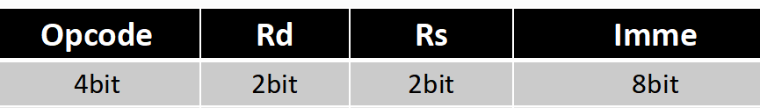
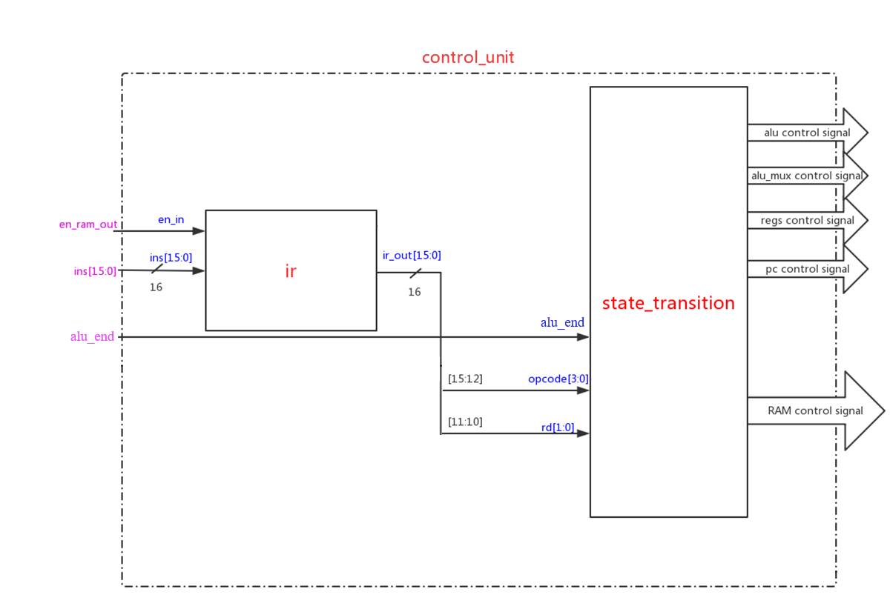
Controller Design

Slide 14
1. Create New Hardware Project
Follow the steps of lab1.ppt to create New Hardware Project

Slide 15

2. Create New Source File -step1
Add files in the code folder as following steps.

Slide 16
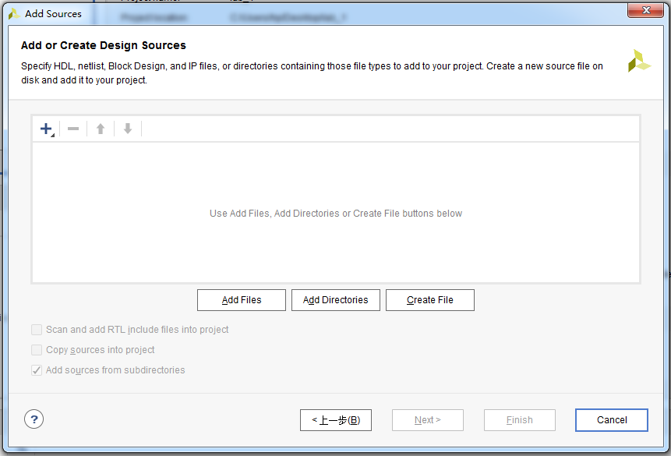
2. Create New Source File -step2
Click here

Slide 17
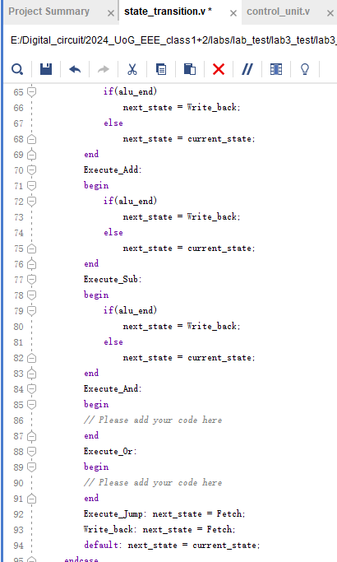
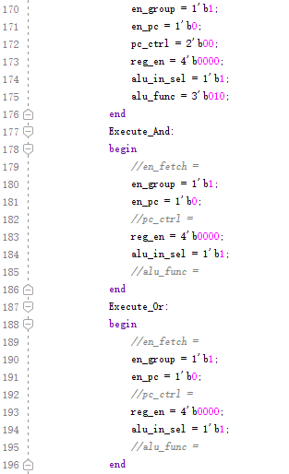
2. Create New Source File -step3
Refer to the next page to complete the state_transition module.

Slide 18
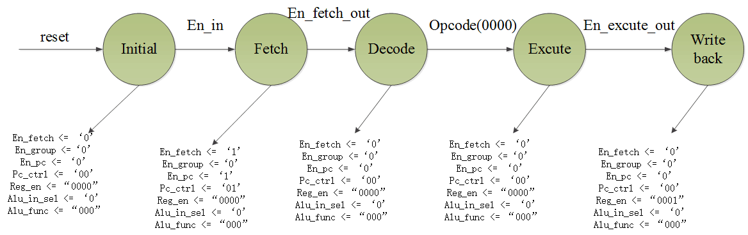
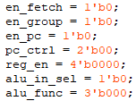
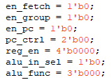
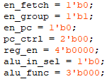
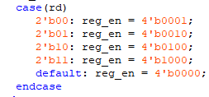
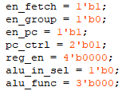
2. Create New Source File -step4

Slide 19
3. Do Synthesis and get the circuit
Follow the steps of lab1.ppt to do Synthesis and get the circuit

Slide 20
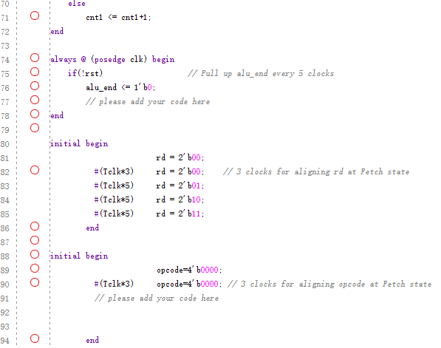
tb_state_transition
4. Create Simulation Source
File -step1
Copy the content in tb_state_transition.v to this window, and complete the code

Slide 21
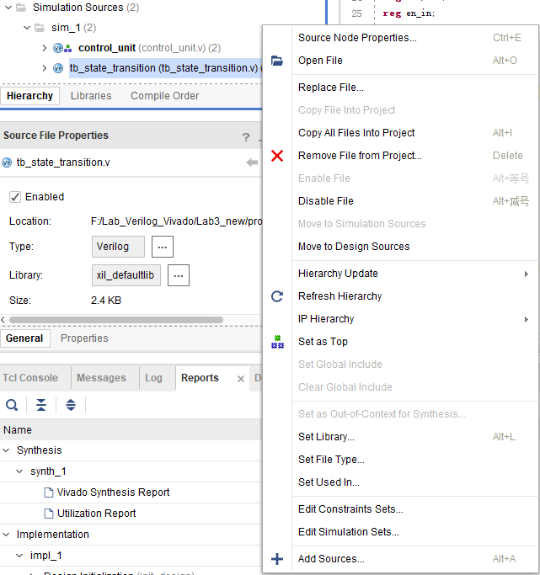
1.Right- click
4. Create Simulation Source
File
-step2
2.Click

Slide 22
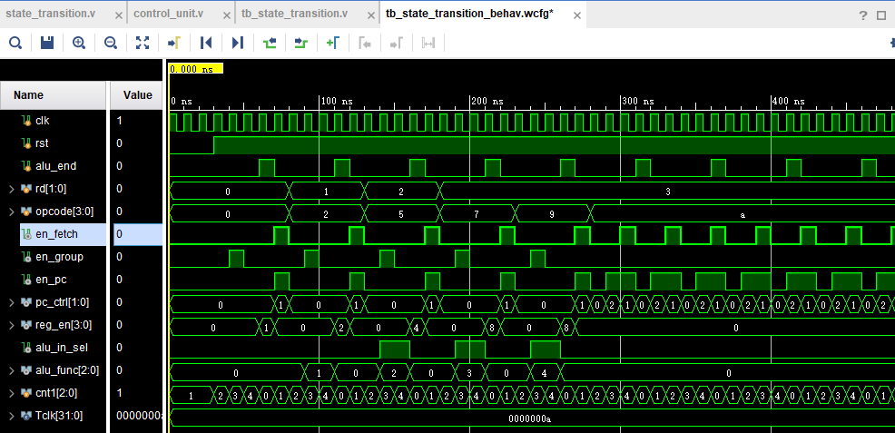
Run simulation and observe the variation of signals. Make sure all of these are right.
4. Create Simulation Source
File
-step3

Slide 23
Digital Logic Design and Application
Lab Course 3
~~End~~

