Slide 1
Digital Logic Design and Application
Lab Course 1
Lecturer:
TA:
Lab Room:

Slide 2
Fundamental
Digital Logic + Computer Architecture
Verilog Language
Tools
EDA software: Vivado 2017.1
Evaluation board: EES331
Lab report submitted
请大家注意，实验报告电子版（pdf）提交给理论课程助教，文件命名为：
“数字逻辑设计及应用+专业+学号姓名+第1次实验报告”
例如“数字逻辑设计及应用+电工+2024190505000张三+第1次实验报告”

Slide 3
Grading
Assessment
Lab1 10% + Lab2 20% + Lab3 20% + Lab4 20% + Lab5 10% + Report1 5% + Repor2 15%
And for each lab:
Pre-Lab preparation and Performance in laboratory (65%)
Laboratory experimental reports (35%)

Slide 4
Grading
Assessment
Lab1 10% + Lab2 20% + Lab3 20% + Lab4 20% + Lab5 10% + Report1 5% + Repor2 15%
And for each lab:
Pre-Lab preparation and Performance in laboratory (65%)
Laboratory experimental reports (35%)

Slide 5
Grading
Assessment
Lab1 10% + Lab2 20% + Lab3 20% + Lab4 20% + Lab5 10% + Report1 5% + Repor2 15%
And for each lab:
Pre-Lab preparation and Performance in laboratory (65%)
Laboratory experimental reports (35%)

Slide 6
Reference
IEEE Standard Verilog Language Reference Manual
Vivado Introduction Using Verilog Design
EES331 User manual （Zynq Book）
Codes for Students

Slide 7
Note
Please save the screenshots of the code, simulation result, etc.
You will need them to write the Lab_report.

Slide 8
Content
EDA tools
Familiar the development environment
Coding, Synthesis and simulation
Compose testbench and do verification
Datapath Design
Controller Design
CPU Integration
CPU Verification and Improvement

Slide 9
Implement for a 3-8 Decoder
Traditional method VS Programmable logic device

Slide 10
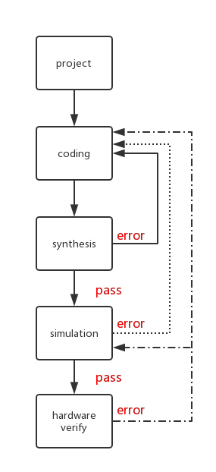
FPGA Design Flow

Slide 11
Coding
module decoder(A,B,C,Y);
input A,B,C;
output reg [7:0] Y;
always@(*)
begin
case({A,B,C})
3'b000:Y=8'b0000_0001;
3'b001:Y=8'b0000_0010;
3'b010:Y=8'b0000_0100;
3'b011:Y=8'b0000_1000;
3'b100:Y=8'b0001_0000;
3'b101:Y=8'b0010_0000;
3'b110:Y=8'b0100_0000;
3'b111:Y=8'b1000_0000;
default: Y=8'd0000_0000;
endcase
end
endmodule
module decoder(A,B,C,D,Y);
input A,B,C,D;
output reg [15:0] Y;
always@(*)
begin
case({A,B,C,D})
4'b0000:Y=16'b0000000000000001;
4'b0001:Y=16'b0000000000000010;
......
4'b1111:Y=16'b1000000000000000;
default: Y=16'b0000000000000000;
endcase
end
endmodule

Slide 12
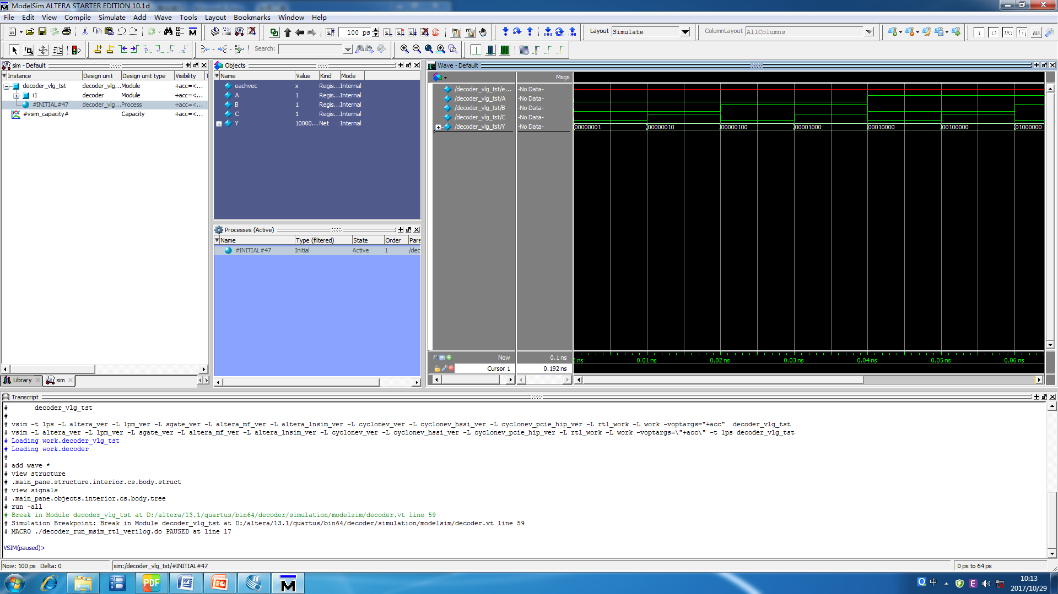
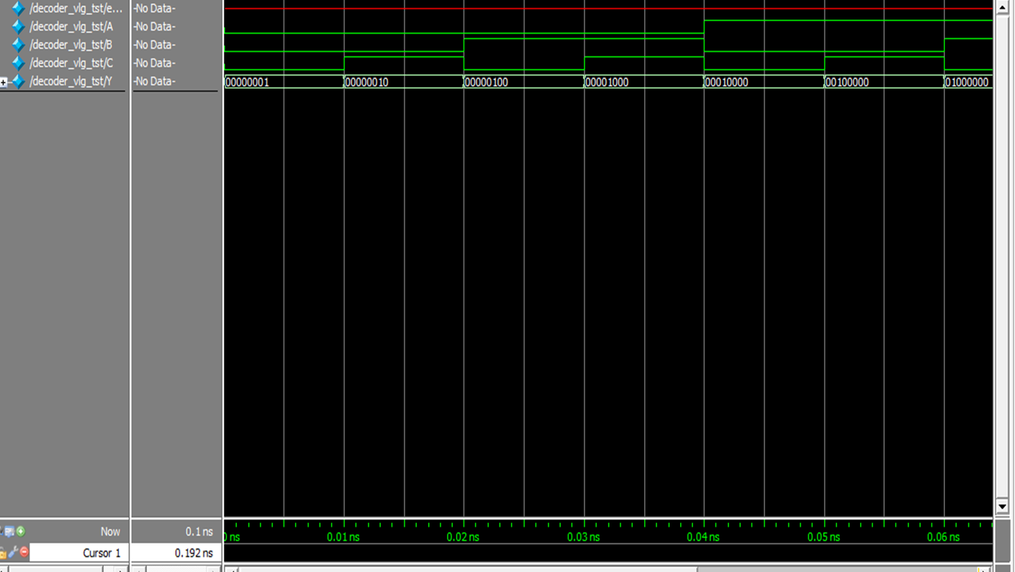
Simulation
begin
A=0;B=0;C=0;
#10 A=0;B=0;C=1;
#10 A=0;B=1;C=0;
#10 A=0;B=1;C=1;
#10 A=1;B=0;C=0;
#10 A=1;B=0;C=1;
#10 A=1;B=1;C=0;
#10 A=1;B=1;C=1;
#30 $stop;
end
A
Test Bench
B
Waveform
C

Slide 13
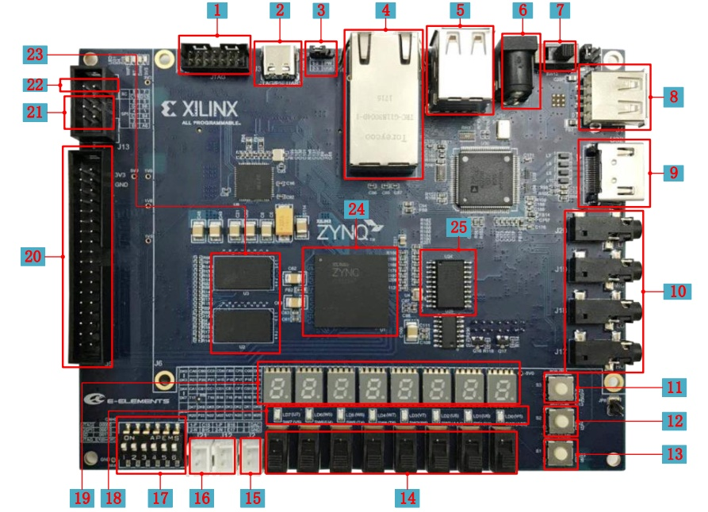
Hardware verify

Slide 14
FPGA Design Flow

Slide 15
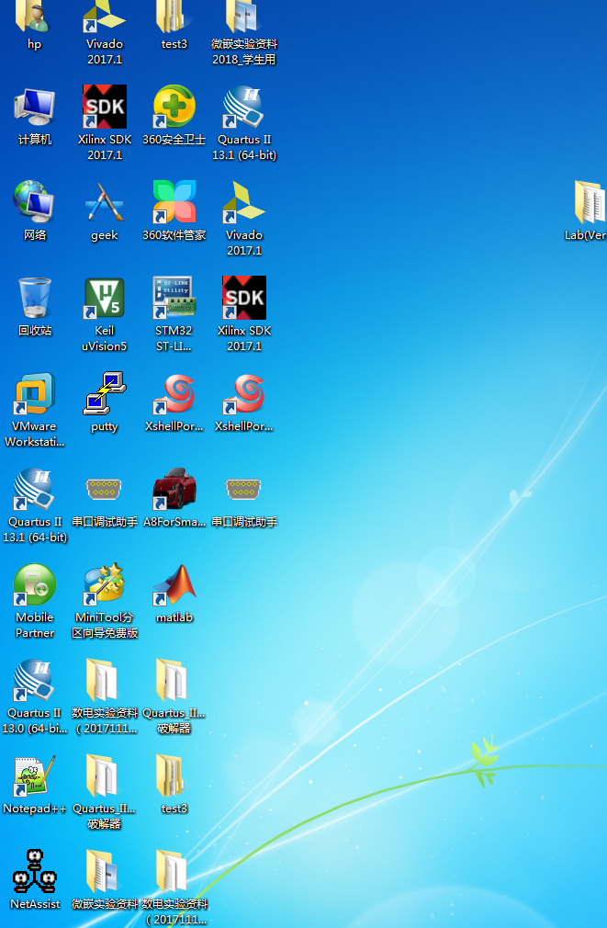
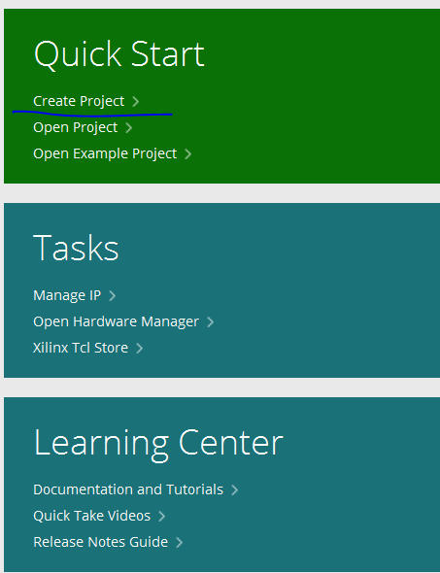
1. Create New Hardware Project -step1
1. Open VIVADO 2017.1
2. Click here
→

Slide 16
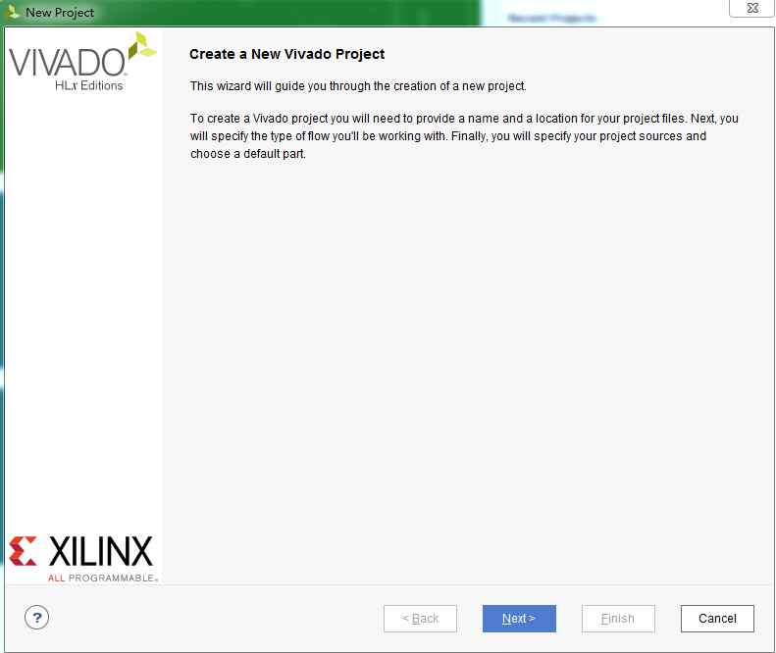
1. Create New Hardware Project -step2
Click here

Slide 17
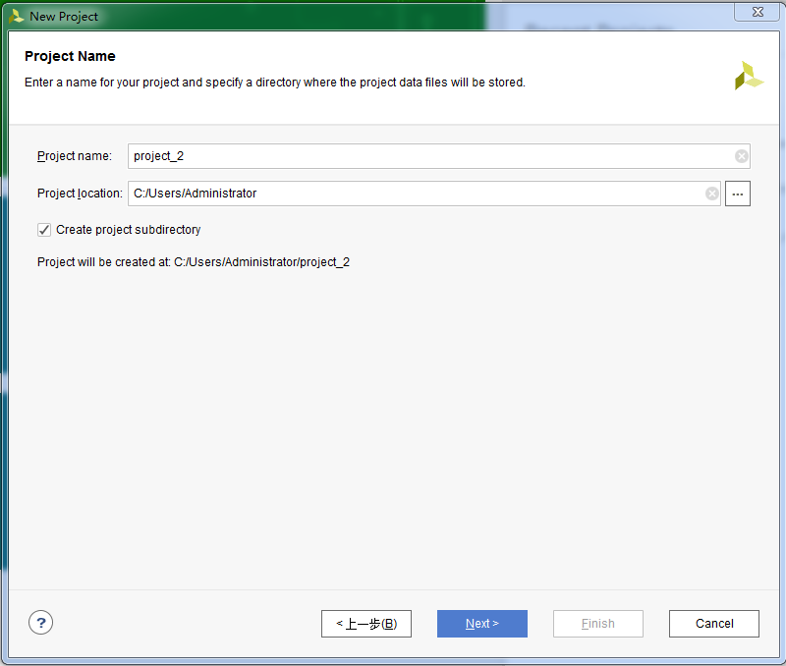
1. Create New Hardware Project -step3
1. Rename new project，select the save path for project
2. Click here

Slide 18
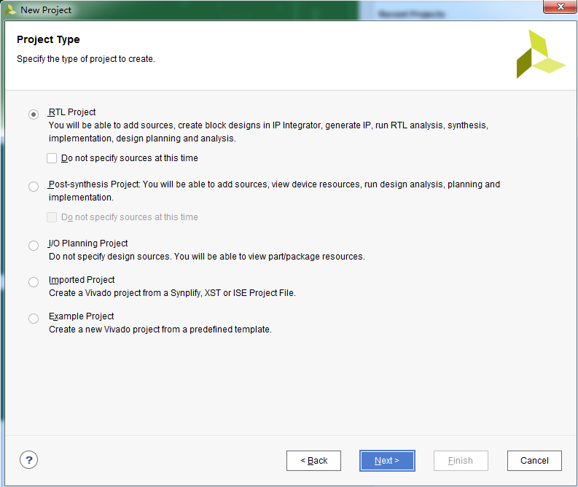
1. Create New Hardware Project -step4
1. Select RTL Project
2. Click here

Slide 19
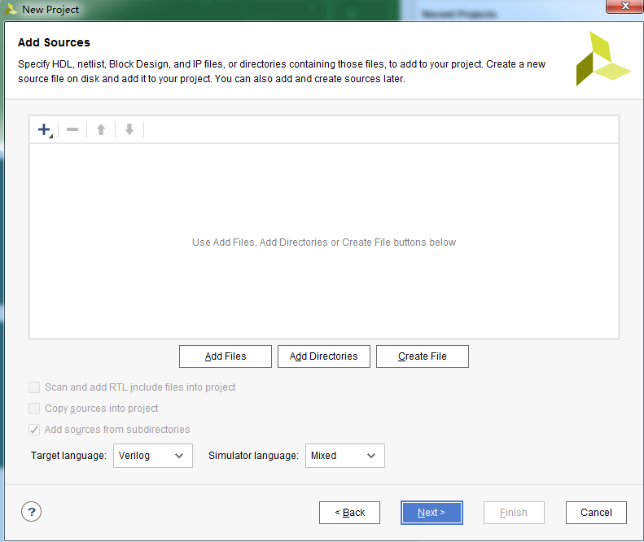
1. Create New Hardware Project -step5
Directly Click here.
Don’t add any other files.

Slide 20
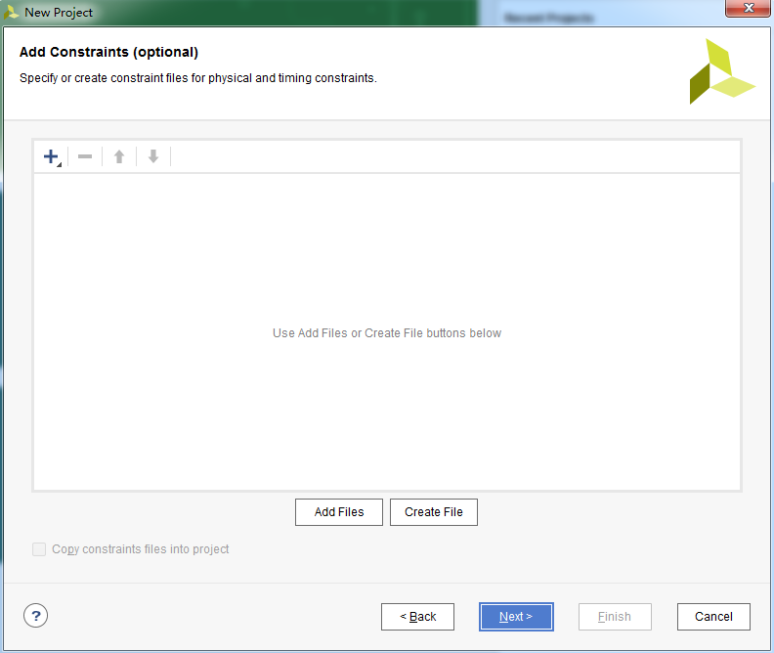
1. Create New Hardware Project -step6
Directly Click here.
Don’t add any other files.

Slide 21
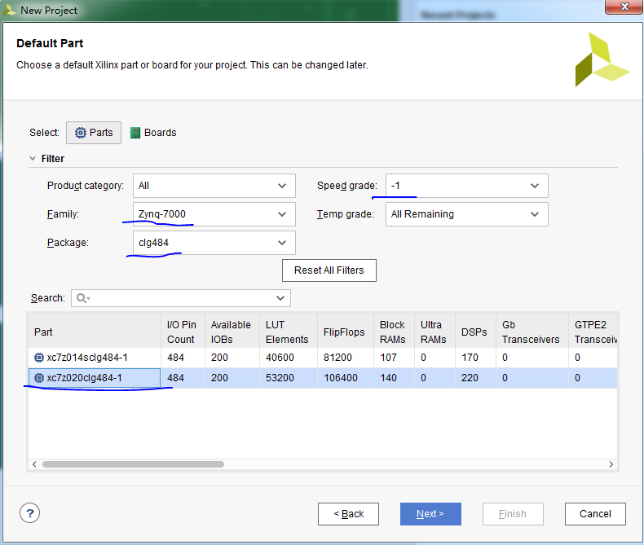
1. Create New Hardware Project -step7
1. Select xc7z020clg484-1 as the following part
2. Click here

Slide 22
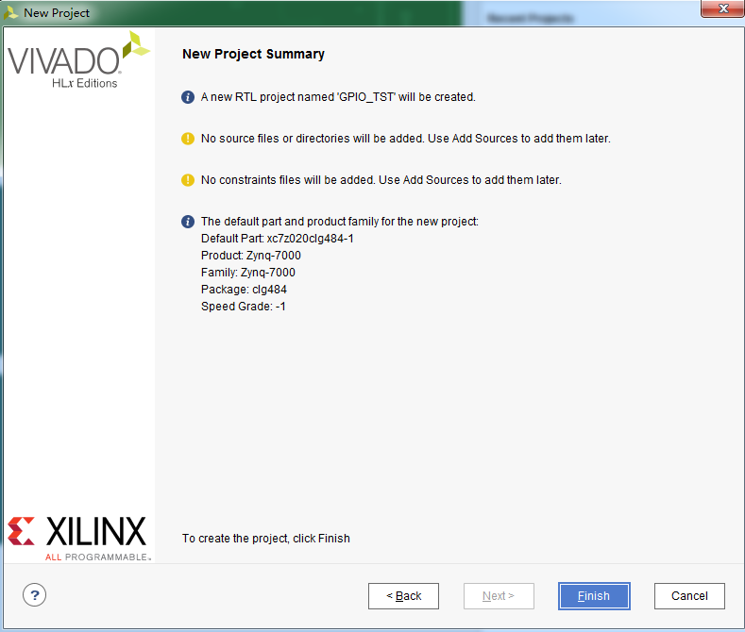
1. Create New Hardware Project -step8
Check the project information，then click here

Slide 23
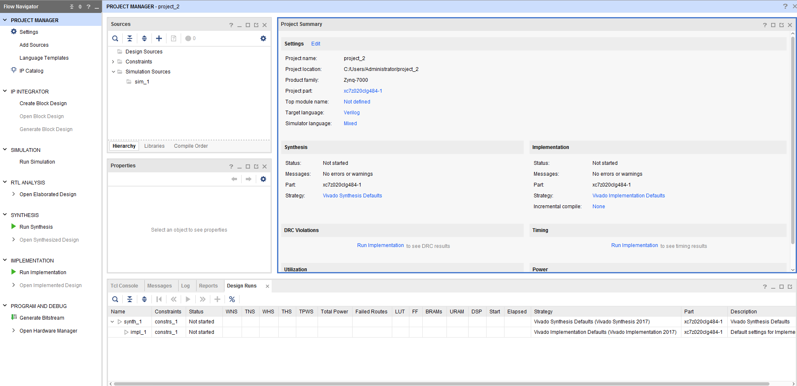
1. Create New Hardware Project -step9
After finished, you can see this window
Source Menu
Simulation Menu
Synthesis Menu
Hardware Program Menu

Slide 24
FPGA Design Flow

Slide 25
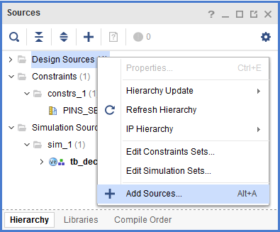
1. Right-click
2. Create New Source File -step1
2. Click here

Slide 26
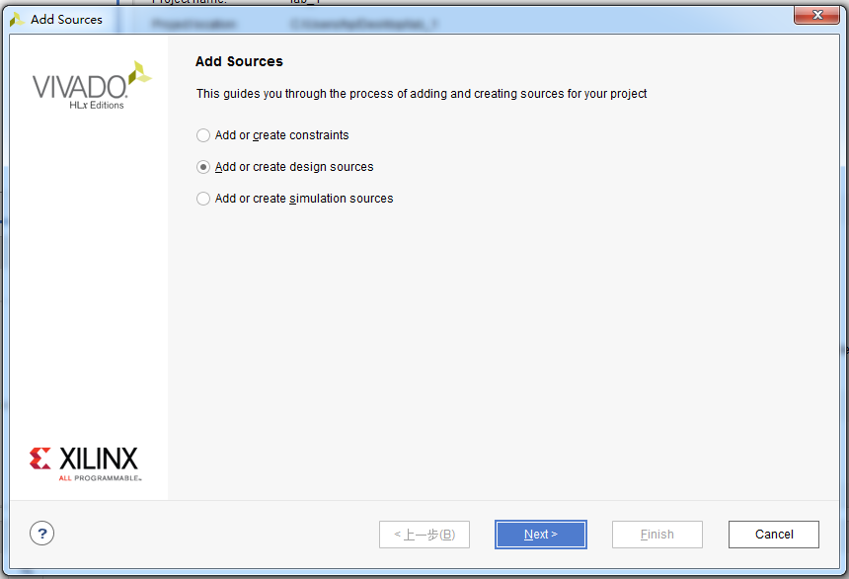
2. Create New Source File -step2
1.Choose it
2. Click here

Slide 27
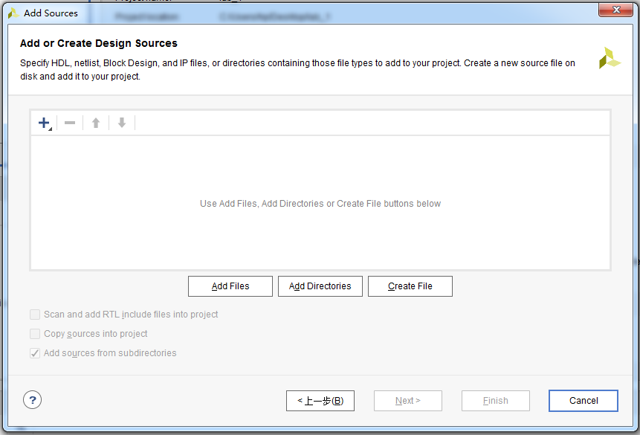
2. Create New Source File -step3
Click here

Slide 28
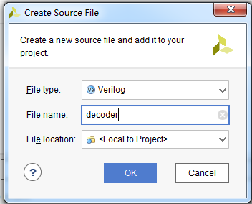
2. Create New Source File -step4
1. Add file name
2. Click here

Slide 29
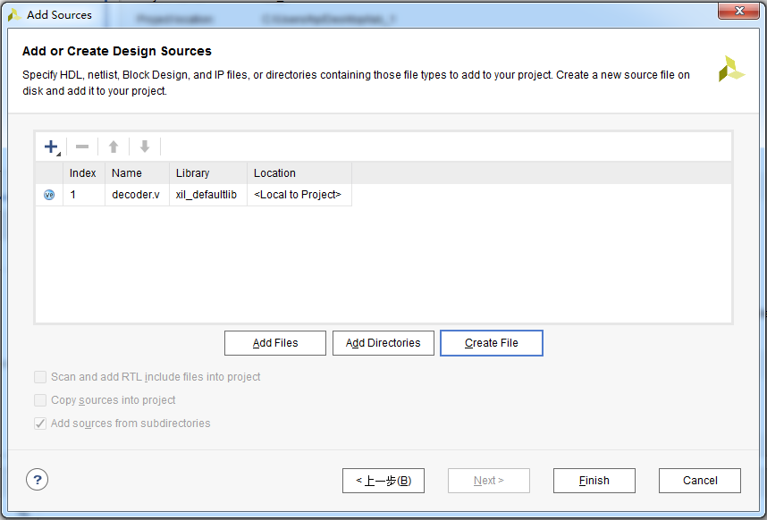
2. Create New Source File -step5
Click here

Slide 30
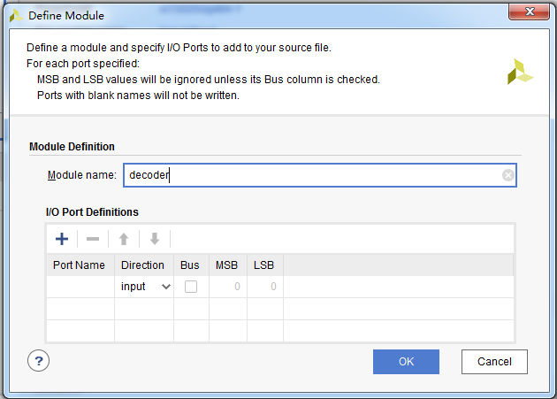
2. Create New Source File -step6
1. Add module name
2. Click here

Slide 31
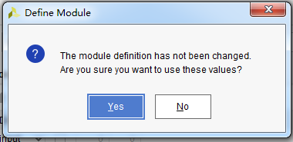
2. Create New Source File -step7
Click here

Slide 32
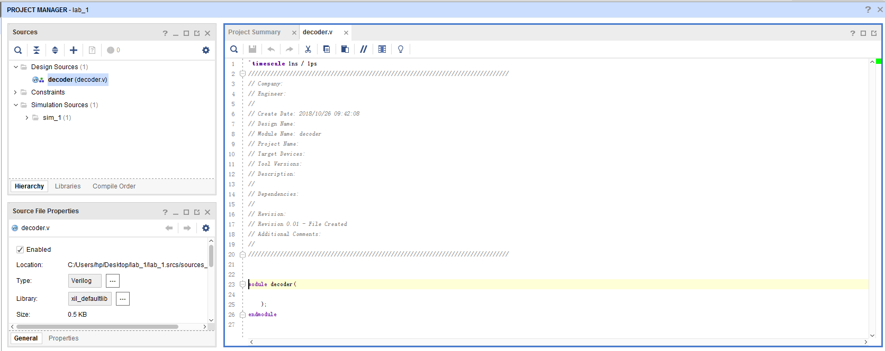
2. Create New Source File -step8
Double click
Add your Verilog here.
The input and output can refer to the next page.

Slide 33
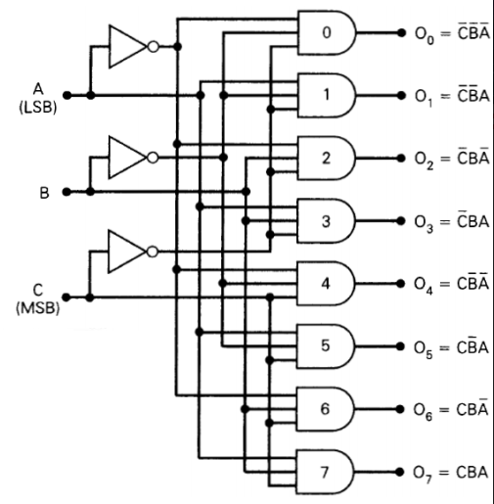
3-8 decoder
2. Create New Source File -step9
module decoder(A,B,C,Y);
input A,B,C;
output reg [7:0] Y;
always@(*)
begin
xxxxxx
xxxxxx
end
endmodule

Slide 34
FPGA Design Flow

Slide 35

3. Do Synthesis and get the circuit -step1
Click here

Slide 36
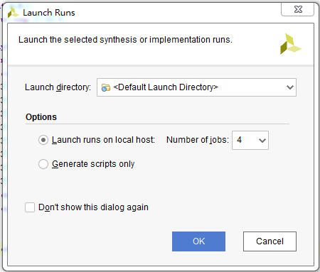
3. Do Synthesis and get the circuit -step1
Click here

Slide 37
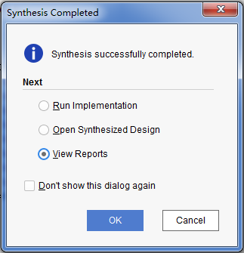
3. Do Synthesis and get the circuit –step2
1.Choose it
After finishing, you can see
this window
2.Click here

Slide 38
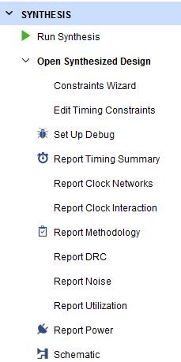
1.Click here
3. Do Synthesis and get the circuit –step3
2.Click here

Slide 39
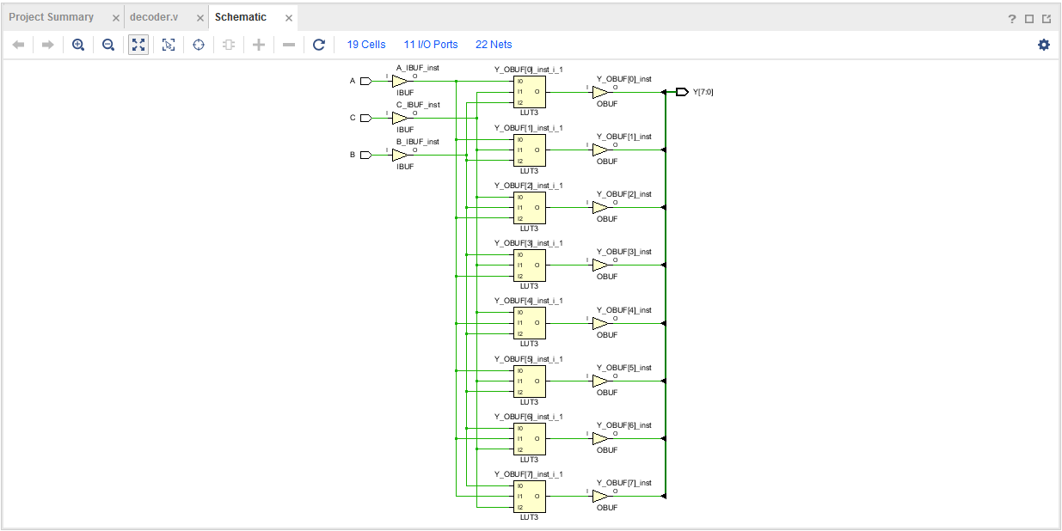
3. Do Synthesis and get the circuit –step4
your circuit based the Verilog code

Slide 40
FPGA Design Flow

Slide 41
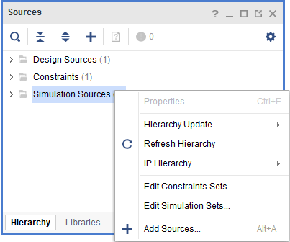
4. Create Simulation Source
File -step1
1. Right-click
2. Click here

Slide 42
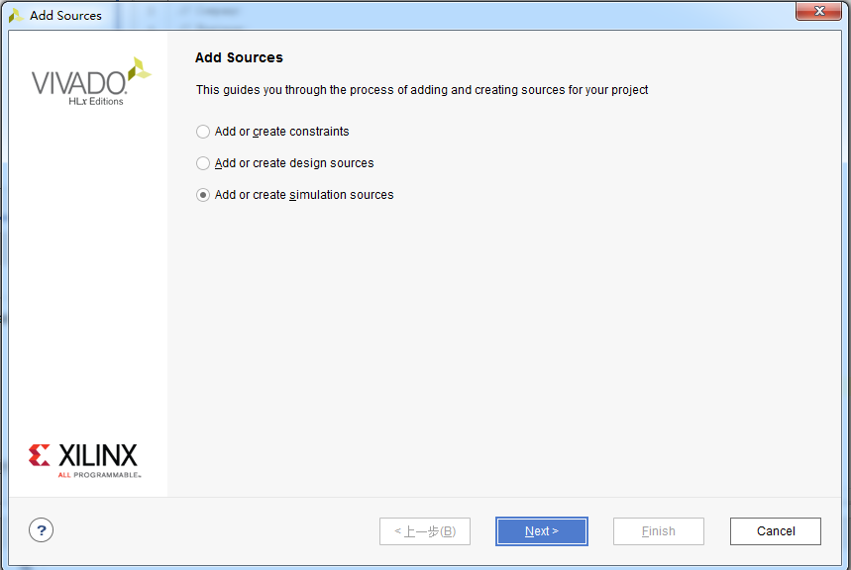
4. Create Simulation Source
File -step2
1.Choose it
2. Click here

Slide 43
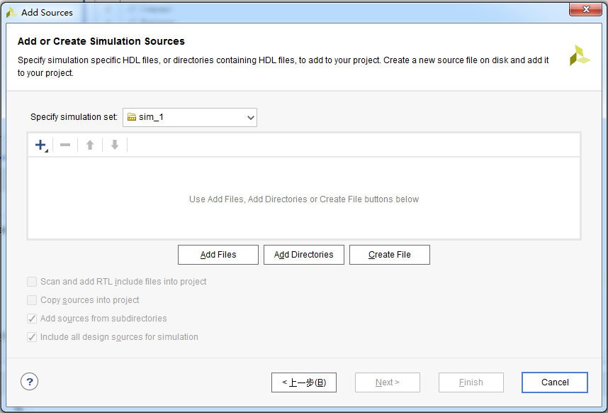
4. Create Simulation Source
File -step3
Click here

Slide 44
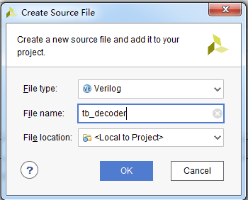
4. Create Simulation Source
File -step4
1. Add file name
2. Click here

Slide 45
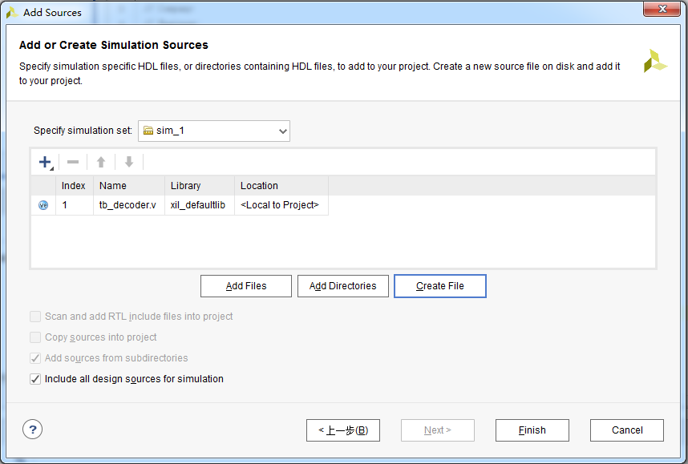
4. Create Simulation Source
File -step5
Click here

Slide 46
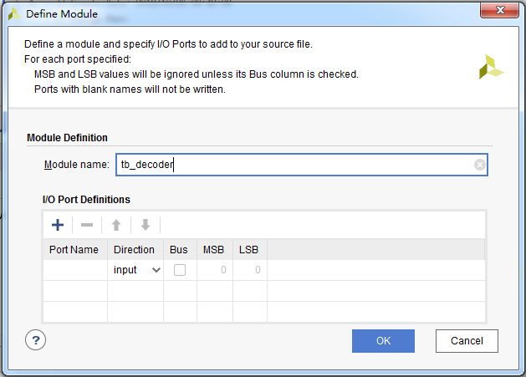
4. Create Simulation Source
File -step6
1. Add module name
2. Click here

Slide 47
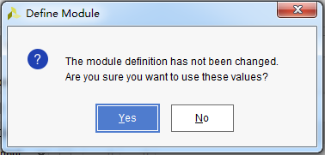
4. Create Simulation Source
File -step7
Click here

Slide 48
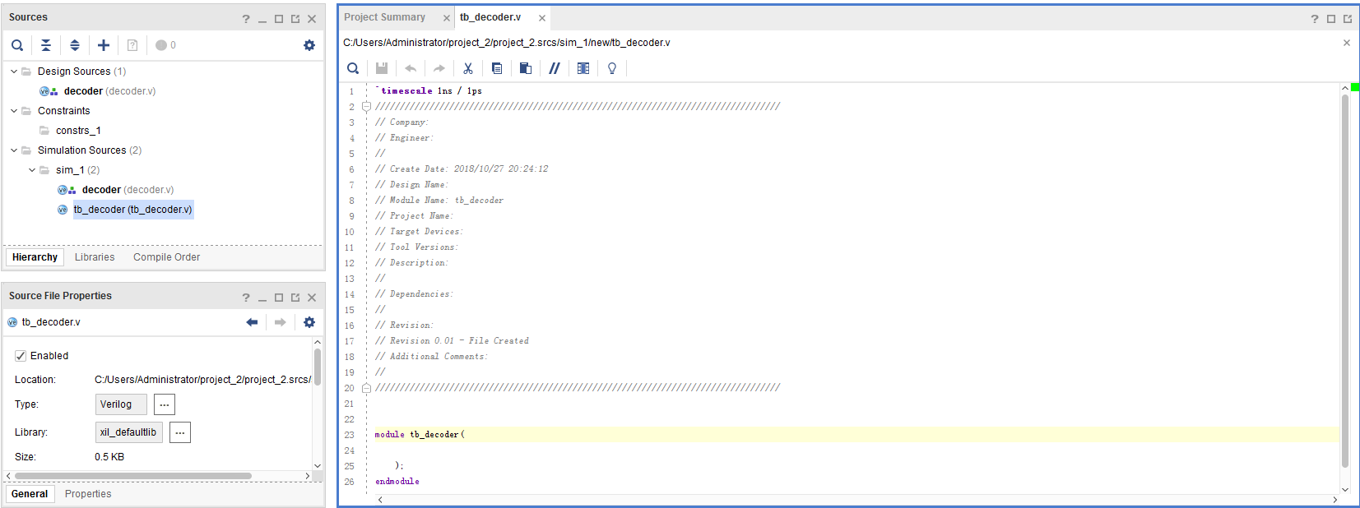
4. Create Simulation Source
File -step8
1. Double click
2. Copy the content in tb_decoder.txt to this window, and complete the code

Slide 49
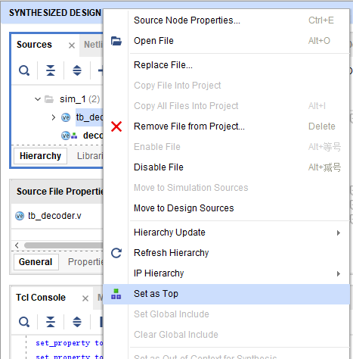
4. Create Simulation Source
File -step9
1.Right- click
2.Click

Slide 50
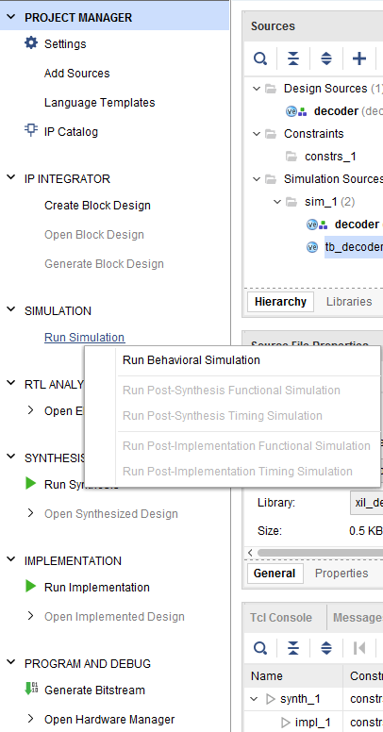
1. Click here
4. Create Simulation Source
File -step10
2. Click here

Slide 51
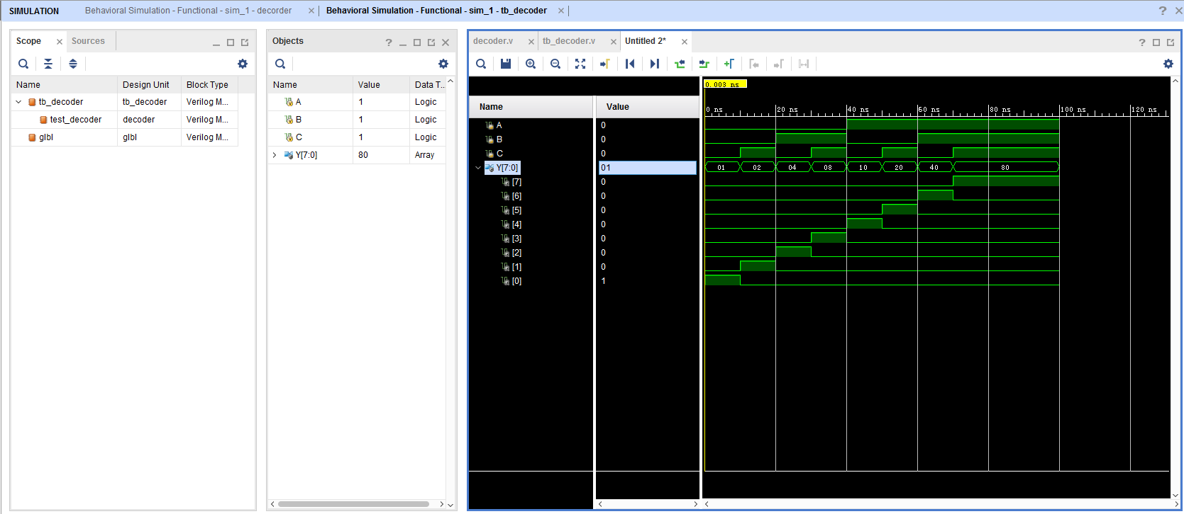
Click here to zoom the window
5. Do the simulation and debug.
Click here to see bit 0~7
Observe the variation of signals. Make sure all of these are right.

Slide 52
FPGA Design Flow

Slide 53
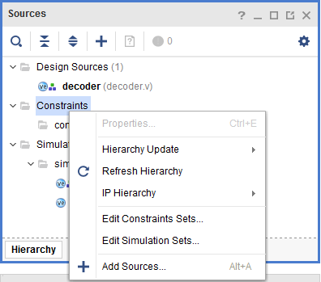
6. Create Constraint Source
File -step1
1. Right-click
2. Click here

Slide 54
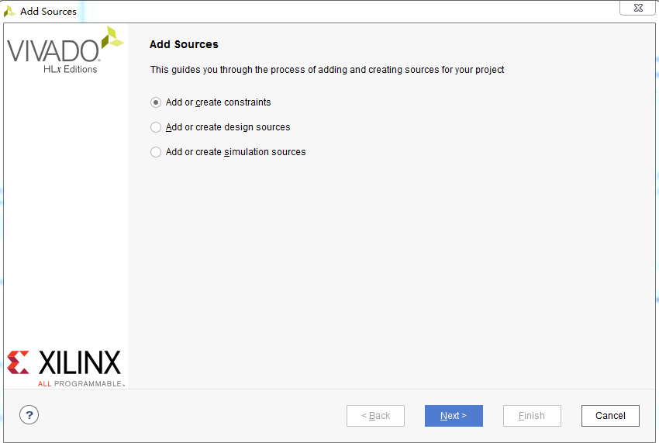
6. Create Constraint Source
File -step2
1.Choose it
2. Click here

Slide 55
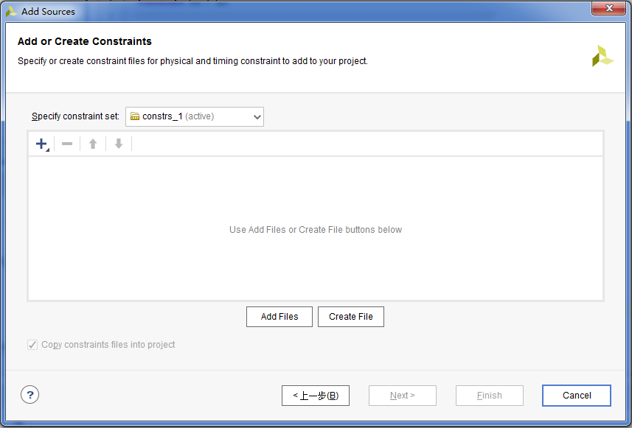
6. Create Constraint Source
File -step3
Click here

Slide 56
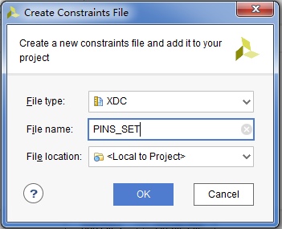
6. Create Constraint Source
File -step4
1. Add file name
2. Click here

Slide 57
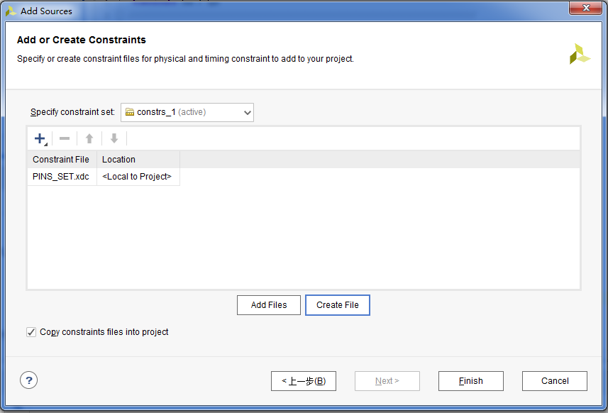
6. Create Constraint Source
File -step5
Click here

Slide 58
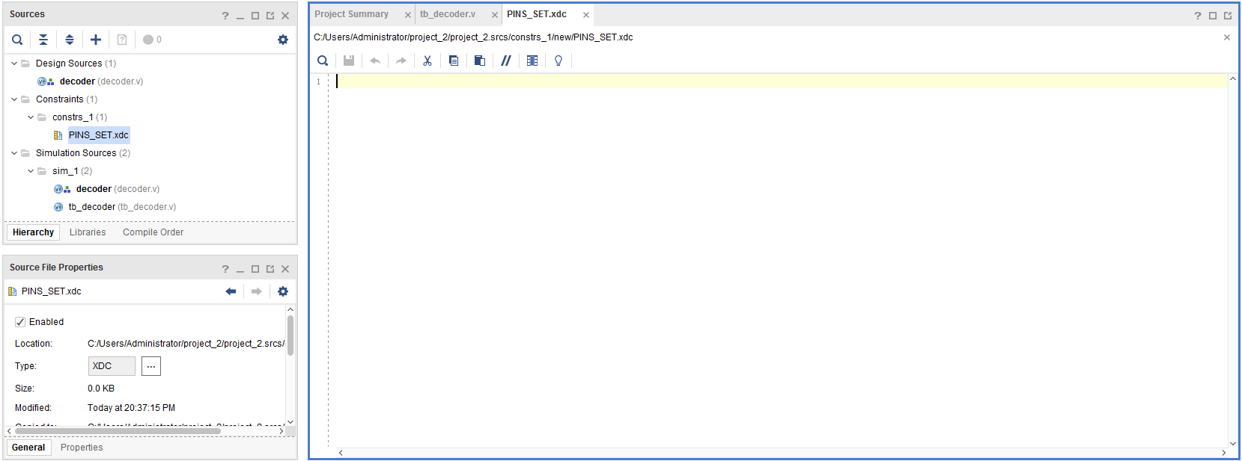
1. Double click
6. Create Constraint Source
File -step6
2. Copy the content in PINS_SET.txt to this window

Slide 59
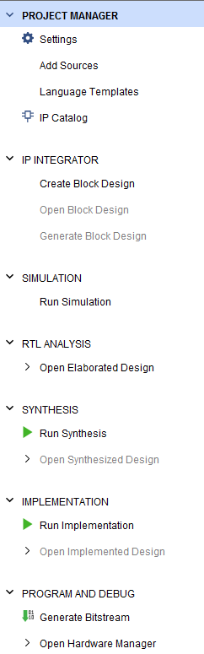
7. Generate Bitstream
File for FPGA
-step1
Click here

Slide 60
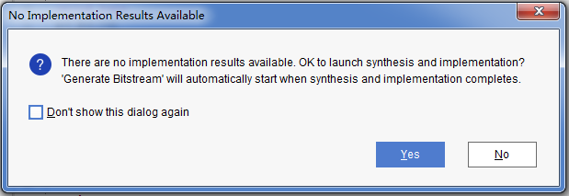
7. Generate Bitstream
File for FPGA
-step2
Click here

Slide 61
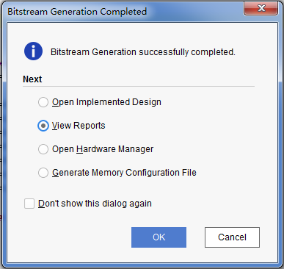
7. Generate Bitstream
File for FPGA
-step3
1.Choose this
You can see
on the top right corner.
2.Click here
After finishing, you can see this window

Slide 62
8.Connect FPGA Target Board With Computer
1. Put all switch(17 ) to ON
2.Connect J3(2) and USB port of computer with USB cable
3. Power on with switch (7)

Slide 63
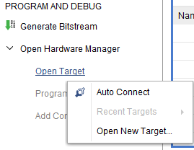
9. Program device
-step1
1. Click here
2. Right-click
3. Click here

Slide 64
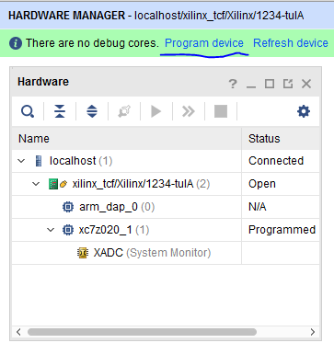
8. Program device
-step2
Click here

Slide 65
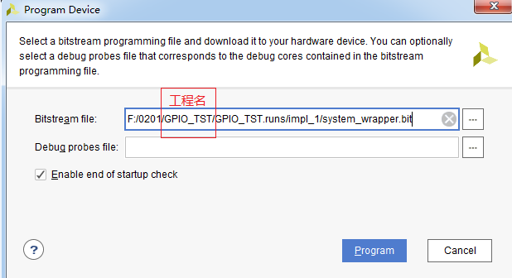
8. Program device
-step3
Find you bit file
Click here

Slide 66
9. Observe phenomena
1. Switch(0,1,2) are the inputs (A,B,C), led(0~7) are the outputs (Y0~Y7)
2. Use the switch to control the led light

Slide 67


Appendix: implement and verify a ledwater

Slide 68
Digital Logic Design and Application
Lab Course 1
~~End~~

