Slide 1
New York & Toronto
Are they similar?

Slide 2
The Cities
New York & Toronto are both big cities. Both being the largest cities in the United States and Canada.
Will their large populations, while not similar to each other are both the largest for their country

Slide 3
Data
New York: (https://geo.nyu.edu/catalog/nyu_2451_34572)
Toronto Zip Code Wikipedia: (https://en.wikipedia.org/wiki/List_of_postal_codes_of_Canada:_M)
Toronto Zip Code CSV: (https://cocl.us/Geospatial_data)

Slide 4
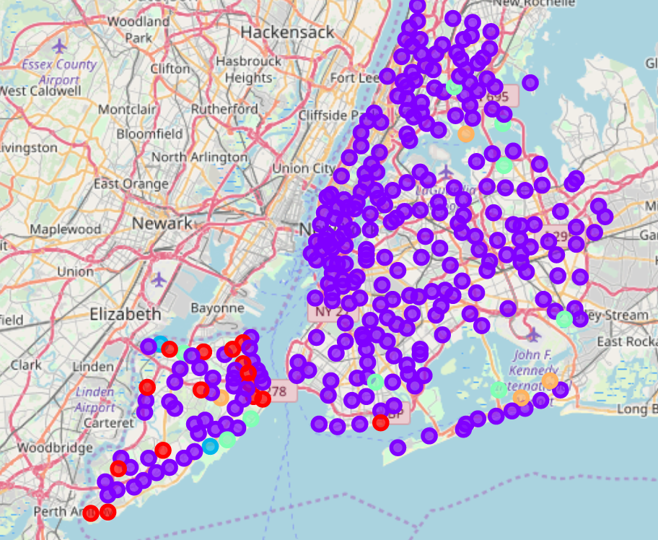
New York Clusters
One cluster dominates in New York
There is one cluster that is mainly in Staten Island, with one exception.
I would have expected to see some clusters based in some of the boroughs.

Slide 5
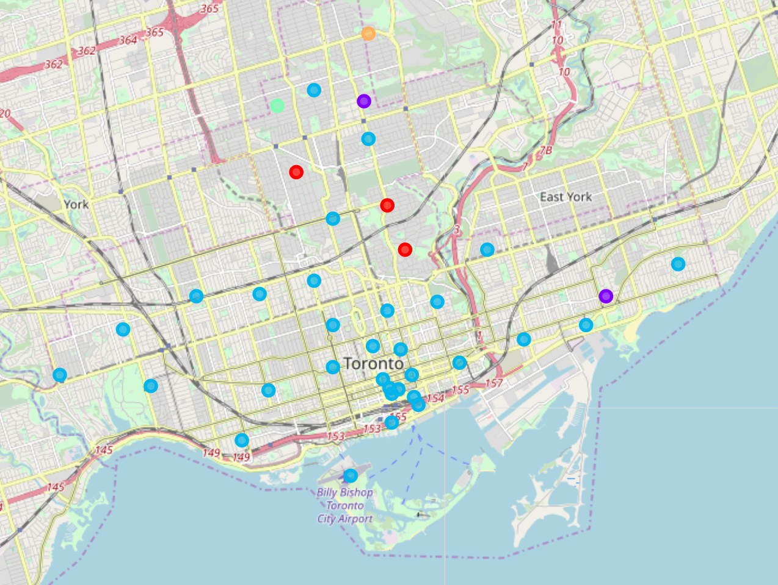
Toronto Clusters
Toronto, comparatively, has a lot less cluster points.
There is also a predominate cluster.
Since some of the neighborhoods were grouped together, some areas that are bare on the map, may be in other points.

Slide 6
Conclusion & Further areas to explore
Looking at New York and Toronto with this data resulted in determining that the two are not similar. It would be interesting to see how the results would be if the Toronto neighborhoods were not grouped together.
Another comparison could be for one section of a larger city and compare the clustering with one borough in New York at a time

