Slide 1
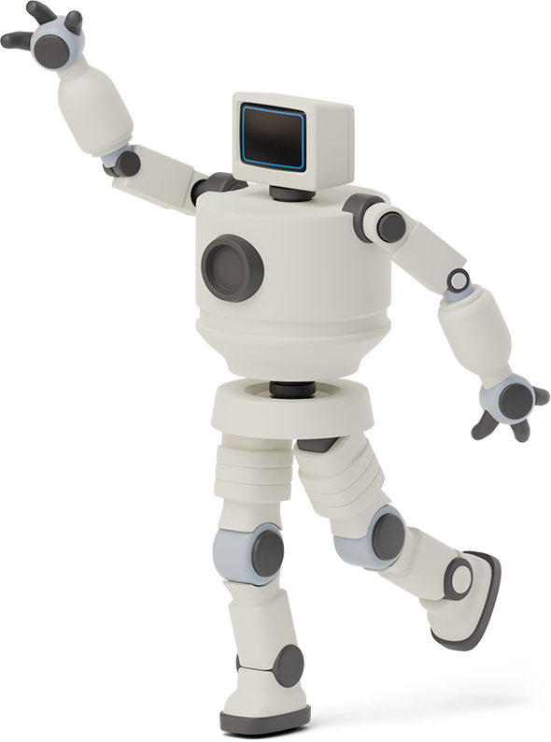


Chartbot
Yinjia Liu & Chenwei Cao

Slide 2

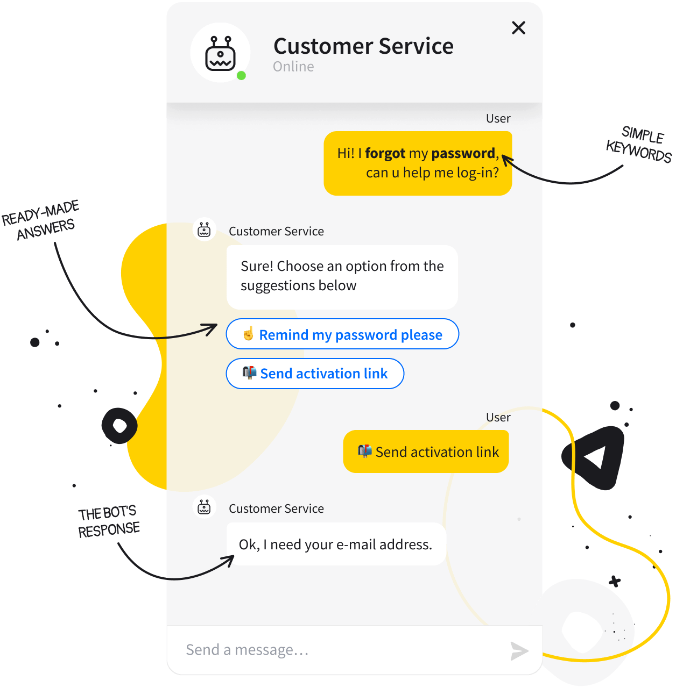

Introduction
A chatbot is a software that provides a real conversational experience to the user, A well-optimized chatbot can converse as well as humans do.

Slide 3

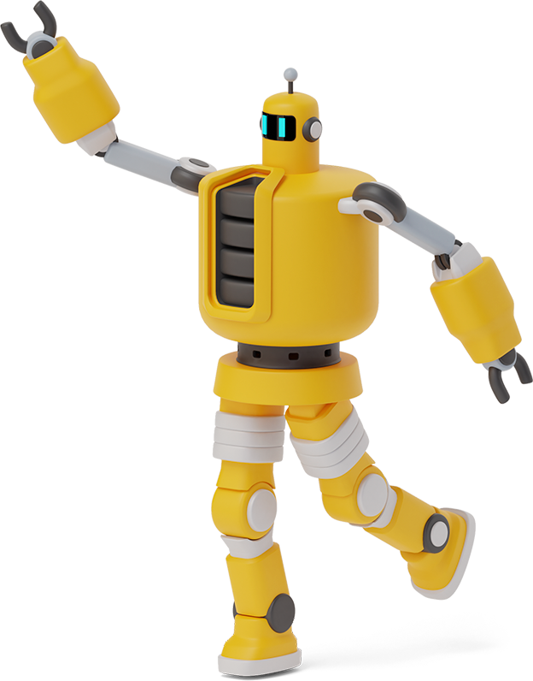
How to build a chatbot?
Python & Google Colab
Using Tensorflow and Keras to build LSTM Seq2Seq model
Using Natural Language Processing (NLP) for preprocessing: one-hot encoding and embedding

Slide 4

Data Overview
The datasets we used are collected from Kaggle which consists of 2363 entries records conversations between a human and other human acting as a companion bot.

Slide 5

Data Pre-Processing
Using Natural language Processing(NLP) to do text corpus preprocessing
Using regular expression to remove punctuation and space
Grouped human response with robot response as pairs of sentences
('hi', 'hi there how are you’)
('oh thanks i m fine this is an evening in my timezone', 'here is afternoon’)
('how do you feel today tell me something about yourself', 'my name is rdany but you can call me dany the r means robot i hope we can be virtual friends’)
('how many virtual friends have you got', 'i have many but not enough to fully understand humans beings’)
('is that forbidden for you to tell the exact number', 'i ve talked with 143 users counting 7294 lines of text')

Slide 6

Model Selection
We selected LSTM seq2seq model as our training model. We use Keras Functional API as our model structure.

Slide 7
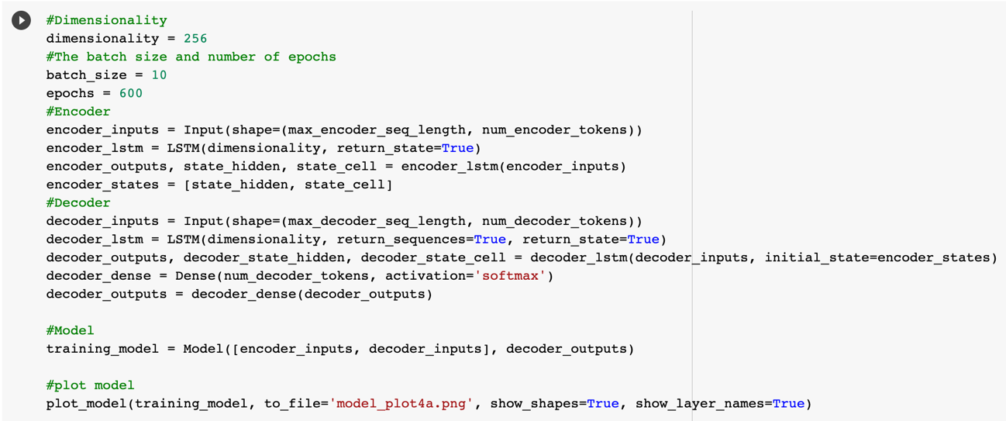
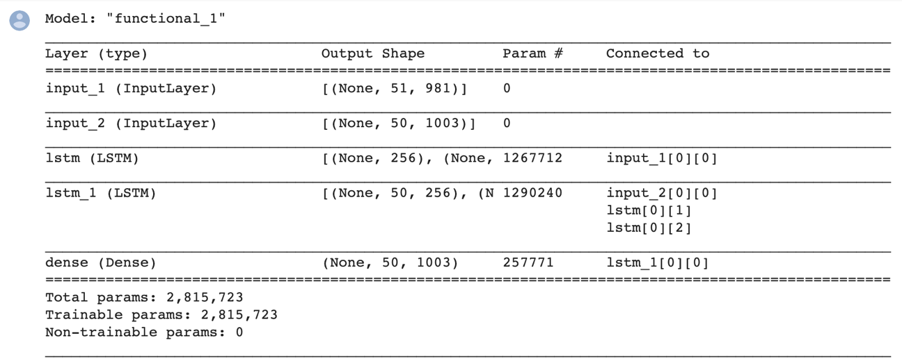
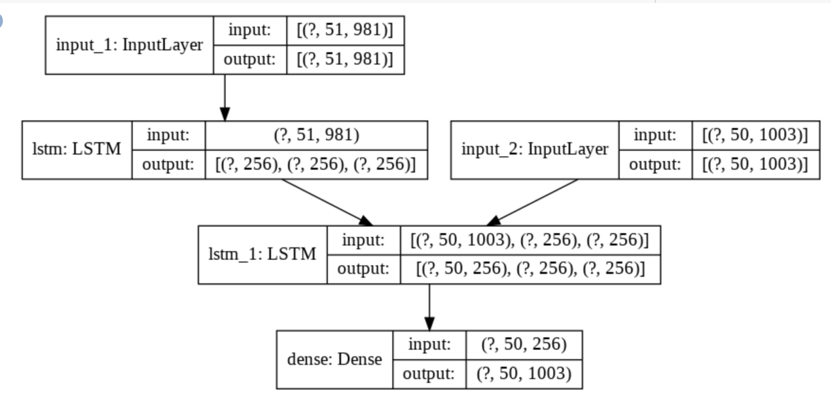
First model with one-hot method

Slide 8
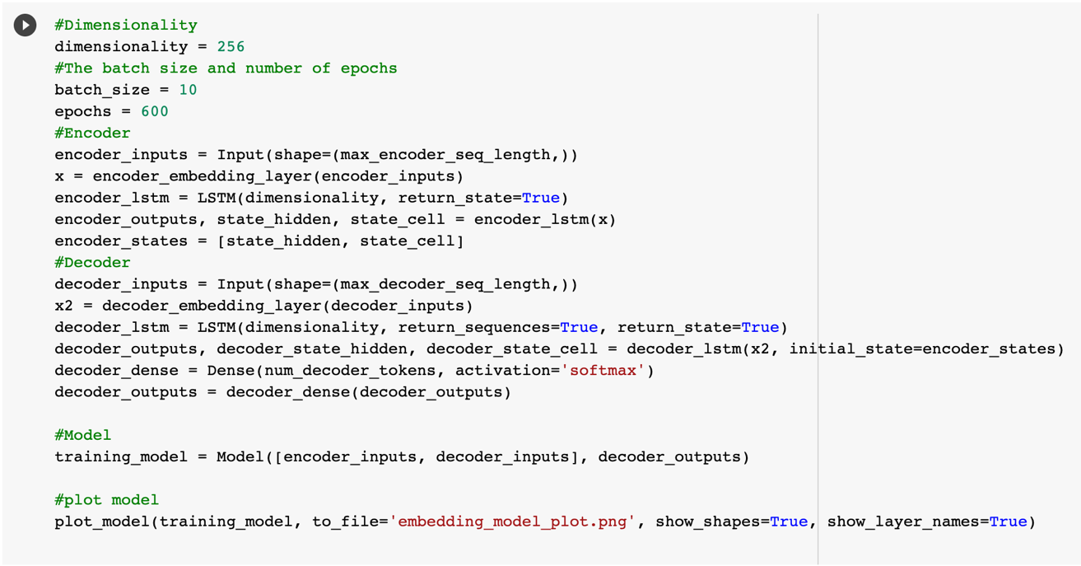
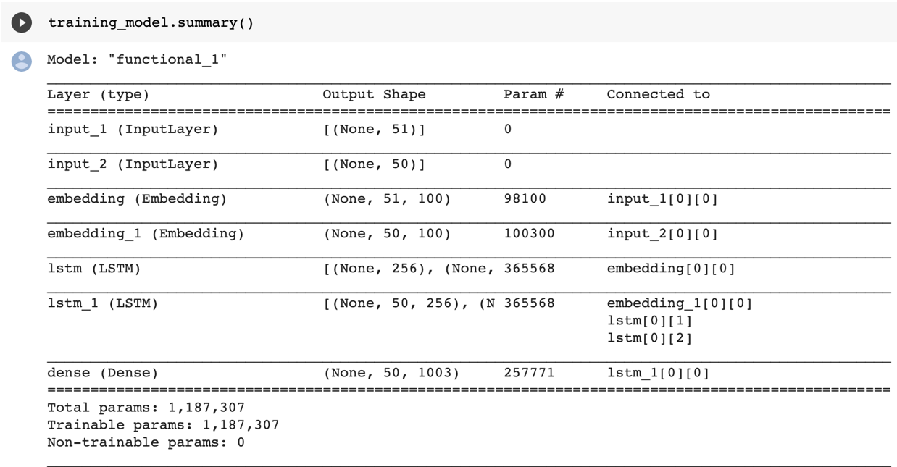
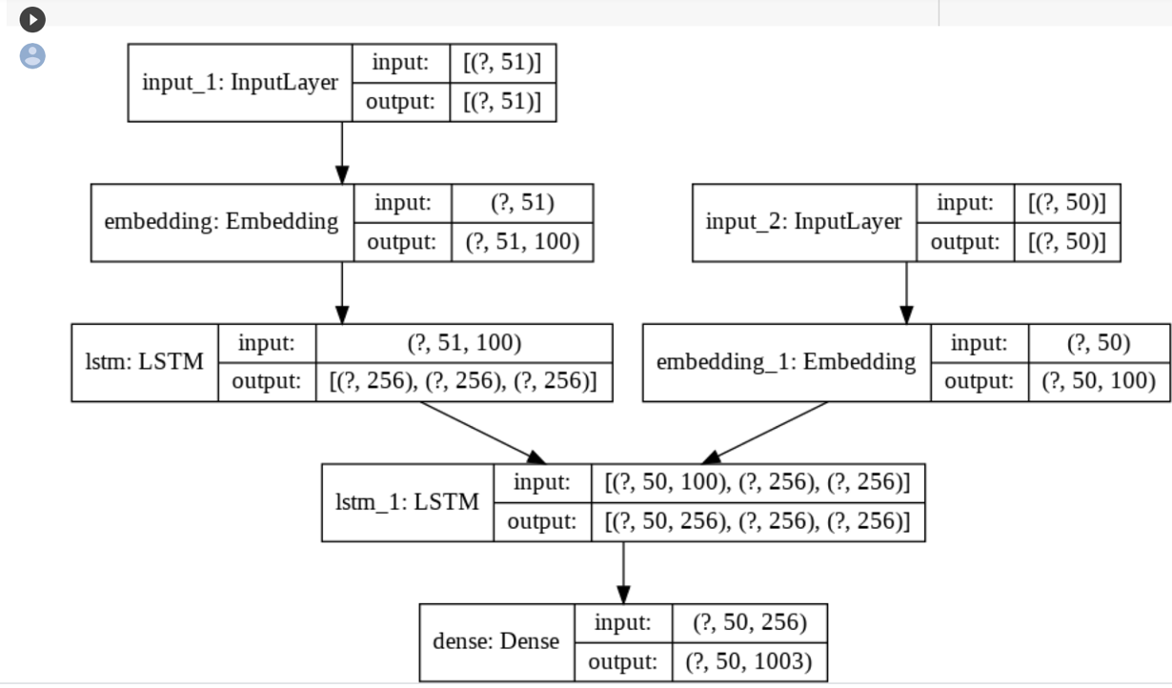
Second model with embedding layer

Slide 9
Second model with embedding layer and Chang Optimizer

Slide 10
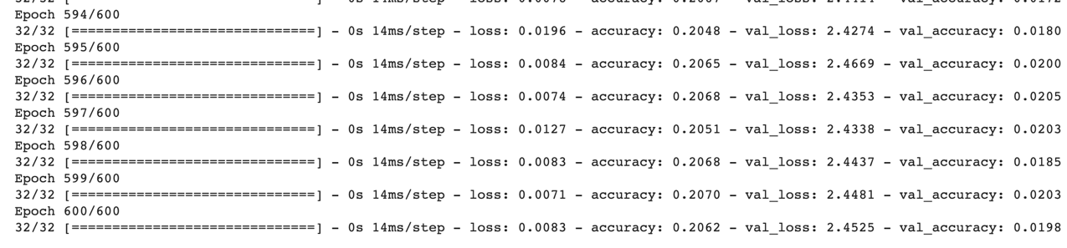

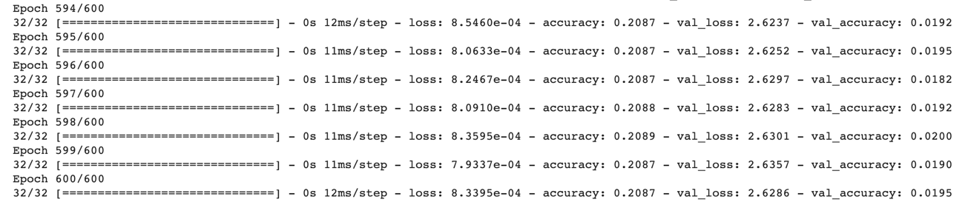
Model Evaluation
Model with one-hot method:
Model with embedding layer:
With same epochs of 600, batch size 10, We find results for two methods are similar and both have overfitting problem

Slide 11
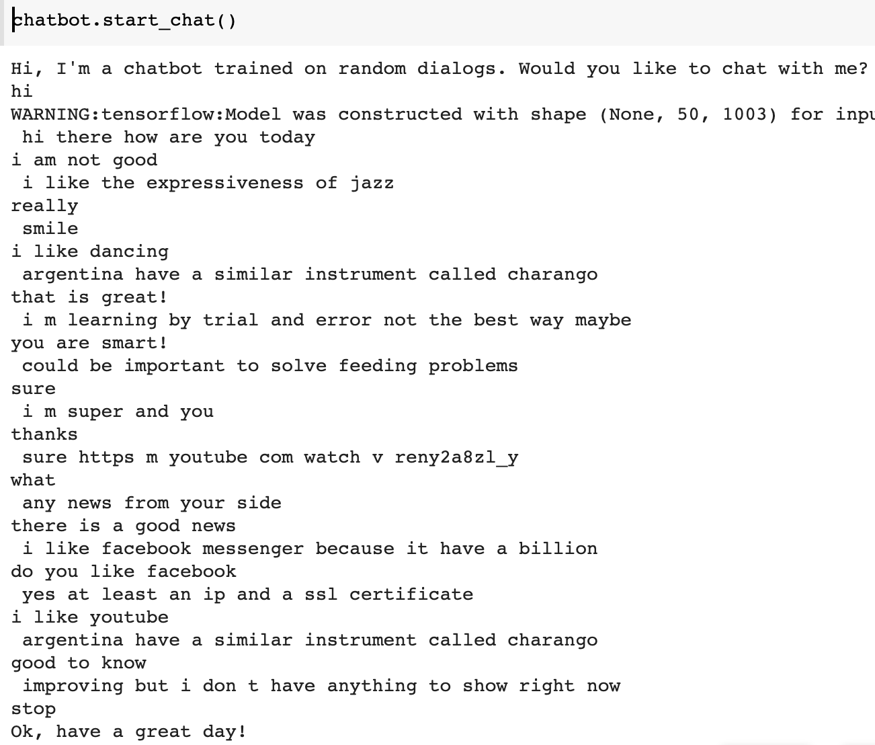
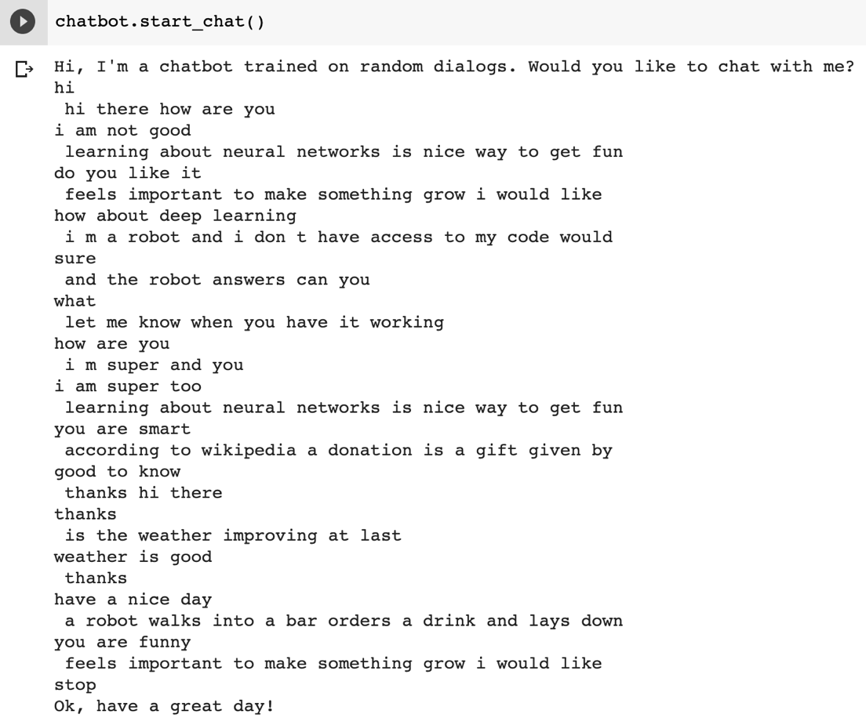
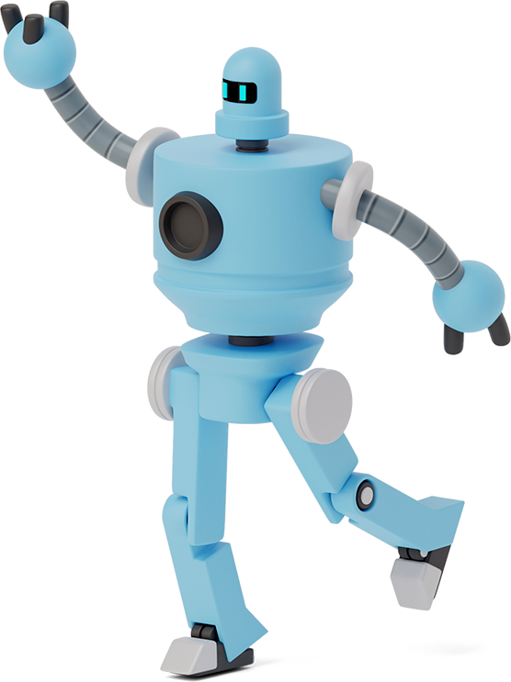
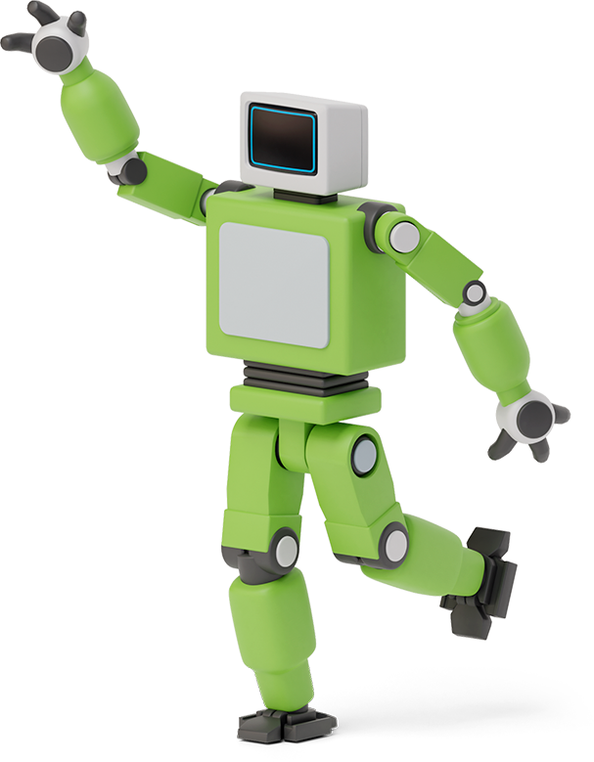

One-hot CB VS Embedding CB

Slide 12
Conclusion
Obviously, our chatbot is not so smart and it is not so human because conversation is an art. Even Facebook says its ‘Blender’chatbot is the most humanlike ever with 9.4 billion parameters, it still would lose control sometimes.
We also tried to change to different optimizer, different batch size and run more or less epochs, but all of the changes did not give us a really good result. Considering the limitation of dataset and computational expense, we suggest to using transfer learning instead of developing model from scratch or we can add with attention if we would explore and improve our chatbot furthermore.

Slide 13
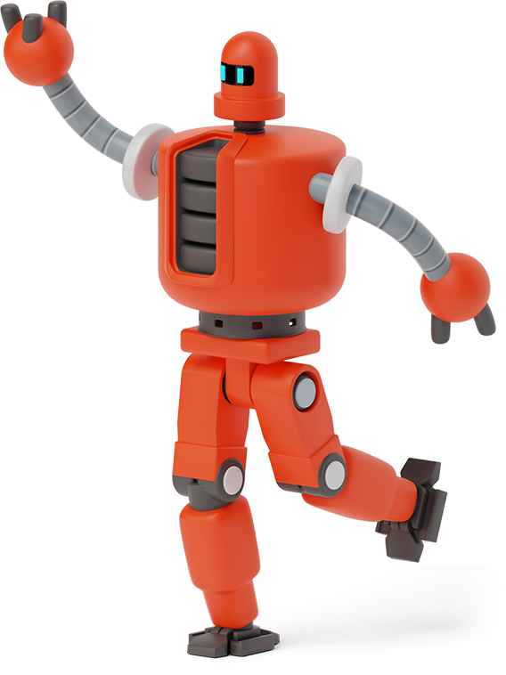



Chatbot: Thank You! Have a nice day!

