Slide 1
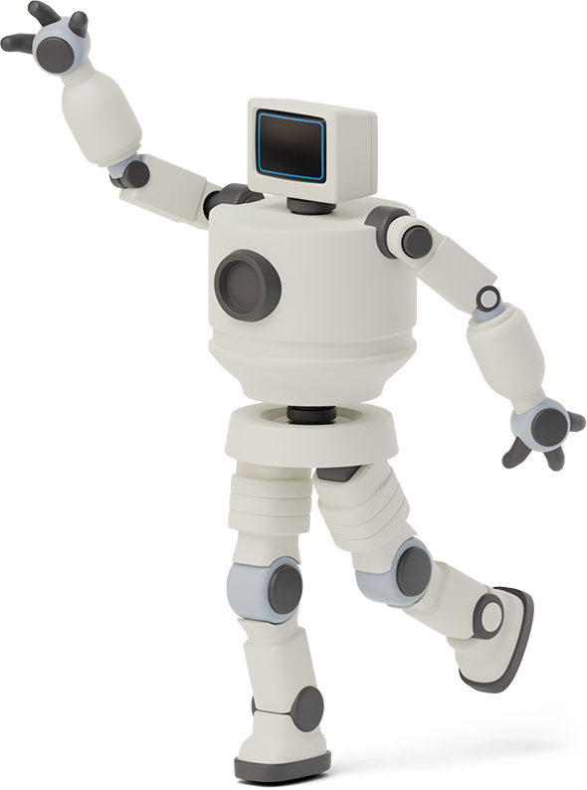


Chartbot
Yinjia Liu & Chenwei Cao

Slide 2

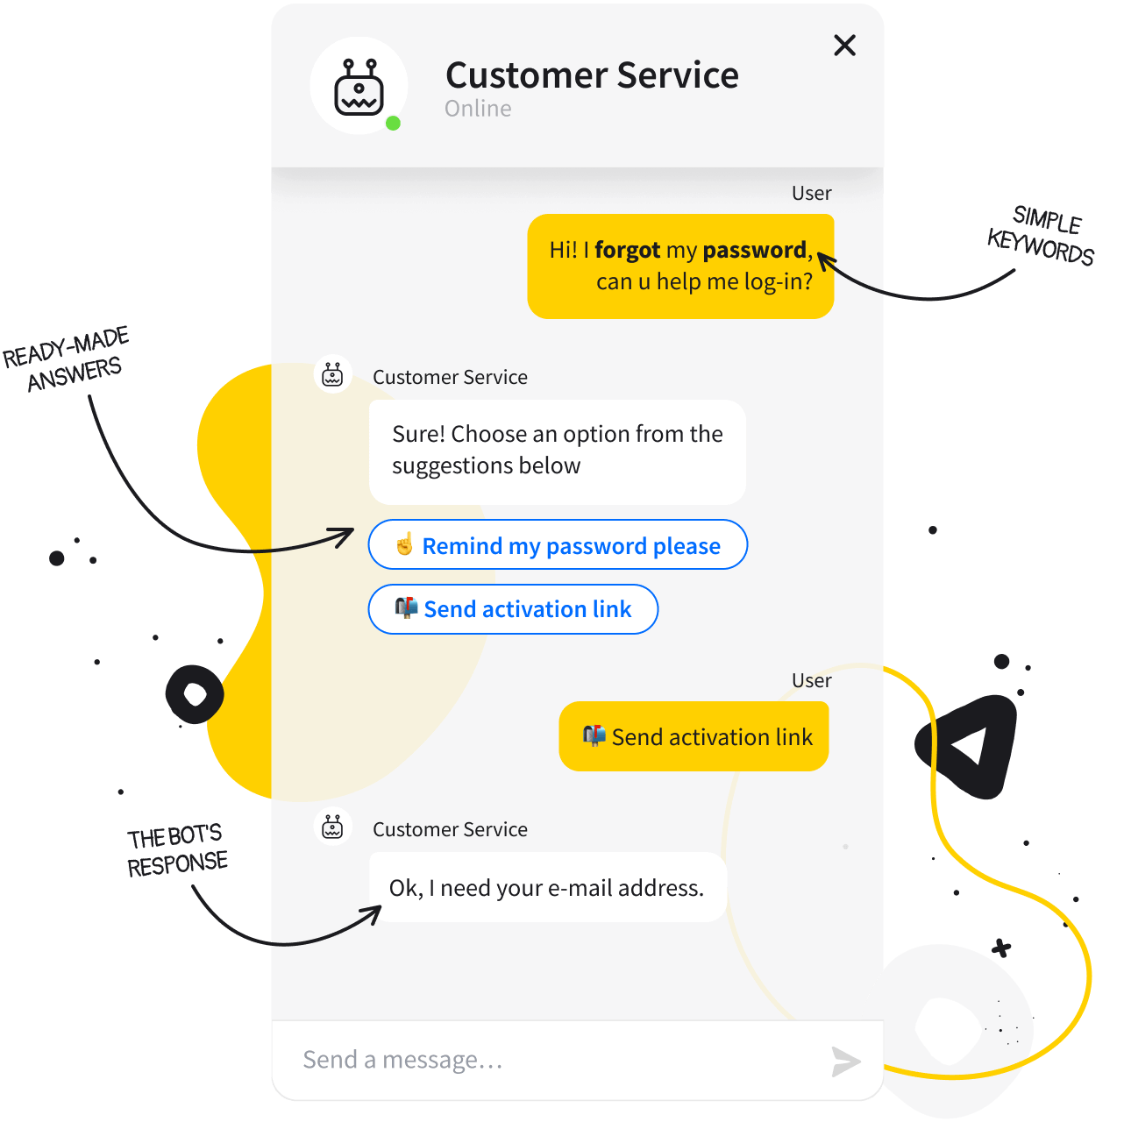

Introduction
A chatbot is a software that provides a real conversational experience to the user, A well-optimized chatbot can converse as well as humans do.

Slide 3

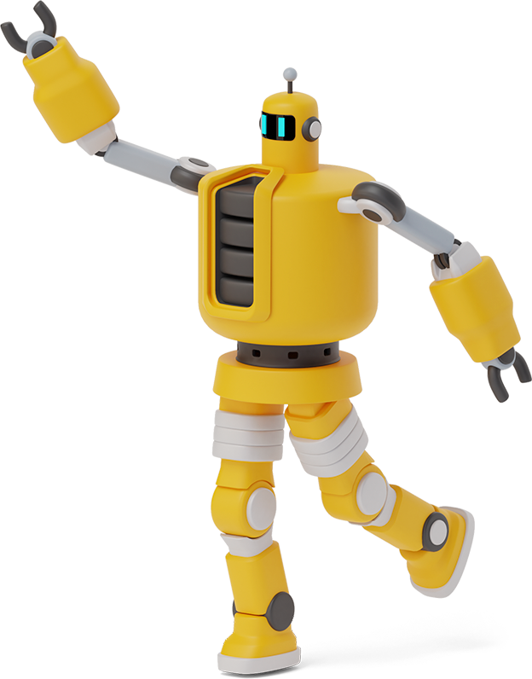
How to build a chatbot?
Python & Google Colab
Using Tensorflow and Keras to build LSTM Seq2Seq model
Using Natural Language Processing (NLP) for preprocessing: one-hot encoding and embedding

Slide 4

Data Overview
The datasets we used are collected from Kaggle which consists of 2363 entries records conversations between a human and other human acting as a companion bot.

Slide 5

Data Pre-Processing
Using Natural language Processing(NLP) to do text corpus preprocessing
Using regular expression to remove punctuation and space
Grouped human response with robot response as pairs of sentences

Slide 6

Model Selection
We selected LSTM seq2seq model as our training model. We use Keras Functional API as our model structure.

Slide 7
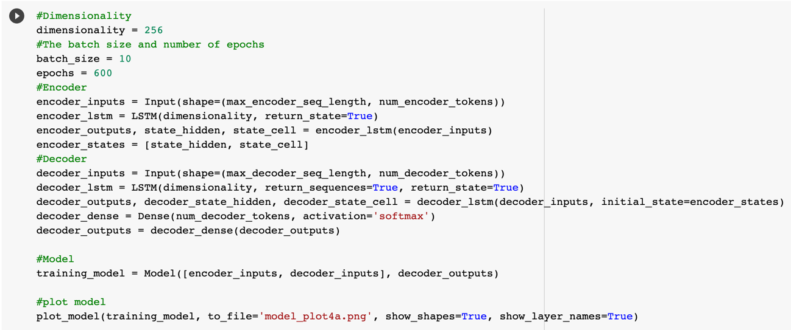
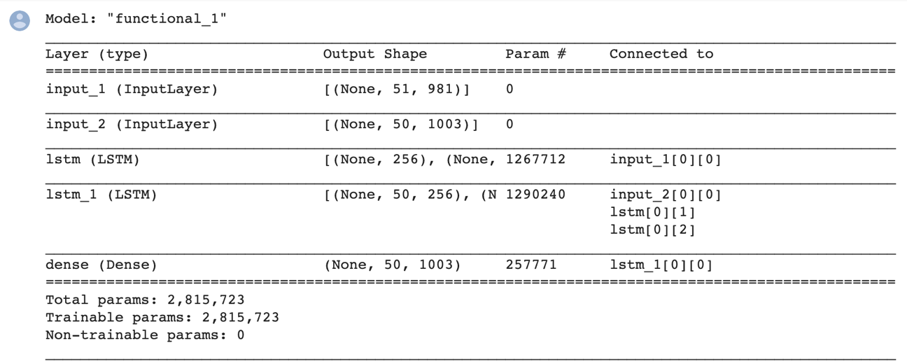
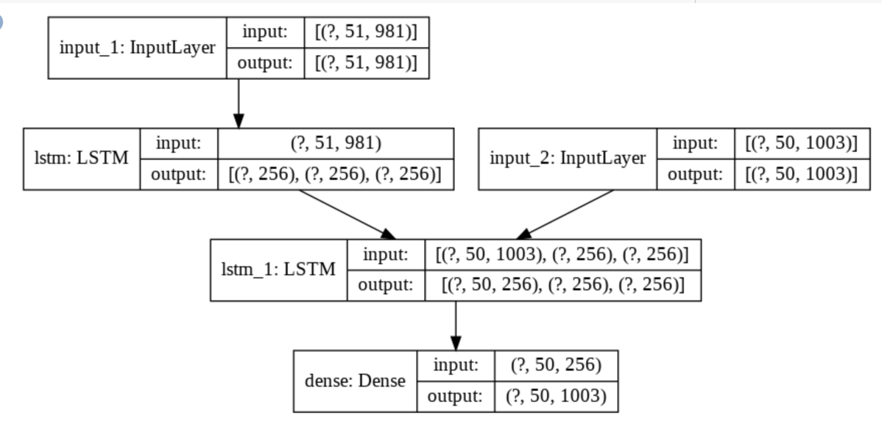
First model with one-hot method

Slide 8
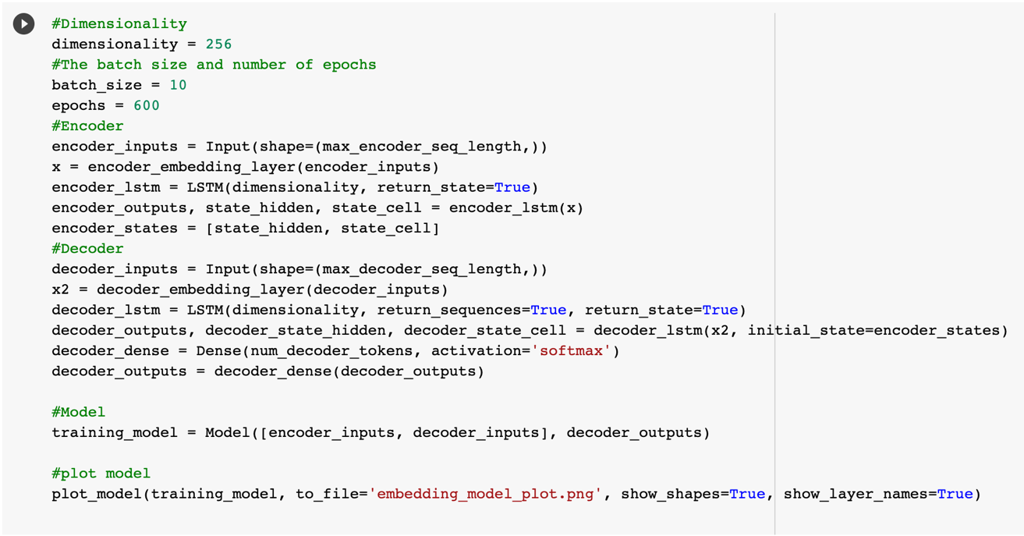
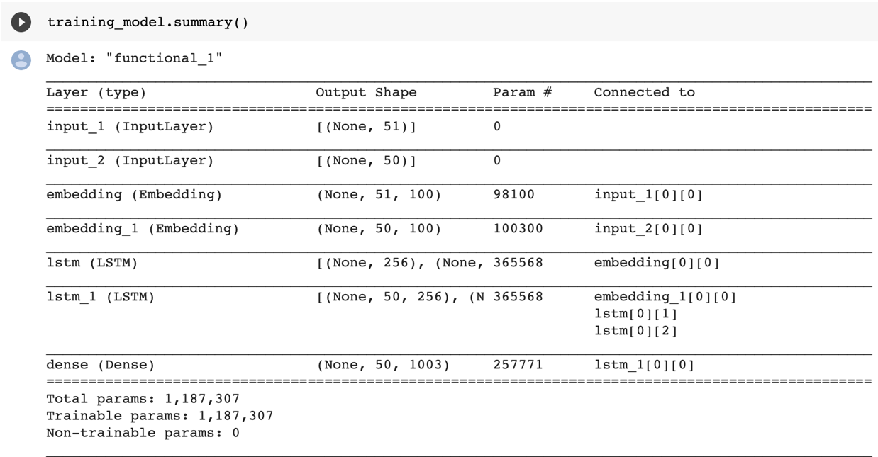
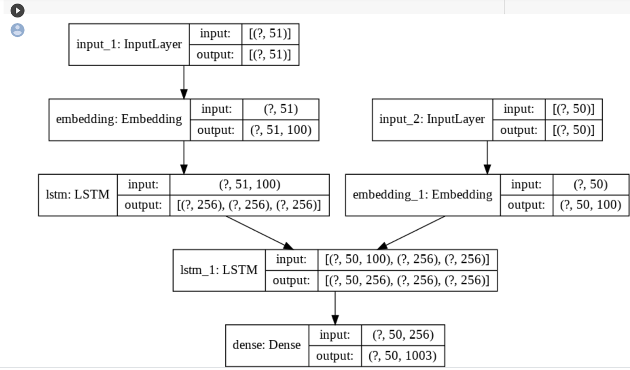
Second model with embedding layer

Slide 9
Second model with embedding layer and Chang Optimizer

Slide 10
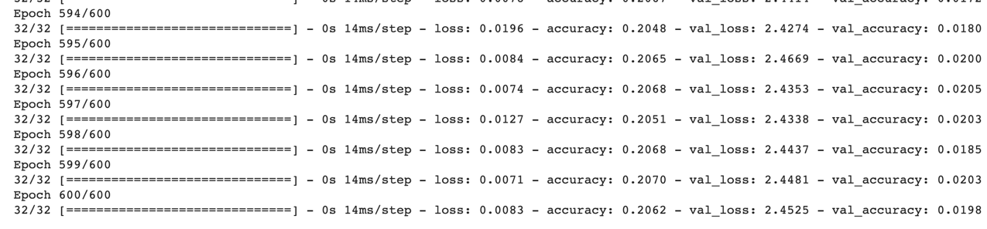

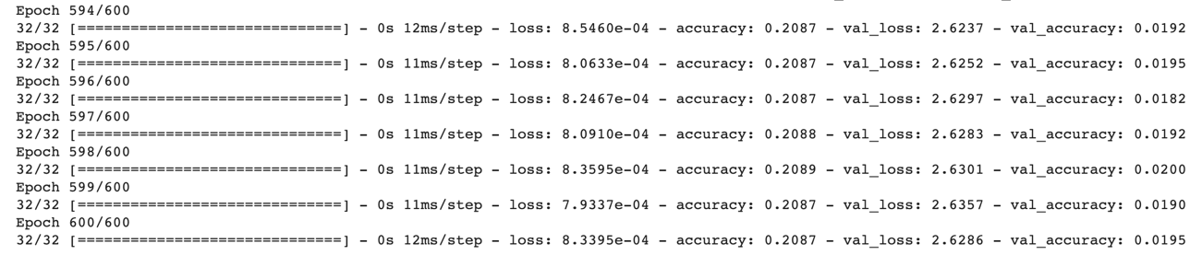
Model Evaluation
Model with one-hot method:
Model with embedding layer:
With same epochs of 600, batch size 10, We find results for two methods are similar and both have overfitting problem

Slide 11
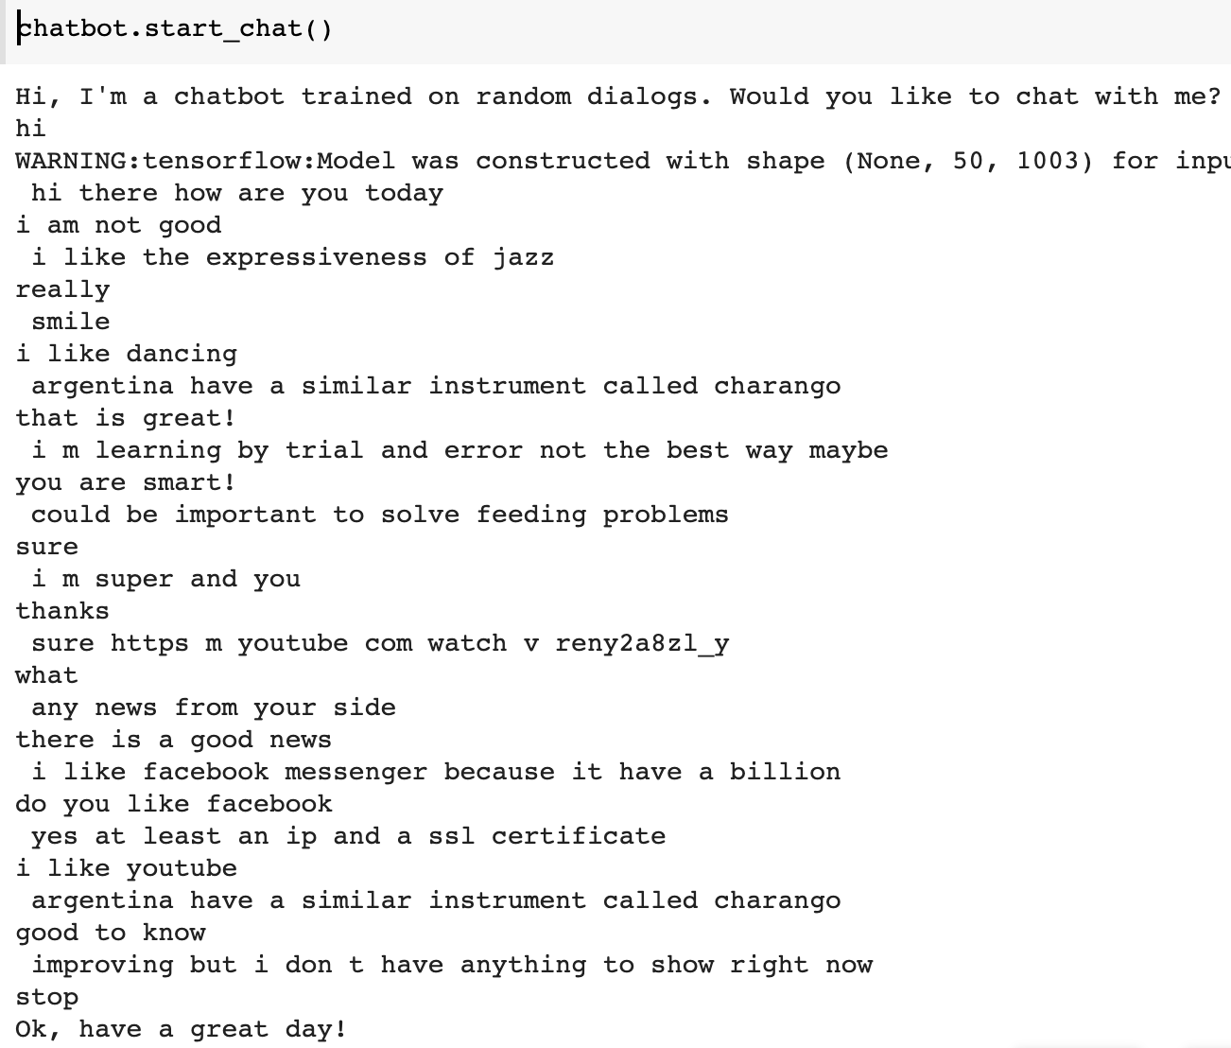
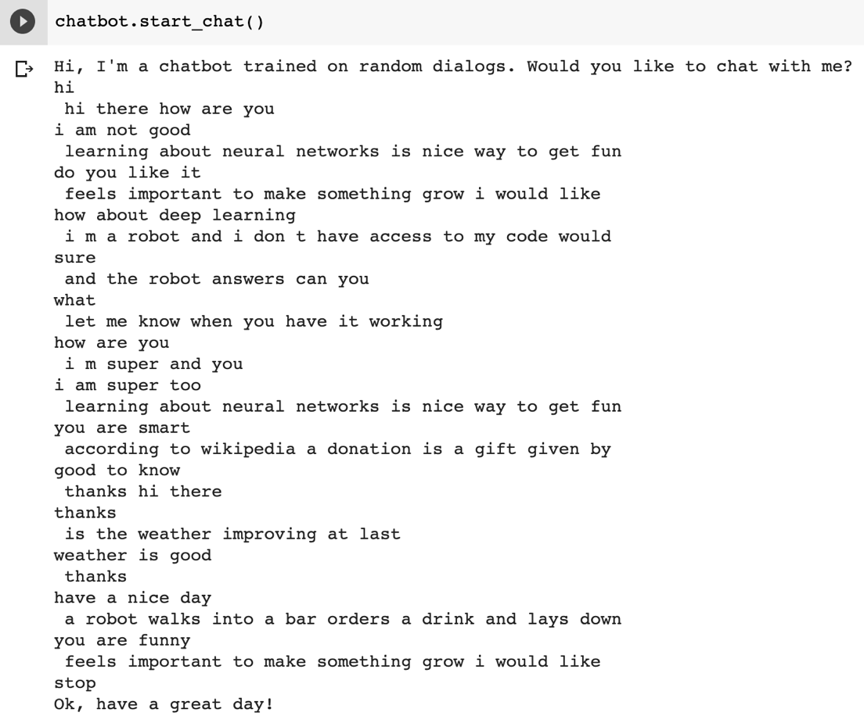
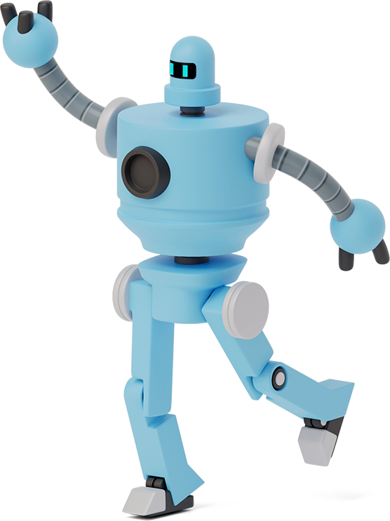
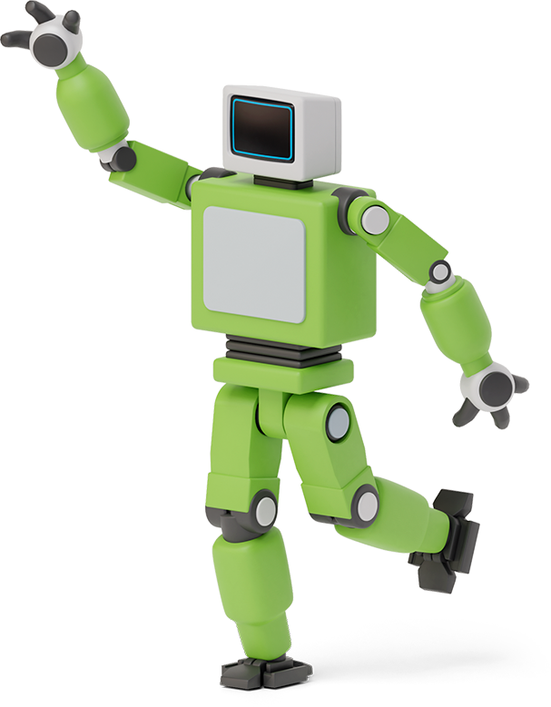

One-hot CB VS Embedding CB

Slide 12
Conclusion
Obviously, our chatbot is not so smart and it is not so human because conversation is an art. Even Facebook says its ‘Blender’chatbot is the most humanlike ever with 9.4 billion parameters, it still would lose control sometimes. We also tried to change to different optimizer, different batch size and runs more or less epochs, but all of the changes did not give us a better result. In terms of that, considering the limitation of dataset and computational expense, we suggest to use transfer learning instead of developing from scratch or we can add with attention if we would explore and improve our chatbot further more.

Slide 13
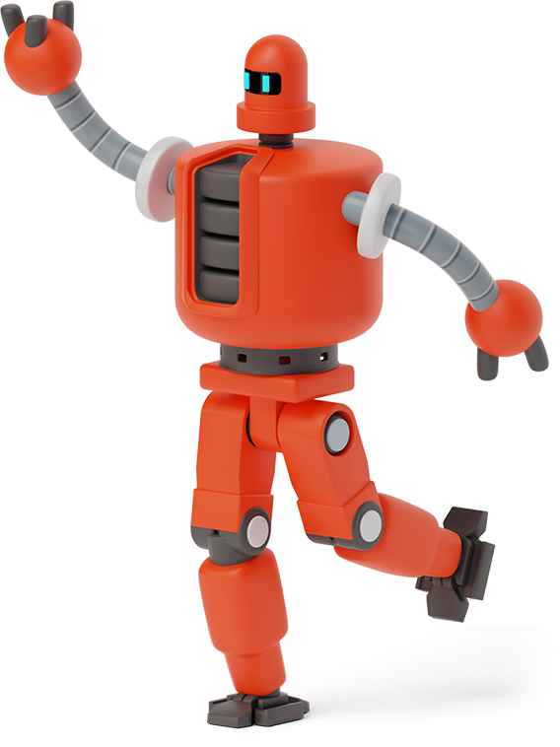



Chatbot: Thank You! Have a nice day!

