Slide 1
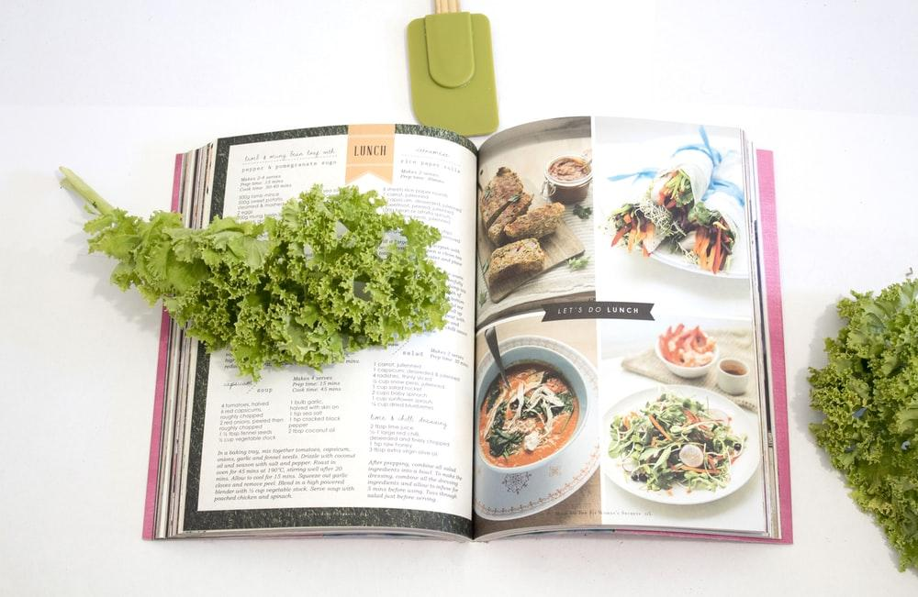
The Home Cooks Guide to Ingredients and Spices
Final Project: Data and Analytics Bootcamp - Team 8
Charlie Willmore, Brittany Garza and Lauren Neidhardt

Slide 2
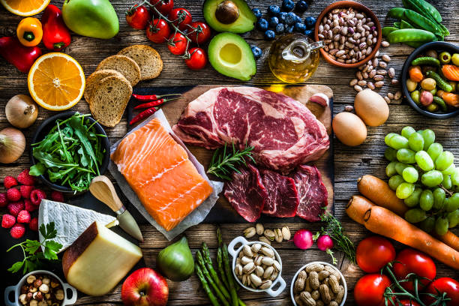
Selected Topic
Charlie had an idea for the average at home chef to be able to have way to know which herbs and spices go well together. We went in a more generalized direction, looking at the overall ingredients within recipes within certain cuisines.
Which ingredients occur in recipes of the same cuisine most frequently and can we use them as a predictor of cuisine?
Notes:
Selected topic and reason why we selected.

Slide 3
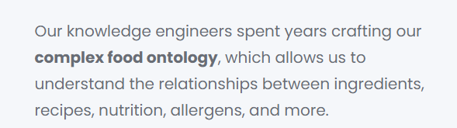
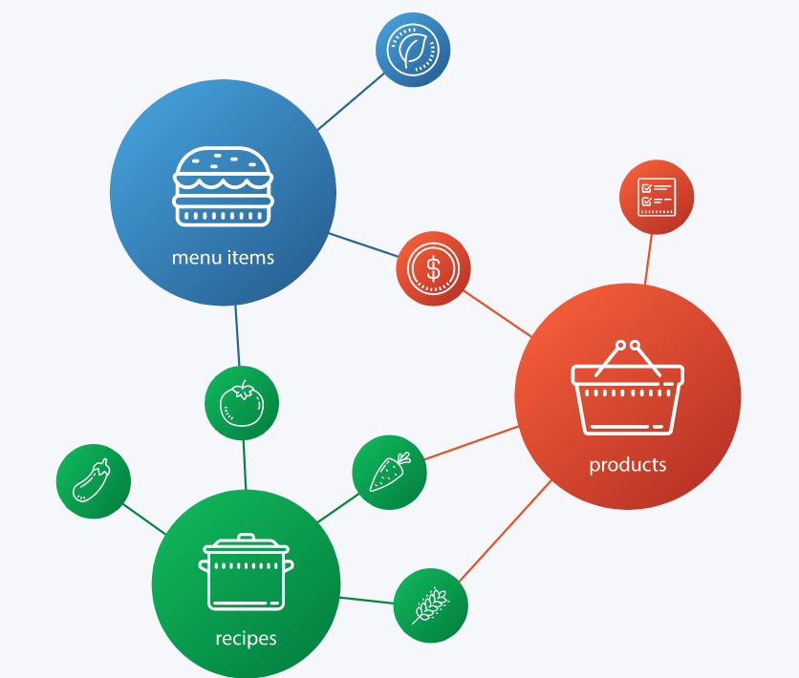
Spoonacular
The Spoonacular API is an online resource containing:
Ingredients
Recipes
Product Information
Menu Items (restaurants)
Notes:
Description of the source data:

Slide 4
Questions we hope to answer with the data:
We hope to be able to see which ingredients most commonly occur within different cuisine types and can those ingredients predict a cuisine type when it is unknown.
Possibly put together recipes based on available ingredients?
Cook certain cuisines based on common ingredients?

Slide 5
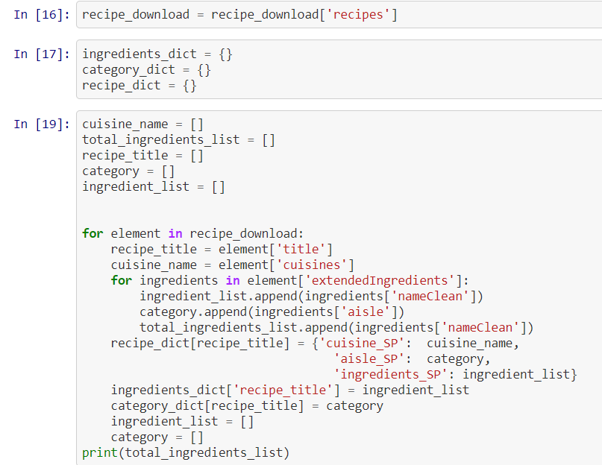
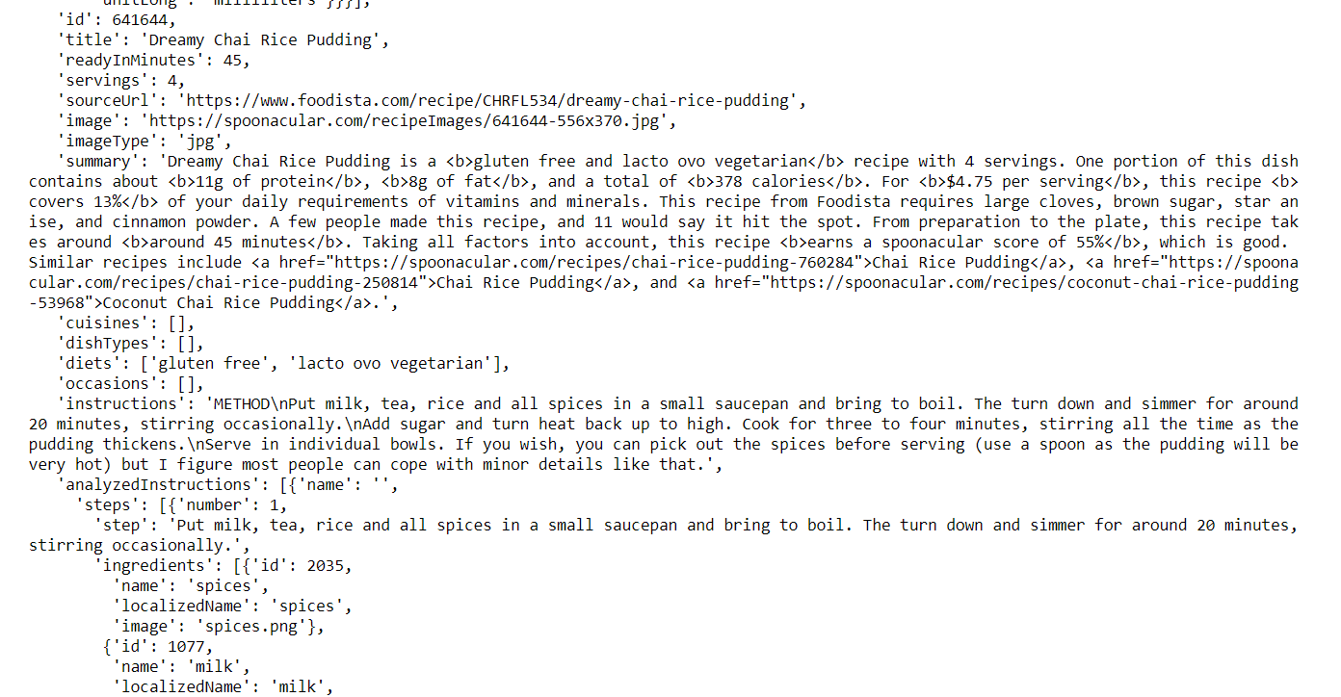
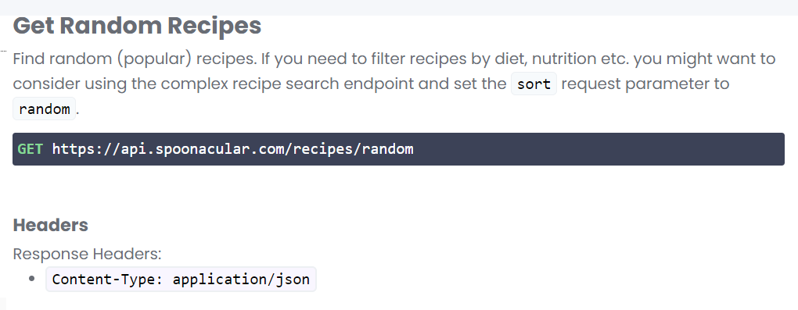
Data Exploration
Initial Data Processing:
Data downloaded via Spoonacular API
Performing a random recipe search, 100 random recipes were downloaded in each call.
Data cleaned in JSON to limit to recipe, cuisine, ingredient names
For loop to pull 10k recipes, merged into single dataframe.

Slide 6
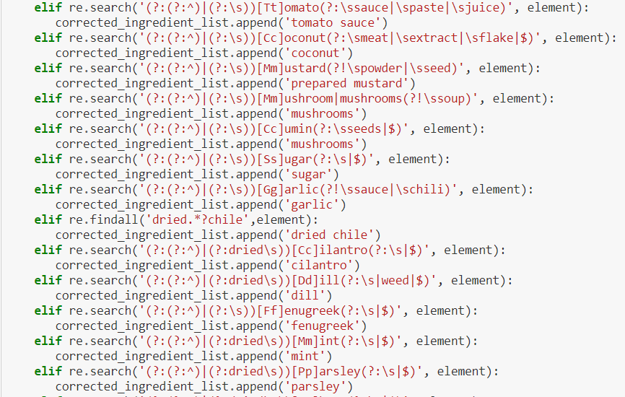
Data Exploration
Create single list of ingredients and their counts
Use Regex to create a consistent, clean list of ingredients
Drop overly common items like salt and pepper, oil

Slide 7
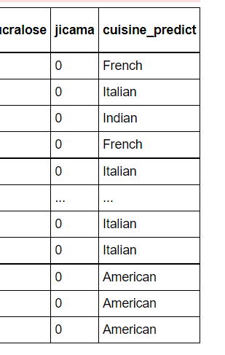
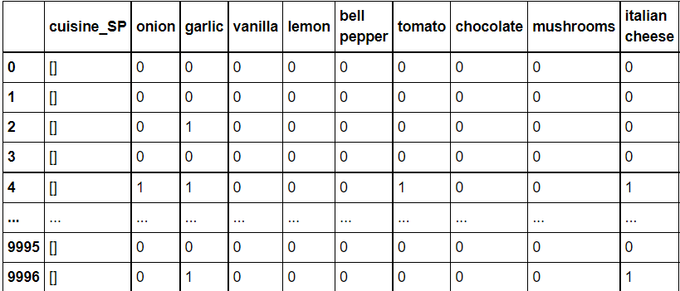
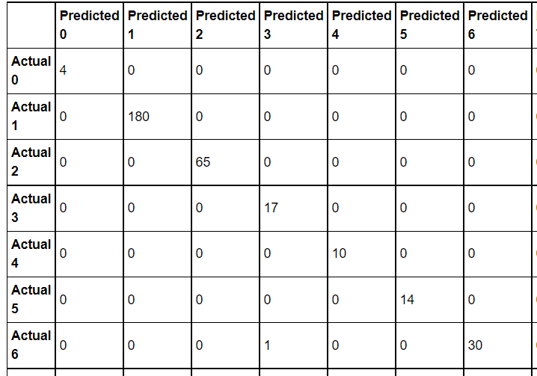
Random Forest
Analysis Phase I:
Random Forest was the machine learning model we chose to classify known ingredients by cuisine and then predict null cuisines in the data. About 7000 recipes had a null value for cuisine, 3000 had a populated value
Ingredients turned into columns, with one column for cuisine
Recipes become the index
Ingredients are given 1 or 0 if they occur in a recipe
Cuisine names normalized
Cuisines encoded
Confusion Matrix

Slide 8
PCA Analysis: Spices

Slide 9
KMeans: Spices

Slide 10
Market Basket Analysis: by Cuisines
Another way to understand the relationship between ingredients and cuisines.

