Slide 1

Ching-Wen Chen
Translated from Chinese (Simplified) to English - www.onlinedoctranslator.com
【Mobile Commerce and Cross-border E-commerce】
are the two major trends in current e-commerce
➜ Using SHEIN, Temu, and Amazon as examples.

Slide 2
Unit Outline
1.Mobile Commerce (M-Commerce)
2.Challenges and opportunities of cross-border e-commerce
3.Cross-border payment systemsandInternational Payments
4.International Logistics Management
5.Case Study: Successful Cross-Border E-Commerce Business ➜byShein,Temu ,AmazonGlobalFor example
6.Multi-language support
7.Multi-currency support

Slide 3
1.Mobile Business
（M-Commerce）
The rise and application of

Slide 4
Definition and Background of Mobile Commerce
Mobile commerce (M-Commerce) refers to
Mobile Commerce
pass throughMobile devices (such as smartphones and tablets)E-commerce activities carried out
With the popularity of smart phones and the development of mobile Internet,
Mobile commerce has become an important part of e-commerce, and its market size continues to grow.

Slide 5
The rise of mobile commerce
The rise of mobile commerce is mainly due to the following factors: 1.Popularity of smartphones:
With intelligenceMobile phone prices fallWith the improvement of mobile phones and functions, more and more consumers are using mobile phones to shop online.
2.Mobile ApplicationAPPDevelopment:
Designed for mobile devicesApplication) makes the shopping experience more convenient and smooth.
3.Advances in mobile payment technology:
likeApple Pay, WeChat PayThe popularity of mobile payment methods such as PayPal has greatly promoted the growth of mobile shopping.

Slide 6
Application Scenarios of Mobile Commerce
1.Mobile Shopping:
Consumers can【Mobile Application,or mobile website】Browse and purchase items.
2.Mobile Payment:
Consumers use mobile devices to complete【existOnline Payment,Or scan the QR code to pay offline】
3.Location Based Services (LBS):
pass throughGPS Positioning Technology, merchants can provide push notifications and services based on geographic location, such asRecommended nearby storesandDiscount notification.
4.Social BusinessandMobile BusinessCombination of:
Consumers canShare your purchases through social media platforms, and complete your purchase directly within the platform.

Slide 7
2.Challenges and opportunities of cross-border e-commerce

Slide 8
Definition of Cross-Border E-Commerce
Cross-border e-commercerefers to
Cross-Border E-Commerce
Through the InternetInternational Trade,
Buyer and SellerBelong toDifferent countriesor Region.
With the development of globalization and the Internet, more and more companies have begun to engage in cross-border e-commerce and sell their products to the global market.

Slide 9
1. Overview of Cross-border E-commerce
Cross-border e-commerceFeatures
Global Market：Enterprises can sell their products all over the world through the Internet, breaking through geographical restrictions. Multi-language and multi-currency support：It is necessary to provide multi-language websites and payment options in multiple currencies to meet the needs of consumers in different countries. Complex legal and tax environment：Cross-border transactions involve the laws, taxes and customs requirements of different countries, which requires companies to have professional knowledge.

Slide 10
2. Market opportunities for cross-border e-commerce
Global Market Size
With the popularization of the Internet and the advancement of logistics technology, the global cross-border e-commerce market continues to grow and is expected to continue to expand in the next few years. The Asia-Pacific region, North America and Europe are the main cross-border e-commerce markets, and consumers' demand for overseas products continues to increase.

Slide 11
Cross-border e-commerce opportunities
Market expansion:
Cross-border e-commerce enables businesses to break through the limitations of local markets, reach global consumers and increase sales opportunities.
Cost advantage:
Products from certain countries or regionsVery low,May have price or quality advantages in other markets, thereby attracting cross-border consumers.
Technological progress:
Global LogisticsandPayment TechnologyThe progress of the Internet has made cross-border transactions more convenient and secure.
Government Support:
Many governments have adopted policies to support the development of cross-border e-commerce., if providedTax incentivesorSimplify customs procedures

Slide 12
Challenges of Cross-Border E-Commerce
Logistics Challenges:
Cross-border logistics involves transportation, customs clearance and delivery in multiple countries.High cost and long time.
Regulations and Compliance:
Import and export regulations and tax policies between different countries,Different legal systems, companies need to comply with relevant laws and regulations to avoid legal risks.
Cultural differences:
Consumer purchasing behaviors and preferences vary from culture to culture, and companies need to understand and adapt to these cultural differences.
Currency Fluctuations and Exchange Rate Risk:
Cross-border transactions involving different currencies, exchange rate fluctuations may affect prices and profits.

Slide 13
3.Cross-border payment systemsand
International Payments

Slide 14
International Payment System
International Payments
It is an important part of cross-border e-commerce.
The convenience and security of payment directly affect consumers' shopping experience and businesses' sales conversion rate.

Slide 15
International payment methods
credit card:
Credit cards are the most common international payment method, almost all cross-border e-commerce platforms support it.
Third-party payment platform:
likePayPal, Alipay International Edition, Skrillwait,
These platforms offer additional security and support payments in multiple currencies.
Local payment methods:
For local payment systems in specific countries,
SEPA in Europe, UPI in India, etc.,
Satisfy the payment habits of local consumers.

Slide 16
Payment Security
SSL Encryption:
Ensure payment informationNo data can be stolen during transmission.
PCI DSS Compliance:
Comply with payment card industry data security standards,Protecting cardholder information.
Two-factor authentication:
Enhance payment security and reduce fraud risks.

Slide 17
4.International Logistics Management

Slide 18
Logistics Management
logistics
One of the key challenges of cross-border e-commerce
Efficiency and cost directly affect consumer satisfaction and corporate competitiveness.

Slide 19
Cross-border logistics model
1.Direct Mail Mode:
commodityDirectly shipped from the exporting country to the consumer’s country,
feature:Simple process,But the delivery time is long.
2.Overseas warehousing model:
Enterprises in target marketsEstablish overseas warehouses,Goods are stored locally in advanceAfter consumers place an order, the goods are shipped from overseas warehouses.
feature:Fast delivery,But the cost is high.
3.Consolidation mode:(Taobao)
willCombine multiple orders and ship to the destination country,
AgainDeliver to consumers in batches,
feature:Suitable for small orders,And the cost is lower.

Slide 20
Logistics Optimization Strategy
Choosing the right logistics partner:
According to the target market and product characteristics,Choose a professional cross-border logistics service provider, ensuring delivery efficiency and service quality.
likeDHL,upswait
Monitor the logistics process:
Use logistics tracking technology to monitor the status of your package at any time, and handle delivery issues in a timely manner.
Optimized packaging:
Choose appropriate packaging materials according to the characteristics of the product and transportation requirements.Reduce damage risk and transportation costs.

Slide 21
5.Case Study: Successful Cross-Border E-Commerce Business
byShein,Amazon GlobalFor example

Slide 22
Case Study: Shein

Slide 23
Case Study: Successful Cross-Border E-Commerce Business
Case 1:SheinGlobal expansion
background:
Shein is a ChineseFast fashion brands,pass throughSocial Media MarketingandGlobal Supply Chain Management, quickly achieving success in the global market.
Strategy:
SheinLeveraging data-driven product developmentandLocalization operation strategy, meet the needs of consumers in different markets, and throughEfficient supply chainandLogistics systemAchieve fast delivery worldwide.
Revelation:
Data DriveandLocalizationyesKey factors for successful cross-border e-commerce,
Businesses need to be flexible in responding to market changes and adjust strategies quickly.

Slide 24
Case Study: Shein
Special performance:
Sheinexist2021Year, yesAll AmericaAPPDownloads1name
Sheinexist19A country, tooAPPDownloads1name
SheinexistFashion/ClothingCategoryInternet traffic is the world's1name
VisitSheinWebsiteAverage length of stayfor8point36Seconds (higher than other brands）
from2013Year starts8Year,The annual growth rate exceeds100%
A business philosophy that is better than competitors:
1.SheinalreadyBeyond【Fast Fashion】, but【Instant Fashion】
2.SheinIt's like【E-commerceTikTok】 ➜gooduse【Big Data Analysis】Gain insights into customer preferences and market trends

Slide 25
Case Study: Shein
A business philosophy that outperforms competitors:
3.SheinIt is the first【Internet Celebrities/KOL】To recommend products (in2010Years ago)
Social Media【FB,Instagram,twitter】Combine【Internet celebrities,KOL】To promote products
Large-scale recruitment【Sheingirl】
ROI of influencersROIfor1:3, very profitable
4. SheinLarge-scale online advertising (Google,FB,TikTok,Instagram
Using big data analysis toPrecise delivery, not just randomly placed

Slide 26
What is Return on Investment?ROI = 1:3
Shein ROI of influencers (ROI)for1:3
This means that every investment1The unit's funds,Shein You can gain from these Internet celebrities3Unit revenue.
In other words,
Shein Every dollar invested in influencer marketing,AllCan generate three returns

Slide 27
Case Study: Shein
A business philosophy that outperforms competitors:
4.Sheinhave【Affiliate Program】,【Distribution】
It is the first【Internet Celebrities/KOL】To recommend products (in2010Years ago)
Social Media【FB,Instagram,twitter】Combine【Internet celebrities,KOL】To promote products
Large-scale recruitment【Sheingirl】
ROI of influencersROIfor1:3, very profitable
5. SheinLarge-scale online advertising (Google,FB,TikTok,Instagram
Using big data analysis toPrecise delivery, not just randomly placed

Slide 28
What is【Affiliate Program, Distribution】
【Affiliate Program】（Affiliate Program), that is【Distribution】plan,
Allows individuals or organizations to becomeShein Through the promotion ofShein To earn commissions from products sold by you.
Join the Affiliate Program:
Partner NeedsRegister and joinShein Affiliate ProgramAfter registration, partners will receive a unique referral link or code to track the sales they bring in.
PromotionShein product(Do you offer exclusive discounts?):
Partners canSocial media, blogs, websitesOther platforms for promotionShein Products.
They will shareShein ofProduct link or exclusive discount code, attracting their audience to make a purchase.
Now many Internet celebrities, in the advertisement【attachProduct link or exclusive discount code】, indicating that he participated【Affiliate Program, Distribution Program】

Slide 29
What is【Affiliate Program, Distribution】
3.Earn commission:
When consumersuse【Promotional Links,Code】existShein When shopping, partners will receiveA certain percentage of commission.
4.Commission Payment:
Shein Commissions are paid to partners periodically in accordance with the terms of the affiliate program. The method and timing of payment may vary and are determined byShein Affiliate Program Rules

Slide 30
Case Study: Shein
A business philosophy that outperforms competitors:
5.SheinProducts【Very cheap price】, average unit price300Taiwan Dollar
6. SheinhaveUnique【Supply Chain Management】
In itsCompare prices among exclusive suppliers to see who has the lowest price, who wins the bid (price-cutting competition)
If the product is returned due to quality issues, the supplier will pay for it.
BecauseSheinofLarge and stable order volume,soSuppliers are willing to accept such stringent requirements
SheinOnline products have always been60More than 10,000 pieces

Slide 31
Case Study: Shein
A business philosophy that outperforms competitors:
7.SheinProductsNew and popular styles, styles change quickly
SheinNew arrivals,Weekly【210,000 pieces】
ZaraNew arrivals,Weekly【20Item】
8. SheinuseBig Data Analysis Market Demand,【Develop new products】
At the beginningFirst【Small quantity order】
ifGood market response【Add another order】

Slide 32
Case Study: Shein
A business philosophy that outperforms competitors:
9.SheinHave your ownExclusive【Design Team】,Exclusive【Supply Chain】
10.SheinThe product development life cycle is short and fast
SheinFrom design to sales, it only takes【3sky】
ZaraNew products,【30~60sky】
Traditional clothing industry,want【90sky】
11. Guangzhou's clothing supply chain,1/3All forSheinservice

Slide 33
Case Study: Shein
A business philosophy that outperforms competitors:
12.SheinFundraising:
2013YearARound of financing500Ten thousand US dollars
2015YearBRound of financing4600Ten thousand US dollars
2018YearCRound of financing
2019YearDRound of financing
2020YearERound of financing
at presentSheinValuation:150Billions of US dollars

Slide 34
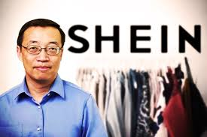
Case Study:Shein
SheinFounder of:Xu Yangtian
On2008Founded in Mainland China

Slide 35
Case Study:Shein
Xu Yangtian UniversityInternational TradeProfessional,
At the beginningSelf-studySEOSearch Engine Optimization”, bought some domain names, andEstablishing an overseas marketWebsite,Sales AgentIndustrial products made in China
Reviews:Hardworking, frank, and always gets to the point when speaking, low-key, no airs
It seems like "I never need to sleep"
A supplier said, "No matter when you go,Even in the early morning2,3You can see Xu Yangtian and his team in a meeting at any time.".

Slide 36
Case Study: Shein
SheinControversy:
1.Plagiarism:
Designs copied from expensive luxury goods
2.Some products are too cheap becausePoor quality

Slide 37
Case Study: Shein
SheinAnalysis of successful business models:
1.Small profits but quick turnover:
SheinAverage unit price300NT$, profit20NT$
SheinDepend on【Many styles/large6010,000 pieces】, small profits but quick turnover
2.Make good use of【Social Media/Internet Celebrities/KOL】Marketing
3.Make good use of【China's manufacturing strength in high quality and low price】, choose to doCross-border e-commerce, the market looks at the world
4.Make good use of【AI/DataDriven business model】ComePrediction【Latest TrendsTrendsandCustomer needs】

Slide 38
TikTok,Shein, Little Red Book Common characteristics that make them popular all over the world
1.Make good use of【AI/DataDriven business model】ComePrediction【MarketTrends,Customer needs,Accurate recommendation】
2.Make good use of【Rapid response supply chain management】

Slide 39
Case Study: Shein analyzeSheinRelated videos of
1. Shein Chinese-style marketing by wealthy people has stunned the American industry! Decoding China's most secretive e-commerce. CommonWealth Magazine
https://www.youtube.com/watch?v=YLY_CWvlZs0
2.Why are mysterious Chinese brands so popular in Europe and America?
https://www.youtube.com/watch?v=dVKrNXProDw
3.Disrupting the fashion industry! WhySHEINSuper cheap and profitable
https://www.youtube.com/watch?v=et9KYBofMGU
4.Mysterious Chinese BrandSHEIN, rising at an astonishing speed, encompassing the United States30%Market share
https://youtu.be/fF3SZTUehsA?t=4

Slide 40
Case Study: Shein analyzeSheinRelated videos of
5."Instant Fashion" Shortest3Sky shelf!SheinMarket value reaches 100 billion US dollars,TVBS
https://www.youtube.com/watch?v=C7fOZ1tmJaI
6. 3Annual performance doubled3times!E-commerceSheinPop-up store in South Africa,TVBS
https://www.youtube.com/watch?v=zuWyY8vigbA
3.Affordable and hot selling!Cross-border e-commerce in ChinaTemu".「Shein"Seize the US, Japan and South Korea markets,TVBS
https://www.youtube.com/watch?v=6h6cY-EjlYE
4.The epidemic reversely boosted the LuKuai Fashion brand valuation to US$100 billion
https://www.youtube.com/watch?v=Q8bM0NCanNY

Slide 41
Please tell me:
2023Year in the United StatesAPPDownloads,1What's your name?
2023Japan KoreaAPPDownloads,1What's your name?

Slide 42
Case Study: Temu

Slide 43
Case Study: Temu
2023YearAll AmericaAPPDownloads,No.1Name isTemu
TemuBeyondTikTok,Instagram,GoogleandYoutube, becoming the United StatesApp StoreMost downloaded free apps
break inSheinInitial launch speed
2023YearQ1/Q2, US marketTemuExceededShein
TemuRevenue increased by more than130%, across60country
In order to compete for the first place in cross-border e-commerce1's market share,TemuMultiple lawsuitsShein

Slide 44
Case Study: Temu
TemuIt is a mainland e-commerceGiant【Pinduoduo】Our Platforms
Pinduoduo
Company owner:Huang Zheng
Featured【Low price productsand social shopping】It passes【WeChat】and other social media platforms to spread virally.
Quickly【Lower-tier and rural cities】The site has gained a large number of users
roll out「Agricultural products up"Strategy, deeply integrated with the rural market, launched "10 billion subsidies" and other promotional activities, successfully attracted a large number of rural users
Taobao: Main attack1,2Line City
Pinduoduo: Main attack3,4Cities + Rural Areas

Slide 45
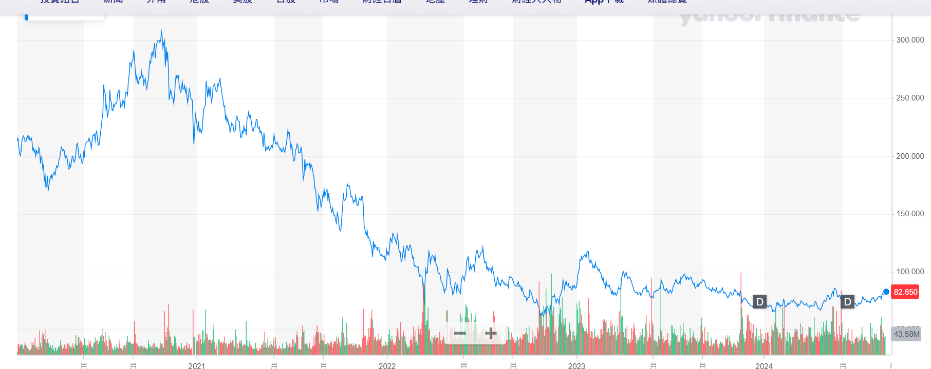
Taobao stock price chart
PinduoduoTaobao's performance has been declining year by year due to its rural-urban approach.

Slide 46
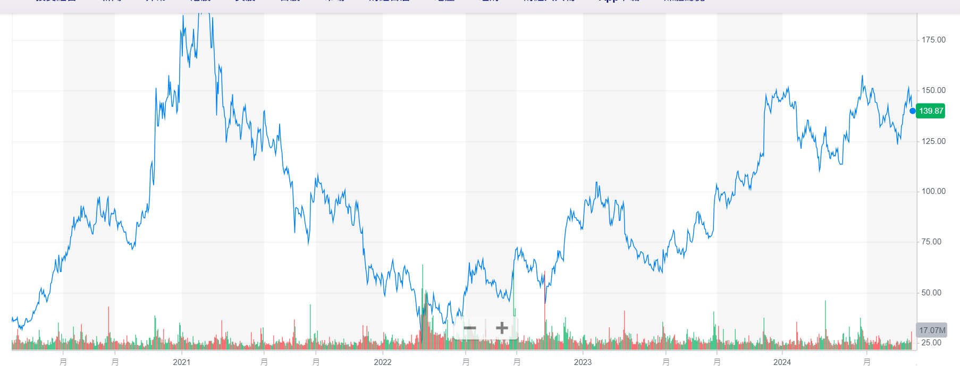
Pinduoduo stock price chart
In recent years, the Internet in mainland China has been suppressed by policies, but Pinduoduo has continued to grow year by year.

Slide 47
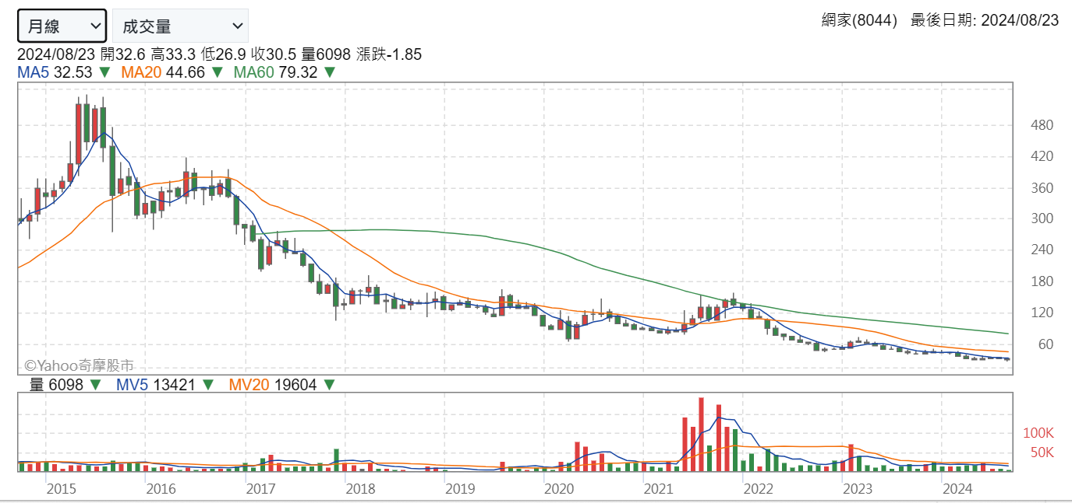
TaiwanPChome, stock price chart
PchomeThe listed companies are:Webmaster:Internet Family(8044-tw),
BecauseShopee/momoOvertaking, resulting in a decline in market share

Slide 48
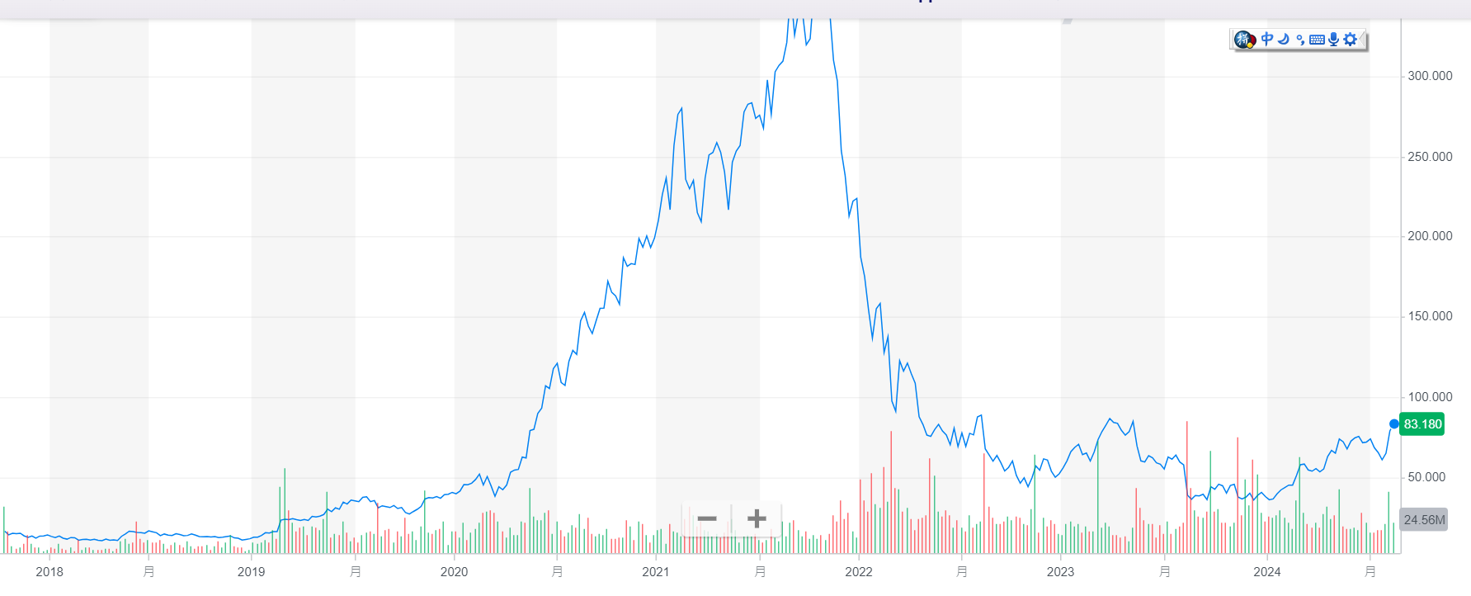
Shopee, stock price chart Shopee's parent company isSeaCompany, video game company
Shopee parent company(SeaCompany), whose main business is video game business, making money,
However, Shopee's business was only profitable in Taiwan. Blindly expanding globally resulted in huge losses, leading to massive layoffs.

Slide 49
Shopee suffered a huge loss
After Shopee's stock price plummeted and massive layoffs...Shopee completely withdraws from this market,exist2022-2023,Cut it off in half a year7000The employees who stayed would not receive promotion or salary increase.
First, blind investment: Shopee fully launched the European market and the American market
2021~2024Facing cross-border e-commerceShein/TemuChallenge
https://www.businesstoday.com.tw/article/category/183025/post/202301130030/

Slide 50
Case Study: Temu
TemuIt is a mainland e-commerceGiant【Pinduoduo】ItsCross-border e-commerce (overseas markets)
Pinduoduoof【Market Cap】exist2023YearOnce surpassed Alibaba, but the market value of both companies is still fluctuating
Pinduoduoof【Active users】alsoSurpassing Alibaba
After Pinduoduo and Taobao have already shared the Chinese market, they have set their sights onCross-border e-commerce leaderShein
2022Year7moonAvailable in Japan,9It was launched in the US in July.exist120HeavenAppDownload volume is brokenSheinrecord

Slide 51
compareTemu,Shein
1.Product Type
◉Temu:supplyWide range of productsClass,includeDaily necessities, clothing and shoes,3CDigitaletc., meeting the needs of more consumers
Shein：Main focus onFashion clothing and accessories, especially women's clothingBut it has also gradually expanded to household goods and beauty products
2.Pricing strategy
◉Temu：With highly competitiveLow priceTo attract consumers, they often offer big discounts and promotions
Shein: Also known for its low price, but inSome products may be priced slightly higher thanTemu

Slide 52
WhyTemuThe price can be comparedSheinLow?
TemuAble toLow priceAlsoFully managed modelAbout,
Because:
Fully managed modelCanAvoid middlemen’s commissions,
useFactory price direct sales

Slide 53
compareTemu,Shein
3.User Experience
Temu: The website and application interface are simple in design, easy to navigate, and the shopping experience is smooth
Shein: Has good user interface design and is globallyThere is a temporary store, enhancing brand reach and user experience
4.Logistics and delivery
◉Temu：Depend onPinduoduo’s supply chain advantages, able to respond quickly to market demands,Faster delivery
Shein：The global delivery network is relatively complete, butDelivery may not be as fast as in some areas.Temu

Slide 54
compareTemu,Shein
5.Customer Service
◉Temu:Customer service response is fast, supporting multiple communication channels
Shein: The customer service is also quite complete, butResponse time may be slow in some cases
6.Environmental Protection and Social Responsibility
Temu: Few public commitments to environmental protection and social responsibility
◉Shein: Despite some criticisms on environmental and labor issues,But it is also gradually improving its supply chain transparency and social responsibility

Slide 55
compareTemu,Shein
7.Market Positioning
Temu：Located inA wide range of consumer groups, especially focusing onCost-effectivenessConsumers (Request for cheap）
Shein：Mainly forYoung, fashionable and sensitiveof consumers, especially women

Slide 56

2024The richest person in mainland China
PinduoduoHuang Zheng
exist 2024Year8moon, becomeChina's richest man
In the Chinese market:Pinduoduo
In the cross-border e-commerce market:Temu

Slide 57
Temu,SheinCompare Videos
Cross-border e-commerce in ChinaTemu".「Shein"Seize the US, Japan and South Korea markets,TVBS
https://www.youtube.com/watch?v=6h6cY-EjlYE
spellDuoduo【Full custody】AmazonLose:
https://www.youtube.com/watch?v=JKmXbOwSgho

Slide 58
TemuCan it be used in Taiwan?

Slide 59
TemuCan it be used in Taiwan?
TemuWebsite can be used
TemuAppCan be installed
However, the shipment was not received in Taiwan.
Worldwide delivery64Countries (including: Africa, South America, Ukraine), but not Taiwan

Slide 60
TemuAnalysis of business model

Slide 61
TemuAnalysis of business model
1.Pricing strategy:
Low price strategy:Focus on high cost-effective products.BecauseFull custodymodel,Temu talentAble to effectively control operating costs
Promotions:Temu Frequent promotions.For example:【Limited time discounts, discounts,Free shipping】
2.Group order mechanism:
Can be used【Group buying model/or share invitation/Help me cut it】Ways to group orders to achieveSufficient quantity can be discountedLower prices
Cross-border group buying：Different from Pinduoduo,Temu It is aimed at the global market.Users can group orders with consumers from different countries,

Slide 62
TemuAnalysis of business model
2.Group order mechanism:
EncourageSocial Mediasuperior【Group order】
existWeChat Moments,Many relatives and friends are group buying.This effect is better than advertising.
3.productDiversity,Comprehensiveness(Department Store)
Multi-category products:Temu Provides a wide range of product lines, from fashion apparel to electronic products and household items, covering all aspects of consumers' daily lives
thisExpanded market coverage.

Slide 63
TemuAnalysis of business model
4.Fully managed business model:
The platform is responsible for:【Commodity supply chain management, warehousing, logistics distribution, and after-sales service】of the entire operation process.
Merchants:Just focus on:Product design and production,
All other aspects related to e-commerce operations are handled byTemu Platform processing.
Logistics and Distribution
Order processing
Customer Service and After-Sales

Slide 64
TemuAnalysis of business model
5.Small e-commerce companies can also obtain the same traffic as large e-commerce companies.
TemuDon’t look at the company, look at the product, whether it is good quality and cheap
As long as the cost-effectiveness is high, it can provide a certain amount of exposure and traffic
Pinduoduo/Temu,verySuitable for small and medium-sized e-commerceDevelopment
6.TechnologyplatformandbigDataanalyzesupport:
Data Driven Decision Making:Temu Use big data analysis to optimize supply chain management, product selection and marketing strategies. Through the analysis of consumer behavior data,Temu Ability to accurately identify consumer needs
Technology Platform:

Slide 65
TemuAnalysis of business model
7.Marketing and Branding
Social Media Marketing:
Temu use【Social Media,Digital Marketing】To increase brand awareness.
Platform throughDiscounts, promotions, and user-generated content (UGC）To attract new customers and increase user stickiness.
Heavy advertising:
Every year in the United StatessuperballSuper Cup, a historic investment140010,000 US dollars for advertising
result,TemuAs a result, the traffic volume increased significantly

Slide 66
7. Case Study: Successful Cross-border E-commerce Enterprises
Case 2:Amazon GlobalCross-border e-commerce model
background:
Amazon through itsGlobal Selling Program, helping sellers sell their products toMore than 100 countries around the worldand regions.
Strategy:
Amazon offersComprehensive cross-border logistics, payment and customer service support, helping sellers solve the challenges in cross-border sales, and relying on its strong brand and platform advantages, it has attracted a large number of global buyers.
Revelation:
Platform operation andComplete support servicesIt is an important boost to the expansion of cross-border e-commerce.
Enterprises can use the power of the platform to quickly open up the global market.

Slide 67
Please ask:
Is Shopee a fully managed business model??

Slide 68
Is Shopee a fully managed business model??
As long as there is a store that is dealing with the following matters,
It is not full custody
Merchants【Answer customer inquiries and process orders】
Merchant processing【Storage of goods, warehousing】
Merchants【CommodityDelivery】
Temu, completely helping merchants handle the above matters
This is【Full custody】Business Model

Slide 69
Please ask:
TaobaoIs it a fully managed business model??

Slide 70
TaobaoIs it a fully managed business model??
As long as there is a store that is dealing with the following matters,
It is not full custody
Merchants【Answer customer inquiries and process orders】
Merchant processing【Storage of goods, warehousing】
Merchants【CommodityDelivery】
However, some of Taobao's【Full custody】
We will discuss this later.

Slide 71
Please ask:
SheinIs it a fully managed business model??

Slide 72
SheinIs it a fully managed business model??
Shein Not a typical full custody model
But it doesTo some extent, it integrates supply chain, logistics and marketing.,Formed an operation model close to full custody
Shein It is a fast fashion brand.
Design, produce, sell and distribute by yourself➜Selling your own brand cannot be called【Full custody】
Not likeTemuMany small companies entrust the platform to handle their business.【Full custody】Management

Slide 73
SheinIs it a fully managed business model??
so,
Cannot be calledSheinFully managed platform
Selling your own products cannot be calledFull custody
It is to help others handle all the business of selling goods.Full custody

Slide 74
Please ask:
Apart fromTemuWhat other e-commerce companies are there?yesAdoption【CompleteTrust】Business Model?

Slide 75
What other e-commerce companies are there?yesAdoption【CompleteTrust】Business Model?
1.JD.comE-commerceof【JD.com】
JD.comThatSelf-operated businessIt is also a fully managed model.JD.com is responsible for all aspects from supply chain, warehousing, logistics to after-sales service.
All subsequent operations and distribution will be completed by JD.com.Merchants only need to provide their products to JD.com.
2.Alibabaof"Cainiao Network" CainiaoNetwork
Cainiao Network：Alibaba's Cainiao Network isAliExpressMerchants provide logistics and warehousing services, especially in cross-border e-commerce. Merchants can choose to entrust their products to Cainiao, which is responsible for international distribution and logistics management.

Slide 76
What other e-commerce companies are there?yesAdoption【CompleteTrust】Business Model?
3.AmazonAmazon FBA（Fulfillment by Amazon）
Features of Full Custody:
Amazon FBAAllow sellers toStore inAmazonWarehouse
Depend onAmazonResponsible for the entire order processing process, including storage, packaging, distribution and after-sales service.
MerchantsRole:
MerchantsNeed to send productsSend toAmazonWarehouse,
Everything after that isAmazonProcessing, including customer service and returns and exchanges.

Slide 77
Please ask:
Are all the products I purchased on JD.com fully managed??

Slide 78
Are all the products I purchased on JD.com fully managed??
Not exactly.
Not all products on JD.com's website are managed by JD.com.
There are two main modes of commodity sales on JD.com:
Full custody (self-operated)
Partial Custody (Non-Custody)

Slide 79
There are two main modes of commodity sales on JD.com:
1.JD.com（JD.com Direct Sales）
Fully managed model
Identification： Usually on the product page it will be marked with "JD.com"or"Self-operated"
2.JD Third-party Sellers（JD Marketplace Sellers）
Non-Fully Custodial Model:
Identification：This type of product will usually display "Depend onXXXThe store delivers goods and provides after-sales service"

Slide 80

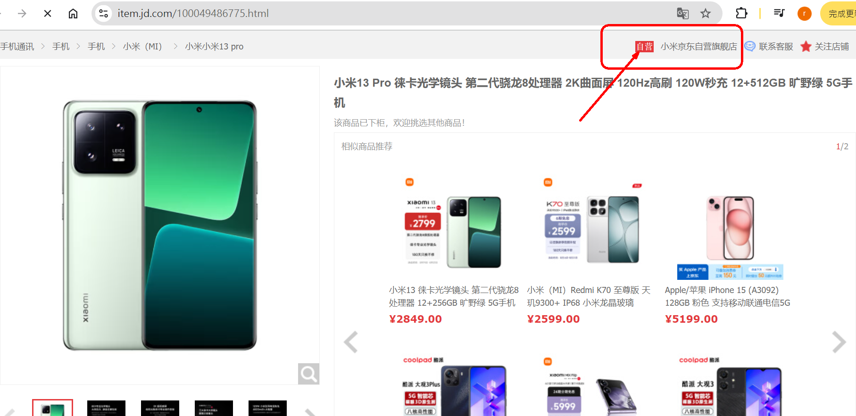
Fully managed model:Will mark "JD self-operated" or "self-operated"

Slide 81
Please ask:
I am hereAmazonAre all products purchased from e-commerce websites managed by a full-service provider??

Slide 82
I am hereAmazonAre all products purchased from e-commerce websites managed by a full-service provider??
Not exactly.
AmazonProduct sales on the platform are divided into3Main modes:
1.Full custody (self-operated)
2.useFull custodyFBAThird-party sellers of services
3.NoFull custodyFBAThird-party sellers

Slide 83
AmazonThe sales of goods are divided into3Mode
1. AmazonSelf-operated (Amazon Direct Sales）
Fully managed model:
Identification:Ships from and sold by Amazon.com
2.useAmazon FBAThird-party sellers of services (Fulfillment by Amazon）
UsedFBAFull custodyAmazon manages the entire logistics and after-sales process, so these products also belong to the full-trust model.
Identification:Fulfilled by Amazon, indicating that Amazon is responsible for the delivery and after-sales service of the product.

Slide 84
AmazonThe sales of goods are divided into3Mode
3.NoFBAThird-party sellers (Non-FBA Third-Party Sellers）
Non-Fully Custodial Model: Amazon only provides platform and technical support and is not responsible for the specific operation and after-sales service of these products.
Identification:Ships from and sold by [Seller's Name]
Indicates that the product is shipped and managed by a third-party seller.

Slide 85
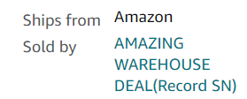
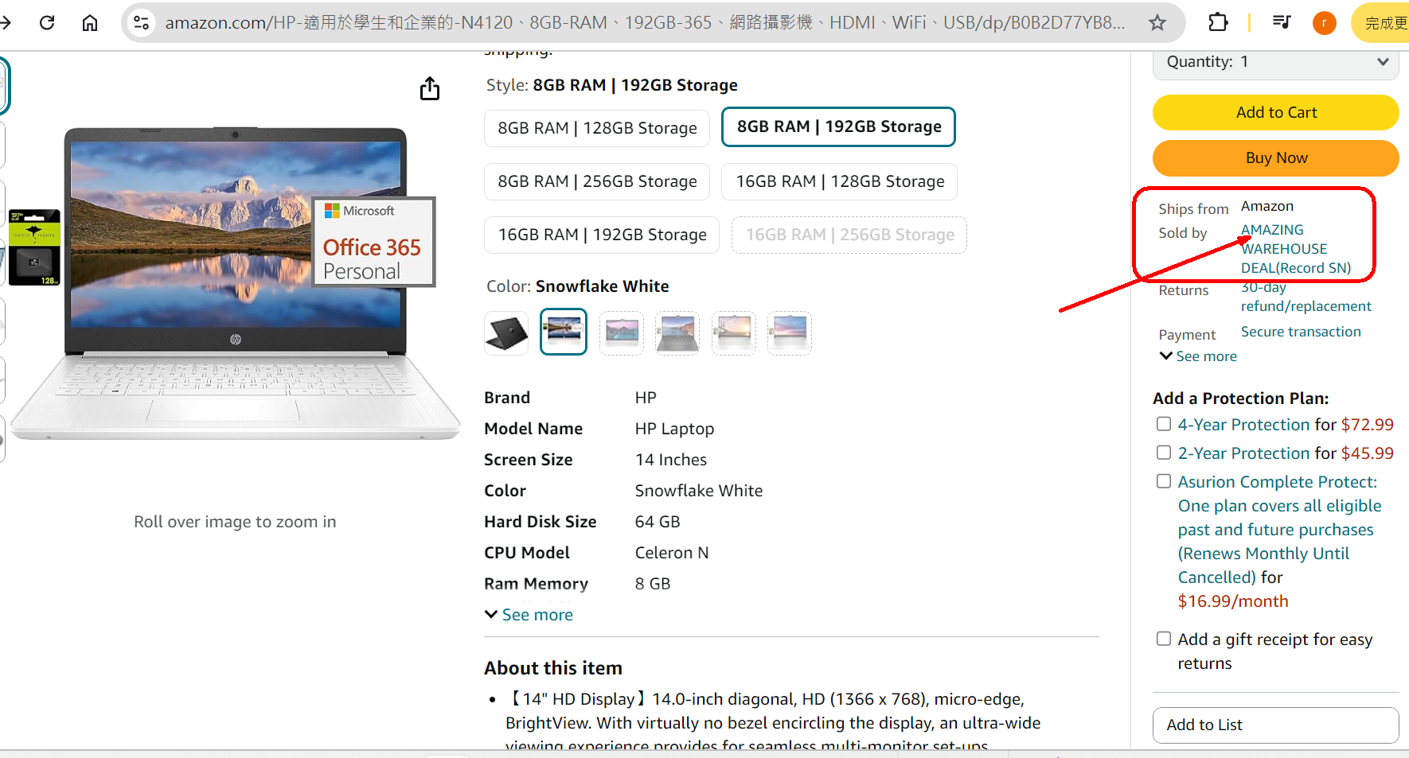
AmazonFull custody(Self-operated)

Slide 86
5.Multi-language and multi-currency support

Slide 87
Multi-language support
In cross-border e-commerce,
Multi-language supportis the key to attracting and retaining consumers from different countries.
By offering localized language options, businesses can improve user experience and increase purchase intent.

Slide 88
Implementation of multi-language support
Website Localization:
Depending on the language and culture of the target market,Translate website content, ensuring the accuracy and affinity of the information.
Customer Support:
supplyMultilingual customer service, answer consumers’ questions and enhance trust.
Multilingual SEO:
SEO optimization for different languages,Improve your visibility in search engines in various countries.

Slide 89
6.Multi-currency support

Slide 90
Multi-currency support
Multi-currency support
Enable consumers to pay using currencies they are familiar with,
Reduce purchasing barriers,
Improve your shopping experience.

Slide 91
Implementation of multi-currency support
Dynamic Currency Conversion:
Depending on the country of the consumer,Automatically display prices in local currency, and provides currency conversion function.
Multi-Currency Settlement:
Enterprises canChoose to receive multiple currencies,
orAutomatically convert to your preferred currency via payment providers, reducing exchange rate risk.
Transparent Pricing:
Clearly display the price of your product and possible conversion fees to avoid confusion among consumers about the final amount they will pay.

Slide 92
7Conclusion

Slide 93
Conclusion
【Mobile Business,andCross-border e-commerce】,yesTwo major trends in current e-commerce.
Rapid growth of mobile commerce:This requires companies to adapt to consumers' demand for shopping anytime, anywhere.
Cross-border e-commerce:It provides enterprises with unprecedented market expansion opportunities.
Although cross-border transactions face challenges in logistics, payment and culture,
But throughReasonable strategy and technical support:Companies can effectively address these challenges and stand out in the global marketplace.
Multi-language and multi-currency support:It is an important guarantee for the success of cross-border e-commerce, helping companies provide localized shopping experience and win the favor of more international consumers.

