Slide 1
Ching-Wen Chen National Taipei University of Technology
Introduction to
E-Commerce Course

Slide 2
Introduction to the course objectives

Slide 3
Course Objectives Introduction
This course aims to help students understand e-commerce through a blend of theory and practical application. Specifically, students will:
Learn the development history of e-commerce. Understand the main types and operation modes of e-commerce. Explore the seven types of e-commerce business models. Learn how to apply online marketing strategies such as SEO, social media marketing, and email marketing.
Develop practical skills in
building e-commerce websites,
encompassing front-end to back-end development and operation.

Slide 4
This course is divided into two parts

Slide 5
This course is divided into two parts
1. Theoretical part:
The development history and current status of e-commerce.
2. Practical part:
Build an e-commerce website. Embed code to track customer behavior. Analyze website traffic. Search engine marketing（SEM）.

Slide 6
The history and current situation of the development of e-commerce

Slide 7
Development history and current status of e-commerce
1. Theoretical part:
The development history of e-commerce. Explore the common development paths of e-commerce platforms for Taiwanese e-commerce companies. Four common strategies for online marketing. The two major trends in e-commerce: Mobile commerce and cross-border e-commerce. Supply Chain Management is the key to the competitiveness of Fast Fashion E-commerce. Social commerce and influencer economy using UGC for marketing are new trends. Seven main types of e-commerce.

Slide 8
About Course Content The teacher‘s idea is…

Slide 9
About Course Content The teacher‘s idea is…
First, let's look at two news stories
…
…
…

Slide 10
About EMI The teacher‘s idea is…

Slide 11
About EMI The teacher‘s idea is…
…
…
…

Slide 12
Practical Section

Slide 13
Practical Section The class will be conducted in a hands-on manner.
Learn the client side web technologies for e-commerce websites (Html + CSS, Javascript). Learn the server side web technologies for e-commerce websites (PHP + MySQL). Learn how to use embedded code (JavaScript) to track customer behavior. Apply SEO techniques and responsive web design (RWD) to improve website ranking in search engines. Use Google Analytics (GA) to analyze website traffic.

Slide 14
Course outline

Slide 15
Course Outline
Week 1: Course Introduction Week 2: Definition and development history of e-commerce, types of e-commerce (B2B, B2C, C2C, etc.), common development paths for Taiwanese e-commerce companies to develop e-commerce platforms. Week 3: Seven ways to run e-commerce: Build your own e-commerce platform, sell on third-party platforms, micro-businesses, social e-commerce, subscription e-commerce, dropshipping model, affiliate marketing. Week 4: Four common strategies for online marketing: SEO-SEM to drive traffic, social media marketing, email marketing, content marketing to build brand image. Week 5: Practice: Architecture of e-commerce website development (including front-end platform, back-end platform, and database), development of front-end e-commerce website (Html + CSS). Week 6: Practice: Basic code for tracking customer behavior: JavaScript. Week 7: Practice: The first important technique of SEO for online marketing, improving ranking in search engines. Week 8: Practice: The second important technique of SEO for online marketing: Responsive Web Design (RWD). Week 9: Midterm Exam.

Slide 16
Course Outline
Week 10: Supply Chain Management is the key to the competitiveness of Fast Fashion E-commerce --> Take Zara and SHEIN as examples. Week 11: Cross-border e-commerce is the current trend in e-commerce --> Take SHEIN, Temu, and Amazon as examples. Week 12: Big Data Analytics in E-commerce: Real-time analysis of transaction data, customer browsing behavior analysis, accurate recommendations, analysis of market demand, risk management --> Take Netflix, SHEIN, and Amazon as examples. Week 13: Social Commerce and Influencer Economy: Using UGC for marketing is a new trend --> Take Xiaohongshu and SHEIN as examples. Week 14: Practice: Setting up a website and practice: Apache + PHP + MySQL, back-end platform construction technology: PHP (1). Week 15: Practice: Back-end webpage integration with database technology: PHP + MySQL (1). Week 16: Practice: Back-end webpage integration with database technology: PHP + MySQL (2). Week 17: Practice: Using Google Analytics to track and analyze customer traffic. Week 18: Final Exam.

Slide 17
Grading method for the class

Slide 18
Grading method
Regular grade: 25%
Class Participation
Pratice hands-on examples in class, use Zuvio for grading points).
Homework: 15%. Midterm Exam: 30%. Final Exam 30%.

Slide 19
Textbook, Reference Books, and Materials Website

Slide 20
Textbook, Reference Books, and Materials Website
No designated textbook. Course uses the teacher's materials website:
https://acupun.site/lecture/Ecommerce_emi/

Slide 21
Teacher's Relevant Industry Experience

Slide 22
Teacher's Relevant Industry Experience
☎Combined with various technologies, including: PHP + Smarty, Bootstrap, Jquery mobile, Javascript.
☎Technology: Combining various technologies, including: PHP + Smarty, Bootstrap, Jquery mobile, Javascript.
Industry experience 3: Production of a long-distance medical treatment system in China (produced for a chain clinic in China). ☎Function 1: This is an online medical treatment system produced for a traditional Chinese medicine clinic. Patients scattered across various provinces in China or overseas can log in to this system, become members, and consult with doctors after making appointments.

Slide 23
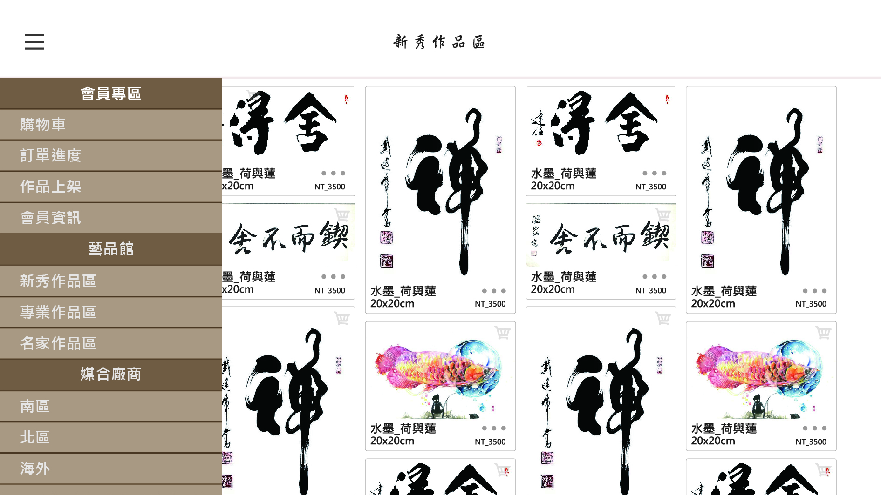
Industry Experience 1: E-commerce app and server-side website design.
Industry Experience 1: Developed an art auction website and created an Art Auction App for Taiwanese companies.
PHP+smarty、
Bootstrap、
Jquery mobile、
Javascript

Slide 24
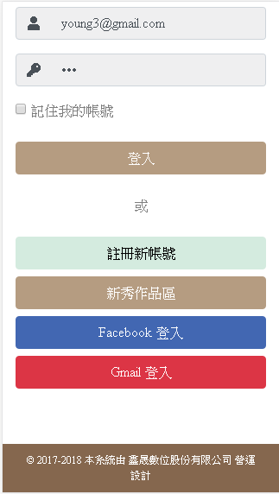
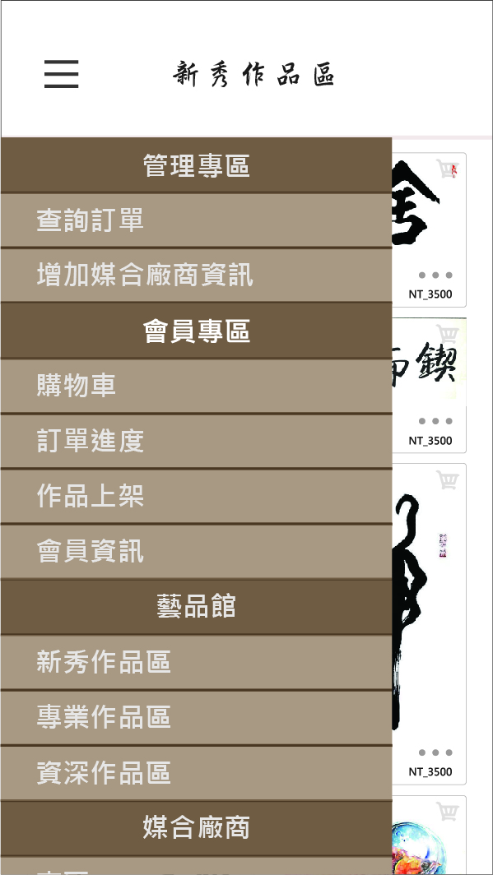
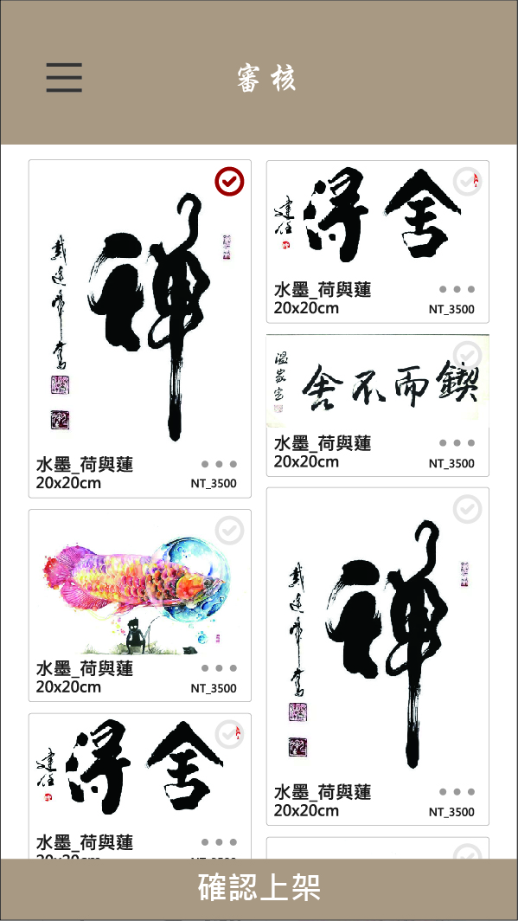
Industry Experience 1: E-commerce app and server-side website design.

Slide 25
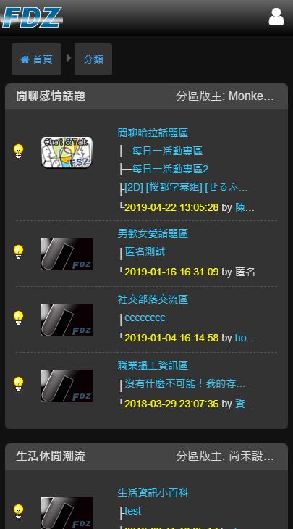
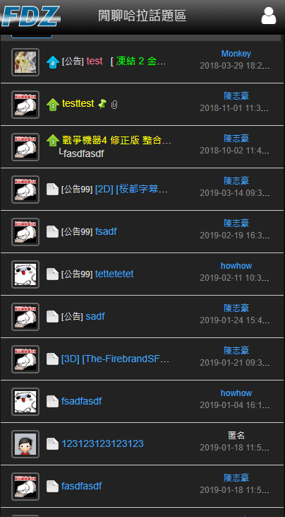
Industry Experience 2 E-commerce app and server-side website design.
Industry experience 2: Mobile version of the forum program (written for a Hong Kong company).

Slide 26
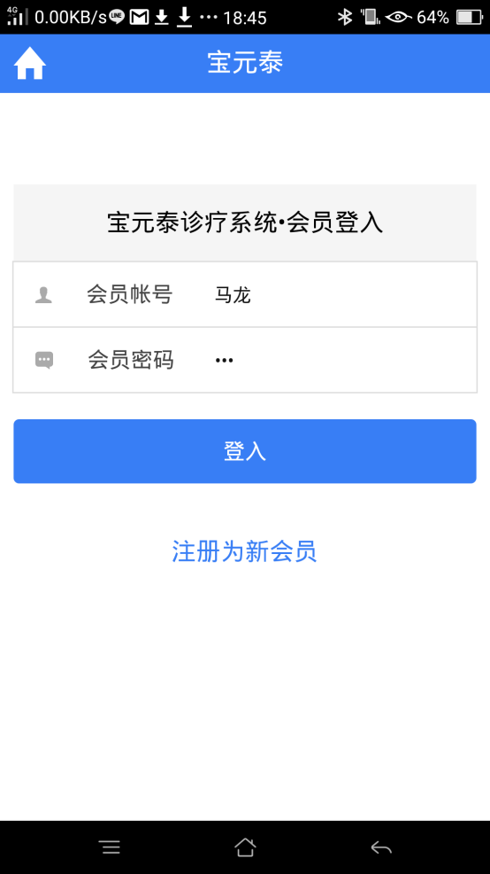
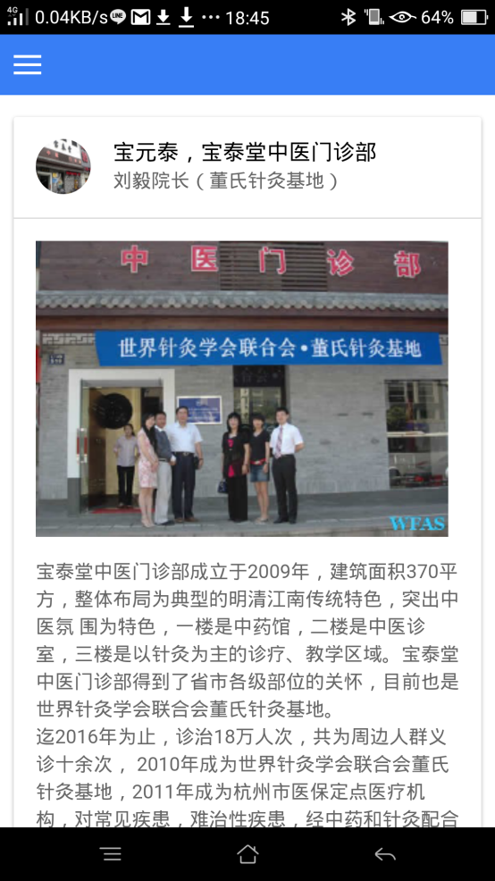
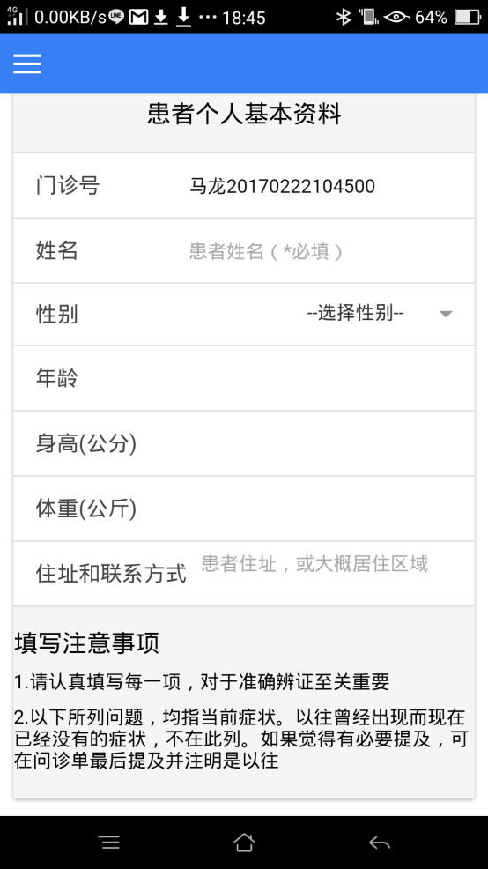
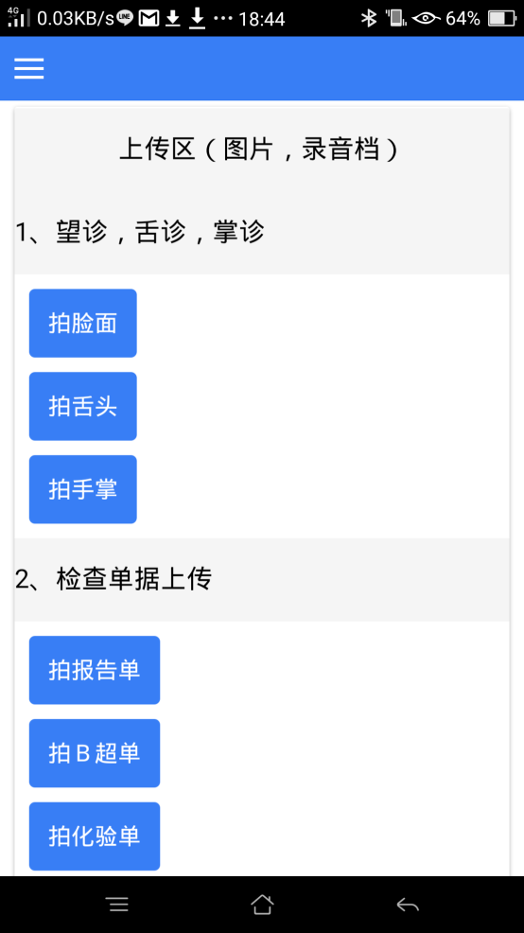
Industry Experience 3： E-commerce app and server-side website design.
Industry Experience 3: Build a remote healthcare system for a network of clinics in mainland China

Slide 27
業界經驗3：電子商務APP， server端網站設計

Slide 28
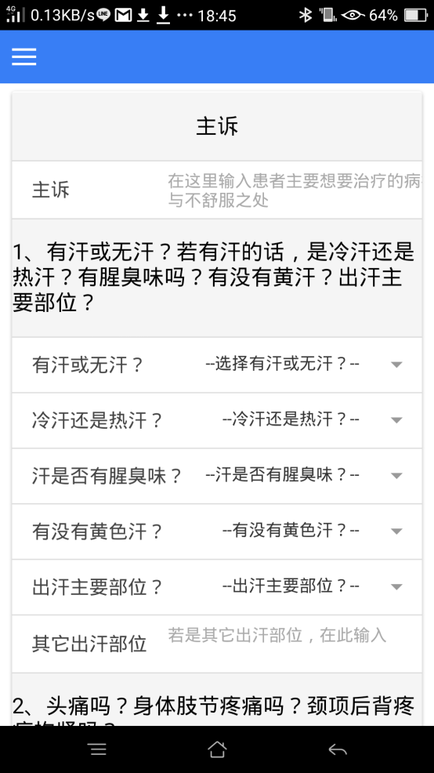
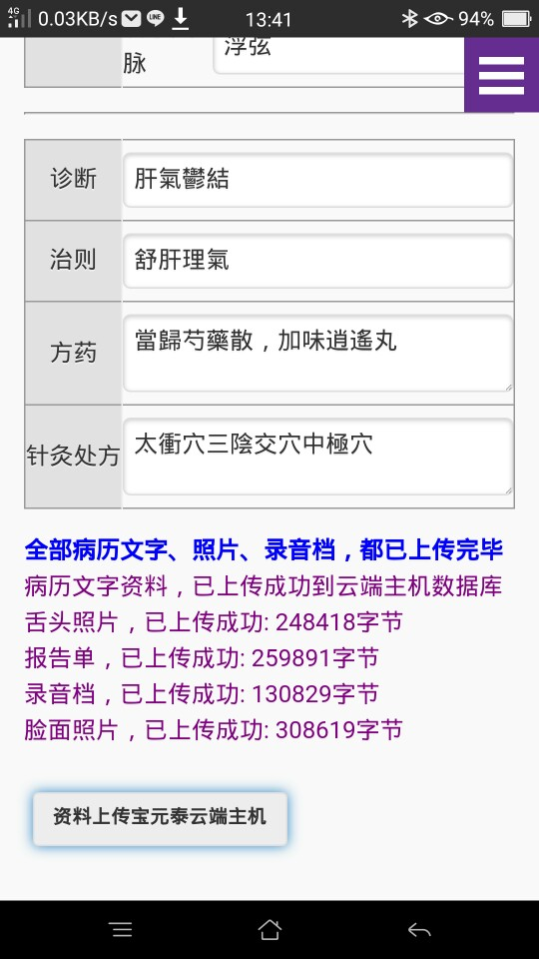
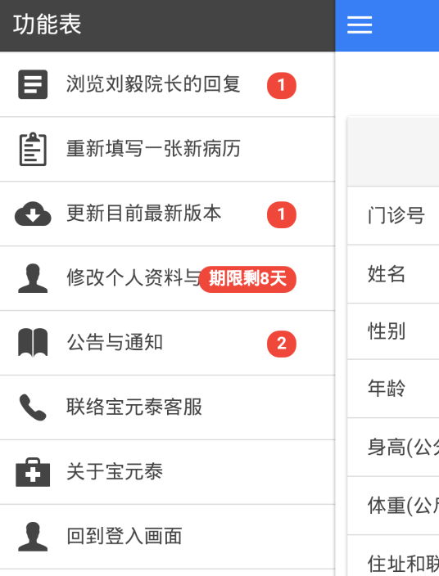
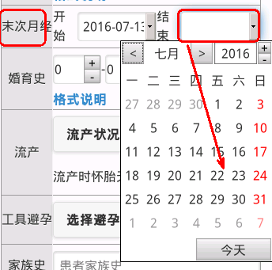
Industry Experience 3： E-commerce app and server-side website design.

Slide 29
Join Zuvio Course

Slide 30
Join the course Line group for updates and discussions

