Slide 1
台北科技大學，經管系，陳擎文
Use GitHub Publish web pages for free

Slide 2
Use GitHub Pages to build your personal website
GitHub was originally a cloud-based platform for archive versioning.
However, it provides a GitHub Pages feature that can be used as a web server,
Simply upload the HTML file to GitHub, and you can use your browser to access the web page。
Note: Only "static web pages" can be displayed.

Slide 3
Sign up for an account first

Slide 4
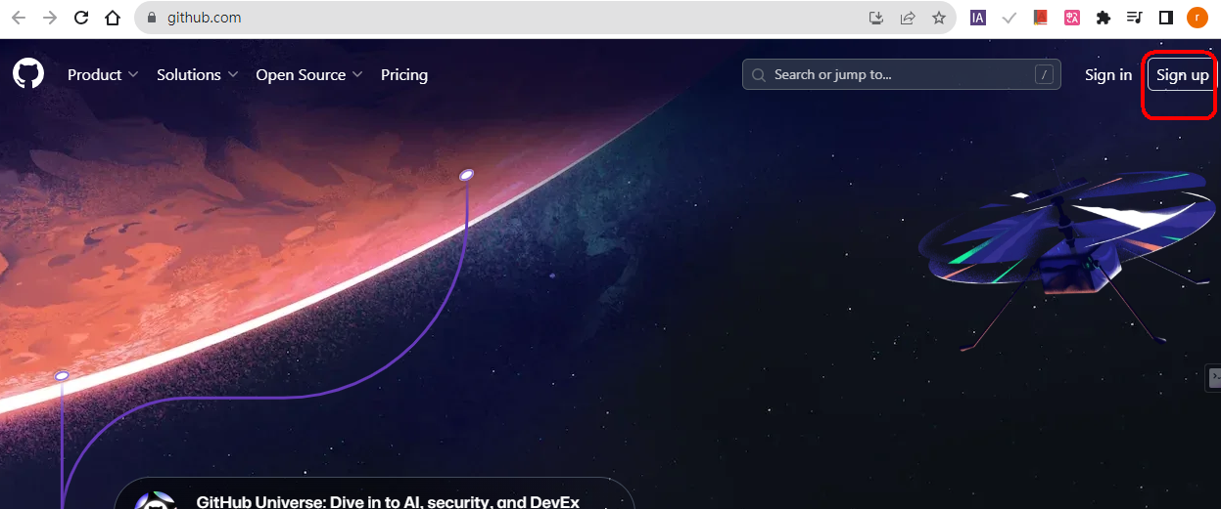
Sign up for a GitHub account到 https://github.com/
Sign up 註冊

Slide 5
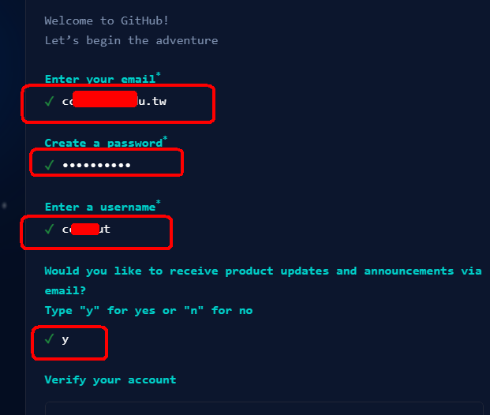
Sign up

Slide 6
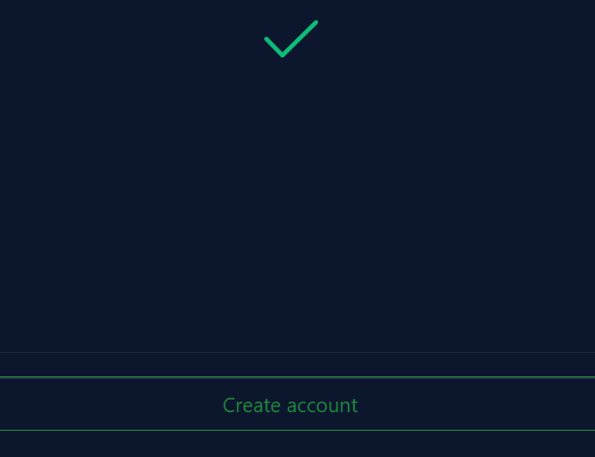
驗證後， create account

Slide 7
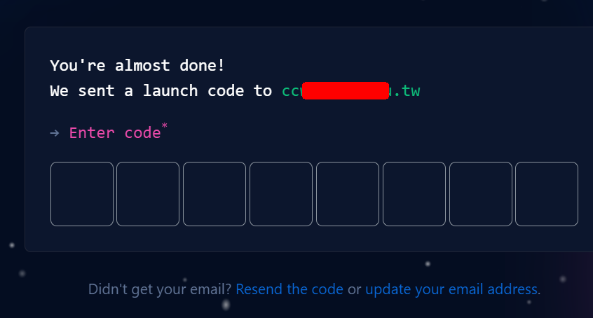
Send the verification code to email，Enter the verification code

Slide 8
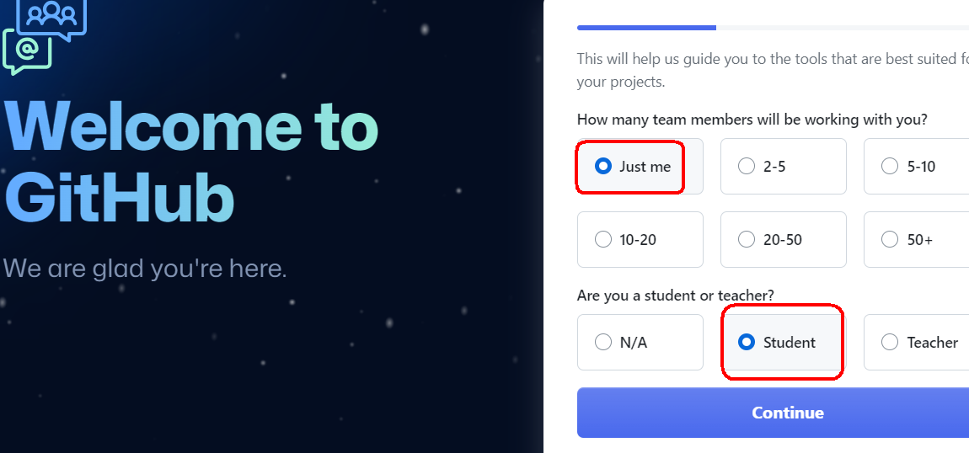

Slide 9
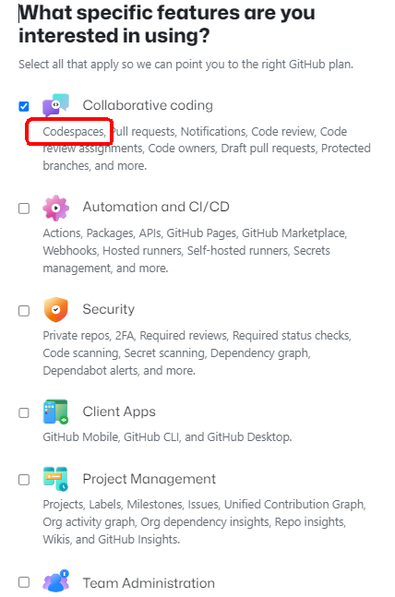

Slide 10
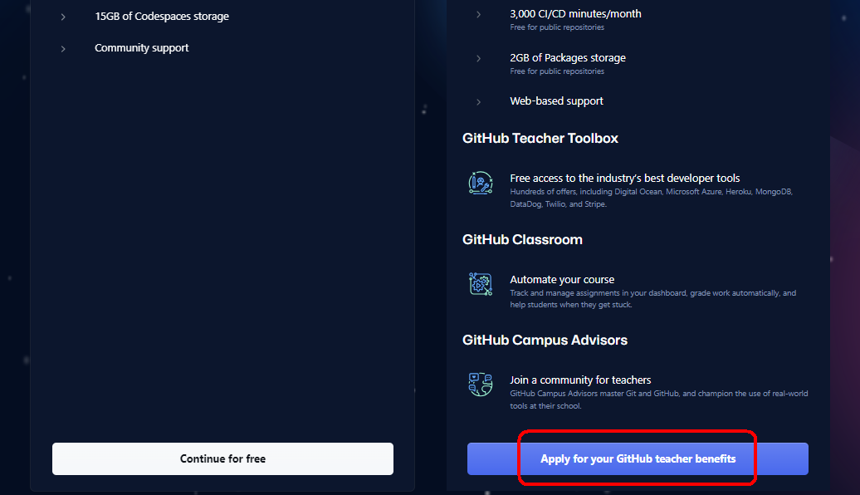

Slide 11
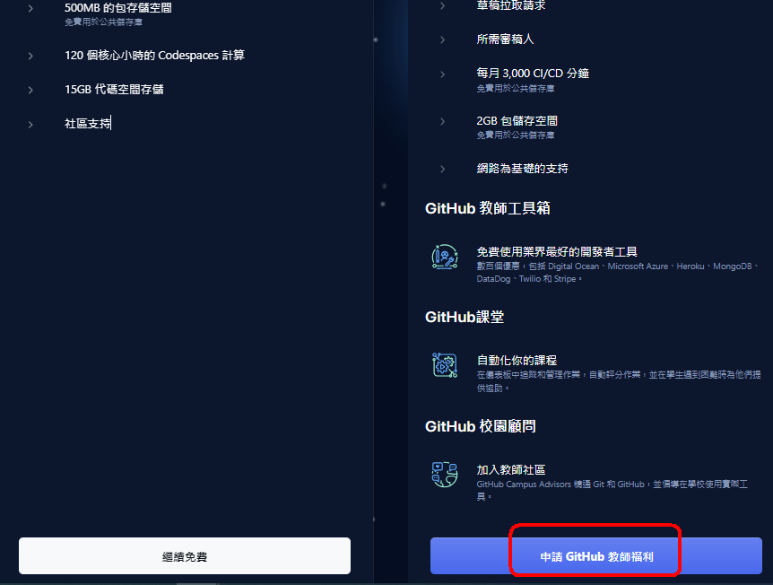

Slide 12


Slide 13
If you are a student or a teacher, you must provide 2 supporting documents
在您修復以下問題之前，無法審核您的申請：
在您完成GitHub 使用者個人資料（其中的全名與您的學術關係文件中顯示的全名以及簡短的個人簡介完全一致）之前，您不太可能得到驗證。請不要使用您的姓名或暱稱的變體。更新個人資料資訊後，請登出並重新登入 GitHub，然後再重新申請。
您是否已完成包含所有相關資訊（例如圖像中顯示的全名和簡短個人簡介）的GitHub 使用者個人資料？

Slide 14
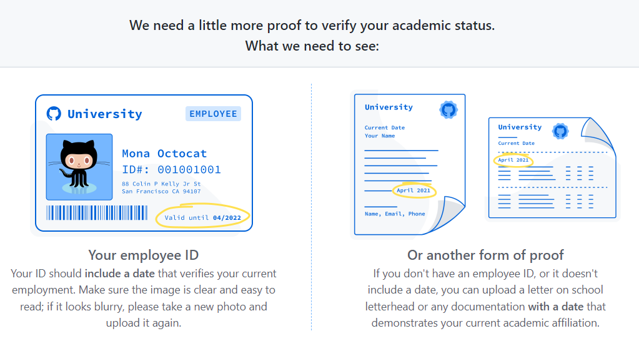
If you are a student or a teacher, you must provide 2 supporting documents, otherwise it will not be authenticated

Slide 15
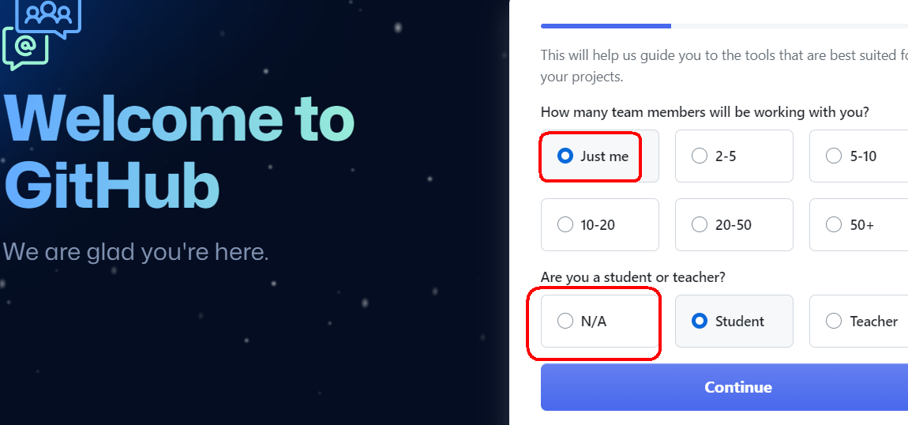
If you find it troublesome, don't use a student account to apply, but use a general account N/A

Slide 16
Establish an archive warehouse
Repository儲存庫

Slide 17
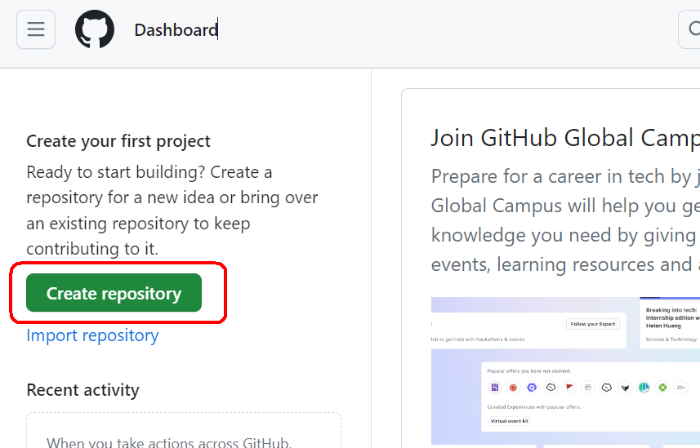
Go to the Home first Create repository

Slide 18
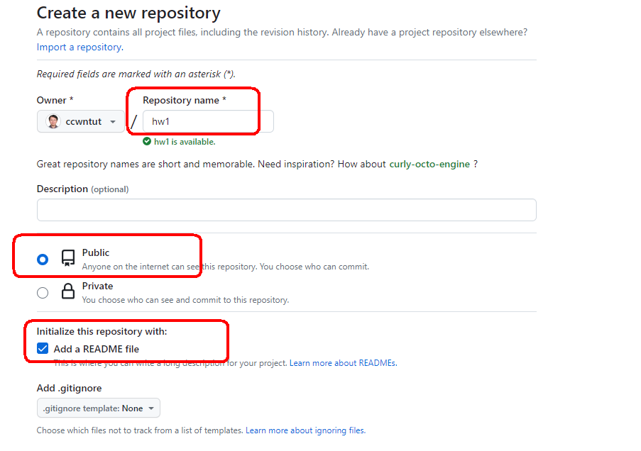
Create repository : hw1

Slide 19
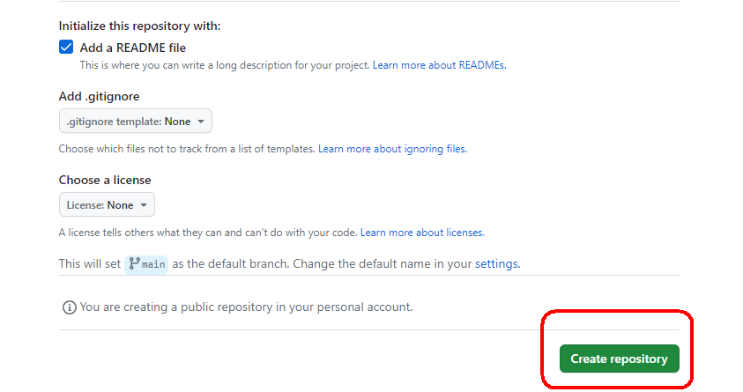
Create repository

Slide 20
Upload you Archives of the website

Slide 21
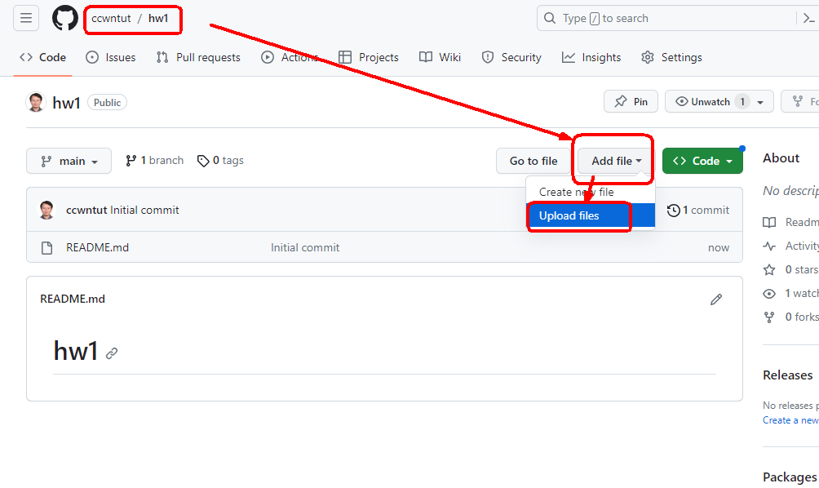
Add files→ upload files

Slide 22
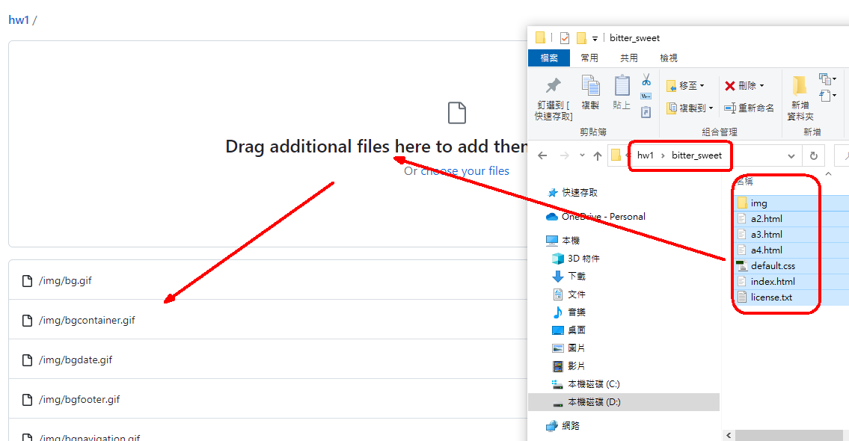
Drag all files and directories into the box

Slide 23
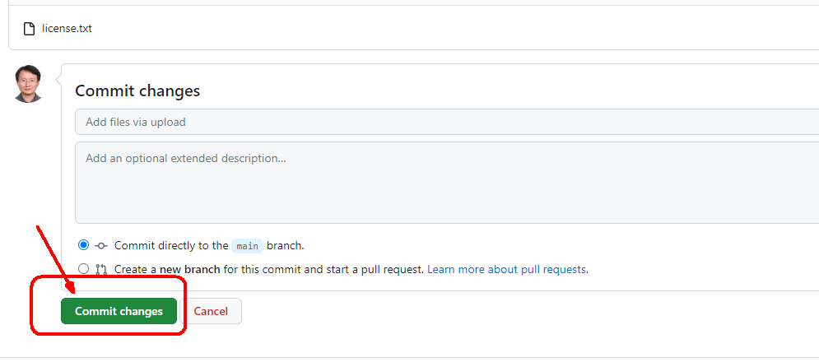
按：commit changes

Slide 24
After uploading, you can't view the web page yet Because, at present, it is only the archive hosting, Didn't convert to pages

Slide 25
Put the file Convert to a web page

Slide 26
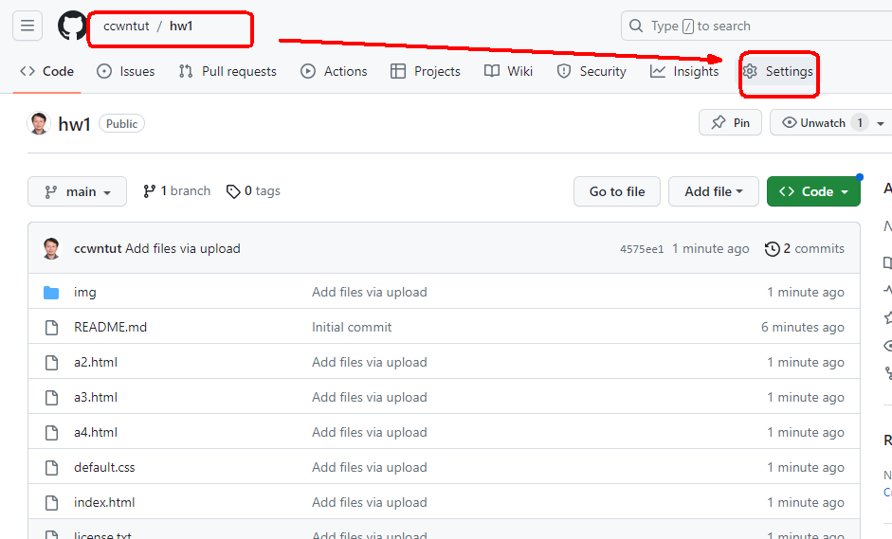
按：settings

Slide 27
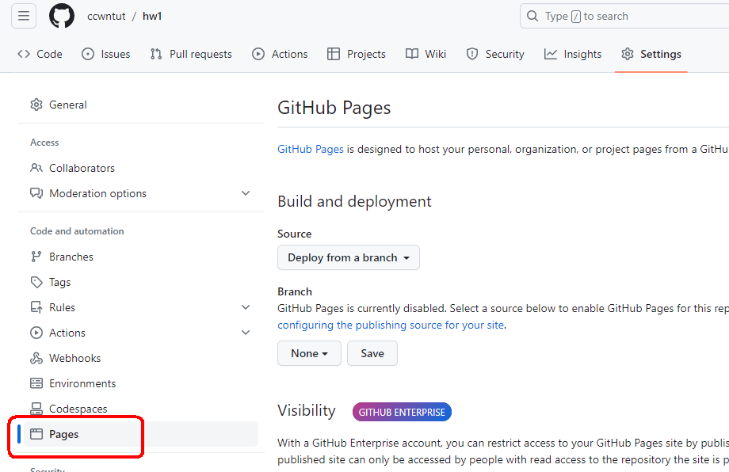
按，左邊menu：pages

Slide 28
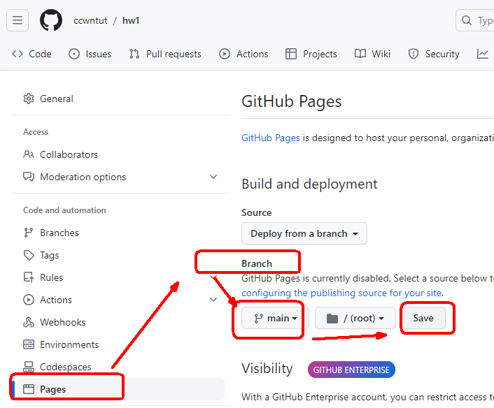
Pages→Branch→main→save

Slide 29
Website conversion time After pressing save for 1~2 minutes, the conversion is successful

Slide 30
Your website URL pattern
個人帳號.github.io/倉庫名稱
ccwntut.github.io/hw1

Slide 31
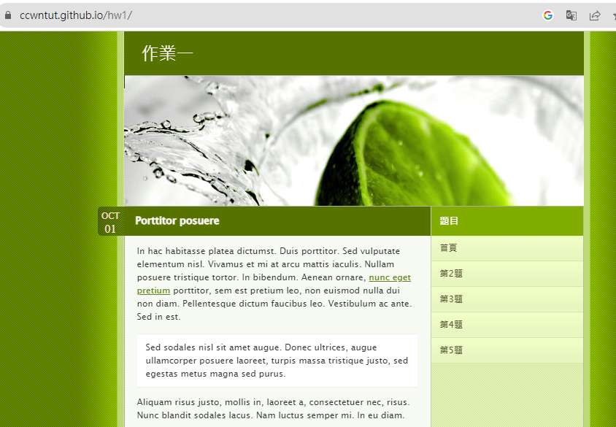
https://ccwntut.github.io/hw1/

Slide 32
How to change the name of your website

Slide 33
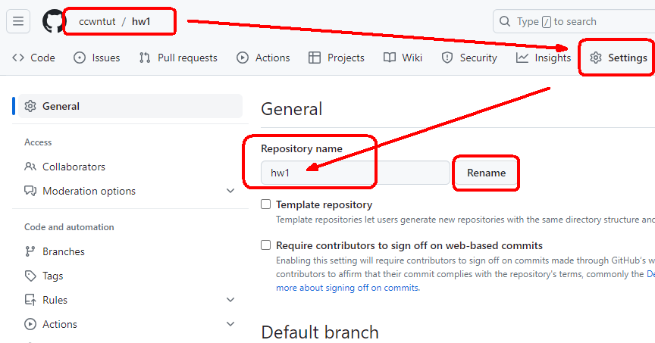
Setting→repository name→rename

Slide 34
How to delete a website hw1

Slide 35
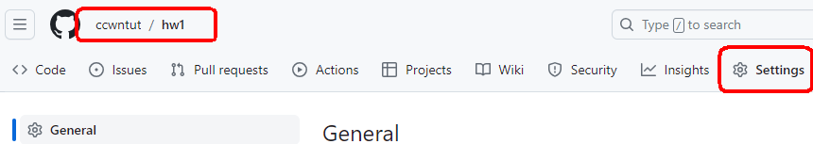
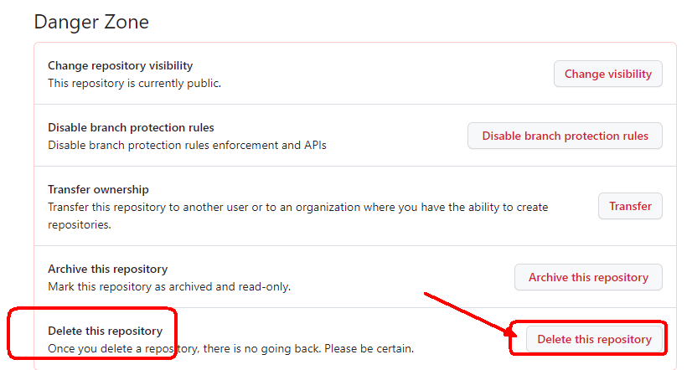
Setting→頁面最下面 →delete this repositoy

