Slide 1
Tech presentation
Project Name: Shop Inventory Admin
There sections
1.Briefing
2.Project Display
3.Question time
Briefing
Techskill sets:
1 Programming Language: Python
2 Framework :Flask,jinja2 template,
3 Database: Postgresql database, postico to display and pyscopg2 to connect
4 Frontend :Html and Css.
5 git and github
6 planning: excalidraw
Planning:
1 Class and Object diamgram
2 Tables diagram
3 wireframe diagram

Slide 2
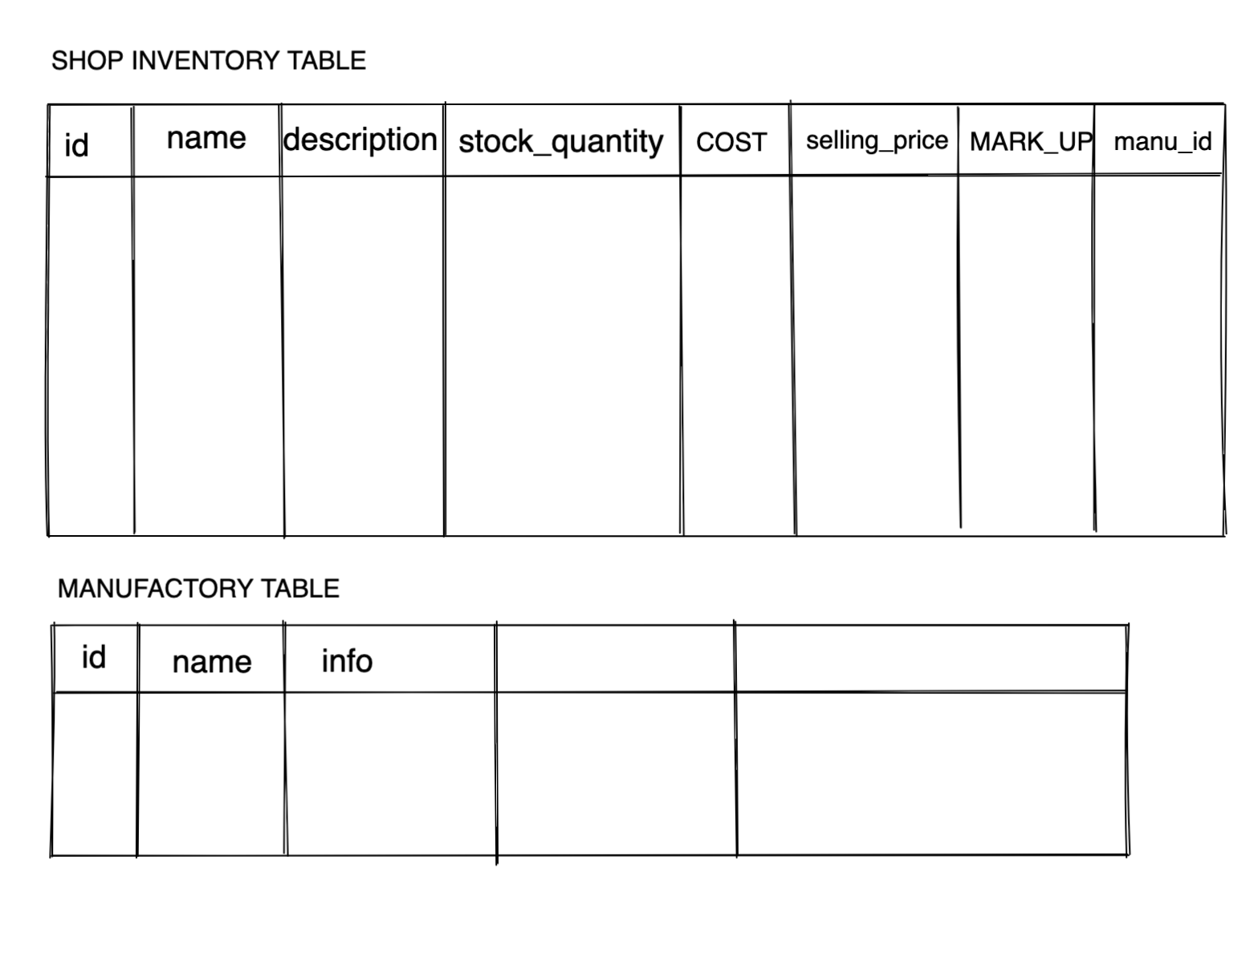
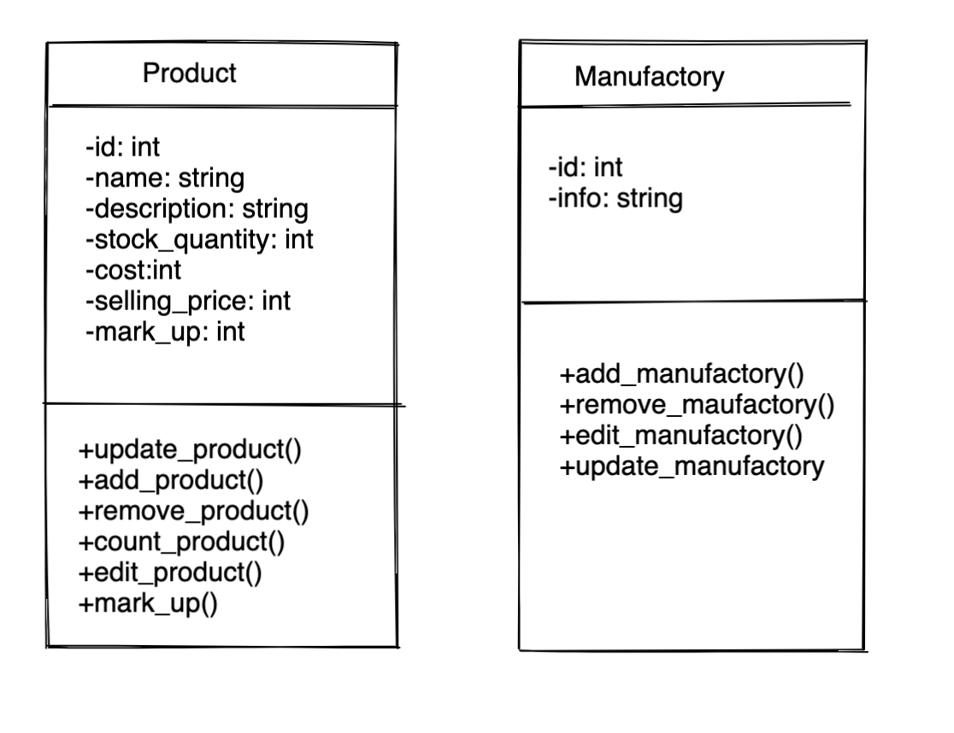

Slide 3
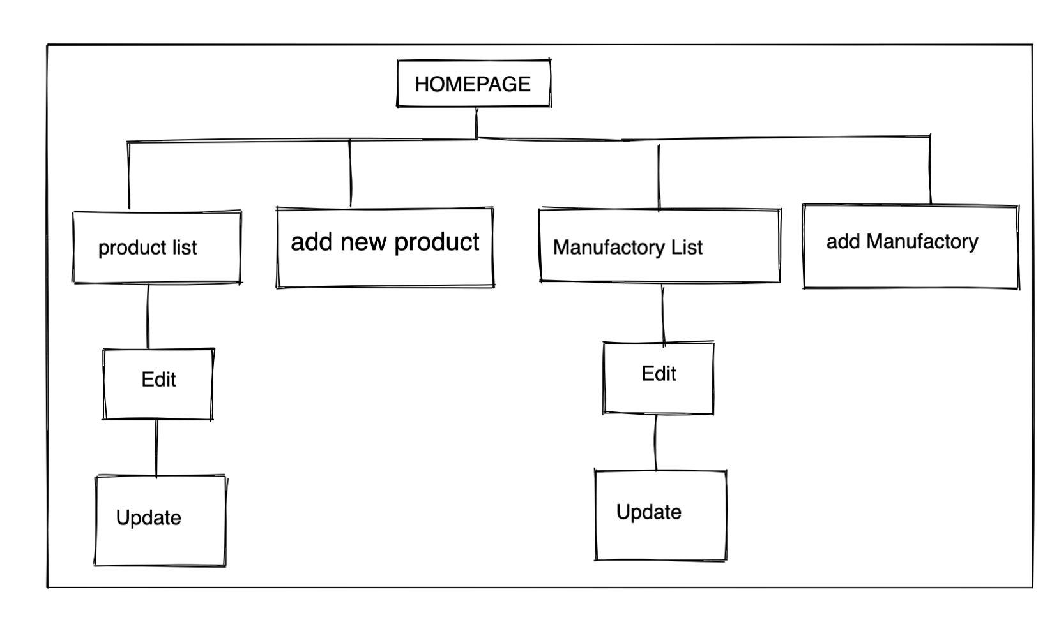

Slide 4
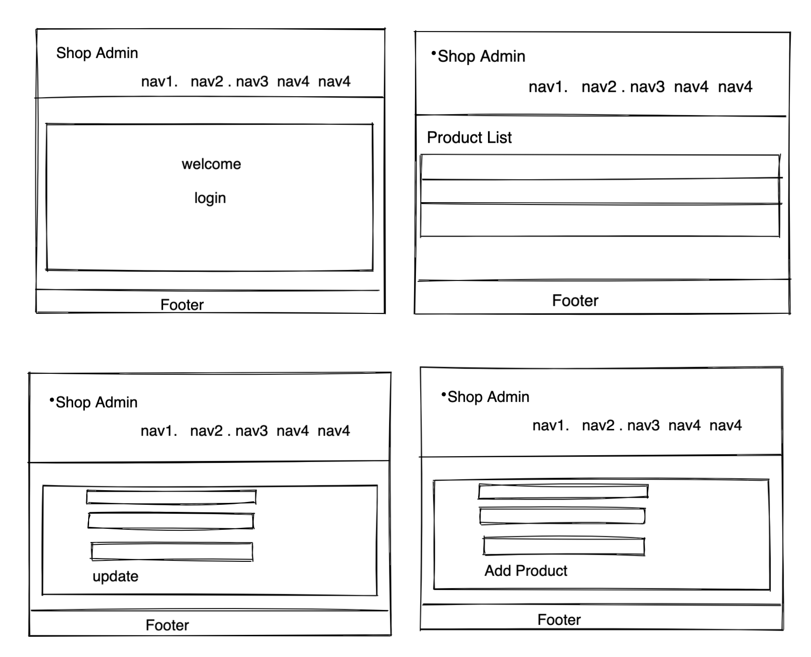

Slide 5
Project Display
1 Website exploring
2.Code display
3.App File System
4.Testing
5 etc…

Slide 6
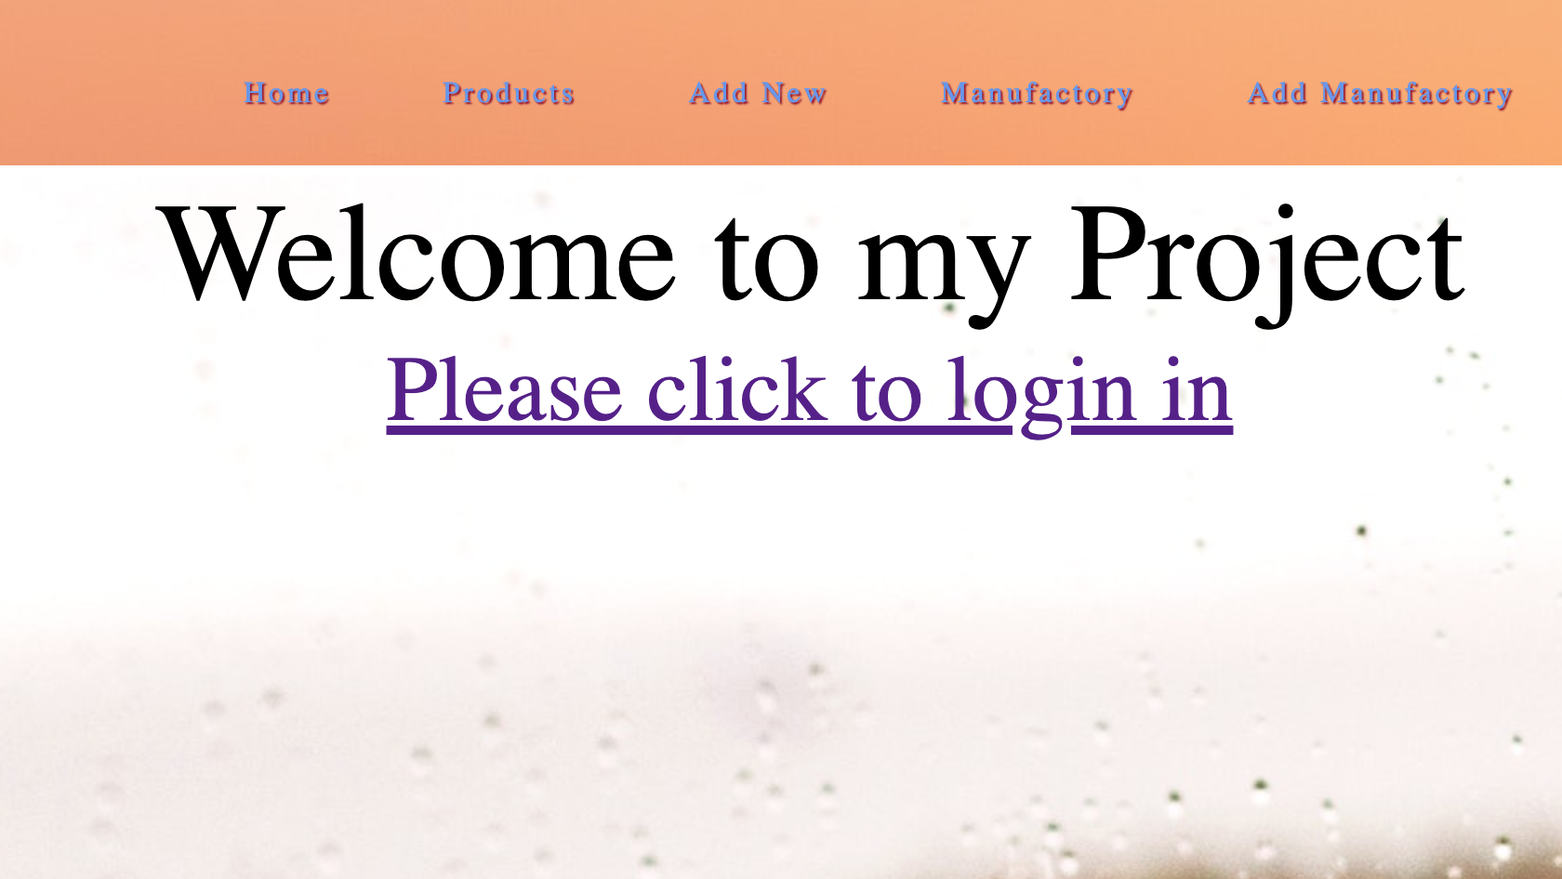

Slide 7
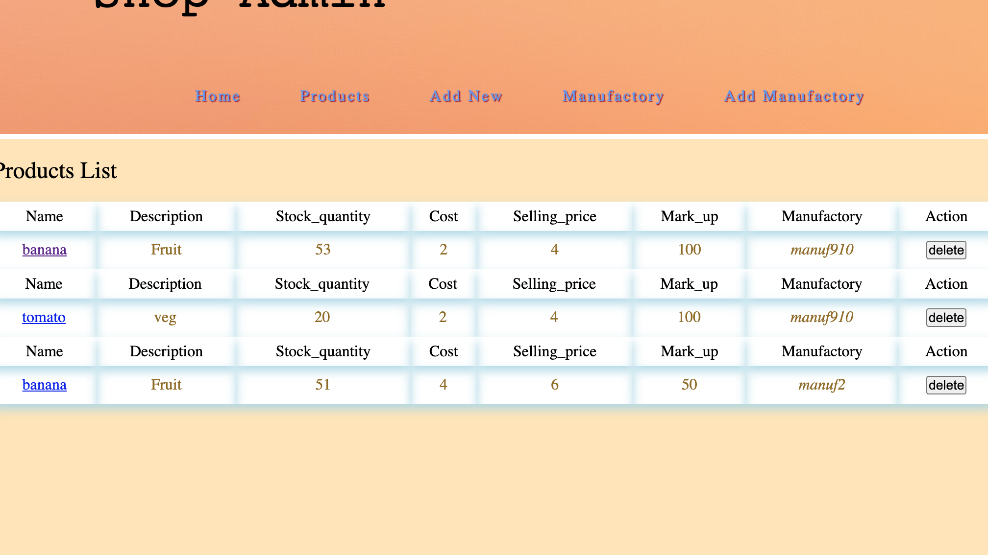

Slide 8
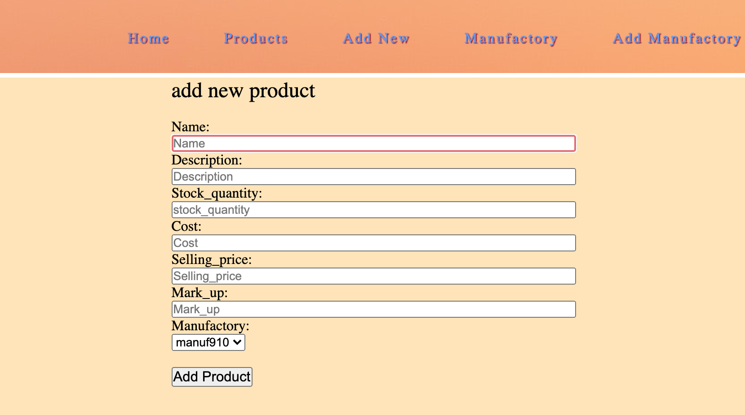

Slide 9
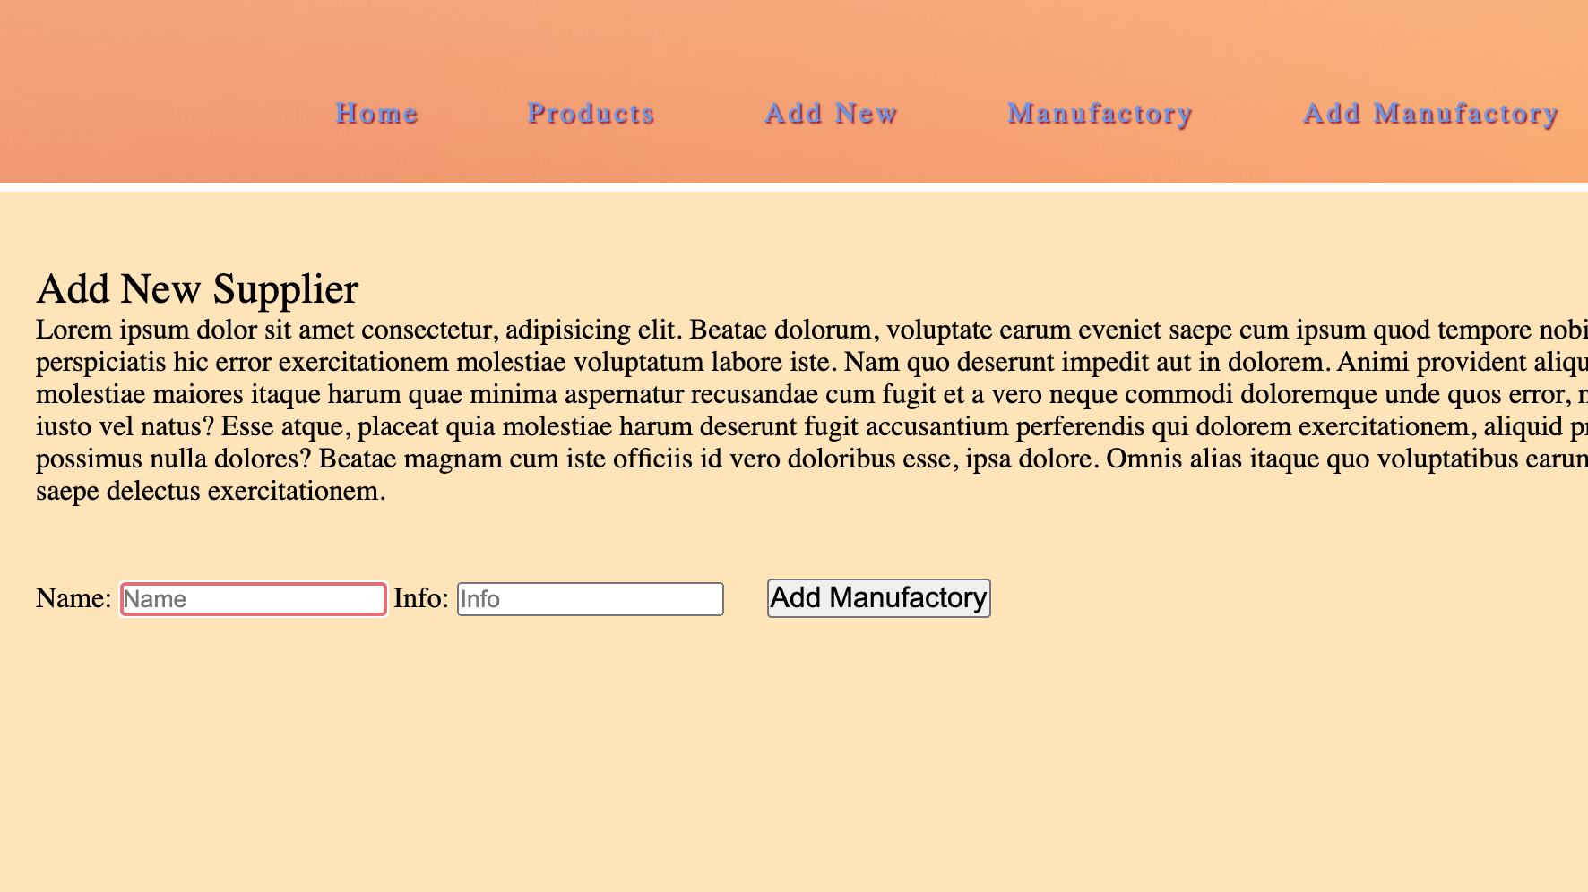

Slide 10
Code display APP FILE SYSTEM TESTCASE TESTING ETC… ANY QUESTION?

Slide 11
Thank you all for listening!
To be continued…

