Slide 1
GAME ACTIVITY DATASET
CHONG YANG

Slide 2
Features
Composite Feature
Behavioral Feature
Variability & Consistency
Engagement Score
Engagement Type
Engagement Rank
Play-Style Type
Session Duration Variance
Recency Activity (Last 30 Days)
Loyalty Score
User Value

Slide 3
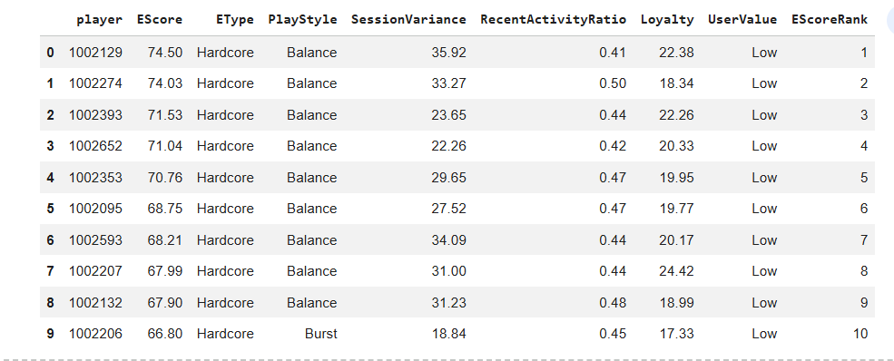
Results Query

Slide 4
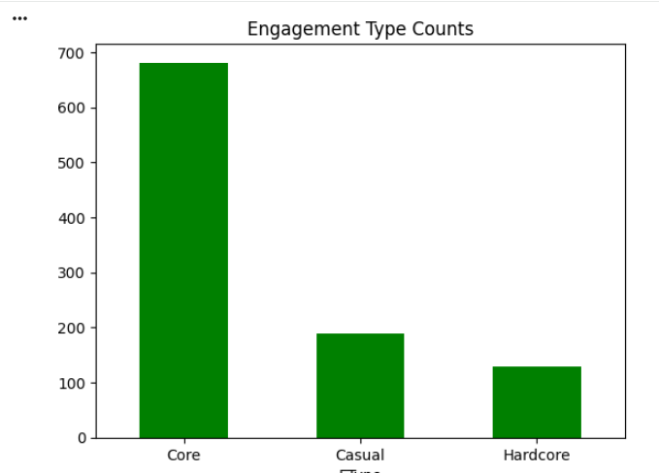
EType
Core: 681
Casual: 190
Hardcore: 130
EScore =
(TotalSessions * 0.4) +
(EventsPerSessions * 0.1) +
(ActiveDays * 0.5 )

Slide 5
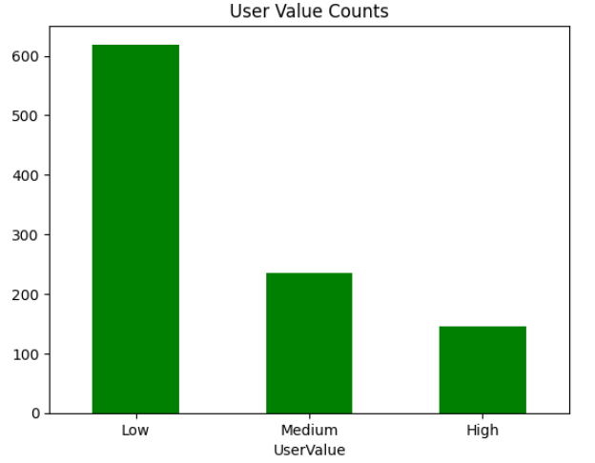
User Value
Low: 619
Medium: 236
High: 146
Based off Loyalty
Loyalty = (AvgMoneySpent * 0.75) +
(AvgSessionDuration * 0.25)

Slide 6
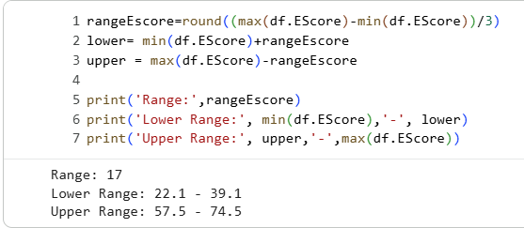
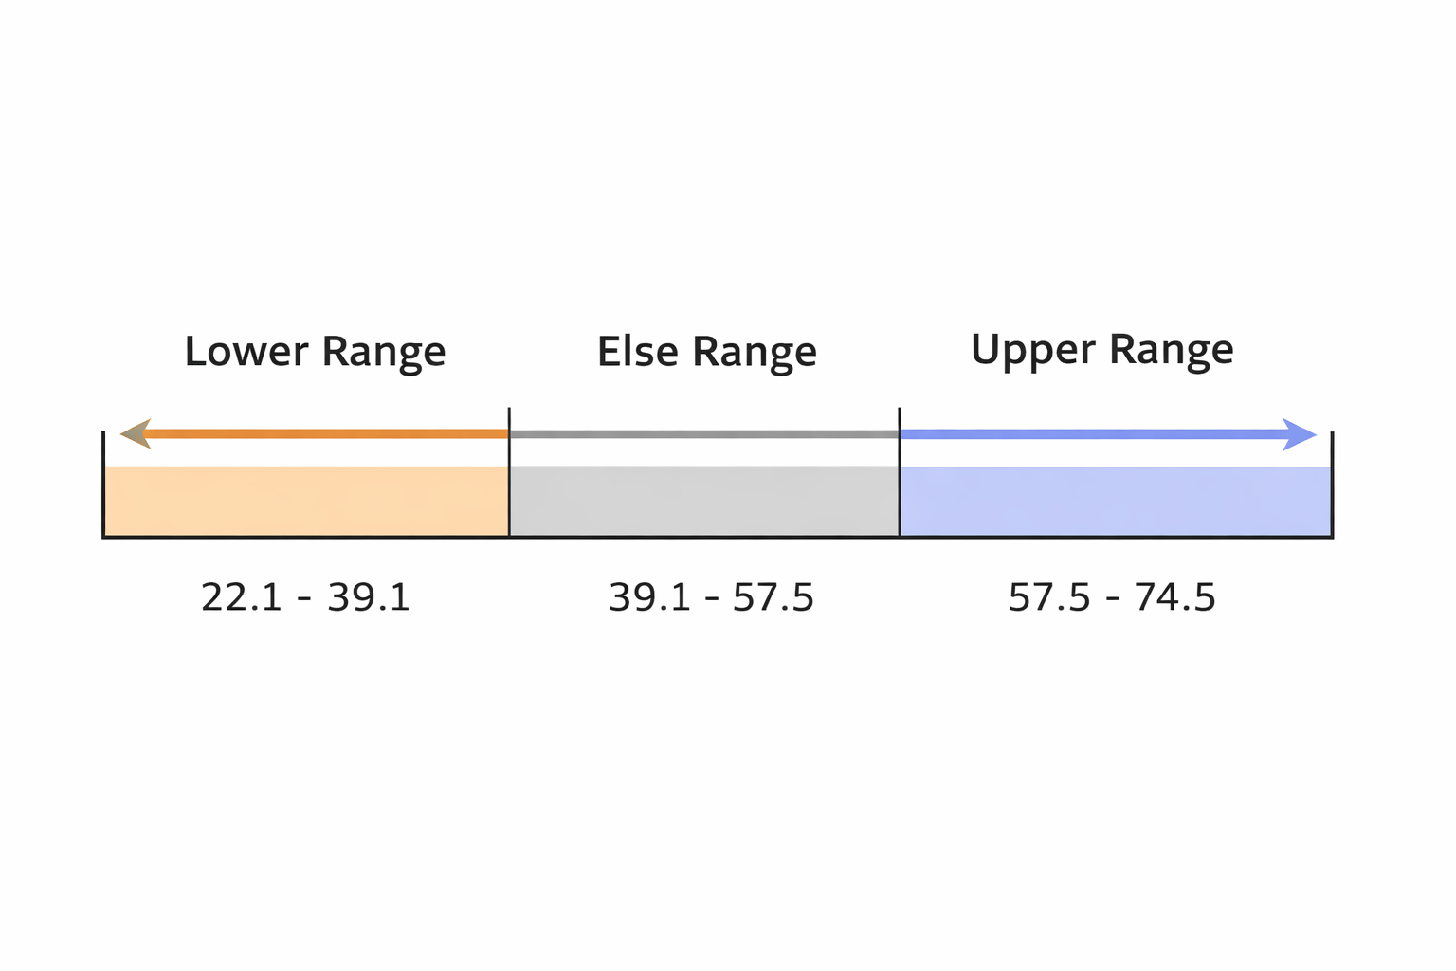
How Categories were Determined

Slide 7
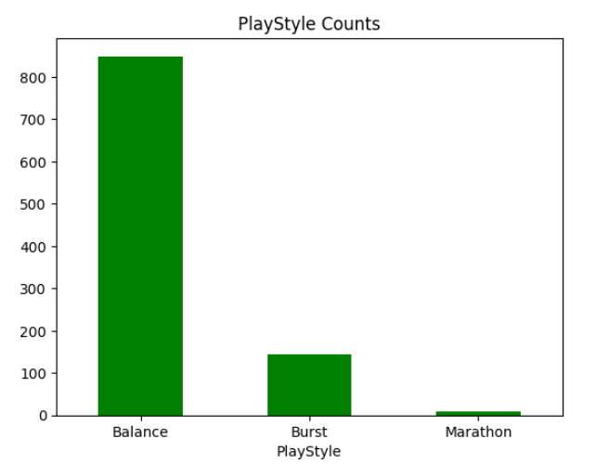
Play-Style
Balance: 849
Burst: 144
Marathon: 8
case when AvgDurationSessions>120 and TotalSession <5 then 'Marathon' when AvgDurationSessions<60 and TotalSession >10 then 'Burst' else 'Balance' end as PlayStyle

Slide 8
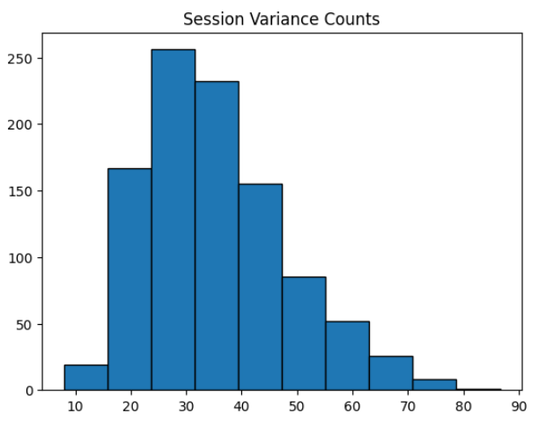
Variance of Session Duration

Slide 9
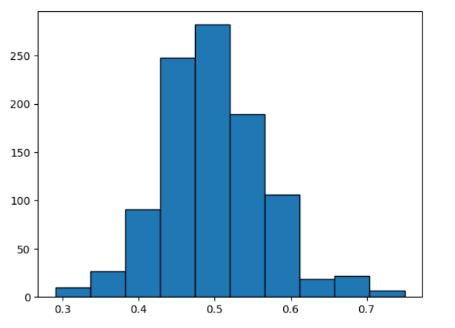
Recent Activity Ratio

Slide 10


Data Validation Check
select count(distinct(playerid)) as TotalPlayers
from GamesActivityClean = 1001
- select playerid, count(distinct(matchID)) as totalsessions
from GamesActivityClean
where playerid=1002129
group by playerId

Slide 11

Validation Continue…
select
sum(currencySpent) as MoneySpent,
count(case when currencySpent <>0 then currencySpent end) as Count
from GamesActivityClean
where playerId=1002129

