Slide 1

PAIRS TRADING & STATISTICAL ARBITRAGE –
MEDIUM FREQUENCY TRADING
Chow Chung Yan

Slide 2
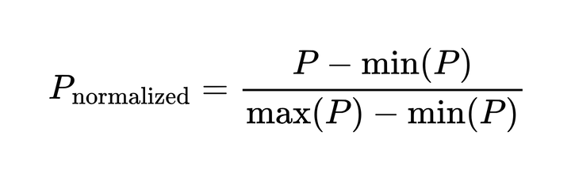
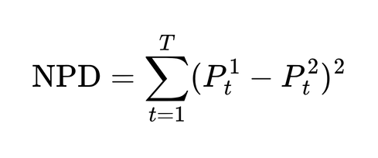
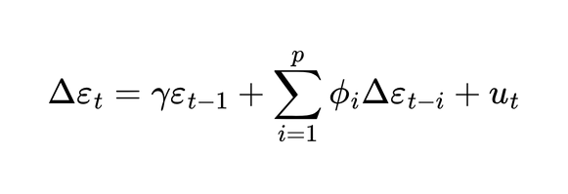

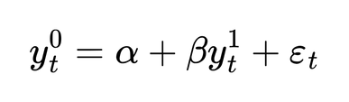
STOCK SELECTION
Stock data is collected at the interval of a day. The closing price is regarded as the stock price.
1. Correlation
Calculating the correlation for all pairs of stocks is computationally expensive. Instead, select the pairs by first data normalization and compute the normalized pair distance (NPD).
2. Clustering
K-means clustering is used to cluster the stock pairs according to the NPD values. The stock pairs with the minimum NPD values from each cluster are selected as candidates. This encourages diversification of selected stock types under the assumption that stocks within the same sectors tend to share similar behaviour.
3. Cointegration test
The stock pair candiates further undergo a conintegration test using the Augmented Engle-Granger (AEG) two-step method. The candidates with a t-statistics of < -3 and p-value of <0.05 are considered.

Slide 3
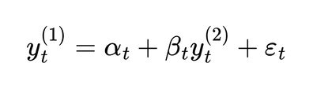
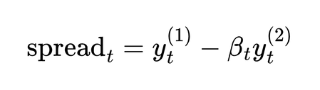
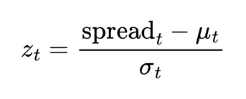
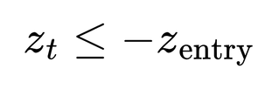
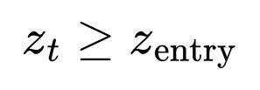

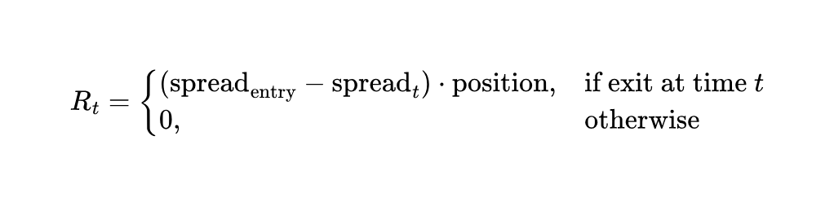
BACKTESTING-METHODOLOGY
1. Data preparation
Stocks are normalized individually. Timestamps where one or more of the stock prices are missing are not considered.
2. Rolling Linear Regression, Spread and Z-score Calculation
Use a rolling linear regression with a backward window of w to model one stock with the other, then calculate the spread.
Using the same window size, calculate a rolling z-score for the spread
3. Signal generation
The entry and exit signals are based on z-score thresholds.
Long entry:
Short entry:
Exit:
4. Portfolio Construction & Reward Calculation
Returns at time t are defined as follows:
where position is +1 for long, –1 for short.
5. Grid Search
Search for the optimal values of entry and exit thresholds, and window size based on cumulative returns.

Slide 4
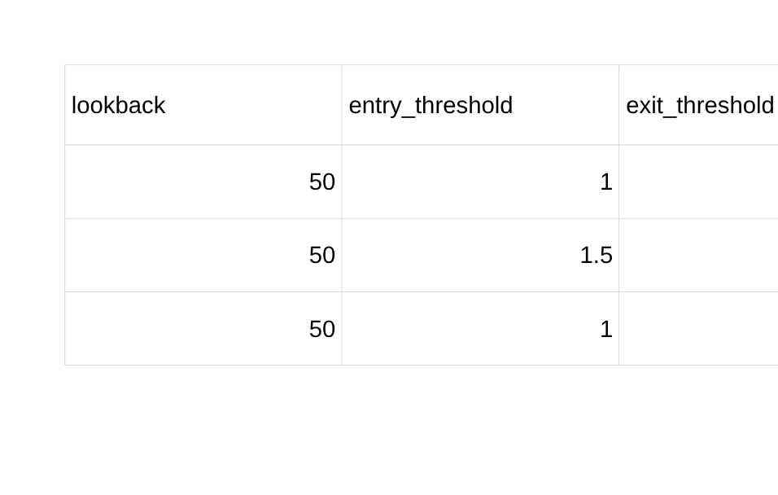
BACKTESTING-RESULTS
3 pairs of stocks are compared. For each pair, the grid search parameters are:
window size = [50, 100, 150]
entry thresholds = [1.0, 1.5, 2.0]
exit thresholds = [0.5, 1.0]
1. Pair 1: 603766.SS and 603665.SS
Cointegration t-statistics: -5.14 ; p-value: 9.01 x 10^ (-5)
Best 3 results:
Note that for all 18 combinations, all of them are profitable (final cumulative reward >0 )

Slide 5

BACKTESTING-RESULTS
2. Pair 2: 601606.SS and 688646.SS
Cointegration t-statistics: -3.47 ; p-value: 0.035
Best 3 results:
13 out of 18 combinations are profitable

Slide 6

BACKTESTING-RESULTS
3. Pair 3: 605366.SS and 603606.SS
Cointegration t-statistics: -3.08 ; p-value: 0.092
Best 3 results:
Only 1 out of 18 combinations is (barely) profitable.
These results suggest that the degree of cointegration is a strong predictor the profitability of pair trading.

