Slide 1
Database Schema & Design
用之前的Database圖片? 我貼在下面

Slide 2
Database Schema-Car System
Rental Spot to longitude and latitude (2 columns)
Spot / to longitude and latitude
Car All info (9 columns)
Car ID / bmid (brand & model) / transportation type / sub type / brand ID / Model ID / price (per hour) / location / In used or not (0 or 1)
Car Status for each time unit (5 columns)
Status ID / time / location / bmid / Car Amount
Query Record (9 columns)
QD ID / Query ID / Deal ID / query time / bmid (brand & model) / rental starting time / rental ending time / location / price
Order Record (11 columns)
Order ID / User ID / qd ID / Car ID / Order time / bmid (brand & model) / rental starting time / rental ending time / location / price / status
Status can be
Confirmed (Pending, car_id = null since car id is not assigned)
Activated (Ready to drive (within 10-20 minutes), assign car id)
Finished (Returned the car)
Canceled

Slide 3
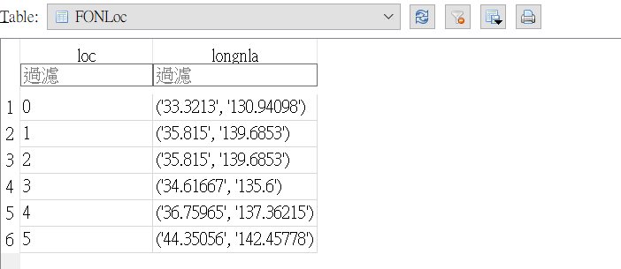
Data in DB-Car System
Rental Spot to longitude and latitude (2 columns)
Spot / to longitude and latitude

Slide 4
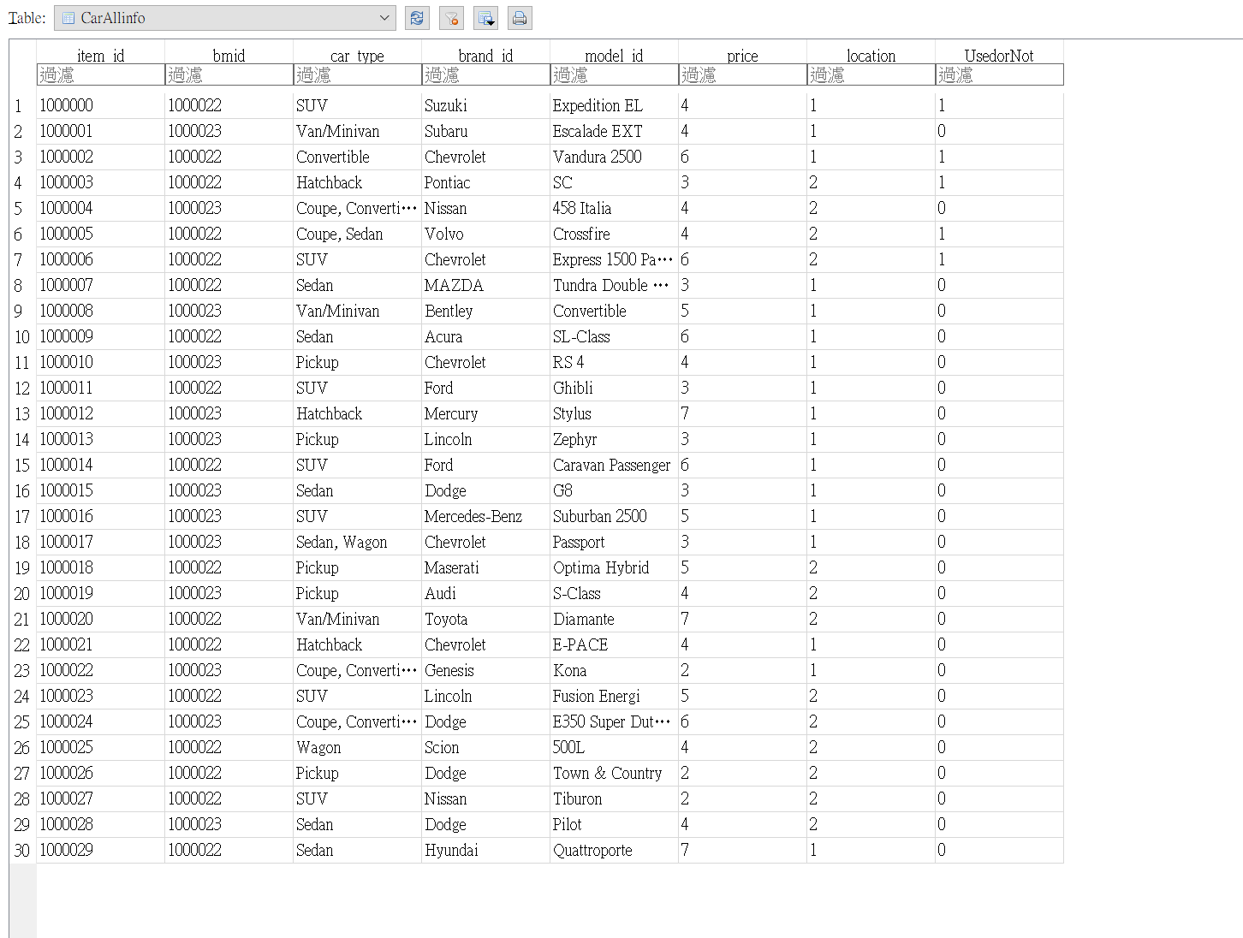
Data in DB-Car System
Car All info (9 columns)
Car ID / bmid (brand & model) / transportation type / sub type / brand ID / Model ID / price (per hour) / location / In used or not (0 or 1)

Slide 5
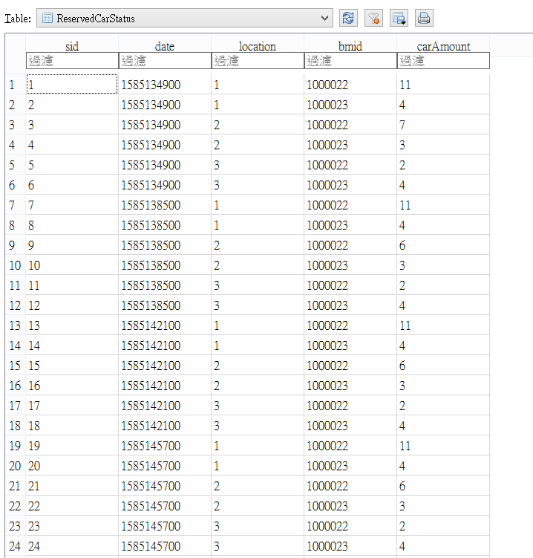
Data in DB-Car System
Car Status for each time unit (5 columns)
Status ID / time / location / bmid / Car Amount

Slide 6
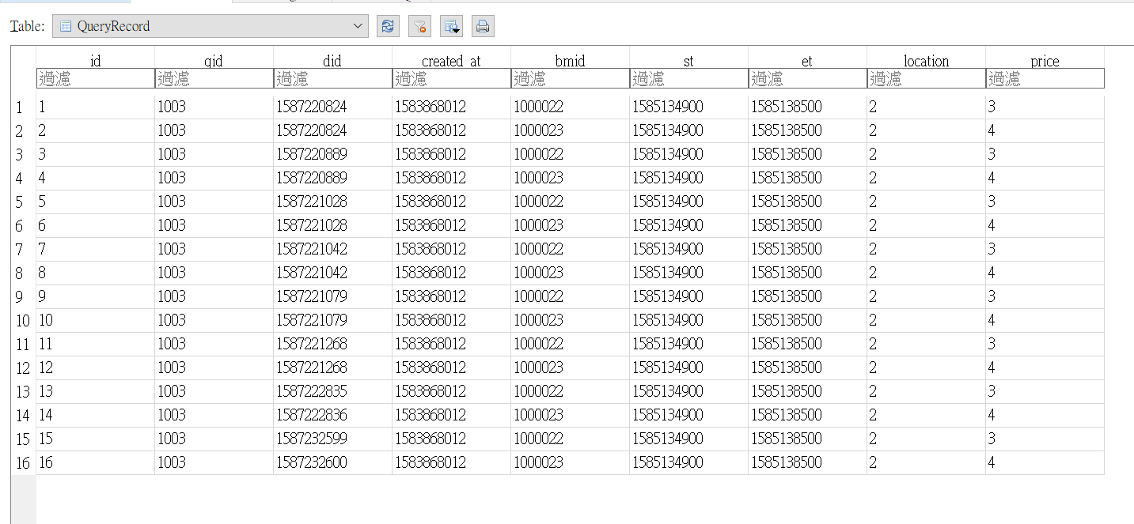
Data in DB-Car System
Query Record (9 columns)
QD ID / Query ID / Deal ID / query time / bmid (brand & model) / rental starting time / rental ending time / location / price

Slide 7
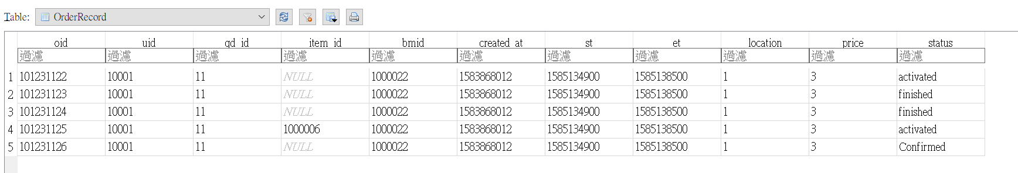
Data in DB-Car System
Order Record (11 columns)
Order ID / User ID / qd ID / Car ID / Order time / bmid (brand & model) / rental starting time / rental ending time / location / price / status

Slide 8
Matchmaking Algorithm
The MMA table contains date column each apart from an hour, rental site column, car type column
1. Choose the rental sites within 10 km
2. Choose the rental period time slots that user actully wanna take
3. Choose the car types, which amount are greater than 0
The reslut is availale car type list that user need.

Slide 9
How does data get updated?
用原本的sequence diagram

Slide 10
Strengths of MMA
Calculate the price based on the available car amount
Easy to maintain, update the availability table periodically
Quick algorithm to filter the available cars

