Slide 1
Robot Writes Words
Cheng Zhang (cz2398)
Yixing Chen (yc3094)
Di Zhu (dz2311)

Slide 2
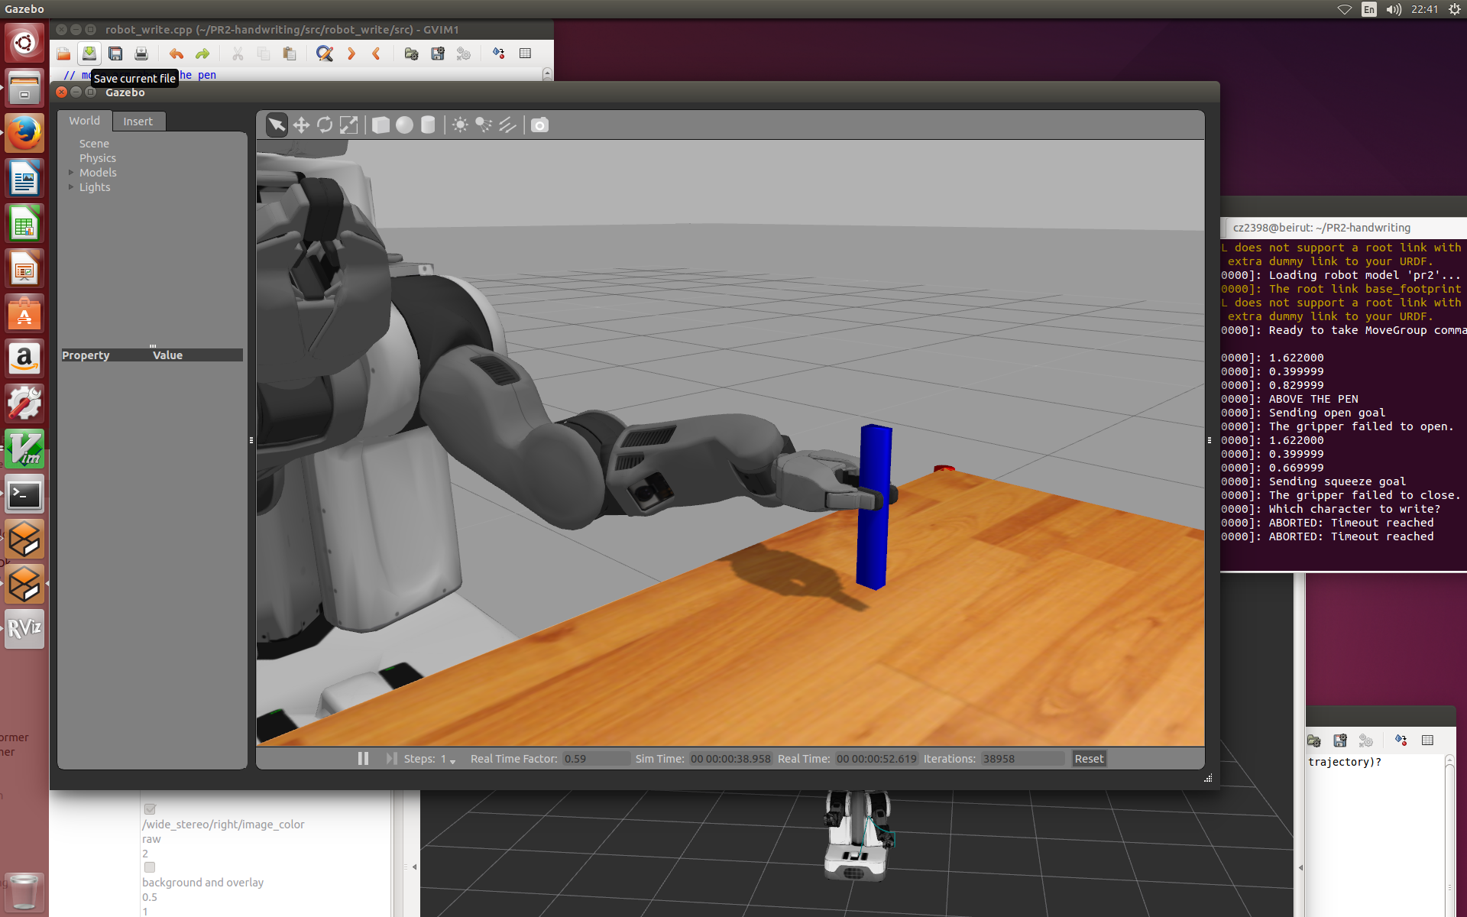
Grasp the pen
Let PR2 move towards the table and grasp the pen.
Because the pen and white paper model cannot be used to write words, we just replace a long rectangle with the pen.
Grasping the pen steadily without tactile sensor is not a easy thing, we adjusted grasping position and orientation for many times in order to avoid the slide of the pen.

Slide 3
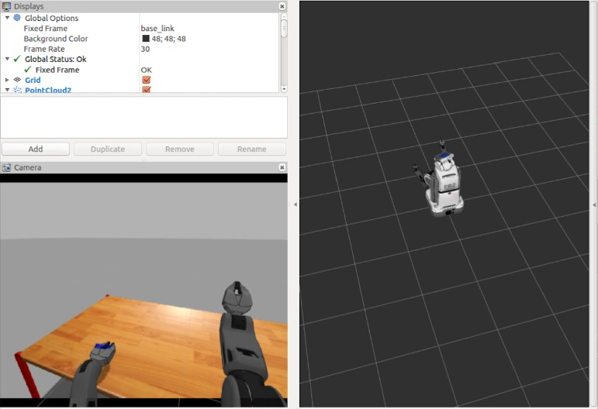
Draw the word
According to the pre-set letter, we use bezier curve to calculate the coordinates of points, and then make the motion planning of robot arm based on these coordinates.
In the process of writing letters, we write the coordinates of the PR2’s gripper into a text file so that we can draw the word in rviz.

Slide 4
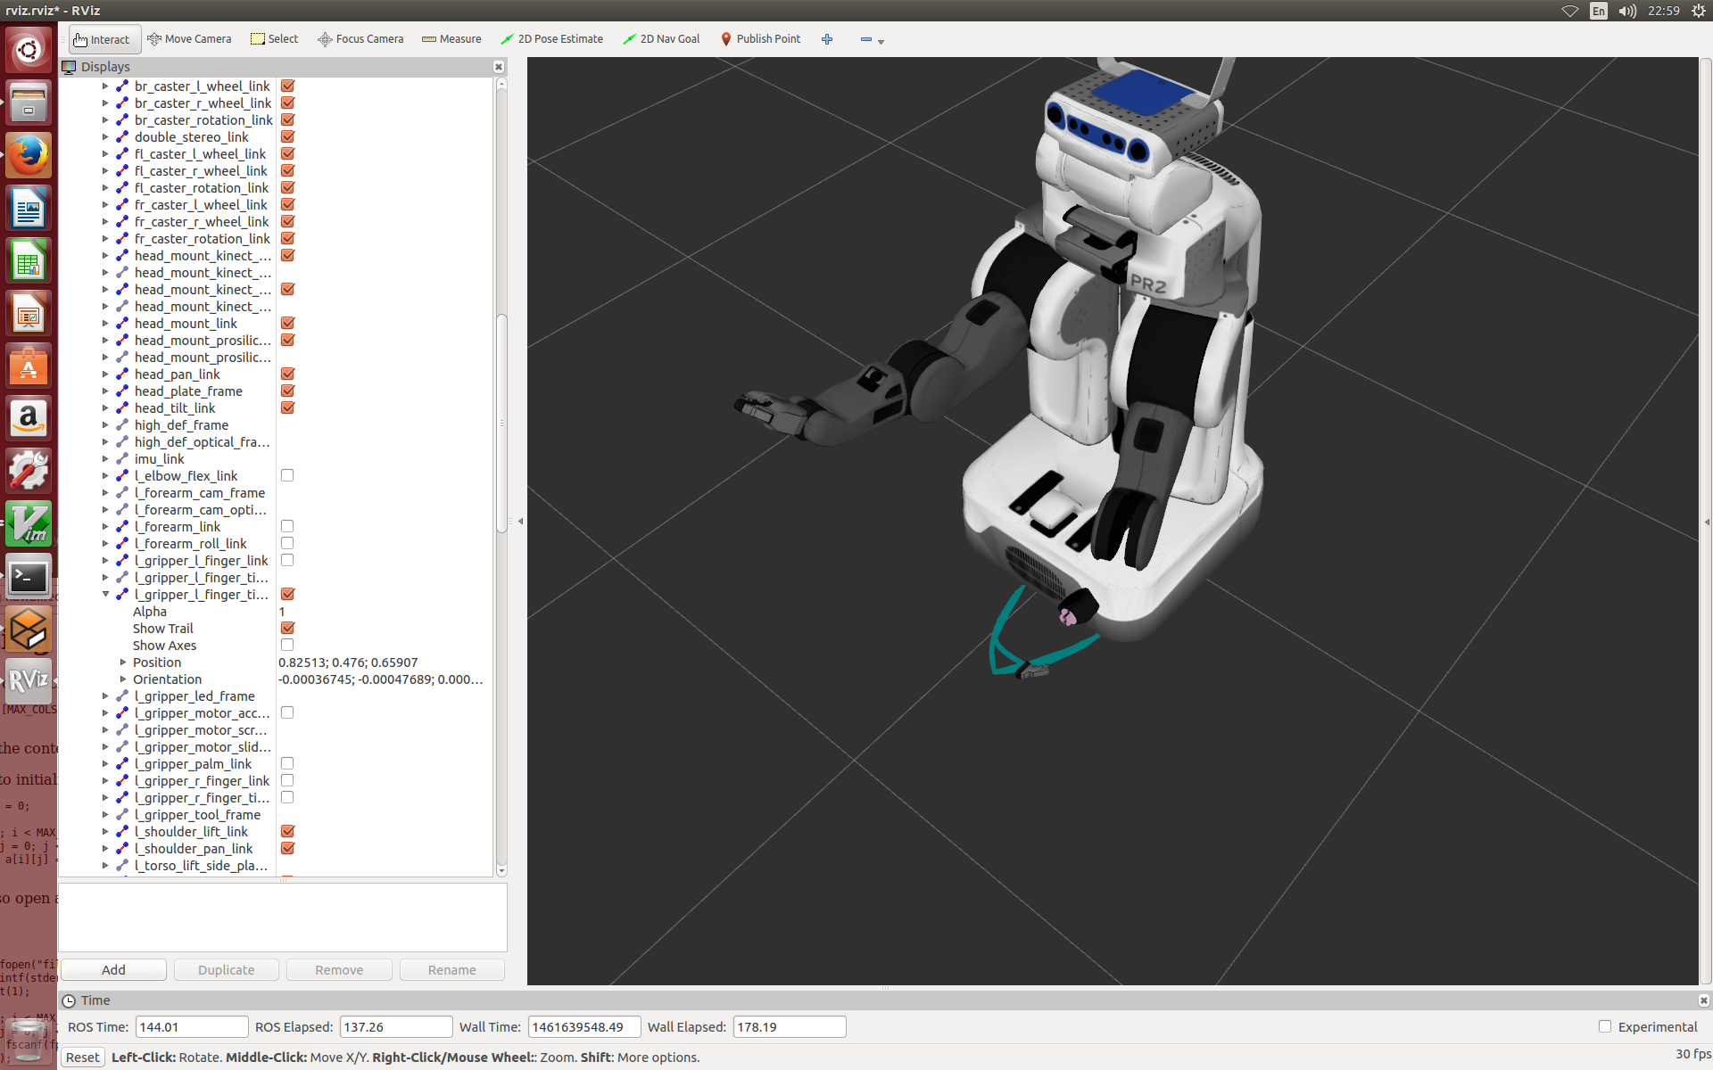
Show the writing process
With the “show trailor ” function in rviz, we can draw the real-time trajectory of the robot’s gripper.
In this picture, we hide part of robot’s hand so that we can see the “A” trajectory.

Slide 5
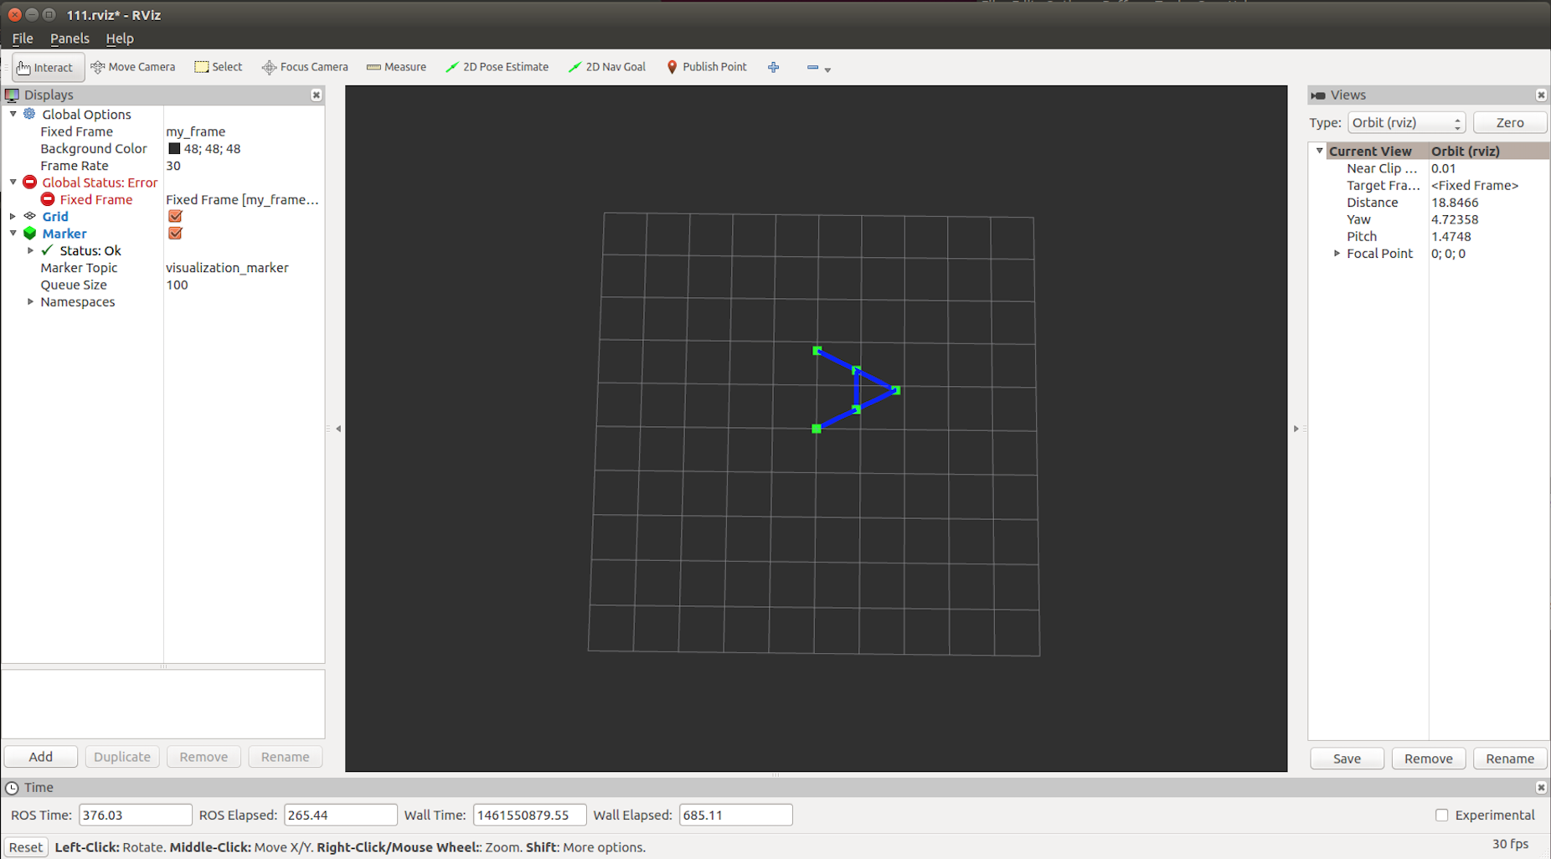
Show the word
Even though we have got the real-time trajectory of robot’s arm, the trajectory contains no points, it’s a 3D trajectory, and it doesn’t like the word on the paper.
So in the process of writing, we store the point coordinates of the robot’s gripper in a text file. We build another C++ program to draw the word in a new rviz window as this picture. So this is the writing result of our project. And this drawing is also real-time.

Slide 6
Problems & Solutions
In the process of our project, we met many problems, and we’ve tried our best to solve these problems.
Problem 1: It’s hard for the robot to grasp the cylinder (pen) steadily.
Solve method:
1. Simplify the model of pen, use long rectangle rather than cylinder as the pen.
2. Adjust the grasp location and orientation to keep steady.
Problem 2: Translate the word to the trajectory of robot’s arm.
Solve method: Use bezier curve to compute the many points coordinates of word, and plan the trajectory of robot’s arm, which improve the robustness of algorithm.
Problem 3: Show the real-time trajectory of robot writing.
Solve method:
1. Use the “show trailor” function in rviz, show the real-time trajectory of robot’s arm. (It’s a 3D trajectory without points, and we still hope to get the word image like it’s on the paper.)
2. Write the points coordinates of robot motion into a text file, and build a cpp file which keeps scanning the text file and draw the real-time image in another rviz window. (In this cpp file, we use <visualization_msgs/Marker.h> head file and visualization_msgs::Marker class.)

Slide 7
Future Plan
We haven’t set base movement after the process of writing, so now our PR2 can just write one character at one time. In the next few days, we will improve this part and let robot write more letters continuously.
By now, we have achieved the main function in our proposal. If it’s possible, we will try to use sensors, like kinect, and make our robot work better.
The scene is relatively simple now, we will add a piece of paper to test the steadiness of the pen.

