Slide 1

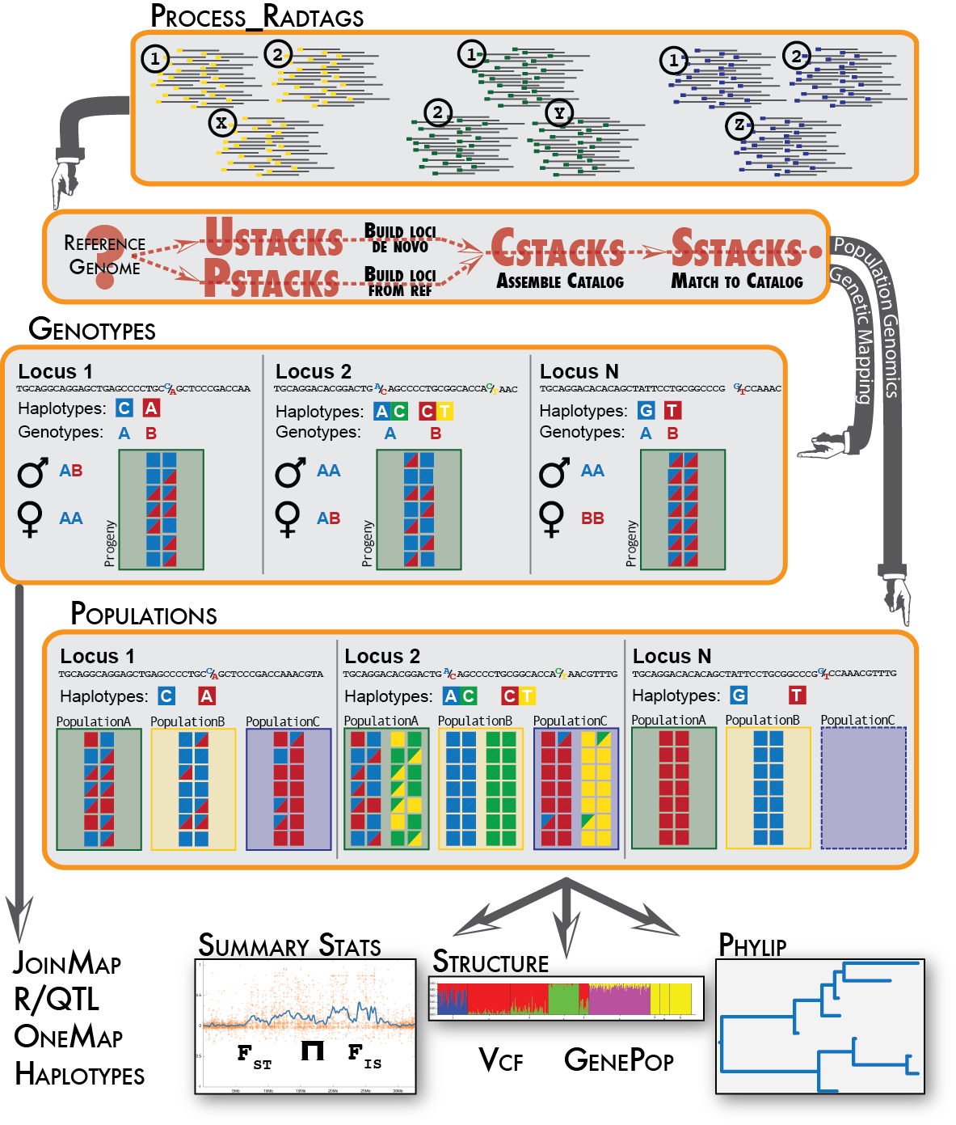
Estimating genetic diversity and population information from short read (ddRAD-seq) type data
03 – denovo_map
Chris Barratt (sDiv / Evolution and Adaptation)
Laura Mendez (Evolution and Adaptation)
Assistant: Dimas Calderon (Evolution and Adaptation)

Slide 2
ddRAD sequencing
Rochette, Rivera-Colón & Catchen, 2019 - Mol. Ecology
process_radtags
Clean and demultiplex the data
ddRADseq Data
ustacks
Building loci de novo for each sample
HPC cluster (EVE) - UFZ
Creates a catalog of all loci across the populations according to sequence similarity
Stacks v2.61
cstacks
sstacks
Match each sample against the catalog
tsv2bam
Transpose the data to be organized by RAD locus. Paired-end reads are fetched and stored for later use
gstacks
A contig is assembled from pair-end reads and overlapped with the single-end locus. SNP calling
Output files for population structure analyses, phylogenetics, demographic history…
populations
Population level statistics and output in different formats. Possibility for further filtering

Slide 3
ddRAD sequencing
Rochette, Rivera-Colón & Catchen, 2019 - Mol. Ecology
process_radtags
Clean and demultiplex the data
ddRADseq Data
ustacks
Building loci de novo for each sample
HPC cluster (EVE) - UFZ
Creates a catalog of all loci across the populations according to sequence similarity
Stacks v2.61
cstacks
sstacks
Match each sample against the catalog
tsv2bam
Transpose the data to be organized by RAD locus. Paired-end reads are fetched and stored for later use
gstacks
A contig is assembled from pair-end reads and overlapped with the single-end locus. SNP calling
Output files for population structure analyses, phylogenetics, demographic history…
populations
Population level statistics and output in different formats. Possibility for further filtering
denovo_map.pl

Slide 4
Bioinformatics
ddRAD sequence data
Workflow
process_radtags

Slide 5
Bioinformatics
ddRAD sequence data
Sample.1.fq
Sample.rem.1.fq
Sample.2.fq
Sample.rem.2.fq
Workflow
process_radtags
Demultiplexing the data

Slide 6
Bioinformatics
ddRAD sequence data
Workflow
process_radtags
parameter optimization

Slide 7
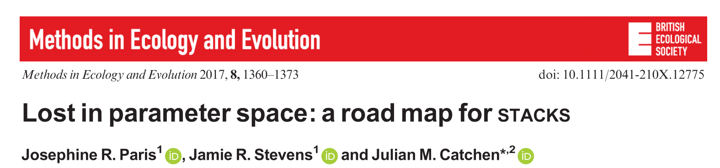
Bioinformatics
ddRAD sequence data
Workflow
process_radtags
parameter optimization

Slide 8
Bioinformatics
ddRAD sequence data
Workflow
process_radtags
m - depth coverage
M - mismatches allowed within indv. (ustacks)
n - mismatches allowed between indv. (cstacks)
parameter optimization
“Find a balance between obtaining true polymorphism and introducing sequencing error”
Notes:
The number of sequence reads for a given locus or nucleotide site.

Slide 9
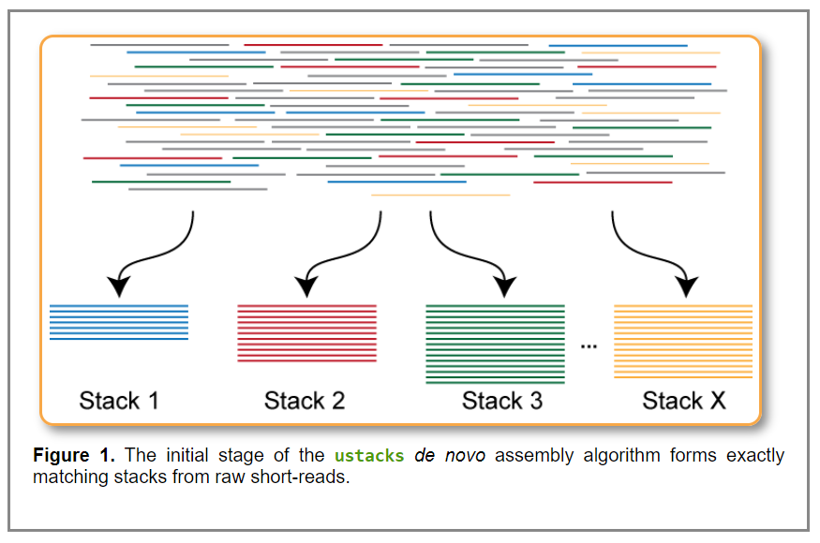
m - Minimum depth coverage (minimum stack depth parameter) ustacks
Controls the number of raw reads required to form an initial stack.
If set to a value of 3 then three or more identical reads must be found to consider those reads a stack. If a stack is formed with only two reads, then those reads are set aside and a stack is not constructed.
If this parameter is set too low, then reads with convergent sequencing errors are likely to be erroneously labeled as stacks.
If this parameter too high, then true alleles will not be recorded and will drop out of the analysis.

Slide 10
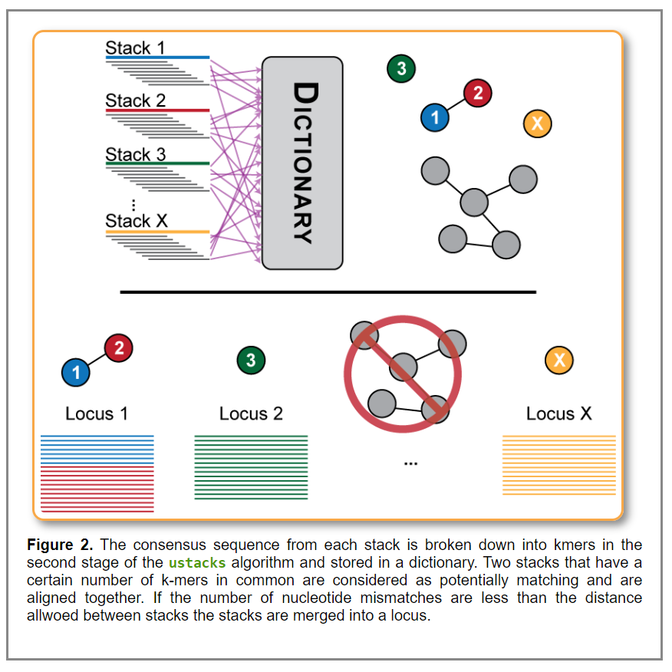
M - Mismatches allowed within indv. (Distance Allowed Between Stacks) ustacks
The distance allowed between stacks parameter represents the number of nucleotides that may be different between two stacks in order to merge them. These nucleotide differences may be due to polymorphisms present between two alleles, or they may be due to sequencing error.
If you set this parameter too low, then some loci will fail to be reconstructed. This means the SNPs contained in that locus will not be identified and this locus will appear as two loci to the remainder of the pipeline.
Setting this parameter too high will allow repetitive sequence to chain together in to large, nonsensical loci.

Slide 11
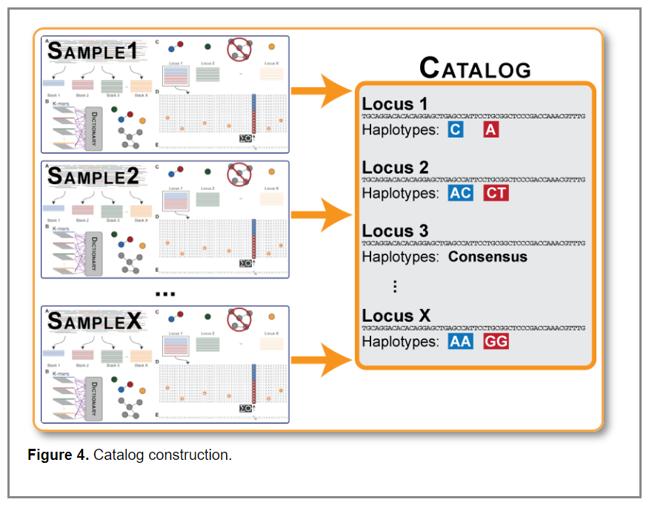
n - mismatches allowed between indv. (Distance Between Catalog Loci) cstacks
Once loci are built per sample, then, the data from each individual will be merged into a catalog (by the cstacks program), which is meant to contain all the loci and alleles in the population.
If the distance between catalog loci parameter is greater than 0, then cstacks will use the consensus sequence from each locus to attempt to merge loci together across samples.
if you set this parameter too low there will be loci across individuals that are represented independently in the catalog that are truly the same locus.
If you set this parameter too high, you will again allow loci close together in sequence space to chain together and create big, erroneous loci in the catalog.

Slide 12
Bioinformatics
ddRAD sequence data
Workflow
process_radtags
m = 3
M = 1-9 denovo_map.pl
n = 1-9
n = M
parameter optimization
“Find a balance between obtaining true polymorphism and introducing sequencing error”

Slide 13
Bioinformatics
ddRAD sequence data
Workflow
process_radtags
m = 3
M = 1-9 denovo_map.pl -> populations -r 0.80
n = 1-9
n = M
parameter optimization
“a locus must be found in 80% of individuals of a single population to be processed”

Slide 14
Bioinformatics
ddRAD sequence data
Workflow
process_radtags
- Number of r80 polymorphic loci
- Number of new polymorphic found for each iteration of M
parameter optimization
“Find a balance between obtaining true polymorphism and introducing sequencing error”

Slide 15
Bioinformatics
ddRAD sequence data
Workflow
process_radtags
- Number of r80 polymorphic loci
- Number of new polymorphic found for each iteration of M
parameter optimization
“Find a balance between obtaining true polymorphism and introducing sequencing error”
~ 14 hours with a population map including 14 individuals

Slide 16
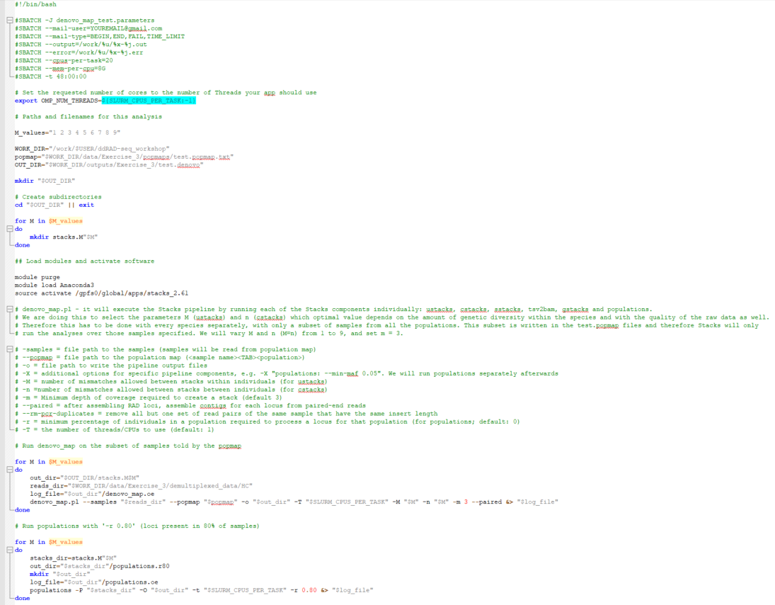
01_denovo_map_test.parameters

Slide 17
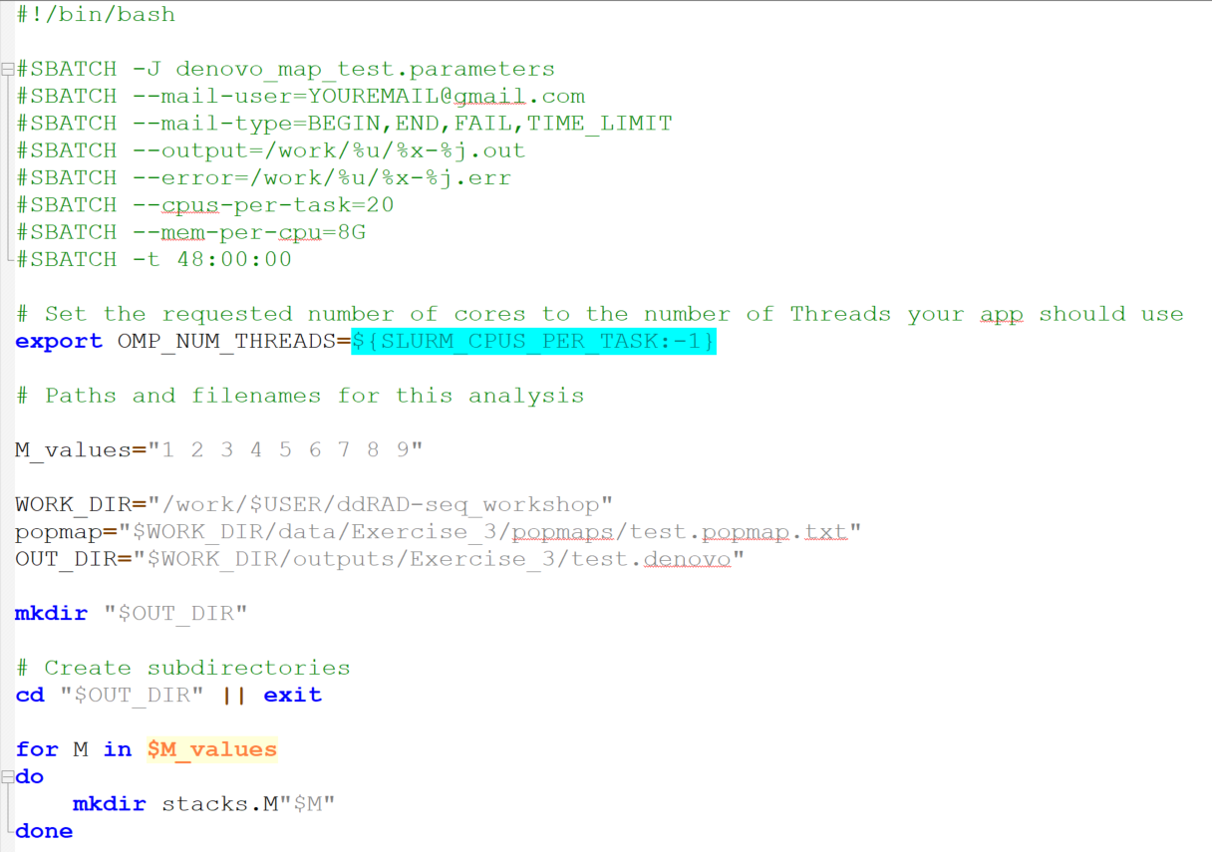
01_denovo_map_test.parameters

Slide 18
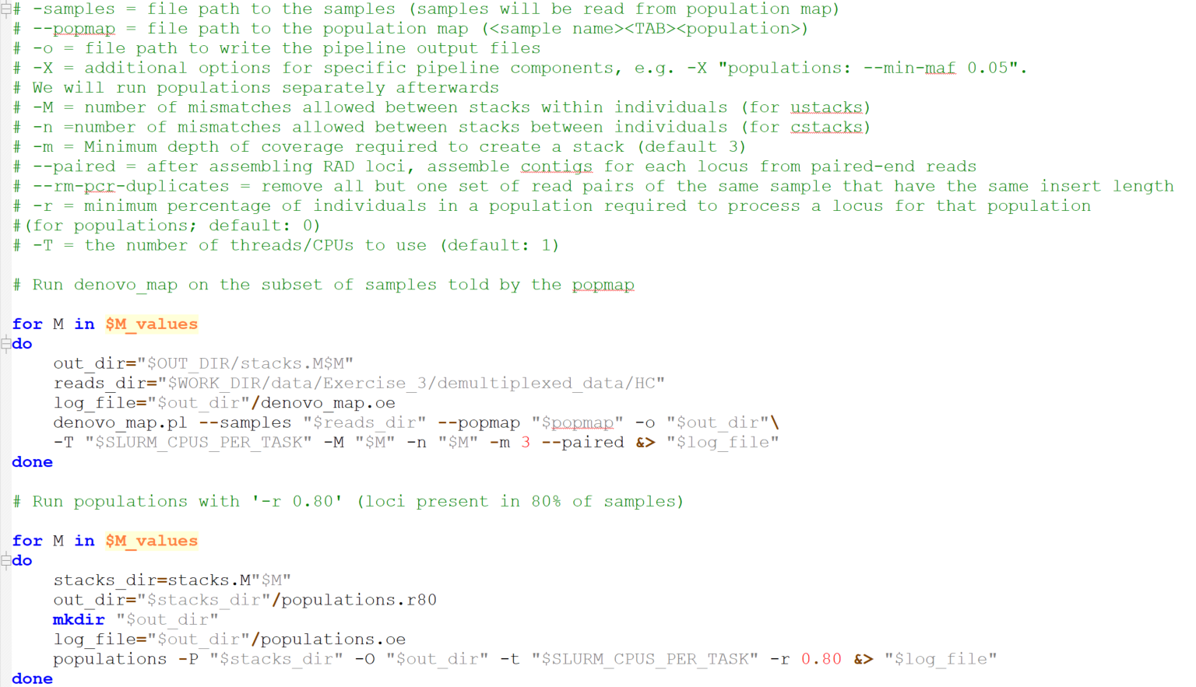
01_denovo_map_test.parameters

Slide 19
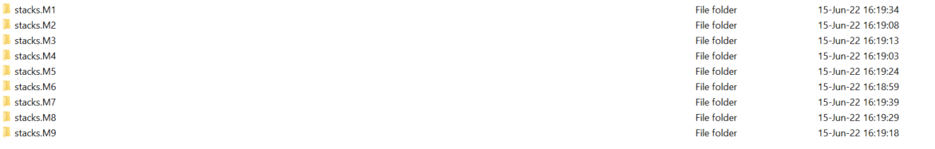
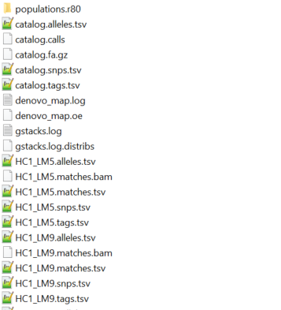
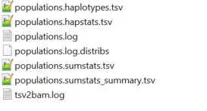

Slide 20
Extract this information:
Number of r80 polymorphic loci
- Number of new polymorphic found for each iteration of M

Slide 21
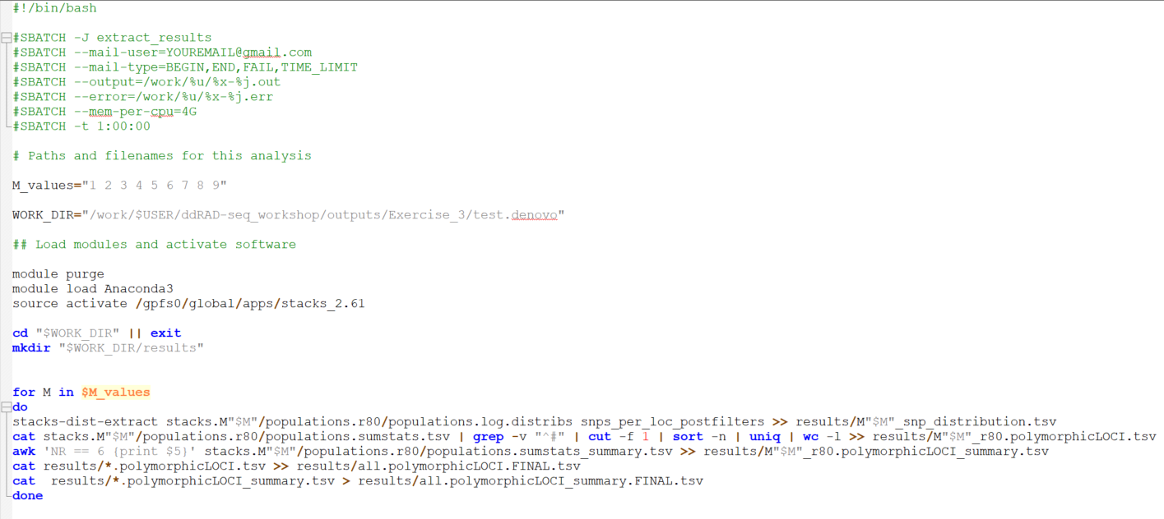
02_extract_results

Slide 22
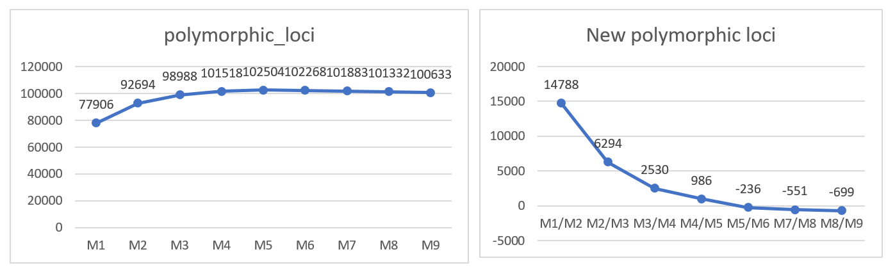
Bioinformatics
Bismarckia nobilis

Slide 23
Bioinformatics
Bismarckia nobilis
“Find a balance between obtaining true polymorphism and introducing sequencing error”

Slide 24
Bioinformatics
Bismarckia nobilis
M = 4
M = n

Slide 25
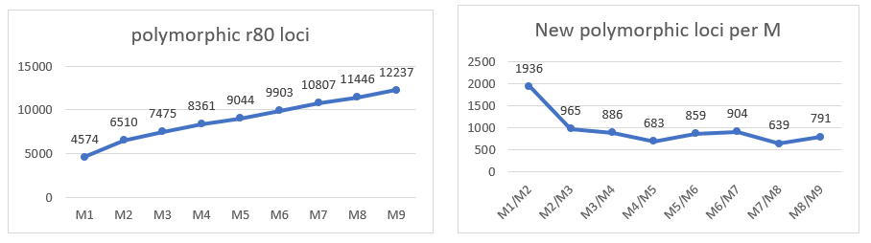
Bioinformatics
Dypsis pinnatifrons

Slide 26
Bioinformatics
Dypsis pinnatifrons
M = 5
M = n

Slide 27
Bioinformatics
ddRAD sequence data
Workflow
process_radtags
parameter optimization
m, M, n

Slide 28
Bioinformatics
ddRAD sequence data
Workflow
process_radtags
parameter optimization
m, M, n
de novo assembly

Slide 29
Bioinformatics
ddRAD sequence data
Workflow
process_radtags
parameter optimization
m, M, n
de novo assembly

Slide 30
Bioinformatics
ddRAD sequence data
Workflow
process_radtags
parameter optimization
m, M, n
de novo assembly
denovo_map.pl
ustacks
cstacks
sstacks
tsv2bam
gstacks

Slide 31
ddRAD sequencing
Rochette, Rivera-Colón & Catchen, 2019 - Mol. Ecology
process_radtags
Clean and demultiplex the data
ddRADseq Data
ustacks
Building loci de novo for each sample
HPC cluster (EVE) - UFZ
Creates a catalog of all loci across the populations according to sequence similarity
Stacks v2.61
cstacks
sstacks
Match each sample against the catalog
tsv2bam
Transpose the data to be organized by RAD locus. Paired-end reads are fetched and stored for later use
gstacks
A contig is assembled from pair-end reads and overlapped with the single-end locus. SNP calling
Output files for population structure analyses, phylogenetics, demographic history…
populations
Population level statistics and output in different formats. Possibility for further filtering

Slide 32
Bioinformatics
ddRAD sequence data
Workflow
process_radtags
parameter optimization
de novo assembly
denovo_map.pl
ustacks
cstacks
sstacks
tsv2bam
gstacks
populations

Slide 33
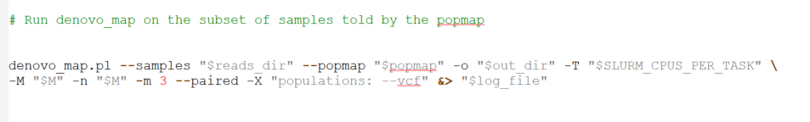
03_denovo_map_full

Slide 34
Bioinformatics
ddRAD sequence data
Workflow
process_radtags
parameter optimization
de novo assembly
denovo_map.pl
ustacks
cstacks
sstacks
tsv2bam
gstacks
populations
.vcf file

Slide 35
Bioinformatics
ddRAD sequence data
Workflow
process_radtags
parameter optimization
de novo assembly
denovo_map.pl
ustacks
cstacks
sstacks
tsv2bam
gstacks
populations
.vcf file
VCFtools
Data exploration

Slide 36
Bioinformatics
ddRAD sequence data
Workflow
process_radtags
parameter optimization
de novo assembly
denovo_map.pl
ustacks
cstacks
sstacks
tsv2bam
gstacks
populations
.vcf file
VCFtools
Data exploration
--freq2 = allele frequency
--depth = mean depth per individual
--site-mean-depth = mean depth per site
--missing-indv = proportion of missing data per individual
--missing-site = proportion of missing data per site
--het = heterozygosity and inbreeding coefficient per individual

Slide 37
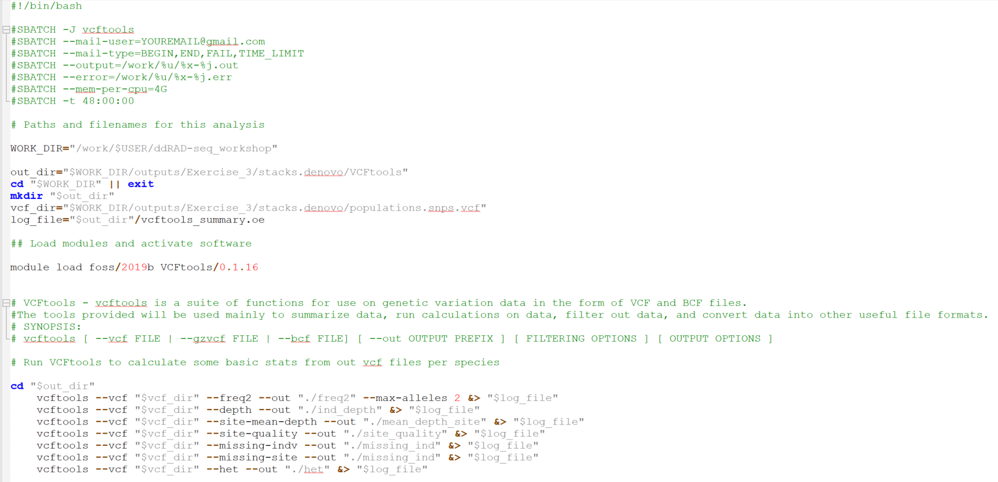
04_extract_results

Slide 38
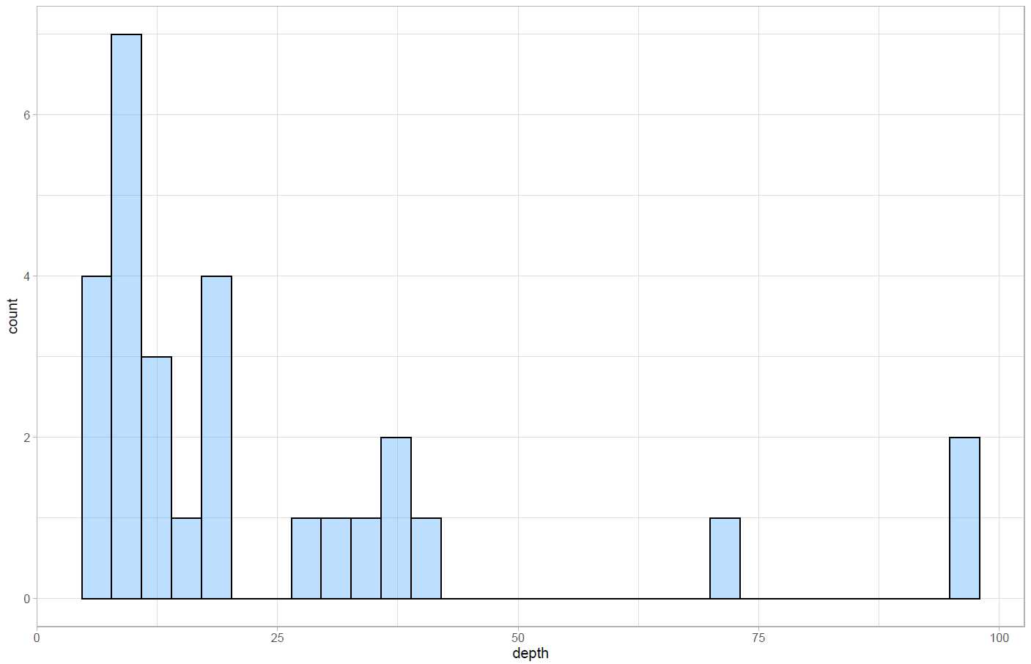
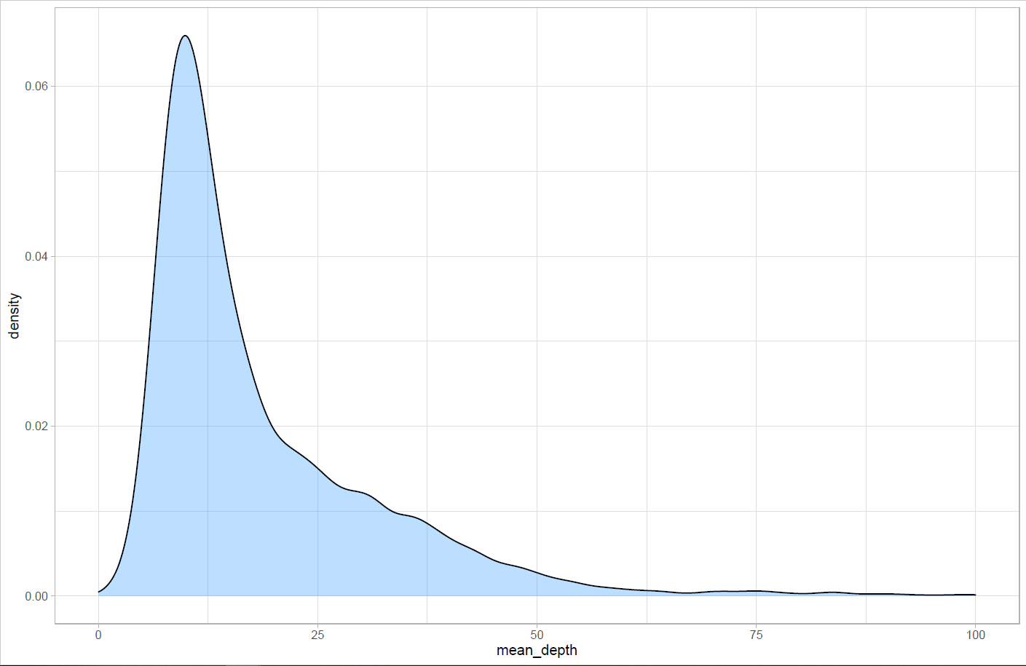
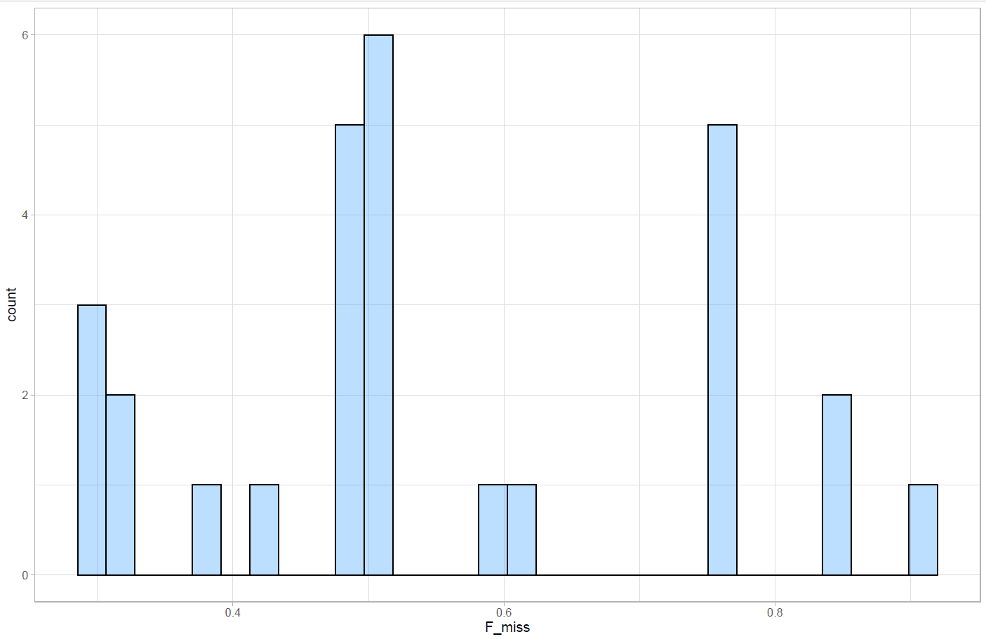
Bioinformatics
Mean depth per individual
Borassus madagascariensis
28 individuals
Variant mean depth
Missing data per individual

Slide 39
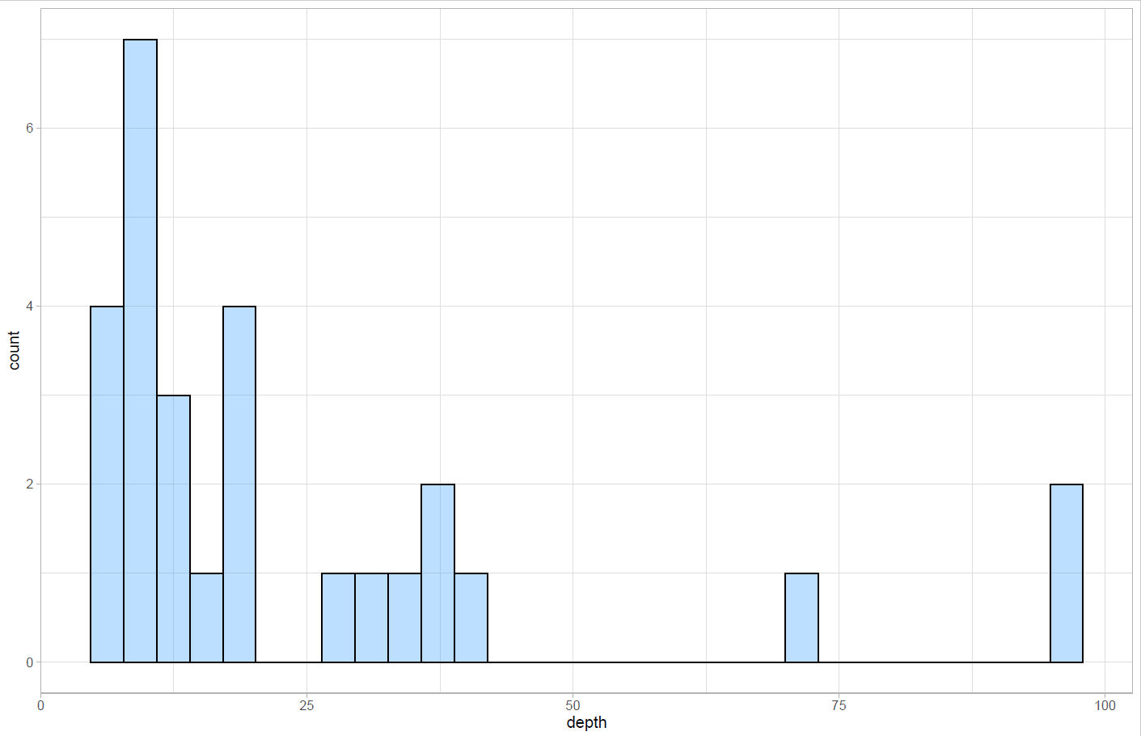
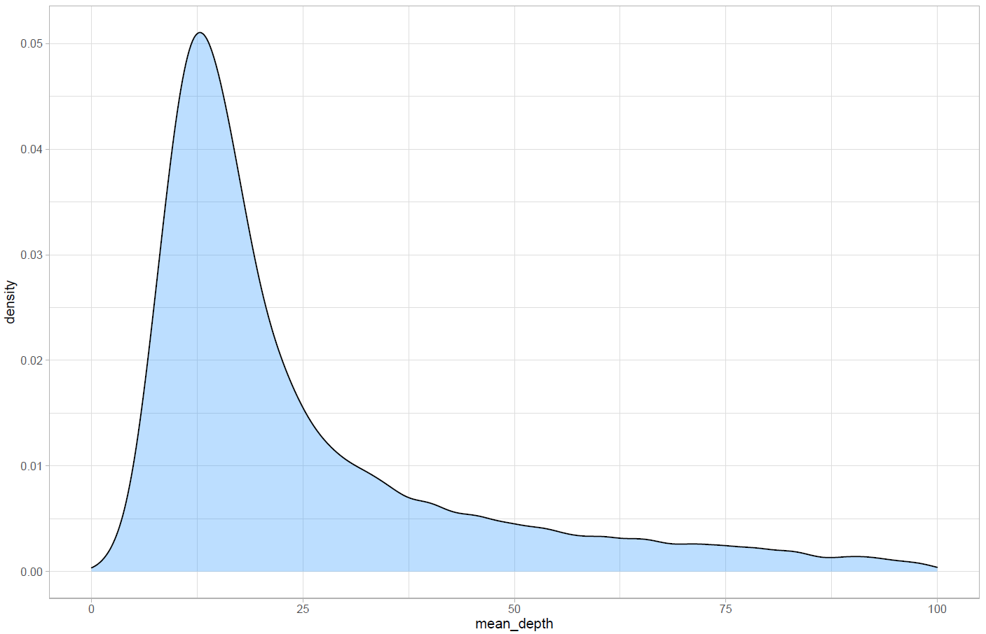
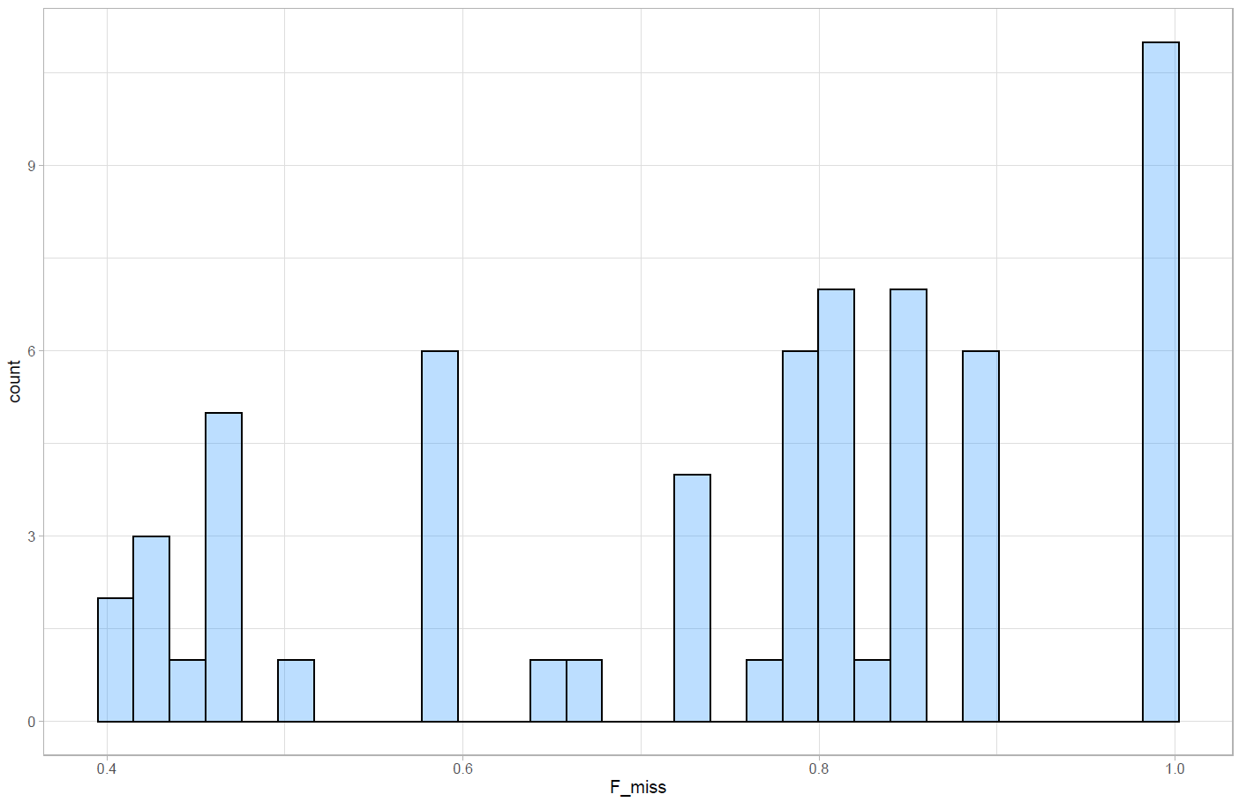
Bioinformatics
Mean depth per individual
Bismarckia nobilis
63 individuals
Variant mean depth
Missing data per individual

Slide 40
Bioinformatics
ddRAD sequence data
Workflow
process_radtags
parameter optimization
de novo assembly
denovo_map.pl
ustacks
cstacks
sstacks
tsv2bam
gstacks
populations
VCFtools

Slide 41
Bioinformatics
ddRAD sequence data
Workflow
process_radtags
parameter optimization
de novo assembly
denovo_map.pl
ustacks
cstacks
sstacks
tsv2bam
gstacks
populations
VCFtools
Identifying bad apples

Slide 42
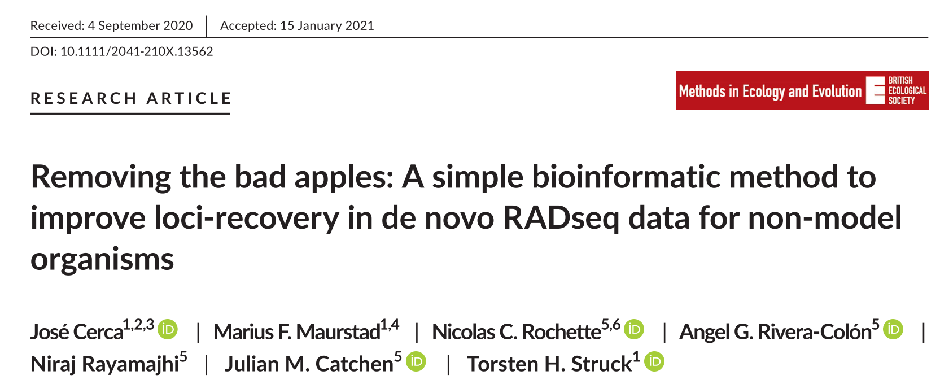
Bioinformatics
ddRAD sequence data
Workflow
process_radtags
parameter optimization
de novo assembly
denovo_map.pl
ustacks
cstacks
sstacks
tsv2bam
gstacks
populations
VCFtools
Identifying bad apples

Slide 43
Bioinformatics
ddRAD sequence data
Workflow
process_radtags
parameter optimization
de novo assembly
denovo_map.pl
ustacks
cstacks
sstacks
tsv2bam
gstacks
populations
VCFtools
proportion of missing data per individual
Identifying bad apples

Slide 44
Bioinformatics
ddRAD sequence data
Workflow
process_radtags
parameter optimization
de novo assembly
denovo_map.pl
ustacks
cstacks
sstacks
tsv2bam
gstacks
populations
VCFtools
Identifying bad apples
Delete individuals > 90% missing data
“helps recovering a higher number of loci”

Slide 45
Bioinformatics
ddRAD sequence data
Workflow
process_radtags
parameter optimization
de novo assembly
denovo_map.pl
ustacks
cstacks
sstacks
tsv2bam
gstacks
populations
New population map -> popmap_90
VCFtools
Identifying bad apples
Deleted individuals > 90% missing data

Slide 46
Bioinformatics
Mean depth per individual
Bismarckia nobilis
63 individuals
Variant mean depth
Missing data per individual

Slide 47
Bioinformatics
ddRAD sequence data
Workflow
process_radtags
parameter optimization
de novo assembly
denovo_map.pl
ustacks
cstacks
sstacks
tsv2bam
gstacks
populations
VCFtools
Identifying bad apples

Slide 48
Bioinformatics
ddRAD sequence data
Workflow
process_radtags
parameter optimization
de novo assembly
denovo_map.pl
ustacks
cstacks
sstacks
tsv2bam
gstacks
populations
VCFtools
Identifying bad apples
Filtering VCFtools

Slide 49
Bioinformatics
ddRAD sequence data
Workflow
process_radtags
parameter optimization
de novo assembly
denovo_map.pl
ustacks
cstacks
sstacks
tsv2bam
gstacks
populations
VCFtools
Identifying bad apples
remove-indels
max-missing 0.50 (max of 50% missing data)
min-alleles 2, max-alleles 2 (only biallelic)
minDP 5, maxDP 100
Filtering VCFtools

Slide 50
Bioinformatics
ddRAD sequence data
Workflow
process_radtags
parameter optimization
de novo assembly
denovo_map.pl
ustacks
cstacks
sstacks
tsv2bam
gstacks
populations
To control for false-positive loci
VCFtools
Identifying bad apples
remove-indels
max-missing 0.25 (max of 75% missing data)
min-alleles 2, max-alleles 2 (only biallelic)
minDP 5, maxDP 100
Filtering VCFtools

Slide 51
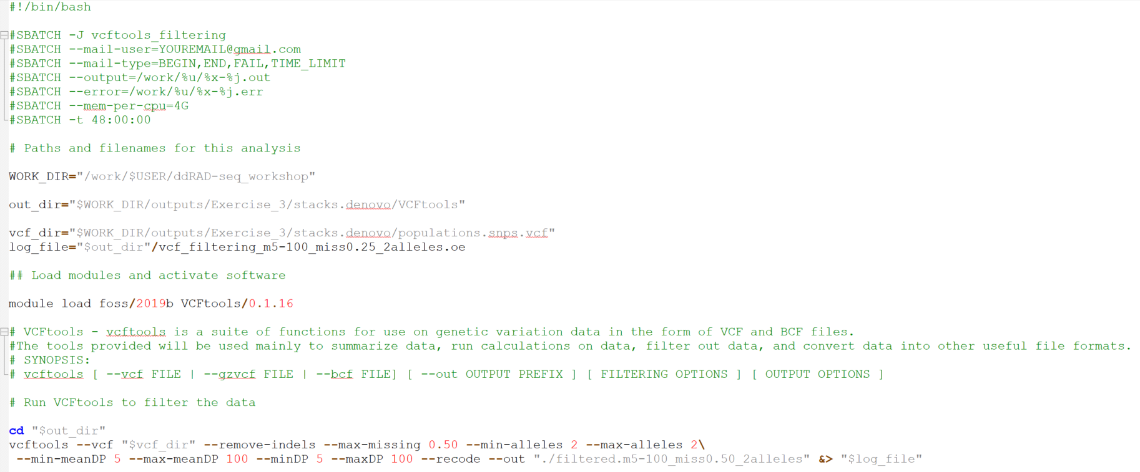
05_VCFtools_filtering

Slide 52
Bioinformatics
ddRAD sequence data
Workflow
process_radtags
parameter optimization
de novo assembly
denovo_map.pl
ustacks
cstacks
sstacks
tsv2bam
gstacks
populations
VCFtools
Identifying bad apples
Filtering VCFtools

Slide 53
Bioinformatics
ddRAD sequence data
Workflow
process_radtags
parameter optimization
de novo assembly
denovo_map.pl
ustacks
cstacks
sstacks
tsv2bam
gstacks
populations
VCFtools
Identifying bad apples
Filtering VCFtools
Filtering
populations

Slide 54
Bioinformatics
ddRAD sequence data
Workflow
process_radtags
parameter optimization
de novo assembly
denovo_map.pl
ustacks
cstacks
sstacks
tsv2bam
gstacks
populations
“a locus must be found in 75% of individuals of a single population to be processed”
VCFtools
Identifying bad apples
Filtering VCFtools
r - 0.75
Filtering
populations

Slide 55
Bioinformatics
ddRAD sequence data
Workflow
process_radtags
parameter optimization
de novo assembly
denovo_map.pl
ustacks
cstacks
sstacks
tsv2bam
gstacks
populations
VCFtools
“a variable site must possess a minimum allele frequency of 5% to be included”
Identifying bad apples
Filtering VCFtools
r - 0.75
min-maf - 0.05
Filtering
populations

Slide 56
Bioinformatics
ddRAD sequence data
Workflow
process_radtags
parameter optimization
de novo assembly
denovo_map.pl
ustacks
cstacks
sstacks
tsv2bam
gstacks
populations
VCFtools
“variable sites with a maximum level of 0.7 heterozygosity will be included”
Identifying bad apples
Filtering VCFtools
r - 0.75
min-maf - 0.05
max-obs-het 0.7
Filtering
populations

Slide 57
Bioinformatics
ddRAD sequence data
Workflow
process_radtags
parameter optimization
de novo assembly
denovo_map.pl
ustacks
cstacks
sstacks
tsv2bam
gstacks
populations
VCFtools
“decreases linkage disequilibrium and increases reproducibility”
Identifying bad apples
Filtering VCFtools
r - 0.75
min-maf - 0.05
max-obs-het 0.7
write-single-snp
Filtering
populations

Slide 58
Bioinformatics
ddRAD sequence data
Workflow
process_radtags
parameter optimization
de novo assembly
denovo_map.pl
ustacks
cstacks
sstacks
tsv2bam
gstacks
populations
VCFtools
To control for false-positive loci
Identifying bad apples
Filtering VCFtools
r - 0.75
min-maf - 0.05
max-obs-het 0.7
write-single-snp
Filtering
populations

Slide 59

Bioinformatics
ddRAD sequence data
Workflow
process_radtags
parameter optimization
de novo assembly
denovo_map.pl
ustacks
cstacks
sstacks
tsv2bam
gstacks
populations
VCFtools
Identifying bad apples
Filtering VCFtools
r - 0.75
min-maf - 0.05
max-obs-het 0.7
write-single-snp
Filtering
populations

Slide 60
Bioinformatics
ddRAD sequence data
Workflow
process_radtags
parameter optimization
de novo assembly
denovo_map.pl
ustacks
cstacks
sstacks
tsv2bam
gstacks
populations
VCFtools
Identifying bad apples
Filtering VCFtools
r - 0.75
min-maf - 0.05
max-obs-het 0.7
write-single-snp
Filtering
populations
Popmap_90

Slide 61
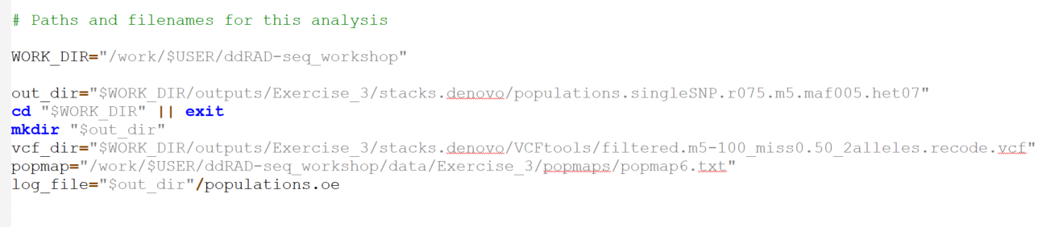
06_populations_filtering

Slide 62
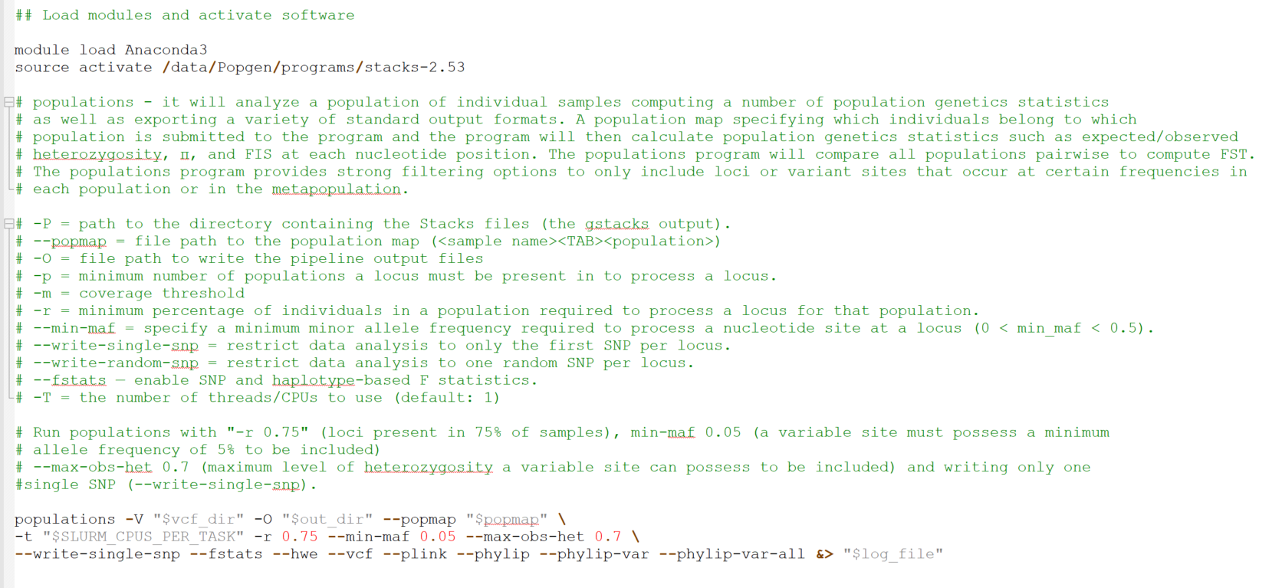
06_populations_filtering

Slide 63
Bioinformatics
ddRAD sequence data
Workflow
process_radtags
parameter optimization
de novo assembly
denovo_map.pl
ustacks
cstacks
sstacks
tsv2bam
gstacks
populations
VCFtools
Identifying bad apples
Filtering VCFtools
Filtering
populations

Slide 64
Bioinformatics
ddRAD sequence data
Workflow
process_radtags
parameter optimization
de novo assembly
denovo_map.pl
ustacks
cstacks
sstacks
tsv2bam
gstacks
populations
VCFtools
Identifying bad apples
Filtering VCFtools
Genetic diversity
He, Ho, Fis, π
Genetic structure
Filtering
populations
ADMIXTURE
Fst
Genetic differentiation
RAxML
Phylogenetic reconstruction

