Slide 1
Recycle Man
Don’t waste your time

Slide 2
The main experiment will take 40 mins.
You will receive $12 per hour as the baseline payment for participating. In addition, for every 20 points you earn in the experiment, you will receive extra $1.

Slide 3
Basic settings
You will be matched with another six players to play the “Recycle Man” experiment. This is how it works:
We recruited six participants previously. Each of them completed the “Recycle Man” experiment in a single-player mode.
During the experiment, the computer will reveal the performance of these six previous players in real time.
We aim to give you a “multi-player” game experience. It’s as if you are doing the experiment with six others, starting at the same time.
Notes:
Add some information.

Slide 4
Basic settings
Single-Player
Record
…
Time
Multi-Player
YOU
YOU
Play back in real time

Slide 5
“Recycle Man” Experiment
In the “Recycle Man” experiment, you search and recycle trashcans to earn rewards.
On each trial, you spend some time searching for a trashcan and deciding whether to recycle it.
To recycle a trashcan, you need to empty the trash in it first. Different trashcans contain different amounts of trash. Emptying fuller trashcans takes more time.
To maximize total earnings in the 40 mins, you should decide whether a trashcan is worth recycling based on how full it is.

Slide 6
“Recycle Man” Experiment
After removing all the trash, you can find either a soda can which worth 1 point, or a soda bottle which worth 3 points.
When you complete the recycling, you will be shown how many points you earned in this trial, along with the average number of points the other six players earned in the same time period.

Slide 7

You start each trial by searching for a trashcan.
The shrinking blue bar indicates the elapsed time since you start searching.
The recycling marker indicates when the trashcan would pop up.

Slide 8
Once the blue bar reaches the recycling marker, a trashcan pops up.
The amount of trash is indicated by the grey bar.

Slide 9
You should decide whether to recycle or forgo this trash can.
K: recycle
D: forgo
You have a fixed duration to make the decision.
You should make the decision before the blue bar vanishes.

Slide 10
If you decide to recycle:
If you decide to recycle (“K”) the trash can, the symbol turns blue.
Noticeably, the recycling doesn’t start immediately after you make the decision!
Notes:
The decision making window is fixed.

Slide 11
If you decide to recycle:
The recycling starts after the blue bar disappears entirely.
As the recycling starts, the trash in the trashcan declines.
Once there is no trash in the trashcan, the recycling is completed.

Slide 12
If you decide to recycle:
Once the recycling is completed, the blue bar appears again, indicating that you start searching for the next trash can.

Slide 13
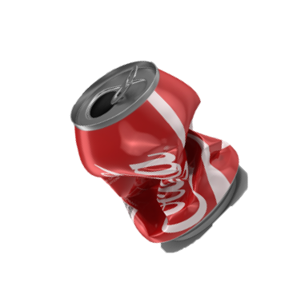
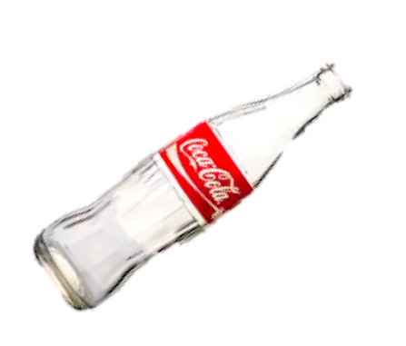
1
You might either recycle a soda can (1 point) or a soda bottle (3 points). And your payoff will appear while you are searching for the next trashcan.
3

Slide 14
1
1.2
Remember you are in a “multi-player” mode.
After your own payoff appears, the average payoff which the other six players accumulated in the same time period also appears
3
1.2

Slide 15


Task Starts
...
...
YOU
...
...
...
...
...
...
...
...
Notes:
To better explain how it works.
The beginning of your experiment is aligned with those of the other six players. When you has spent 10 min in this experiment, for example, the other six players also have spent 10 min in the experiment.
The specific trial structures can be different. Different players might take different actions and encounter different trashcans.

Slide 16
1
1.2
Task Starts
...
...
YOU
...
...
...
...
...
...
...
...
Notes:
When it comes to payoff, we show your payoff for a trial. The duration of a trial covers multiple processes. Specifically, it includes searching for a trashcan, deciding whether to recycle it and the recycling process.
The payoff you get for a trial is not a reward for a specific action. Instead, it is more like a reward for the entire time you spent in this trial.
Similarly, for the other six players, we show the average points they earned during the same period of time. In this example,

Slide 17
If you decide to forgo:
If you forgo (“D”) a trash can, the symbol turns red.
You don’t not spend any time recycling on the forgone trial yet you still need to wait until the blue bar disappears.

Slide 18
If you decide to forgo:
As soon as the blue bar disappears, you start searching the next trash can.
You don’t earn any reward in the forgone trial.
0
1.2

Slide 19
If you miss a trial:
If you don’t make the decision before the blue bar disappears entirely, you miss a trial.

Slide 20
If you miss a trial:
You will be penalized with a 2 point loss if you miss a trial.
-2
1.2

Slide 21
Summaries:
Recycle
Recycling
Decision
Your Payoff
Others’ Average
Forgo
Searching for a new trashcan

Slide 22
Summaries:
A fuller trashcan requires longer time to recycle.
To maximize rewards in the 40 mins, you should decide whether a trashcan is worth recycling based on how full it is.
You will be shown how many points you earned in each trial, along with the average number of points the other six players earned in the same time period.

Slide 23
Quiz:
1.Which trashcan is more worth to recycle:
A fuller one
A less fuller one

Slide 24
Practice:
You will go through several practice trials.
They only serve for demonstration purposes and are not related with the main experiment.

Slide 25


You and the other six players will search for and recycle trashcans in two different campuses.
You will all spend a 20-min block in each campus.
Campus 1
Campus 2

Slide 26
Block1
Block2
YOU
...

