Slide 1
Recycle Man
Don’t waste your time

Slide 2
You will complete a computer-based decision-making experiment today, which is called “Recycle Man”.
First, we will go through the instructions and do some practice. Then, the main experiment will take 40 mins.
With better decisions, you can earn more rewards in the 40 mins.

Slide 3
You receive $12 per hour as the baseline payment for participating.
In addition, for every 20 points you earn in the experiment, you receive extra $1.
Notes:
Add a little thing under
Put a little trashcan to on the processor bar.

Slide 4
In the “Recycle Man” experiment, the players search and recycle trashcans to earn rewards.
On each trial, you will spend some time searching for a trashcan and deciding whether to recycle it.
To recycle a trashcan, you need to empty the trash in it first. Different trashcans contain different amounts of trash. Emptying fuller trashcans takes more time.
After removing all the trash, you can find either a soda can which worth 1 point, or a soda bottle which worth 3 points.
Notes:
Add some information.

Slide 5
To maximize rewards in 40 mins, you shall decide whether a trashcan is worth recycling based on how full it is.

Slide 6

You start each trial by searching for a trashcan.
The shrinking blue bar indicates the elapsed time since you start searching.
The recycling marker indicates when the trashcan would pop up.

Slide 7
Once the blue bar reaches the recycling marker, a trashcan pops up.
The amount of trash is indicated by the grey bar.

Slide 8
You shall decide whether to recycle or forgo this trash can.
K: recycle
D: forgo
You have a fixed duration to make the decision.
You shall make the decision before the blue bar vanishes.

Slide 9
If you decide to recycle:
If you decide to recycle (“K”) the trash can, the symbol turns blue.
Noticeably, the recycling doesn’t start immediately after you make the decision!
Notes:
The decision making window is fixed.

Slide 10
If you decide to recycle:
The recycling starts after the blue bar disappears entirely.
As the recycling starts, the trash in the trashcan declines.
Once there is no trash in the trashcan, the recycling is completed.

Slide 11
If you decide to recycle:
Once the recycling is completed, the blue bar appears again, indicating that you start searching for the next trash can.

Slide 12
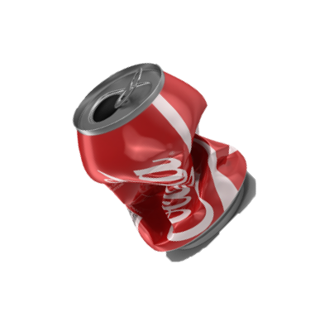
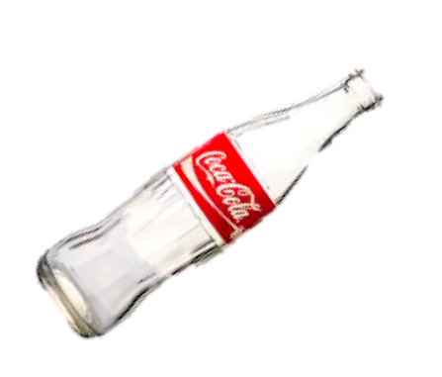
1
While searching for the next trashcan, the payoff for recycling the previous trashcan will appear.
You might either recycle a soda can (1 point) or a soda bottle (3 points).
3

Slide 13
Task Starts
YOU
...
...
Trial t - 1
Trial t
Trial t + 1
searching, deciding and recycling.
Notes:
On each trial, you get 1 / 3 points; or 0 if.
What does it mean.
A trial includes all processes we mentioned before. It includes the time for you to search for the trashcan, decide whether to recycle it, and complete the recycling if you determine to recycle it. And you get the payoff for the all these processes.
Trials are back to back

Slide 14
If you decide to forgo:
If you forgo (“D”) a trash can, the symbol turns red.
You don’t not spend any time recycling on the forgone trial yet you still need to wait until the blue bar disappears.

Slide 15
If you decide to forgo:
As soon as the blue bar disappears, you start searching the next trash can.
You don’t earn any reward in the forgone trial.
0

Slide 16
If you miss a trial:
If you don’t make the decision before the blue bar disappears entirely, you miss a trial.

Slide 17
If you miss a trial:
You will be penalized with a 2 point loss if you miss a trial.
-2

Slide 18
Summaries:
Recycle
Recycling
Decision
Feedback
Forgo
Searching for a new trashcan

Slide 19
Summaries:
A fuller trashcan requires longer time to recycle.
To maximize rewards in 40 mins, you shall decide whether a trashcan is worth recycling based on how full it is.
You can either find a soda can or soda bottle (1 pt. or 3 pt.).
Notes:
Emphasize it is not helpful to try to preidic the reward and

Slide 20
Quiz:
1.Which trashcan is more worth to recycle:
A fuller one
A less fuller one

Slide 21
Practice:
You will go through several practice trials.
They only serve for demonstration purposes and are not related with the main experiment.

Slide 22
The main experiment has two blocks, each with 20 mins.
In each block, you search for and recycle trashcans in different campuses.
In different campuses, the amount of trash in the trashcan differ. Consequently, the recycling time is different across blocks.

Slide 23
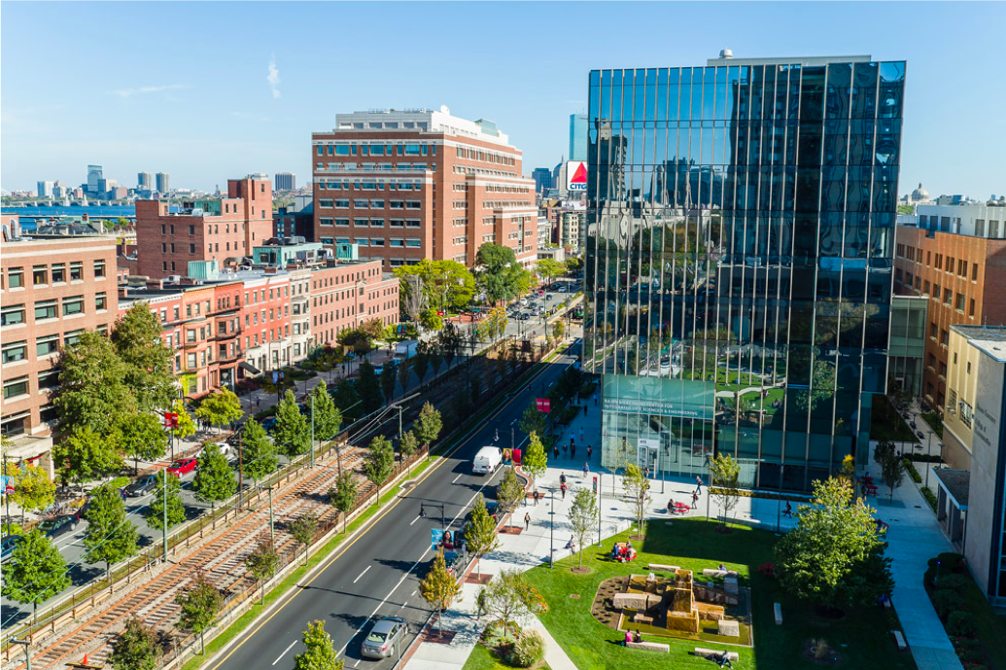
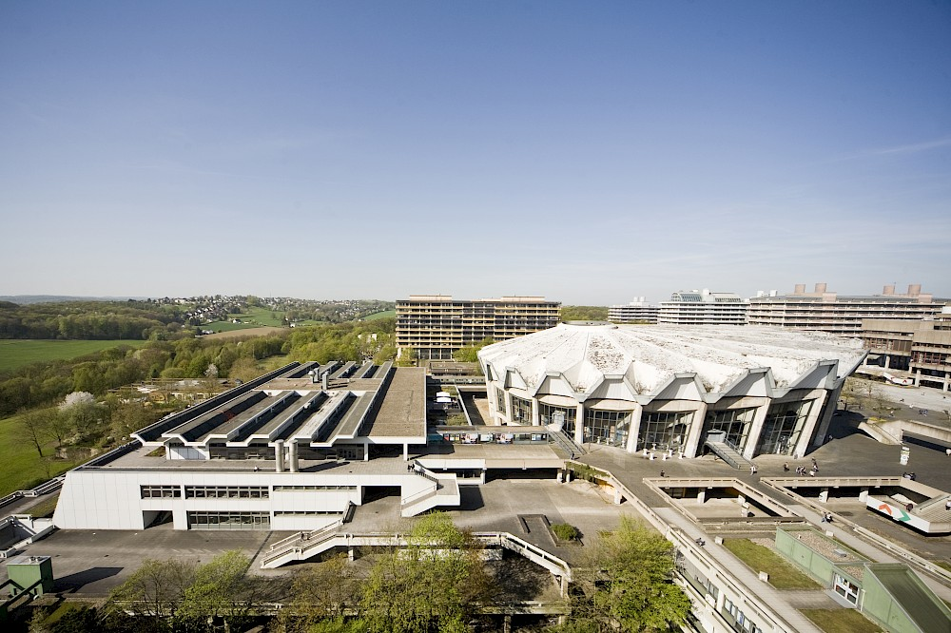
You can find the total points your earned and the remaining time in this block on the screen.
Earned:
Time left:
Earned:
Time left:
Campus 1
Campus 2

