Slide 1
Recycle Man
Don’t waste your time

Slide 2
The main experiment will take 40 mins.
You receive $12 per hour as the baseline payment for participating. In addition, for every 20 points you earn in the experiment, you receive extra $1.

Slide 3
Basic settings
You will be matched with another six players to play the “Recycle Man” experiment. This is how it works:
We recruited couples of participants previously. Each of them completed the “Recycle Man” experiment in a single-player mode.
We randomly choose six of them and match them with you.
When you are playing the experiment, the computer will reveal the performance by these six previous players in real time.
We aim to give you a “multi-player” game experience. You shall feel you are doing the experiment with six others, starting at the same time.
Notes:
Add some information.

Slide 4
Basic settings
Single-Player
Record
…
Time
Multi-Player
YOU
YOU
Play back in real time

Slide 5
“Recycle Man” Experiment
In the “Recycle Man” experiment, you search and recycle trashcans to earn rewards.
On each trial, you spend some time searching for a trashcan and deciding whether to recycle it.
To recycle a trashcan, you need to empty the trash in it first. Different trashcans contain different amounts of trash. Emptying fuller trashcans takes more time.
Your have 40 min in total to earn rewards. You shall decide whether a trashcan is worth recycling based on how full it is.

Slide 6
“Recycle Man” Experiment
After removing all the trash, you can find either a soda can which worth 1 point, or a soda bottle which worth 3 points.
When you complete the recycling, you will be presented how many points you earn in this trial, along with how many points the other six players earn on average.

Slide 7

You start each trial by searching for a trashcan.
The shrinking blue bar indicates the elapsed time since you start searching.
The recycling marker indicates when the trashcan would pop up.

Slide 8
Once the blue bar reaches the recycling marker, a trashcan pops up.
The amount of trash is indicated by the grey bar.

Slide 9
You shall decide whether to recycle or forgo this trash can.
K: recycle
D: forgo
You have a fixed duration to make the decision.
You shall make the decision before the blue bar vanishes.

Slide 10
If you decide to recycle:
If you decide to recycle (“K”) the trash can, the symbol turns blue.
Noticeably, the recycling doesn’t start immediately after you make the decision!
Notes:
The decision making window is fixed.

Slide 11
If you decide to recycle:
The recycling starts after the blue bar disappears entirely.
As the recycling starts, the trash in the trashcan declines.
Once there is no trash in the trashcan, the recycling is completed.

Slide 12
If you decide to recycle:
Once the recycling is completed, the blue bar appears again, indicating that you start searching for the next trash can.

Slide 13
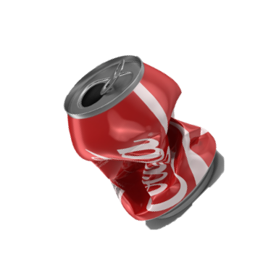
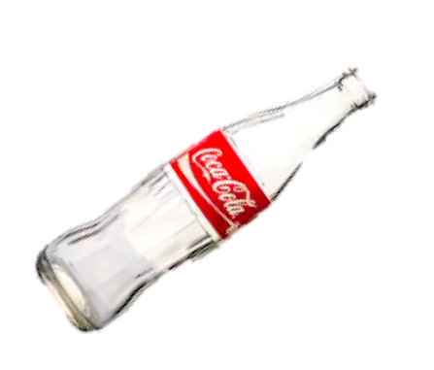
1
You might either recycle a soda can (1 point) or a soda bottle (3 points). And your payoff will appear while you are searching for the next trashcan.
3

Slide 14
1
1.2
Remember you are in a “multi-player” mode.
After your own payoff appears, the average payoff which the other six players accumulate during the last trial also appears
3
1.2

Slide 15
Task Starts
YOU
...
...
Trial t - 1
Trial t
Trial t + 1
searching, deciding and recycling.
Notes:
The very beginning of your experiment is aligned with the other six players. Your timelines are nicely synchronized. For example, when you spend 10 min in this experiment, you can assume the other six players also spend 10 min in the experiment and you all have 30 min to go.
You go through trials back to back. A trial includes all processes we mentioned before. It includes the time for you to search for the trashcan, decide whether to recycle it, and complete the recycling if you determine to recycle it. And you get the payoff for the all these processes.
The other six players get rewards for that period of time as well, so that

Slide 16
Task Starts
3
YOU
...
...
Trial t - 1
Trial t
Trial t + 1
searching, deciding and recycling.

Slide 17
If you decide to forgo:
If you forgo (“D”) a trash can, the symbol turns red.
You don’t not spend any time recycling on the forgone trial yet you still need to wait until the blue bar disappears.

Slide 18
If you decide to forgo:
As soon as the blue bar disappears, you start searching the next trash can.
You don’t earn any reward in the forgone trial.
0
1.2

Slide 19
If you miss a trial:
If you don’t make the decision before the blue bar disappears entirely, you miss a trial.

Slide 20
If you miss a trial:
You will be penalized with a 2 point loss if you miss a trial.
-2
1.2

Slide 21
Summaries:
Recycle
Recycling
Decision
Your Payoff
Others’ Average
Forgo
Searching for a new trashcan

Slide 22
Summaries:
A fuller trashcan requires longer time to recycle.
To maximize rewards in 40 mins, you shall decide whether a trashcan is worth recycling based on how full it is.
You can either find a soda can or soda bottle (1 pt. or 3 pt.).
Notes:
Emphasize it is not helpful to try to preidic the reward and

Slide 23
Quiz:
1.Which trashcan is more worth to recycle:
A fuller one
A less fuller one

Slide 24
Task
In the “Recycle Man” experiment, you search and recycle trashcans to earn rewards.
Notes:
Add some information.

Slide 25
Task
On each trial, you spend some time searching for a trashcan and deciding whether to recycle it.
To recycle a trashcan, you need to empty the trash in it first. Different trashcans contain different amounts of trash. Emptying fuller trashcans takes more time.
After removing all the trash, you can find either a soda can or a soda bottle.

Slide 26
Task
At the end of each trial, you will be notified how many rewards you earn in the trial. A soda can will give you 1 point and a soda bottle will give you 3 points.
You will also be notified how many rewards the other six players obtain on average during the same period of time.

Slide 27
You start each trial by searching for a trashcan.
The shrinking blue bar indicates the elapsed time since you start searching.
The recycling marker indicates when the trashcan would pop up.

Slide 28
Once the blue bar reaches the recycling marker, a trashcan pops up.
The amount of trash is indicated by the grey bar.

Slide 29
You shall decide whether to recycle or forgo this trash can.
K: recycle
D: forgo
You have a fixed duration to make the decision.
You shall make the decision before the blue bar vanishes.

Slide 30
If you decide to recycle:
If you decide to recycle (“K”) the trash can, the symbol turns blue.
Noticeably, the recycling doesn’t start immediately after you make the decision!
Notes:
The decision making window is fixed.

Slide 31
If you decide to recycle:
The recycling starts after the blue bar disappears entirely.
As the recycling starts, the trash in the trashcan declines.
Once there is no trash in the trashcan, the recycling is completed.

Slide 32
If you decide to recycle:
Once the recycling is completed, the blue bar appears again, indicating that you start searching for the next trash can.

Slide 33
1
While searching for the next trashcan, the payoff for recycling the previous trashcan will appear.
You might either recycle a soda can (1 point) or a soda bottle (3 points).
3

Slide 34
If you decide to forgo:
If you forgo (“D”) a trash can, the symbol turns red.
You don’t not spend any time recycling on the forgone trial yet you still need to wait until the blue bar disappears.

Slide 35
If you decide to forgo:
As soon as the blue bar disappears, you start searching the next trash can.
You don’t earn any reward in the forgone trial.
0

Slide 36
If you miss a trial:
If you don’t make the decision before the blue bar disappears entirely, you miss a trial.

Slide 37
If you miss a trial:
You will be penalized with a 2 point loss if you miss a trial.
-2

Slide 38
Summaries:
Recycle
Recycling
Decision
Feedback
Forgo
Searching for a new trashcan

Slide 39
Summaries:
A fuller trashcan requires longer time to recycle.
To maximize rewards in 40 mins, you shall decide whether a trashcan is worth recycling based on how full it is.
You can either find a soda can or soda bottle (1 pt. or 3 pt.).
Notes:
Emphasize it is not helpful to try to preidic the reward and

Slide 40
Quiz:
1.Which trashcan is more worth to recycle:
A fuller one
A less fuller one

Slide 41
Practice:
You will go through several practice trials.
They only serve for demonstration purposes and are not related with the main experiment.

Slide 42
The main experiment has two blocks, each with 20 mins.
In each block, you search for and recycle trashcans in different campuses.
In different campuses, the amount of trash in the trashcan differ. Consequently, the recycling time is different across blocks.

Slide 43
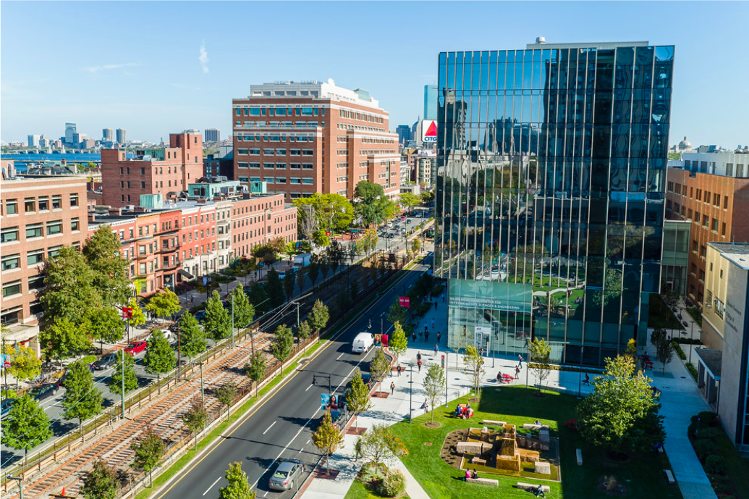
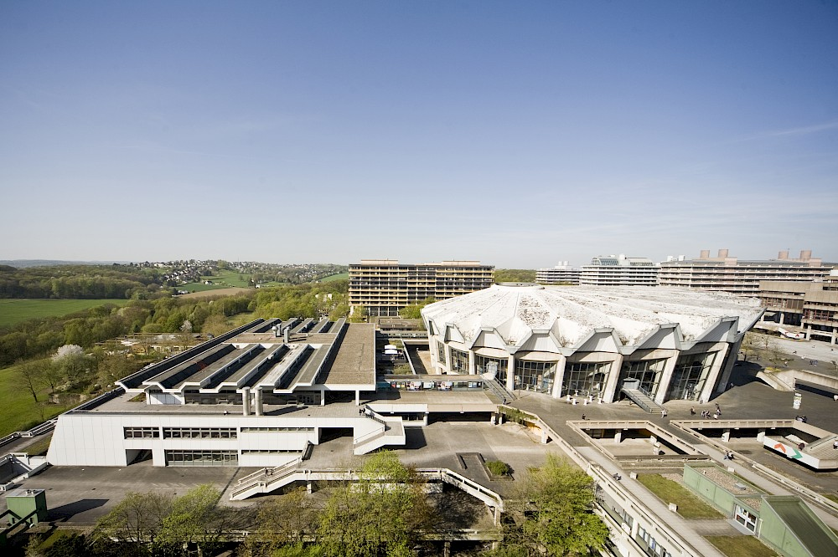
You can find the total points your earned and the remaining time in this block on the screen.
Earned:
Time left:
Earned:
Time left:
Campus 1
Campus 2

