Slide 1
Do Variabilities in Interval Timing Explain Individual Differences in Calibration Success When Pursuing Uncertain Future Rewards
Tiantian Li
Cognition and decision lab
Advisor: Joe mcguire

Slide 2
Deciding how long to keep waiting for future rewards is a nontrivial problem in our everyday life, especially when the timing of rewards is uncertain.

Slide 3
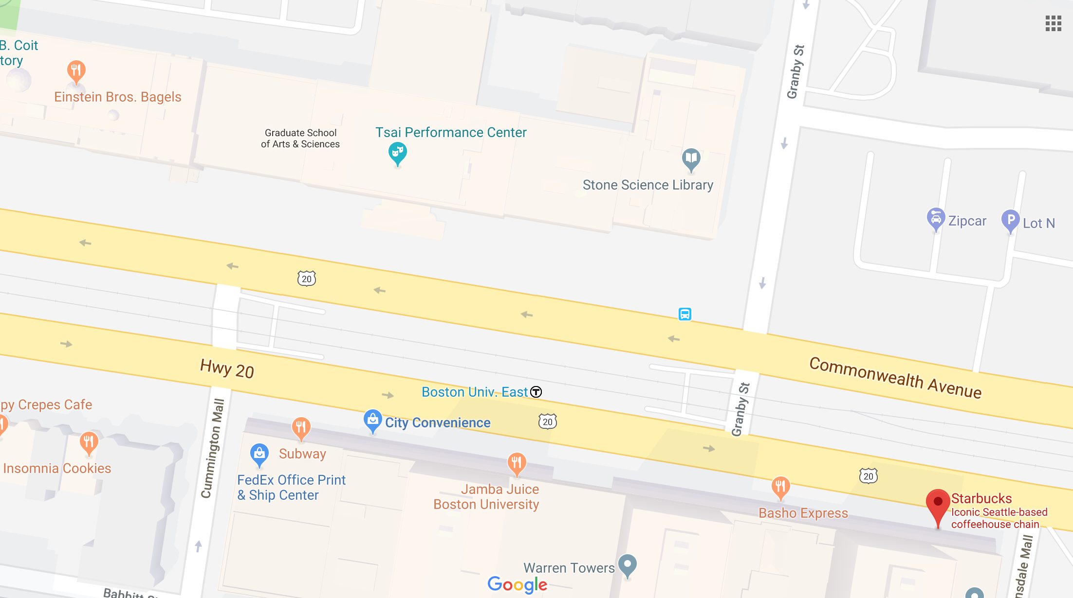
Imagine…

Slide 4
Background
Self control == key to success?
However, in some situations that seem to challenge self control, infinitely waiting for rewards with uncertain delay might not be an efficient strategy (Rachlin, 2000; Dasgupta and Maskin, 2005)
Waiting in line for coffee, waiting for public transportation, finding a weight loss strategy...
Whether to sustain or curtail persistence is a crucial decision to make in these situations

Slide 5
Background
Traditionally, it is believed that persistence toward future rewards relies on a classical dual system in which self-regulatory psychological processes compete with and override impulsive, reward-sensitive processes. ((Casey et al, 2011; Heatherton and Wagner, 2011)
However, previous study has shown that one way to navigate situations with uncertain future rewards is to dynamically update one’s belief on the subjective value of the awaited rewards as time passes (McGuire and Kable, 2013).
BOLD activity in VMPFC during persistence tasks suggests that delay-of-gratification decisions are more likely to depend on a dynamic reappraisal of awaited future reward. (McGuire and Kable, 2015)

Slide 6
Background
The dynamic update of one’s belief on the subjective value of the awaited rewards depends on many factors
Decision makers’ estimate of reward timing
Decision makers need to dynamically update their belief of the remaining delay in order to adaptively calibrate persistence

Slide 7
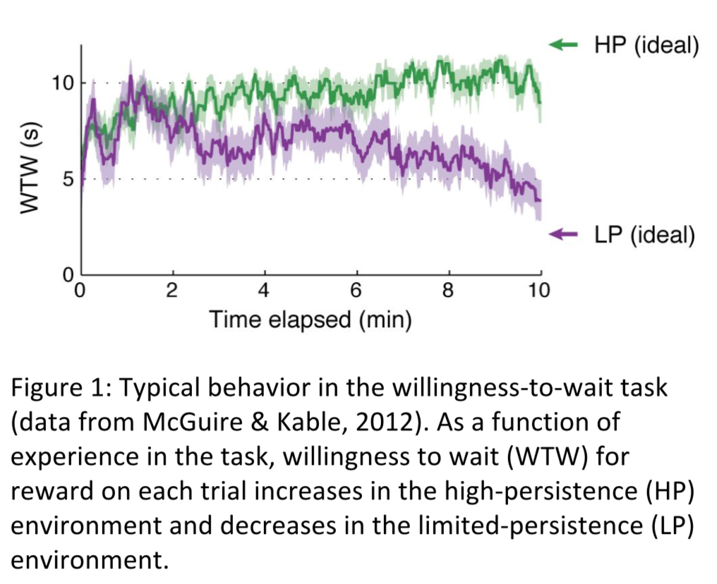
Background
Previous research showed that without knowing reward timing distribution upon entering an environment, decision makers are able to adapt to higher persistence if it is advantageous to wait longer or to lower persistence if it is advantageous to quit earlier. ​(McGuire and Kable, 2012)
However, despite this calibration, human subjects still struggle to reach the optimal waiting behavior (​McGuire and Kable, 2012)​
Reasons behind this non-optimal adaptation remains unclear.

Slide 8
Background
The optimality of human behaviors has been widely studied in the field of psychology and economics.
Human perception and memory are the two systems that can effectively approximate optimal statistical inference (Geisler, Perry, Super, and Gallogly, 2001; Weiss, Simoncelli, and Adelson, 2002; Körding and Wolpert, 2004;)
Cognitive judgments under uncertainty are often considered to be error-prone and less optimal (Griffiths and Tenenbaum, 2006)
Therefore, it is of this study’s interest to understand the reasons behind the non-optimality of these cognitive judgments, specifically decision making when pursuing uncertain future rewards.

Slide 9
Background
We observe differences in calibration success and performance in pursuing uncertain future rewards across individual
To gain insight on this optimality problem
What makes someone better at calibrating persistence to pursue uncertain future rewards?
Temporal beliefs.
Hypothesis: A more accurate reward timing estimate will be able to promote more optimal persistence behavior.

Slide 10
Background
If some individuals are equipped with stronger ability to understand time
Can we possibly relate timing ability to a known cognitive system that captures individual differences in behavior?
If so, perhaps training on this cognitive system can improve timing estimation ability, hence improve persistence behaviors.

Slide 11
Background
Previous research argued for a functional interaction between time and numbers in the cognitive system (Oliveri et al, 2008).
One of the most established systems that is thought to well capture individual differences is the Approximate Number System (ANS).
ANS describes people’s ability to distinguish between non-symbolic numerical magnitudes without counting
People with higher ANS acuity is believed to have better numeric ability, and individuals with greater numeric ability tend to perform better on decision making tasks. (Peters, 2012; Peters, Hart, Tusler, and Fraenkel, 2014;)

Slide 12
Hypothesis summary
ANS acuity can capture individuals’ ability in timing estimation.
Individuals with more accurate reward timing estimate show more optimal persistence behavior.
Individuals with higher ANS acuity perform more accurately for timing task.

Slide 13
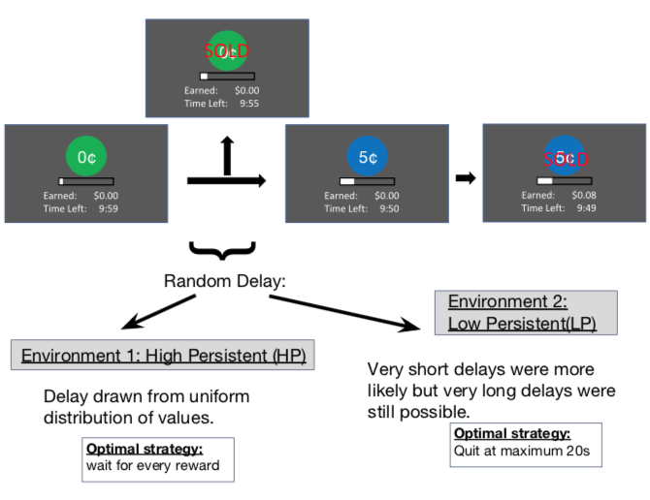
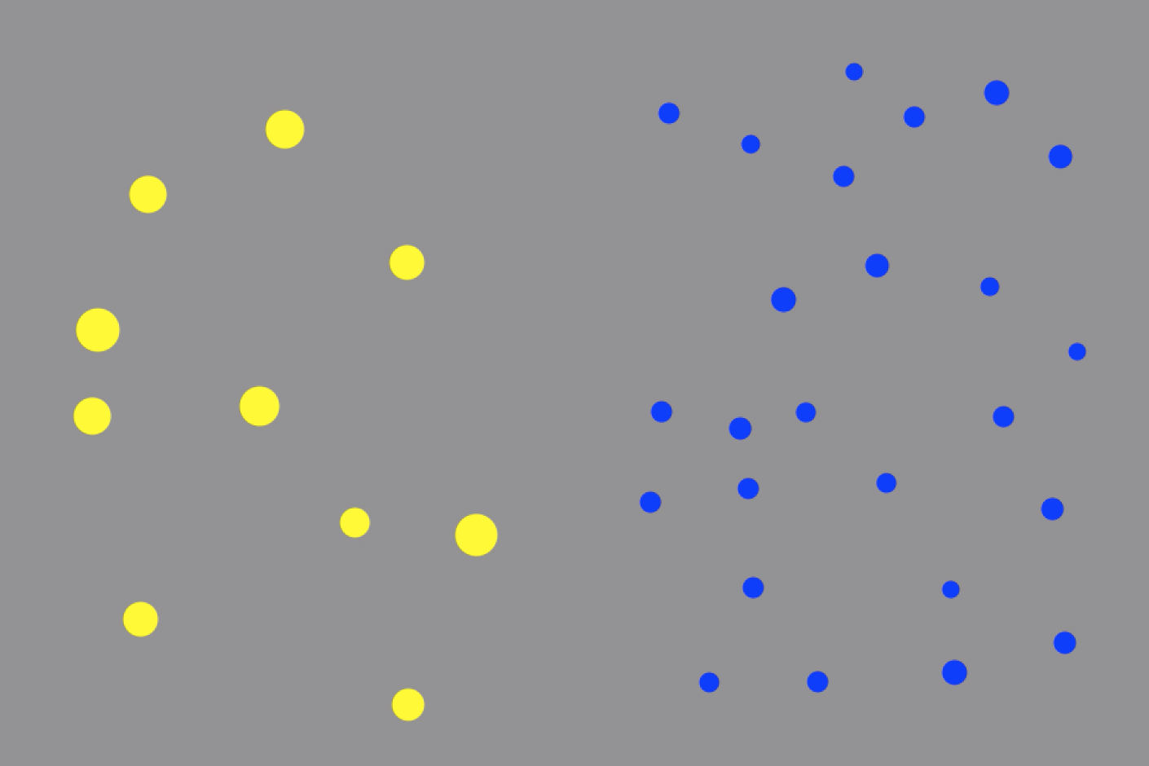
Task
ANS task
Willingness-to-Wait task
Timing estimation task
Direct estimation of reward timing during WTW task. No monetary reward.
Notes:
2 panels presented simultaneously. We constructed the dot collections by controlling two main factors: The ratio between the numbers of dots in each collection (i.e., the discrete dimension) and the ratio between the summed area occupied by each collection (i.e., the continuous dimension). Five different ratios (1/2, 3/5, 2/3, 3/4, 8/9) were used for both dimensions. The number of dots in a collection ranged from 30 to 60 for half of the stimuli, and from 50 to 100 for the other half. The dot size varied within each collection to prevent it to be used as a cue to numerosity, and dot positions were randomly generated without overlap. Cumulative area varied between 12.5% and 25% of the area of the background square.
By varying orthogonally the numerical ratio and the physical ratio, we manipulated the congruity between the number of dots and their cumulative area, giving rise to four different sets of stimuli, with four items for each ratio in each set. Number and cumulative area were positively related in a first congruent set of trials (n = 100), so that the most numerous array also had the largest area. In a second incongruent set (n = 100), number and cumulative area were negatively related to each other, so that the most numerous collection had the smallest area. In a third, same-area set (n = 20), the number of dots varied whereas the cumulative area was maintained equal in the two collections. In a fourth same-number set (n = 20), cumulative area varied whereas the number of dots was the same in each collection. Finally, the four pairs that were identical for both dimensions were included in the stimulus set but were not further analyzed.

Slide 14
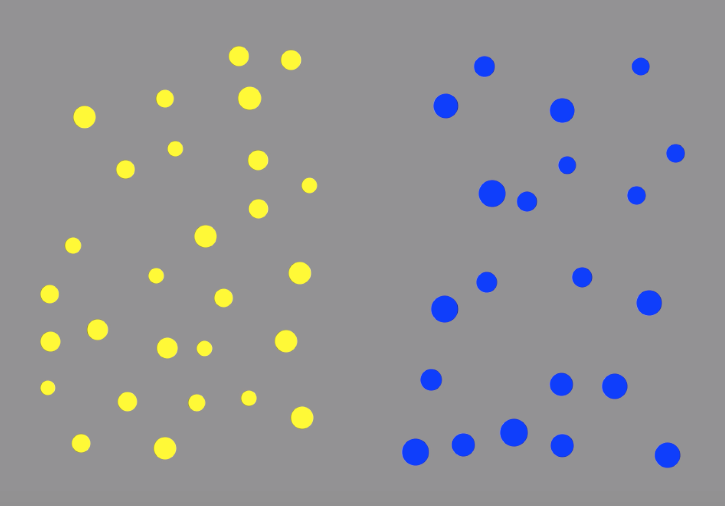
Task (n= 42 - 4)
ANS task
Willingness-to-Wait task
Timing estimation task
Notes:
2 panels presented simultaneously. We constructed the dot collections by controlling two main factors: The ratio between the numbers of dots in each collection (i.e., the discrete dimension) and the ratio between the summed area occupied by each collection (i.e., the continuous dimension). Five different ratios (1/2, 3/5, 2/3, 3/4, 8/9) were used for both dimensions. The number of dots in a collection ranged from 30 to 60 for half of the stimuli, and from 50 to 100 for the other half. The dot size varied within each collection to prevent it to be used as a cue to numerosity, and dot positions were randomly generated without overlap. Cumulative area varied between 12.5% and 25% of the area of the background square.
By varying orthogonally the numerical ratio and the physical ratio, we manipulated the congruity between the number of dots and their cumulative area, giving rise to four different sets of stimuli, with four items for each ratio in each set. Number and cumulative area were positively related in a first congruent set of trials (n = 100), so that the most numerous array also had the largest area. In a second incongruent set (n = 100), number and cumulative area were negatively related to each other, so that the most numerous collection had the smallest area. In a third, same-area set (n = 20), the number of dots varied whereas the cumulative area was maintained equal in the two collections. In a fourth same-number set (n = 20), cumulative area varied whereas the number of dots was the same in each collection. Finally, the four pairs that were identical for both dimensions were included in the stimulus set but were not further analyzed.

Slide 15

ANS Task
Settings adopted from Chesney et al, 2015.
display.times = 200
numerosity.ratio.ranges (n=13) = (1.049,1.067) (1.114,1.131) (1.187,1.201) (1.24,1.264) (1.317,1.353) (1.39,1.425) (1.49, 1.51) (1.57,1.601) (1.65,1.701) (1.76,1.815) (1.85,1.92) (1.99,2.01) (2.41,2.61)
num.dots.range = (10,30)

Slide 16
Timing Task
next
+
+
firstTime | secondTime
0.7 | 1.4
2.5 | 1.5
1.2 | 1.8
3.3 | 4.4
9.9 | 8.8
1.8 | 0.9
2.1 | 3.5
2.7 | 1.8
2.8 | 2.1
3.2 | 3.6
1.4 | 0.7
1.5 | 2.5
1.8 | 1.2
4.4 | 3.3
8.8 | 9.9
0.9 | 1.8
3.5 | 2.1
1.8 | 2.7
2.1 | 2.8
3.6 | 3.2
next
Stimuli delay ratio adopted from Guillaume et al., 2013.
10 different ratios (1/2, 3/5, 2/3, 3/4, 8/9) & reverse.
20 sets of stimuli per block x4
Notes:
Pwr power analysis how many subjects will produce powerful outcome?
Pwr.r.test in r (n=40, power=.8)
Other example ANS acuity relate to something
Recruiting, make a manual for task instruction
Alison mackey Penn changing brain
Anna schapiro penn

Slide 17
Results

