Slide 1
Artificial Neural Networks

Slide 2
Learning Outcomes
Examine the basic principles of artificial neural networks.
Discuss the operation of the Multi Layer Perceptron through the use of suitable examples.
Discuss the derivation of the weight update formula through the use of backpropagation.

Slide 3
Neural Networks
Biologically inspired family of algorithms that is inspired by the human brain
Neural Networks are used for classification, clustering and numeric prediction tasks.
Most popular types are
Multi Layer Perceptron (MLP) used for classification
Radial Basis Function (RBF) used for classification and numeric prediction
Self Organizing Map (SOM) used for clustering
Convolutional Neural Network (CNN)used for image classification
Long Short Term Memory (LSTM) used for modelling time series

Slide 4
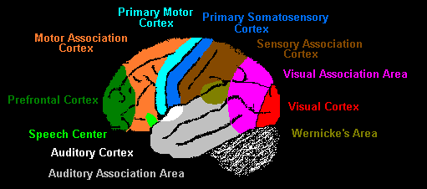
Sensory Areas of the Human Brain

Slide 5
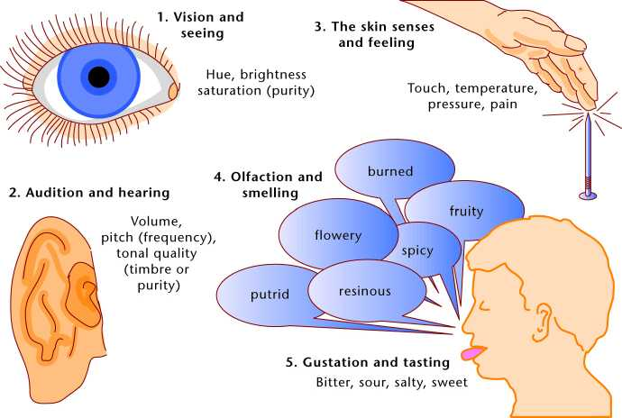
Brain performs classifications, predictions and associations

Slide 6
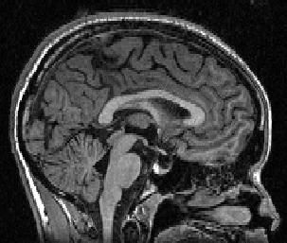
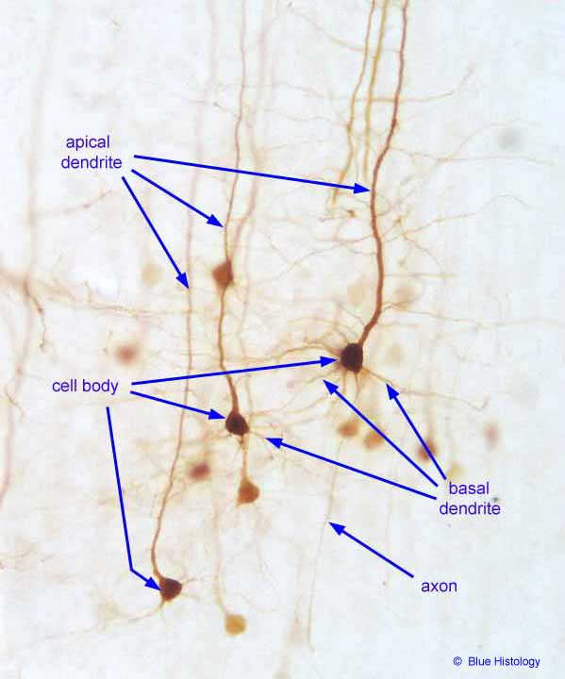
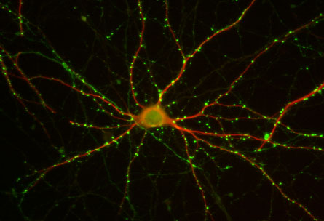
Neural Networks
Huge connectivity: each neuron sends and receives 10⁴ of synapses (contacts)
Huge complexity
10¹¹ of neurons in the brain

Slide 7
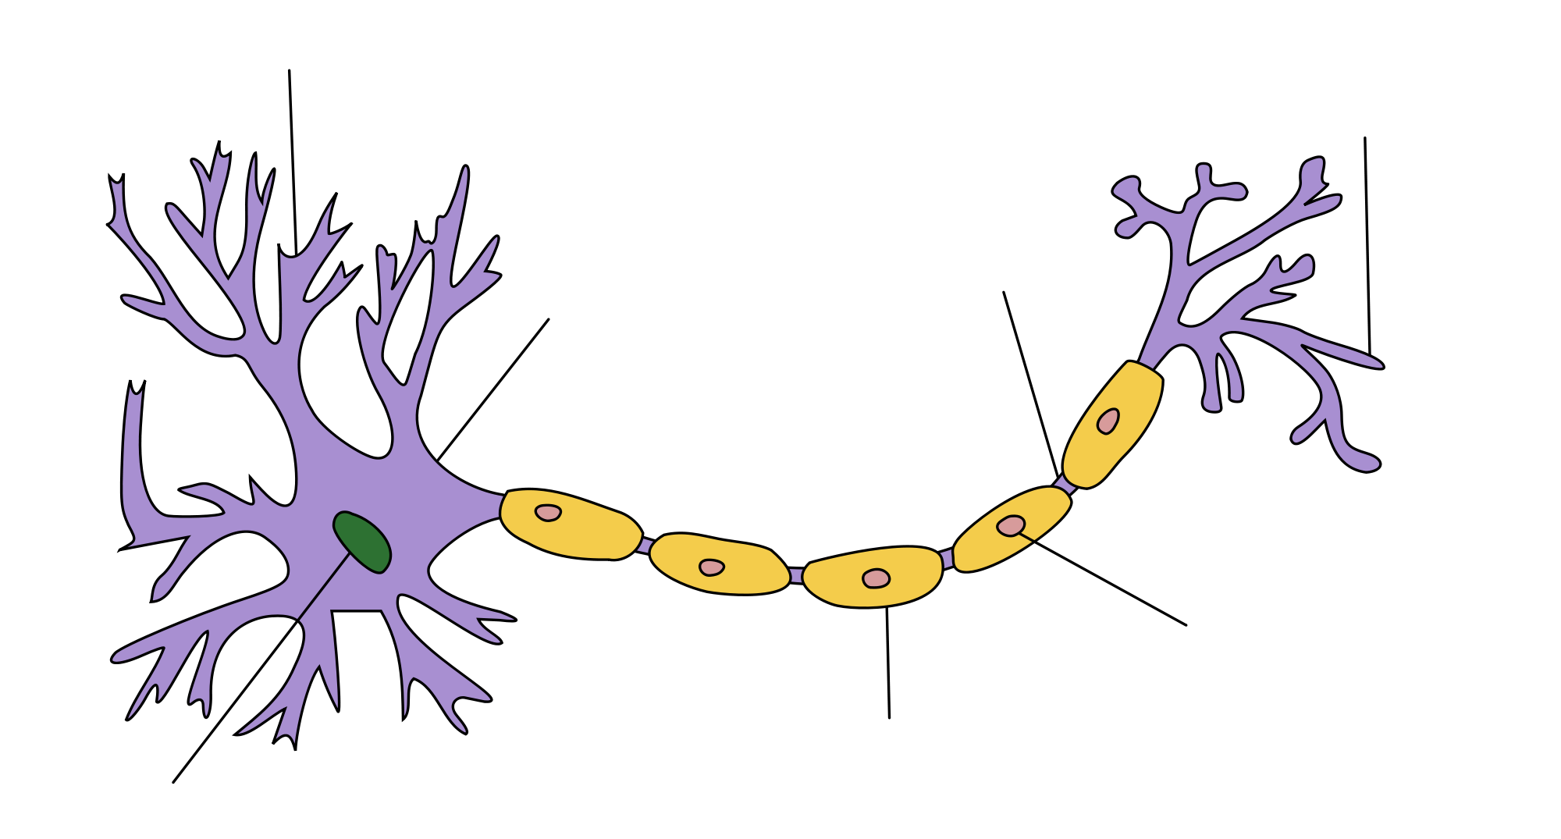
Neuron Interconnectivity

Slide 8
Artificial Neural Networks (ANN)
Output Y is 1 if at least two of the three inputs are equal to 1.

Slide 9
Artificial Neural Networks (ANN)

Slide 10
Artificial Neural Networks (ANN)
Model is an assembly of inter-connected nodes and weighted links
Output node sums up each of its input value according to the weights of its links
Compare output node against some threshold t
Perceptron Model
or

Slide 11
Limitations of Simple Perceptrons
Simple perceptrons can be used to classify problems which are linearly separable
For such problems a single line can be drawn which separates the two classes with zero (or near zero) error

Slide 12
Limitations of Simple Perceptrons
However simple perceptrons cannot solve non linear classification problems such as the XOR problem
These types of problems can only be solved by adding another layer (called the hidden layer) of neurons to the network

Slide 13
General Structure of ANN
Training ANN means learning the weights of the neurons

Slide 14
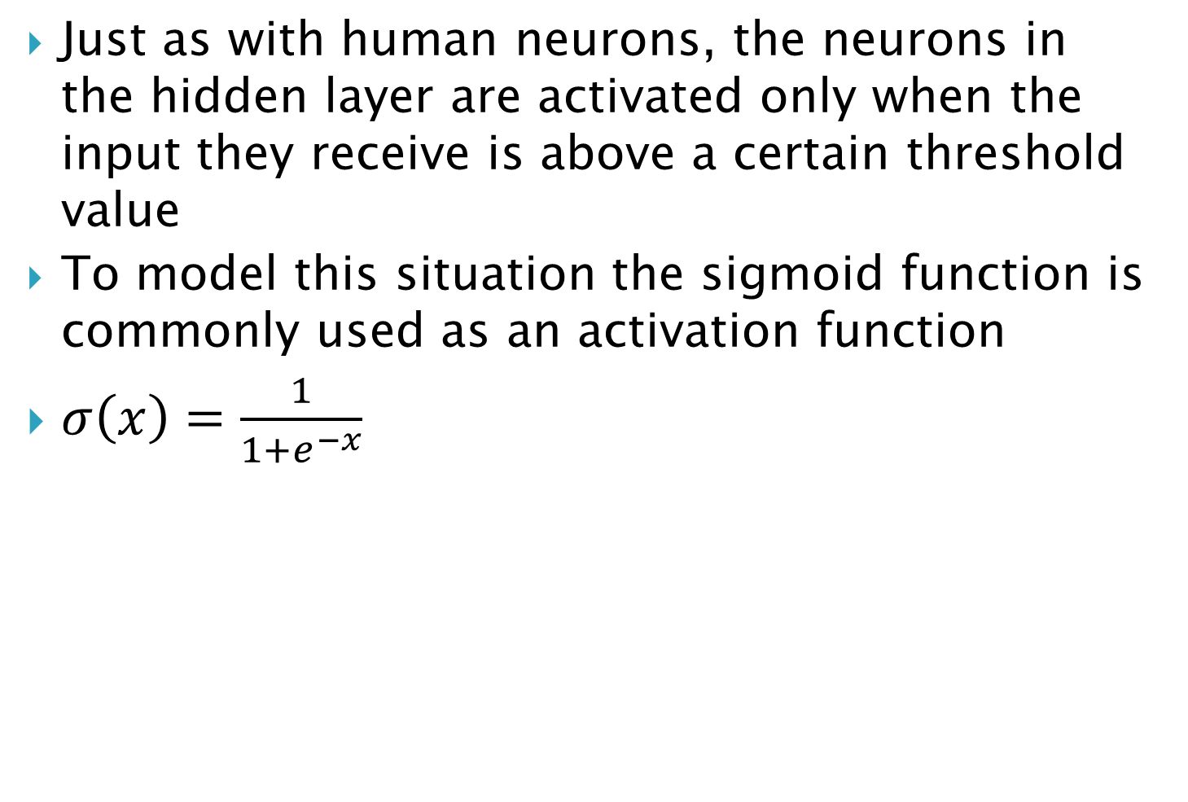
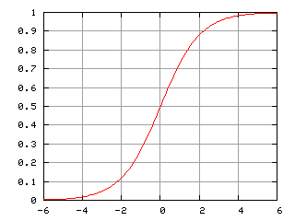
Activation Functions

Slide 15
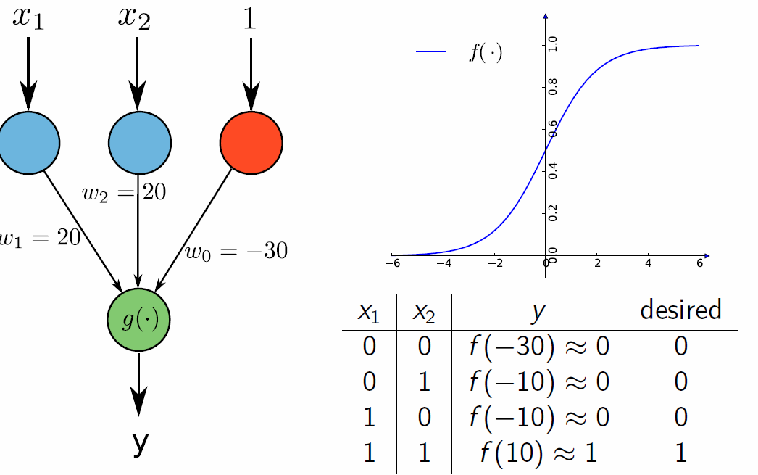
Solving the Logical AND Problem
In this and the next 4 slides the functions f and the sigmoid are one and
the same

Slide 16
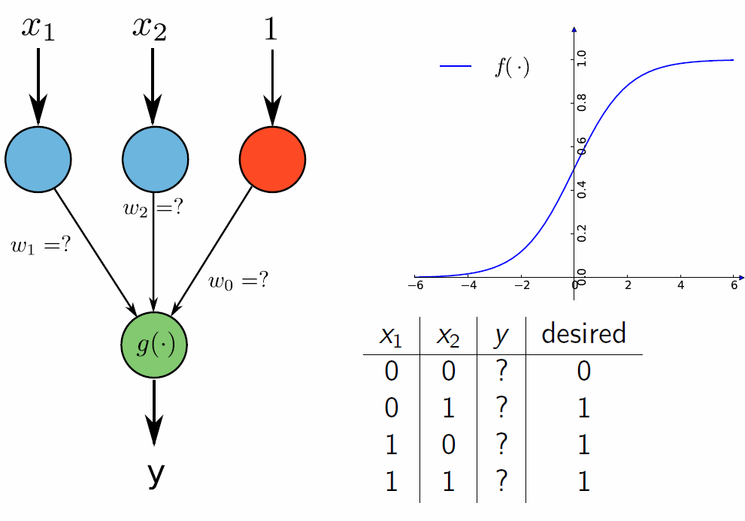
Solving the Logical OR Problem

Slide 17
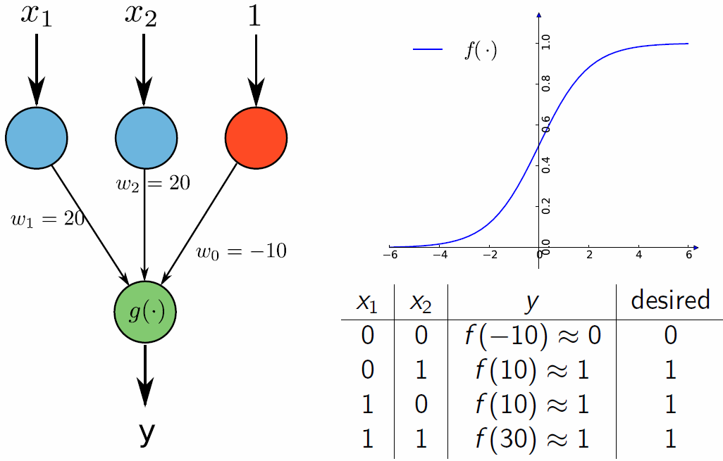
Solving the Logical OR Problem

Slide 18
Solving the Logical XNOR Problem
The XNOR problem is more difficult than the logical AND problem.
It cannot be solved by a single neuron as it is a 2 stage process
(X1 XNOR X2) = a1 OR a2 where a1=(X1 AND X2) and a2=(NOT X1 AND NOT X2)
This can be seen from the following truth table
X1 | X2 | a1 | a2 | a1 OR a2 | X1 XNOR X2
0 | 0 | 0 | 1 | 1 | 1
0 | 1 | 0 | 0 | 0 | 0
1 | 0 | 0 | 0 | 0 | 0
1 | 1 | 1 | 0 | 1 | 1

Slide 19
Neural Net for Solving the Logical XNOR Problem
a1 and a2 can be computed in parallel and so 2 neurons can be assigned to do the computation in the hidden (intermediate layer).
1
1
-30
-10
-30
20
a1
20
y
20
20
20
20
a2

Slide 20
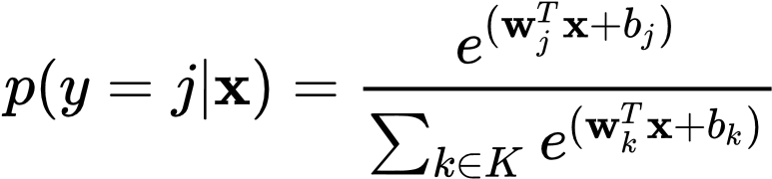
Solving classification problems with Softmax
Classification problems involving more than two classes are solved through the Softmax function which is implemented as an additional layer
hidden
hidden
logits
apple: yes/no?
bear: yes/no?
candy: yes/no?
dog: yes/no?
egg: yes/no?
Softmax

Slide 21
General Algorithm for learning ANN
Initialize the weights (w₀, w₁, …, w_{k})
Compute the error at each output node (k), and the hidden node (j) connected to it.
Now adjust the weights w_{jk} such that
w_{jk}(new) = w_{jk}(current)+Δw_{jk}
where Δw_{jk}=rError(k)O_{j}
r = learning rate parameter (0<r<1)
Error(k) = the computed error at node k
O = output of node j

Slide 22
Algorithm for learning ANN
Thus it can be seen that the observed errors are used to adjust the weights so that the overall error is minimized
For example if the desired output at node k is 1 and the actual output is 1.2, then the error = (1-1.2)=-.2, so we need to decrease the weight of all incoming links starting from all nodes (e.g. j1, j2) that feed into node k
The weight adjustment process is done iteratively until the error is below some specified threshold – this will involve scanning the data many times over
j₁
w_{j1k}
k
actual = 1.0, observed =1.2
j₂
w_{j2k}

Slide 23
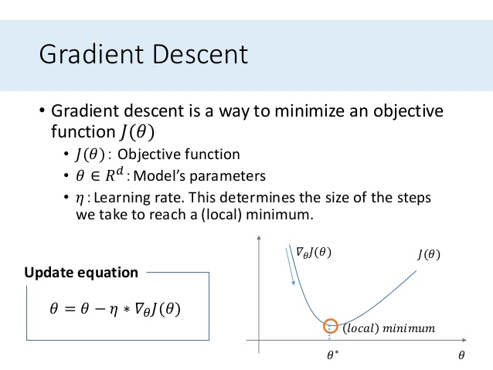
Backpropagation learning
A rigorous derivation of the weight update expression using the method of gradient descent available from: backprop.pdf
Gradient descent is a commonly used for minimizing a function

Slide 24
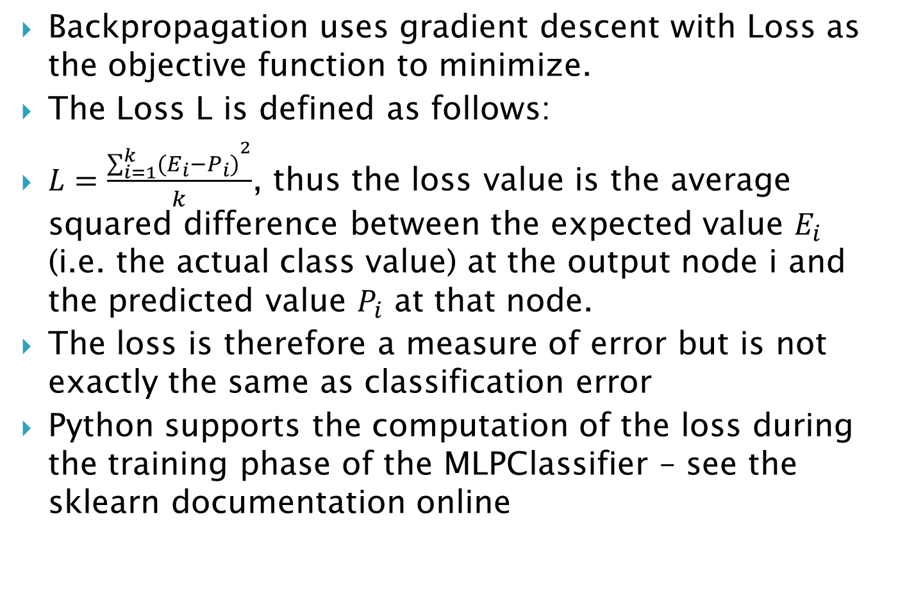
The Loss function in Backpropagation Learning

Slide 25
Major Parameters for Multi Layer Perceptrons
Learning rate – this determines the size of the “steps taken” in the weight adjustment process – larger steps means learning takes place quicker but accuracy may suffer
Number of epochs – the number of times that the training dataset is scanned – larger the value the more accurate the model (generally 100 or more)
The number of hidden neurons used – generally chosen as (attributes+classes)/2
Momentum – some implementations add a term called the momentum to the current weight – this is a small fraction of the update value from the previous iteration; the momentum makes the learning process smoother

Slide 26
Neural Networks - Strengths
Neural Nets work well with datasets containing noise
Have consistently good accuracy rates across several domains
Can be used for both supervised (classification and numeric prediction) as well as unsupervised learning

Slide 27
Neural Networks - Weaknesses
Lack the ability to explain their behaviour (unlike Decision Trees and Naïve Bayes)
In some cases, overtraining can cause over fitting
With large datasets training time can be large – very much larger than the Decision Tree and Naïve Bayes methods

Slide 28
Neural Network Applications
In general can be used for classification as well as for numeric prediction
For classification has been used for recognizing both printed and handwritten digits
For numeric prediction has been used for forecasting time series such as weather data (temperature, pressure, wind speed, etc), stock market prices, etc.
Neural Network handwritten recognition:
http://myselph.de/neuralNet.html
http://www.sund.de/netze/applets/BPN/bpn2/ochre.html
Neural Nets play Pong:
http://www.youtube.com/watch?v=LD6OgKEj5JE

