Slide 1
Project Presentation of CO-OP Project at Industry (Module-2) (22CS421)
CHITKARA
UNIVERSITY
On
AI-Native Development Platforms
vs Traditional IDEs:
Impact of Agentic AI on Software Engineering
Harshita
B.E. Computer Science and Engineering
Supervised By
Dr Shyam Goyal , Chitkara University
Department of Computer Science and Engineering, Chitkara University, Punjab

Slide 2
Introduction
CHITKARA
UNIVERSITY
The AI Shift in Software Development
Large language models have fundamentally changed how software is written — but controlled comparisons are lacking.
Industry Context:
• Gartner (2025): most business apps will use low-code tools
• GitHub survey: ~97% of US devs use AI assistants; many report 50%+ time savings
The Gap:
No prior study compares manual, Copilot-assisted, and fully agentic workflows on identical projects with objective log instrumentation.
2

Slide 3
Research Objectives
CHITKARA
UNIVERSITY
RQ1
Time-to-MVP & Setup
How do W1, W2, W3 differ in time-to-MVP and setup time across simple and complex projects?
RQ2
Code Quality
How do the three workflows compare in bug density (defects/100 LOC) and code throughput (LOC/hr)?
RQ3
Verification Overhead
How much workflow time is spent verifying AI code? What caused the overhead — code errors or environment issues?
RQ4
Developer Role Shift
What new roles emerge when developers shift from writing code to orchestrating agents?
3

Slide 4
Methodology
CHITKARA
UNIVERSITY
W1 — Manual
W2 — Copilot
W3 — Claude (Agentic)
VS Code, no AI assistance. Full developer control. Used as control baseline.
VS Code + GitHub Copilot. Developer controls architecture; AI suggests completions.
Natural language prompts only. Claude plans, writes, and refines. Developer verifies.
Two Benchmark Projects:
Todo List App — Basic CRUD, localStorage, responsive UI (simple scope) E-Commerce Site — Product catalog, cart, checkout, JWT auth, Supabase (complex)
All 6 runs on identical hardware: Intel Core i5, 16GB RAM, Fedora Linux, Node.js v24.14.0
Key Metrics Tracked:
T_setup • T_mvp • LOC/hr • Debug cycles • Bug density (/100 LOC) • Verification overhead (%) • Agentic trace • CLI log
4

Slide 5
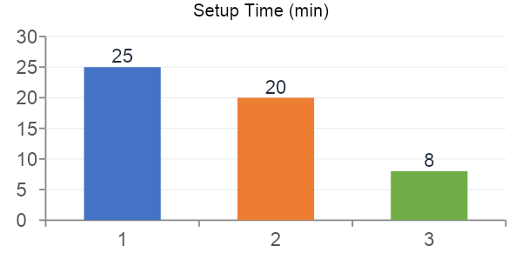
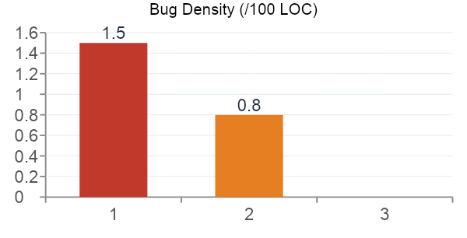
Results — Todo List App
CHITKARA
UNIVERSITY
Metric | W1 Manual | W2 Copilot | W3 Claude
T_mvp (hrs) | 1.75 | 0.80 | 0.58
LOC / hr | 102 | 224 | ~1,017
Debug cycles | 4 | 2 | 1
Verification % | 12% | 22% | ~40%
5

Slide 6
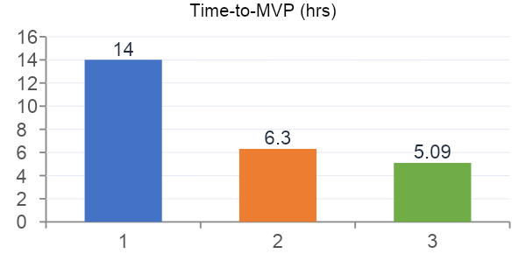
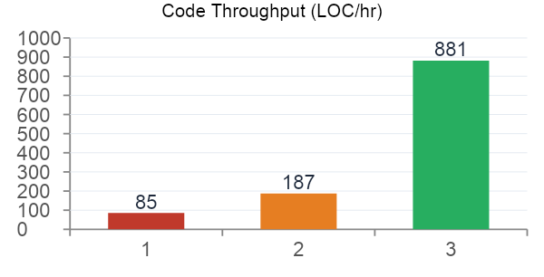
Results — E-Commerce Website
CHITKARA
UNIVERSITY
Metric | W1 Manual | W2 Copilot | W3 Claude
T_setup (min) | 45 | 35 | 15
Debug cycles | 8 | 5 | 4
Bug density (/100 LOC) | 2.5 | 1.6 | 0.5
Verification % | 13% | 24% | 35%
6

Slide 7
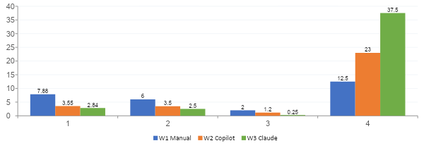
Aggregate Results — Both Projects
CHITKARA
UNIVERSITY
−64%
+915%
−88%
+200%
Time-to-MVP
LOC/hr
Bug Density
Verif. Overhead
7

Slide 8
Agentic Trace & Verification Overhead
CHITKARA
UNIVERSITY
Key Finding: Overhead is Environment-Driven, Not Code-Quality-Driven
# | Action | Time | Type
1 | Upload research + scaffold prompt | T+0 min | Scaffold
2 | Clarification — tech stack | T+2 min | Refinement
3 | Build project todo list | T+3 min | Feature prompt
4 | Next.js + Tailwind + zip output | T+5 min | Refinement
5 | Continue (tool call limit hit) | T+8 min | Recovery
6 | ENOSPC inotify watcher error | T+12 min | Debug #1
7 | inotify watcher limit resolution | T+14 min | Verification
Overhead Attribution:
~40% overhead in Todo List W3
→ OS-level ENOSPC inotify error → NOT from Claude's code quality
~35% overhead in E-Commerce W3
→ Route collision + Supabase API misconfiguration → Environment issues, not code failures
Implication:
Fix your dev environment first — not AI prompts — to reduce verification overhead.
8

Slide 9
Hybrid Orchestration Framework (HOF)
CHITKARA
UNIVERSITY
New developer roles emerging in agentic workflows:
Role 1
Prompt Architect
Designs and maintains the Standardized Prompting Protocol (SPP). Precise, structured prompts yield integration-ready code on first generation. Vague prompts increase recovery rounds and cost.
Role 2
Agentic Trace Auditor
Reads CLI and trace logs to verify correctness and identify what caused overhead. Structured logs distinguish environment failures from code-level failures — turning opinions into evidence.
Role 3
System Orchestrator
Ensures separately generated components fit together. Upfront architectural choices (Next.js, Tailwind, output format) shape everything Claude produces downstream.
9

Slide 10
Conclusion & Future Work
CHITKARA
UNIVERSITY
Key Contributions
Future Work
1. First controlled comparison of manual, AI-assisted & agentic workflows with objective trace evidence 2. W3 reduces time-to-MVP by 64% and bug density by 88% vs manual baseline 3. Verification overhead is environment-driven, not code-quality-driven 4. Hybrid Orchestration Framework (HOF) defines 3 structured developer roles for agentic settings
• Complete all W1/W2 runs & E-Commerce W3 session • Test on properly configured Linux to isolate OS overhead • Automated agentic trace analysis tooling • HOF multi-developer team evaluation • Longitudinal maintenance study (6–12 months)
Bottom Line: Expect large scaffolding gains with agentic AI, followed by an unavoidable verification phase. Code quality is high — environment setup is the bottleneck.
Thank You
10

