Slide 1

Finding New Movies

Slide 2
Our New Station
We have money to create new TV movies
How to create movies that people will watch?

Slide 3
Script Analyzer
We can create a script analyzer that will read the script and predict how the new script will be rated

Slide 4
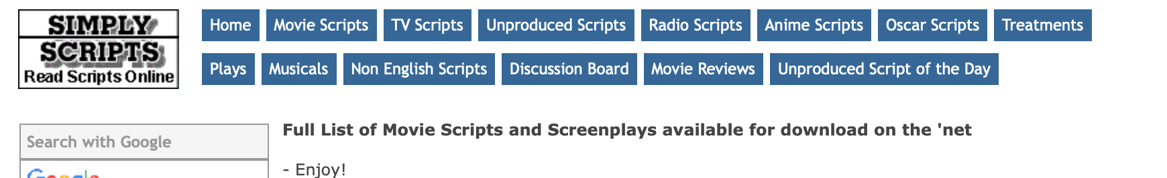
Scripts
Use published scripts to create analyzer
Scrape from simplescripts.com using Beautiful Soup
Original website has links to scripts, not the actual scripts
Some links are broken
Some links are to files that just notifications that the script isn’t there
Manual scrubbing of these files
Multiple file formats
Converted all to .txt files
Convert files to “bag of words”
Take the text and represent it as individual words out of context, with a count as to how many times it appears in the individual text
Notes:
A “bag-of-words” is when we take text and break down the number of times a word occurs in the text

Slide 5
Rated Movies
Use IMDB rating system
Out of ten stars
Data also included genre of the film

Slide 6
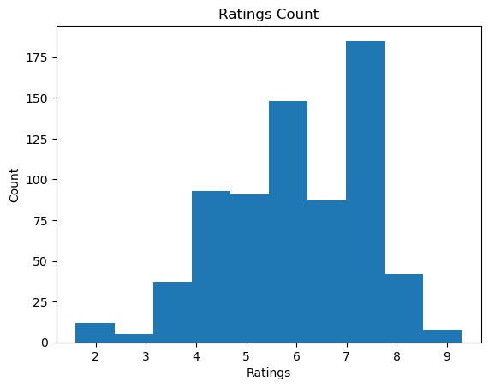
Ratings
Notes:
Ratings are averaged across users and rounded to the nearest tenth by IMDB
These are the original ratings

Slide 7
Rated Movies
Use IMDB rating system
Out of ten stars
Data also included genre of the film
Came in multiple files
Join files to get genre, movie name, and ratings
Convert genres into “bag-of-words”
Add the genres to the ”bag-of-words” from the scripts

Slide 8
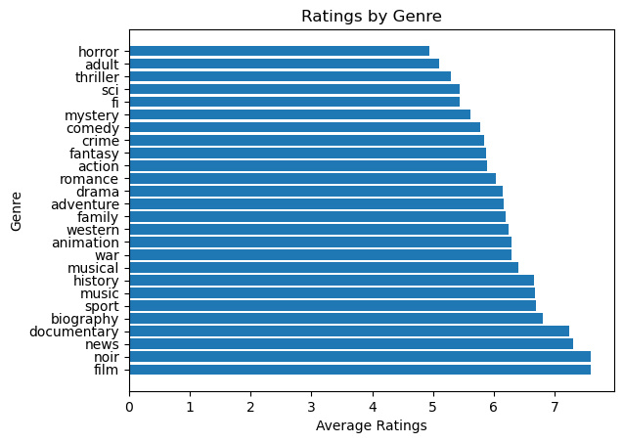
Ratings by Genre

Slide 9
Making the Recommender
Features
Bag-of-words
Over 6000 words, including genres
Cull features
SVD
27 features
Have about 700 scripts; 27 is approximately the square root of 700
Predicted variable
Integer ratings
Multiply original ratings by 10 to get integers

Slide 10
Training the Recommender – Methods
Simple
Mean of ratings
Random forest
Gradient booster
Linear regression
Notes:
Random forest and gradient booster are complex and powerful methods
Linear regression is a simple model, and easy to understand, but random forest and gradient booster can be more accurate

Slide 11
Training the Recommender – Accuracy
Root mean squared error (RMSE)
Lower is better

Slide 12
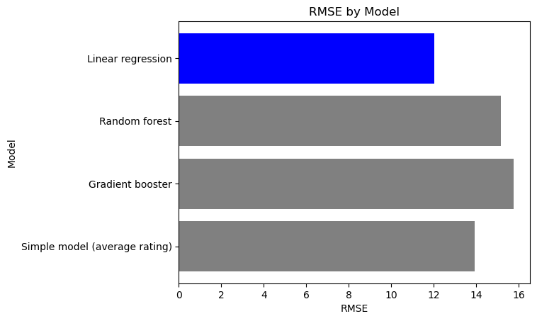
RMSE for the Four Models
Notes:
Ah but can we do better with linear regression by changing the number of features? I used select k best, a function from scikitlearn, to select original features that best predict the ratings

Slide 13
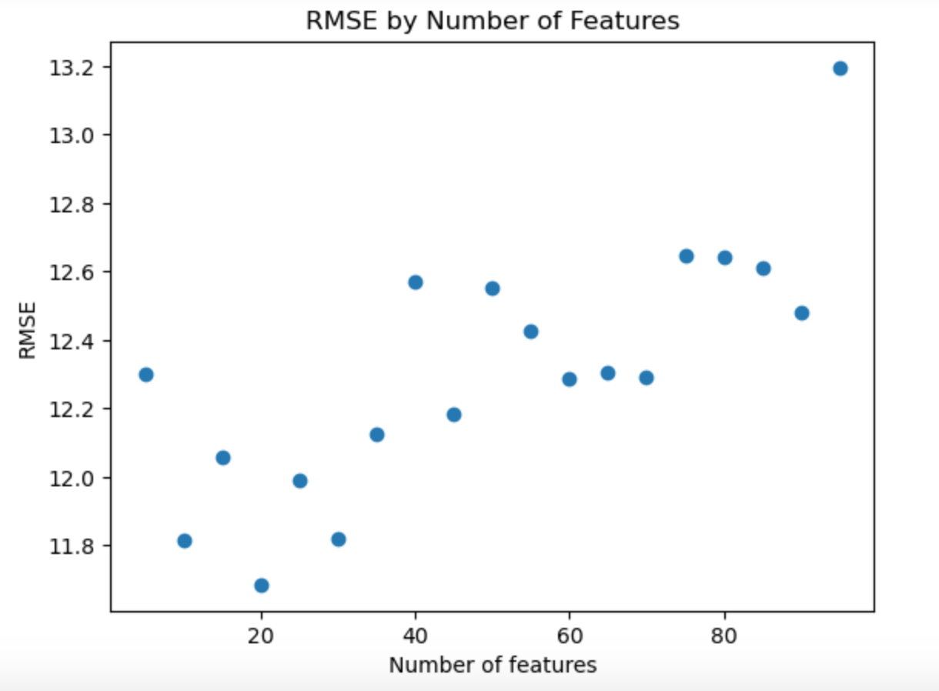
Limiting the Features
RMSE = 11.685
Notes:
Tested various number of features and found that 20 features gave best result.
How much influence do each of the features have on the linear regression?

Slide 14
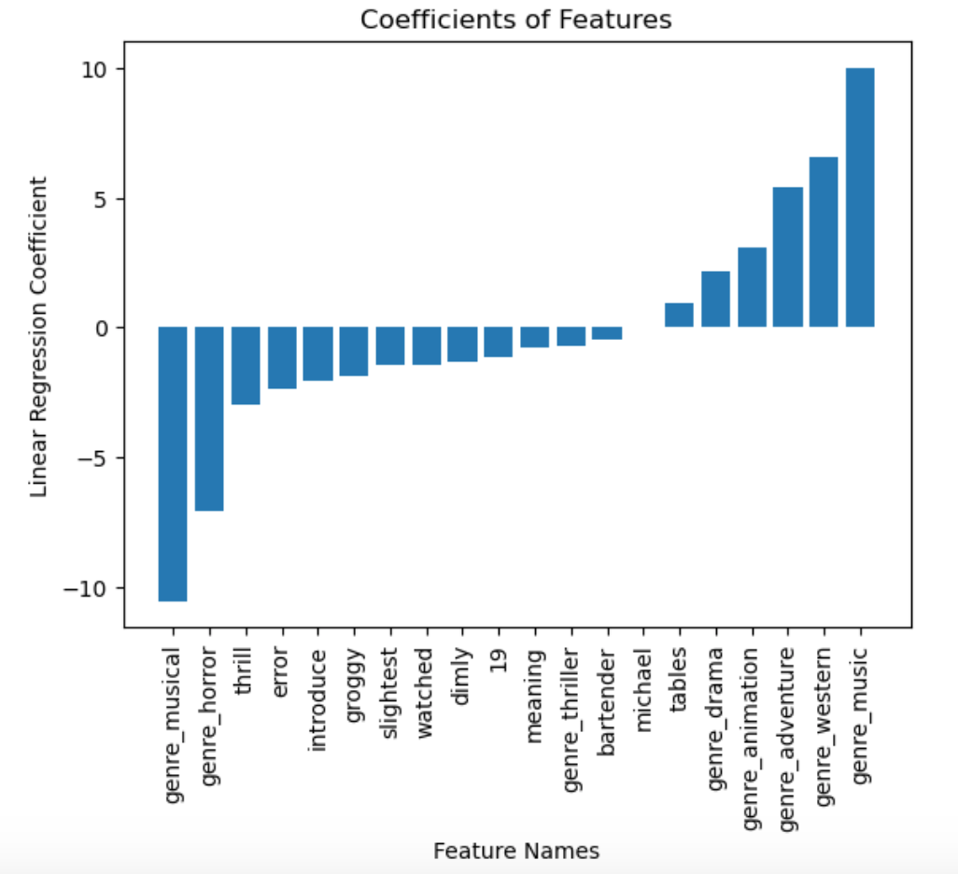
Coefficients
Notes:
We can see that the two strongest features are genre_musical and genre_music. This is a contradiction, as these refer to the same kind of movie. We can also see that genre_horror has a strong negative influence on the linear regression, and genre_adventure and genre_western have a strong positive influence.
To wrap up…

Slide 15
Recommendations
Don’t make a horror movie
Consider adventure movies or westerns
Don’t make a musical until we figure out the difference between “music” and “musical” as a genre

Slide 16
Future Work
More scripts
Only through 2009
Determine difference between “music” and “musical” as genres
Other rating systems
Rotten Tomatoes
Amazon

Slide 17
Any Questions?

Slide 18
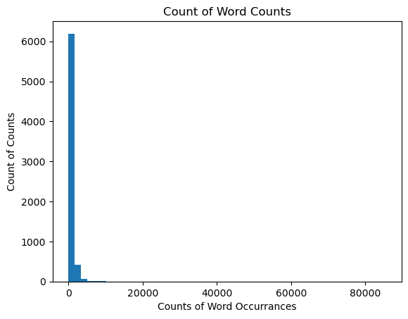
Word Recurrences Across Scripts
Notes:
Most words occur only a few times.
The number 13 occurs over 85,000 times

Slide 19
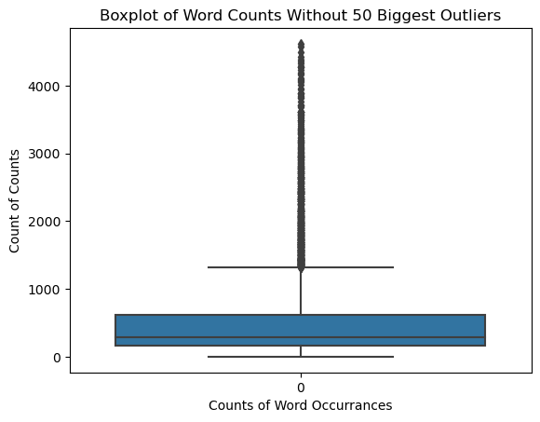
Word Recurrences Without Outliers

Slide 20
Random Forest Parameters
Number of trees | 120
Max-depth | None
Criterion | ‘Gini’

Slide 21
Gradient Booster Parameters
Learning rate | 0.05
Number of estimators | 250
Max. features | 10
Max. depth | 2

