Slide 1

Finding New Movies

Slide 2
Our New Station
We have money to create new TV movies
How to create movies that people will watch?

Slide 3
Script Analyzer
We can create a script analyzer that will read the script and predict how the new script will be rated
Need scripts and ratings as training data

Slide 4
Data Collection
Ratings from IMDB via Kaggle
simplyscripts.com
Data Wrangling
Concatenate ratings files to be just American fiction movies and their ratings and genres
Scrape scripts from web and convert to text files
EDA
Ratings range from 2.0 to 9.0
Words not highly correlated with ratings
Modeling
Three model formats
Merge ratings and scripts
Feature reduction
RMSE as accuracy

Slide 5
Finding Scripts
Simplyscripts.com
Links to other websites with the scripts
Download scripts
Beautiful Soup
Clean files
Files were not all scripts
Convert scripts to text files
In HTML, pdf, and .txt format
Read into Pandas dataframe

Slide 6
“Bag of words”
Take the text and represent it as individual words out of context
Count how many times a word appears in each individual text
Words are the features; the data is count of appearances
Convert scripts to “bag-of-words” for script analyzer

Slide 7
Rated Movies
Use IMDB rating system
Out of ten stars

Slide 8
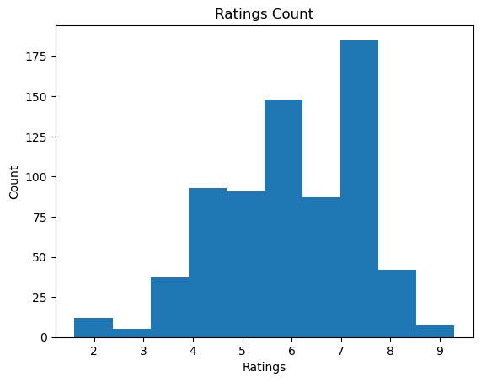
Ratings
Notes:
Ratings are averaged across users and rounded to the nearest tenth by IMDB
These are the original ratings

Slide 9
Rated Movies
Use IMDB rating system
Out of ten stars
Data also included genre of the film
Came in multiple files
Join files to get genre, movie name, and ratings
Convert genres into “bag-of-words”
Add the genres to the “bag-of-words” from the scripts

Slide 10
Data for the Recommender
Features
Bag-of-words
Over 6000 words, including genres
Cull features
SVD
27 features
Have about 700 scripts; 27 is approximately the square root of 700
Predicted variable
Need integer ratings
Multiply original ratings by 10 to get integers

Slide 11
Training the Recommender – Methods
Simple
Mean of ratings
Random forest
Gradient booster
Linear regression
Notes:
Random forest and gradient booster are complex and powerful methods
Linear regression is a simple model, and easy to understand, but random forest and gradient booster can be more accurate

Slide 12
Training the Recommender – Accuracy
Root mean squared error (RMSE)
Lower is better

Slide 13
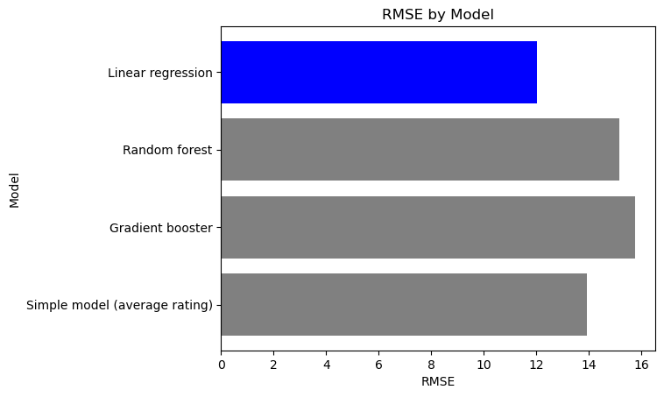
RMSE for the Four Models
Notes:
Ah but can we do better with linear regression by changing the number of features? I used select k best, a function from scikitlearn, to select original features that best predict the ratings

Slide 14
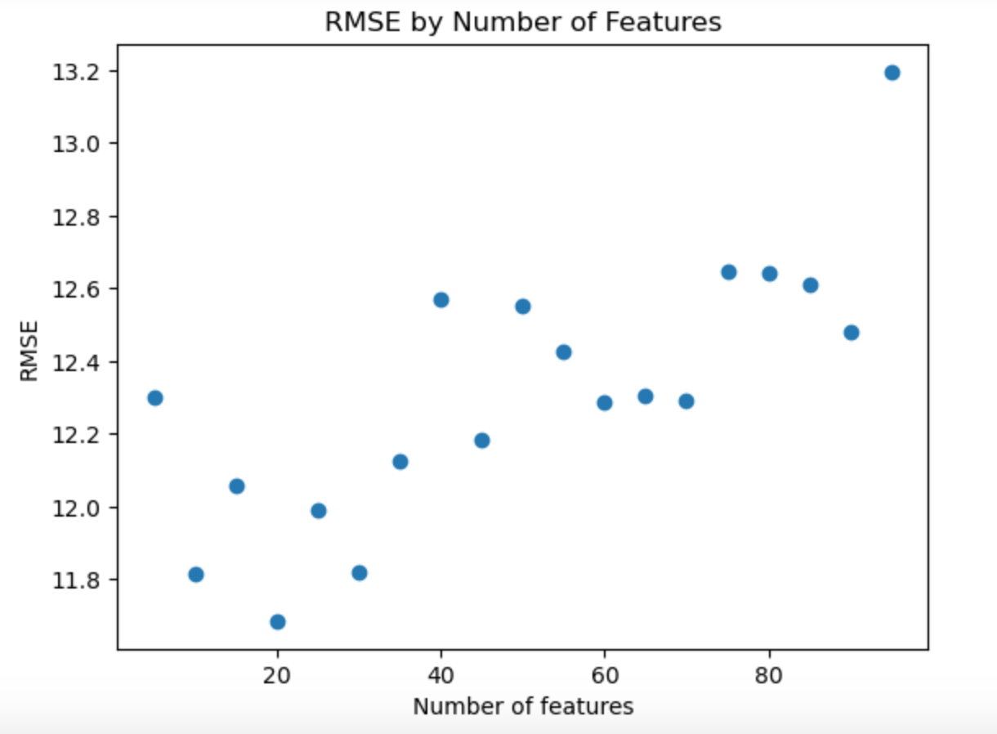
Limiting the Features Again
RMSE = 11.685
Notes:
Tested various number of features and found that 20 features gave best result, which was also lower than the SVD model.
How much influence do each of the features have on the linear regression?

Slide 15
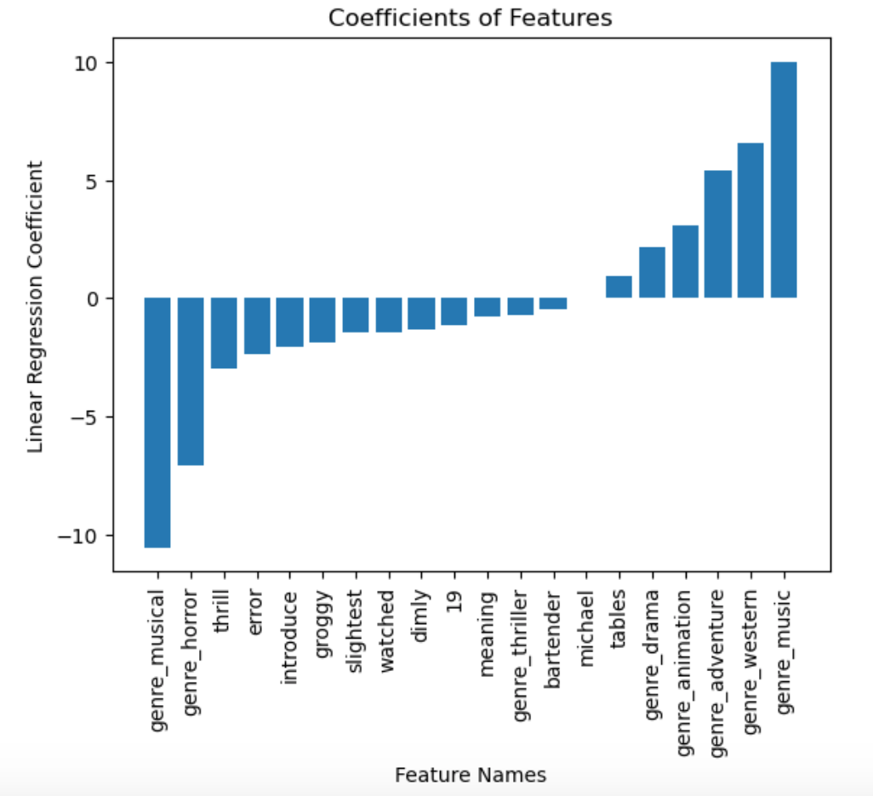
Coefficients
Notes:
We can see that the two strongest features are genre_musical and genre_music. This is a contradiction, as these refer to the same kind of movie. We can also see that genre_horror has a strong negative influence on the linear regression, and genre_adventure and genre_western have a strong positive influence.
To wrap up…

Slide 16
Recommendations
Don’t publish a horror movie
Consider adventure movies or westerns
Don’t publish a musical until we figure out the difference between “music” and “musical” as a genre

Slide 17
Future Work
More scripts
Only through 2009
Determine difference between “music” and “musical” as genres
Other rating systems
Rotten Tomatoes
Amazon

Slide 18
Any Questions?

Slide 19
Appendix

Slide 20
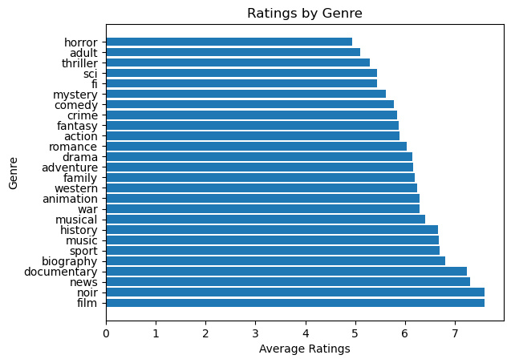
Ratings by Genre

Slide 21
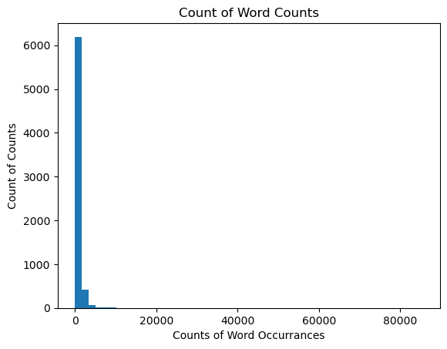
Word Recurrences Across Scripts
Notes:
Most words occur only a few times.
The number 13 occurs over 85,000 times

Slide 22
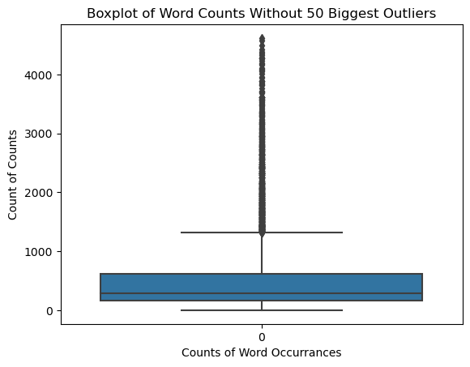
Word Recurrences Without Outliers

Slide 23
Random Forest Parameters
Number of trees | 120
Max-depth | None
Criterion | ‘Gini’

Slide 24
Gradient Booster Parameters
Learning rate | 0.05
Number of estimators | 250
Max. features | 10
Max. depth | 2

