Slide 1

Finding New Movies

Slide 2
Our New Station
We have money to create new TV movies
How to create movies that people will watch?

Slide 3
Script Analyzer
We can create a script analyzer that will read the script and predict how the new script will be rated
Need scripts and ratings as training data

Slide 4
Finding Scripts

Slide 5
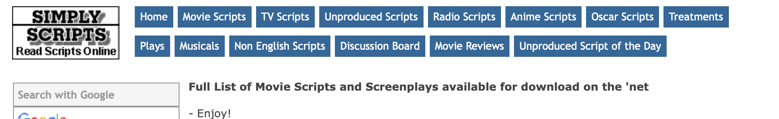
Find published scripts on simplyscripts.com
Write function using Beautiful Soup to open links on website
Is link good?
NO
Skip link
YES
Download file
Manually delete
Is file a script?
NO
YES
Leave alone to be converted and cleaned

Slide 6
Write functions that convert other file types to .txt format
Scripts as files on computer
Read converted files into Pandas dataframe
Convert script text into bag-of-words
Save resulting dataframe

Slide 7
“Bag of words”
Take the text and represent it as individual words out of context
Count how many times a word appears in each individual text
Words are the features; count of appearances is the data

Slide 8
Finding Ratings

Slide 9
Rated Movies
Use IMDB rating system
Out of ten stars

Slide 10
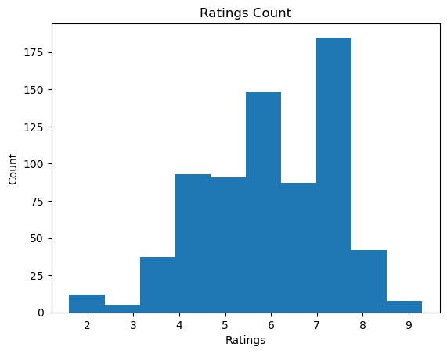
Ratings
Notes:
Ratings are averaged across users and rounded to the nearest tenth by IMDB
These are the original ratings

Slide 11
Rated Movies
Use IMDB rating system
Out of ten stars
Data also included genre of the film

Slide 12
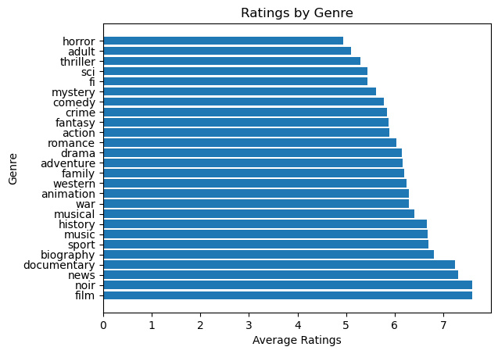
Ratings by Genre

Slide 13
Rated Movies
Use IMDB rating system
Out of ten stars
Data also included genre of the film
Came in multiple files
Join files to get genre, movie name, and ratings
Convert genres into “bag-of-words”
Add the genres to the “bag-of-words” from the scripts

Slide 14
Data for the Recommender
Features
Bag-of-words
Over 6000 words, including genres
Cull features
SVD
27 features
Have about 700 scripts; 27 is approximately the square root of 700
Predicted variable
Need integer ratings
Multiply original ratings by 10 to get integers

Slide 15
Training the Recommender – Methods
Simple
Mean of ratings
Random forest
Gradient booster
Linear regression
Notes:
Random forest and gradient booster are complex and powerful methods
Linear regression is a simple model, and easy to understand, but random forest and gradient booster can be more accurate

Slide 16
Training the Recommender – Accuracy
Root mean squared error (RMSE)
Lower is better

Slide 17
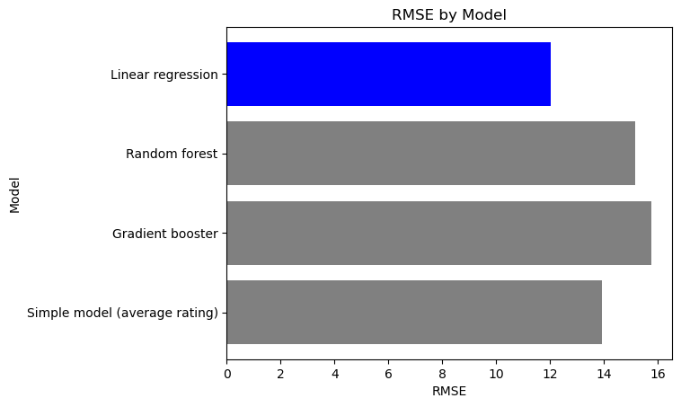
RMSE for the Four Models
Notes:
Ah but can we do better with linear regression by changing the number of features? I used select k best, a function from scikitlearn, to select original features that best predict the ratings

Slide 18
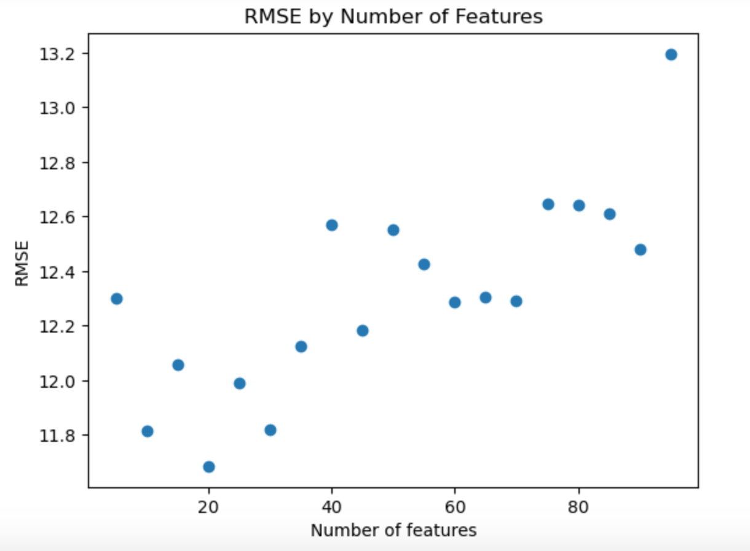
Limiting the Features Again
RMSE = 11.685
Notes:
Tested various number of features and found that 20 features gave best result.
How much influence do each of the features have on the linear regression?

Slide 19
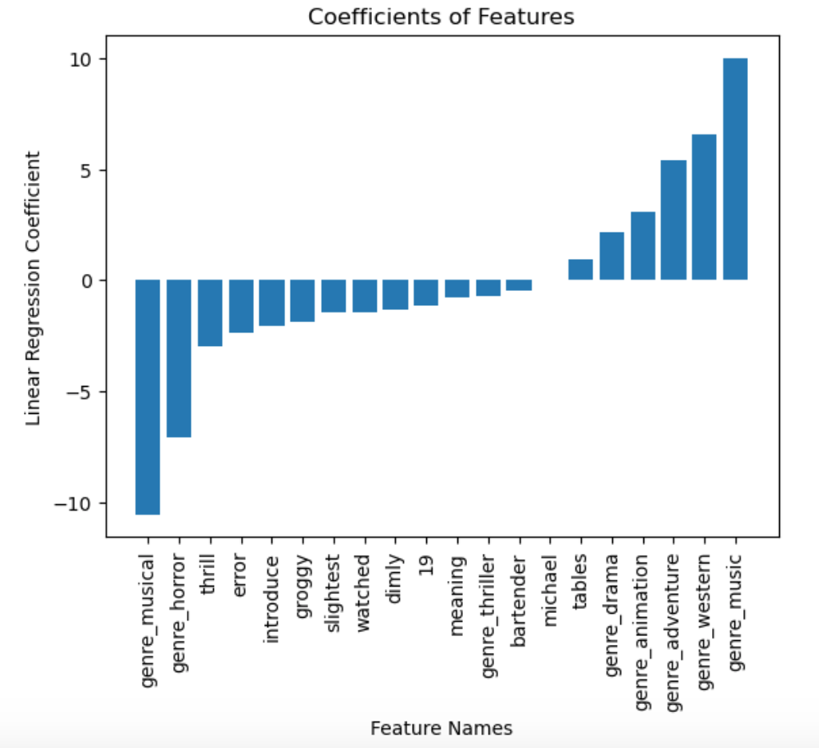
Coefficients
Notes:
We can see that the two strongest features are genre_musical and genre_music. This is a contradiction, as these refer to the same kind of movie. We can also see that genre_horror has a strong negative influence on the linear regression, and genre_adventure and genre_western have a strong positive influence.
To wrap up…

Slide 20
Recommendations
Don’t publish a horror movie
Consider adventure movies or westerns
Don’t publish a musical until we figure out the difference between “music” and “musical” as a genre

Slide 21
Future Work
More scripts
Only through 2009
Determine difference between “music” and “musical” as genres
Other rating systems
Rotten Tomatoes
Amazon

Slide 22
Any Questions?

Slide 23
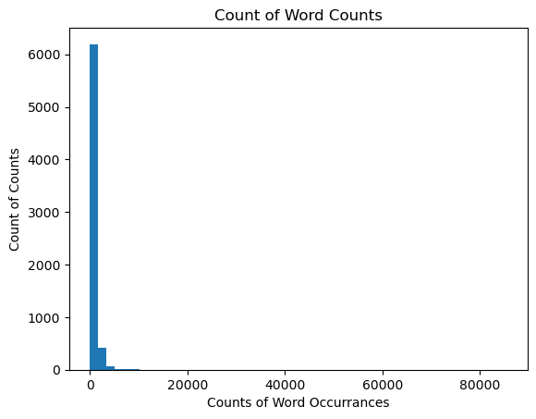
Word Recurrences Across Scripts
Notes:
Most words occur only a few times.
The number 13 occurs over 85,000 times

Slide 24
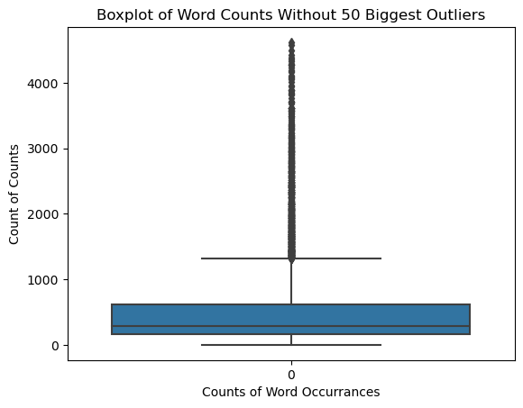
Word Recurrences Without Outliers

Slide 25
Random Forest Parameters
Number of trees | 120
Max-depth | None
Criterion | ‘Gini’

Slide 26
Gradient Booster Parameters
Learning rate | 0.05
Number of estimators | 250
Max. features | 10
Max. depth | 2

