Slide 1

Finding New Movies

Slide 2
Our New Station
We have money to create new TV movies
How to find movies that people will watch?

Slide 3
Rated Movies
Use IMDB rating system
Out of ten stars

Slide 4
Script Analyzer
We can create a script analyzer that will read the script and predict how the new script will be rated

Slide 5
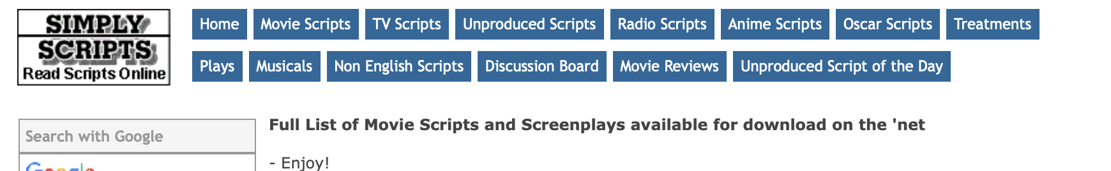
Scripts
Use published scripts to create analyzer
Also include genre from IMDB

Slide 6
Making the Recommender
Features
Bag-of-words
Over 6000 words, including genres
Predictor
Integer ratings
Notes:
Convert ratings to integers by multiplying by 10

Slide 7
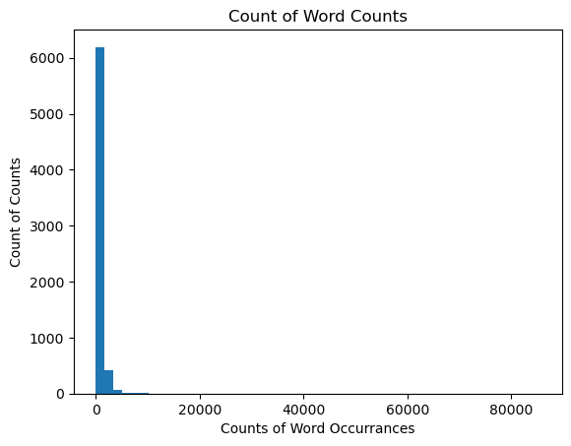
Word Recurrences Across Scripts
Notes:
Most words occur only a few times.
The number 13 occurs over 85,000 times

Slide 8
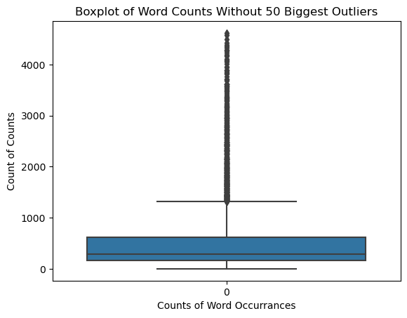
Word Recurrences Without Outliers

Slide 9
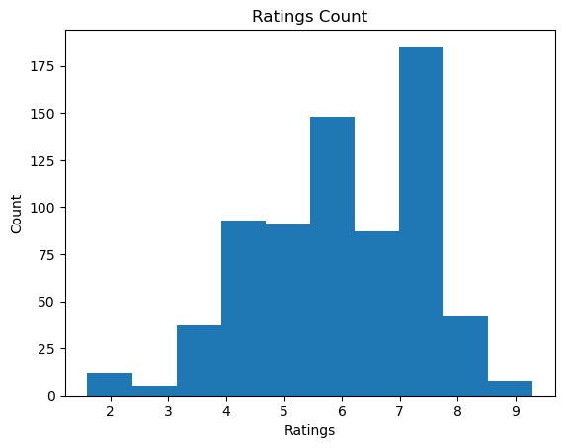
Ratings
Notes:
Ratings are averaged across users and rounded to the nearest tenth by IMDB
These are the original ratings

Slide 10
Training the Recommender – Methods
Simple
Mean of ratings
Random forest
Gradient booster
Linear regression

Slide 11
Training the Recommender – Accuracy
Root mean squared error (RMSE)

Slide 12
Random Forest Parameters
Number of trees | 120
Max-depth | None
Criterion | ‘Gini’

Slide 13
Gradient Booster Parameters
Learning rate | 0.05
Number of estimators | 250
Max. features | 10
Max. depth | 2

Slide 14
RMSE
Simple model (average rating) | 13.923
Gradient booster | 15.761
Random forest | 15.156
Linear regression | 12.040

Slide 15
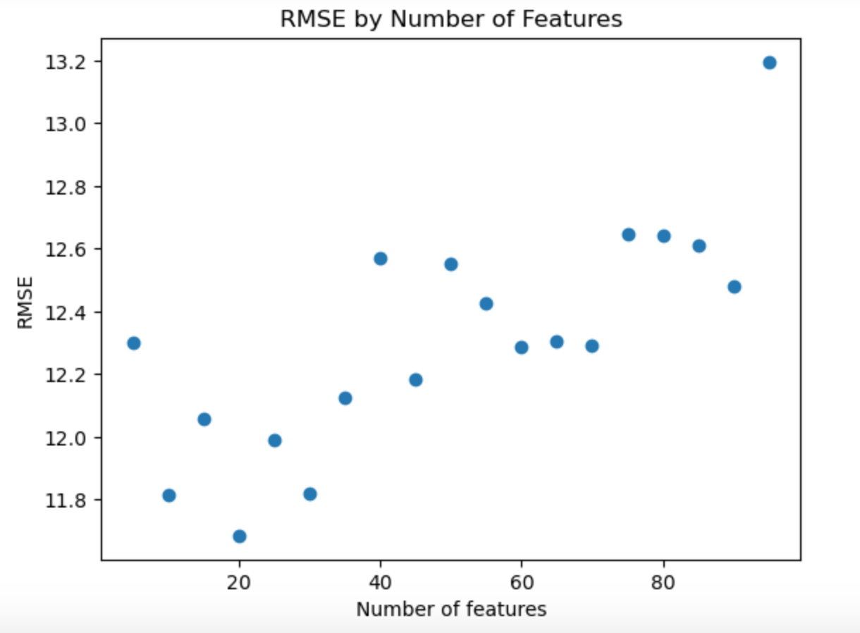
Select k Best Features
RMSE = 11.685

Slide 16
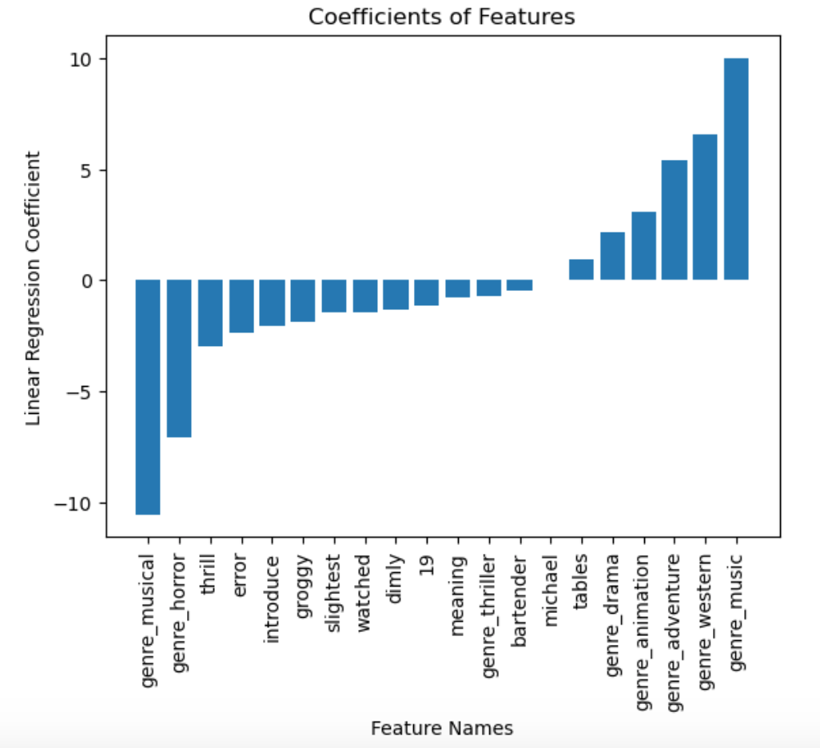
Coefficients

Slide 17
Recommendations
Don’t make a horror movie
Consider adventure movies or westerns
Don’t make a musical until we figure out the difference between “music” and “musical” as a genre

Slide 18
Future Work
More scripts
Only through 2009
Determine difference between “music” and “musical” as genres
Other rating systems
Rotten Tomatoes
Amazon

