Slide 1
Engaging Readers
Notes:
Engaged readers are buying readers! What can we learn from readers engaged on the internet?
https://www.kaggle.com/datasets/jealousleopard/goodreadsbooks?select=books.csv

Slide 2
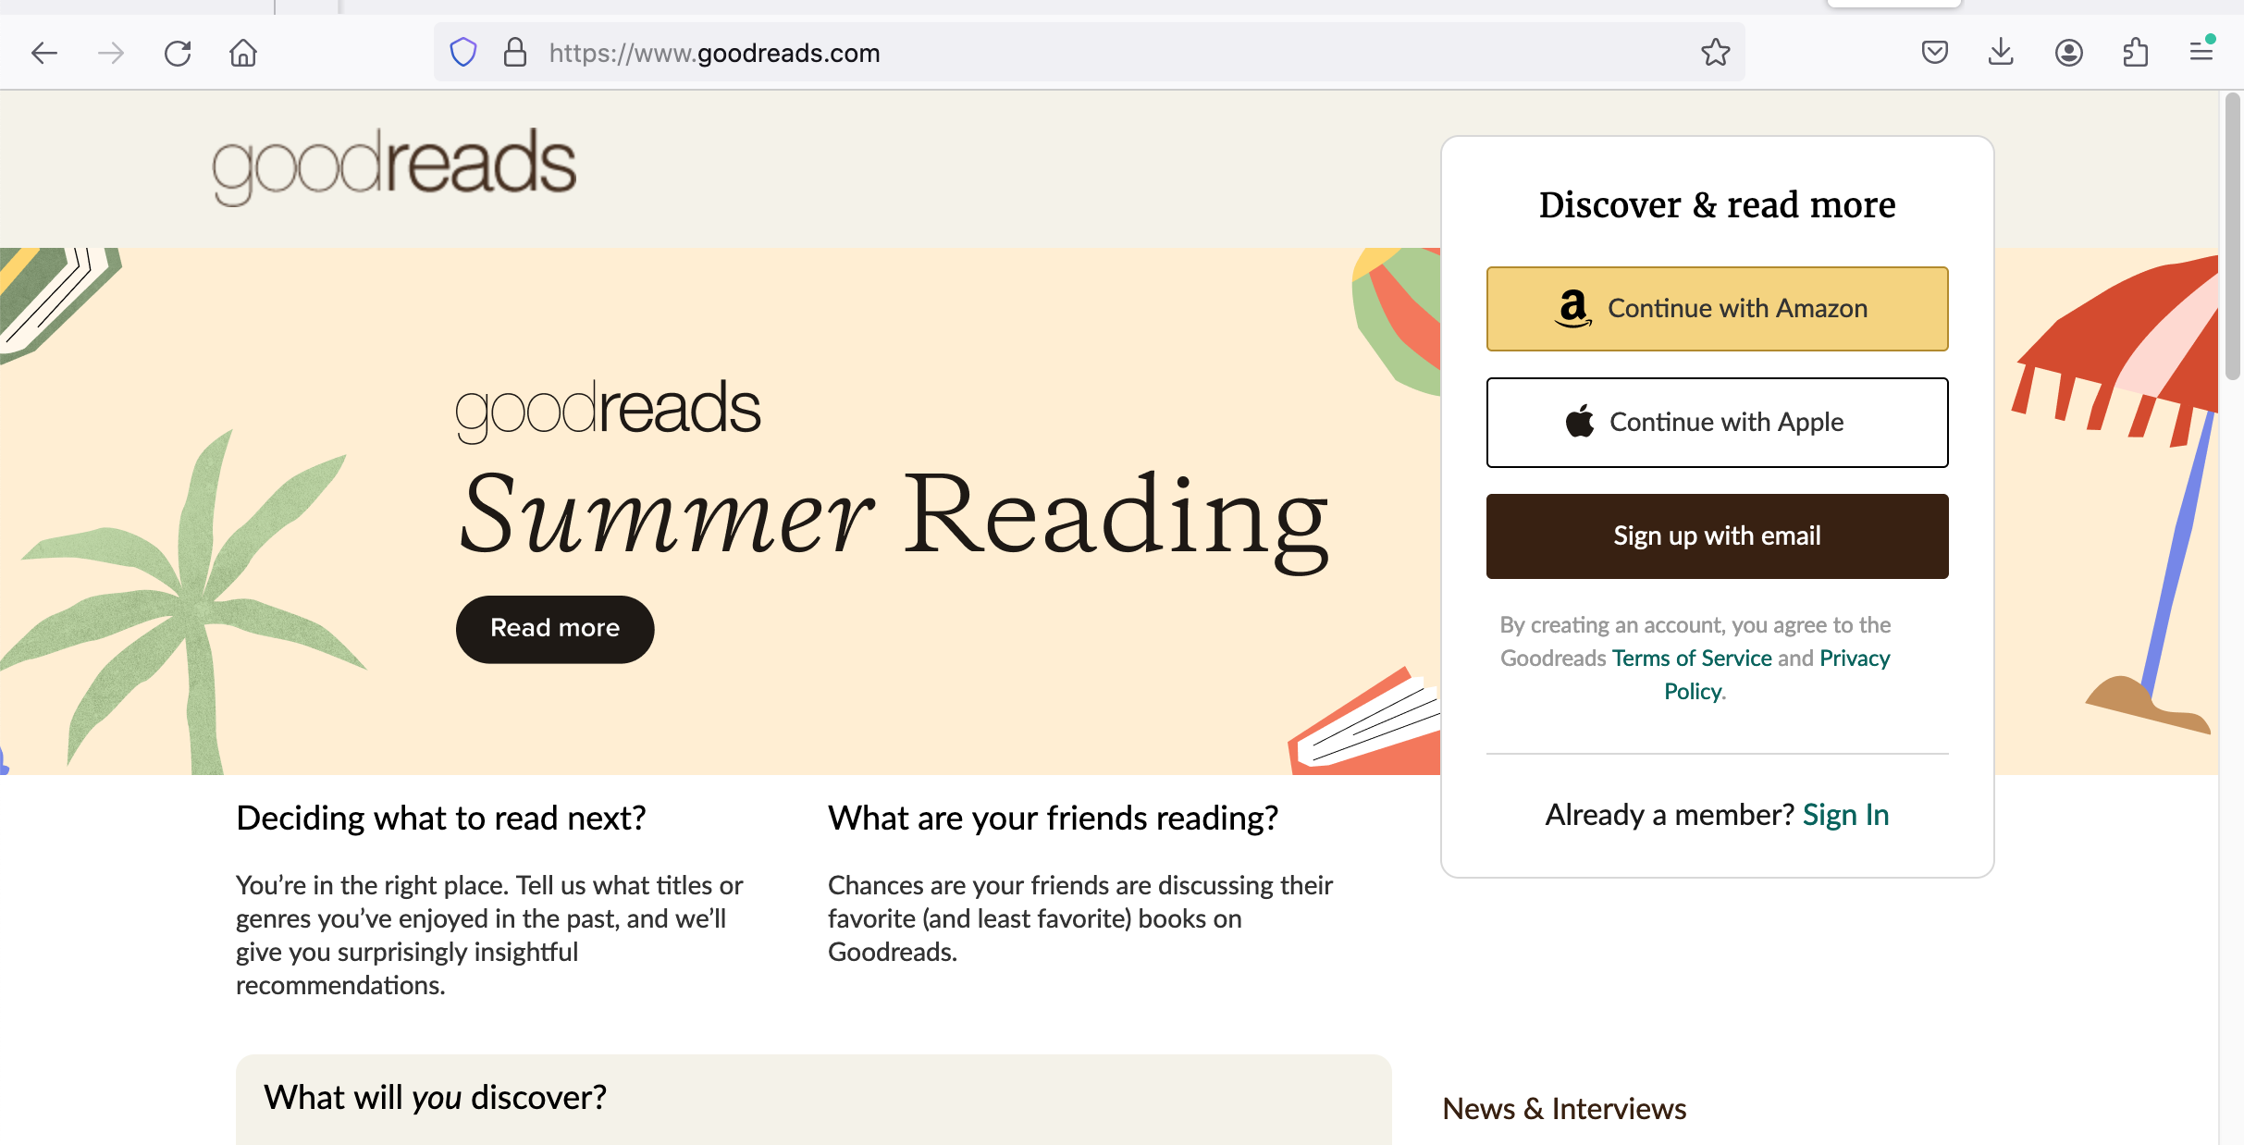
Goodreads
Notes:
Goodreads is a social media site focused on books. Readers can log their reading, post reviews, and interact with each other. Reviews can either be star-based, or actual text reviews.

Slide 3
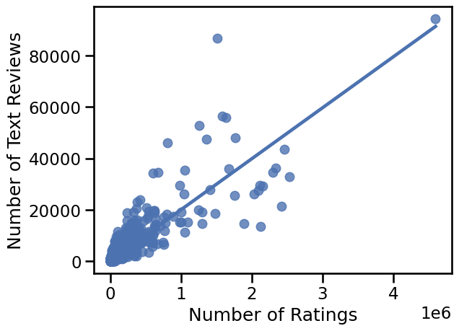
Review Correlation
Notes:
Here we see that the types of reviews users posts are positively correlated in the number of the reviews. However! It’s important to note the scale. The most-reviewed book as of 2020 – “Twilight” by Stephenie Meyer, published by Little, Brown and Co - has 95,000 text reviews but over 4.5 million star ratings. Nonetheless, books that have more star ratings are more likely to have text reviews. We can leverage that into reader engagement.

Slide 4
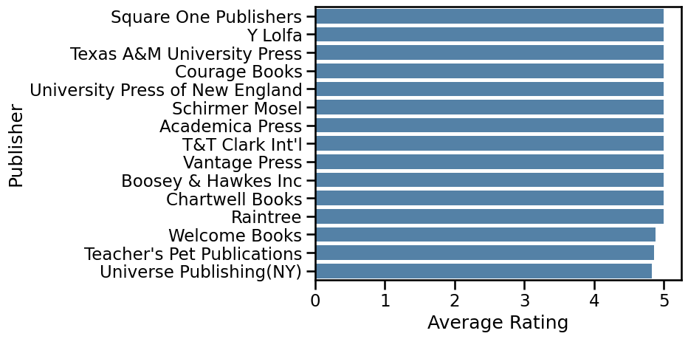
Highly Rated Publishers
Notes:
The star rating system is from 1 to 5 stars. Here we see there are some lucky publishers that have an _average_ of a five-star rating. However…

Slide 5
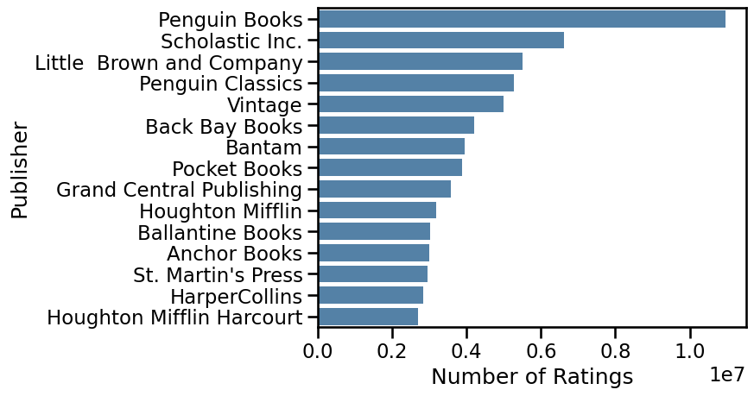
Most Rated Publishers
Notes:
… here we see the publishers with the most star ratings. It is worth noting at this point that there is no overlap between the publishers on the two graphs. So while we should aim to publish quality books, we shouldn’t chase after pure five-star reviews. What about the number of textual reviews?

Slide 6
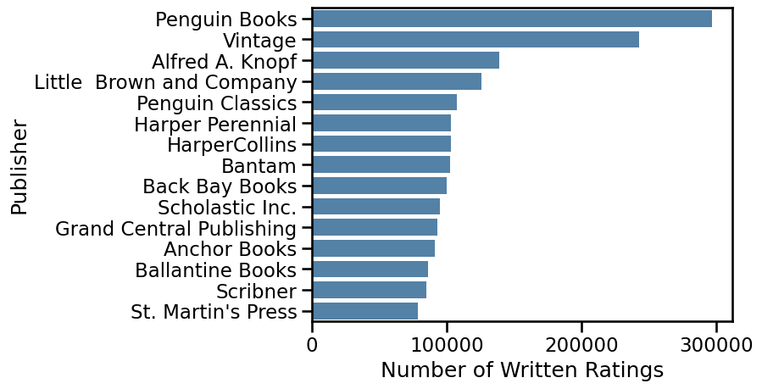
Most Reviewed Publishers
Notes:
As expected from our comment that the number of textual reviews is correlated with the number of star reviews, there is some overlap here. Penguin Books has the most ratings for both star and textual reviews, thanks to books like “The Secret Life of Bees” and “Lord of the Flies”. Little, Brown, and Co are in the top five, as is Penguin Classics.

Slide 7
Recommendations
Engaged readers are key
Offer rewards for engagement
Drawings for posting reviews on Goodreads
Other engagement sites
LibraryThing
“BookTok”
Litsy
Notes:
Engaged readers are more likely to buy more books! We can encourage engagement by offering rewards for engagement on Goodreads and other social media reading sites, such as LibraryThing, Litsy, BookTok, and Reddit. It is not worth, however, chasing perfect ratings, as those are not necessary for high engagement.

