Slide 1
Engaging Readers for Increasing Revenue
Notes:
Engaged readers are buying readers! How can we engage readers further?
https://www.kaggle.com/datasets/jealousleopard/goodreadsbooks?select=books.csv

Slide 2
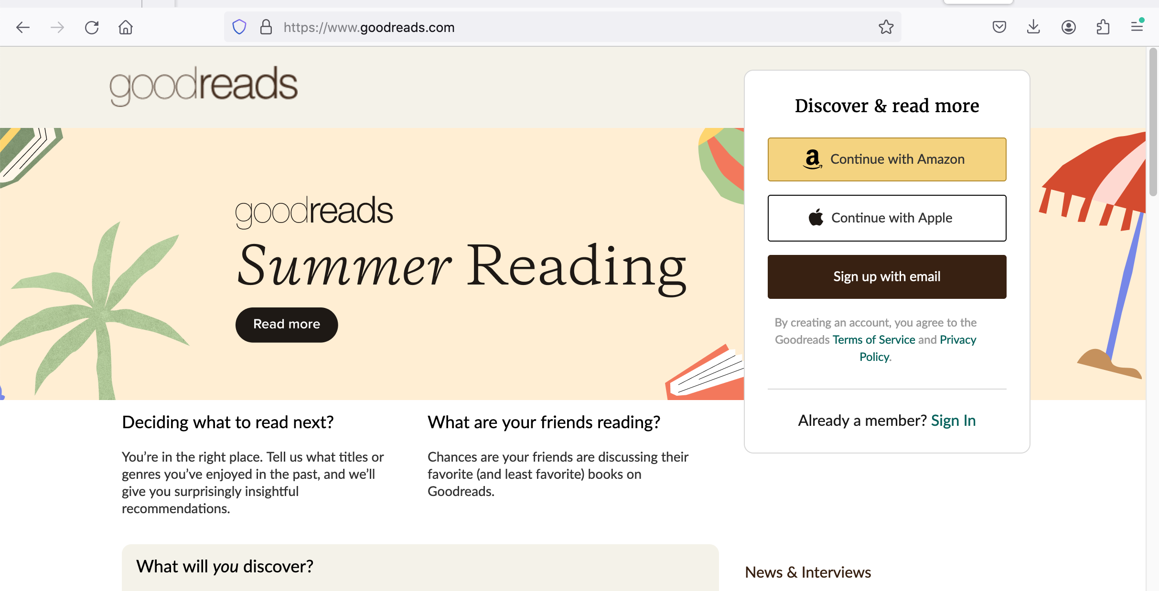
Goodreads
Notes:
Goodreads is a social media site focused on books. Readers can log their reading, post reviews, and interact with each other. Reviews can either be star-based, or actual text reviews.

Slide 3
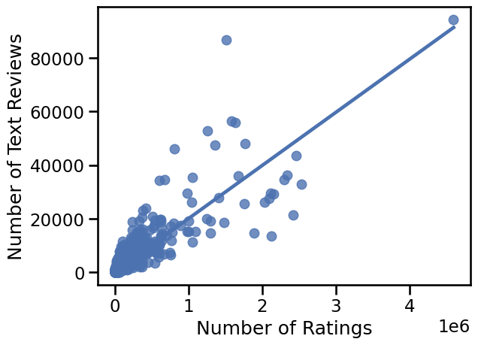
Review Correlation
Notes:
Here we see that the types of reviews users posts are positively correlated. However! It’s important to note the scale. The most-reviewed book as of 2020 – “Twilight” by Stephenie Meyer, published by Little, Brown and Co - has 95,000 text reviews but over 4.5 million star ratings. Nonetheless, books that have more star ratings are more likely to have text reviews. We can leverage that into reader engagement by encouraging our readers to leave text reviews, rather than just star ratings

Slide 4
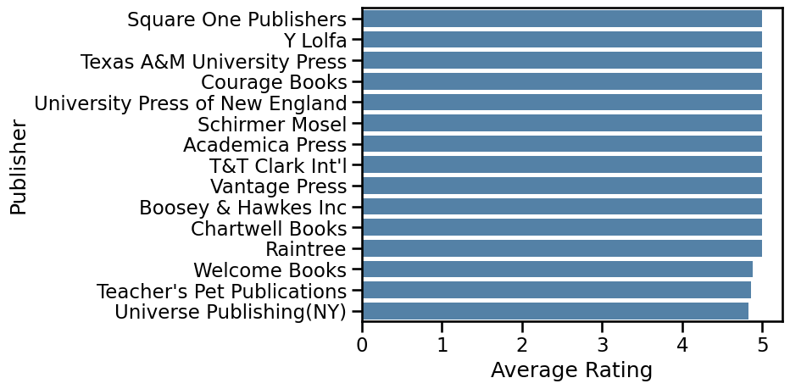
Highly Rated Publishers
Notes:
The star rating system is from 1 to 5 stars. Here we see there are some lucky publishers that have an _average_ of a five-star rating. However…

Slide 5
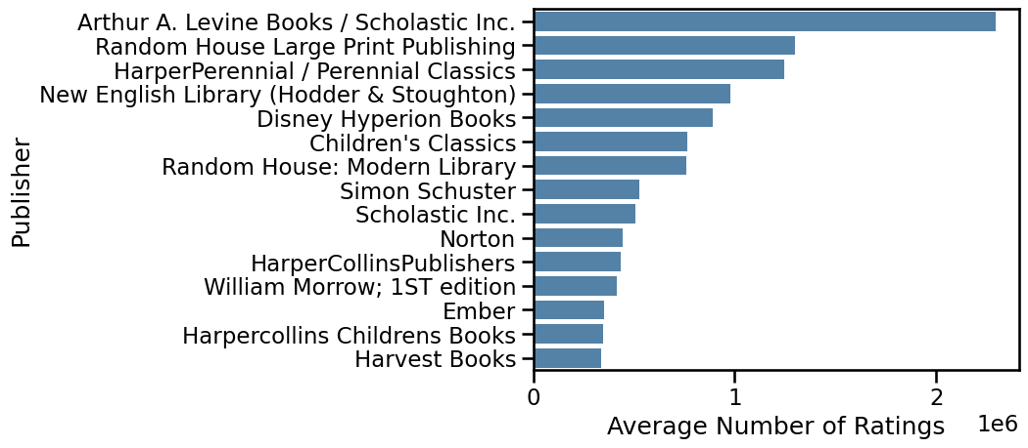
Most Rated Publishers – Average Ratings
Notes:
… here we see the publishers with the highest average number of star ratings per book. It is worth noting at this point that there is no overlap between the publishers on the two graphs. So while we should aim to publish quality books, we shouldn’t chase after pure five-star reviews: our competitors are more likely to be in this graph.
Note the high number of children’s publishers. We don’t have a lot of children’s books yet – this may be something for us to look into. But we can also find competitors if we look at the total number of ratings, rather than the average per book for each publisher

Slide 6
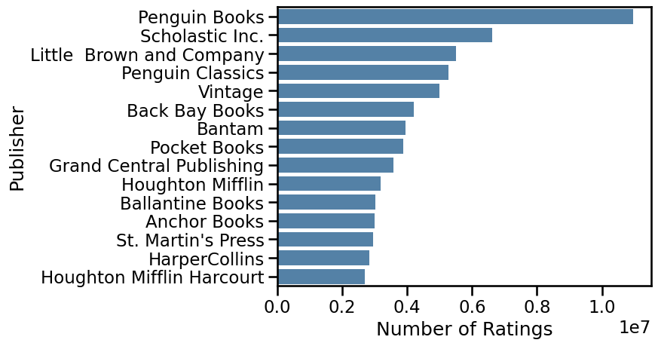
Most Rated Publishers – Total Ratings
Notes:
Here we see the total number of ratings. Penguin Books has over ten million total ratings. Scholastic is in both graphs, as are divisions of HarperCollins.
But we started off with a correlation between star ratings and text reviews. What about the number of text reviews? Can that give us any information about our competitors?

Slide 7
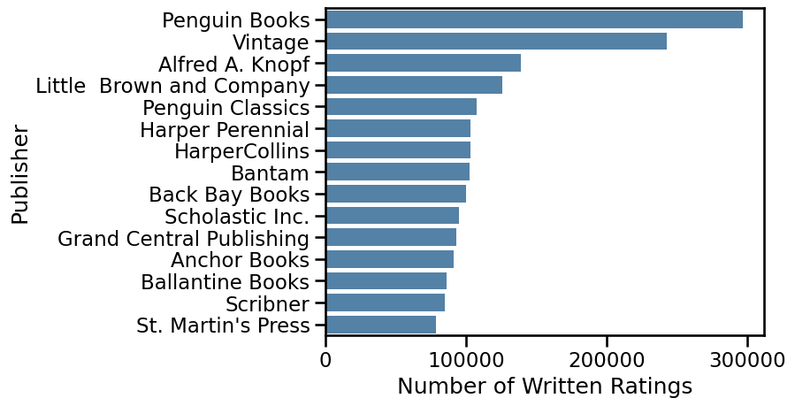
Most Reviewed Publishers
Notes:
As expected from our comment that the number of textual reviews is correlated with the number of star reviews, there is some overlap here. Penguin Books has the most ratings for both star and textual reviews, thanks to books like “The Secret Life of Bees” and “Lord of the Flies”. Little, Brown, and Co are in the top five of both, as is Penguin Classics. But we can see some other competitors like Scribner and Ballantine Books.

Slide 8
Recommendations
Engaged readers are key
Offer rewards for engagement
Drawings for posting reviews on Goodreads
Other engagement sites
LibraryThing
“BookTok”
Litsy
Notes:
As we know, engaged readers are more likely to buy more books! We can encourage engagement by offering rewards for text reviews on Goodreads. This will encourage people to leave star reviews also. In addition, we can work with other social media reading sites, such as LibraryThing, Litsy, BookTok, and Reddit. It is not worth, however, chasing perfect ratings, as those are not necessary for high engagement.

